Slide 1
Implementation of EC-Earth 10km global coupled demonstrator and performance analysis
Miguel Castrillo, Kim Serradell, Mario Acosta
Barcelona Supercomputing Center
The ESiWACE project has received funding from the European Union’s Horizon 2020 research and innovation program under grant agreement No 675191
This material reflects only the author's view and the Commission is not responsible for any use that may be made of the information it contains.

Slide 2
The EC-Earth coupled 10km demonstrator
EC-Earth - A European community Earth-System Model
IFS (atmosphere)
T1279L91: ~16km grid point distance, 2.1M grid points
NEMO-LIM (ocean – sea-ice)
ORCA12L75: ~9km grid point distance, 13.2M grid points
Total 3D space: 1,024kM vertices

Slide 3
Development of T1279-ORCA12
Develop initial data
Including OASIS interpolation weight files
Create namelists for IFS, NEMO-LIM (XIOS) and OASIS
Adapt source code and existing runscripts
Introduce required changes in the experiment workflow
Scalability tests / load balance studies / profiling

Slide 4
The EC-Earth coupled 10km demonstrator in MareNostrum3
First global, coupled ~10km simulations (T1279 – ORCA12):
EC-Earth 3.2 (IFS36r4 + NEMO 3.6 + OASIS3-MCT)
2,035 MPI tasks - 60 SDPD
1,170 NEMO
848 IFS
16 XIOS
1 runoff mapper
MareNostrum3 @ BSC

Slide 5
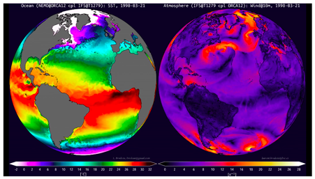
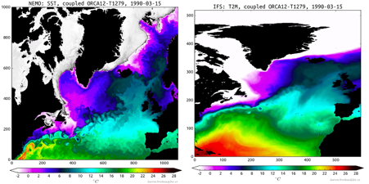
First simulations from the EC-Earth coupled 10km demonstrator
First global, coupled ~16km simulations (T1279 – ORCA12):
Left, Global Sea Surface Temperature of the ocean component NEMO. Right, Global Speed Wind at 10m of atmosphere component IFS.
Left, regional crop Sea Surface Temperature of the ocean component NEMO. Right, regional crop Temperature at 2m of the atmosphere component IFS.
Surface current speed in ORCA12 coupled to IFS (EC-Earth 3.2)
Wind speed at 10m in IFS T1279 coupled to ORCA12 (EC-Earth 3.2)

Slide 6
Deployment for production in MareNostrum4: Tackled issues
I/O management
Use of MareNostrum4 data-transfer nodes
Optimal libraries and dependencies
Come up with a stable environment
OmniPath: numerous tests and collaboration with operations to find a good configuration (tmi, PSM2)
XIOS update: decrease number of communications
Controlling process pinning: better memory management

Slide 7
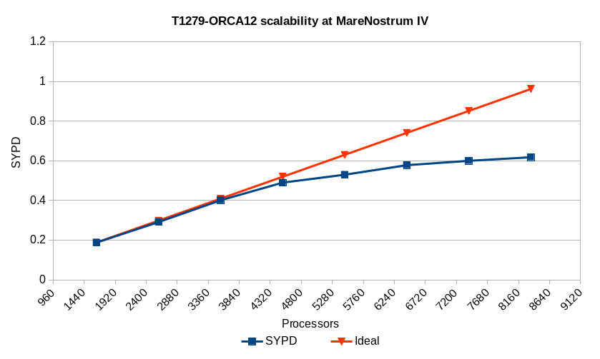
The EC-Earth coupled 10km demonstrator in MareNostrum4
Load balance study
Load balance study
…

Slide 8
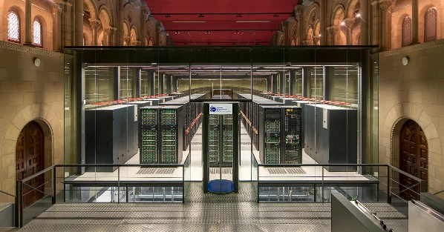
The EC-Earth coupled 10km demonstrator in MareNostrum4
Operational global, coupled ~10 km simulations (T1279 – ORCA12):
EC-Earth 3.2 (IFS36r4 + NEMO 3.6 + OASIS3-MCT)
5,040 MPI tasks - 0.44 SYPD, 160 SDPD
3,209 NEMO
1,584 IFS
69 XIOS
1 runoff mapper
MareNostrum4 @ BSC
100 year exp ~40M ch !!!

Slide 9
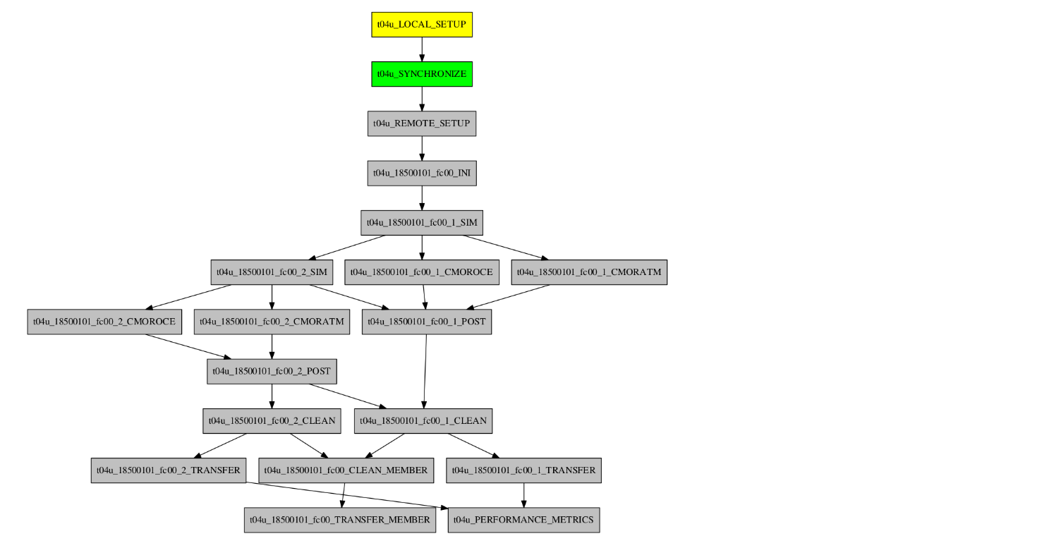
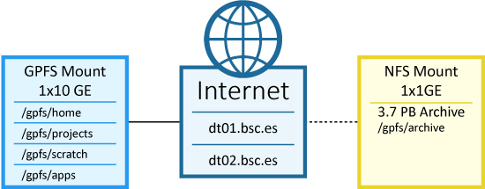
Running production runs in Autosubmit
Adapting workflow for production: data transfer nodes
localhost
dt01.bsc.es
dt01.bsc.es
dt01.bsc.es

Slide 10
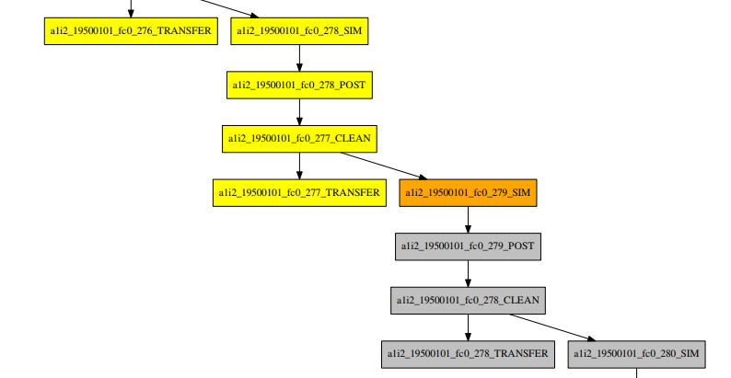
Running production runs in Autosubmit
Production runs: Managing the workflow

Slide 11
The EC-Earth coupled 10km demonstrator: production runs
PRIMAVERA is a Horizon 2020 project which aims to develop a new generation of advanced and well-evaluated high-resolution global climate models, capable of simulating and predicting regional climate with unprecedented fidelity, for the benefit of governments, business and society in general.
The High Resolution Model Intercomparison Project (HighResMIP) is a CMIP6 endorsed MIP that applies, for the first time, a multi-model approach to the systematic investigation of the impact of horizontal resolution.

Slide 12
The EC-Earth coupled 10km demonstrator: production runs
Courtesy of: Thomas Arsouze

Slide 13
The EC-Earth coupled 10km demonstrator: production runs
Courtesy of: Thomas Arsouze

Slide 14
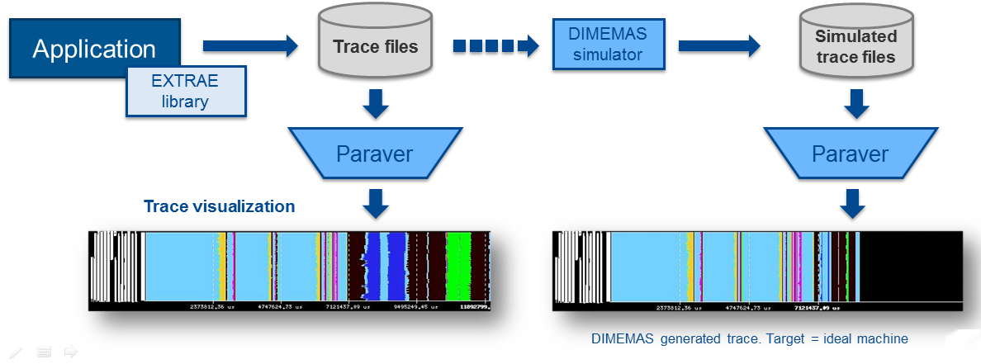
Performance analysis
Since 1991
Based on traces
Open Source: http://www.bsc.es/paraver
Extrae: Package that generates Paraver trace-files for a post-mortem analysis
Paraver: Trace visualization and analysis browser
Includes trace manipulation: Filter, cut traces
Dimemas: Message passing simulator

Slide 15
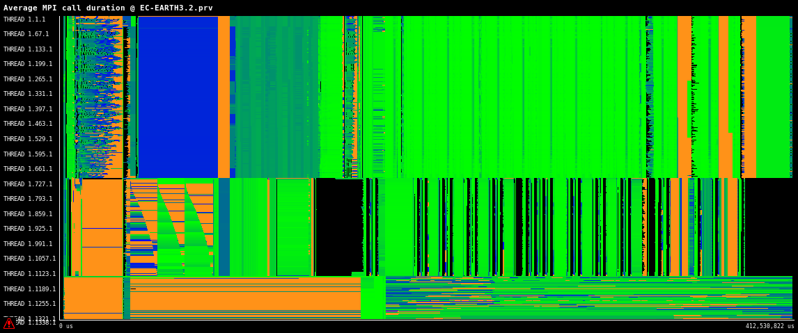
T1279-ORCA12: Performance analysis

Slide 16
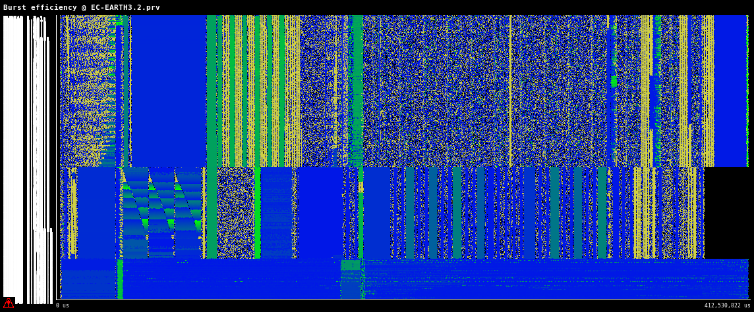
T1279-ORCA12: Performance analysis

Slide 17
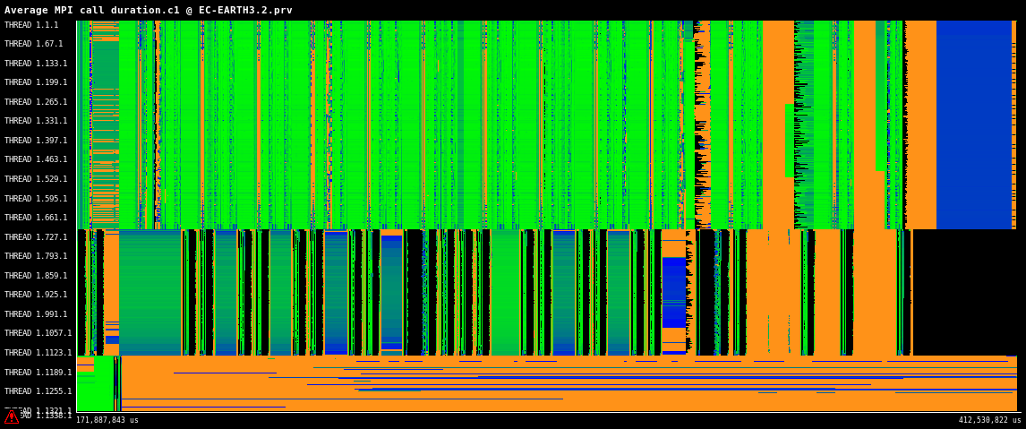
T1279-ORCA12: Performance analysis

Slide 18
Challenges (bottlenecks)
Reduce I/O overhead → Interface IFS with XIOS
NEMO-LIM (ORCA12): Up to 3 SYPD in MareNostrum4 (LIM -> 2OCE stp)
Detach sea-ice from NEMO. Couple through OASIS.
Update IFS to newest cycle, using octahedral grid
Update NEMO to NEMO4 (and beyond)
Most of these improvements can be real in EC-Earth4

Slide 19
Results and conclusions
At the end of this project T1279-ORCA12 is:
Developed and shared among EC-Earth consortium partners
Deployed and tested in MareNostrum3 and MareNostrum4 HPC systems
Used in production for other H2020 projects such as PRIMAVERA
Used to investigate the scalability of ultra-high resolution coupled models, enabling to push computational challenges of the current HPC generation

Slide 20
Thank you
THANK YOU
miguel.castrillo@bsc.es

