Slide 1
Decadal Climate Prediction at BSC
S. Wild, F.J. Doblas-Reyes, J. Acosta-Navarro, R. Bilbao, L.-P. Caron , R. Cruz-García, M. Donat, M. Ménégoz, Y. Ruprich-Robert, B .Solaraju Murali, P. Ortega, V. Sicardi
EUCP General Assembly
Venice, 5th February 2019

Slide 2
Producing decadal hindcasts DCPP A
ERA I
+
ORA-S4
EC-Earth 3.3
yearly start dates
1960-2017, starting 1st Nov
10 members
Model:
Atmosphere: IFS, T255L91
Ocean: NEMO, ORCA1L75
Sea ice: LIM 3
+ OASIS coupler
Initial conditions, full-field
Atmosphere:
ECMWF reanalyses (ERAInt + ERA40)
with GPCP-corrected land surface
Ocean and sea-ice reconstruction:
ICs are produced using a NEMO only simulation
forced by DFS (ERA-I) fluxes and nudged towards ORA S4
NEMO only: DFS + ORA-S4
1958
2015
2017
Ocean and Ice Initial Conditions (5 members)
EC-Earth Hindcasts
1960...... yearly
.....2017
ECMWF Reanalyses (3D T-Pert.)
Following Guemas et al. (Clim. Dyn., 2014)

Slide 3
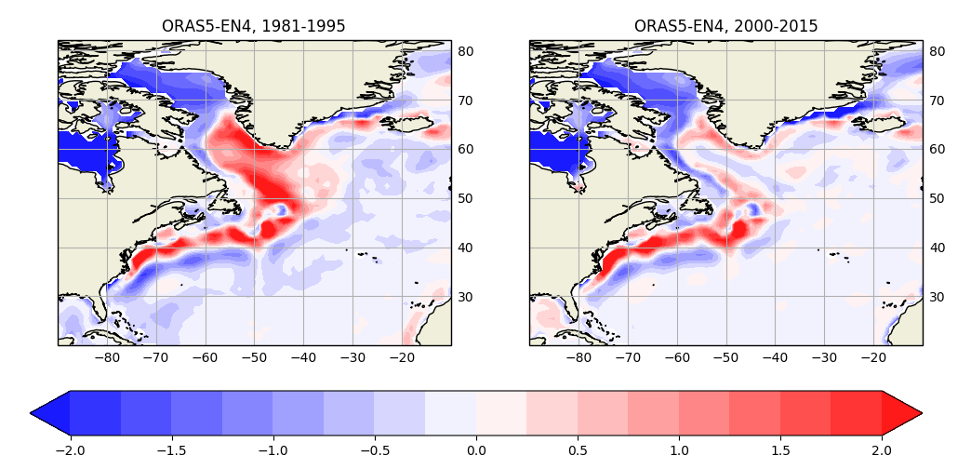
Towards high resolution prediction
*SEAS5 (initialized with ORAS5) has been reported to have non-stationary SST biases
A comparison of ORAS5 with different observational products shows large changes near the Labrador Sea, potentially linked to AMOC processes.
Model:
Atmosphere: IFS, T255L91 → T511L91 (HR)
Ocean: NEMO, ORCA1L75 → ORCA025L75 (HR)
Sea ice: LIM 3
+ OASIS coupler
Initial conditions
Atmosphere:
ERAInt + ERA40 (with corrected land)
Ocean and sea-ice reconstruction:
ICs are produced using a NEMO only simulation
forced by DFS fluxes and nudged towards ORA S5*
5 reconstructions are generated by applying random perturbations to surface air temperature and turbulent fluxes in atmospheric forcing fields
SST difference between ORAS5 and EN4 in the periods 1981-1995 and 2000-2015
To smooth the effect of theses non-stationary biases in ORAS5 in our OCE+SI reconstruction, we apply a relatively weak restoring coefficient (40 W/m²/K)
Later used to generate the initial condition ensemble
Notes:
3

Slide 4
Climate response to volcanic aerosols
EC-Earth2.3 (CMIP5) hindcasts (1961-2001) show significant skill in surface temperature the first two forecast years due to the initialisation. Afterwards skill becomes dominated by the external forcings.
A comparison with hindcasts that exclude the volcanic forcing (DCPP-C) shows that the volcanic forcing contributes to an increase in skill, but is only statistically significant after detrending.
EC-Earth2.3 simulates a lack of cooling, or a slight warming, in the Niño3.4 region during three years after volcanic eruptions (dynamical response attributed to the volcanic forcing), but shows no clear impact on ENSO (larger ensemble size needed).
Skill of EC-Earth simulations over the first five forecast years estimated from a comparison with HadCRUT4 observations: Correlation (a and b) and RMSE (c) of 12 months running mean anomalies of the global near-surface temperature; (d) Correlation of the SST in the Nino 3.4 region.
Ménégoz et al. (2018, ERL)

Slide 5
Decadal Climate Prediction Panel of CMIP6
Idealised AMV experiments, DCPP C
Coupled model daily North Atlantic SST Climatology +/- AMV pattern
Restoring (like a spring) of SST through non-solar surface fluxes :
Restoring coefficient of ɣ = -40W/m²/K over North Atlantic (Eq-70ºN)
Free ocean-ice-land-atmosphere interactions outside of North Atlantic
25 members, 10 years of simulation
North Atlantic SST time series (Ting et al. 2009)
AMV pattern
Externally forced variability
AMV
(dataset: Ersst_v4)
1

Slide 6
Idealised AMV experiments, DCPP C
Impact of AMV on number of heat wave days in June-July-August
OBS
1x AMV
2x AMV
3x AMV

Slide 7
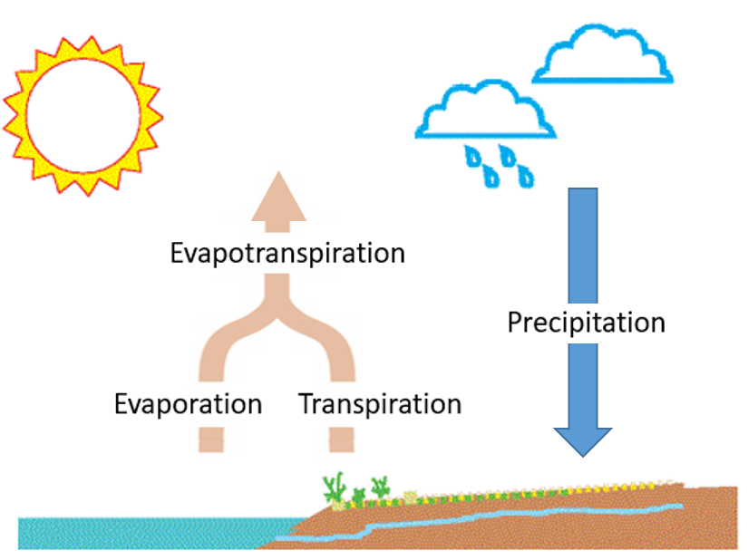
Applications: agriculture
SPEI6
INIT: Initialized decadal prediction
NoINIT: Non initialized climate projection
INIT
INIT - NoINIT
Multi-model correlation between the predicted ensemble mean and reference (from GHCN and GPCC) SPEI6 index for the boreal summer (July to September) averaged over forecast years 2 to 5.
Jul
Aug
Sep
Correlation coefficient

Slide 8
Applications: agriculture
INIT: Initialized decadal prediction
NoINIT: Non initialized climate projection
Six-month mean temperature index (T6)
INIT
INIT - NoINIT
Residual Correlation
Multi-model correlation between the predicted ensemble mean and reference (from GHCN) T6 index for the boreal summer (July to September) averaged over forecast years 2 to 5.
Jul
Aug
Sep
Correlation coefficient

Slide 9
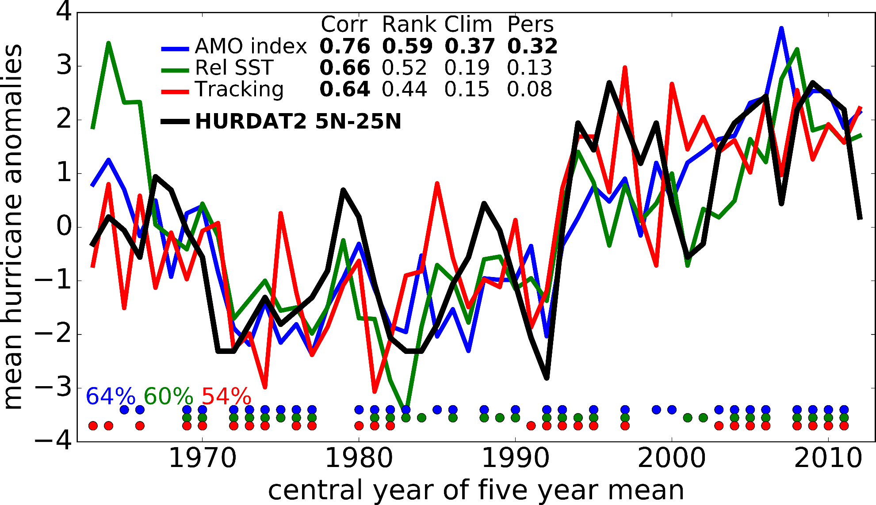
Applications: tropical cyclones
3 different techniques
RMSSS - average 2-5 years
Indicate that the right tercile was forecasted for that 4-year period
How often was the right tercile forecasted?
Caron et al. (BAMS, 2018)

Slide 10
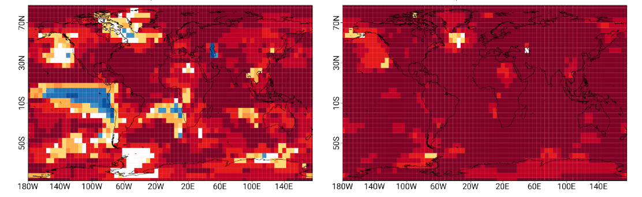
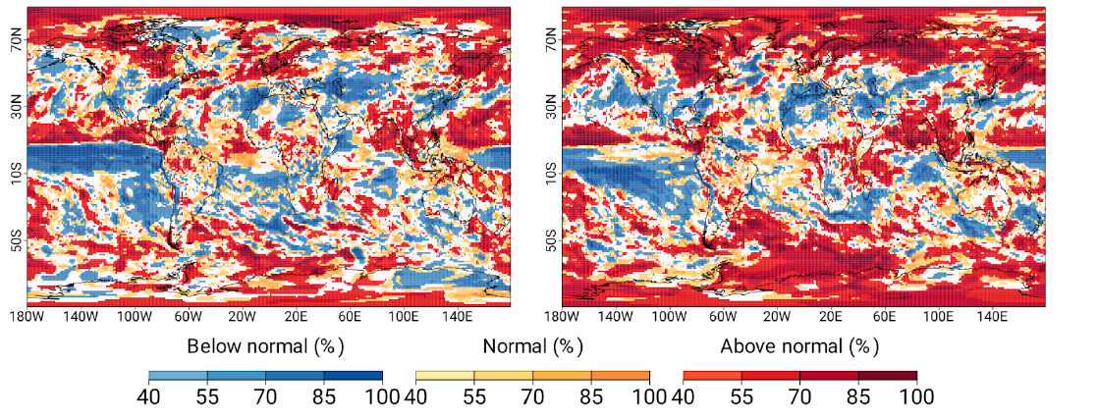
Real-time forecasts
Year 1
Years 1-5
Temperature
Precipitation
Probabilistic forecast of most likely tercile category for Nov 2017 – Oct 2018 (left column) and Nov 2017 – Oct 2022 (right column). The most likely category (below, normal, and above normal) and its percentage of probability to occur is shown. White indicates forecast probabilities are below 40% for all 3 categories.

Slide 11
Summary
EC-Earth 3.3 is ready to start with the DCPP A hindcasts. This will also be the next real-time forecast system.
High-resolution decadal predictions (every second start date, five forecast years) will be performed by this summer.
Pre-CMIP6 DCPP C experiments (volcanoes and AMV) will be repeated with the CMIP6 version.
Work ongoing to illustrate the potential value of decadal predictions in insurance (tropical cyclones), wind energy and agriculture.

Slide 12
Thanks

