Slide 1
DMI, 26-27 October 2016
EC-Earth3.2 at the BSC-ES
François Massonnet
and the Climate Prediction Group
R. Bilbao, O. Bellprat L. Brodeau, R. Cruz-García, F. Doblas-Reyes, E. Exarchou, N. Fučkar, J. García-Serrano, V. Guemas, M. Ménégoz, C. Prodhomme, V. Sicardi, E. Tourigny

Slide 2
Status of EC-Earth3.2 at BSC
ORCA1L75
Runs in seasonal prediction mode
Stratospheric aerosols are being added (M. Ménégoz)
ORCA025L75
Many compatibility issues were fixed (see portal): bathymetry, closed seas, …
Does not run beyond 20 time steps, trying with short time step.
PRIMAVERA & HighResMIP formatting: ongoing (E. Tourigny)
Reproducibility tests are underway (Massonnet, Ménégoz, Acosta)
More to follow at the EC-Earth meeting

Slide 3
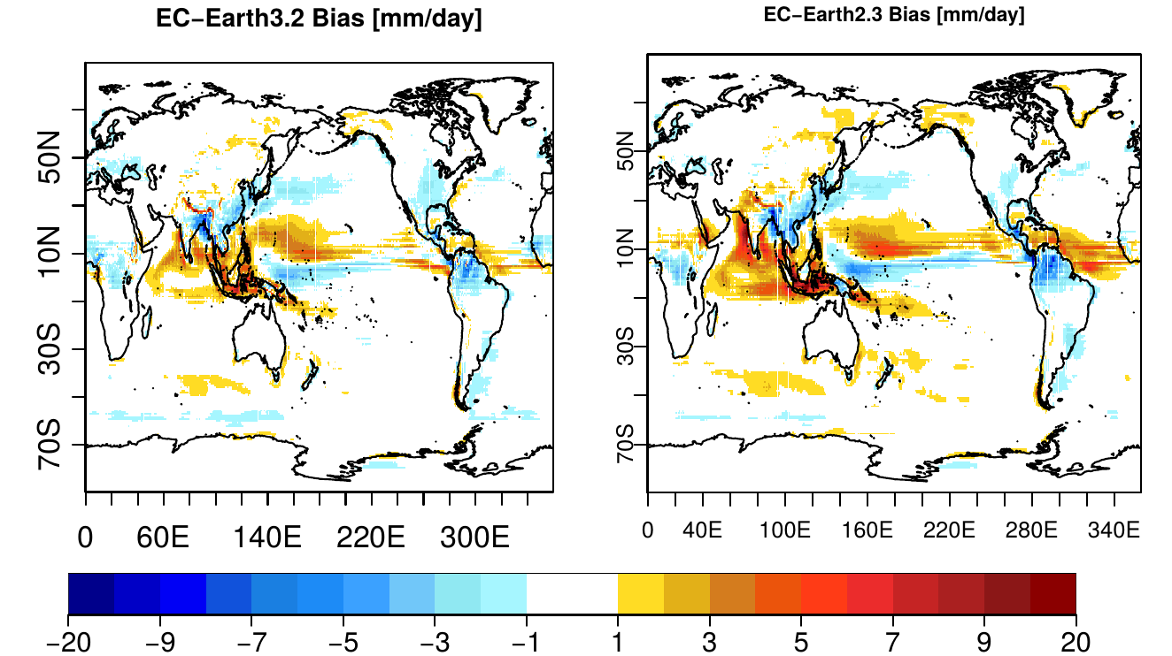
JJA Precipitation bias (1993-2009)
CMIP6
CMIP5
mm/day

Slide 4
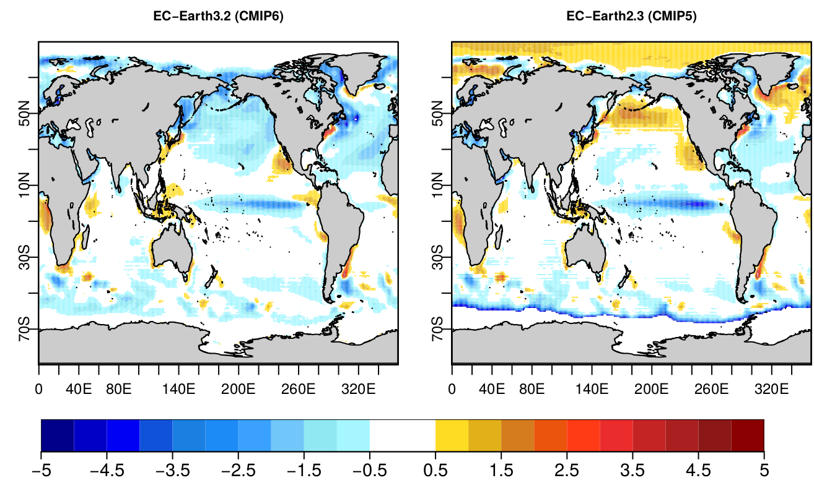
JJA SST 1993-2009 bias
CMIP6
CMIP5
°C

Slide 5
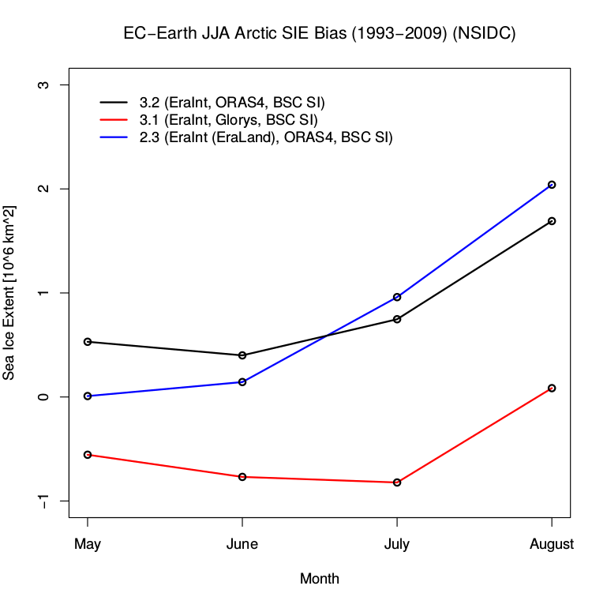
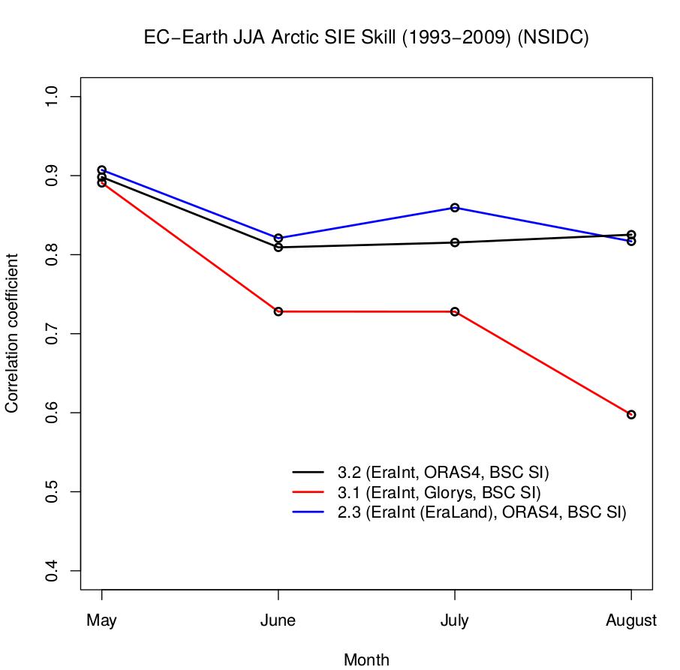
JJA Arctic sea ice extent 1993-2009
Bias
Correlation
CMIP5
CMIP5
CMIP6
CMIP6
EC-3.1 (! Init. Glorys)
EC-3.1 (! Init. Glorys)

Slide 6
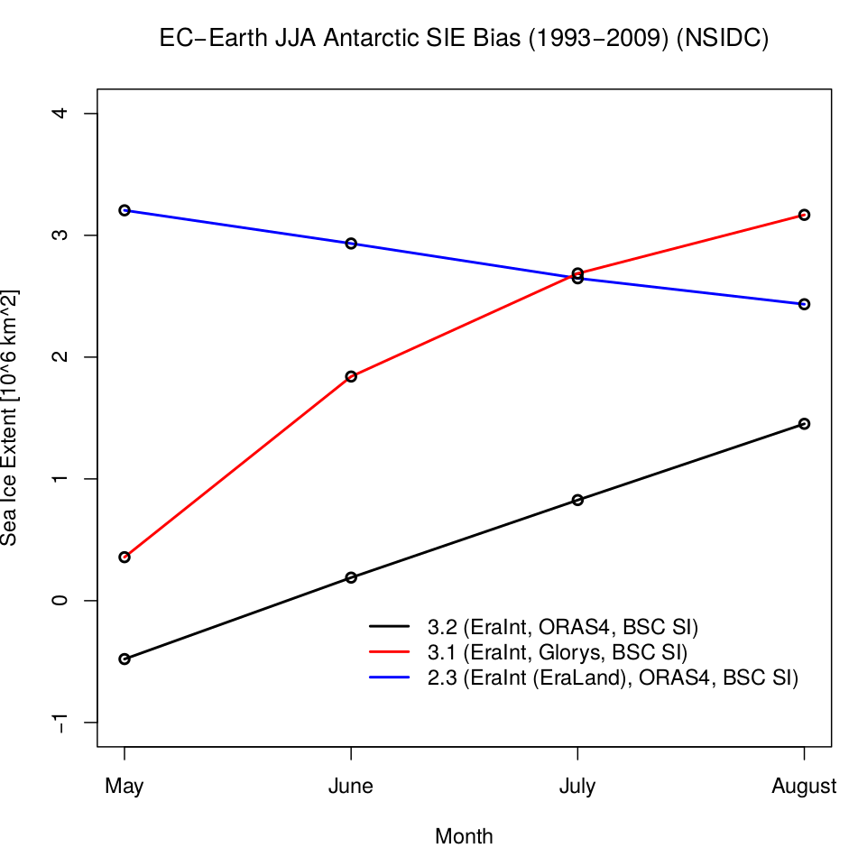
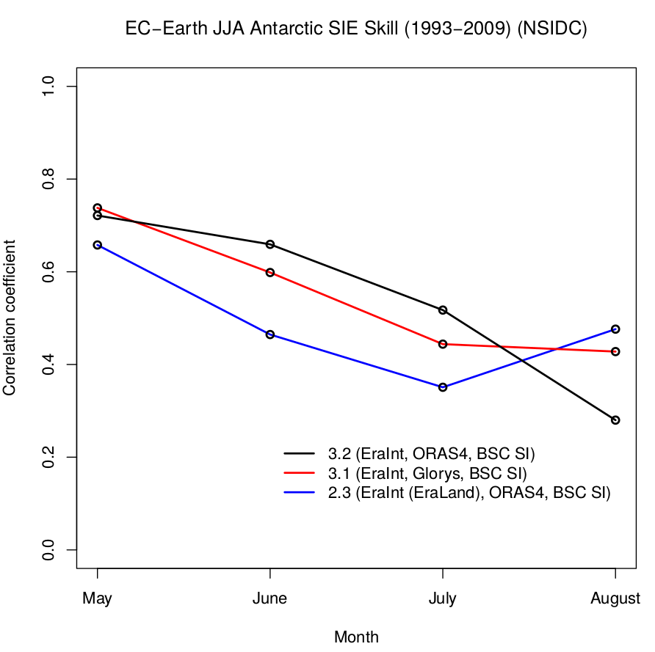
JJA Antarctic sea ice extent 1993-2009
Bias
Correlation
CMIP5
EC-3.1 (! Init. Glorys)
CMIP6
EC-3.1 (! Init. Glorys)
CMIP5
CMIP6

Slide 7
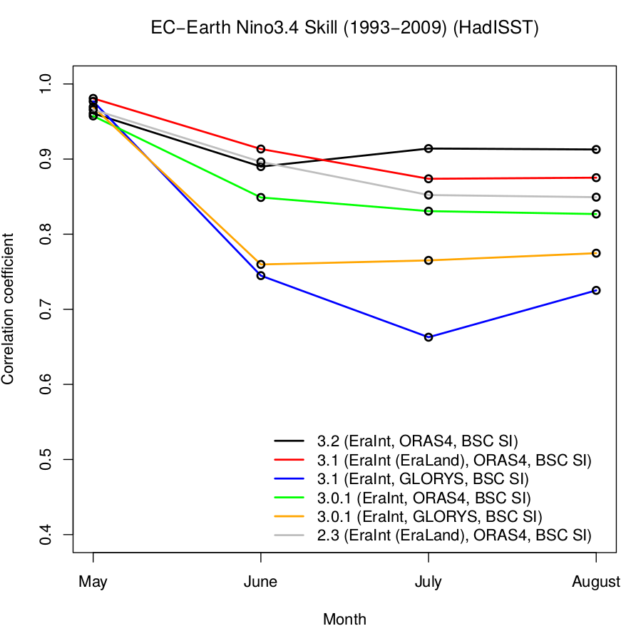
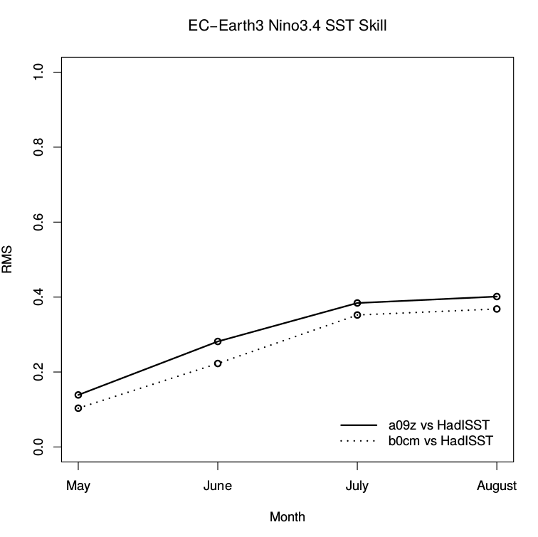
JJA Niño3.4 SST 1993-2009
CMIP6
CMIP5
CMIP6
CMIP5

Slide 8
DMI, 26-27 October 2016
The EnKF in EC-Earth3.2
François Massonnet
and the Climate Prediction Group
R. Bilbao, O. Bellprat L. Brodeau, R. Cruz-García, F. Doblas-Reyes, E. Exarchou, N. Fučkar, J. García-Serrano, V. Guemas, M. Ménégoz, C. Prodhomme, V. Sicardi, E. Tourigny

Slide 9
Frequently asked questions
What is an ensemble Kalman Filter (EnKF)?
What is the scientific purpose of an EnKF?
What are possible applications of the EnKF in climate sciences?
What are the advantages and downsides wrt other methods?
How does an EnKF work?
How does it affect the workflow?
Is it dependent on the version of EC-Earth used?
What happens with the ocean when sea ice is assimilated?
How much extra resources does the EnKF require?
What is the typical length of an assimilation cycle?
What is the space required to save the experiment?
Can we run with less than 25 members?
What is the status of the EnKF in EC-Earth?
What are the plans of the EnKF in EC-Earth?

Slide 10
Frequently asked questions
What is an ensemble Kalman Filter (EnKF)?
What is the scientific purpose of an EnKF?
What are possible applications of the EnKF in climate sciences?
What are the advantages and downsides wrt other methods?
How does an EnKF work?
How does it affect the workflow?
Is it dependent on the version of EC-Earth used?
What happens with the ocean when sea ice is assimilated?
How much extra resources does the EnKF require?
What is the typical length of an assimilation cycle?
What is the space required to save the experiment?
Can we run with less than 25 members?
What is the status of the EnKF in EC-Earth?
What are the plans of the EnKF in EC-Earth?

Slide 11
What is an EnKF?
What is the scientific purpose of an EnKF?
A Kalman Filter (KF) is a multivariate statistical problem of state estimation by maximizing the posterior state distribution, given observations, assuming bias-free models and observations and gaussian distribution of errors.
Every word is important!!!

Slide 12
What is an EnKF?
What is the scientific purpose of an EnKF?
A Kalman Filter (KF) is a multivariate statistical problem of state estimation by maximizing the posterior state distribution, given observations, assuming bias-free models and observations and gaussian distribution of errors.
Two inputs
One output
Prior knowledge (model) with uncertainty
Most consistent model state with observations
Kalman Filter
Observations with uncertainty
An EnKF works as a KF, but uses ensembles to estimate prior uncertainty

Slide 13
What is an EnKF?
2. What are possible applications of the EnKF in climate science?
State estimation for reconstruction (reanalyses)
State estimation for initialization (initial conditions)
Parameter estimation (tuning/calibration)
Three « hot » questions of climate science are addressed with the same tool! How cool is that?
This was the subject of my thesis, see references.

Slide 14
What is an EnKF?
3. What are the advantages and downsides w.r.t. other methods?
 | Nudging | Variational (3D/4D Var) | Sequential methods (EnKF) | Particle filtering
Ease of implementation | Fair | Hard (coding adjoint) | Medium-Hard | Medium
CPU consumption | Low | Low-Medium | High (~20-50 members) | Very high (~100 members to avoid degenerate solution)
Needs changes in model code? | Yes (restoring term added to tendencies) | Yes (adjoint) | No | No
Physical consistency | Little (univariate) | Up to linear approximation | Up to linear approximation | Full consistency
Estimation of prior uncertainty | None | Static | Dynamic | Dynamic
Assumptions to reach optimality | Not defined as an optimization problem | Gaussian centered errors | Gaussian centered errors | None
Produces ensembles? | No | No | Yes (hence available as IC) | Yes (hence available as IC)
The EnKF is, all in all, a honest tradeoff to estimate a system state with satisfactory physical consistency given limited resources available

Slide 15
Frequently asked questions
What is an ensemble Kalman Filter (EnKF)?
What is the scientific purpose of an EnKF?
What are possible applications of the EnKF in climate sciences?
What are the advantages and downsides wrt other methods?
How does an EnKF work?
How does it affect the workflow?
Is it dependent on the version of EC-Earth used?
What happens with the ocean when sea ice is assimilated?
How much extra resources does the EnKF require?
What is the typical length of an assimilation cycle?
What is the space required to save the experiment?
Can we run with less than 25 members?
What is the status of the EnKF in EC-Earth?
What are the plans of the EnKF in EC-Earth?

Slide 16
Frequently asked questions
What is an ensemble Kalman Filter (EnKF)?
What is the scientific purpose of an EnKF?
What are possible applications of the EnKF in climate sciences?
What are the advantages and downsides wrt other methods?
How does an EnKF work?
How does it affect the workflow?
Is it dependent on the version of EC-Earth used?
What happens with the ocean when sea ice is assimilated?
How much extra resources does the EnKF require?
What is the typical length of an assimilation cycle?
What is the space required to save the experiment?
Can we run with less than 25 members?
What is the status of the EnKF in EC-Earth?
What are the plans of the EnKF in EC-Earth?

Slide 17
How does an EnKF work?
1. How does it affect the workflow?
Before
Physics rules
ece-ifs+nemo.sh
19930501→19930531
outputs
To archive
All restarts (31 May 1993)
ece-ifs+nemo.sh
19930601→19930630

Slide 18
How does an EnKF work?
1. How does it affect the workflow?
After
Physics rules
Observations
ESA-CCI or OSI-SAF SIC
ece-ifs+nemo.sh
19930501→19930531
Ice + oce restarts (31 May 1993)
outputs
To archive
EnKF
(NERSC)
IFS + oasis
restarts
SanityCheck
Statistics rules
Updated ice + oce restarts (31 May 1993)
ece-ifs+nemo.sh
19930601→19930630

Slide 19
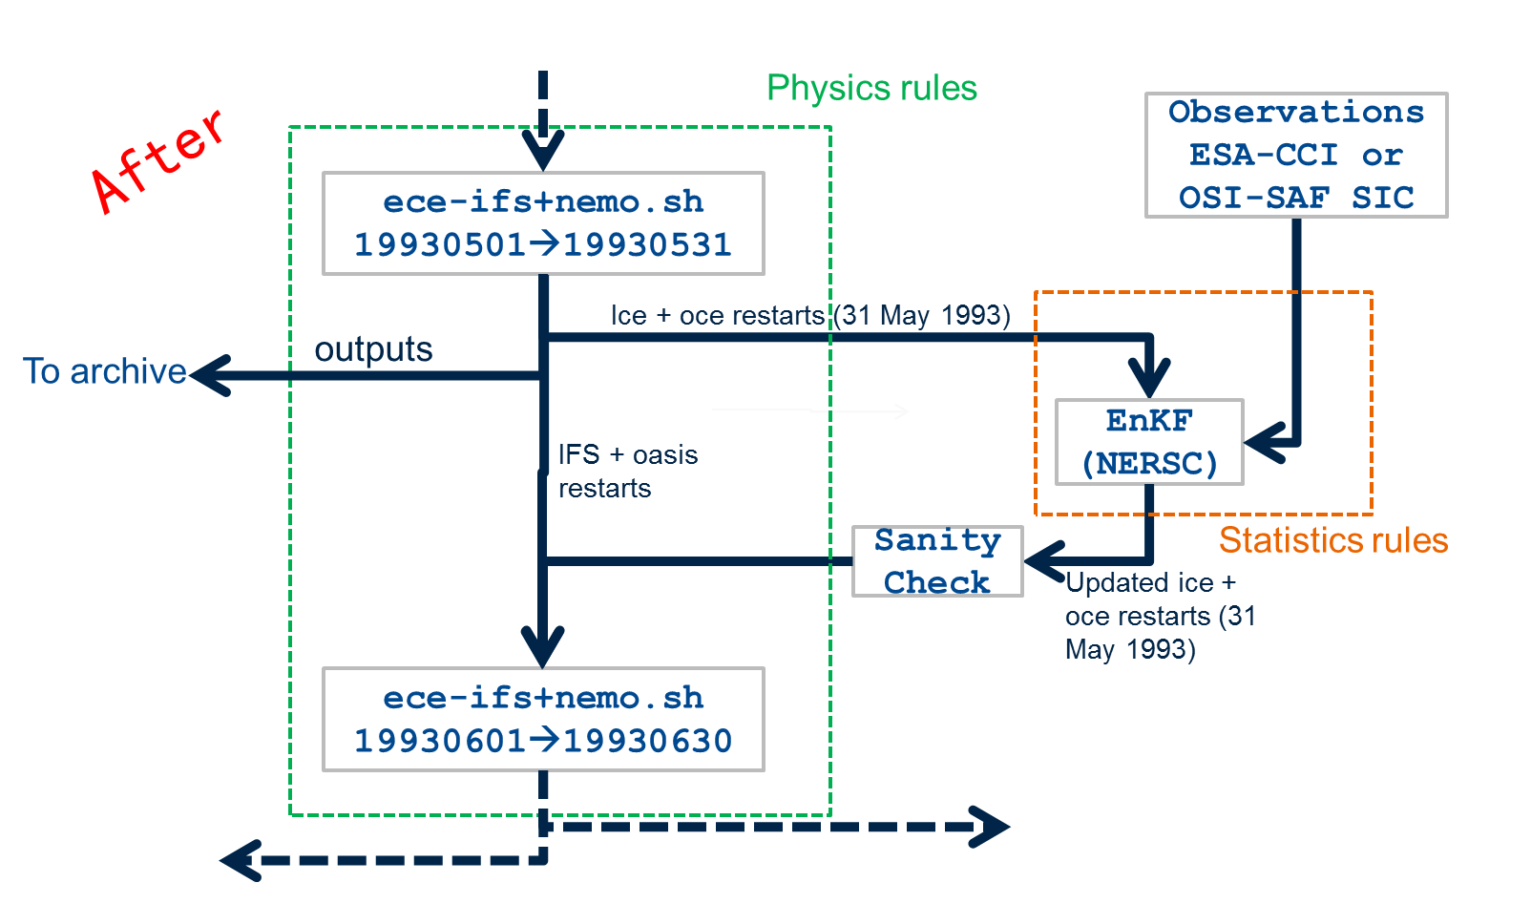
How does an EnKF work?
Member 1
Member 2
Member 3

Slide 20
How does an EnKF work?
Offline interpolation to model grid SIC + uncertainty (bash)
Observations
ESA-CCI or OSI-SAF SIC
EnKF
(NERSC)
List of variables to update
Inflation
Radius of localization
SanityCheck
Checks variables are within physical bounds
Checks physical consistency between variables
Statistics rules

Slide 21
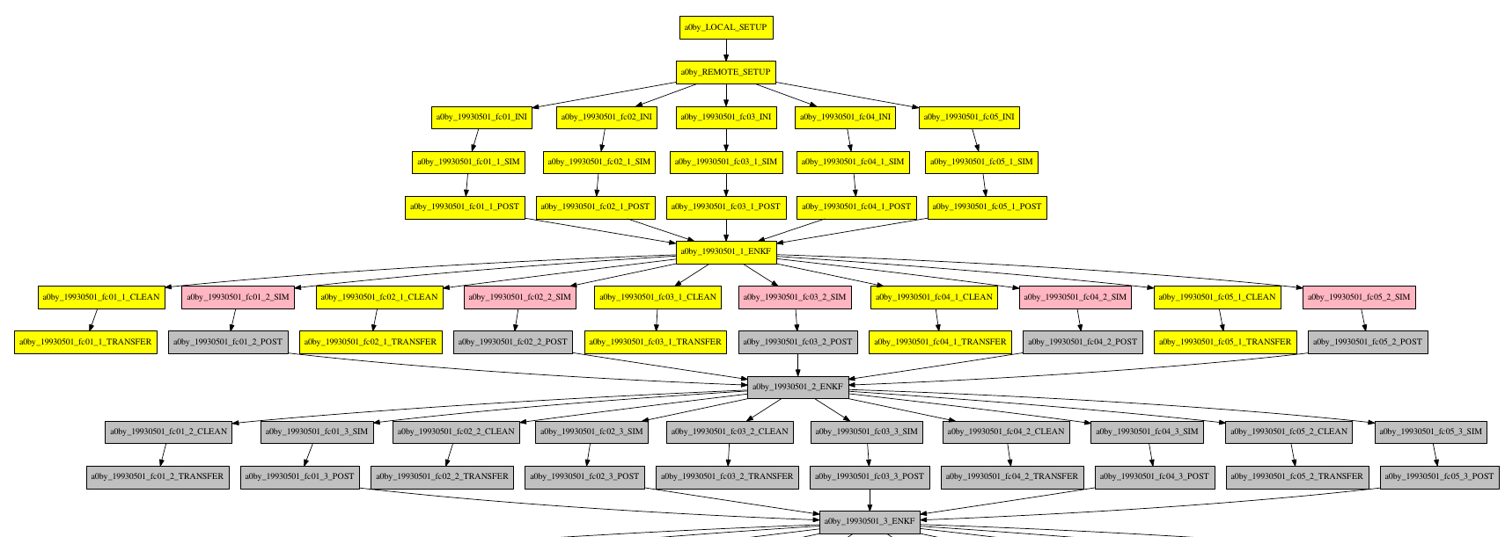
How does an EnKF work?
Implementation in a workflow manager: Autosubmit

Slide 22
How does an EnKF work?
2. Is it dependent on the version of EC-Earth used?
NO, unless state variables are added, deleted or renamed in EC-Earth
3. What happens to the ocean when sea ice is assimilated
To cut a long story short, all oceanic variables and sea ice variables are updated even though only SIC is assimilated.
The update of each variable (T, S, U, V, …) is based on the relationship it has with SIC, learned from the ensemble.
This guarantees a state that is consistent up to the linear approximation.

Slide 23
Frequently asked questions
What is an ensemble Kalman Filter (EnKF)?
What is the scientific purpose of an EnKF?
What are possible applications of the EnKF in climate sciences?
What are the advantages and downsides wrt other methods?
How does an EnKF work?
How does it affect the workflow?
Is it dependent on the version of EC-Earth used?
What happens with the ocean when sea ice is assimilated?
How much extra resources does the EnKF require?
What is the typical length of an assimilation cycle?
What is the space required to save the experiment?
Can we run with less than 25 members?
What is the status of the EnKF in EC-Earth?
What are the plans of the EnKF in EC-Earth?

Slide 24
Frequently asked questions
What is an ensemble Kalman Filter (EnKF)?
What is the scientific purpose of an EnKF?
What are possible applications of the EnKF in climate sciences?
What are the advantages and downsides wrt other methods?
How does an EnKF work?
How does it affect the workflow?
Is it dependent on the version of EC-Earth used?
What happens with the ocean when sea ice is assimilated?
How much extra resources does the EnKF require?
What is the typical length of an assimilation cycle?
What is the space required to save the experiment?
Can we run with less than 25 members?
What is the status of the EnKF in EC-Earth?
What are the plans of the EnKF in EC-Earth?

Slide 25
How much extra resources does the EnKF require?
There are N=24 members to integrate, hence 24 SIM jobs, but all 24 jobs can be submitted independently.
The EnKF job is itself quite fast (15 min on 16 procs) but cannot start until the last of the 24 SIM jobs is finished ☹. That’s the bottleneck of sequential methods.

Slide 26
How much extra resources does the EnKF require?
At ORCA1L75 with EC-Earth3.2:
CPU consumption is ~ 24 [members] x 432 [procs] x 0.2 [hrs] = 2 kCPUhrs per cycle. (one cycle = one month here). This makes ~0.8 million CPUhrs for producing initial conditions over a full period. CPU consumed during EnKF jobs is negligible.
At ORCA1, with EC-Earth3.2, it takes between 2 hours and 5 hours of physical time (depending on load on machine) to complete a full SIM-EnKF cycle. Expect at least 3 physical days to finish one year

Slide 27
How much extra resources does the EnKF require?
Disk space:
- If you want to save everything
24 members, save original (forecast) and updated (analysis) sea ice and ocean restarts + IFS + OASIS restarts: 5.5 Go per member, 132 Go per cycle.
This makes 55 To for a full period (35 yr, monthly cycles)
- If you want to save only the analyzed restarts (not forecasts), 40 To.
- If you want to save only the mean of all 24 restarts, this makes 1.7 To. But then, an alternative perturbation strategy has to be proposed when starting predictions from the initial states produced by the EnKF

Slide 28
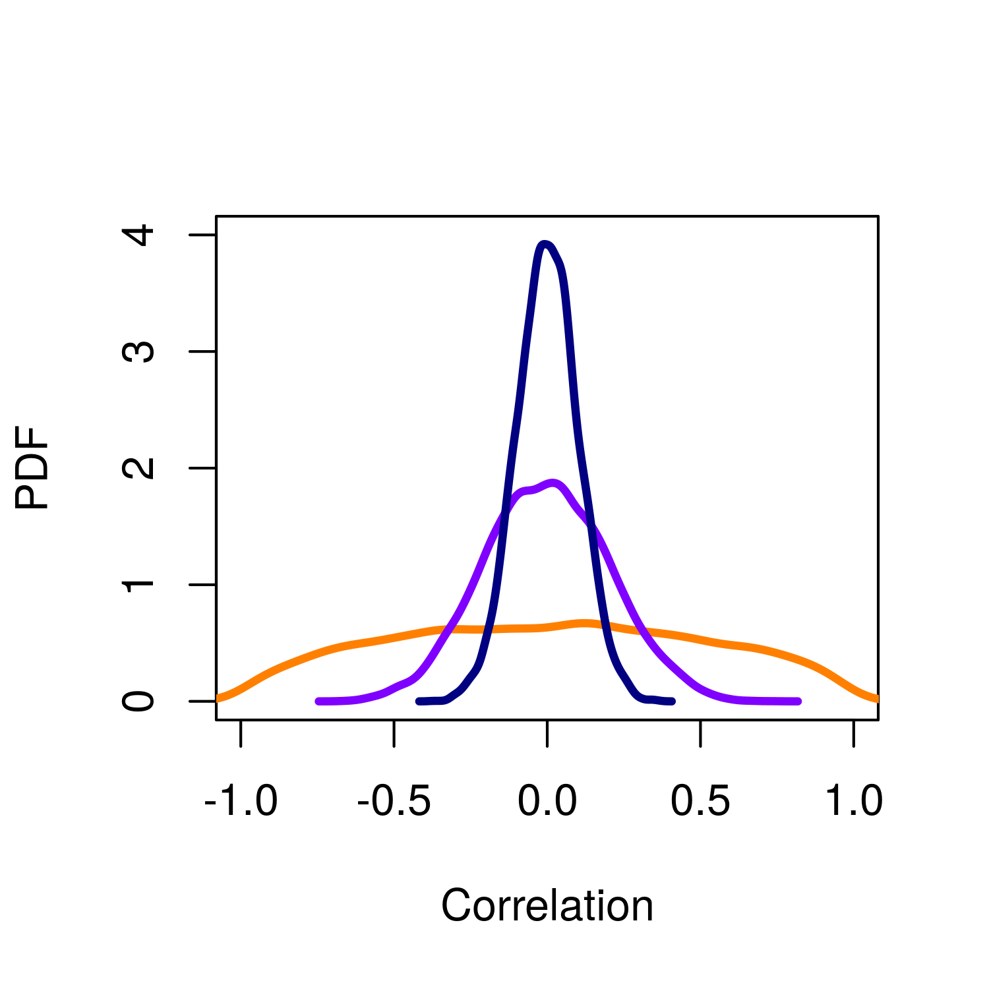
How much extra resources does the EnKF require?
Do we really need 24 members? Can’t we just run 5?
PDF of sample correlation between 2 variables with true correlation = 0.0
100 members
True correlation
With 5 members, there are good chances to observe spurious correlations even though no physical link is actually present
24 members
5 members

Slide 29
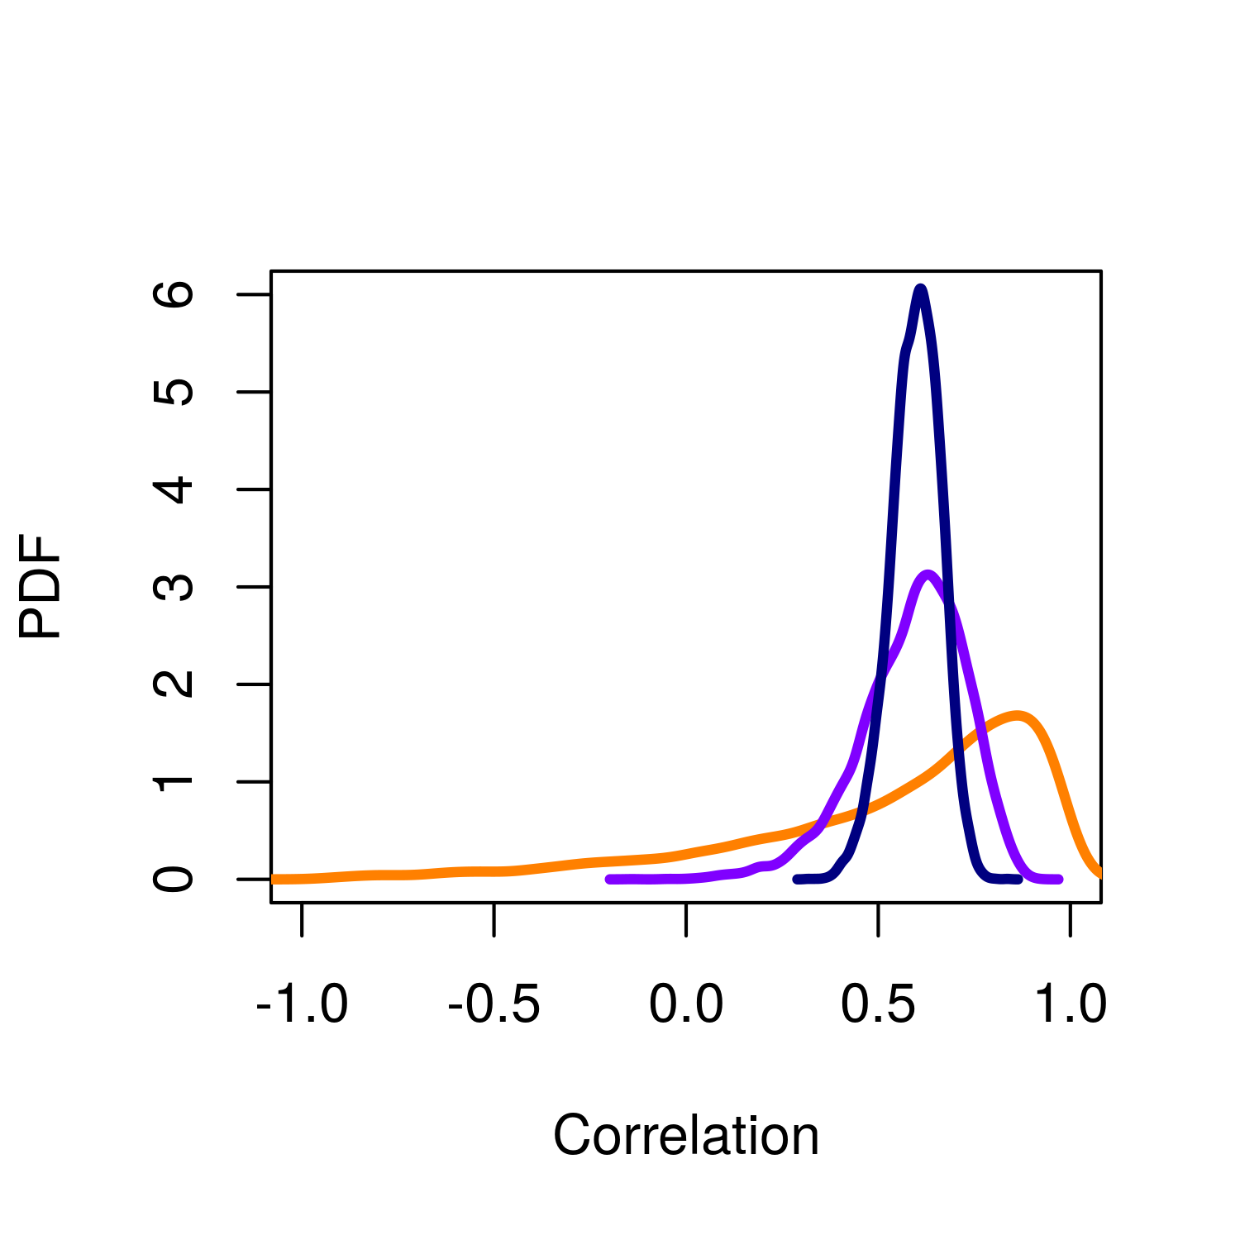
How much extra resources does the EnKF require?
Do we really need 24 members? Can’t we run just 5?
PDF of sample correlation between 2 variables with true correlation = 0.6
100 members
True correlation
If a physical link exists (e.g. SSS-SIC), then with 5 members we will wrongly estimate the strength of the association, leading to either too strong or too weak updates.
24 members
5 members

Slide 30
How much extra resources does the EnKF require?
Can we call the EnKF routine less often than every month?
That’s a test to do.
But the longest the assimilation window, the less constrained the initial state.
Also, the longest the assimilation window, the larger the spread, the larger the bias, and hence the larger the updates, the larger the risk to have restartability issues (because all updates are done in a linear space)

Slide 31
Frequently asked questions
What is an ensemble Kalman Filter (EnKF)?
What is the scientific purpose of an EnKF?
What are possible applications of the EnKF in climate sciences?
What are the advantages and downsides wrt other methods?
How does an EnKF work?
How does it affect the workflow?
Is it dependent on the version of EC-Earth used?
What happens with the ocean when sea ice is assimilated?
How much extra resources does the EnKF require?
What is the typical length of an assimilation cycle?
What is the space required to save the experiment?
Can we run with less than 25 members?
What is the status of the EnKF in EC-Earth?
What are the plans of the EnKF in EC-Earth?

Slide 32
Frequently asked questions
What is an ensemble Kalman Filter (EnKF)?
What is the scientific purpose of an EnKF?
What are possible applications of the EnKF in climate sciences?
What are the advantages and downsides wrt other methods?
How does an EnKF work?
How does it affect the workflow?
Is it dependent on the version of EC-Earth used?
What happens with the ocean when sea ice is assimilated?
How much extra resources does the EnKF require?
What is the typical length of an assimilation cycle?
What is the space required to save the experiment?
Can we run with less than 25 members?
What is the status of the EnKF in EC-Earth?
What are the plans of the EnKF in EC-Earth?

Slide 33
What is the status of the EnKF in EC-Earth?
Two configurations are currently working at BSC-ES
Stand-alone simulations
NEMO3.6, forced by perturbed Drakkar Forcing Set 5.2
24 members
1979-1999 completed
Assimilation of OSI-SAF SIC (1979-1993) and ESA-CCI SIC (1993-1999).
Simulation is ongoing on MareNostrum3
Coupled simulations
EC-Earth3.2
24 members
1993-1994 completed
Assimilation of ESA-CCI SIC (1993-1999)
Simulation is ongoing on MareNostrum3

Slide 34
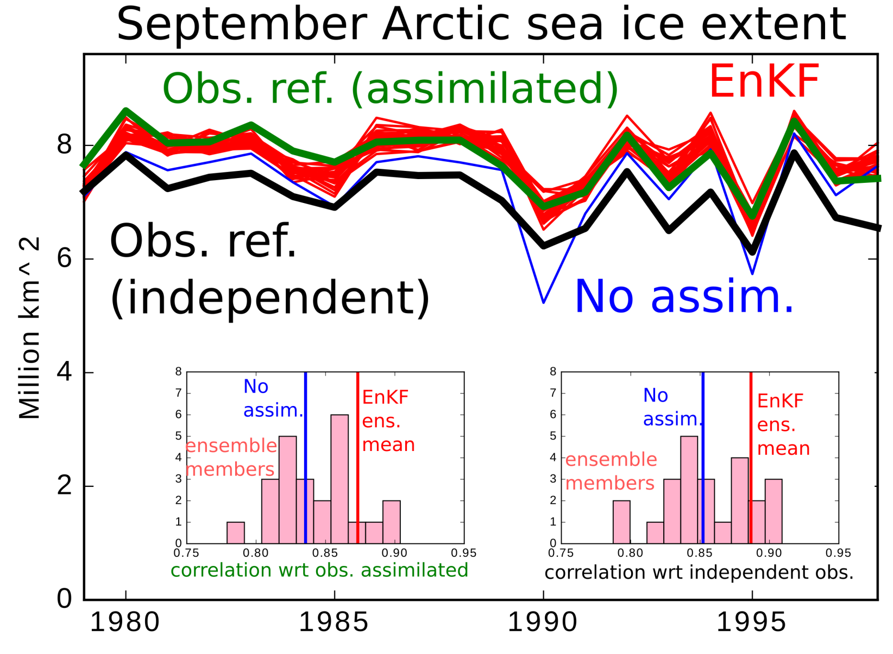
Results from stand-alone config.

Slide 35
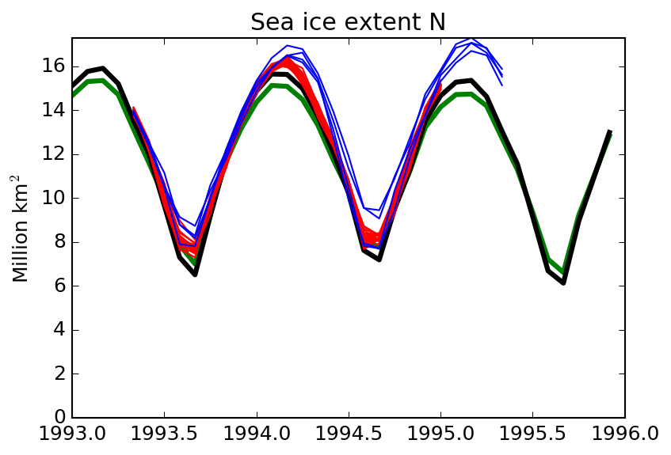
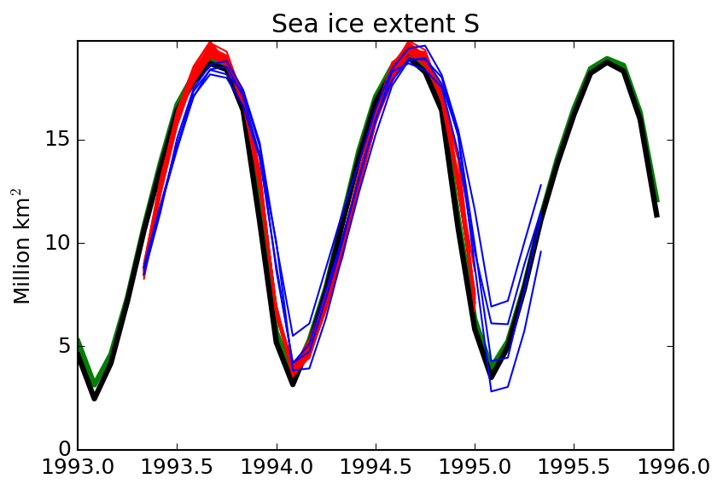
Results from coupled experiments
The EnKF is able to keep EC-Earth track the observed sea ice extent despite systematic biases in the model
Start from IC obtained in EnKF forced reanalysis
Free, coupled
EnKF, coupled
Obs assimilated (ESA)
« Independent» obs (NSIDC)
The model is over confident in winter in Arctic, we may try to assimilate less often to increase the magnitude of the updates

Slide 36
Frequently asked questions
What is an ensemble Kalman Filter (EnKF)?
What is the scientific purpose of an EnKF?
What are possible applications of the EnKF in climate sciences?
What are the advantages and downsides wrt other methods?
How does an EnKF work?
How does it affect the workflow?
Is it dependent on the version of EC-Earth used?
What happens with the ocean when sea ice is assimilated?
How much extra resources does the EnKF require?
What is the typical length of an assimilation cycle?
What is the space required to save the experiment?
Can we run with less than 25 members?
What is the status of the EnKF in EC-Earth?
What are the plans of the EnKF in EC-Earth?

Slide 37
Frequently asked questions
What is an ensemble Kalman Filter (EnKF)?
What is the scientific purpose of an EnKF?
What are possible applications of the EnKF in climate sciences?
What are the advantages and downsides wrt other methods?
How does an EnKF work?
How does it affect the workflow?
Is it dependent on the version of EC-Earth used?
What happens with the ocean when sea ice is assimilated?
How much extra resources does the EnKF require?
What is the typical length of an assimilation cycle?
What is the space required to save the experiment?
Can we run with less than 25 members?
What is the status of the EnKF in EC-Earth?
What are the plans of the EnKF in EC-Earth?

Slide 38
What are the plans of the EnKF in EC-Earth?
(short-term) The ongoing stand-alone and coupled reanalyses will be extended to cover a full 1979-now period
(short-term) The ongoing stand-alone reanalysis will be the base for DCPP
(short-term) An assessment of the quality of the reanalysis will be done
(mid-term): launch ORCA025 stand-alone EnKF
(long-term): change EnKF code to also update atmosphere
(long-term): launch ORCA025 coupled EnKF

Slide 39
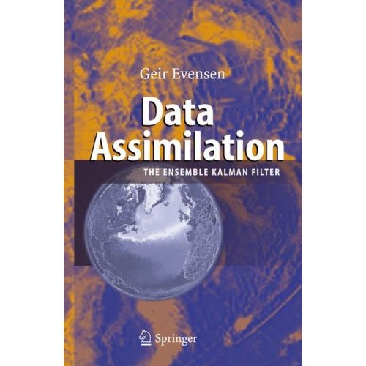
References
Evensen’s book (basics, theory, examples)
http://enkf.nersc.no/
(source code)
F. Massonnet’s thesis (applications to sea ice)
www.climate.be/u/fmasson

