Slide 1
WP3: CSTools - BSC functions

Slide 2
Bias adjustment methodologies
Method | Equation | Description | Reference
Simple bias correction |  | Based on the assumption that both the reference and forecasted distribution are well approximated by a Gaussian distribution.
Calibration method |  | Variance inflation modifies the predictions to have the same inter-annual variance as the reference dataset and corrects the ensemble spread to improve the reliability.
Leung et al. (1999)
Doblas-Reyes et al.
(2005)
correlation between the ensemble mean forecast and the observations
Bias adjusted forecast
Forecast climatology
ρ
Forecast standard deviation
Original forecast
Reference climatology
Ensemble mean
Reference standard deviation
standard deviation of the difference between the ensemble members and the ensemble mean
σ_{e}

Slide 3
Impact of bias-adjustments on skill
Uncorrected
ECMWF System 4 seasonal predictions of 10-m wind speed and ERA-Interim
Simple
Calibration
Fair Ranked Probability Skill Score

Slide 4
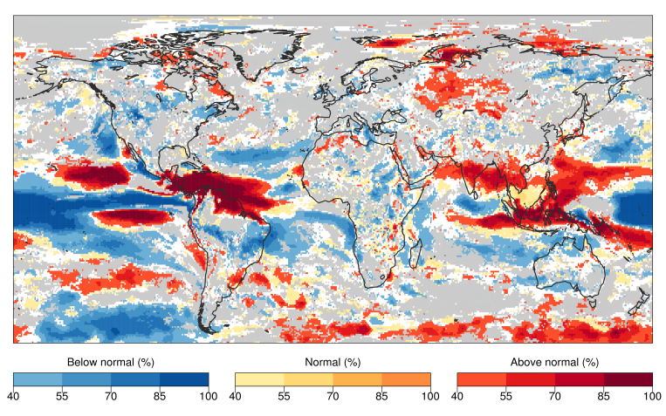
PlotMostLikelyQuantileMap
How will be the next month/season temperature?
✔
Only areas with positive skill (RPSS) are shown to the users
✔
Summarising information in one map only
ECMWF S4 10-m wind speed seasonal forecast for DJF 2015 initialized the 1st of November. The most likely wind speed category (below-normal, normal or above normal) and its percentage probability to occur is shown. White areas show where the probability is less than 40 % and approximately equal for all three categories. Grey areas show where the seasonal forecasts don’t improve the climatology.

Slide 5
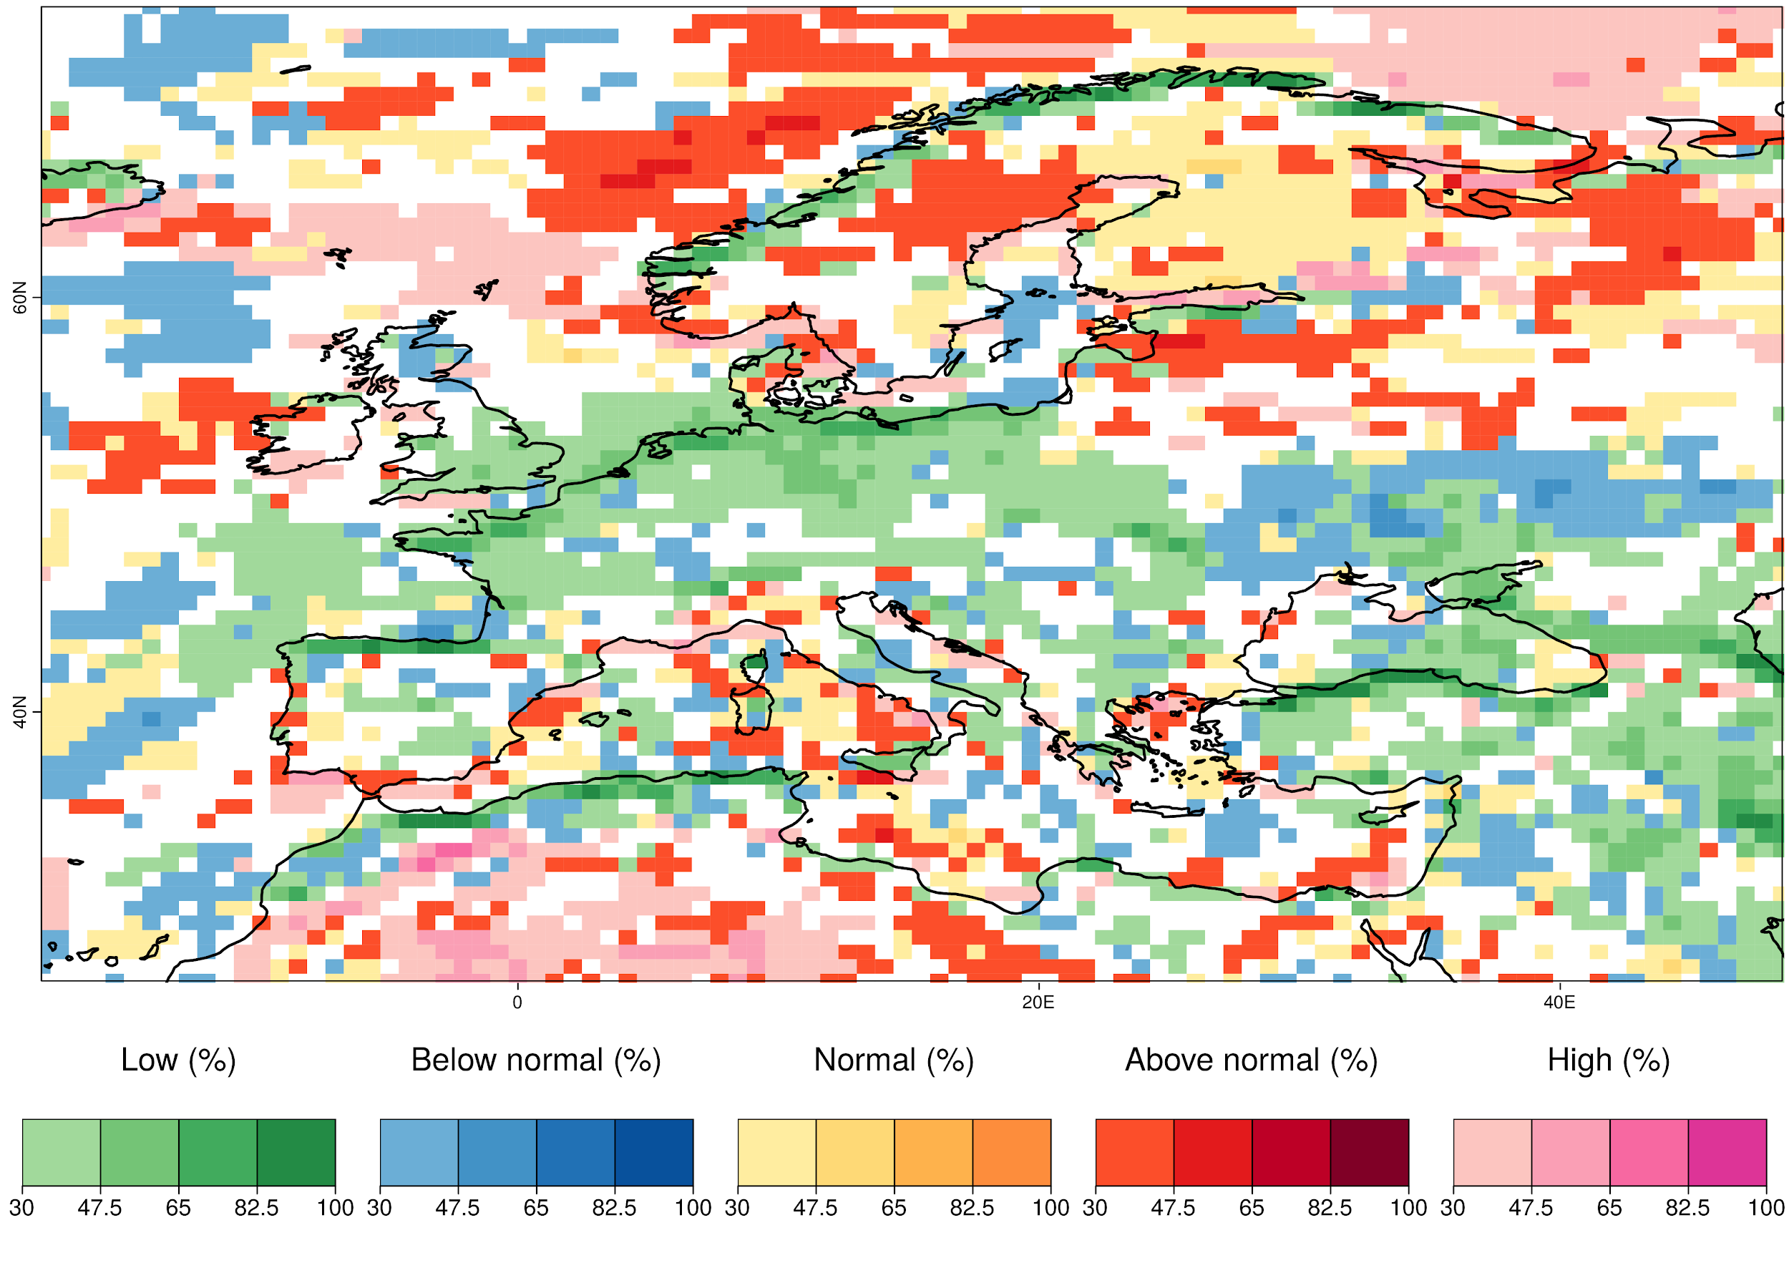
PlotMostLikelyQuantileMap
Example with 5 categories.

Slide 6
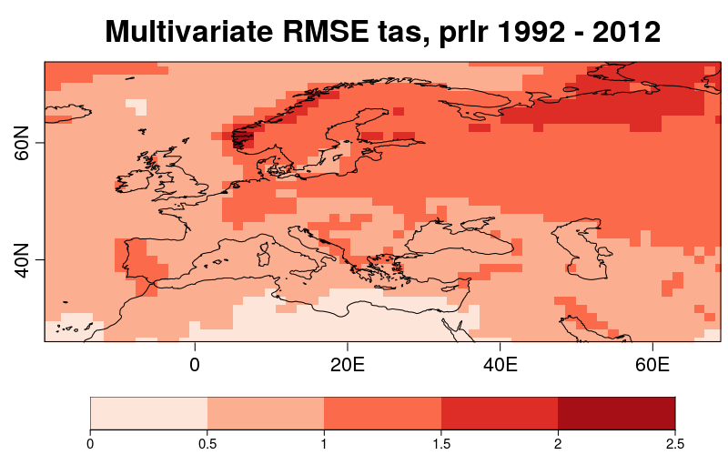
MultiVarRMSE
This function calculates the RMSE from multiple variables at once. The multivariate RMSE is computed as the mean of each variable's RMSE scaled by its observed standard deviation. The variables can also be weighted based on their relative importance, as defined by the user.
Example of the multivariate RMSE for surface air temperature and precipitation combined, from 1992 to 2012, using the Glosea5 seasonal forecasting system over Europe. In this example, temperature is assigned a weight of 2 and precipitation a weight of 1.
Vignette available: https://cran.r-project.org/web/packages/CSTools/vignettes/MultivarRMSE_vignette.html

Slide 7
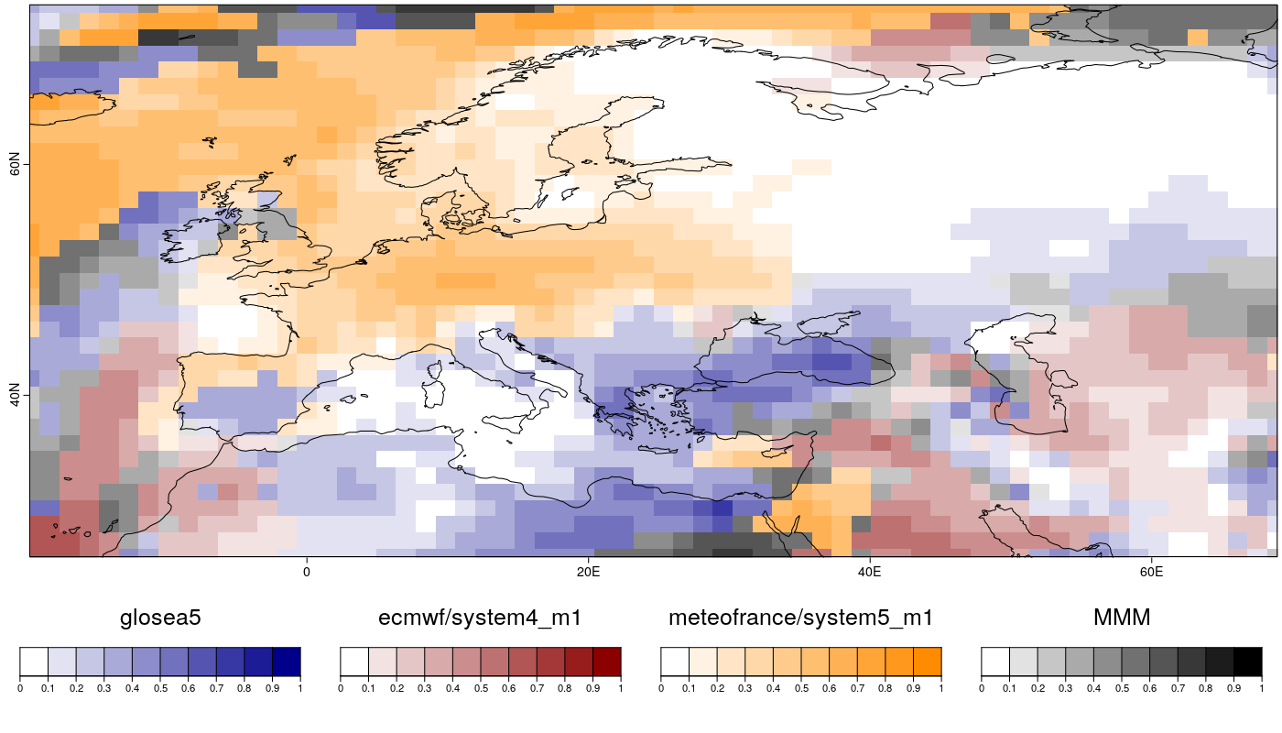
MultiMetric/PlotCombinedMap
This function calculates the anomaly correlation coefficient (ACC), the root mean square error (RMS) and the root mean square error skill score (RMSSS) of individual models and multi-model ensemble forecasts. It can also be used to identified the best model/forecast over a particular region, as well as the particular level of skill over that region.
Spatial representation of the highest correlation values for each grid point obtained for three different models - GloSea5 (blue), ECMWF System 5 (red) and Météo-France System 5 (yellow) seasonal forecasting systems as well as the ensemble mean (MMM - grey) versus a reference dataset.
Vignette available: https://cran.r-project.org/web/packages/CSTools/vignettes/MultiModelSkill_vignette.html

Slide 8
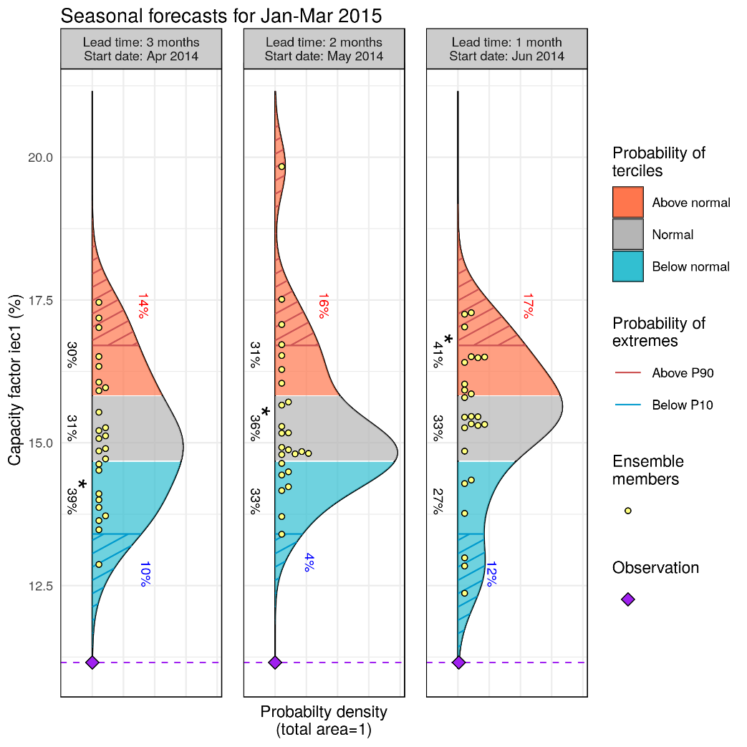
PlotForecastPDF
Three forecasts with
different lead time
Extremes:
prob. above P90
Tercile probabilities
and Most Likely Tercile
Ensemble members
PDF from ensemble dressing
Observed value

