Slide 1
Description of WP 3.10 and 3.11:
- Assessment of the potential of CCI/CCI+ data to constrain mineral dust simulations at the regional scale
- Production of a pilot dust reanalysis at the regional scale
Enza Di Tomaso, Martina Klose, Carlos Pérez García-Pando
Barcelona Supercomputing Center

Slide 2
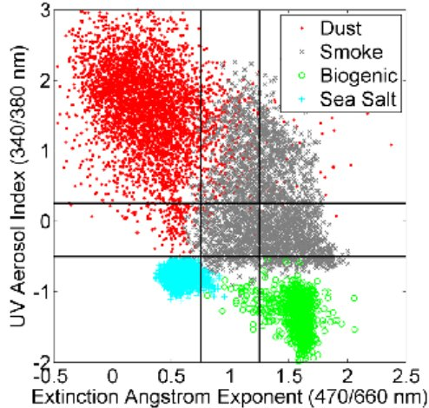
WP 3.10 & 3.11 - Motivations
Current aerosol (and dust) data assimilation is mainly based on retrievals in the visible part of the electromagnetic spectrum, and with no information on aerosol speciation
IASI dust retrievals have the potential to overcome these drawbacks. A previous CCI case study made by BSC showed the potential of IASI for dust DA but with a few important limitations.
(Vries et al., 2015)
Notes:
Limitation previous study:
- global coarse resolution simulation
- L3 (1 degree aggregation) observations
- conversion to VIS AOD
- limited period
- no synergy with other ECVs that can impact the model first-guess
IASI dust AOD features:
- observations available day time and night time
- over ocean and over land (desert)
- 10 μm: detection of dust aerosol coarse mode (infrared wavelengths and ‘‘V’’ shaped depression of the Brightness Temperature)
- pixel level uncertainty

Slide 3
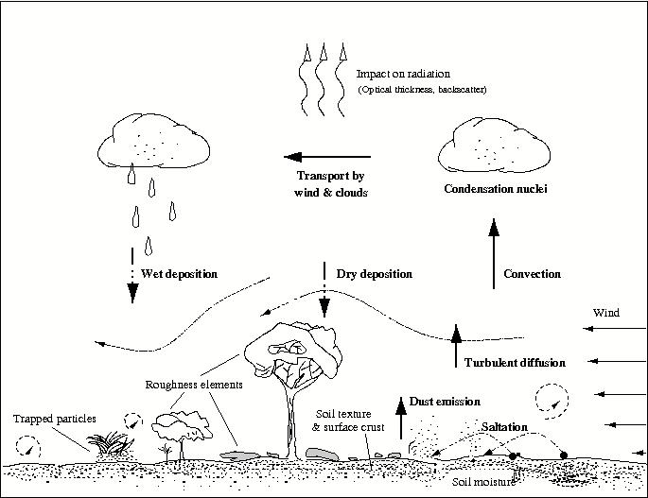
WP 3.10 & 3.11 - Motivations
Surface characteristics are important for dust emissions
Current use of Land Cover information in dust models is provided at a coarse resolution and is related to green vegetation only.
Possible ways to use new HRLC data:
- Improve parameter estimates used in meteorological and land-surface modules
- Move from universal to land-cover-type dependent parameters to calculate surface characteristics in dust model
(Shao, 2008)
Notes:
Different vegetation types affect differently dust emissions
Currently used in MONARCH (BSC model):
Land cover type:
- Meteorological component estimates aerodynamic roughness length (z0) based on USGS 94-category land use and regionally (N Africa and Asia) uses 1/4x1/4 degree resolution z0 based on POLDER-I (Laurent et al. 2008)
(Green) Vegetation cover fraction:
- The meteorological and land-surface component uses USGS monthly climatology at 1km resolution
- The dust module uses MODIS LAI at 0.1x0.1 degree resolution, at a monthly variation, and available for 2000-2015
- to calculate a drag partition to correct the threshold friction velocity for sediment mobilization
- to estimate the erodible (bare) area for dust flux calculation
- [optional] to scale dust flux

Slide 4
WP 3.10 - Description
WP3.10: Assessment of the potential of CCI/CCI+ data to constrain mineral dust simulations at the regional scale
ECVs involved: Aerosol dust and High Res LC
CCI IASI dust data will be assimilated in model simulations, while CCI+ high resolution land cover data (once data will become available) will be used to enhance the NMMB-MONARCH’s land use type, with a consequent impact on dust emissions

Slide 5
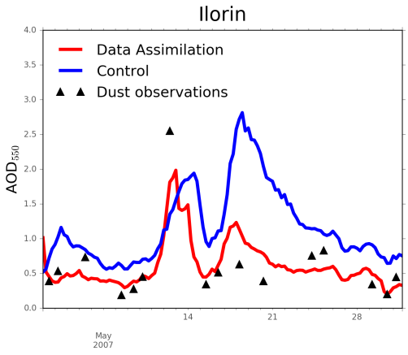
WP 3.10 - Aims
Aims:
- demonstrating the use of CCI/CCI+ data to produce dust analyses at the regional scale;
- assessing the synergy of CCI aerosol data (in particular when constraining atmospheric concentrations over dust source areas) with CCI+ land cover data (used for an enhanced characterization of dust emissions);
(Di Tomaso)
- set the basis for the assessment activity 11 on the production of a pilot dust reanalysis, where the impact on dust cycles at different temporal scales will be evaluated.

Slide 6
WP 3.11 - Description
WP3.11: Production of a pilot dust reanalysis at the regional scale
ECVs involved: Aerosol dust and High Res LC
CCI IASI dust data will be assimilated in model simulations for the reanalysis period. Simulations will make use also of CCI+ high resolution land cover data, once these will become available, in order to enhance the NMMB-MONARCH’s land use type.

Slide 7
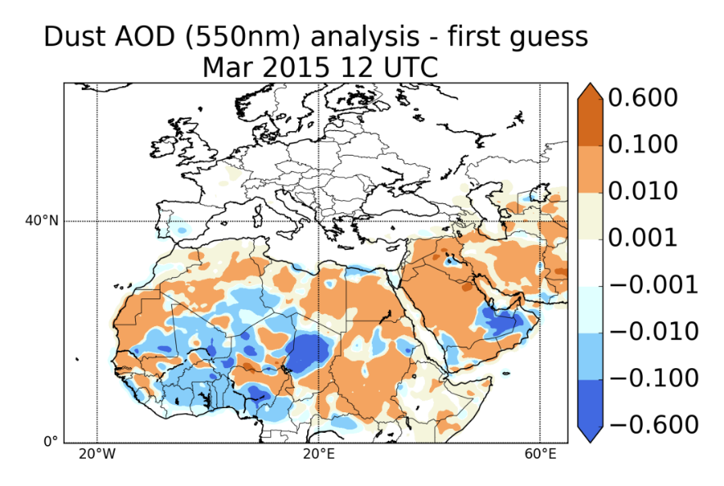
WP 3.11 - Aims
Aims:
- producing a pilot dust regional reanalysis based on CCI/CCI+ data, over a 1 year period
- detection of systematic (spatial and temporal) patterns of data impacts on the dust analysis through statistics of innovations
- assessing whether their integration in model simulations can improve the monitoring of mineral dust and the characterization of dust cycles
(Di Tomaso)

Slide 8
WP 3.10 & 3.11 - Experiments
Planned experiments:
- Control, Ensemble free-run, IASI-DA, LC + IASI-DA using the BSC dust model (ensemble-based DA)
Use of uncertainty:
- retrieval pixel-level uncertainty will be used to characterize observation error statistics
Assessment of consistency:
- study analysis increments by dust source areas with/without updated information on LC

Slide 9
WP 3.10 & 3.11 - Interactions
Planned interactions:
CCI+ ECV teams: LC, HRLC teams
Initial discussions: domain, variable values&types, temporal resolution, period, format
CCI ECV teams: email discussion started with ULB (C3S ECV)
Interactions also via a web-based project managing tool (e.g., Trello)
External:
DustClim consortium (dust reanalysis)
WMO SDS-WAS hosted by BSC/AEMET
Links within CMUG: Aerosol global reanalysis (ECMWF)
Notes:
Questions to raise during the Integration Meeting

