Slide 1
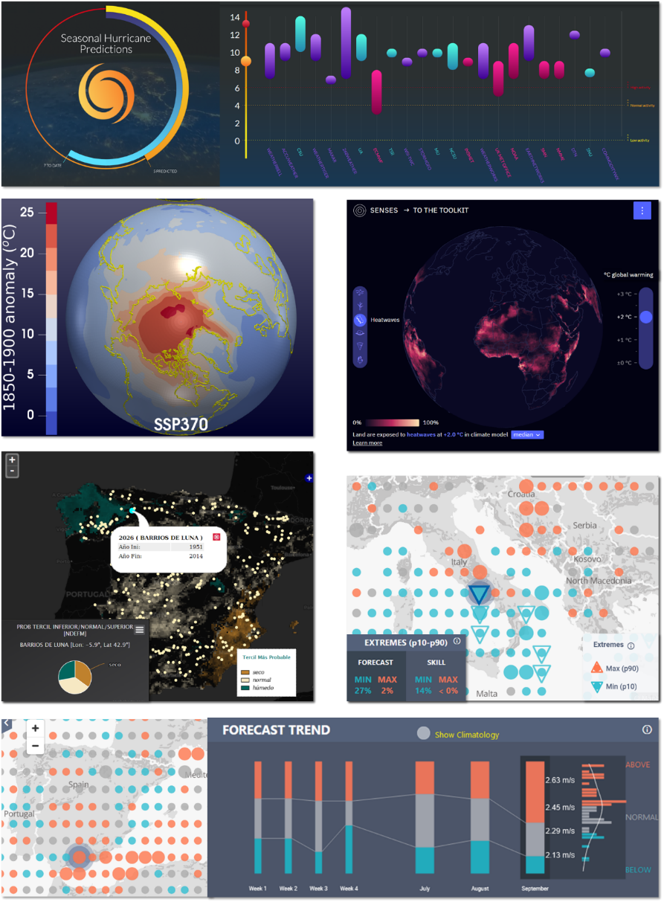
VISUALISATION IN CLIMATE SERVICES:
CURRENT PRACTICE AND RECOMMENDATIONS
Marta Terrado, Diana Urquiza, Sara Octenjak, Andria Nicodemou, Dragana Bojovic, Luz Calvo, and Isadora Christel
AIM: Obtain a picture of the current visualisation practices in the field of climate services.
Provide recommendations of good practices for the next generation of climate services.
METHOD: Workshop organisation structured in break-out group discussions (22 projects).
Analysis of results using affinity maps to take the pulse of the community.
RESULTS: Identification of current practices and challenges in climate services visualisation.
CONCLUSION: The climate science field can benefit from good practices in other disciplines (e.g. User Experience, Data visualisation, Graphic Design, Psychology) and improve accessibility to climate information ‘leaving no-one behind’.
Representation of probabilistic information in different climate service visualisations (Terrado et al. in preparation)

Slide 2
Average/median value
(no probability)
Variability: anomalies
(no probability)
Average/median value: scenarios
(no probability)
Thresholds:
extreme events probability
Most likely category:
terciles
Probability Distribution Function (PDF)

Slide 3
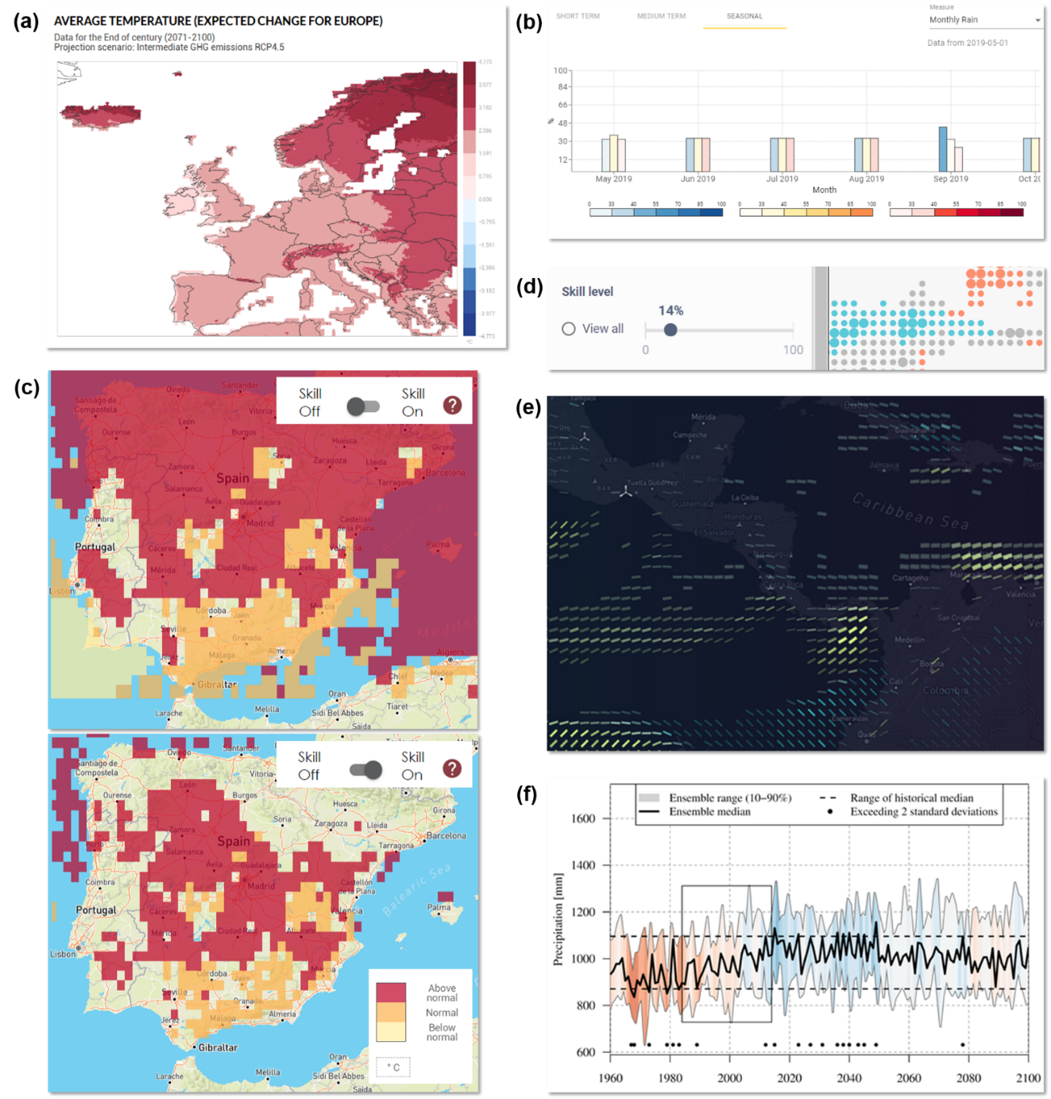
Hide information with high uncertainty (replace by a reference)
No uncertainty information
Possibility to see information with different levels of uncertainty (filter by threshold)
Uncertainty integrated in the visualisation (through visual encoding)
Hide/show information with high uncertainty (use of a mask)
Uncertainty represented as an additional parameter (uncertainty range)

