Slide 1
Emulating tropospheric chemistry with physics-informed machine learning
Alessio Melli*, Camille Mouchel-Vallon*, Isidre Mas Magre*, Hervé Petetin*, and Oriol Jorba Casellas*
* Barcelona Supercomputing Center, Barcelona (Spain)
EGU25-5628
Vienna, 1st May 2025 – AS3.28 – Air Pollution Modeling

Slide 2
Goals of this study
chemistry transport model using
operator splitting approach
...
chemistry solver
ML inference
offline training
...
Implement baseline ML model in CTM: fast inference
Gather insight from the use of smallest black box
aiming to retain physical consistency, and possibly interpretability
2

Slide 3
Case studies
toy mechanism
POLLU mechanism 20 species, 25 reactions [1]
stiff system
no T dep.
no photolysis
e.g., Carbon bond 5 (59 species, 156 reactions) [2]
...complex chemistry will follow
[1] Verwer, Jan G. SIAM Journal on Scientific Computing 15.5 (1994): 1243-1250
[2] Yarwood, Greg, et al. Final report to the US EPA, RT-0400675 8 (2005): 13
3

Slide 4
Baseline model
Simple neural network:
fully connected multilayer perceptron
small hyperparameter tuning
on limited search space*
identify best configuration
using 80% of dataset
test the tuned model on 20%
input
features
target
features
*: optimizer hyperparameters
# neurons per layer
# hidden layers
4

Slide 5
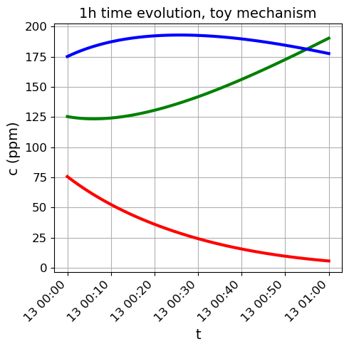
Data generation
B C
A
predict
predict
dataset design choice:
c
∆c
5

Slide 6
Baseline model: performance
x: ground truth
y: model output
1:1 line
linear regression
toy mechanism test set
c
~1 million parameters to capture the system
POLLU mechanism
no performance
6

Slide 7
Baseline model: performance
x: ground truth
y: model output
1:1 line
linear regression
toy mechanism test set
∆c
model struggles for low concentration changes: customizing the loss function?
POLLU mechanism
no performance
7

Slide 8
Baseline model + soft constraints
1. penalty for weighted sum of concentration changes ≠ 0
2. penalty for final concentration values < 0
molar weights
&
stoichiometry
loss determination
input
features
2
weights
ɑ, β
target
features
search space:
optimizer hyperparameters
constraints’ weights
8

Slide 9
Soft constraints: performance
x: ground truth
y: model output
1:1 line
linear regression
∆c
toy mechanism test set
∆c
with soft constraints
9

Slide 10
Thanks for your kind attention
Next steps
Significant data reduction: optimize dataset generation
Data pre-processing: how to handle properly different concentration ranges
Generalizability: assess out-of-distribution performance
EACH: This research has been supported by the Grant PCI2024-155075-2 funded by MICIU/AEI /10.13039/501100011033 and Cofunded by the European Union (EACH Project).
RESPIRE: We acknowledge the RESPIRE project, which is part of the Recovery, Transformation and Resilience Plan (Plan de Recuperación, Transformación y Resiliencia, PRTyR) funded by the European Commission to repair the harm caused by the Covid-19 crisis.

Slide 11
x: ground truth
y: model output
1:1 line
linear regression
Baseline model: performance
toy mechanism test set
∆c
c
c
∆c
8

Slide 12
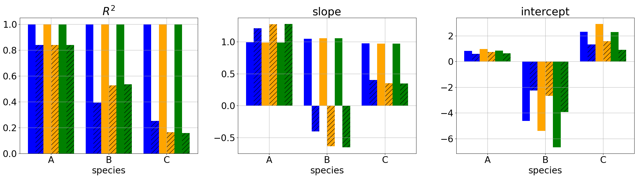
Baseline model: effect of dataset size
train, eval, test
500k, 300k, 200k
÷20
train, eval, test
24k, 8k, 200k
train, eval, test
242, 80, 200k
÷100
toy mechanism test set
∆c c
∆c
Inefficient training or careless dataset generation?
9

Slide 13
Goals of this study
applicationoriented
Implement baseline ML model in CTM: fast inference
Find efficient dataset size
Retain physical consistency, and possibly interpretability
Apply soft physics constraints to the loss function
Exploring architectures: mech-MLP vs fc-MLP
Data transformations: definition of targets, feature normalization
ML oriented

Slide 14
Baseline model: HP tuning
toy mechanism
Train, eval, test
600k, 200k, 200k
Train, eval, test (reduced)
6k, 2k, 200k
Train, eval, test (very-reduced)
0.06k, 0.02k, 200k

Slide 15
Baseline model: HP tuning
POLLU mechanism
Train, eval, test
600k, 200k, 200k
Train, eval, test (reduced)
6k, 2k, 200k
Train, eval, test (very-reduced)
0.06k, 0.02k, 200k

Slide 16
Hints?
Insights from the shape of phase space
Angles in point-cloud representation
Weighting the loss function
[0,1]/Z-score normalization of the dataset

Slide 17
Thanks for your kind attention

Slide 18
POLLU mechanism
toy mechanism

Slide 20
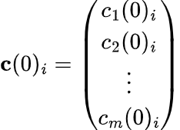
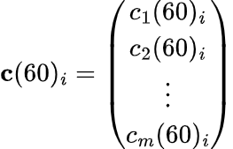
Data generation with CAMP boxmodel
For both mechanisms:
N ~ 1e6
Simulations run for 1h, using only t = 60s
inputs
c
dc

Slide 21
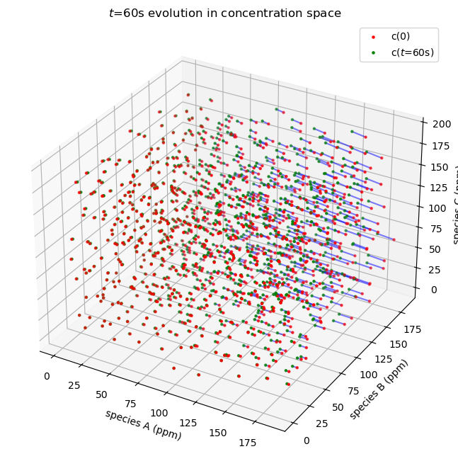
Data exploration
Surrogate of phase space using a subset of N ~ 10k
x: concentration (ppm), y: concentration change (ppm, t=60s)
toy mechanism

Slide 22
Data exploration
Surrogate of phase space using a subset of N ~ 10k
x: concentration (ppm), y: concentration change (ppm, t=60s)
POLLU mechanism

