Slide 1
EC-Earth meeting
2-4 February 2016
Reproducibility of EC-Earth
F. Massonnet, M. Asif, M. Acosta, O. Bellprat, E. Exarchou, J. García-Serrano, V. Guemas, M. Ménégoz, O. Mula-Valls, K. Serradell, F. J. Doblas-Reyes, X. Yepes
Notes:
Page of Reproducibility : https://earth.bsc.es/wiki/doku.php?id=reproducibility
This study is motivated by one question, that we can phrase in two ways: from a science point of view, or from a more pragmatic point of view.
The science question is: should we account for hardware/software errors in our simulations? Do our ensembles reflect correctly the uncertainty of our model, or are we underestimating another source of error, namely machine errors?
The more pragmatic question is: as we are about to start CMIP6 simulations, is it legitimate to run two members of historical simulations here in CNR, two at SMHI and two at BSC, and consider this 2 + 2 + 2 ensemble as similar to a 6-member ensemble that would have been run here?
We already gave insights on this aspect last year.
1

Slide 2
Where were we?
At the last EC-Earth meeting (May 2015):
Machine error (e.g., roundoff) also contributes to model uncertainty
This error adds to well-known model physics/coupling, initial condition and forcing errors
Notes:
Link to presentation of last year: http://ic3.cat/wikicfu/img_auth.php/Fm_ecearth.pdf
At the last EC-Earth meeting it was shown that machine error is generally overlooked.
2

Slide 3
Where were we?
At the last EC-Earth meeting (May 2015):
Machine error (e.g., roundoff) also contributes to model uncertainty
This error adds to well-known model physics/coupling, initial condition and forcing errors
EC-Earth3.1 was found to be bit-reproducible
Two runs performed under exactly the same conditions produced exactly the same output
Notes:
The good news: under strict experimental conditions we are able to reproduce exactly the same output, bit-to-bit
Then we addressed the question of reproducibility from a climate model user perspective: Suppose CMIP6 simulations are due soon: can we distribute the load of simulations in different institutes? To that end we ran three experiments on three different platforms. The simulations were identical in terms of initial conditions, length, number of ensembles, forcing (pre-industrial), codes and namelists. The only difference between the experiments was actually related to the machines themselves: OS, libraries, compiler versions, number and distribution of processors. And we got this surprising result:
3

Slide 4
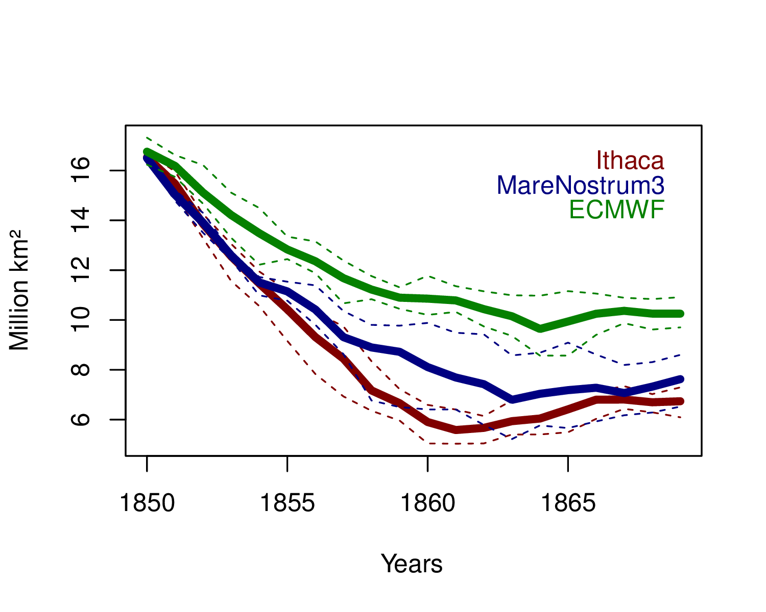
Where were we?
At the last EC-Earth meeting (May 2015):
Machine error (e.g., roundoff) also contributes to model uncertainty
This error adds to well-known model physics/coupling, initial condition and forcing errors
EC-Earth3.1 was found to be bit-reproducible
Two runs performed under exactly the same conditions produced exactly the same output
EC-Earth3.1 was found to be not climate-reproducible
Moving from one machine to another caused different climates
Winter (September) Antarctic sea ice extent
5-member range
mean
ECMWF
MareNostrum3
Ithaca
Notes:
The figure shows sea ice extent in the Southern Ocean in winter, in the twenty year integrations carried out on all three platforms. The surprising result was that each machine tended to have its own climate, as shown by the fact that ensembles did not systematically overlap. We also showed that this result could very unlikely have been obtained by chance.
However we noticed two problems in our experimental design:
The massive drift of all simulations
The fact that not everything was made to have reproducibility: aspects that we were ignoring at this time could have had an impact on the results.
4

Slide 5
Issue 1: the massive drift: can we reliably exchange restarts among centers?
Initial conditions were from an equilibrated run carried out at CNR
Winter (September) Antarctic sea ice extent
Notes:
We used equilibrated restarts from CNR (Italy; Paolo Davini) to make these simulation. Despite the fact that CNR uses the same version of EC-Earth as us, we had this massive shock. We found later that our namelists and codes were different, even if the same model version was checked out. Nobody was wrong, it’s just that we all (consciously or not) introduce patches, modifications in our versions.
So the bottom line here is that even if we believe that we use the same model version as another institute of the EC-Earth consortium, we are probably farther away to them than we think, and it’s very to take other’s restarts for granted – or to assume that they won’t be the source of problems in simulations.
5

Slide 6
Issue 1: the massive drift: can we reliably exchange restarts among centers?
Initial conditions were from an equilibrated run carried out at CNR
Winter (September) Antarctic sea ice extent
We decided to let EC-Earth equilibrate for 40 more years before starting a new stream of reproducibility experiments
Notes:
To solve that issue we decided to let one member of one of our machine equilibrate, before a second stream of reproducibility experiment was started.
6

Slide 7
Issue 2: we didn’t maximize the odds of success
Floating Point (FP) options were not set to ensure reproducibility
Number and distribution of CPUs were different
Winter (September) Antarctic sea ice extent
598 CPUs
512 CPUs
72 CPUs
Notes:
The second issue is more technical. There are certain flags that are used at compilation time which can ensure accuracy of the results, reproducibility of the results, or performance of the results. The thing is that it is impossible to achieve all three of them! We can ask for bit-to-bit reproducibility of the results, but this can have dramatic consequences on performance, for example.
7

Slide 8
User-approach: climate-reproducibility
Developer-approach: bit-reproducibility
Results can be different, but statistics must be the same
Results must be the same, strictly
Notes:
The concept of reproducibility itself is not obvious to define.
8

Slide 9
User-approach: climate-reproducibility
Developer-approach: bit-reproducibility
Results can be different, but statistics must be the same
Results must be the same, strictly
EC-Earth3.1
Initialized from our own equilibrated run
5 members
Pre-industrial forcing
2 platforms, same # CPUs and domain decomposition
Only 10 years for now
Same compilation options as before
Notes:
The User approach takes the problem as a whole, including its constraints. It is not always possible to decide which version of MPI to use, for example.
9

Slide 10
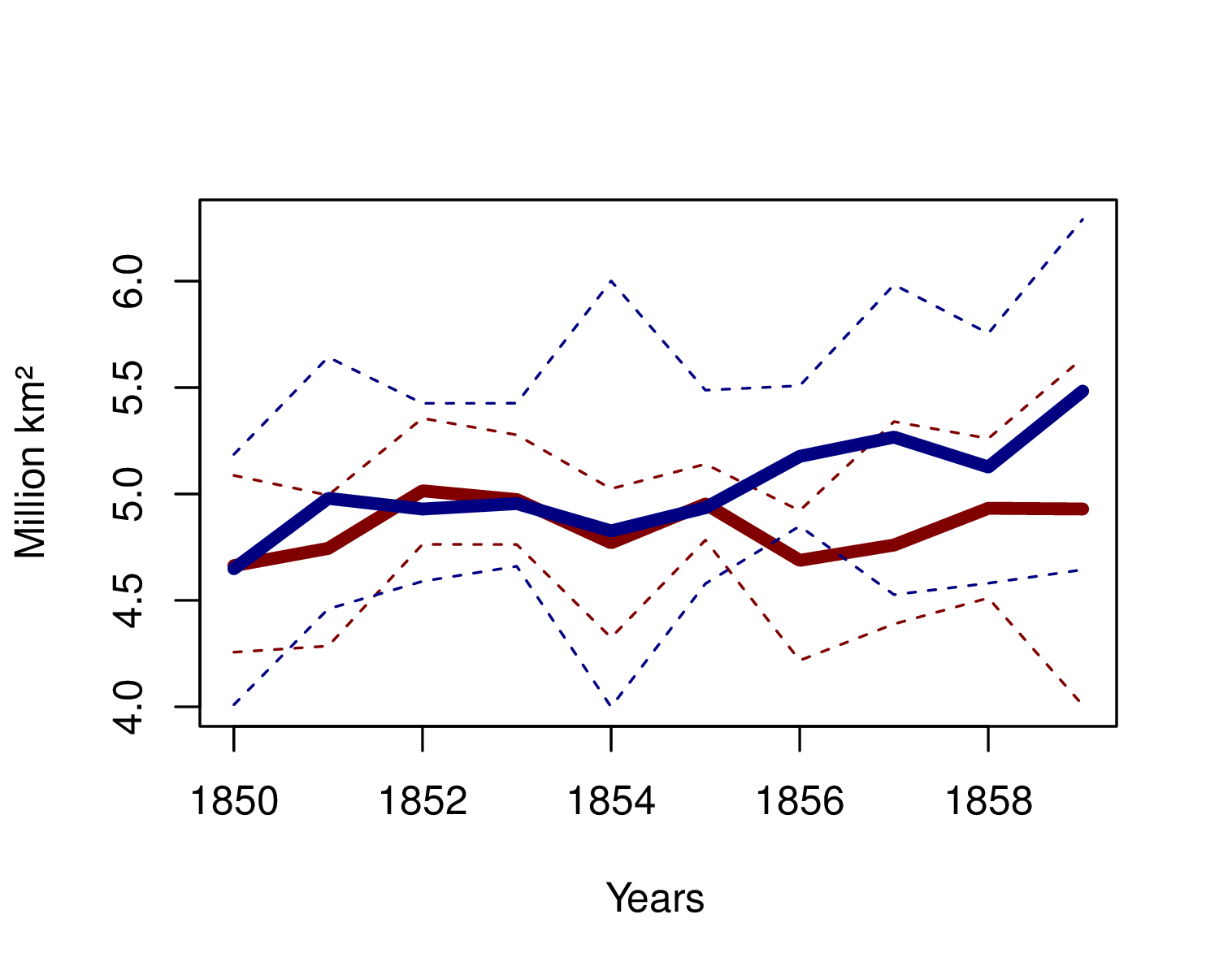
This time, the two ensembles cannot be statistically distinguished from each other
Winter Antarctic sea ice extent
MareNostrum3
Ithaca
(same domain decomposition)
!
Only ten years
Only two platforms
Only five members
ECMWF (missing here) was the one standing out
Notes:
10

Slide 11
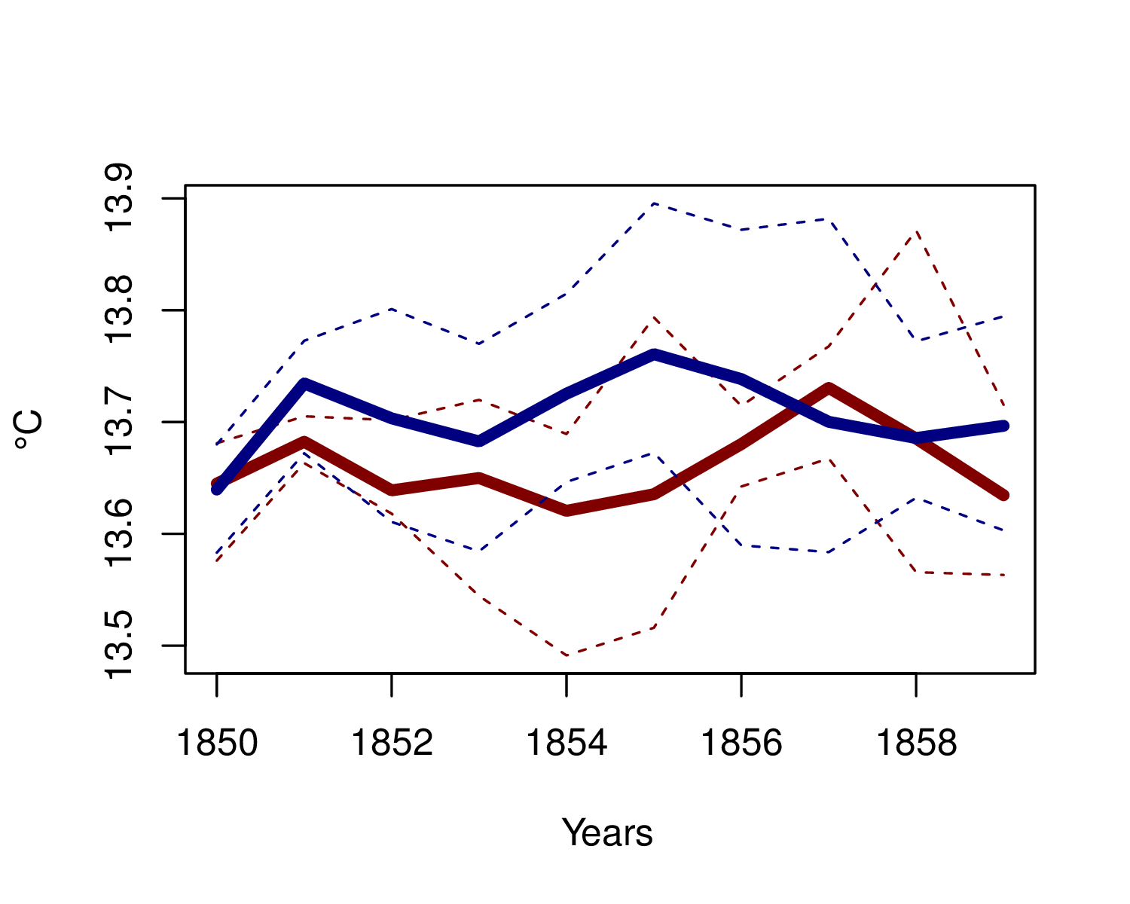
This time, the two ensembles cannot be statistically distinguished from each other
Global-Mean, annual-mean 2-m temperature
MareNostrum3
Ithaca
Notes:
11

Slide 12
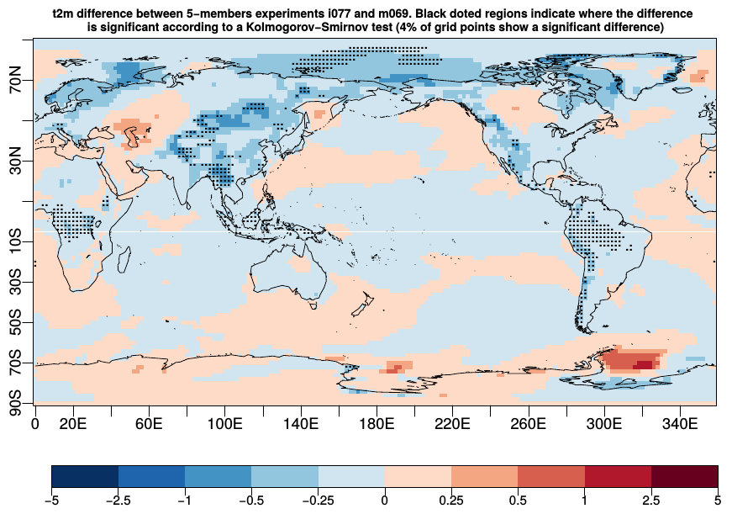
This time, the two ensembles cannot be statistically distinguished from each other
2-m air temperature difference between Ithaca and MareNostrum3 (ensemble means)
Dots = 5-member ensembles are statistically different from each other (Kolmogorov-Smirnov Test, α= 5%). Dots cover 4% of the planet.
°C
Notes:
12

Slide 13
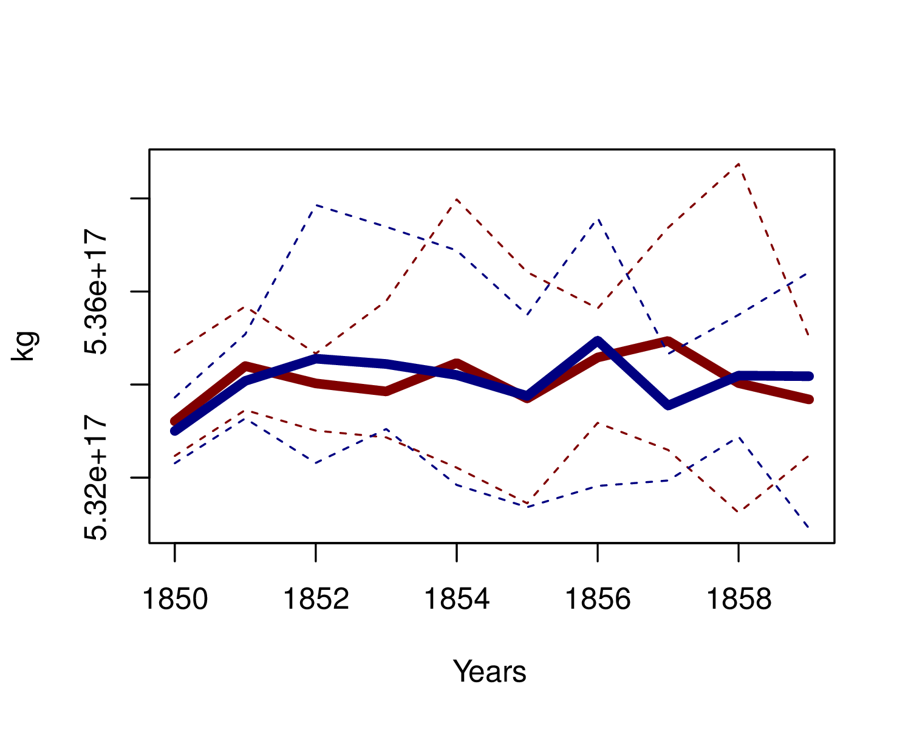
This time, the two ensembles cannot be statistically distinguished from each other
Cumulated precipitation
MareNostrum3
Ithaca

Slide 14
Next experiments to be conducted
At MareNostrum3, with different #CPUs from Ithaca’s
At ECMWF, with same #CPUs as Ithaca’s
At ECMWF, with different #CPUs from Ithaca’s
And the experiments should, ideally, be repeated with EC-Earth3.2!

Slide 15
Conclusions
Don’t exchange restarts across centers unless you are sure of what you are doing
EC-Earth3.1, after equilibration, and for the same domain decomposition, now looks climate-reproducible (! Cautions)
A systematic reproducibility procedure has to be defined and applied with EC-Earth3.2, ideally before CMIP6 runs are started

Slide 16
Strategic question to discuss
How do we handle CMIP6 simulations?
Option 1 (clean, but unrealistic): One partner does all the simulations on the same machine.
Option 2 (fast, but questionable): Split the load of simulations
3 members run at BSC
1 member run at BSC
1 member run at KNMI
1 member run at SMHI
In that case, we have to recognize that this « 1 + 1 + 1 » ensemble will have likely a larger spread: it also comprises hardware/software uncertainty

Slide 17
Option 3 (tradeoff): One partner takes one type of experiment
(examples)
piControl → BSC
Historical: 5 members → KNMI
RCP4.5: 6 members → SMHI
In that case, ensembles would be more consistent but we may have trouble in experiments that are connected, e.g. historical and RCP.

Slide 18
User-approach: climate-reproducibility
Developer-approach: bit-reproducibility
Results can be different, but statistics must be the same
Results must be the same, strictly
EC-Earth 3.2beta
Initialized from default initial conditions
1 platform (MareNostrum 3)
Two domain decompositions:
- IFS: 320 & NEMO: 288
- IFS: 128 & NEMO: 64
Only 1 month
Different compilation options
Notes:
The concept of reproducibility itself is not obvious to define.
18

Slide 19
Model development has the following objectives
Accuracy
(be close to a reference)
Reproducibility
(be similar across configurations)
Performance
(use resources efficiently)
Compiler options let you control the tradeoffs between accuracy, reproducibility and performance
Notes:
It is NOT possible to achieve all three aspects at the same time. The developper has to choose which part he/she wants to favour
19

Slide 20
Different compilation flags can be used to control the tradeoffs between accuracy, reproducibility and performance
To control Floating-Point (FP) operations
fp-model precise, fimf-arch-consistency, fpe0, fma, ftz ...
To control optimization options
O1, O2, O3, xHost, ipo ...

Slide 21
Why is it necessary to control FP operations?
FP numbers have finite resolution 1.77777777 → 1.77778
Rounding can change intermediate results
A+B+C =/ A+C+B
FP errors are caused by:
Algorithm
Conditional numerical computation for different systems and/or input data can have unexpected results.
Non-deterministic task/process scheduler
Asynchronous task/process scheduling can change the order of some operations between reruns.
Memory alignment
If memory alignment is not guaranteed, the results could be computed differently between reruns.

Slide 22
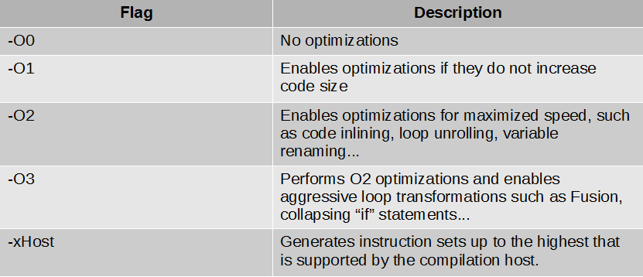
Compilation flags to control optimizations

Slide 23
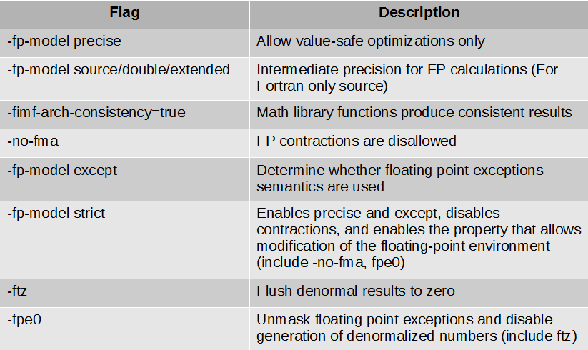
Compilation flags to control FP operations

Slide 24
These flags enable or disable:
Value safety
Make safe some operations such as Reassociation → (a+b)+c or a+(b+c)
Floating-point expression evaluation
Avoid operations using a different precision between variables
Precise floating-point exceptions
FP exceptions (overflow, underflow, divide by zero…) are synchronized with the operation causing it and optionally unmasked.
Floating-point contractions → a=b*c+d
Floating-point unit environment access
Control some options such as the rounding mode

Slide 25
Classification of flags
Value safety (fp-model precise,ftz)
Floating-point expression evaluation (fp-model source/double, fimf-arch-consistency=true)
Precise floating-point exceptions (fp-model strict,fpe0)
Floating-point contractions (fp-model strict, no-fma)
Floating-point unit environment access (fp-model strict, ftz)
Optimization options (O2,O3,xHost)

Slide 26
List of compilation flags used in the experiment
-O2 -fp-model precise -xHost -r8
-O2 -fp-model strict -xHost -r8
-O3 -fp-model precise -xHost -r8
-O3 -fp-model strict -xHost -r8
-O2 -fp-model precise -fp-model double -fimf-arch-consistency=true
-no-fma -r8
-O2 -fp-model double -fimf-arch-consistency=true -no-fma -ftz -r8
-O2 -fp-model precise -fp-model double -fimf-arch-consistency=true
-no-fma -fpe0 -r8
-O2 -fp-model strict -fp-model double -fimf-arch-
consistency=true -no-fma -fpe0 -r8

Slide 27
Comparing outputs, they are different
Using same domain decomposition and different flags among runs
Using same flags and different domain decomposition
Using same flags and domain decomposition
(in 1-month simulations with EC-Earth 3.2beta)

Slide 28
Non-deterministic task in parallel applications
MPI reduction(+): order of summation depends on several external factors
In asynchronous tasks done in a efficient way, the order to add all variables (A,B,C...) is according to when each MPI process has the value calculated.
The order could change the result A+B+C...
E+C+A...
Σ
A
B
C
D
E
F
G
H
8-cores MPI job

Slide 29
Relation between Performance and Accuracy & Reproducibility
Accuracy
(be close to a reference)
Performance Accuracy & Reproducibility
Speed
FP Precision
Performance → Improve using optimization methods but reduce Reproducibility and Accuracy
Reproducibility & Accuracy → Improve using Floating-point control methods but reduce performance
Reproducibility
(be similar across configurations)
Performance
(use resources efficiently)
Notes:
It is NOT possible to achieve all three aspects at the same time. The developper has to choose which part he/she wants to favour
29

Slide 30
Conclusions about bitwise reproducibility
Is the modelled climate able to obtain a bitwise precision using some combination of compilation flags? → NO
Is bitwise precision possible without losing parallel and sequential performance? → NO
How do we deal with the associated uncertainties?
Use a statistical method to quantify the differences and propose a minimum to achieve instead of bit-for-bit precision in order to avoid critical restrictions in performance.
Determine a combination of flags (Floating-point control and optimization) and optimization methods which achieve a balance between performance and accuracy & reproducibility in both, runs in a particular platform and runs in two different platforms with a similar architecture.

