Slide 1
Assessment of the forecast quality of different seasonal climate prediction systems for the wind energy sector
Doo Young Lee¹, Albert Soret¹, Veronica Torralba¹, Nicola Cortesi¹, Pierre-Antoine Bretonnière¹, Francisco Javier Doblas-Reyes^{1,2}
¹Barcelona Supercomputing Center, Barcelona, Spain
²Institució Catalana de Recerca i Estudis Avançats (ICREA), Barcelona, Spain

Slide 2
Background and Introduction
Today people around the world are looking forward to the growth and wider application of renewable energies contributing to the total energy supply. Wind power will especially play an increasingly important role in providing a substantial share of renewable energy supply over the coming years (Troccoli et al. 2010).
The ability to reliably and accurately anticipate and respond to changes in wind energy supply and demand is essential to stabilize and secure the entire electricity network. To minimize the significant disruption to energy supply and demand, the predictions of the key variables (wind speed and temperature) which are most relevant to wind power supply and energy demand are used.
Previous works have dealt with the sensitivity of the energy system to the variability at either short or long-time scales, such as weather forecasts (Amin, 2013; Troccoli et al. 2013) or climate change projections (Ebinger and Vergara, 2011; IPCC 2011), while there were few researches on the use of climate predictions at the seasonal time scale due to general perception on their low quality of prediction (Doblas-Reyes et al. 2013).

Slide 3
Background and Introduction
In the recent years, the performance of the seasonal climate prediction is significantly improved. However, seasonal predictions still have systematic errors. Many climate scientists and climate communities have tried to solve this problem to produce better climate information (Buontempo et al. 2014; Coelho and Costa 2010).
To reduce the forecast uncertainty and improve reliability of forecast, we carry out a statistical post-processing stage using two bias adjustment techniques named as simple bias correction (Leung et al. 1999) and calibration (Von Storch and Zwiers 2001).
Finally, we evaluate and compare the quality of performance of the several seasonal prediction systems along with the bias adjusted predictions obtained from the statistical post-processing. The forecast quality assessment will be the first step toward getting better climate information to improve forecast quality and accuracy.

Slide 4
Objectives
The final goal of this study is to provide more useful and reliable climate information for the wind energy industry through the assessment and improvement of forecast quality and accuracy of seasonal climate prediction.
To assess the forecast quality of seasonal climate prediction systems for wind energy sector with climate variables such as 10m wind speed and T2m which are related to wind energy supply and demand.
Systematic assessment of a multi-model ensemble prediction has been also carried out for the enhancement of seasonal predictability for wind energy sector and satisfying the needs of the wind-energy community.
To recognize the large observational uncertainty of these variables at the global scale, we have performed the assessment with two different observational references.

Slide 5
Data and Methodology
Data
Coupled atmosphere-ocean general circulation models used
Model Name | AGCM | Resolution | OGCM | Resolution | Ensemble Member
ECMWF System 4 (ECMWF_S4) | IFS CY36R4 | TL255L91 | NEMO3.0 | 1°lat ×1°lon L42 | 51
Meteo-France System 4 (METFR_S4) | ARPEGE5.2 | TL127L31 | NEMO3.2 | 1°lat × 1°lon L42 | 15
Meteo-France System 3 (METFR_S3) | ARPEGE4 | ~300km × ~300km, L91 | OPA8.2 | 2°lat × 2°lon L31 | 11
Observational references (reanalysis)
ECMWF Interim Reanalysis (ERA-Interim)
Japanese 55-year Reanalysis (JRA-55)
Target season, variables and Periods
Boreal winter (DJF), 10-m wind speed, 2-m temperature
22-year period of 1991-2012

Slide 6
Data and Methodology
Methods
Post-processing method
-To statistically minimize forecast errors and formulate reliable probabilities
Simple Bias Correction (SBC)
- for the bias correction of the systematic model mean error
- calculated by multiplying the seasonal mean anomaly by the ratio of sd of reference to the interannual sd of ensemble members
Calibration (Cal)
- similar way to the SBC, but apply an inflation of the ensemble spread simultaneously to obtain more reliable ensemble prediction
Multi-model ensemble
Deterministic: simple composite method for ensemble mean of individual models
Probabilistic: model mean for each categorical probability of individual models
Leave-one-out cross-validation
To derive a more accurate estimate of model prediction performance and avoid overfitting

Slide 7
Data and Methodology
Forecast Quality Assessment (Verification Measures)
- To investigate the ability of the forecast systems for reproducing adequately the observed 10-m wind speed and 2-m temperature variability, a variety of verification measures are applied.
- Forecast quality consists in the simultaneous comparison of predicted and observed values with a range of deterministic and probabilistic verification measures.
- The forecast quality measures can give confidence in building accuracy and reliability on the quality of the predictions by comparing with the observed values.
TCC (Temporal Correlation Coefficient)
FRPSS (Fair Ranked Probability Skill Score)
Reliability Diagram
Difference of Two Correlation Coefficients

Slide 8
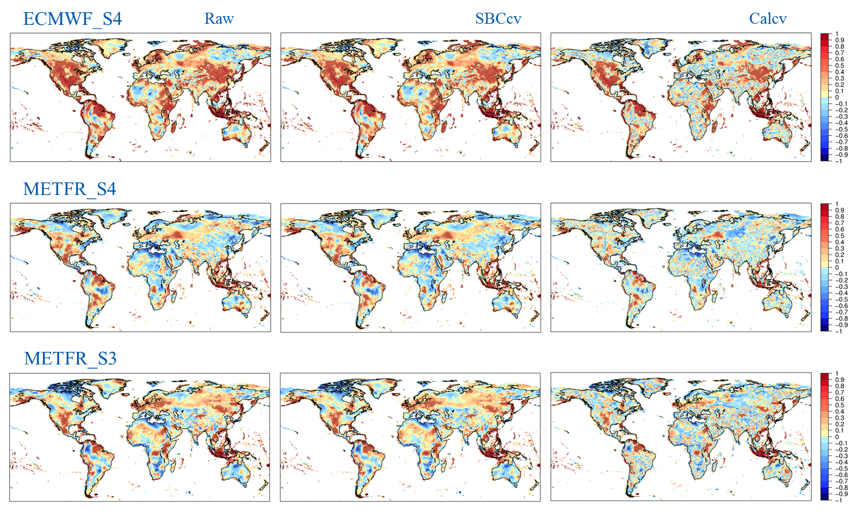
Temporal Correlation Coefficient (TCC)
(10m wind speed)

Slide 9
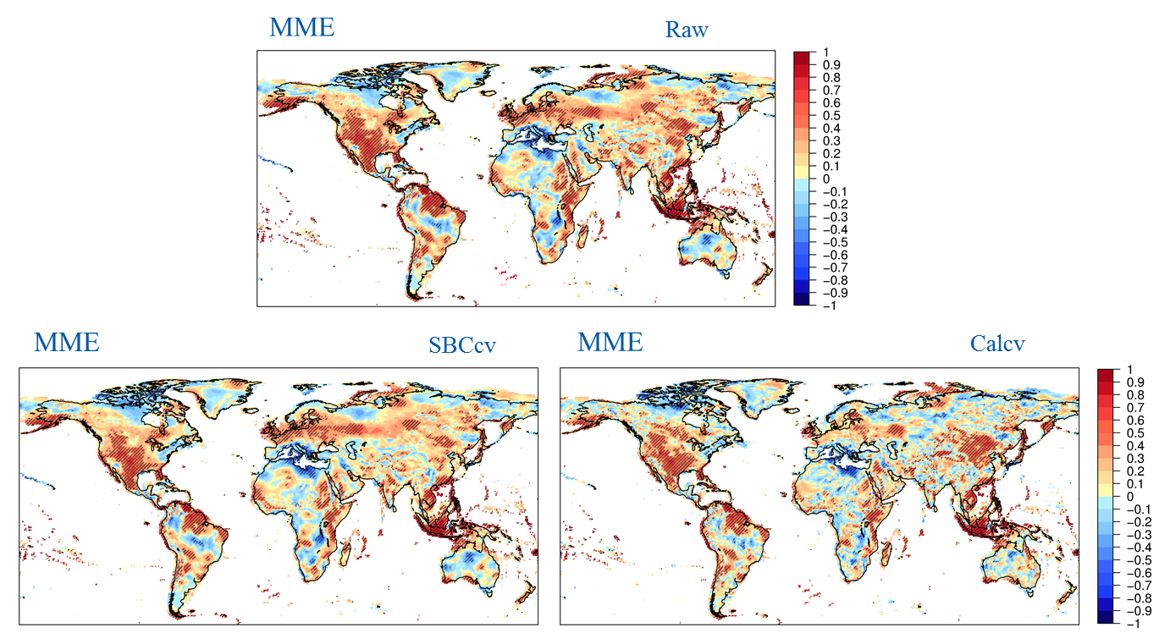
Temporal Correlation Coefficient (TCC)
(10m wind speed)
The MME predictions show a slight improvement in skills over some areas, but not any noticeable compared to the ECMWF_S4. The spatial distribution of the significant skills of the MME predictions are similar; but the Cal shows slightly lower skills than SBC and Raw.

Slide 10
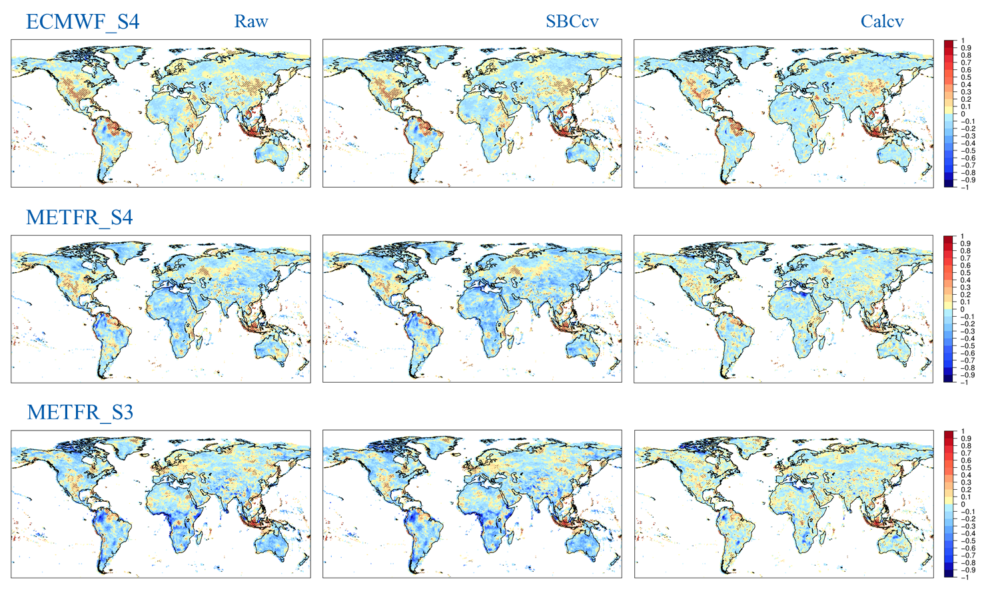
Fair Ranked Probability Skill Score (FRPSS)
(10m wind speed)

Slide 11
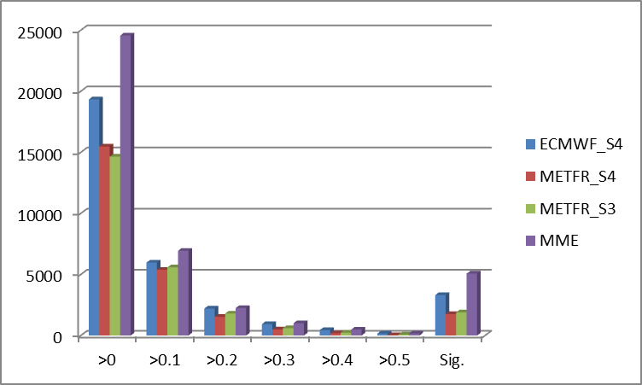
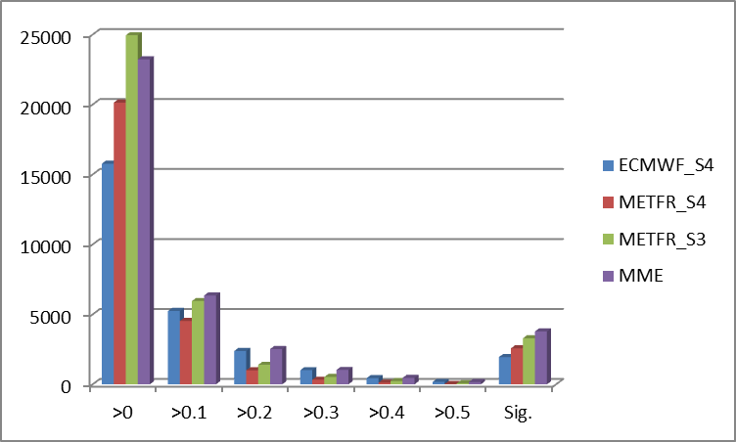
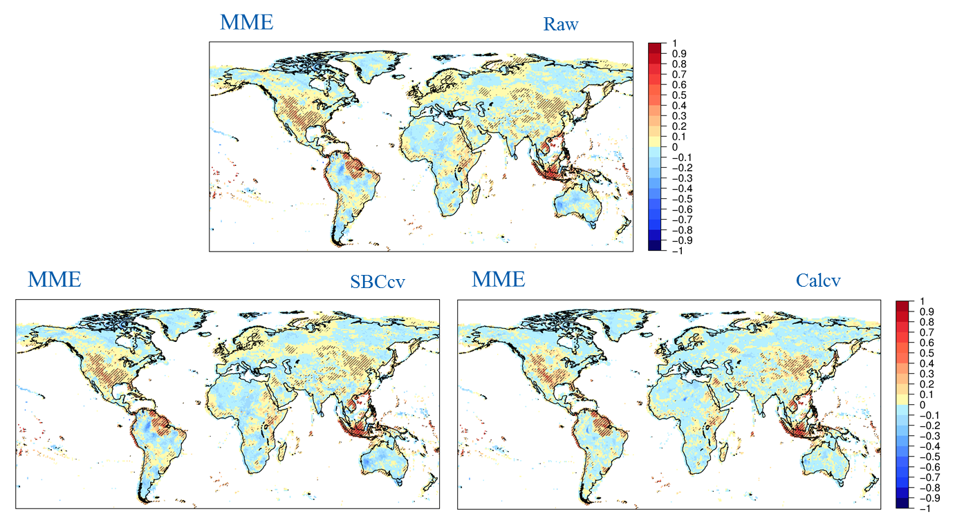
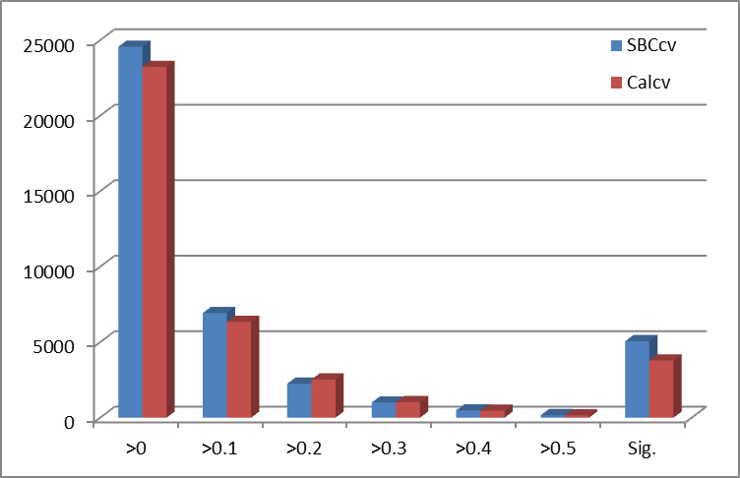
Fair Ranked Probability Skill Score (FRPSS)
(10m wind speed)
SBCcv
Calcv
Notes:
Number of grid points of significant skills for the MME prediction is increased.
slanted line : significant difference of correlation

Slide 12
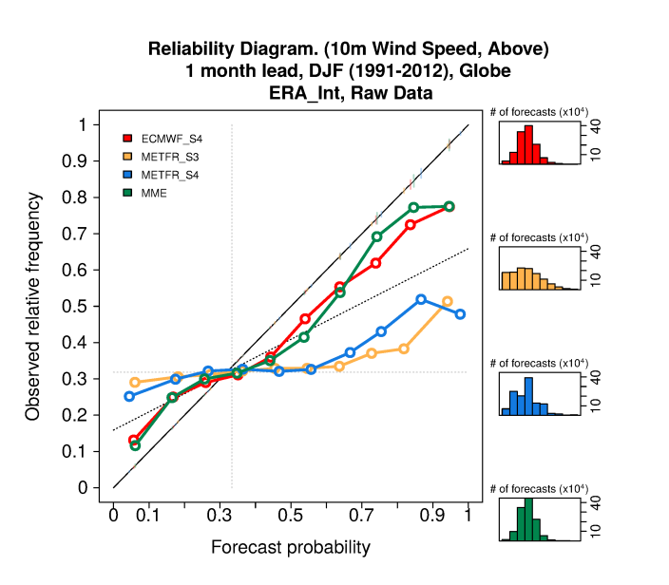
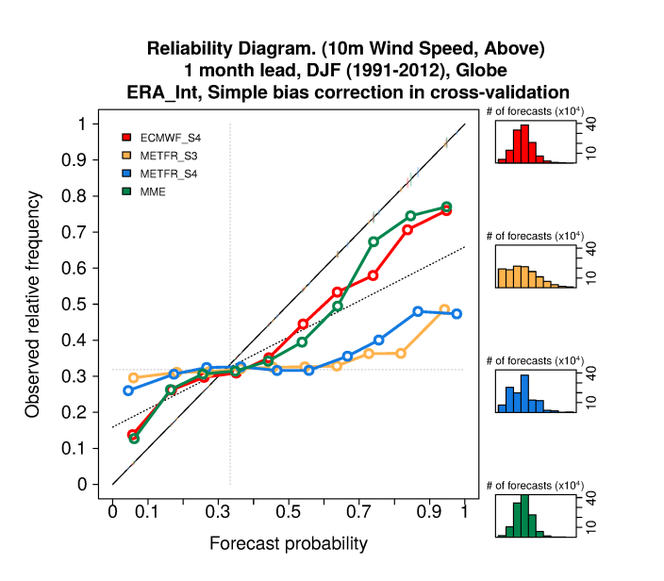
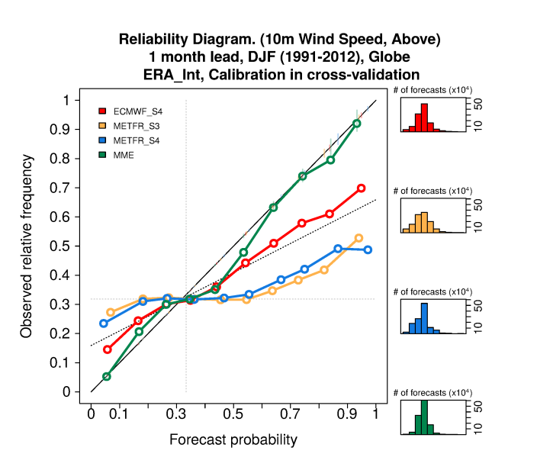
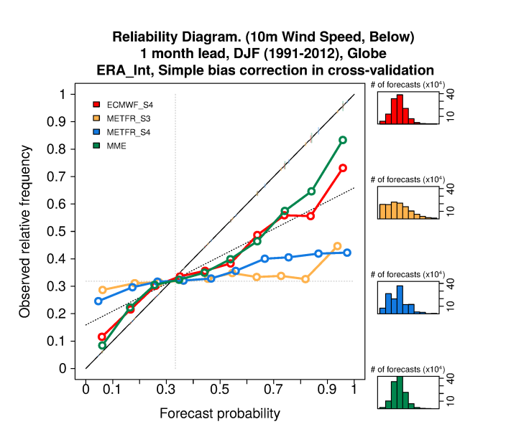
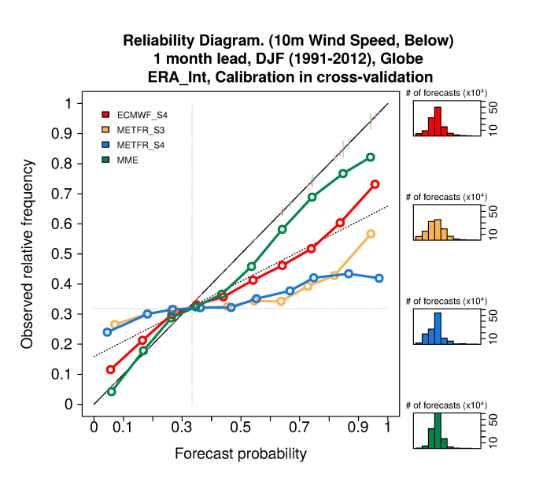
Reliability Diagram
(10m wind speed)
Raw
SBCcv
Calcv
Above
Below

Slide 13
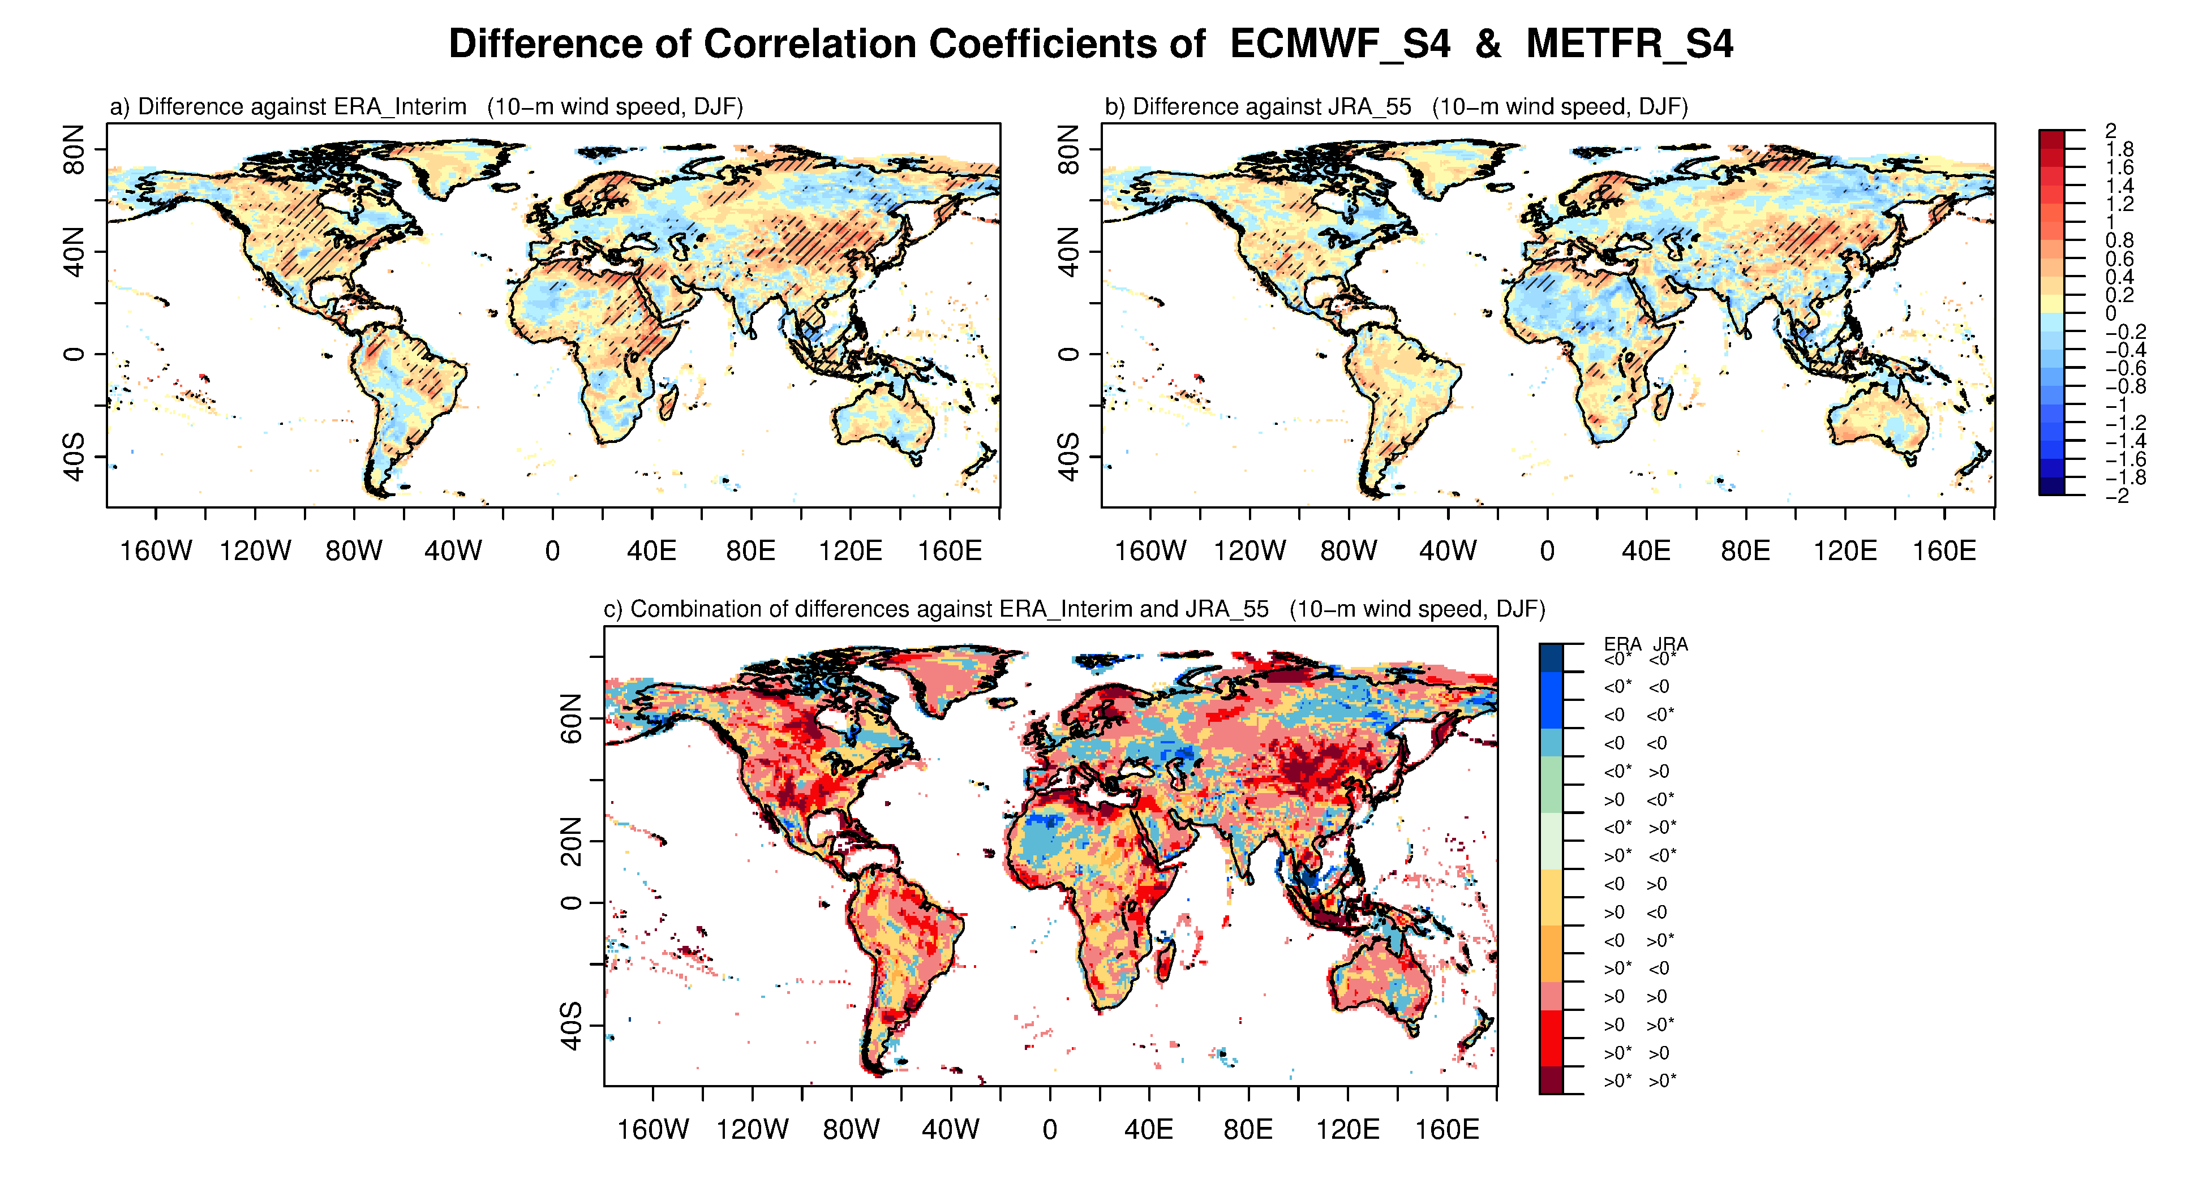
Difference of Two Correlation Coefficients
(10m wind speed)
Red (blue) colors: positive (negative) values of differences in correlation for both cases.
Asterisk: significant areas at the 90% confidence level.
Yellow and green colors: the other possible combinations of differences and significance

Slide 14
For 2m temperature
TCC and FRPSS,
Generally, the skill performances of the deterministic and probabilistic forecasts for 2m temperature are more skillful than 10m wind speed.
The spatial distributions of the skill performance for temperature are similar to those for wind speed.
Reliability Diagram,
The reliability curves for temperature are generally less flat than those for wind speed.
Skill Difference,
The uncertainty regions in the skill difference for temperature are decreased compared to wind speed.
Notes:
Due to the time limit of presentation, I would like to skip the results for 2m temperature. I just summarized the features for 2m temperature.

Slide 15
Summary and Conclusions
The climate forecasts from global seasonal prediction systems of the ECMWF’s System 4 and Meteo-France’s Systems 3 and 4, selected by the availability of 6 hourly 10-m wind speed and 2-m temperature data, are used during the periods of 1991-2012.
To investigate the ability of the forecast systems to reproduce adequately the observed 10-m wind speed and 2-m temperature variability, a variety of verification measures are applied with a range of deterministic and probabilistic verification measures.
The relative merit of post-processing methods (simple bias correction and calibration) is evaluated in their ability to improve aspects of the forecast quality by reducing the impact of the model systematic errors.
For the TCC, the ECMWF_S4 generally has better skills than other systems. The calibration data shows slightly lower skills than SBC data. Generally, the skill performance for temperature is better than wind speed.
For the FRPSS, the main features of prediction skills of the individual models and MME are similar to those of TCC. From the number of grid points having the significant skills, the relative improvement of skill in MME can be easily found.

Slide 16
Summary and Conclusions
Contrary to the skill scores, the MME prediction by the calibration method has relatively more reliable curve compared to those of the Raw and SBC method. The sharpness diagrams from the calibration method show the frequency peak near the climatological frequency.
When identifying genuine improvements of the prediction skills, we have to be very careful on the regions associated with the large uncertainty according to the different reanalysis datasets due to a possible ambiguous interpretation.
We need to estimate the local performance for wind farm area. The forecast quality assessment will be the first step toward getting better climate information to improve forecast quality and accuracy for wind energy industry. The advantages of using a multi-model ensemble based on the combination of independent different forecast systems have been illustrated for the first time for wind energy sectors.
The results of this study suggest that the wind-energy sector has good opportunities to reduce the uncertainty of future energy estimates.

Slide 17
Thank you!
For further information please contact
doo.young@bsc.es, dylee1220@gmail.com

Slide 19
Data and Methodology
Methods
fc = (f-f_m) * (s_o/s_em) + o_m
fc : corrected field
f : forecast of a specific year
f_m : climatology of the hindcast (ensemble mean)
s_o : standard deviation of the observations
s_em : standard deviation of the hindcast (ensemble mean)
o_m : climatology of the observations
Post-processing method
-To statistically minimize forecast errors and formulate reliable probabilities
Simple Bias Correction (SBC)
- for the bias correction of the systematic model mean error
- calculated by multiplying the seasonal mean anomaly by the ratio of sd of reference to the interannual sd of ensemble members
Calibration (Cal)
- similar way to the SBC, but apply an inflation of the ensemble spread simultaneously to obtain more reliable ensemble prediction
fc = (a * z_{i}) + (b * z_{ij}) + o_m
[ a = abs(r) * (s_o/s_em) , b = sqrt(1 - r²) * (s_o/s_e)]
fc = corrected field
z_i : ensemble mean of the forecast anomaly
r : correlation between the ensemble mean of the hindcast and the observations
s_o : standard deviation of the observations
s_em : standard deviation of the ensemble mean of the hindcast
z_ij : difference between each ensemble member and the ensemble mean of the forecast anomaly
s_e : standard deviation of the difference between the ensemble members of the hindcast and the ensemble mean for each start date
o_m=climatology of the observations
Multi-model ensemble
Deterministic: simple composite method for ensemble mean of individual models
Probabilistic: model mean for each categorical probability of individual models
Leave-one-out cross-validation
To derive a more accurate estimate of model prediction performance and avoid overfitting

Slide 20
Spatially averaged correlation skill score
10-m wind speed | Raw |  | SBCcv |  | Calcv
Globe | AAVE | Sig.AAVE | AAVE | Sig.AAVE | AAVE | Sig.AAVE
ECMWF_S4 | 0.175 | 0.484 | 0.169 | 0.482 | 0.121 | 0.437
METFR_S4 | 0.023 | 0.155 | 0.019 | 0.144 | 0.006 | 0.151
METFR_S3 | 0.066 | 0.254 | 0.063 | 0.265 | 0.034 | 0.225
MME | 0.110 | 0.362 | 0.100 | 0.368 | 0.098 | 0.363
2-m temperature | Raw |  | SBCcv |  | Calcv
Globe | AAVE | Sig.AAVE | AAVE | Sig.AAVE | AAVE | Sig.AAVE
ECMWF_S4 | 0.294 | 0.563 | 0.284 | 0.559 | 0.201 | 0.549
METFR_S4 | 0.190 | 0.553 | 0.183 | 0.549 | 0.134 | 0.476
METFR_S3 | 0.236 | 0.492 | 0.227 | 0.489 | 0.136 | 0.441
MME | 0.292 | 0.556 | 0.280 | 0.552 | 0.236 | 0.560

Slide 21
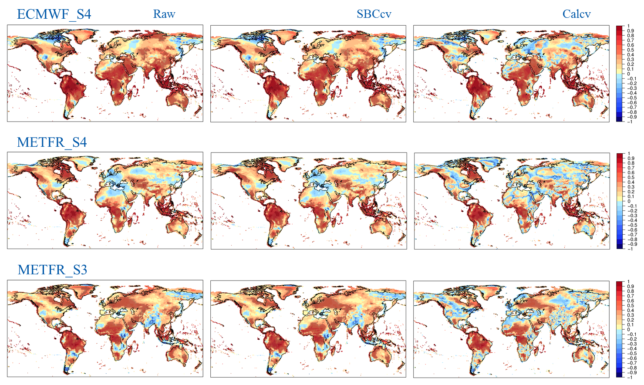
Temporal Correlation Coefficient (TCC)
(2m temperature)

Slide 22
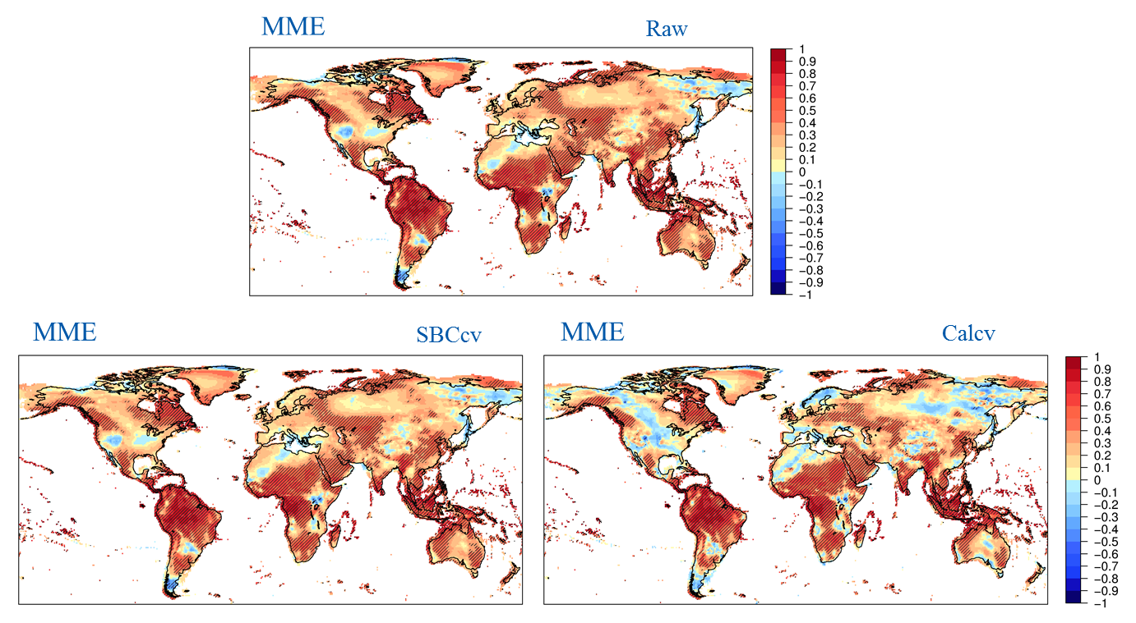
Temporal Correlation Coefficient (TCC)
(2m temperature)

Slide 23
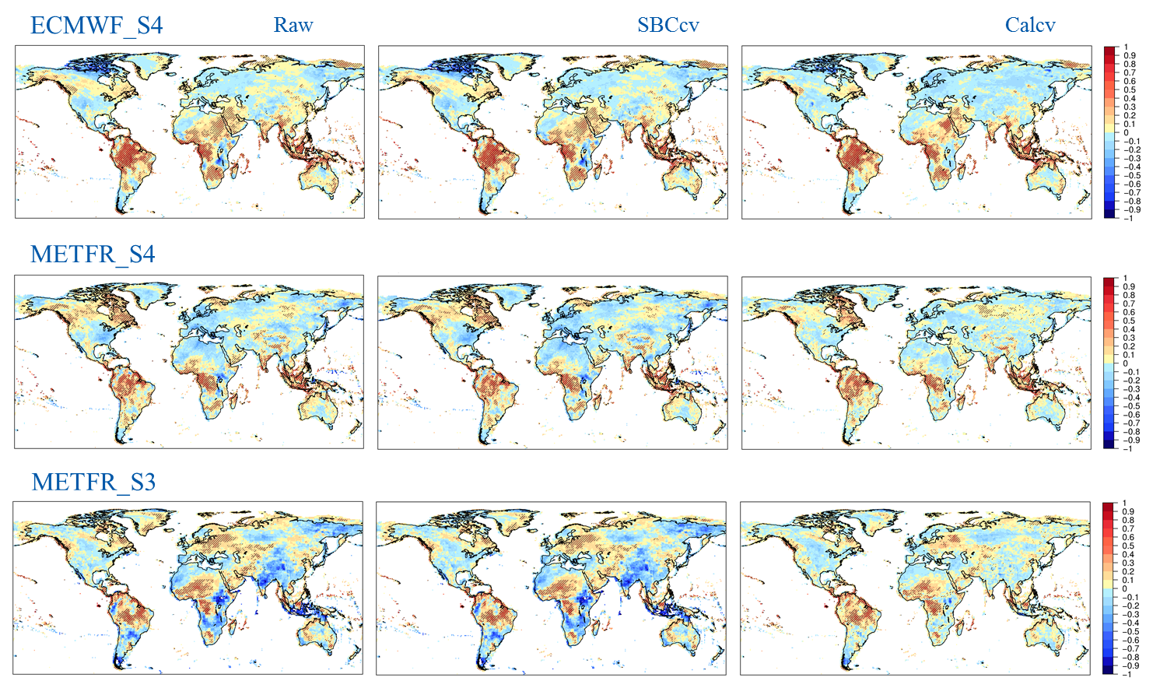
Fair Ranked Probability Skill Score (FRPSS)
(2m temperature)

Slide 24
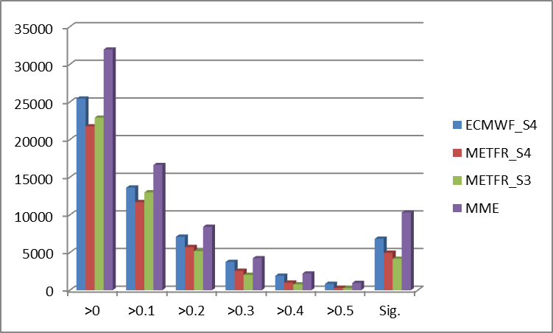
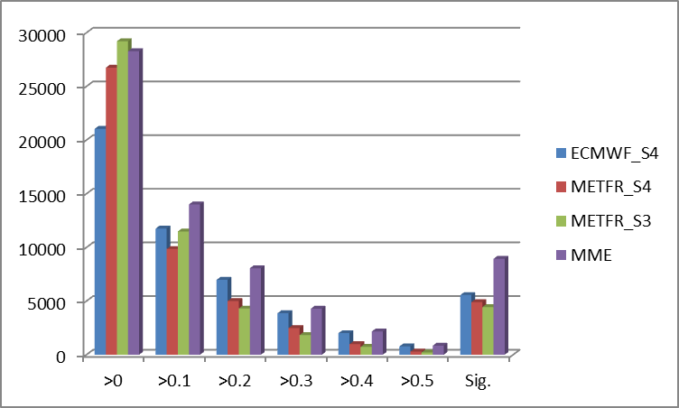
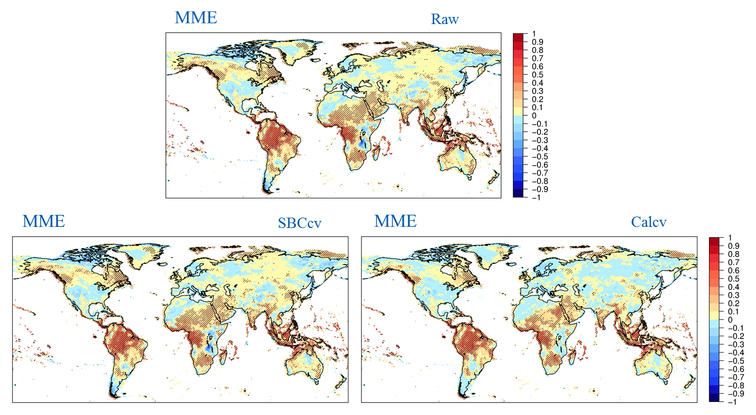
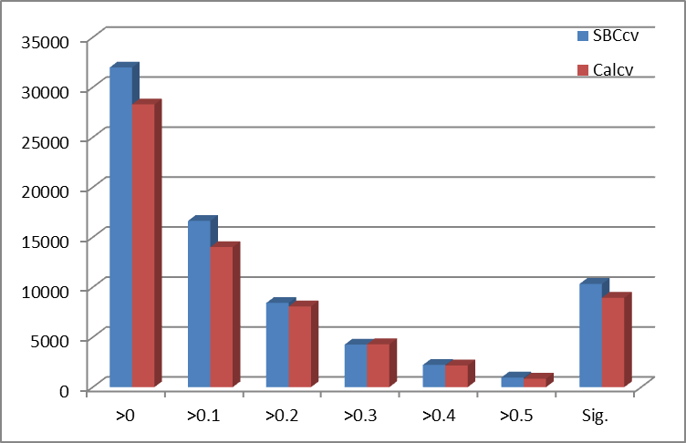
Fair Ranked Probability Skill Score (FRPSS)
(2m temperature)
SBCcv
Calcv

Slide 25
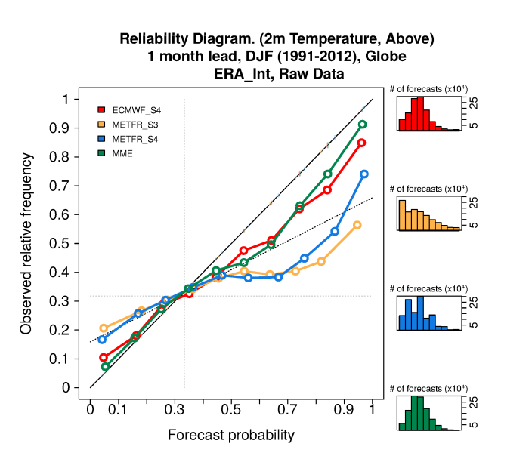
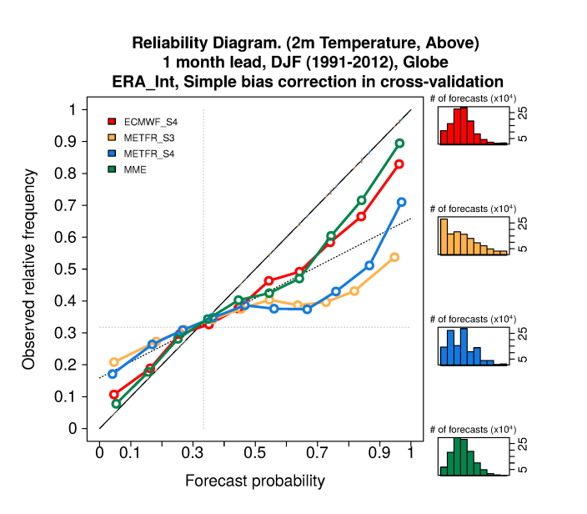
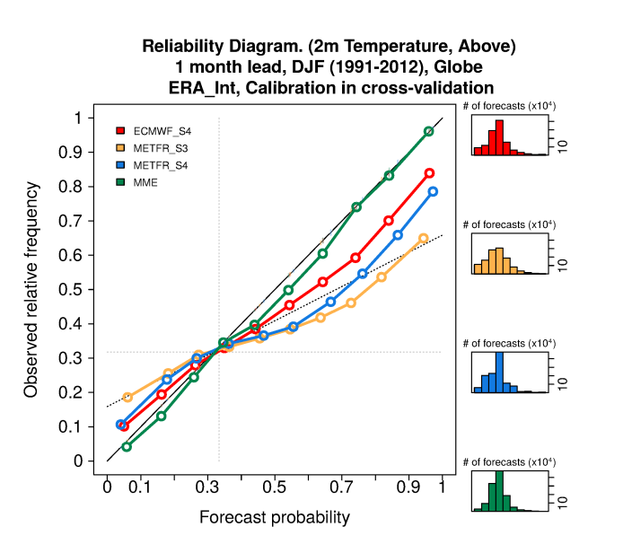
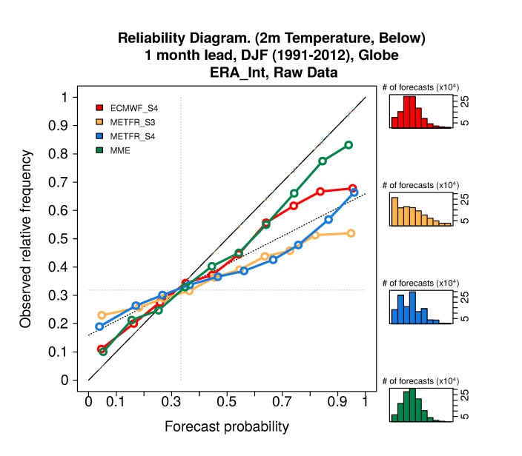
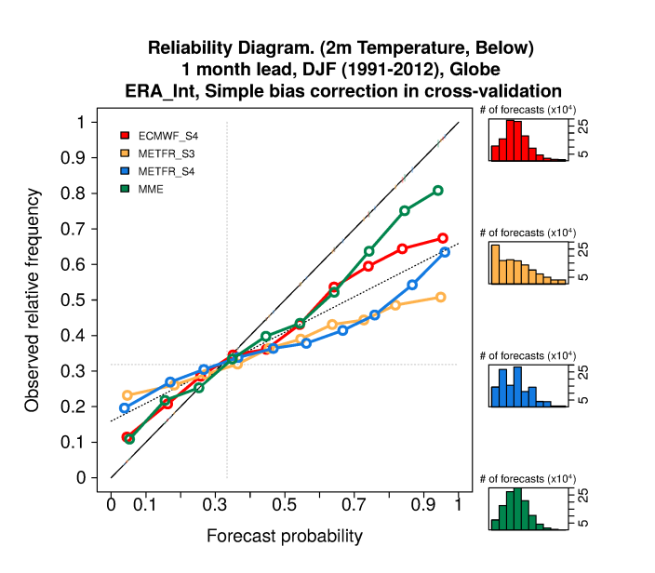
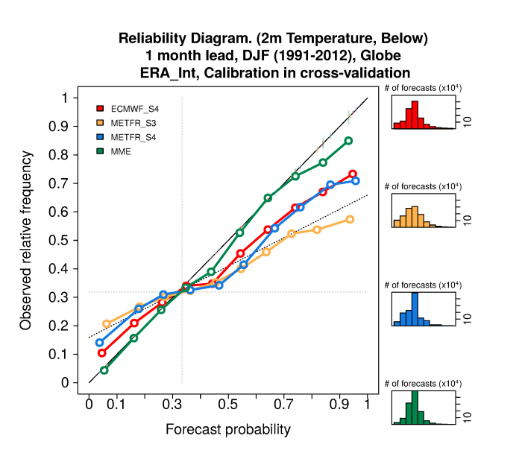
Reliability Diagram
(2m temperature)
Raw
SBCcv
Calcv
Above
Below

Slide 26
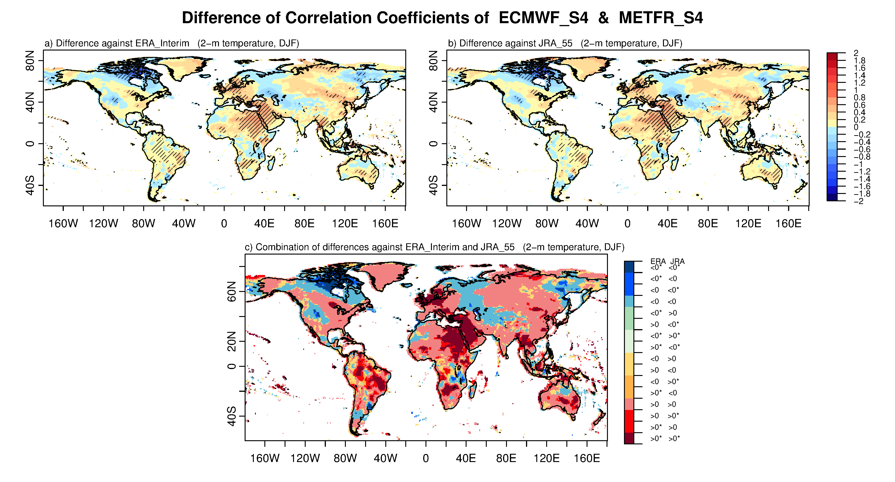
Difference of Two Correlation Coefficients
(2m temperature)
Red (blue) colors: positive (negative) values of differences in correlation for both cases.
Asterisk: significant areas at the 90% confidence level.
Yellow and green colors: the other possible combinations of differences and significance

