Slide 1
Status of QC for tall tower wind data
Jaume Ramon
Llorenç Lledó
13/11/2018
INDECIS 2nd GA, Dublin

Slide 2
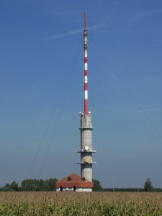
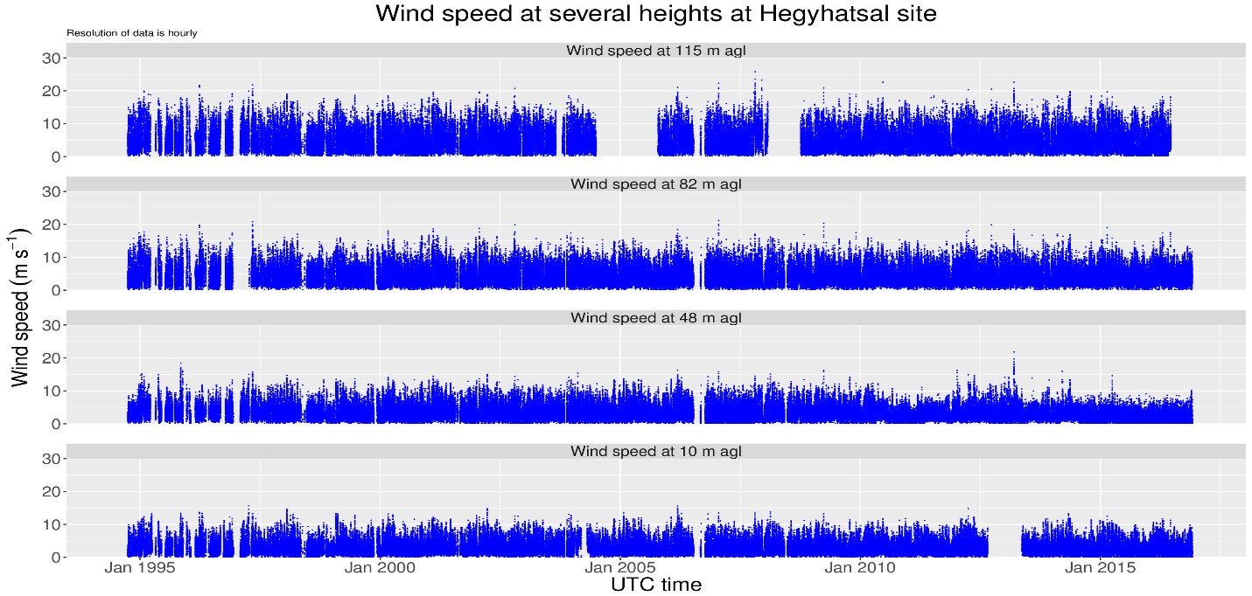
Tall tower data singularities
1. Parallel measurements at several heights
2. Sensor redundancy
Hegyhatsal tower, Hungary
Notes:
Remember mentioning the high correlation between parallel measurements
<number>

Slide 3
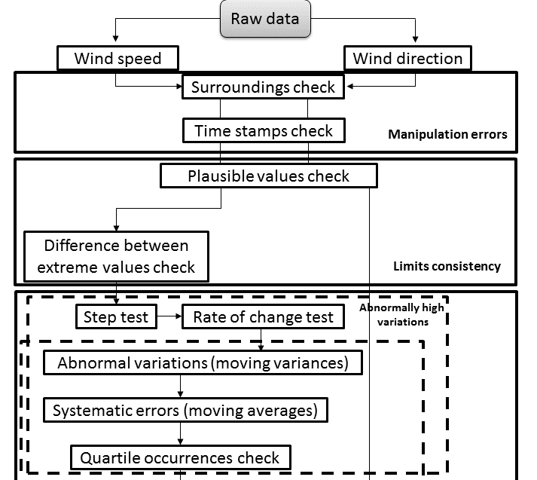
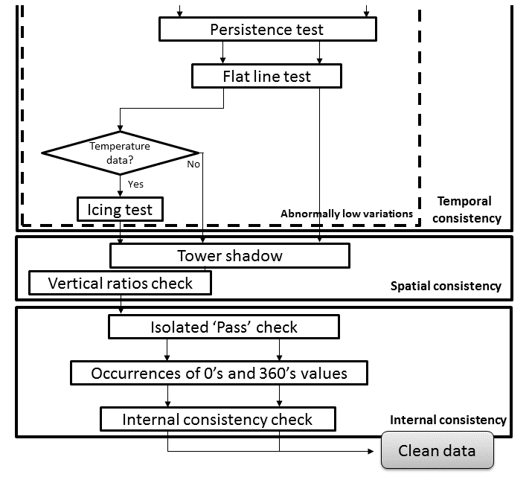
Quality Control routines
Notes:
Remember mentioning the high correlation between parallel measurements
<number>

Slide 4
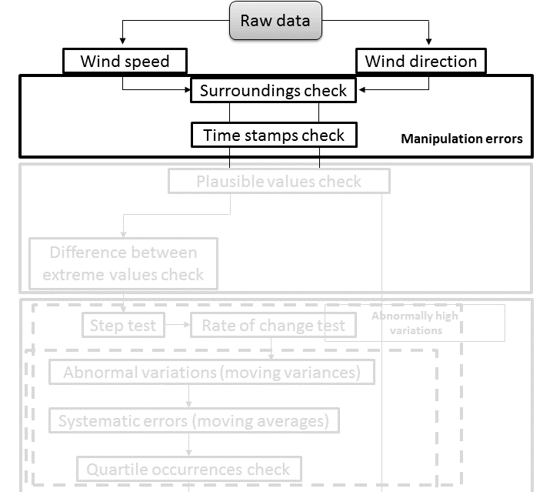
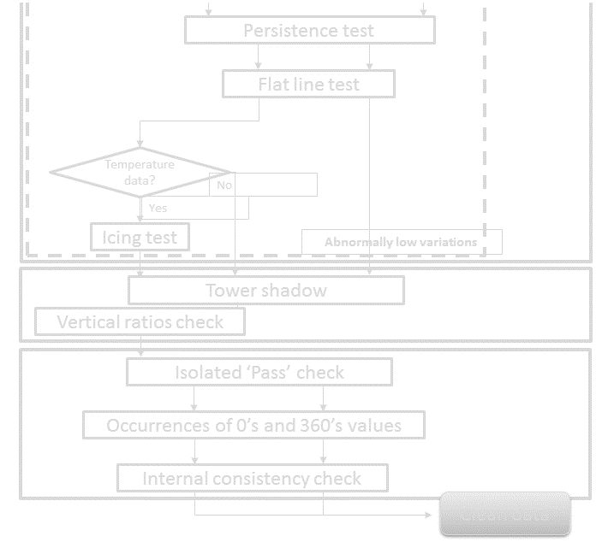
Quality Control routines
Notes:
Remember mentioning the high correlation between parallel measurements
<number>

Slide 5
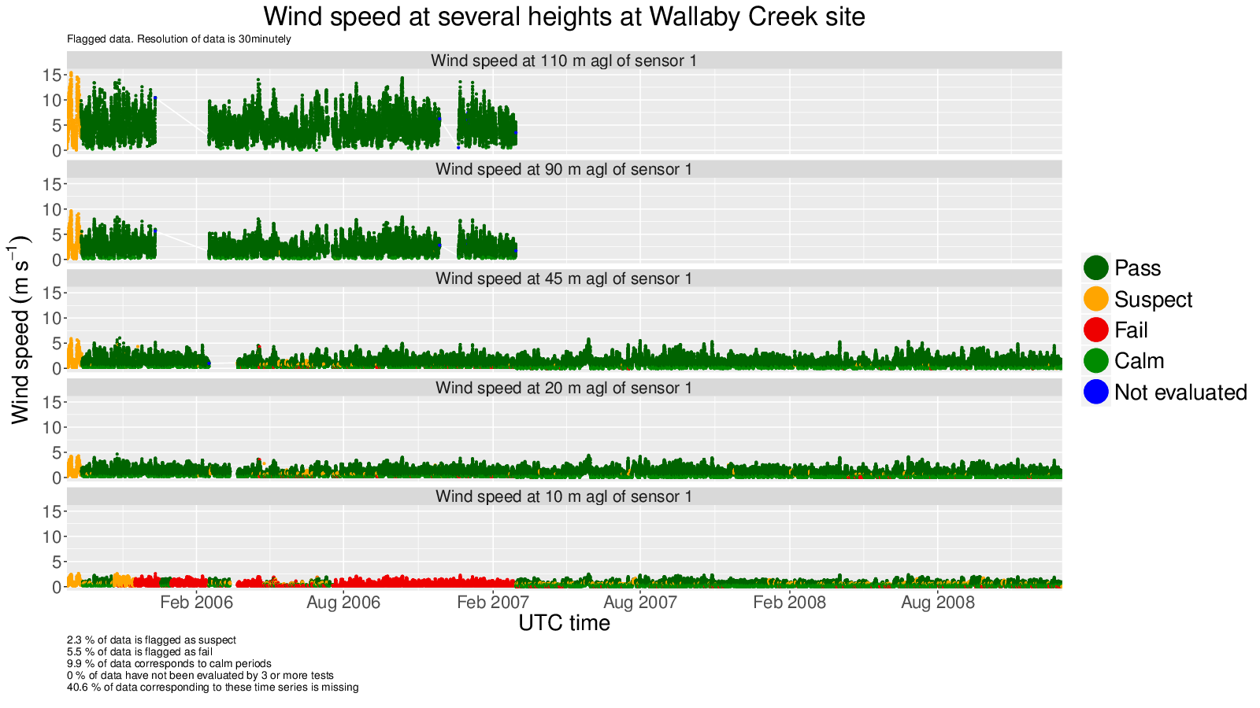
Quality Control routines
Wallaby Creek, Australia
Notes:
Mention here the flags used
<number>

Slide 6
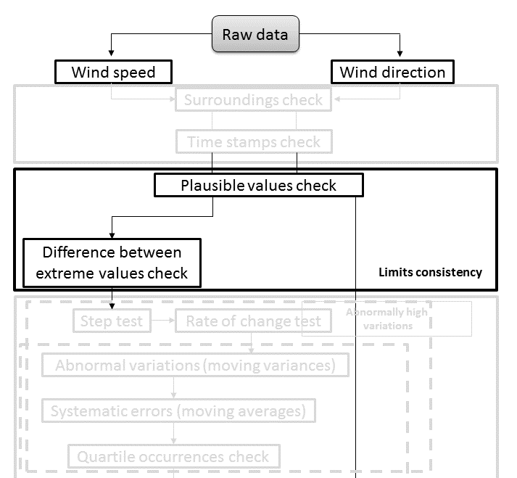
Quality Control routines
Notes:
Remember mentioning the high correlation between parallel measurements
<number>

Slide 7
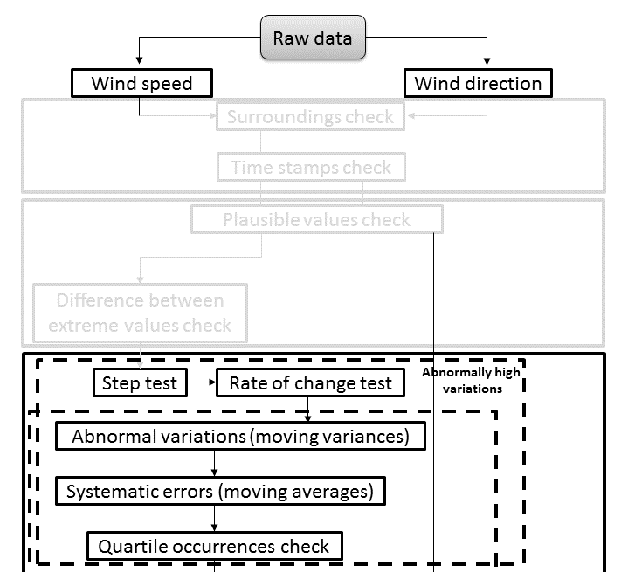
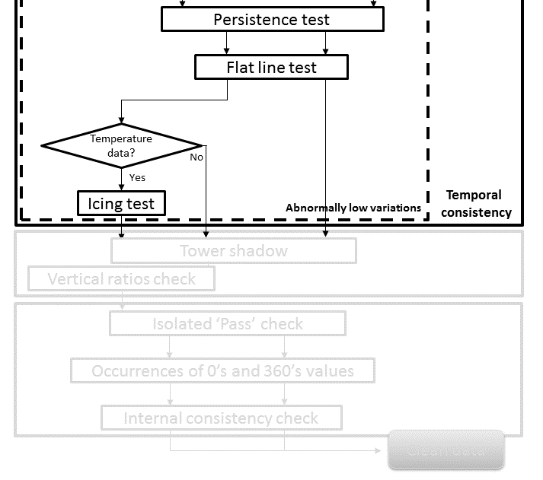
Quality Control routines
Notes:
Remember mentioning the high correlation between parallel measurements
<number>

Slide 8
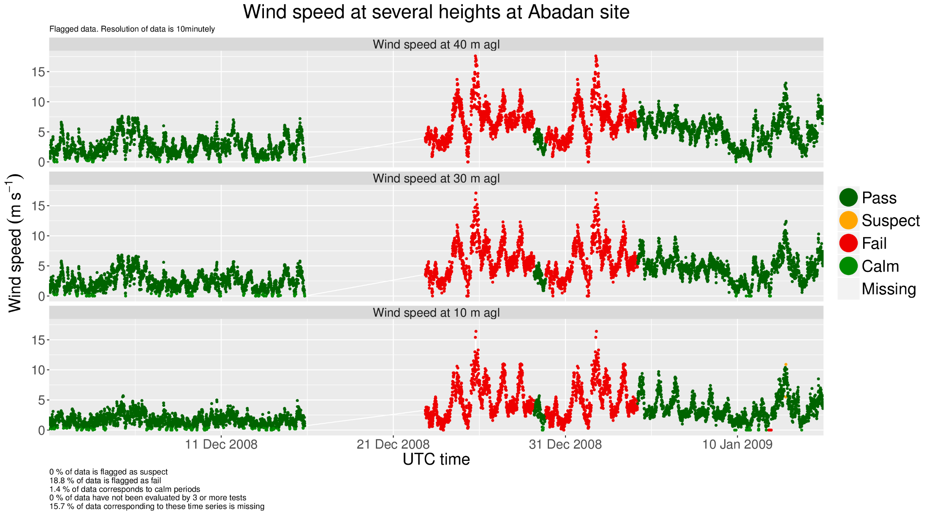
Quality Control routines
Abadan, Iran
Notes:
Remember mentioning the high correlation between parallel measurements
<number>

Slide 9
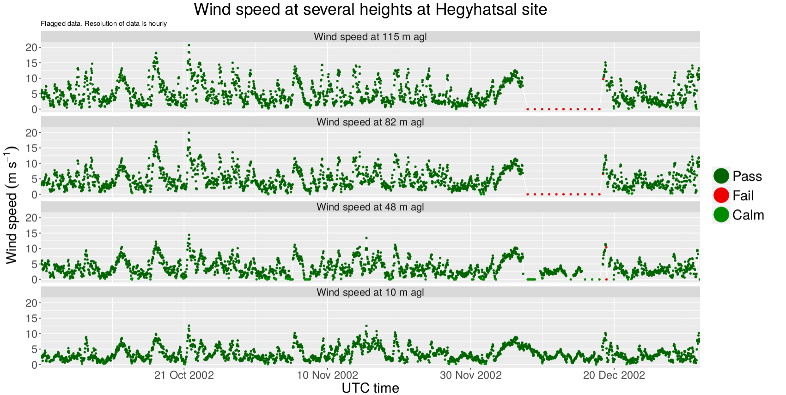
Quality Control routines
Hegyhatsál, Hungary
Notes:
Remember mentioning the high correlation between parallel measurements
<number>

Slide 10
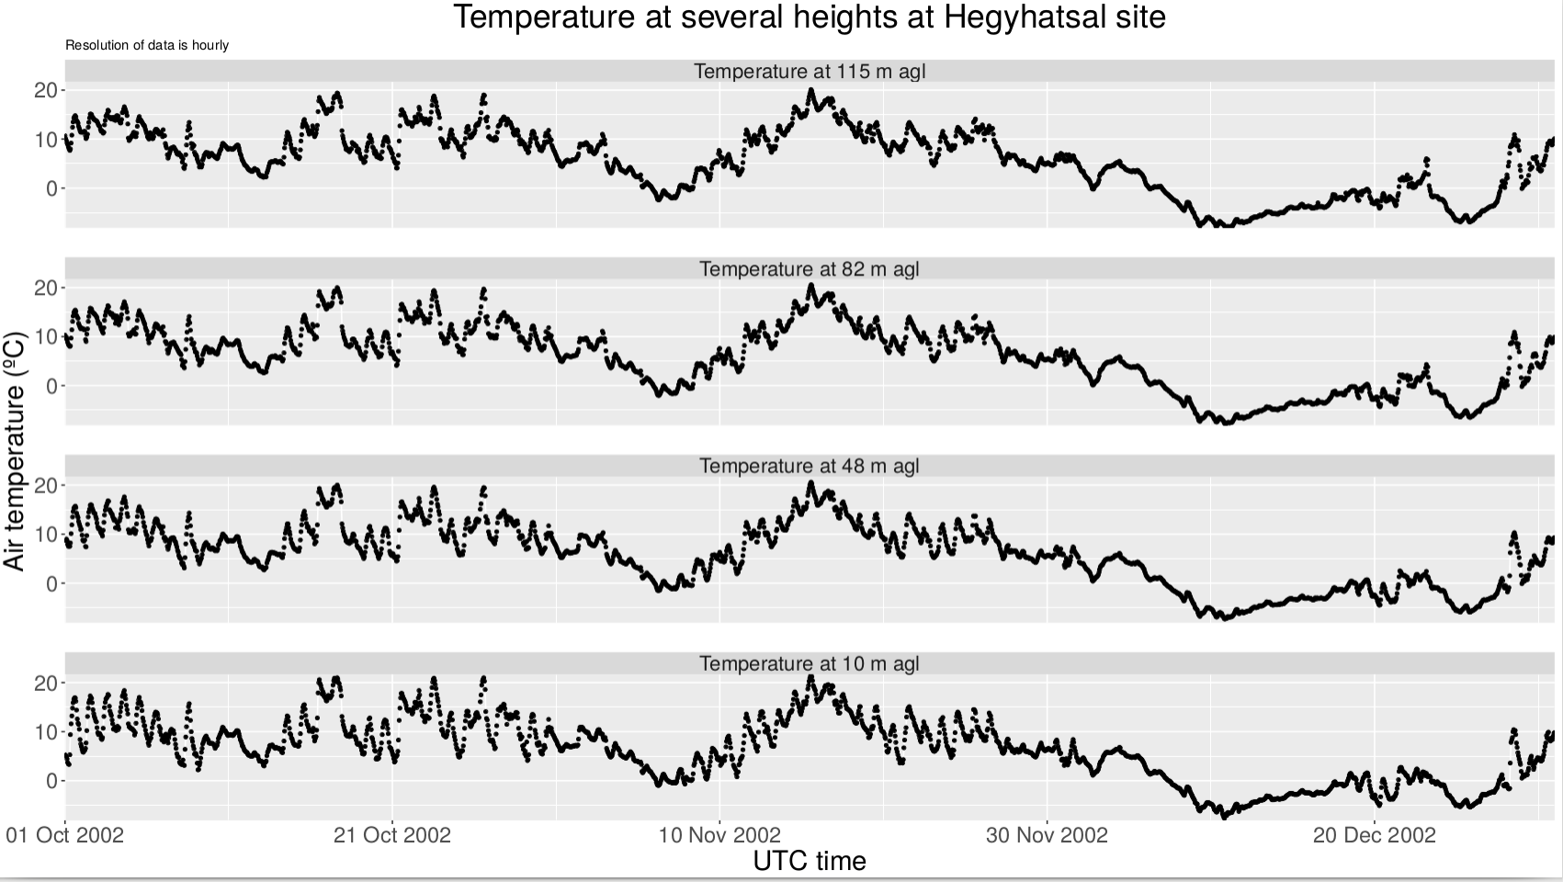
Quality Control routines
Notes:
Remember mentioning the high correlation between parallel measurements
<number>

Slide 11
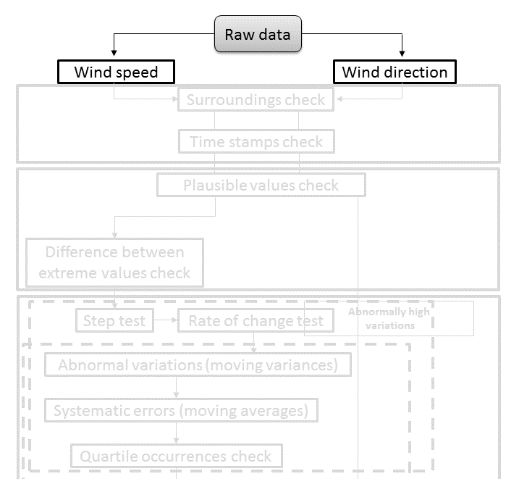
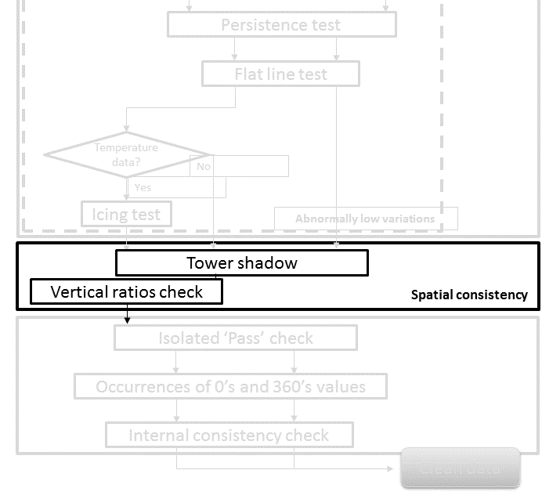
Quality Control routines
Notes:
Remember mentioning the high correlation between parallel measurements
<number>

Slide 12
Quality Control routines
Ratio between wind speed from sensor 1 (S1) and sensor 2 (S2) at 100 meters agl
Shadow on S2
Shadow on S1
Wind direction (degree)
S1
S2
FINO3 met mast, Deutschland
Notes:
Remember mentioning the high correlation between parallel measurements
<number>

Slide 13
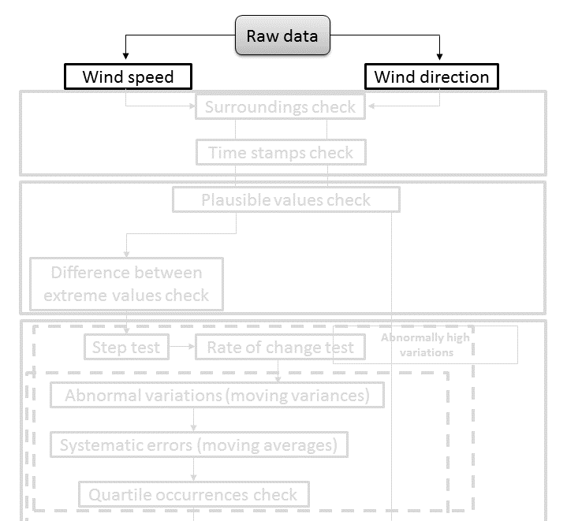
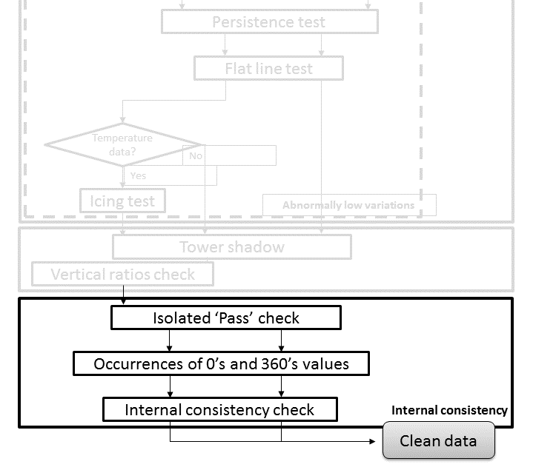
Quality Control routines
Notes:
Remember mentioning the high correlation between parallel measurements
<number>

Slide 14
Homogenisation assessment of the quality controlled Tall Tower Database
Poor spatial density of tall towers.
Furthermore, no data periods usually appear simultaneously in all measurement levels.
One approach could be:
Fill in gaps using data from the nearest level of measurement (when available).
Run Climatol only to assess the quality of time series in terms of homogeneity (SNHT).
Notes:
Remember mentioning the high correlation between parallel measurements
<number>

Slide 15
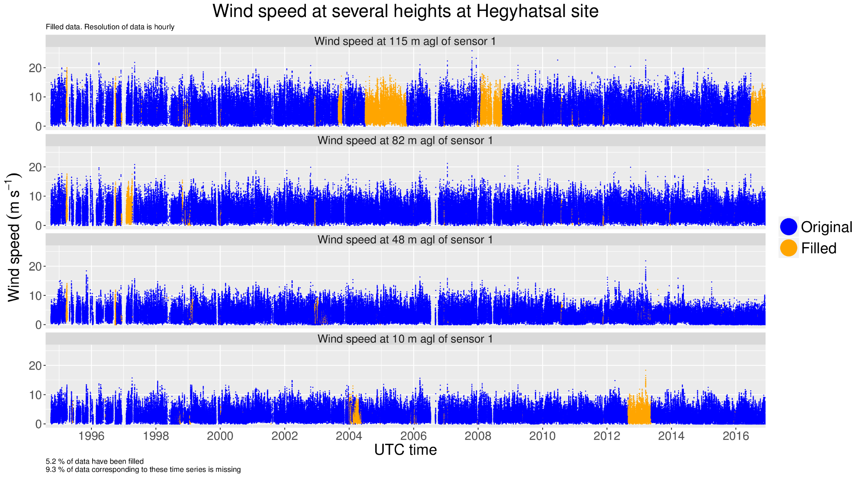
Gap filling
Notes:
Remember mentioning the high correlation between parallel measurements
<number>

Slide 16
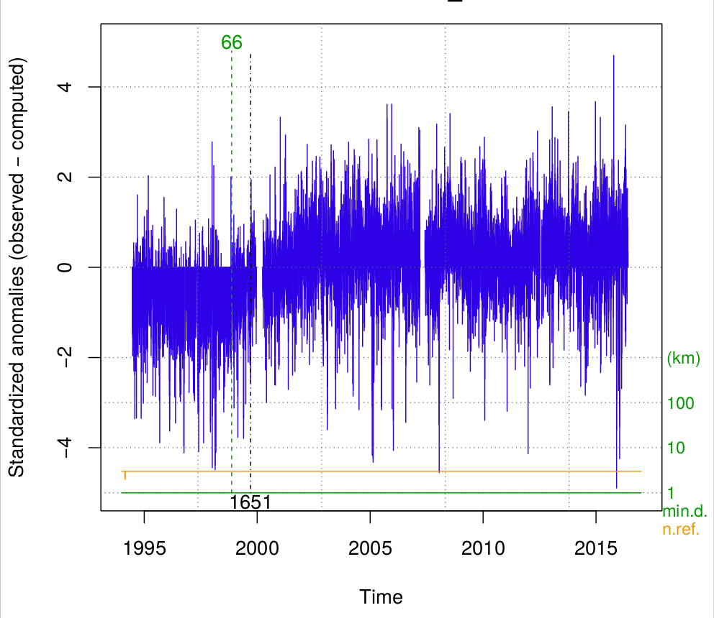
Climatol
American Samoa, US
Notes:
Remember mentioning the high correlation between parallel measurements
<number>

Slide 17
Conclusions
A total of 18 quality control routines have been coded and run over the Tall Tower Raw Database
Two special tests have been added to this suite: ‘tower shadow’ and ‘vertical ratios’
Tall tower data appear to be difficult to homogenise
Fill in gaps (when possible) using a simple linear model (power law) using data from other measurement levels
Run Climatol to assess the quality of time series in terms of homogeneity.
Test the robustness of the QC software suite using INDECIS benchmark (Tall Baboon)
Notes:
<number>

Slide 18
THANK YOU!
jaume.ramon@bsc.es
INDECIS is part of ERA4CS, an ERA-NET initiated by JPI Climate, and funded by FORMAS (SE), DLR (DE), BMWFW (AT), IFD (DK), MINECO (ES), ANR (FR) with co-funding by the European Union’s Horizon 2020 research and innovation programme under grant agreement no 690462
www.indecis.eu

