Slide 1
Good practices for user engagement and communication of operational services
1 June 2018
Second WMO Workshop on Operational Climate Prediction

Slide 2
USER’S JOURNEY
Establishing ‘good practices’ for a user’s journey that has different stages
User engagement
Visual communication
Capacity
building
Exploitation

Slide 3
USER ENGAGEMENT
Language matters
Language
Speak the language of users
Terminology
Need for more precise terminology and definitions
Understanding
Be in the place of the user

Slide 4
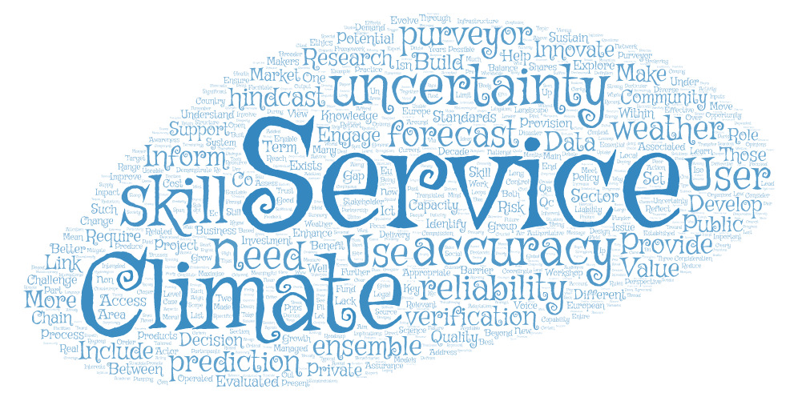
USER ENGAGEMENT
Terminology: more precise terminology and definitions
Notes:
Concerted communication strategy that prevents users to be discouraged by certain barriers (involuntarily) built by the climate observational and modelling community through the use of specialized terminology, data formats and software that are unfamiliar and unnecesarily complicated to users (terms such as skill, uncertainty, ensemble, accuracy, reliability, etc).

Slide 5
USER ENGAGEMENT
Language: speak the language of users
User-engagement activities
Focus groups (Portuguese)
Workshop (Italian)
Workshop (Spanish)
Help cover underrepresented areas
Notes:
Importance to use languages other then English when the user community requires it. It is true that when we are working with the renewable wind energy, many users are comfortable with English, but that has resulted to not be the case in the agricultural community. If an effective user engagement wants to be achieved, having some activities/material in the local language of users may improve a lot the user engagement strategy.

Slide 6
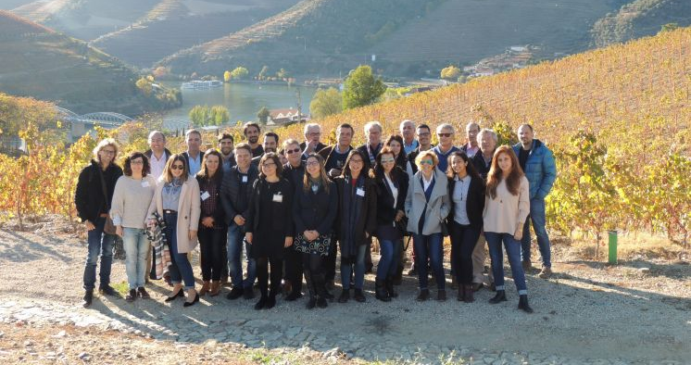
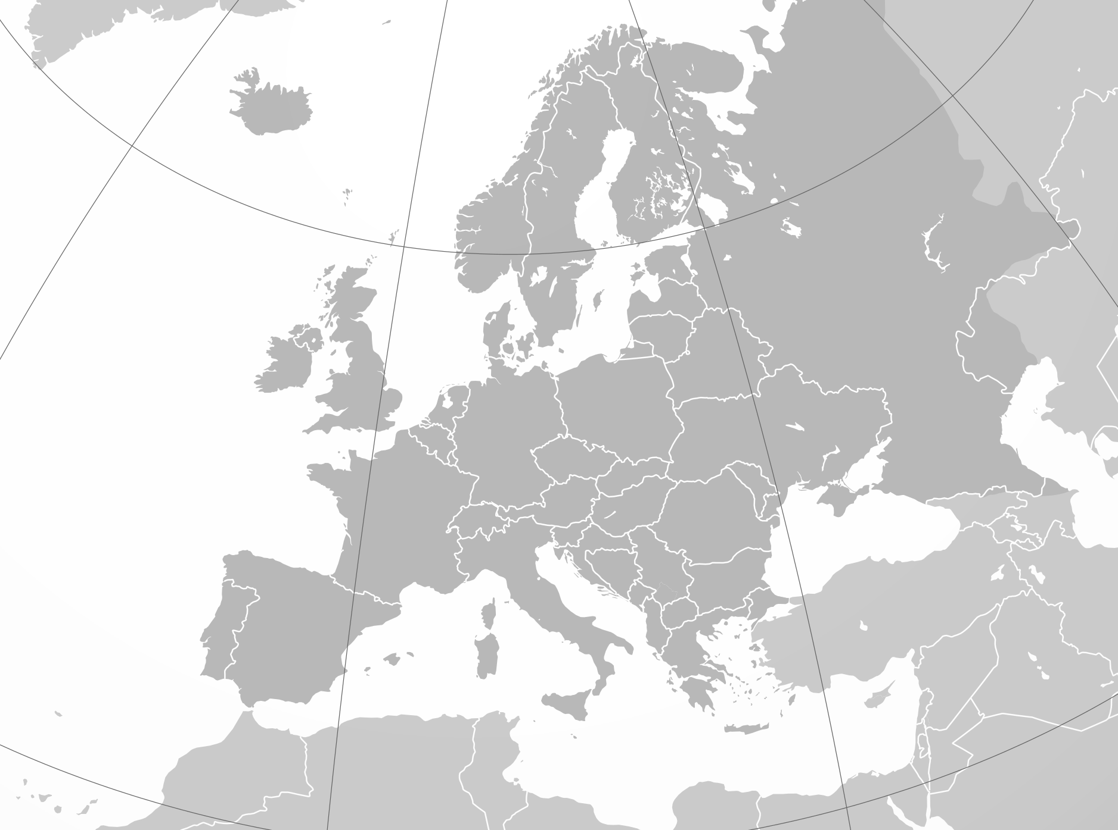
USER ENGAGEMENT
Understanding: go where the users are
15-16 May 2018
Barilla, Ravenna
(Italy)
3-4 May 2018
Sogrape, Porto
14-15 Nov 2017
Symington, Vila Nova de Gaia
(Portugal)
12 June 2018
DCOOP, Antequera
(Spain)
Notes:
Better understand the context under which users take decisions, there is a need to go where the users are.

Slide 7
VISUAL COMMUNICATION
Do not underestimate visual communication
Color scales fit/ color-blind friendly
Access to easy-to-understand information (depending on user sector, intended use of information & capabilities)
Visually appealing
Notes:
The main lesson learnt about visual communication is ‘do not underestimate visual communication’. Here, it is important to provide information in a way that is easily understood by users (and that means different things for different users according to the sector they belong to, the intended use of the information and the user capabilities). In visual communication, the use of color scales is somenthing non-trivial, and we have to pay attention and consider different factors when choosing them, ensuring that they are color-blind friendly. And last but not least, they need to be visually appealing – that makes a great difference on user’s disposition

Slide 8
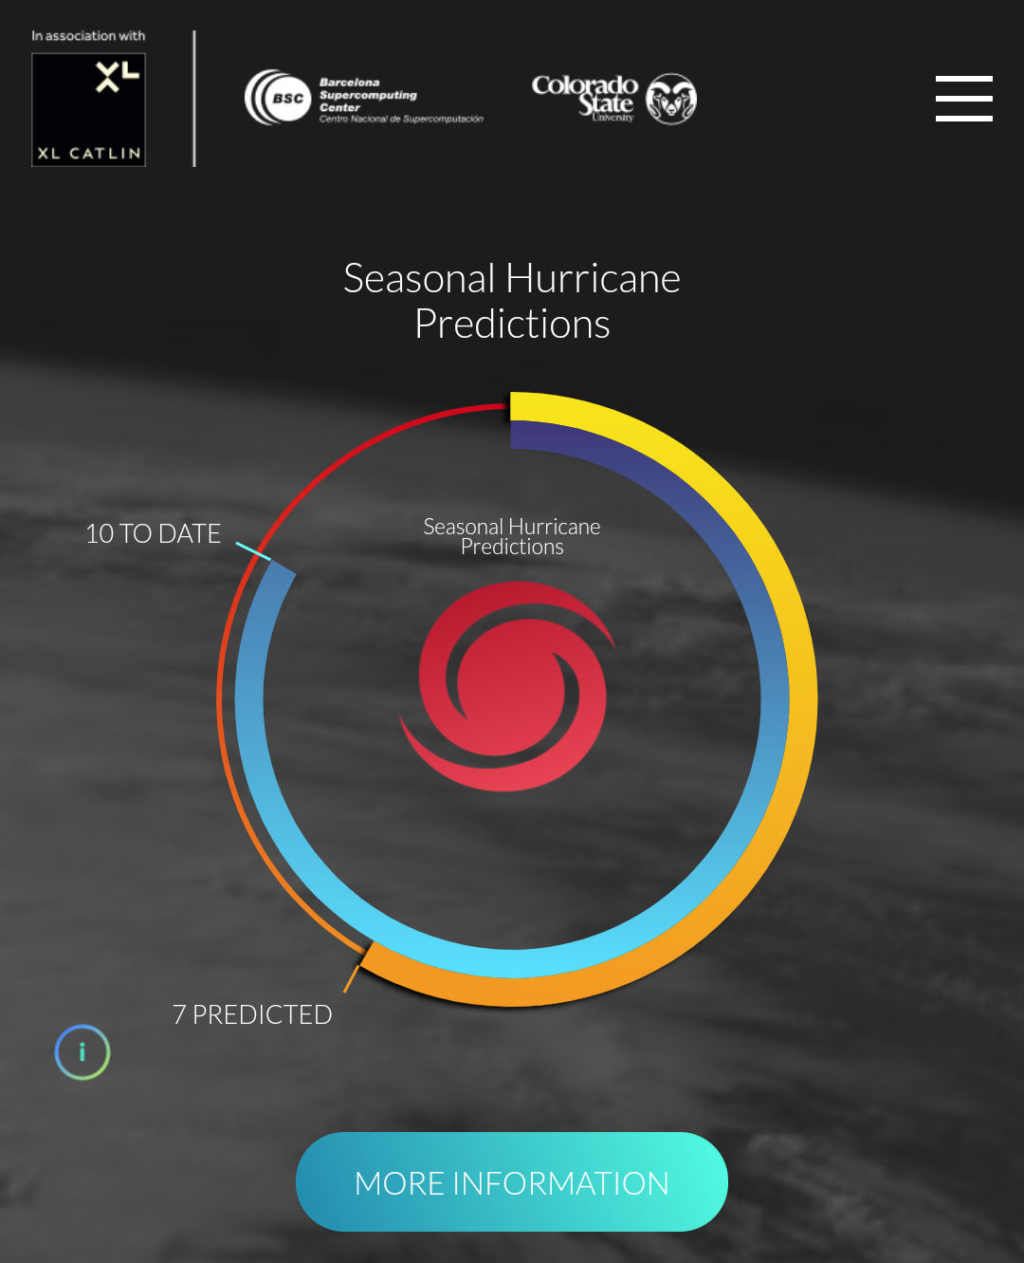
VISUAL COMMUNICATION
Access to easy-to-understand information
www.seasonalhurricanepredictions.org
Season 2017
Season 2018
Notes:
Provide the information which is more relevant in a clear and synthetic way, that is easy to understand by the user. The user needs to find the main content immediately. An effort has been made here to have a multidisciplinary team of scientists, communication specialists and a designer. The site has been awarded with the ‘Site of the day’ in designnominees.com. The option to have additional information for advanced users available – progressive disclosure of information

Slide 9
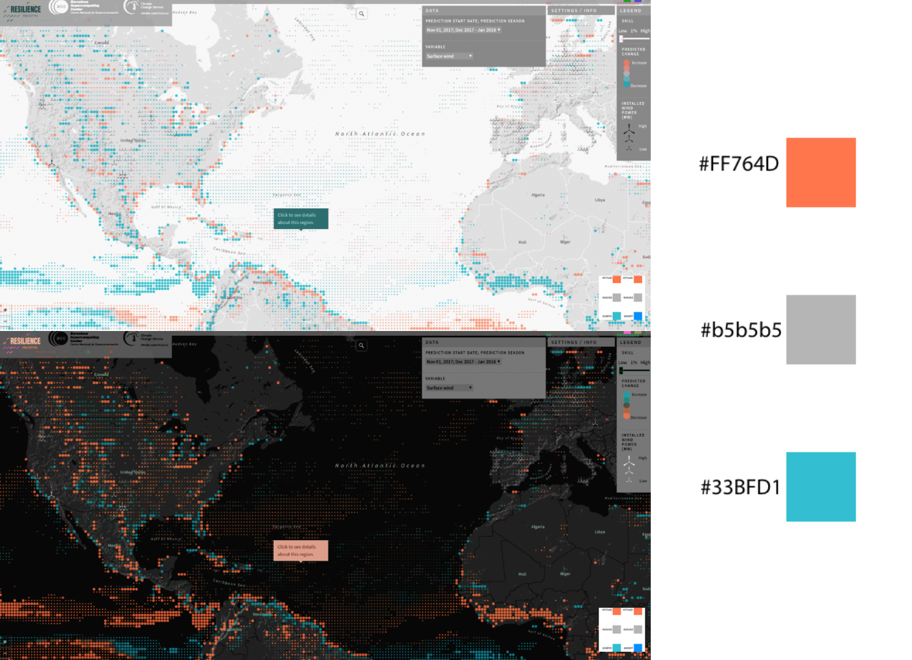
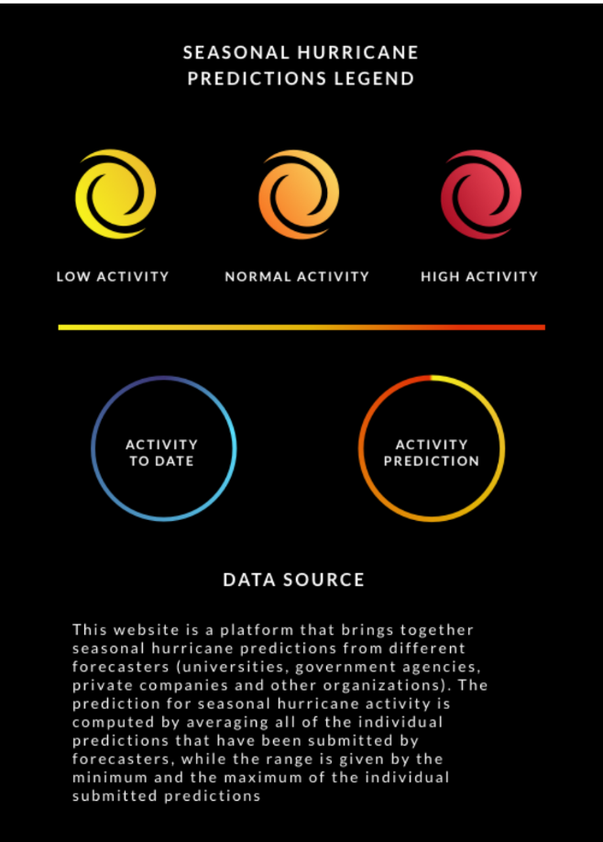
VISUAL COMMUNICATION
Color scales fit
High contrast
Intuitive colors
Color-blind friendly
Notes:
When developing visualizations, all visual aspects matter. Selected color scales need to have high enough contrasts to be clearly seen (e.g with different skin selections) and use intuitive colors (using a blue – low to red- high scale works for temperature related variables, whereas it doesn’t work for precipitation-related variables, or water)
Color-blind friendly - there are online tools (color blind simulators) that allow you to see how a color blind person sees a particular color scale. Important to make tests of user experience to assess the understanding of the information presented.

Slide 10
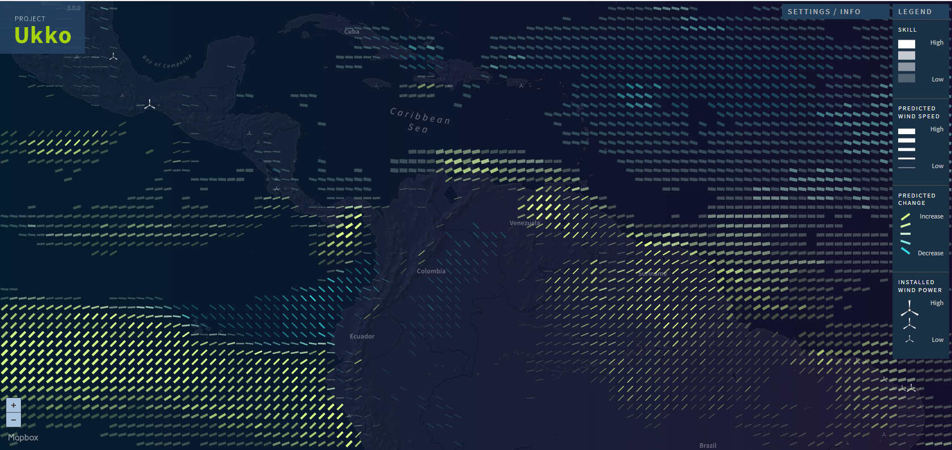
VISUAL COMMUNICATION
Visually appealing
Clim4Energy
project-ukko.net
Notes:
Project Ukko, developed in the framework of the project EUPORIAS, was a success story of a visually appealing way of displaying information on seasonal predictions of wind. It received the ‘Information is beautiful’ award.
Have a nice visualization is a key first step towards encouraging user’s attitud to use the tool, but the tool needs to be useful to them, that is, they need to find the information they require and in the format they want it and they are able to use it. That’s why our research continued enhancing the available tools so that they are more tailored to user needs, but always keeping in mind the importance of the visual part. This was done in the CLIM4Energy project (Copernicus) and is continuing with a horizon2020 project called S2S4E.

Slide 11
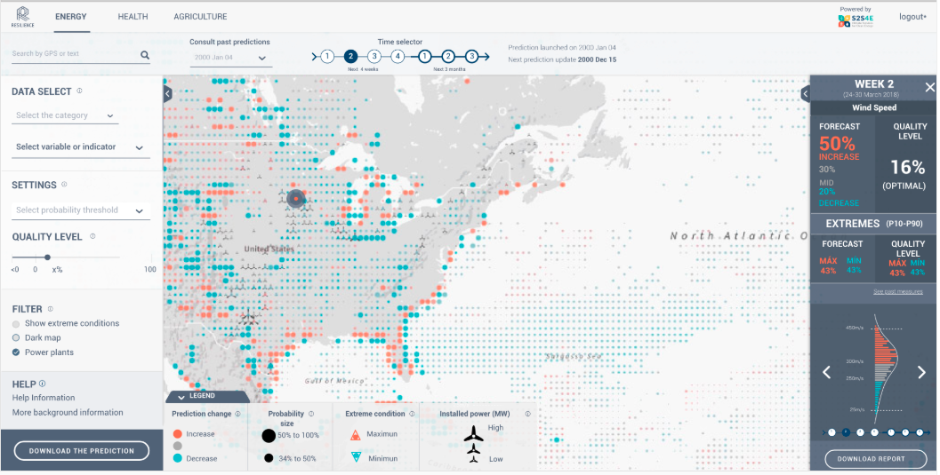
VISUAL COMMUNICATION
Visually appealing
Clim4Energy
Notes:
Following users’ requirements, new types of information are provided in the new visualization platforms developed, where special focus needs to be put on the way to communicate the information so that to continue being easy to understand and appealing; but at the same time, it incorporates user’s feedback and try to correct those items/things that were identified to be counterintuitive for users or accomodates new user demands.

Slide 12
CAPACITY BUILDING
Capacity building needs time
Co-production
Guidance and training
Notes:
The main lesson learnt from capacity building is that it needs time. It involves providing guidance and training for the users and also through a co-production of services

Slide 13
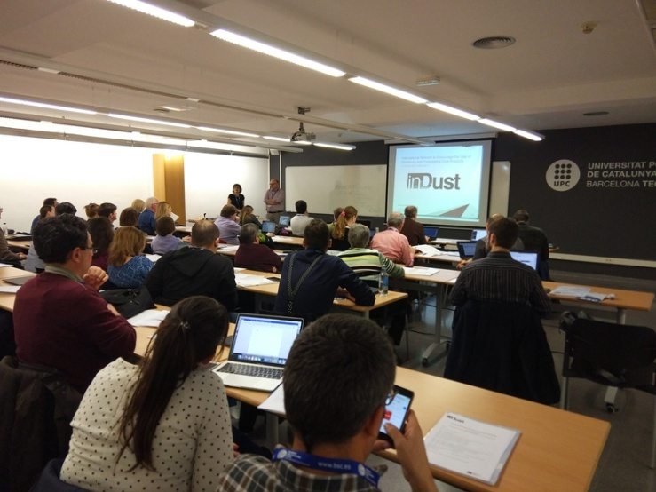
CAPACITY BUILDING
Guidance and training
International network to encourage the use of monitoring and forecasting dust products
Strengthen links and collaboration with different communities
Enhance understanding on scientific processes that impact relevant sectors
Enhance technical capacities of local operational specialists (meteorologists, climatologists…)
Notes:
Provide guidance and training is very important to build capacity among the (potential) user communities and constitutes a key step for the users’ uptake of the provided operational services.
A nice way to provide guidance and training is through the creation of COST Actions that are international networks to encourage the use of products. This allows to strengthen the links and collaboration among different communities (e.g. educational and scientific), enhance the understanding of scientific processes and how they have an impact on some sectors, or enhance the technical capacities of local operational specialists on the analysis and prediction of the provided data

Slide 14
CAPACITY BUILDING
Co-production
(2011-2014)
(2012-2016)
(2017-2020)
ENEA
UK Met Office
BSC
Involvement of user champions that have learnt enough about the topic to be project partners and act as ambassadors
First attempt to engage with users in the design of interfaces
Specific prototypes designed with feedback from users
Concept of UIP
Notes:
Co-production is a very important aspect for building capacity and to illustrate it I would like to show you the example of an evolution starting with the CLIM-RUN project, and FP7 project. S2s4E the role of users is more active, since they are already part of the project as user champions; and that later on can be ambassadors in their sector

Slide 15
EXPLOITATION
Make use of results
Knowledge transfer to other sectors and actors (society, policy, public and private action)
Users’ uptake of products that ensures continuity after the project
Added value assessment
Notes:
In the exploitation part, I am not talking about the lesson learnt because we haven’t yet reached this stage, but the objective here is to make use of results (outside from the project context). Here, the assessment of the added value of climate predictions is necessary, as well as the successful knowledge transfer to other sectors (this can be helped by user ambassadors described in the capacity building section). All that is needed for the final & desired part that is the user’s uptake of the generated products that ensures continuity after the project.

Slide 16
marta.terrado@bsc.es isadora.jimenez@bsc.es
SDS-WAS
Clim4Energy
Seasonal Hurricane Predictions
The research leading to these results has received funding from the EU Seventh and Horizon2020 Framework Programme under grant agreements nº 776767, 730253, 308291, 776787 and 265192, and is part of the Copernicus Climate Change Service (C3S_441_Lot2_CEA), a program implemented by ECMWF on behalf of the European Commission

Slide 17
User engagement
Involve users in the proposal from the beginning
Language
Speak the language of users
Be there
Go where the users are
Language
Need for more precise terminology and definitions
Provide something back
To hold users’ interest

Slide 18
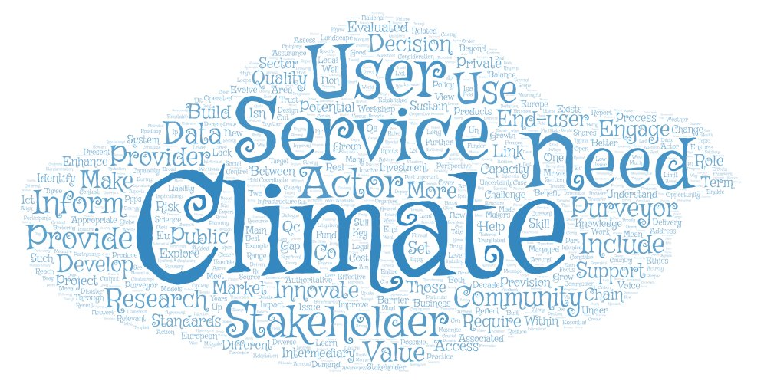
USER ENGAGEMENT
Terminology: more precise terminology and definitions of the user communities
Notes:
More precise use of terminology and definitions of terms that are broadly accepted by the whole climate service community (e.g. interchangeable use of terms such as user, end-user, stakeholder, actor…). Enhancing climate services ontologies and semantics would improve coherence and user communications

Slide 19
Involve users in the proposal

Slide 20
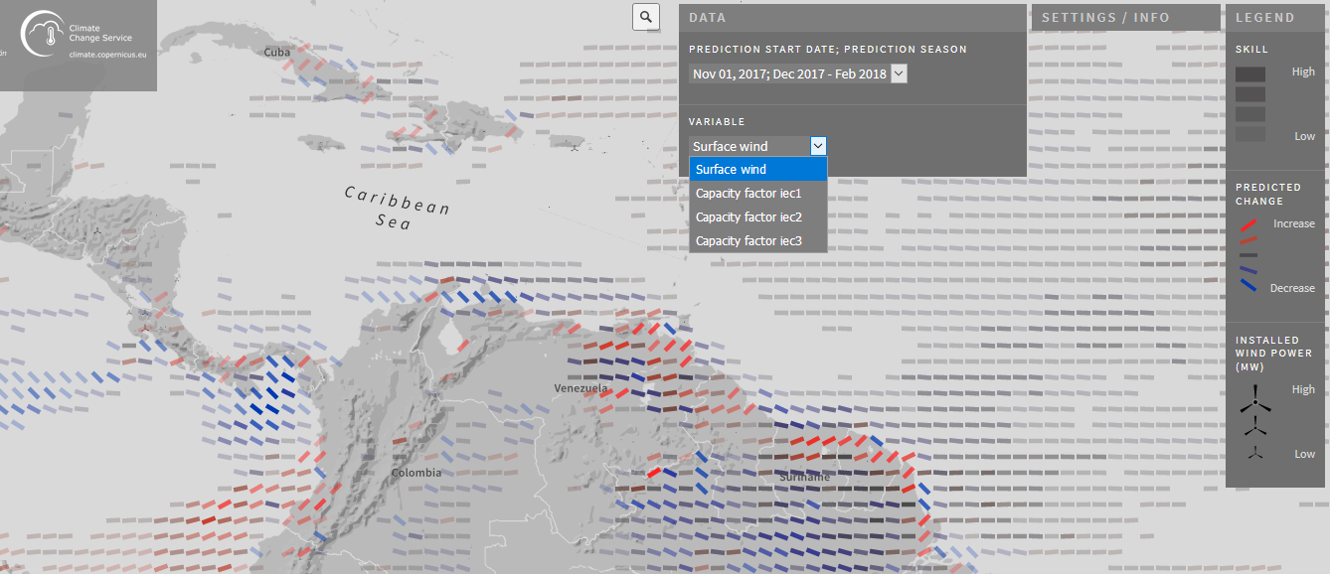
VISUAL COMMUNICATION
Visually appealing
Clim4Energy
Visualisation tests
Alternative color scales
Display panel
Skin selection (dark, light)
Probability of glyphs size
Alternative detail panels
www.bsc.es/ess/resilience
Notes:
NO SÉ SI ÉS NECESSARI MOSTRAR RESILIENCE AQUÍ, POTSER PASSAR DIRECTAMENT A S2S4E?

Slide 21
CAPACITY BUILDING
Co-production
(2011-2014)
(2012-2016)
(2017-2020)
Static case study setting to engage with users in the design of interfaces
Involvement of user champions that have learnt enough about the topic to be involved in the project
Concrete prototypes designed with feedback from users
Concept of UIP
Unrealistic expectations (exact amount of P and T months in advance)
Uncertainty barrier
Bigger effort on clarity (too difficult to understand)
Improve accessibility and usability
Probability barrier
Interest in forecasts of extreme events
User mostly – but not completely- aware of the benefits
Interest in high resolution – Europe wide – extremes
Improve skill & uncertainty

