Slide 1
Evaluation and Quality Control Function of the Climate Data Store and the Sectoral Information System
Francisco Doblas-Reyes
(Barcelona Supercomputing Center and ICREA)
with contributions from the C3S_512 and C3S_513 contracts

Slide 2
C3S EQC
The Copernicus Climate Change Service (C3S) comprises several main components, including the Climate Data Store (CDS) and the Sectoral Information System (SIS). Alongside these, there is an Evaluation and Quality Control (EQC) function.
The purpose of the EQC function in the C3S is to independently assess the quality of all C3S products and services, and to ensure that users have the information they need in order to use the products and services for their own purposes. This is a pioneering effort in climate service delivery.

Slide 3
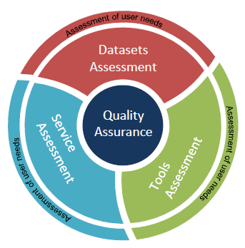
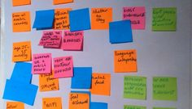
EQC of the CDS
The Climate Data Store (CDS) is a complex infrastructure that requires an Evaluation and Quality Control (EQC) function providing a comprehensive quality assurance service:
CDS datasets: provide information about the technical and scientific quality and fitness-for-purpose, along with independent assessment of the datasets
CDS toolbox: assessment of maturity and fitness for purpose of the software provided to explore the datasets
CDS service: performance assessment of the CDS infrastructure (e.g. speed, responsiveness, system availability)
CDS users: user requirement assessment to measure users’ satisfaction with the CDS. Map evolving user needs into viable user requirements to ensure a user-oriented evolution of the CDS

Slide 4
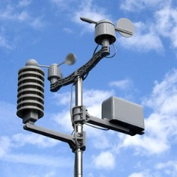
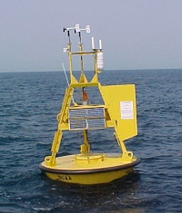
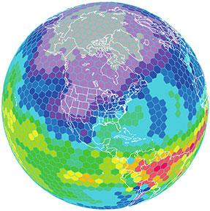
EQC of the CDS datasets
The Quality Assurance Reports (QAR) are organised in a database integrated in the CDS and hold all the available EQC information according to user requirements
QAR available in the CDS
A challenge: the CDS datasets include a wide variety of data types:
Satellite observations
In-situ observations
Reanalysis
Seasonal forecasts
Global and regional climate projections
This poses challenges to provide a seamless and homogeneous EQC information for the whole CDS datasets
To overcome this issue a synthesis table is integrated in the CDS web portal

Slide 5
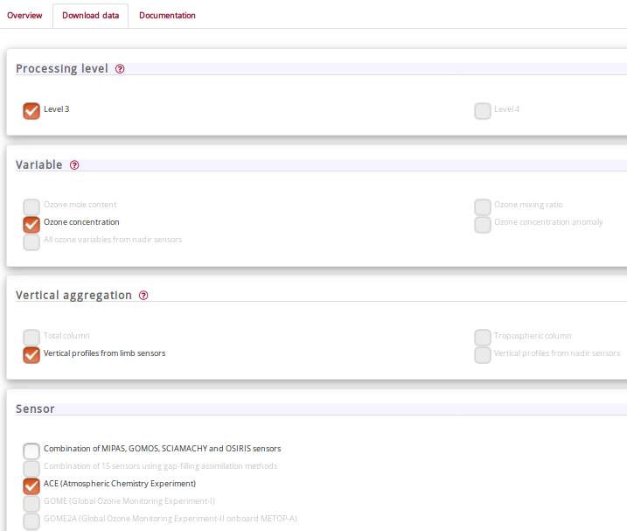
EQC of the CDS datasets
EQC
The information will be made available via a new tab in the CDS web pages with the same look and feel as the download option
The user selects the dataset and variable of interest
A set of information is presented by displaying the synthesis table with the web page being created dynamically
Show EQC information

Slide 6
EQC of the CDS datasets
EQC
The EQC information is organized and homogenised across all datasets
The layout is agnostic of the product type selected
The user can dig into the EQC information created dynamically through successive clicks on the box of interest
INTRODUCTION
ACCESS
USER DOCUMENTATION
INDEPENDENT ASSESSMENT
PRODUCT NAME: Ozone monthly gridded data from 1970 to present
VARIABLE: Ozone concentration
PROCESSING LEVEL: Level 3
SENSOR: ace (atmospheric chemistry experiment)
VERTICAL AGGREGATION: vertical profiles from limb sensors
Dataset overview
Temporal and spatial coverage and resolution
INTRODUCTION
Providers
Dataset version
Record update

Slide 7
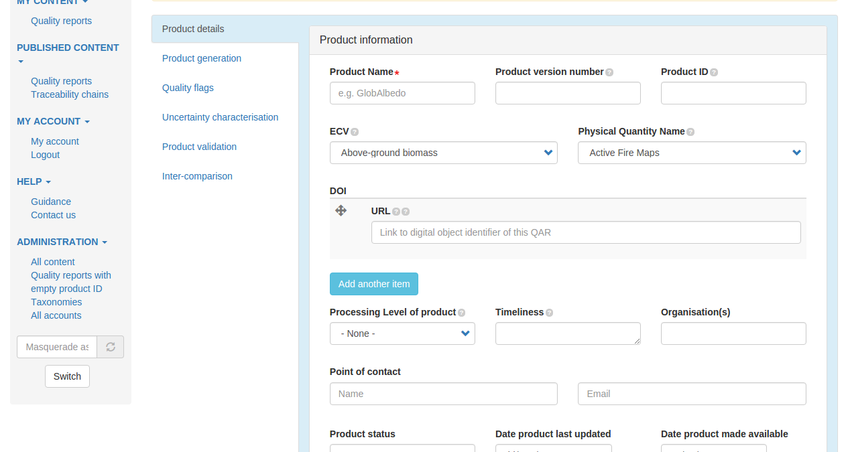
EQC of the CDS datasets
Dataset overview
INTRODUCTION
The synthesis table web pages are built dynamically, based on the information stored and displayed through a Content Management System (CMS) that is an integral part of the CDS
Temporal and spatial
Providers
Dataset version
Record update

Slide 8
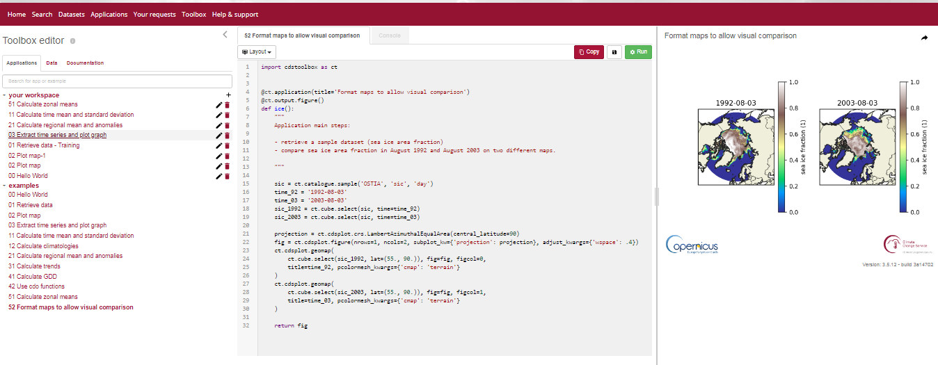
EQC of the CDS toolbox
The toolbox documentation tab has the list of the software tools where the user is offered the possibility to see the related EQC information.

Slide 9
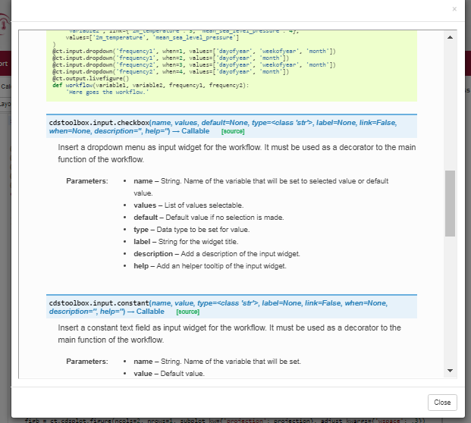
EQC of the CDS toolbox
When the user clicks one of the tools, a web page opens describing breafly the tool function
The user will be offered the possibility to access the details of the related EQC information
Show EQC information

Slide 10
EQC of the CDS toolbox
A web page will be built dynamically, (from the information available in the CMS) showing the EQC information organised and homogenised in a synthesis table
The user clicks on the box of interest and will be directed to another web page (also created dynamically) displaying the specific EQC element
Documentation
Code versioning and testing
DOCUMENTATION AND DESCRIPTION
Toolbox data model compliance
Tool F4P

Slide 11
EQC OF THE CDS TOOLBOX
The Toolbox should have an EQC tab where additional EQC information is reported about workflows, the editor, the CDM, etc.
EQC

Slide 12
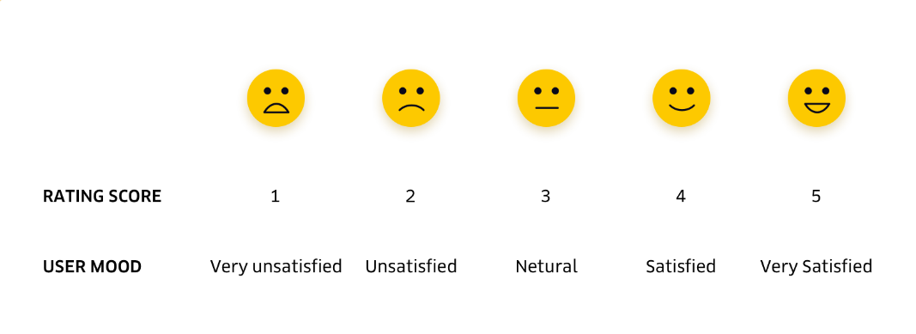
EQC of the CDS service
The EQC function measures and reports the technical quality of the whole service (e.g. system availability, response time). A number of KPIs have been defined inspired by the internationally-recognized standard ISO/IEC 25010 and 25011.
CDS KPIs
Performance
Reliability
Visibility
Overall quality
Suitability
Rate the speed of the toolbox
Monitoring of the CDS infrastructure is based on, among other things:
A set of Key Performance Indicators (KPIs)
On-line rating widgets to monitor user satisfaction
Development of a web dashboard hosting the KPIs and widget statistics

Slide 13
EQC for SIS
The aim of this contract (C3S_513) is to guarantee fitness-for-purpose, user relevance and quality of SIS activities.
This is achieved through two main objectives:
Define an EQC for SIS Framework that provides ECMWF and C3S users with the ability to assess whether the SIS services and data are fit-for-purpose
Ensure that SIS Workflows and Applications accepted into the CDS are of good quality and will generate outputs that uphold the standards required for ensuring C3S is a trustworthy source of climate information

Slide 14
EQC for SIS
C3S Sectors
SIS activities and outputs covered by C3S_513 includes:
SIS datasets, such as climate impact indicators
SIS tools and workflows, to be made available in the CDS toolbox
SIS applications that users can use to interact with datasets and workflows
Related SIS documentation, user guides, tutorials, etc.

Slide 15
C3S EQC for SIS
The main activities as part of the C3S_513 contract are:
Review of procedures currently in use to guarantee the quality of services
Develop and implement an EQC for SIS Framework
Implement and maintain an operational C3S User Requirement Database (URDB)
Analyse SIS requirements collected in the URDB
Organise user engagement activities to ensure user relevance of the SIS

Slide 16
EQC benefits
The benefits of the C3S EQC framework for users includes:
Feedback from users on C3S will be gathered and recorded
We will make recommendations for C3S evolution to meet user needs
Improve the accessible provision of quality assurance information
Support fitness-for-purpose assessment of C3S outputs
Enabling the use of C3S information in decision making by C3S users

