Slide 1
A portable framework to generate initial conditions for IFS/OpenIFS from ERA reanalysis products using OpenIFS
Xavier Yepes-Arbós
Etienne Tourigny
Mario C. Acosta
Francisco J. Doblas-Reyes
The research leading to these results has received funding from the EU H2020 Framework Programme under grant agreement no. 823988
This material reflects only the author’s view and the Commission is not responsible for any use that may be made of the information it contains
20/06/2019
5th OpenIFS workshop 2019, University of Reading, UK

Slide 2
Introduction
Models used in weather and climate forecasts must initialize the state of the Earth system (atmosphere, ocean, land and cryosphere) from observations

Slide 3
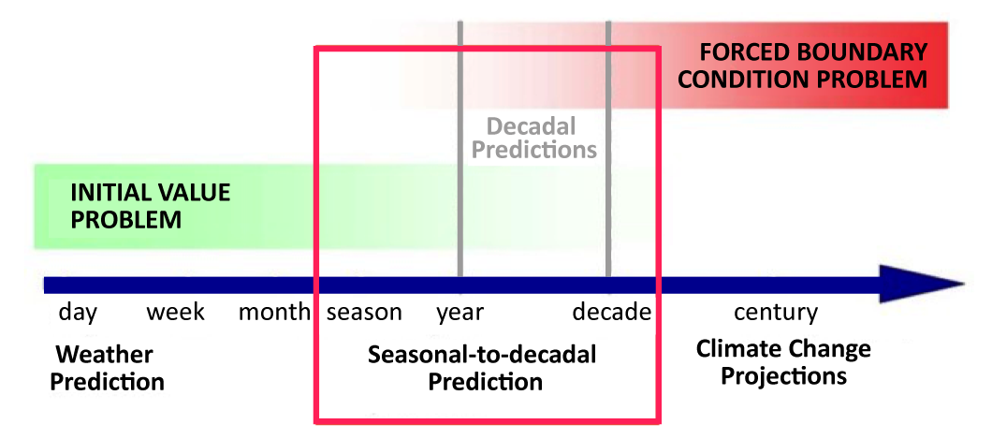
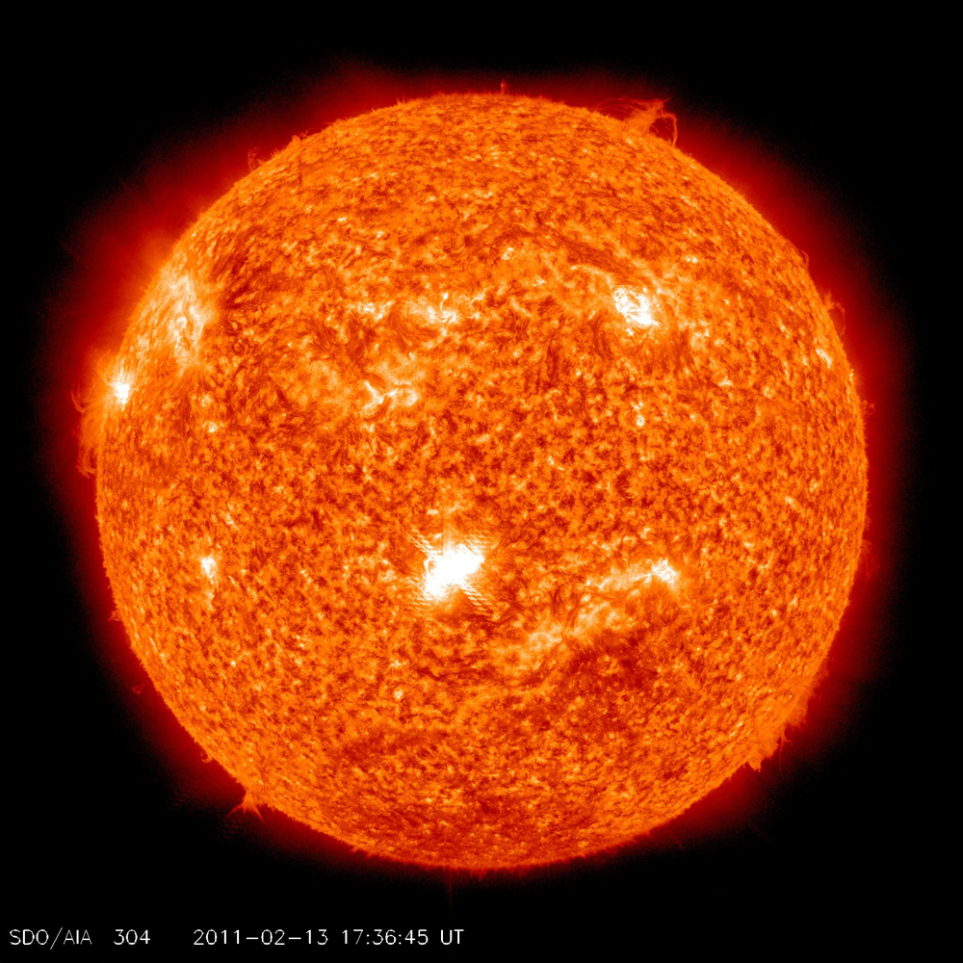
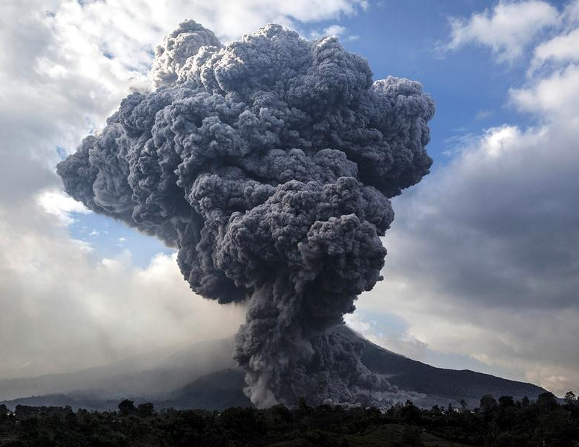
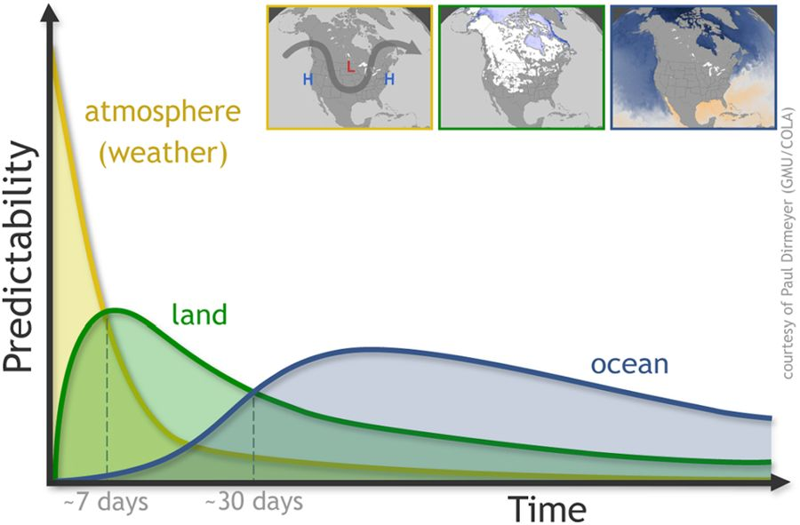
Cornerstones of climate prediction
Meehl et al 2009
Predictability relying on good guess of future changes in the forcing
Solar Activity
Volcanic Aerosols
©NASA/SDO
©Ulet IfansastiGetty Images
GHGs
©Paul Dirmeyer (GMU/COLA)
atmosphere
(weather)
Predictability
Mariotti et al 2018
©European Environment Agency
land
Predictability arising from the memory of slow processes/components in the climate system
ocean/sea ice
~7 days
~30 days
Time
Notes:
"Climate prediction lies at the cornerstone of weather prediction (initial value problem) and climate change (forced boundary conditions problem)"
"Therefore climate prediction experiments require an initial state of the atmosphere, land, ocean and sea-ice, which is as close as possible to the observed state"

Slide 4
Introduction
Models used in weather and climate forecasts must initialize the state of the Earth system (atmosphere, ocean, land and cryosphere) from observations
Retrospective forecasts (or hindcasts) in weather or climate prediction mode are used to evaluate the model’s performance and are typically initialized from reanalysis products

Slide 5
Climate prediction experiments
5-member prediction started 1 Nov 1960
1960
2015
Observations

Slide 6
Climate prediction experiments
5-member prediction started 1 Nov 2014
5-member prediction started 1 Nov 1970
… every year …
5-member prediction started 1 Nov 1965
5-member prediction started 1 Nov 1960
1960
2015
Observations

Slide 7
Introduction
Models used in weather and climate forecasts must initialize the state of the Earth system (atmosphere, ocean, land and cryosphere) from observations
Retrospective forecasts (or hindcasts) in weather or climate prediction mode are used to evaluate the model’s performance and are typically initialized from reanalysis products
However, the horizontal and vertical resolution of the reanalyses can be different and additional operations are needed to fit the grid model of the hindcast
This is the case of EC-Earth

Slide 8
EC-Earth
EC-Earth is a global coupled climate model, which integrates a number of components models in order to simulate the Earth system
The two main components are IFS as the atmospheric model and NEMO as the ocean model

Slide 9
EC-Earth
The EC-Earth climate model relies on atmospheric initial conditions derived from ERA-Interim
These data must be obtained for several start dates (4 each year) for the entire period covered by the reanalysis product

Slide 10
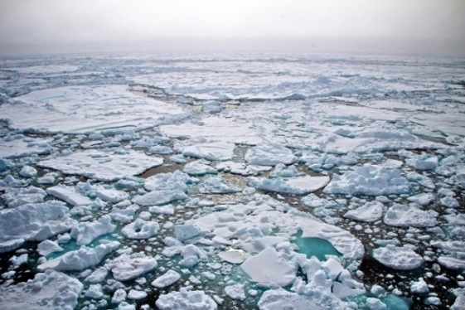
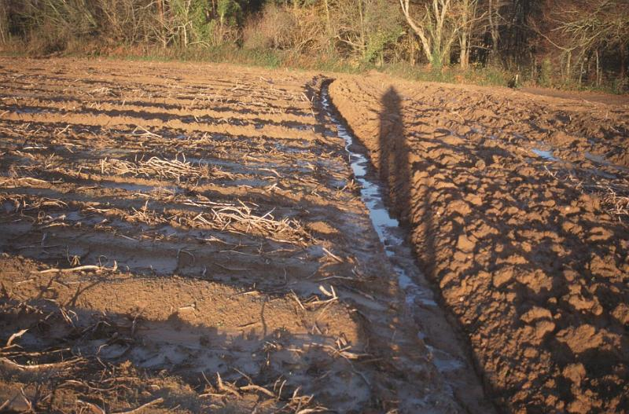
Initial conditions produced at BSC
ATM:
Interpolated to model grid with IFS + prepIFS
Now at BSC with OpenIFS + Autosubmit
Etienne Tourigny / Xavier Yepes
Initial Conditions
LAND:
Offline land-surface simulation with corrected fluxes from ERA-Interim
Emanuel Dutra / Etienne Tourigny
Atmosphere
reanalysis
(ERA 40 + Interim)
Land reanalysis
(ERA-Land)
Ocean reanalysis
(ORAS4)
Sea Ice
reanalysis
produced in-house
ocean
sea ice
soil moisture

Slide 11
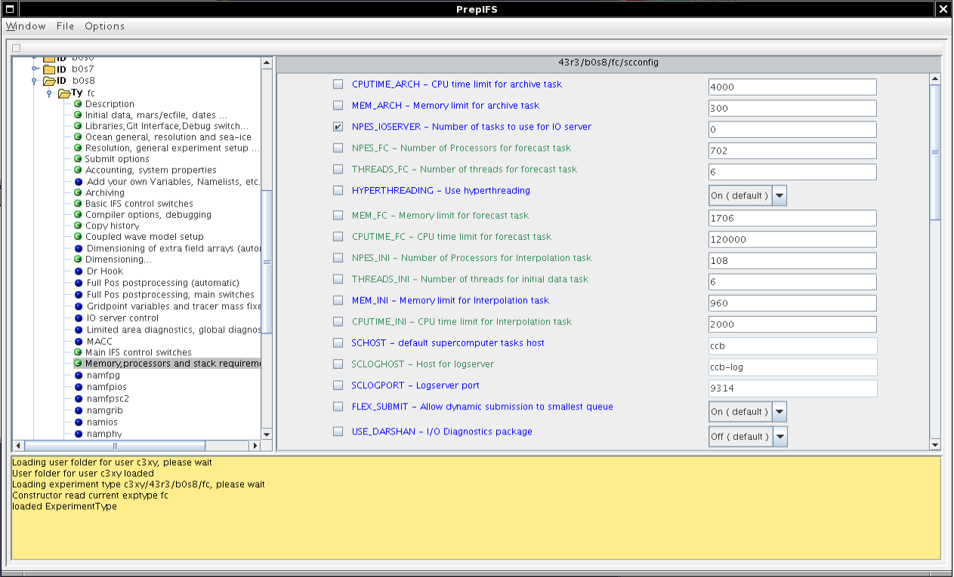
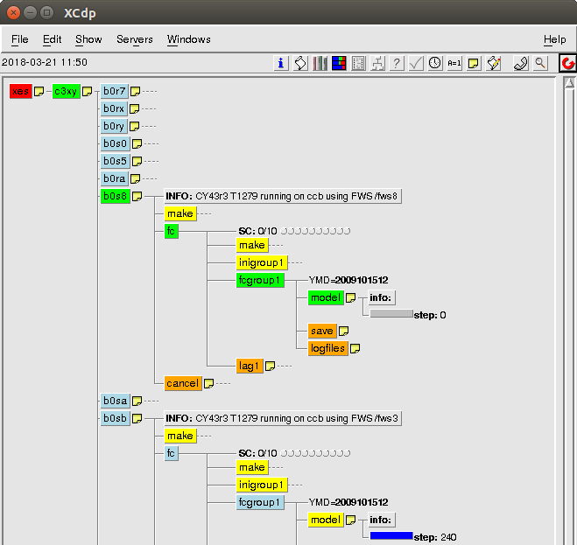
Current procedure
The current procedure to get initial conditions derived from ERA-Interim is using the ECMWF HPC infrastructure
It runs an IFS experiment created with the prepIFS tool and managed with the XCdp manager
These two softwares are ECMWF-dependent
experiment submission
prepIFS
XCdp

Slide 12
Current procedure
The three main steps are:
Download the reanalysis data at its native resolution using MARS requests
Reanalysis request
MARS
Reanalysis data

Slide 13
Current procedure
The three main steps are:
Download the reanalysis data at its native resolution using MARS requests
Running IFS in mode 927 to make use of FullPos, a powerful post-processing package that performs horizontal and vertical interpolations
Reanalysis request
Output grid resolution
MARS
IFS in mode 927
Reanalysis data

Slide 14
Current procedure
The three main steps are:
Download the reanalysis data at its native resolution using MARS requests
Running IFS in mode 927 to make use of FullPos, a powerful post-processing package that performs horizontal and vertical interpolations
Post-processing the result and archival on MARS
Reanalysis request
Output grid resolution
MARS
IFS in mode 927
Post-
process
MARS
Reanalysis data
Archival

Slide 15
New procedure
The current procedure is robust and relatively fast
However, there are two main drawbacks:
It relies on ECMWF infrastructure and support
It is vulnerable to changes in the HPC platform used
To overcome them, the original scripts have been simplified to run on other HPC platforms
The new framework is made of three scripts:
Get initial data
Initial data interpolation
Initial data post-processing

Slide 16
Get initial data
Retrieves reanalysis data from MARS at the native resolution:
Land surface and upper-air fields from ERA-Interim (T255L60), ERA5 (T639L137), etc
Optionally, surface fields from ERA-Land like experiments. Ongoing work to generate these surface fields with EC-Earth OSM.
Runs on ecgate with some MARS commands, for efficiency and ease of porting
Result can be automatically uploaded to a remote HPC machine (e.g. MareNostrum4 at BSC)

Slide 17
Get initial data
Retrieves reanalysis data from MARS at the native resolution:
Land surface and upper-air fields from ERA-Interim (T255L60), ERA5 (T639L137), etc
Optionally, surface fields from ERA-Land like experiments. Ongoing work to generate these surface fields with EC-Earth OSM.
Runs on ecgate with some MARS commands, for efficiency and ease of porting
Result can be automatically uploaded to a remote HPC machine (e.g. MareNostrum4 at BSC)
However, it could be adapted to run on a remote HPC machine by using the CDS API instead of MARS client

Slide 18
Initial data interpolation
OpenIFS 40r1 can be deployed and set up on a remote HPC machine to run on mode 927 (e.g. MareNostrum4 at BSC):
mpirun -n $NPES ./master.exe -v ecmwf -e $EXPVER \
-t1. -ft0 -aeul 2>stderr.lst >stdo.lst
Mode 927 uses FullPos to interpolate input GRIB files to a given output resolution
It is necessary to adjust the OpenMP stack size from 128M to 512M
Several output resolutions have been successfully tested, such as T255, T511 and T1279

Slide 19
Initial data post-processing
Performs post-processing such as:
Re-ordering the fields of the output GRIB files (replacing MARS get/put commands of the previous procedure)
Replace some land fields from the ERA-Land data
Perturb the 3D temperature field using Python (grib_api + random) for generation of additional members (used for seasonal prediction)
Runs on a remote HPC machine (e.g. MareNostrum4 at BSC)
Initial conditions data is ready to be used for IFS/OpenIFS
Packaged in a .tar file compatible with the Autosubmit workflow manager for initializing EC-Earth historical/seasonal prediction experiments

Slide 20
Automation with Autosubmit
Autosubmit is a python-based tool to create, manage and monitor experiments by using computing clusters, HPCs and supercomputers remotely via ssh
It is an open source software developed by BSC and publicly available on the PyPI repository
The three previous scripts are automated with Autosubmit to:
Minimize user intervention
Minimize errors
Optimize some processes

Slide 21
Automation with Autosubmit

Slide 22
Results
Initial conditions were created using ERA-Interim:
For years 1979-2018 (last year available)
Start of each calendar year (Jan 1st)
Each seasonal prediction start date (Feb 1st / May 1st / Aug 1st / Nov 1st)
At T255 resolution (a1tz) and T511 resolution (a1uc)
ERA-Land conditions from existing experiments (gbg4, gbg6)

Slide 23
Results
Performance:
Bottleneck in the get_inidata: can take from 5 minutes to one hour per start date, depending on MARS status, 24h sufficient to download entire ERA-Interim period with 5 dates/year
Interpolation and post-processing take each < 1 minute per start date
Using the Autosubmit workflow manager allows to do tasks in parallel: the interpolation and post-processing are done as soon as data is available for each start date
Queuing times on MN4 much longer than computation times
Improvements can be done by grouping several interpolation/post-processing tasks in one scheduler task

Slide 24
Results
Validation:
Results were compared to ICs from those generated using prepIFS (b0q0, b0q2): very few differences were found
Differences in climatology between 2 sets of ICs:
GG SFC fields: 100% identical
GG ML fields: differences < 1% in scarce grid points for cc and clwc
SH lnsp systematic differences < 0.00013243% , due to minor differences in orography
SH ML: {t, vo, d} small differences in scarce grid points, much smaller than observational errors, probably due to differences in compilers
A seasonal prediction hindcast was done for all start years (1979-2018), and 4 start dates:
No instabilities were found
Results statistically similar to those initialized with ICs from prepIFS

Slide 25
Conclusions
In the EC-Earth community there is a need to generate initial conditions to run climate prediction experiments
The current procedure is not manageable for large periods and relies on ECMWF infrastructure
To overcome these shortcomings, a framework to generate initial conditions for IFS/OpenIFS has been implemented being:
Portable across other HPC platforms rather than ECMWF
Easy to use
Uses OpenIFS to interpolate reanalysis data
Interpolations are fast, including configuration T1279L137
Results have almost no differences between the two procedures
Everything is automated with Autosubmit

Slide 26
Thank you
xavier.yepes@bsc.es

