Slide 1
S2S4E Energy Day - Webinar #1 Visual communication of forecasts for renewable energy
Isadora Ch. Jiménez, BSC

Slide 2
@S2S4E

Slide 3
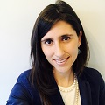
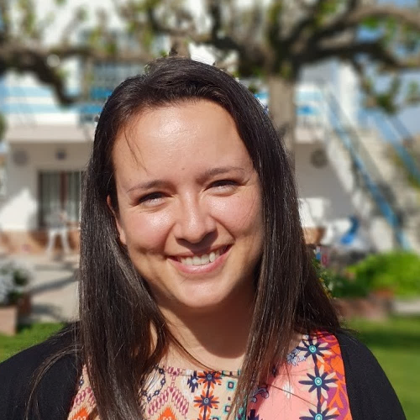
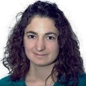
Ilaria Vigo
Moderator, BSC
Isadora Jiménez
Head of Knowledge Transfer team, BSC
@isadorachristel
Andrea Manrique
Climate scientist, BSC
@S2S4E

Slide 4
Weather Forecast
Climate Predictions
Multidecadal and Projections
Present-15d
10 d-1 month
1 month–7 month
2-30 years
20-100 years
●
●
●
●
●
S2S4E project
Next 4 weeks
Next 3 months

Slide 5
UNCERTAINTY
Notes:
Hope you all agree with me, but the challenges can be summarised in just one word, uncertainty. But what each of us understands by uncertainty is very relative.

Slide 6
Uncertainty
means lack of precision or that the exact value for a given time is not predictable, but it does not usually imply lack of knowledge. Often, the future state of a process may not be predictable, such as a roll with dice, but the probability of finding it in a certain state may be well known (the probability of rolling a six is 1/6, and flipping tails with a coin is 1/2). In climate science, the dice may be loaded, and we may refer to uncertainties even with perfect knowledge of the odds. Uncertainties can be modelled statistically in terms of pdfs, extreme value theory and stochastic time series models.
CLIMATE SCIENTISTS
Notes:
EUPORIAS project did a nice glossary to explain different terms in climate services. This is the best definition they reach, and I am sure it was not easy to get everybody happy about it. But if it was really a glossary for externals, why so many explanations and justifications?
And there is plenty more about uncertainties, we can then move into RELIABILITY definition, different types of uncertainties of the model, on the initial conditions, of the…

Slide 7
Uncertainty
Uncertainty is a situation which involves imperfect or unknown information. It applies to predictions of future events, to physical measurements that are already made, or to the unknown. Uncertainty arises in partially observable and/or stochastic environments, as well as due to ignorance, indolence, or both.
USERS

Slide 8
Reliable
is a charactheristic of a forecast system for which the probabilities issued for a specific event vary a proportion of times equal to the climatological frequency of the event. A reliable system which predicts, for example 50% (or 20%, or 73%) probability of rain, should, on averge, be correct 50% (or 20%, or 73%) of the times, no more, no less.
CLIMATE SCIENTISTS
Notes:
EUPORIAS project did a nice glossary to explain different terms in climate services. This is the best definition they reach, and I am sure it was not easy to get everybody happy about it. But if it was really a glossary for externals, why so many explanations and justifications?
And there is plenty more about uncertainties, we can then move into RELIABILITY definition, different types of uncertainties of the model, on the initial conditions, of the…

Slide 9
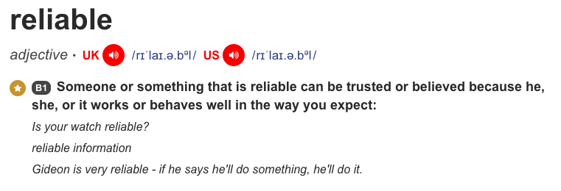
USERS
Notes:
If you analyse it with time and patience, both definitions convey similar message, one in the language of scientist and the other in the language of the rest of the people. Scientists’ definition is about exact, correct and numerical definition. But users are the rest. And they have this in their mental schemes.
And Reliable is about trust and uncertain is about imperfect or unknown information and therefore, not trusting.

Slide 10
Building TRUST
The challenge is…
Notes:
So to reword a bit the challenge. The problem is uncertainty and the solution is building trust.

Slide 11
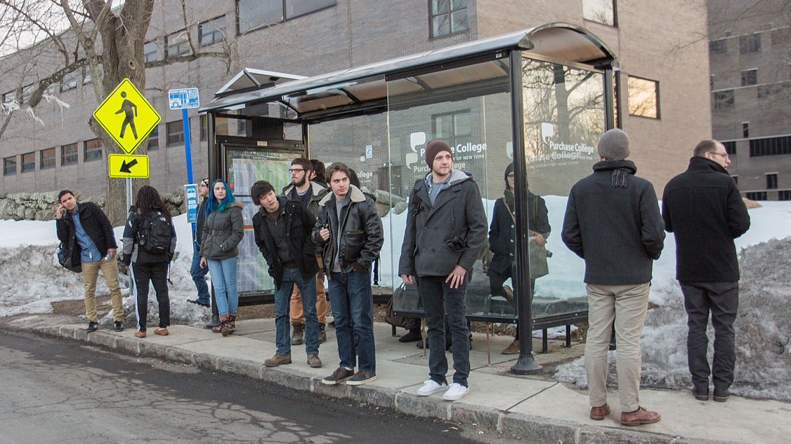
Users ≠ Decision makers
Notes:
Even more importantly. When we call them USERS there is an automatic idea in our minds. They are people expecting our results ready to use them. But they are not just users. They are decision makers. Which means thet they have to handle with many other sources of information that need to be taken into account. And some of those sources of concern are even
ISNOT OUR USER IS A DECISIONMAKER AND USES LOTS OF OTHER INFO.

Slide 12
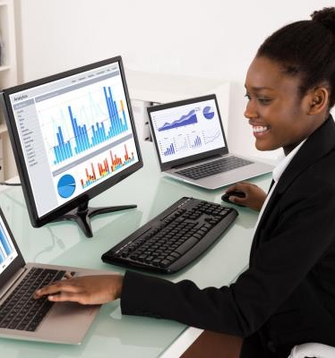
Typology of
decisión makers

Slide 13
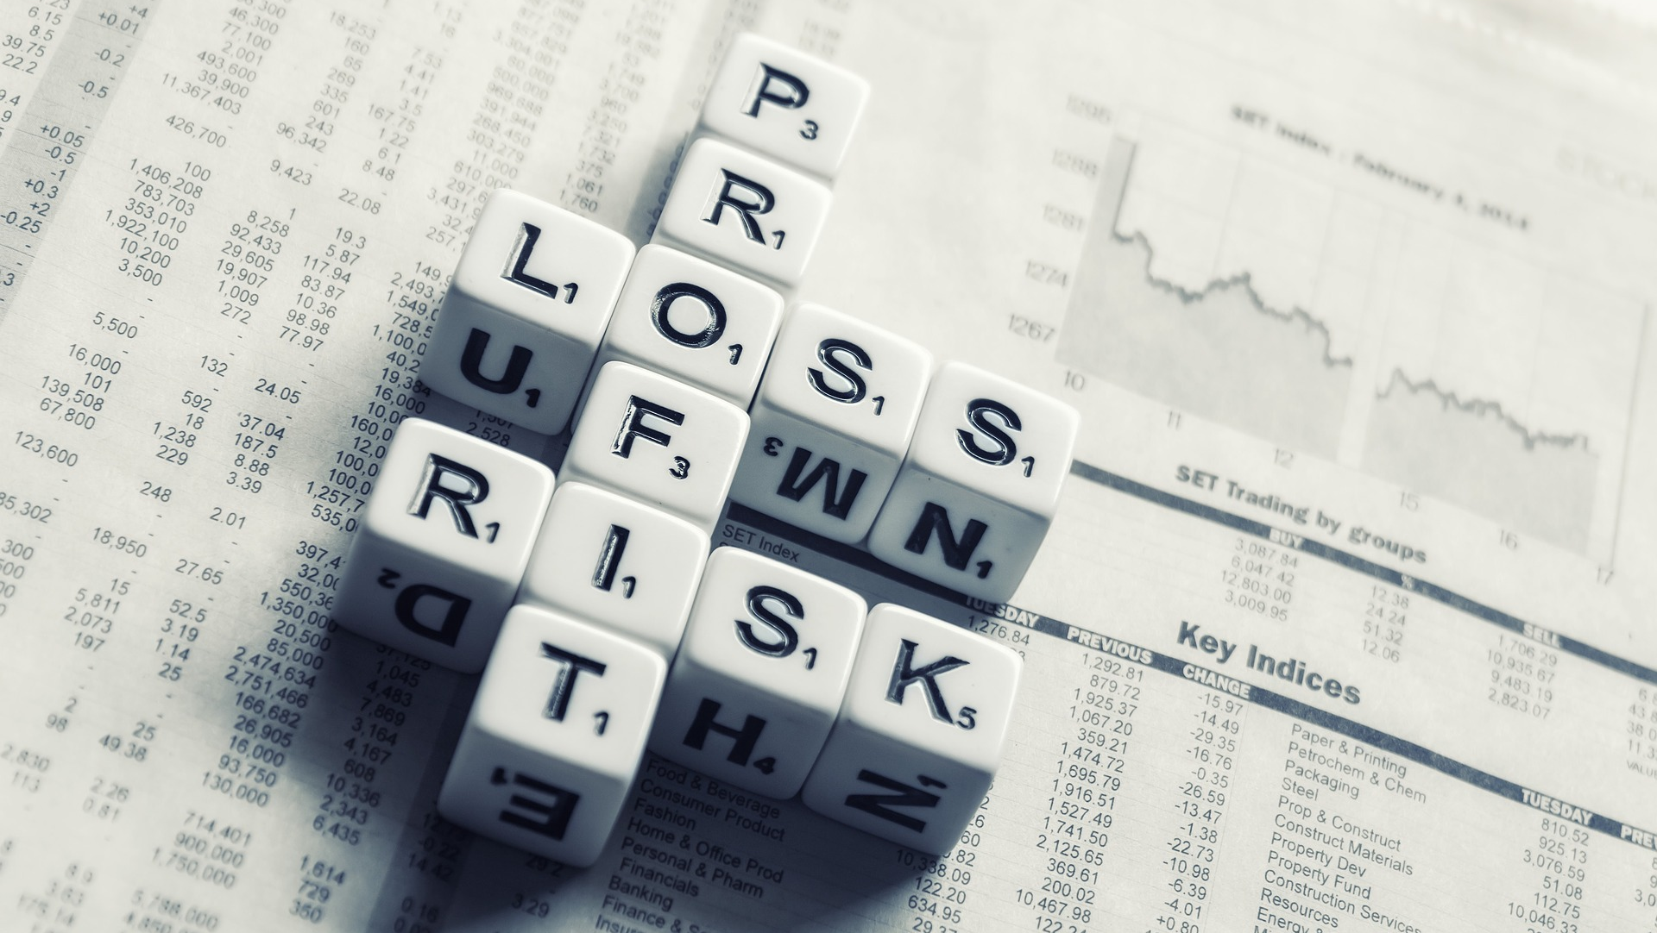
Understand motivations

Slide 14
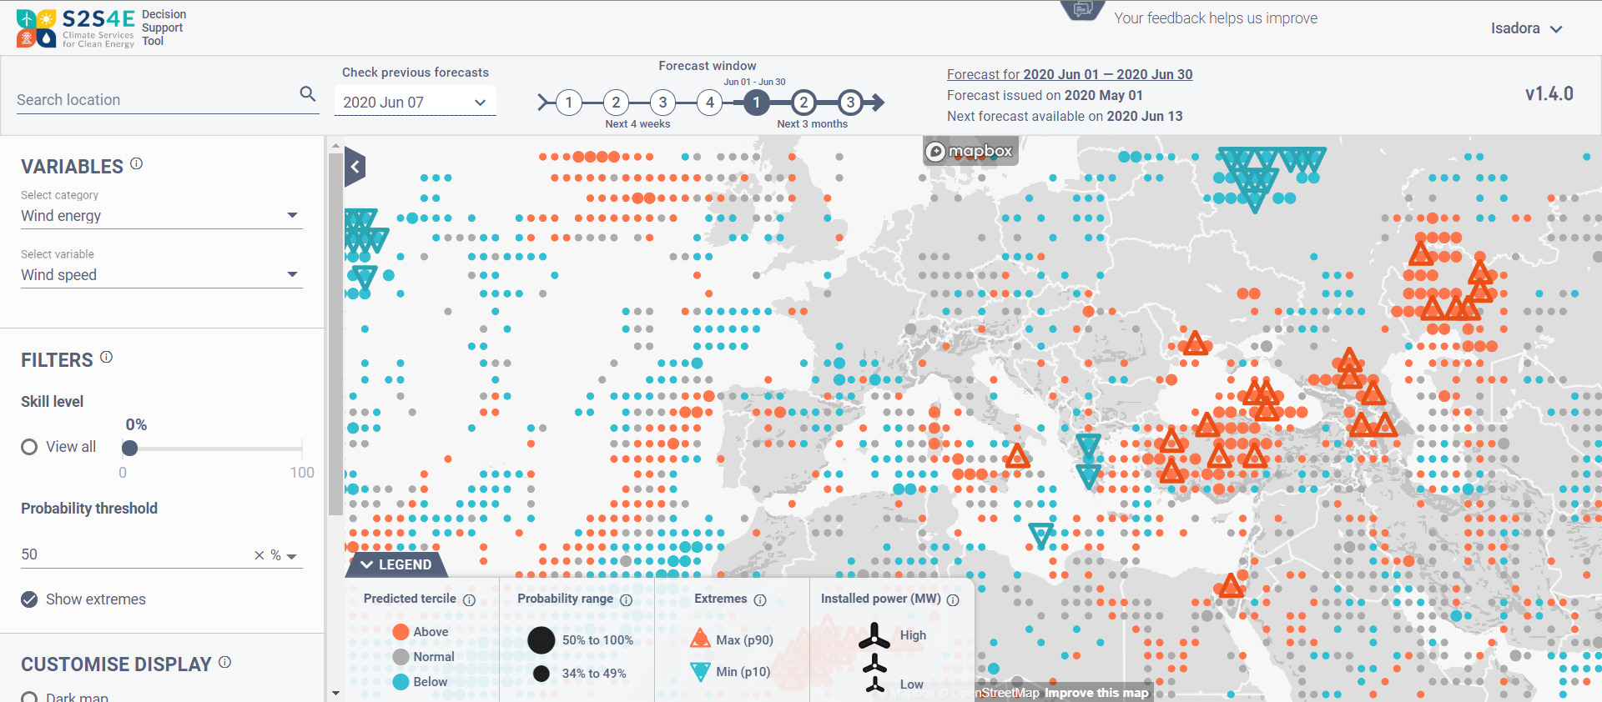
www.s2s4e.eu/dst
user
Notes:
So to reword a bit the challenge. The problem is uncertainty and the solution is building trust.

Slide 15
1 “Seamless” timescales 2 WHICH forecast should I use? 3 WHEN should I use these forecats? 4 Can I TRUST these forecasts? 5 From simple to advanced
Visualising the forecasts
Notes:
So to reword a bit the challenge. The problem is uncertainty and the solution is building trust.

Slide 16
1 “Seamless” timescales 2 WHICH forecast should I use? 3 WHEN should I use these forecats? 4 Can I TRUST these forecasts? 5 From simple to advanced
Visualising the forecasts
Notes:
So to reword a bit the challenge. The problem is uncertainty and the solution is building trust.

Slide 17
1 “Seamless” timescales 2 WHICH forecast should I use? 3 WHEN should I use the forecats 4 Can I TRUST these forecasts? 5 From simple to advanced
Visualising the forecasts
Notes:
So to reword a bit the challenge. The problem is uncertainty and the solution is building trust.

Slide 18
1 “Seamless” timescales 2 WHICH forecast should I use? 3 WHEN should I use the forecats 4 Can I TRUST these forecasts? 5 From simple to advanced
Visualising the forecasts
Notes:
So to reword a bit the challenge. The problem is uncertainty and the solution is building trust.

Slide 19
1 “Seamless” timescales 2 WHICH forecast should I use? 3 WHEN should I use the forecats 4 Can I TRUST these forecasts? 5 From simple to advanced
Visualising the forecasts
Notes:
So to reword a bit the challenge. The problem is uncertainty and the solution is building trust.

Slide 20
And a final remark
… visualisation tools are only a part of the climate service
Notes:
So to reword a bit the challenge. The problem is uncertainty and the solution is building trust.

Slide 21
Additional resources...
Webinar series – direct access to experts and later recordings
https://s2s4e.eu/climate-services/webinar-series
Monthly outlooks with sub-seasonal and seasonal forecasts
https://s2s4e.eu/climate-services/outlooks
Case studies for relevant events in the past
https://s2s4e.eu/climate-services/case-studies
Technical reports, publications, methods, R-package
https://s2s4e.eu/climate-services/public-deliverables

Slide 22
Thank you
Get in touch for more information!
Isadora.jimenez@bsc.es
@isadorachristel
Follow us on LinkedIn, Twitter and Facebook!
@s2s4e
This project has received funding from the Horizon 2020 programme under grant agreement n°776787.
The content of this presentation reflects only the author’s view. The European Commission is not responsible for any use that may be made of the information it contains.

Slide 23
@S2S4E

Slide 24
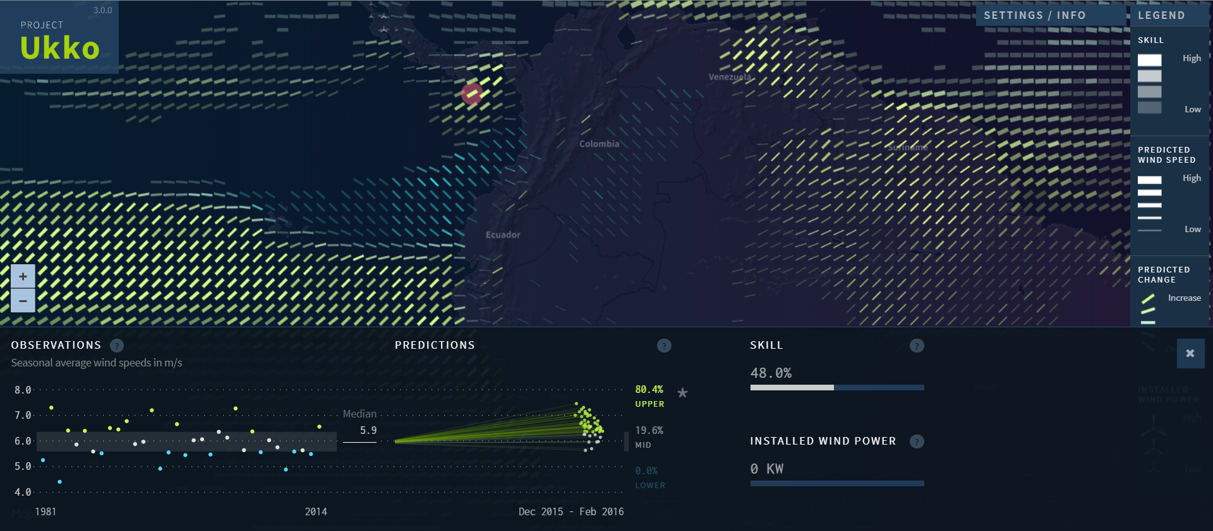
Semi-operational prototype (2015)
Low fidelity prototype
http://www.project-ukko.net/
http://www.project-ukko.net/
Low fidelity prototype
http://www.project-ukko.net/

