Slide 1
WP4: Wind Energy

Slide 2
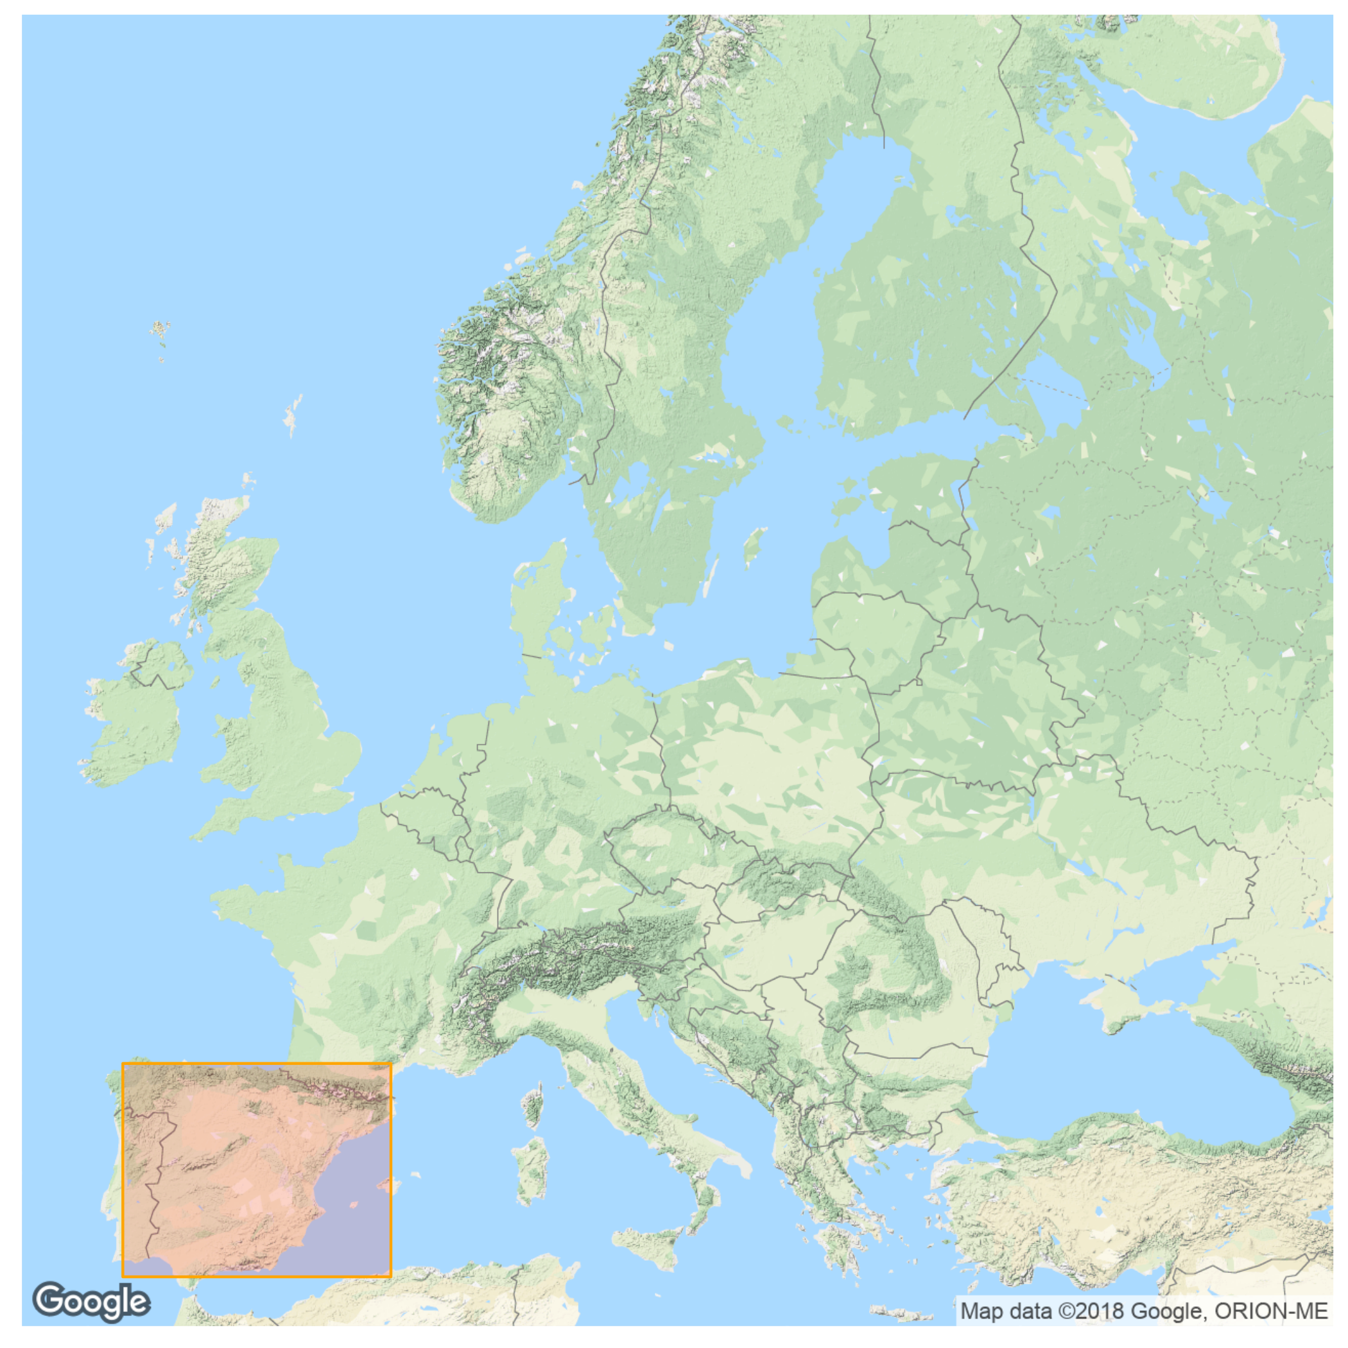
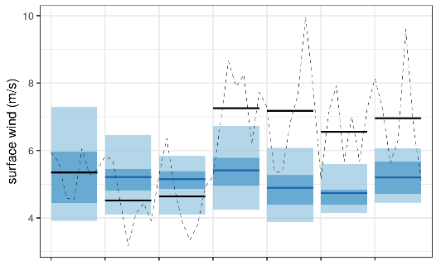
Case study – March 2018, Spain
Iberia, Mar 2018:
high winds, highest generation ever
USER interaction

Slide 3
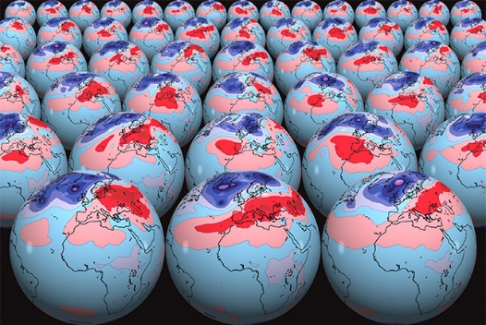
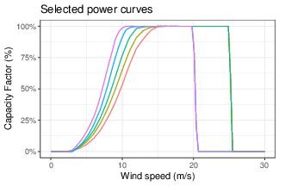
Wind capacity factor fcsts
Bias adjust methods
1. CSTools Calibration (adjusts mean, variance and reliability)
Torralba, et al. (2017): Seasonal Climate Prediction: A New Source of Information for the Management of Wind Energy Resources https://doi.org/10.1175/JAMC-D-16-0204.1
SEAS5 sfcWind
2. Empirical Quantile Mapping
(adjusts distribution shape)
Reanalysis (ERA-I)
Adjusted hindcast
Lledó et al. (2019): Seasonal forecasts of wind power generation
https://doi.org/10.1016/j.renene.2019.04.135
IMPACT MODEL capacity factor
CF fcsts

Slide 4
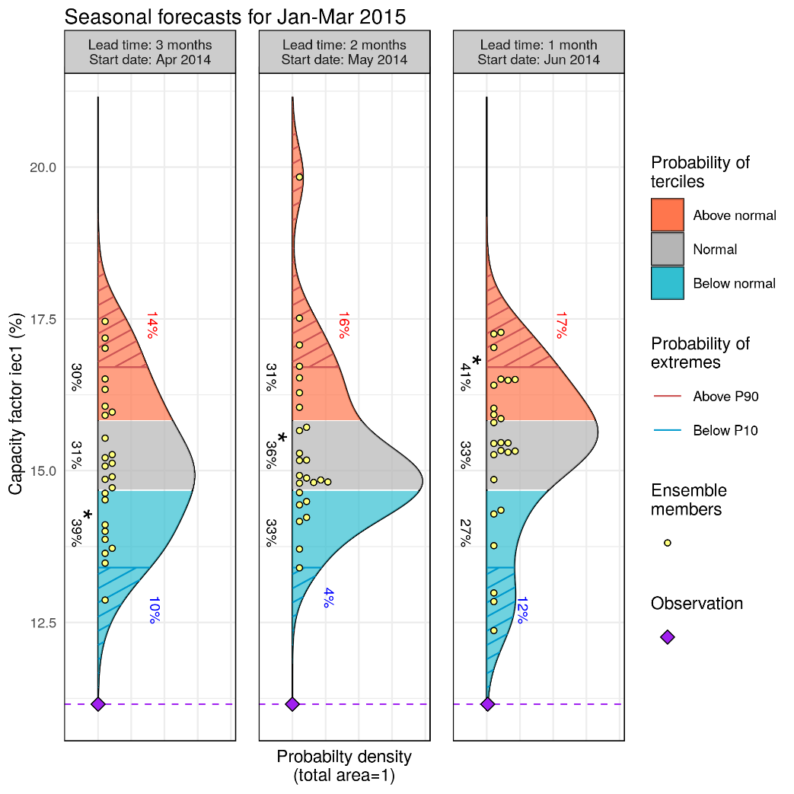
Visualization of products
CSTools - plotForecastPDF
Three forecasts with
different lead time
Extremes:
prob. above P90
Tercile probabilities
and Most Likely Tercile
Ensemble members
PDF from ensemble dressing
Observed value

Slide 5
Verification of products
PROBABILISTIC
DETERMINISTIC
Tercile probabilities:
Ranked Prob. Skill Score [RPSS]
Ensemble mean:
Correlation
Probabilities of exceedance:
(above P90 or below P10)
Brier Skill Score [BSS]
Skill in predicting PDF: Continuous Ranked Prob. Skill Score [CRPSS]

