Slide 1
EQC Status Overview
Francisco Doblas-Reyes^{1,2}
1 Barcelona Supercomputing Center (BSC)
2 Institució Catalana de Recerca i Estudis Avançats (ICREA)

Slide 2
EQC: Engaged and future activities
Quality assurance for seasonal forecasts
Action engaged
In preparation
(PIN or ITT out)
Quality assurance framework for earth observations
CDS
Not started
Quality assurance for climate projections
EQC
Quality assessment of ECV products and reanalyses
Sectoral gap analysis and user requirements
Ensures C3S is state-of-the-art
Identifies gaps in the Service
Bridges Copernicus with Research Agenda in Europe (e.g. H2020, national research projects)
Monitors continually, quality of C3S products and services
“Quality Assurance” body
Contributes and develops URDB/SES/etc documents
SIS
EQC of operational SIS
J.N. Thépaut (ECMWF)

Slide 3
Challenges of the EQCs
Address adaptation: it must provide information for all kind of services including adaptation, taking advantage that many users are already familiar with the climate-change problem.
Provide consistency: it must build trust, ensuring a high degree of coherence across products, underlying data sets, processing methods, communication, etc.
Provide innovation: it should make recent developments from research operational to answer real-world issues.
Address efficiency: the EQC information should be timely, e.g. respond to users’ queries with a delay as short as possible, which imposes conditions on the algorithms considered.
Define the target: data, products, communication, etc.

Slide 4
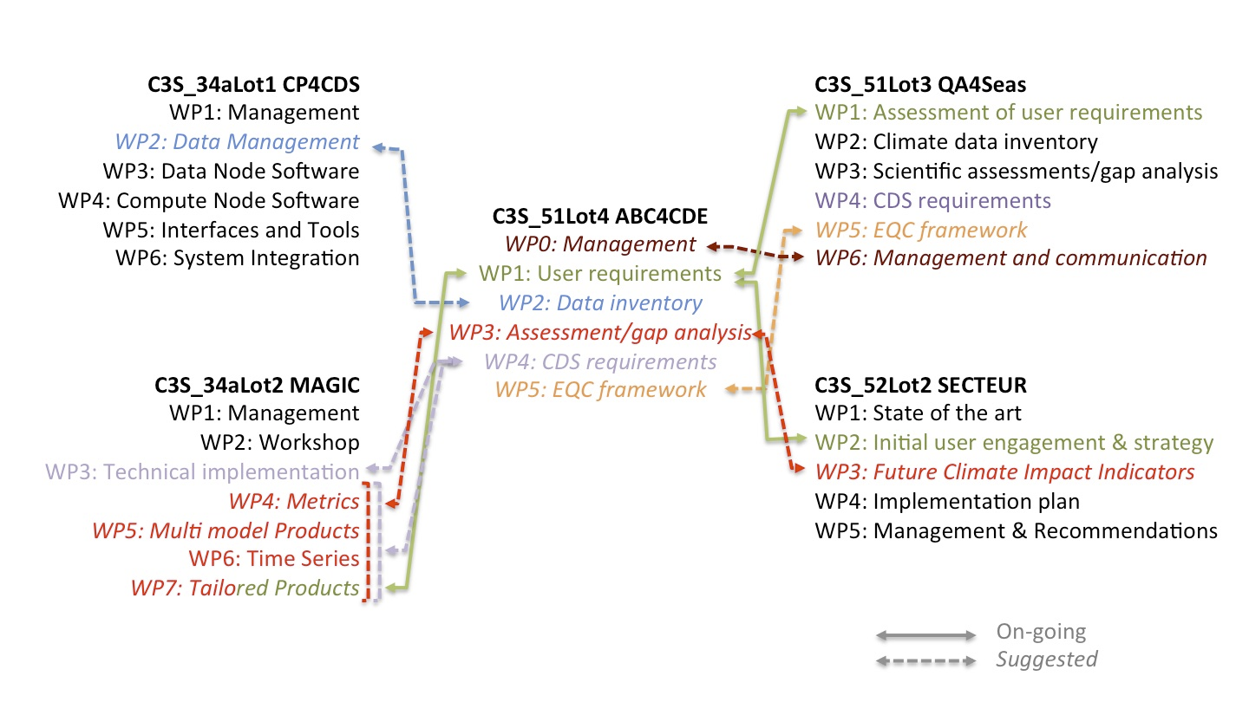
Framework for collaboration
C3S EQC Workshop 12-14 June 2017
H. Gregow (FMI)

Slide 5
What is EQC information?
Some examples:
Observations are expected to provide accuracy estimates.
Reanalyses should come along with a validation against independent observations.
Forecasts have no real value without an estimate of quality based on past performance.
Projections require a scientific validation of the models used (e.g. IPCC WGI Ch. 9).
But quality information is much more complex than this.

Slide 6
Collaboration between EQCs
User engagement and assessment of needs
EQC for seasonal
User Requirement Data Base
Share contacts from EQC SIS survey participants with an interest in seasonal, projections and observations
Share survey protocol
Share survey info on use of projections
Contacts from survey participants with an interest in projections/ observations
Sharing survey questions
EQC for SIS
EQC for projections
Further collaboration opportunities will be exploited as contracts develop further
EQC for observations
M. Soares (Univ. Leeds)

Slide 7
Users’ requests
Results from a survey where 42 out of 53 respondents receive seasonal forecast information, with a large majority of NMHSs.
Note that these are far from solved issues
M. Soares, A. Taylor (Univ. Leeds)

Slide 8
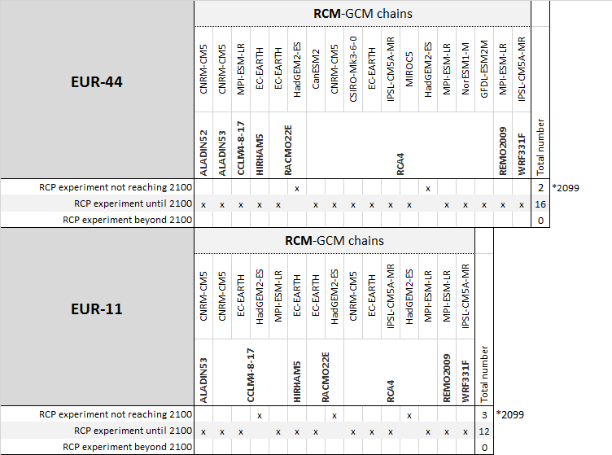
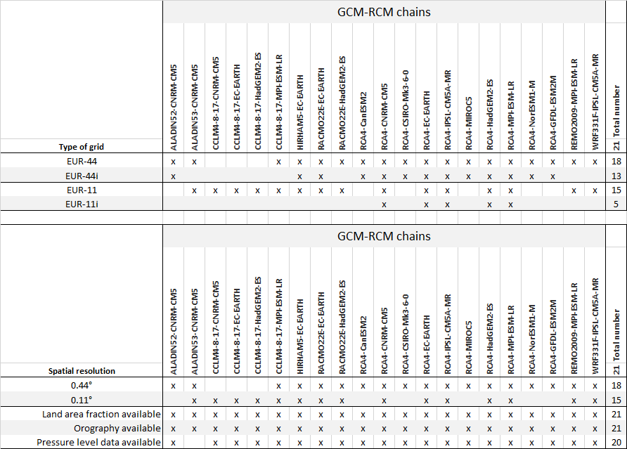
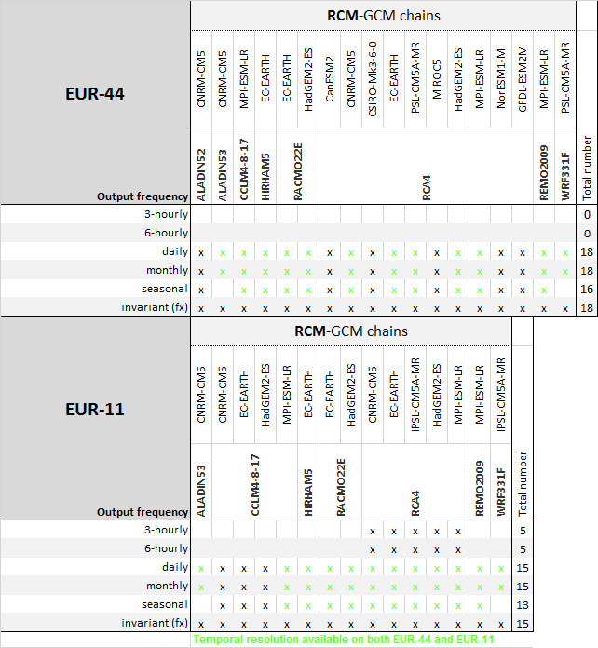
Data inventories
Evaluation matrices for the different aspects
Multiplied criteria:
resolution, data frequency, available variables and scenarios
Narrow ensemble
Proposal to CDS

Slide 9
Scientific assessment and gap analysis
Once the data are identified and available, a critical question is which of the available data will be used as the data use will depend on, among other things, the quality information.
C3S51_Lot4 considers two criteria:
Inadequate sources for the user’s application should be omitted (e.g. discard “bad” models).
The sources retained should be diverse enough to still adequately represent all uncertainties (e.g. has the solution enough spread?)
What does “bad” mean?

Slide 10
Scientific assessment and gap analysis
Definitions are important:
Diagnostics can be derived from any geophysical data set, independently of any reference (e.g. Arctic sea-ice area).
Metrics reflect the agreement of a diagnostic from a system with respect to the same diagnostic computed from a reference.
Performance: RMSE of Arctic sea-ice area in a historical run.
Predictability: spread of Arctic sea-ice area in a multi-model.
Forecast quality: explained variance of Arctic sea-ice area.
Process-based: heat budget analysis of Arctic sea ice.
A constraint is a metric applied to an ensemble of simulations displaying relationships between two diagnostics, one of which can be observed.
Diagnosis is an integrated statement for an EQC purpose. It involves the use of diagnostics and different metrics, together with prior knowledge about the system itself and its underlying physics.
The CRISTO framework for evaluation might help: completeness, rationale, interpretability, stability, transparency, observability.
F. Massonnet (UCL)

Slide 11
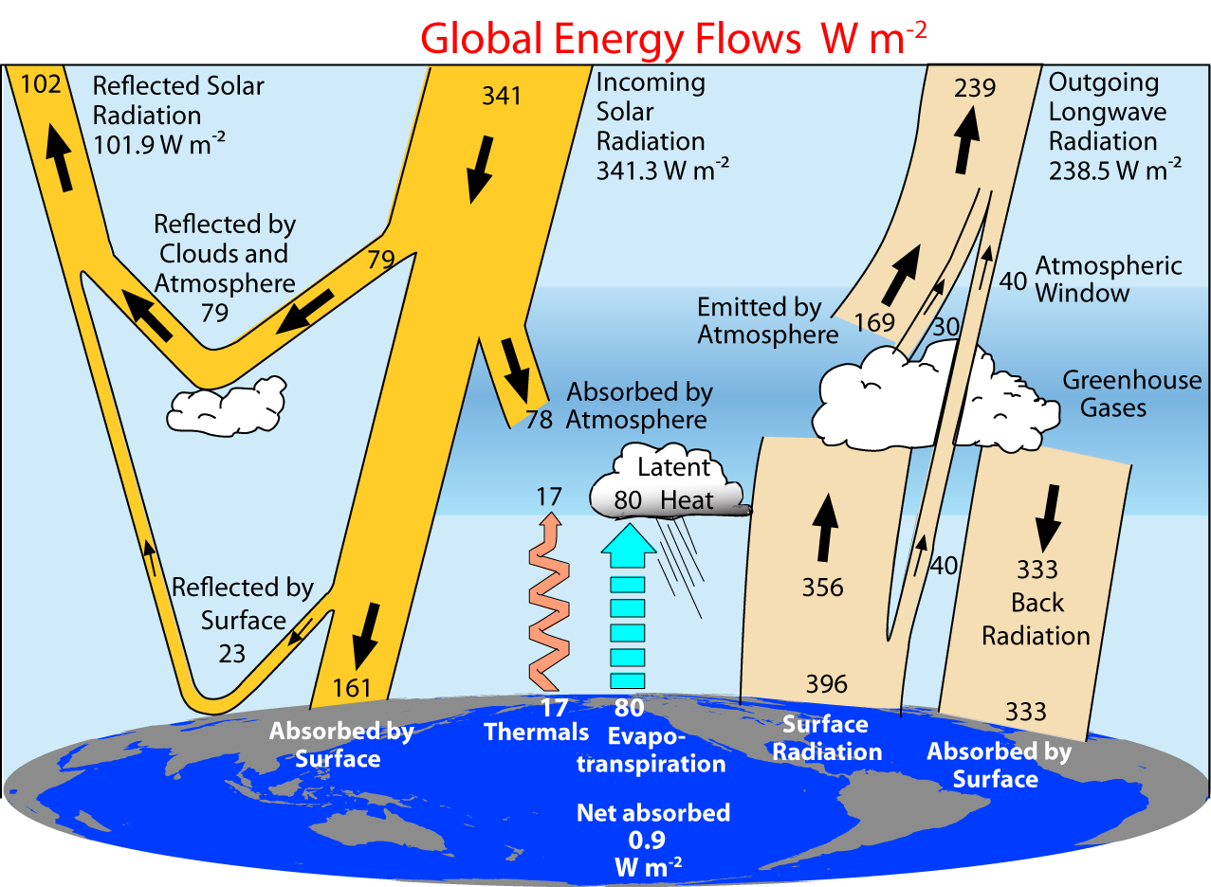
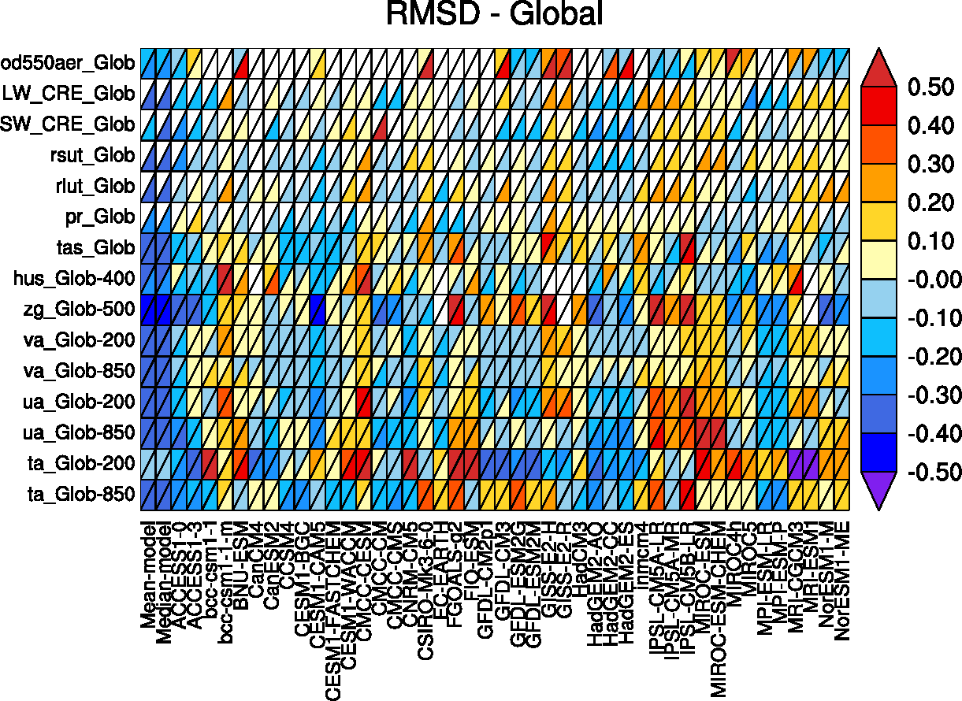
Scientific assessment and gap analysis
Diagnostics and metrics for climate projections: ESMValTool, CVDP (NCAR), AutoAssess (Met Office), s2dv (BSC), Freva (FUB), PMP (PCMDI).

Slide 12
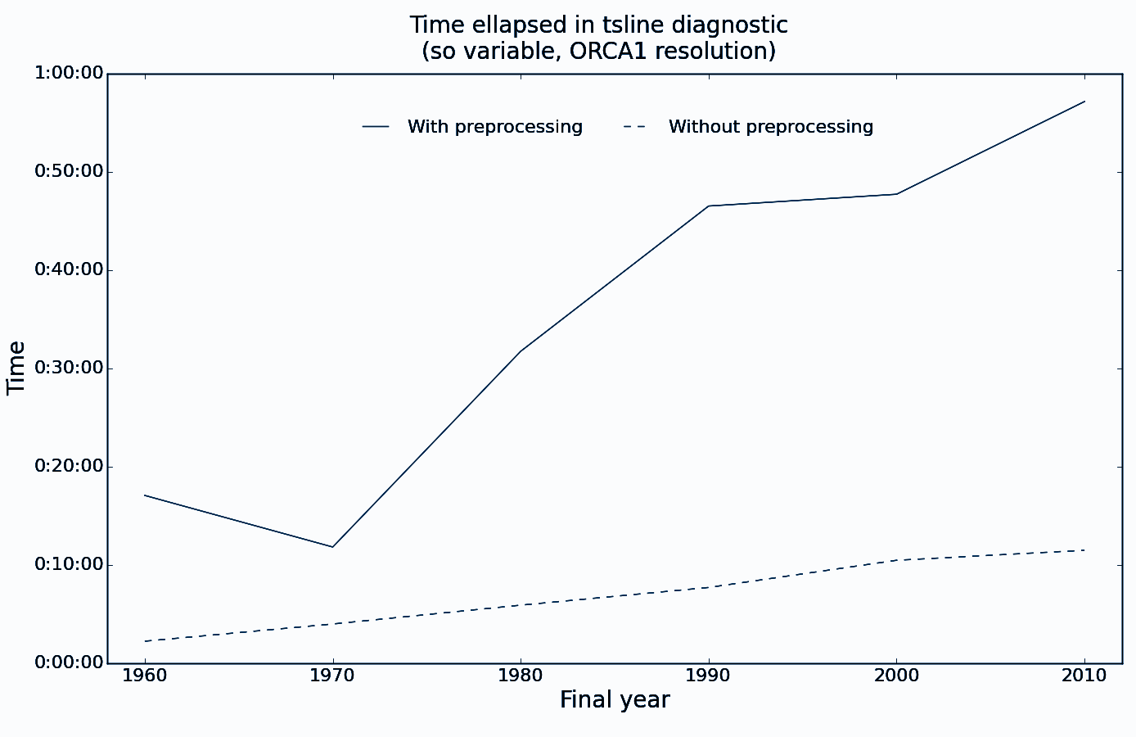
Scientific assessment and gap analysis
The example of ESMValTool:
Recoding all the diagnostics and metrics that it contains is prohibitive and prone to errors. Benefit from the community.
A rewrite of the backend is taking place as we speak: migration to python, communication in-memory, common pre-processing, parallelisation, etc.
Data provenance to be moved from
being stored in the output file plus
a logfile to full provenance approach.
But waiting for C3S to define
requirements !!
J. Vegas (BSC)

Slide 13
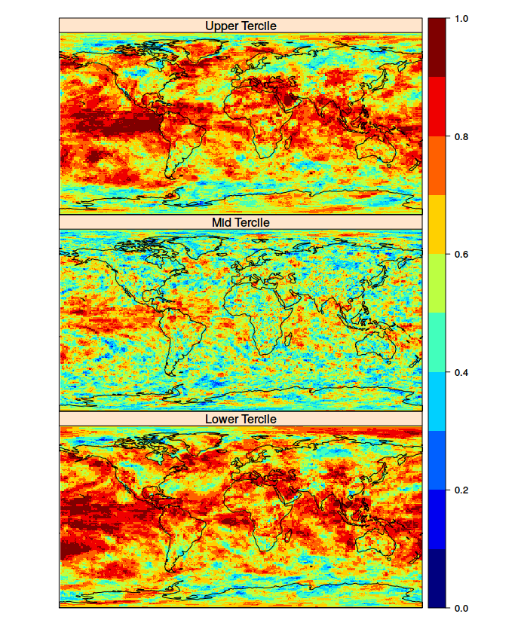
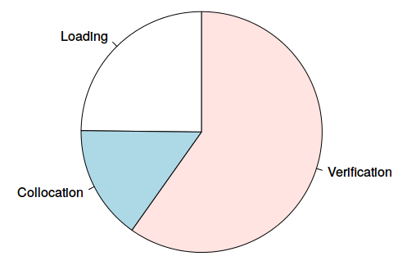
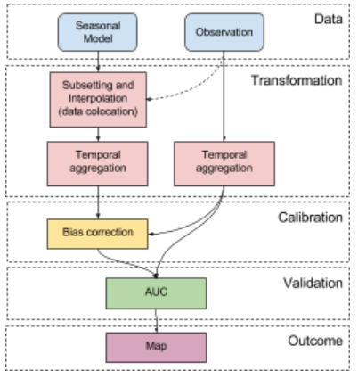
Scientific assessment and gap analysis
More on performance: example of multi-model seasonal verification, with performance analysis of a ROC area estimate using loadeR, SpecsVerification and easyVerification
J. Bedia (Predictia)

Slide 14
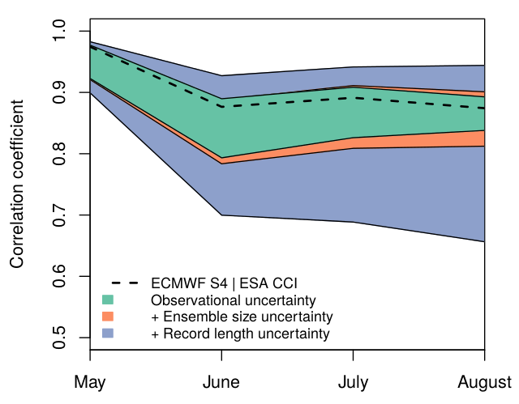
Scientific assessment and gap analysis
Making the most of C3S: bringing in observational and reference uncertainty in the EQC process.
Niño 3.4 SST correlation of the ensemble mean for EC-Earth3.1 (T511/ORCA025) predictions with ERAInt and GLORYS2v1 ics, and BSC sea-ice reconstruction started every May over 1993-2009
O. Bellprat (BSC)

Slide 15
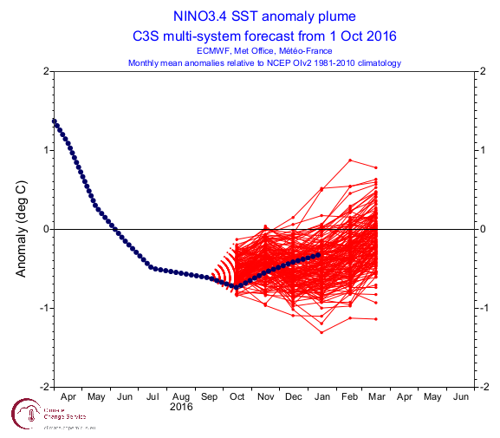
CDS requirements and EQC framework
How to identify data/products to ensure a minimum quality?
Reproducibility: ability of an entire process to be duplicated.
Traceability: ability to verify the history, location, or application of an item by means of documented recorded identification.

Slide 16
CDS requirements and EQC framework
How to identify data/products to ensure a minimum quality?
Reproducibility: ability of an entire process to be duplicated.
Traceability: ability to verify the history, location, or application of an item by means of documented recorded identification.
Seasonal forecasts of wind speed

Slide 17
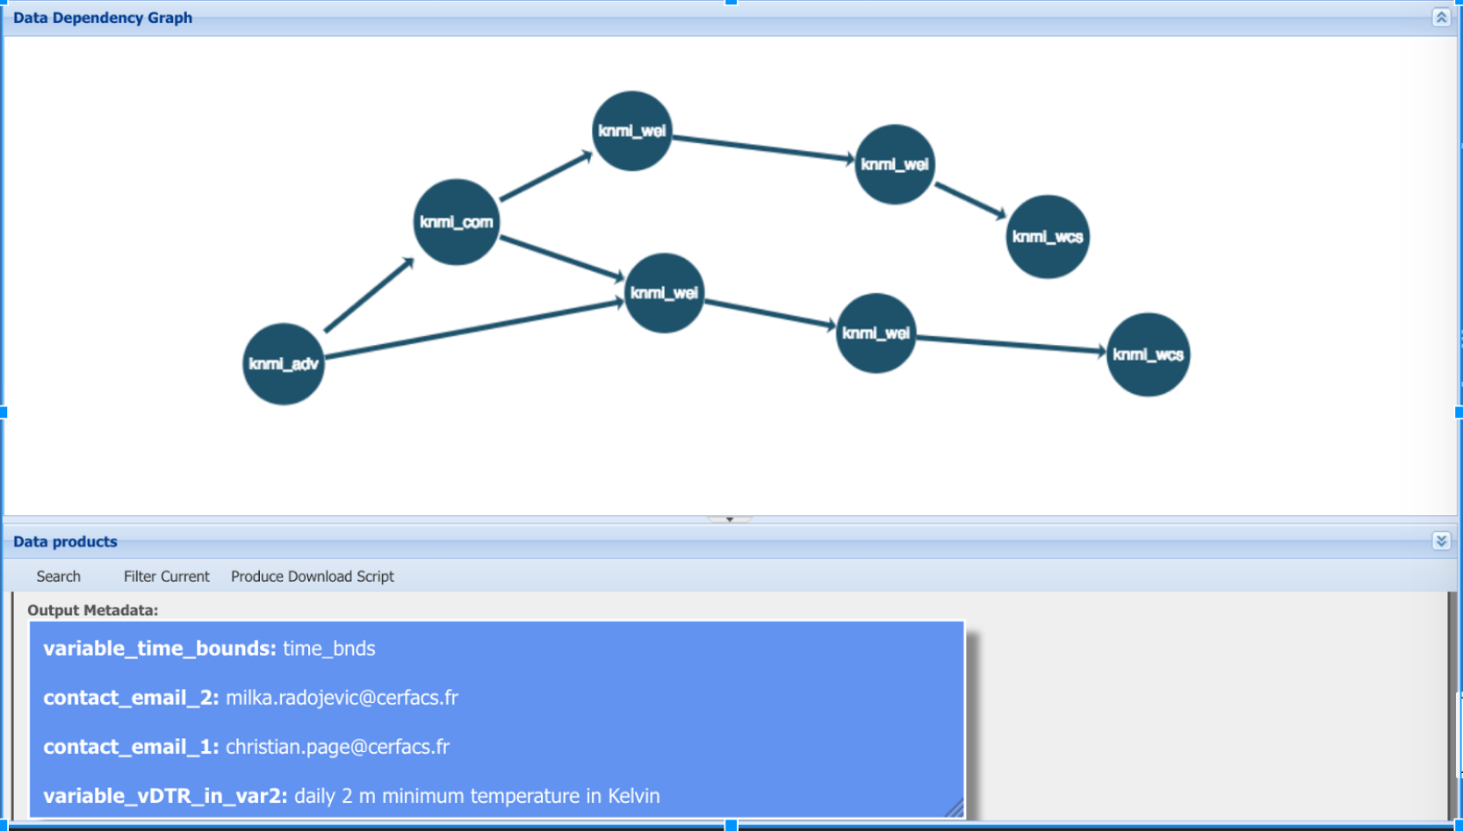
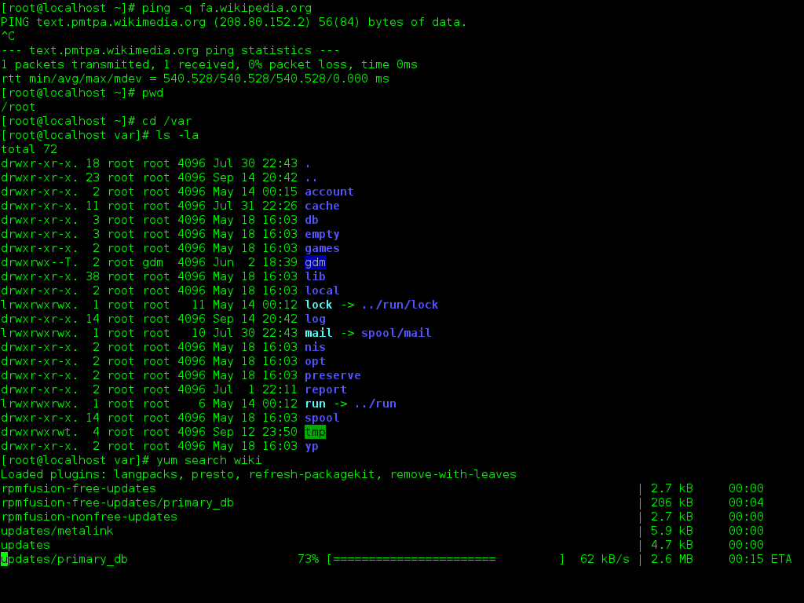
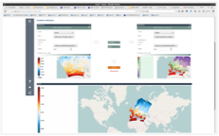
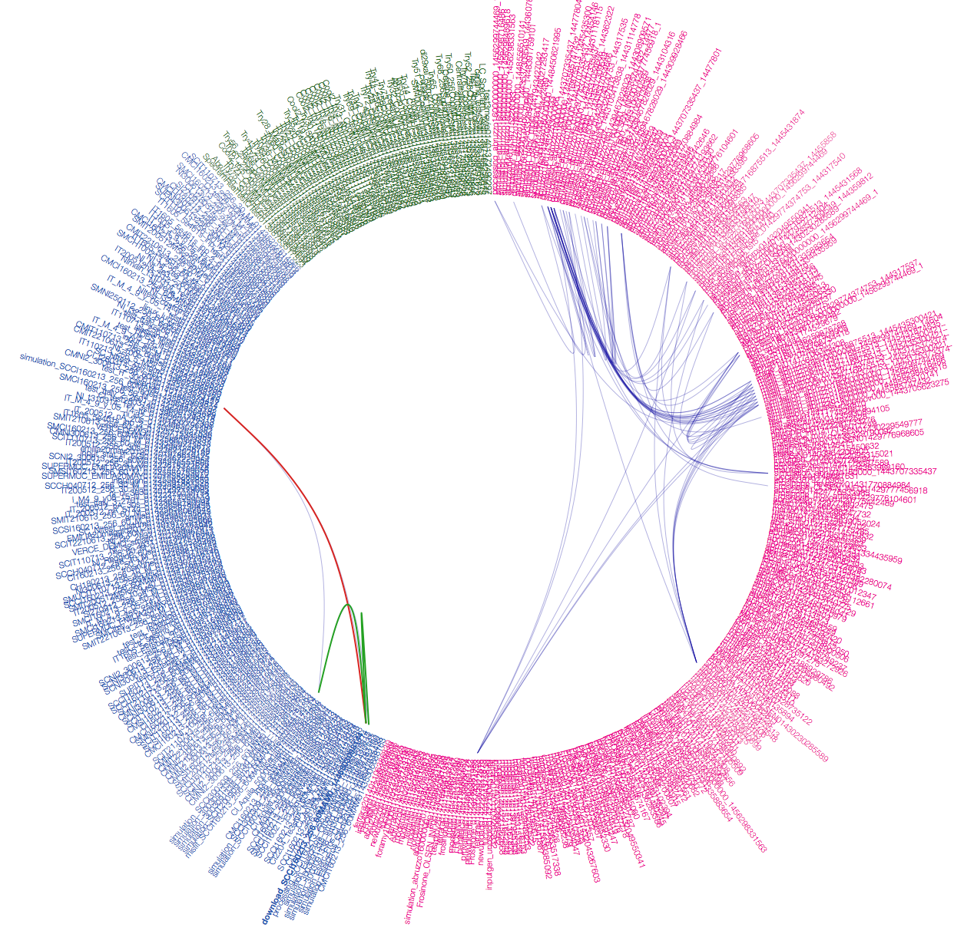
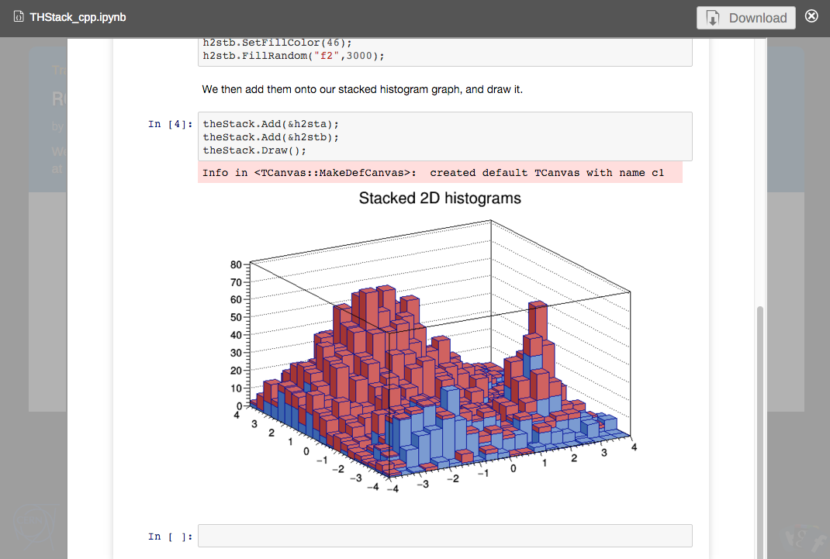
CDS requirements and EQC framework
How to identify data/products to ensure a minimum quality?
Generalised metadata and provenance information are key elements of all the components of the service.
Two approaches for product provenance are under discussion: S-PROV and Resource Description Framework (RDF). They are not mutually exclusive.
Validate
Analyse / Discover
Report / Outreach / Preserve
Procedures / Tools / Development
Repeat / Verify
A. Spinuso (KNMI)

Slide 18
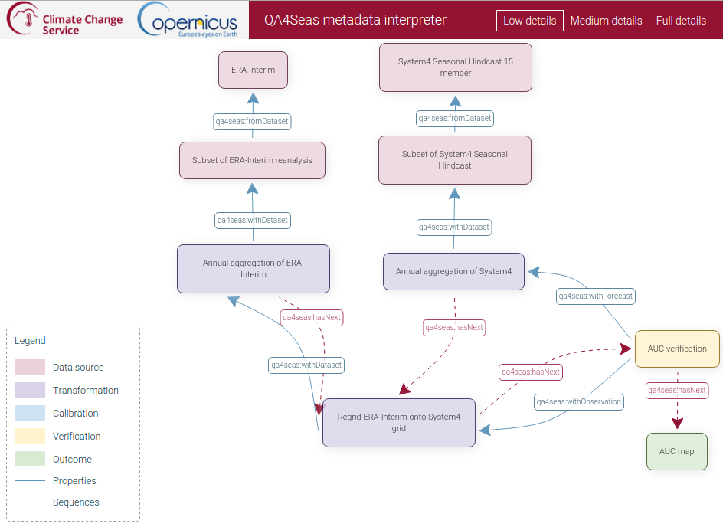
CDS requirements and EQC framework
How to identify data/products to ensure a minimum quality?
The RDF-based approach aims at the reproducibility of objects (NetCDF file, image) with human and machine-readable solution.
It uses a semantic metadata model that builds the vocabularies on existing initiatives (e.g. VALUE for downscaling).
D. San Martín (PREDICTIA)

Slide 19
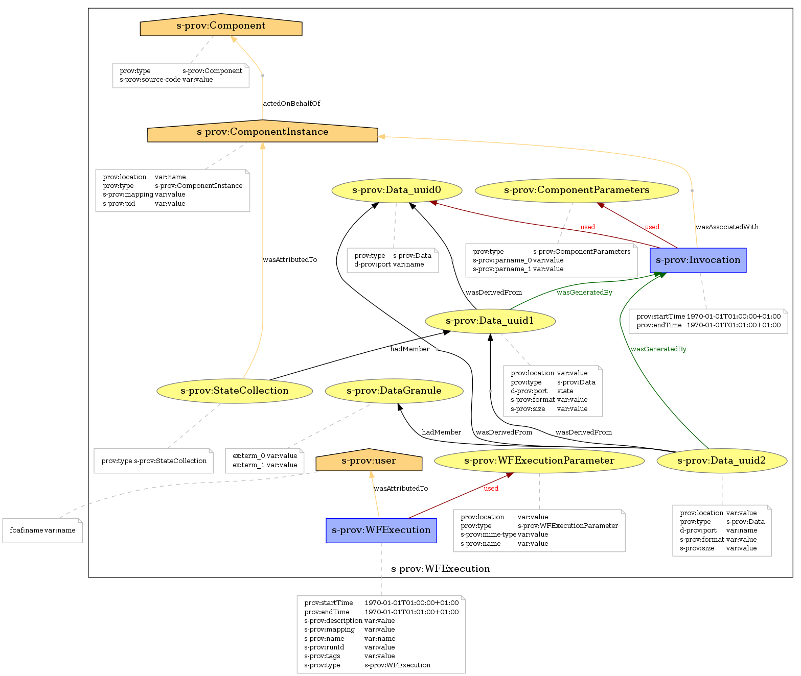
CDS requirements and EQC framework
How to identify data/products to ensure a minimum quality?
S-PROV represents the relationships occurring between the players of a data-intensive computation in a scientific domain.
Uses W3C PROV as data model and S-PROVFlow for reproducibility as a service.
A. Spinuso (KNMI)

Slide 20
CDS requirements and EQC framework
Provenance and metadata challenges:
Engage the (expert) users.
Define the level of granularity to describe the objects.
Inform about and display different levels of abstraction.
Define the curation of elements other than raw data.
Which components of the C3S are involved and where does the governance reside?

Slide 21
Summary
EQC is user driven, but not all users are feeding in yet.
Data inventories hep identifying gaps.
EQC information is not neutral, precise definitions are necessary.
Existing packages are an invaluable source of solutions, but should be considered within a framework.
Handling metadata and provenance information require a generic, common approach for all the EQC (and other components) work in C3S.

