Slide 1
(Open)IFS-XIOS integration for the future EC-Earth 4 version: the benefits of outputting CMORized netCDF files
Xavier Yepes-Arbós, Mario C. Acosta, Gijs van den Oord and Glenn Carver
The research leading to these results has received funding from the EU H2020 Framework Programme under grant agreement no. 641727
This material reflects only the author’s view and the Commission is not responsible for any use that may be made of the information it contains
23/10/2018

Slide 2
Index
1. Introduction
2. How will EC-Earth benefit from XIOS?
3. IFS-XIOS integration and optimization overview
4. Performance evaluation
5. Conclusions
2

Slide 3
1. Introduction

Slide 4
Introduction
Earth system models have benefited of the exponential growth of supercomputing power
This allows to use more complex computational models to find more accurate solutions
As a consequence, the generated amount of data has grown considerably
However, since the I/O was not significant enough in the past, not much attention was paid to improve it
4

Slide 5
Introduction
Earth system models have benefited of the exponential growth of supercomputing power
This allows to use more complex computational models to find more accurate solutions
As a consequence, the generated amount of data has grown considerably
However, since the I/O was not significant enough in the past, not much attention was paid to improve it
is no exception!
5

Slide 6
EC-Earth overview
EC-Earth is a global coupled climate model, which integrates a number of component models in order to simulate the Earth system
The two main components are IFS as the atmospheric model and NEMO as the ocean model
6

Slide 7
The I/O problem in EC-Earth
In particular, the IFS version of EC-Earth is experiencing an I/O bottleneck
EC-Earth has been recently used to run experiments using the T511L91-ORCA025L75 configuration under the H2020 PRIMAVERA project
Experiments require to output a lot of fields, causing a considerable slowdown in the EC-Earth execution time
I/O in IFS represents about 30% of the total execution time
7

Slide 8
IFS overview
The Integrated Forecast System (IFS) is a global data assimilation and forecasting system developed by the European Centre for Medium-Range Weather Forecasts (ECMWF)
It has two different output schemes:
The Météo-France (MF) I/O server which is fast and efficient from a computational point of view. It is only used at ECMWF, such its operational forecasts
A sequential I/O scheme which is slow and inefficient from a computational point of view. It is used by non-ECMWF users, this is, in OpenIFS and in the IFS version of EC-Earth
8

Slide 9
IFS overview
The inefficient sequential I/O scheme of IFS requires a serial process:
Gather all data in the master process of the model
Then, the master process sequentially writes all data
This is not scalable for higher grid resolutions, and even less, for future exascale machines
9

Slide 10
Objective
Taking advantage that NEMO is already outputting data through XIOS, we chose to integrate XIOS into IFS as well
The XML Input/Output Server (XIOS) is an asynchronous MPI parallel I/O server developed by the Institute Pierre Simon Laplace (IPSL)
The use of XIOS has the objective of improving the computational performance and efficiency of IFS (by extension EC-Earth), and thus, reduce the execution time
Moreover, it has a series of additional benefits (explained in next section)
10

Slide 11
European collaboration
Netherlands eScience Center (NLeSC)/Koninklijk Nederlands Meteorologisch Instituut (KNMI)
ECMWF
11

Slide 12
2. How will EC-Earth benefit from XIOS?

Slide 13
Current EC-Earth workflow
EC-Earth runs experiments that have different tasks in their workflows
Post-processing task is sequentially executed after the simulation task
13

Slide 14
Post-processing in EC-Earth
IFS is originally developed for weather forecasting, so it writes using the GRIB format to meet critical time-to-solution requirements
When IFS is used in EC-Earth for climate modeling, post-processing is needed to:
Convert GRIB files to netCDF files
Transform data to be CMIP-compliant (CMORization)
Compute diagnostics
Post-processing turns into an expensive process
14

Slide 15
XIOS’ key role
The current operations performed in the EC-Earth post-processing task are avoidable, since XIOS has these features:
Output files are in netCDF format
Written data is CMIP-compliant (CMORized)
It is able to post-process data online to generate diagnostics
Thus, the use of XIOS in EC-Earth has a twofold effect:
Improve the computational performance and efficiency of the model, and thus, reduce the execution time (previously mentioned)
Reduce the critical path of its workflow by avoiding the post-processing task
15

Slide 16
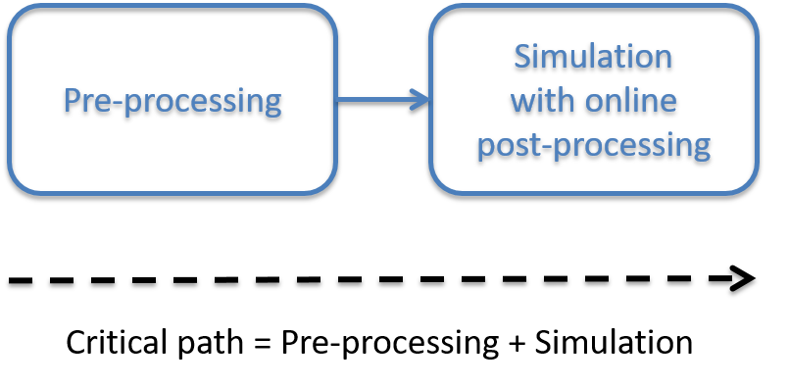
Future EC-Earth workflow
Critical path will be shortened by concurrently running post-processing with the simulation
Simple workflows are less prone to have configuration errors
16

Slide 17
Other benefits
The configuration of XIOS is more intuitive than the current approach. It is done through an XML file
Data compression
Save storage space because it will be only stored processed data ready to be used
17

Slide 18
3. IFS-XIOS integration and optimization overview

Slide 19
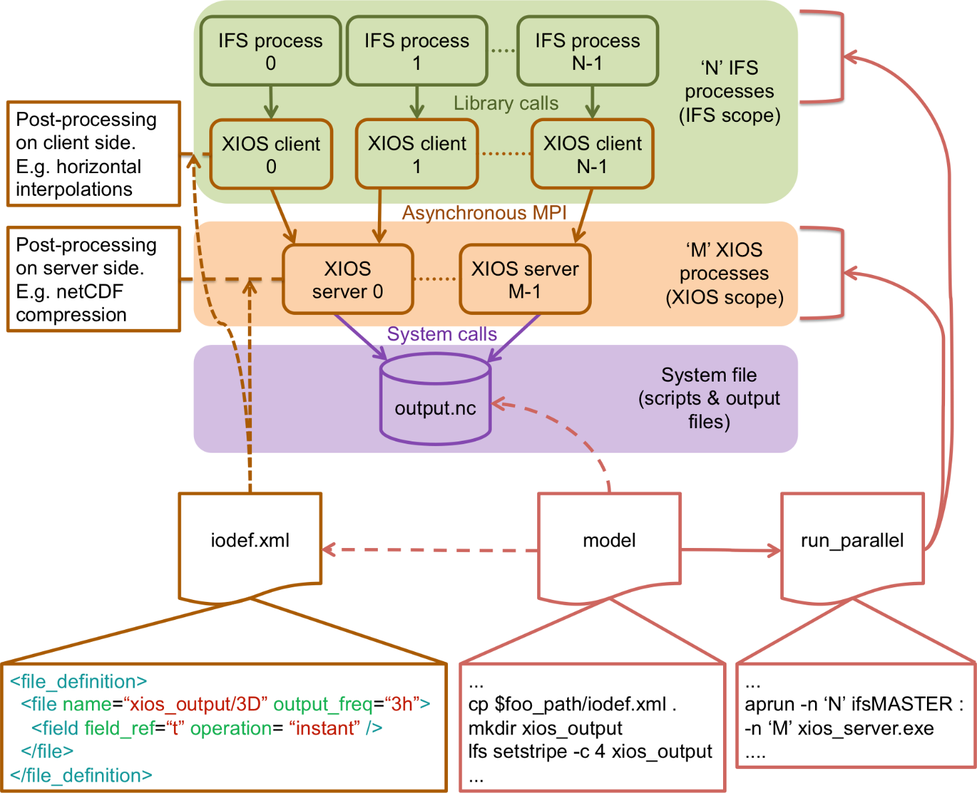
Scheme of the IFS-XIOS integration
19

Slide 20
Development steps
XIOS setup
Initialization
Finalization
Context: calendar and geometry (axis, domain and grid)
Iodef.xml file
Grid-point fields transfer
NPROMA blocks gather
Send fields
Environment setup
XIOS compilation
Include and link XIOS, netCDF and HDF5
Model script
Supporting MPMD mode
FullPos integration to support vertical post-processing: grid-point fields only
20

Slide 21
Development steps
XIOS setup
Initialization
Finalization
Context: calendar and geometry (axis, domain and grid)
Iodef.xml file
Grid-point fields transfer
NPROMA blocks gather
Send fields
Environment setup
XIOS compilation
Include and link XIOS, netCDF and HDF5
Model script
Supporting MPMD mode
FullPos integration to support vertical post-processing: grid-point fields only
21

Slide 22
FullPos integration
FullPos is a post-processing package currently used by IFS
The use of FullPos is necessary to perform vertical interpolations not supported by XIOS
It is called as usual, and afterwards, data is sent to XIOS
For now, it is only possible to output grid-point fields
22

Slide 23
Optimization techniques used
Parallelization using OpenMP threads
Optimized compilation of XIOS with -O3
Computation and communication overlap
23

Slide 24
Optimization techniques used
Parallelization using OpenMP threads
Optimized compilation of XIOS with -O3
Computation and communication overlap
24

Slide 25
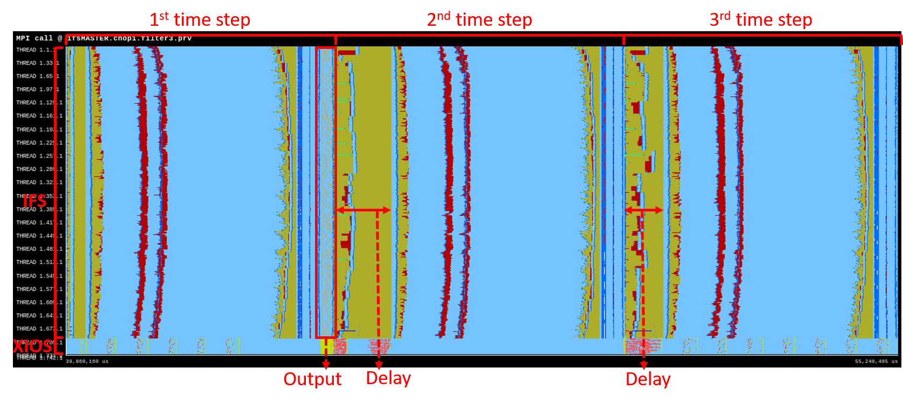
Computation and communication overlap
The trace shows that after an output time step, there is a delay in the communications of the next two time steps (MPI_Waitany and MPI_Alltoallv)
There is a conflict between intra IFS communications and IFS to XIOS communications
25

Slide 26
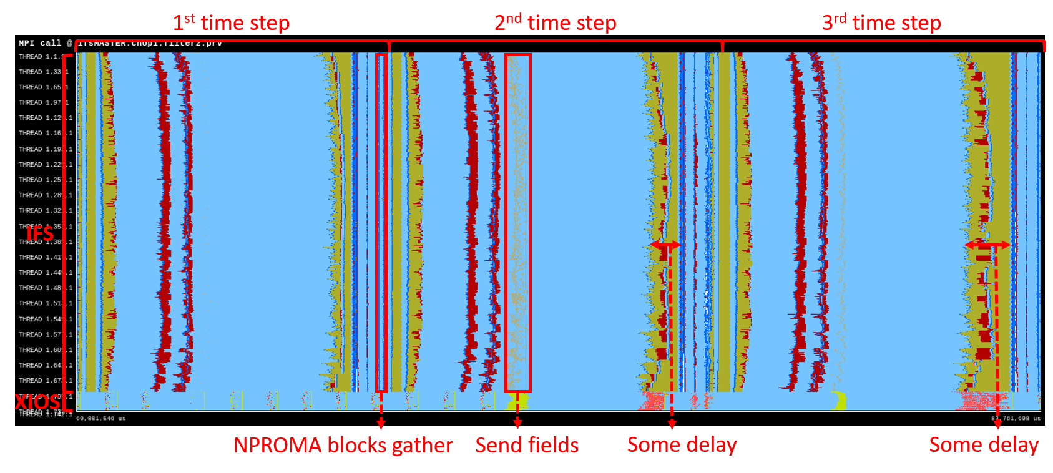
Computation and communication overlap
The sending of data to XIOS is delayed to truly overlap computation and communication
The trace shows that there is no delay at the beginning of the 2nd and 3rd time steps. However, there is some delay at the end, but it is less significant
26

Slide 27
4. Performance evaluation

Slide 28
Execution overview
ECMWF HPC platform (Cray XC40)
IFS CY43R3
Octahedral reduced Gaussian grid. Horizontal resolution: T1279 (16 km)
702 MPI processes, each with 6 OpenMP threads
10 days of forecast with a time step of 600 seconds
Output frequency: 3 hours
Only grid-point fields. NetCDF files size: 2.5 TB
28

Slide 29
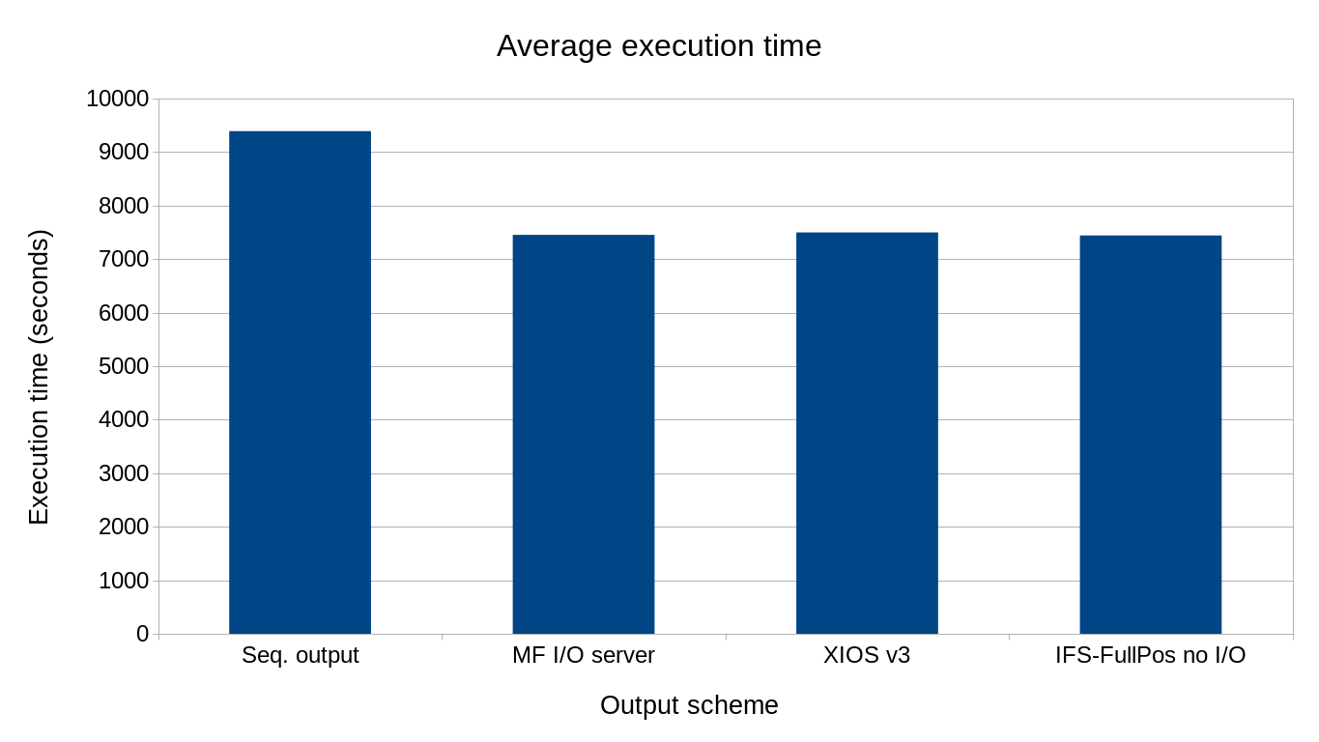
Comparison test
29

Slide 30
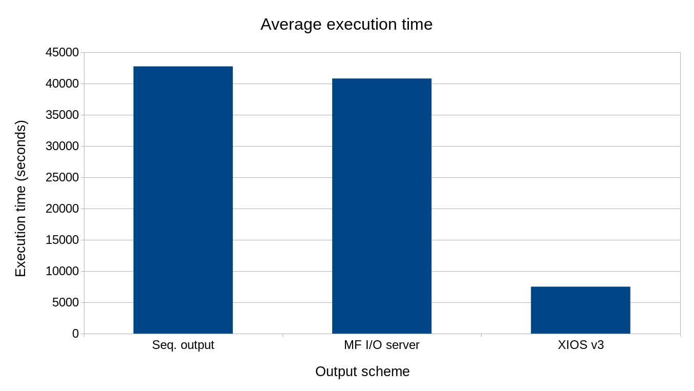
Comparison test adding GRIB to netCDF post-processing
30

Slide 31
5. Conclusions

Slide 32
Conclusions
The presented development is easy-to-use
The integration with no optimizations already improved the execution time:
Sequential output 9391 seconds (20.7% of overhead) → IFS-XIOS integration 7682 seconds (3.1% of overhead)
The integration with optimizations is fast and efficient:
It only has a 0.7% of overhead
Within 56 seconds IFS outputs 2.5 TB of data
When post-processing to convert GRIB to netCDF files is taken into account:
The post-processing takes 9.2 hours (sequentially performed, as in EC-Earth)
Thus, the most optimized version is a 5.7x faster than the sequential output and a 5.4x faster than the MF I/O server
32

Slide 33
Conclusions
These numbers denote that the development is scalable and efficient as well as will address the I/O issue
Summary of benefits for EC-Earth 4:
Increase the performance and efficiency of the whole model
Online diagnostics computation
CMORized netCDF files
Data compression
Simpler output configuration file using XML syntax
Experiments with simpler workflows
Save thousands of computing hours and storage space
33

Slide 34
Conclusions
These numbers denote that the development is scalable and efficient as well as will address the I/O issue
Summary of benefits for EC-Earth 4:
Increase the performance and efficiency of the whole model
Online diagnostics computation
CMORized netCDF files
Data compression
Simpler output configuration file using XML syntax
Experiments with simpler workflows
Save thousands of computing hours and storage space
Save money!
34

Slide 35
Ongoing and future work
Transform fields from spectral space to grid-point space, post-process and send them to XIOS
The development done for IFS will be ported to OpenIFS (next release)
Adapt the future EC-Earth 4 version to output fields and compute online diagnostics from OpenIFS and NEMO components through XIOS
35

Slide 36
Thank you!
xavier.yepes@bsc.es

Slide 37
Additional slides

Slide 38
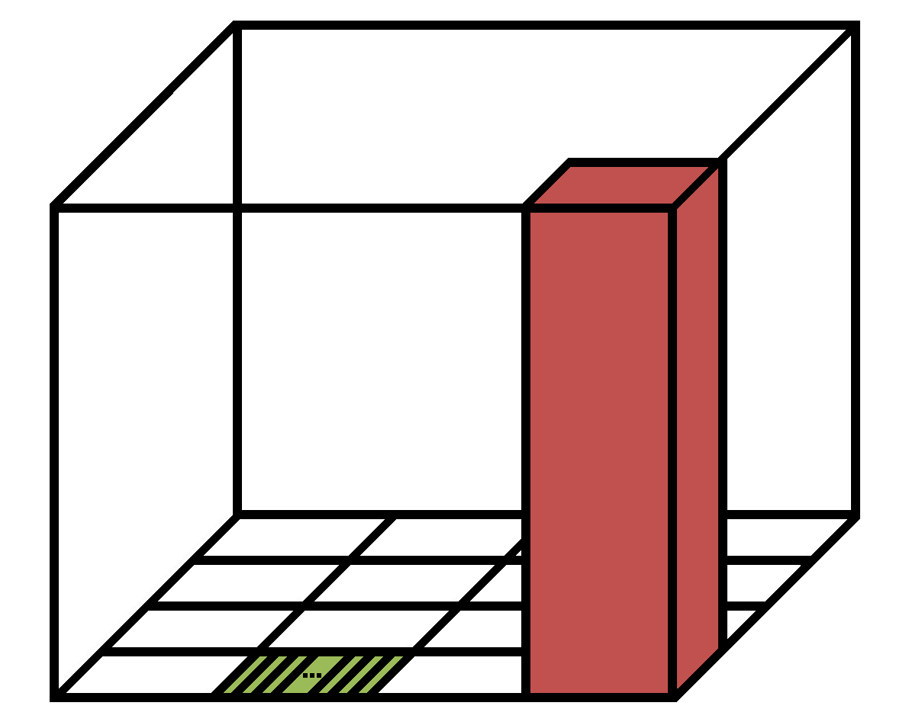
Subdomain decomposition in IFS
IFS uses a blocking strategy to efficiently parallelize the manipulation of data arrays using OpenMP
IFS_data_array(NPROMA, NFLEVG, NFIELDS, NGPBLKS)
NFLEVG
NGPBLKS block
One element
NPROMA
38

Slide 39
NPROMA blocks gather
The IFS data arrays do not match with the XIOS ones:
IFS_data_array(NPROMA, NFLEVG, NFIELDS, NGPBLKS)
XIOS_data_array(unidimensional 2D domain, NFLEVG)
It is necessary to re-shuffle fields data before sending them
According to the blocking strategy used in IFS, an XIOS-style array has to be built by gathering NPROMA blocks
39

Slide 40
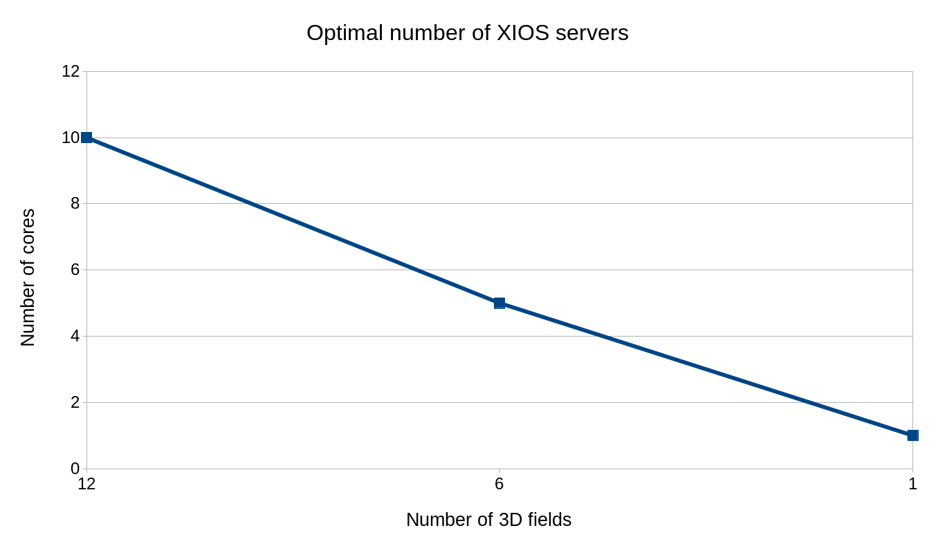
Optimal number of XIOS servers
40

