Slide 1
Bringing the complexity of organic chemistry to climate models with machine learning techniques
#PlanDeRecuperación
Camille Mouchel-Vallon, Alma Hodzic, John Schreck, Charlie Becker, Keeley Lawrence, Siyuan Wang, Jinkyul Choi, Daven Henze, David John Gagne
PASC24, Zürich, 2024/06/05

Slide 2
Context
1st objective: A high resolution spatial (up to 2.5x2.5 km) and temporal (hourly) emissions system to compute emissions of primary atmospheric pollutants for Spain to be used in the national air quality prediction system.
Gaseous primary atmospheric pollutants
NO_{x}, CO, SO_{x}, NH₃, NMVOCs
Non-Methane Volatile Organic Compounds are emitted by human and natural activities and their chemical evolution in the atmosphere has an impact on air quality, health and climate

Slide 3
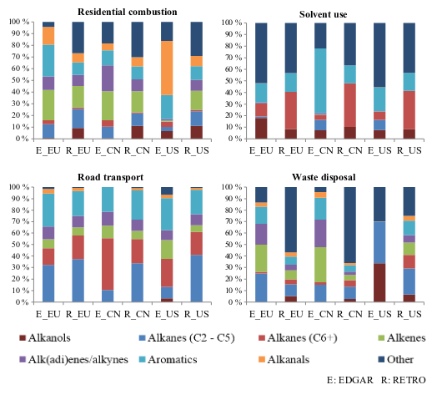
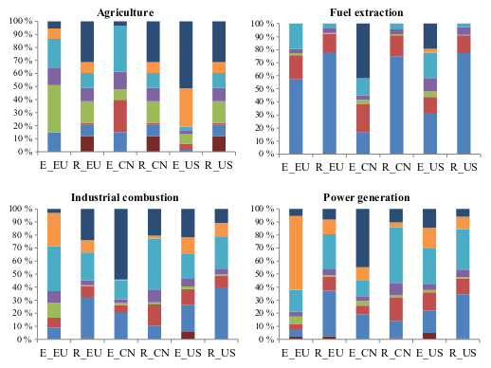
Primary organic compounds: many sources, high diversity, high uncertainty
Distribution of emitted organic compounds families for two different inventories in Europe, China and USA
(Huang et al., 2017)

Slide 4
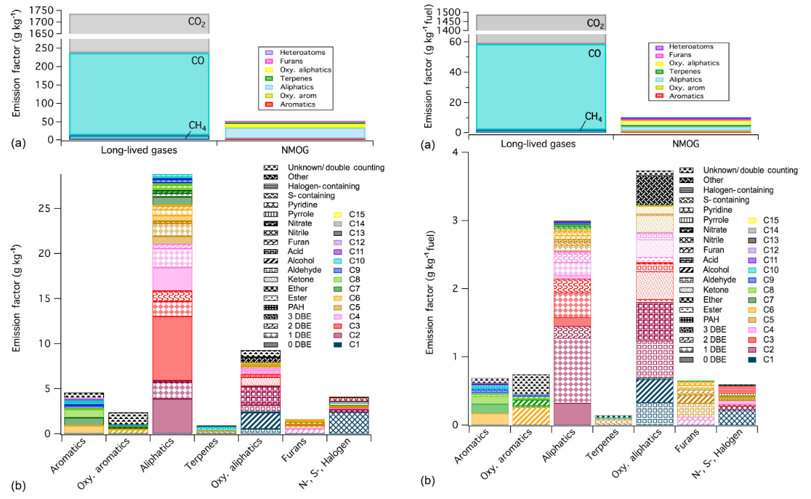
Primary organic compounds: many sources, high diversity, high uncertainty
Indonesian peat fire
Chinese rice straw
Measured fire emissions composition
(Hatch et al., 2017)

Slide 5
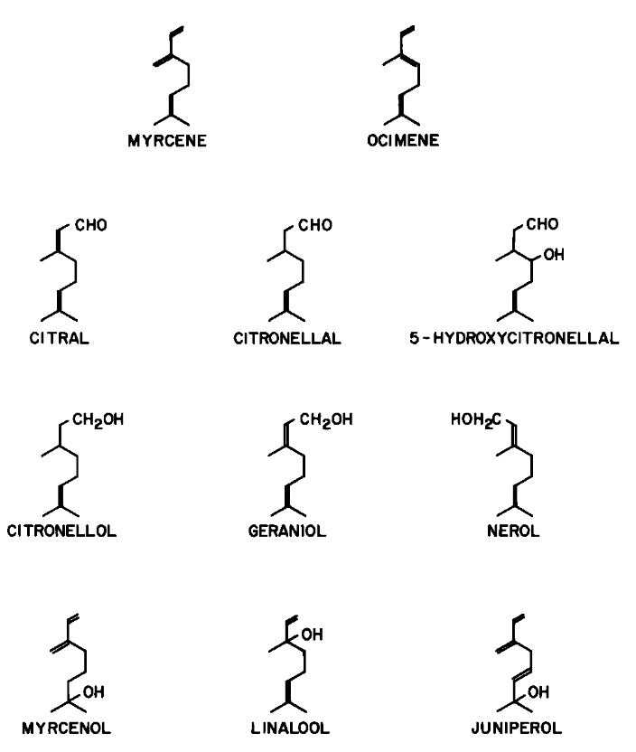
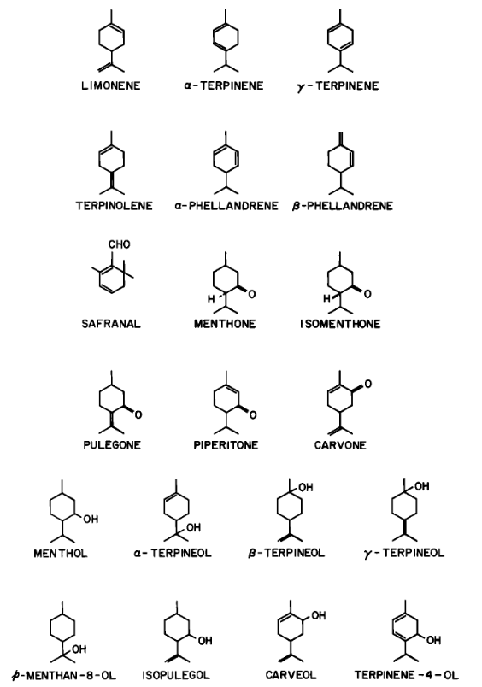
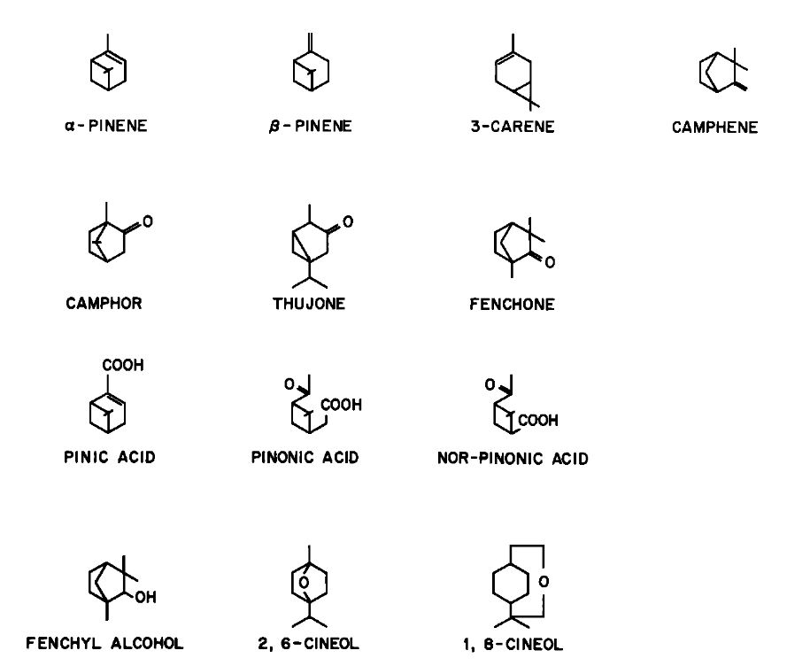
Primary organic compounds: many sources, high diversity, high uncertainty
isoprene
Inventory of terpenoids emitted by plants
(Graedel, 1979)

Slide 6
Atmospheric Evolution of Organics : formation of oxidized compounds
Aqueous oxidation
Oxidized Volatile Organic Compounds
Dissolution
Dissolution
Activation
Secondary Organic Aerosol
Oxidized Volatile Organic Compounds
Low volatility
Gaseous oxidation
Volatile Organic Compounds
Wet and dry deposition
Biogenic and anthropogenic emissions

Slide 7
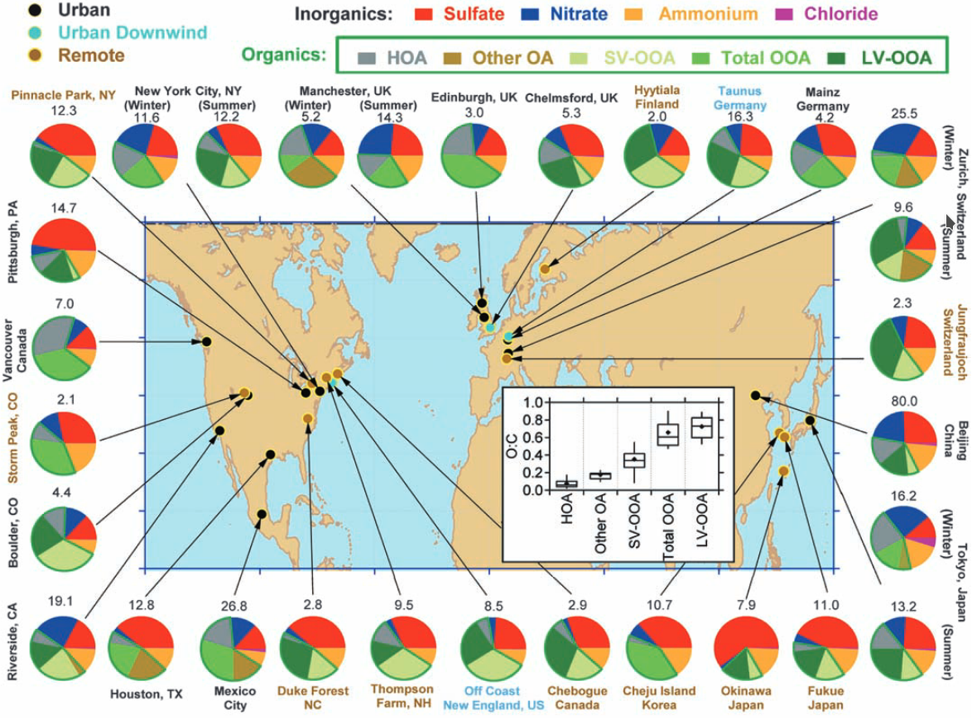
Atmospheric Evolution of Organics : formation of oxidized compounds
Aqueous oxidation
Oxidized Volatile Organic Compounds
Dissolution
Dissolution
Activation
Secondary Organic Aerosol
Oxidized Volatile Organic Compounds
Low volatility
Gaseous oxidation
Volatile Organic Compounds
Wet and dry deposition
Measured PM1 composition
Jimenez et al. (2009)
Biogenic and anthropogenic emissions

Slide 8
Atmospheric Evolution of Organics : formation of oxidized compounds
Aqueous oxidation
Oxidized Volatile Organic Compounds
Dissolution
Dissolution
Activation
Secondary Organic Aerosol
Oxidized Volatile Organic Compounds
Low volatility
Gaseous oxidation
Volatile Organic Compounds
Wet and dry deposition
Contributions to rain composition in the tropics
Bakayoko et al. (2021)
Biogenic and anthropogenic emissions

Slide 9
Impacts
hygroscopicity
optical properties
Climate impacts
Aqueous oxidation
OVOC
Dissolution
Dissolution
Activation
ozone chemistry
particulate matter composition
Air quality and health impacts
OVOC
SOA
Gaseous oxidation
Low volatility
VOC
Wet and dry deposition
rain composition
inputs to soils
Ecosystems impacts
Biogenic and anthropogenic emissions

Slide 10
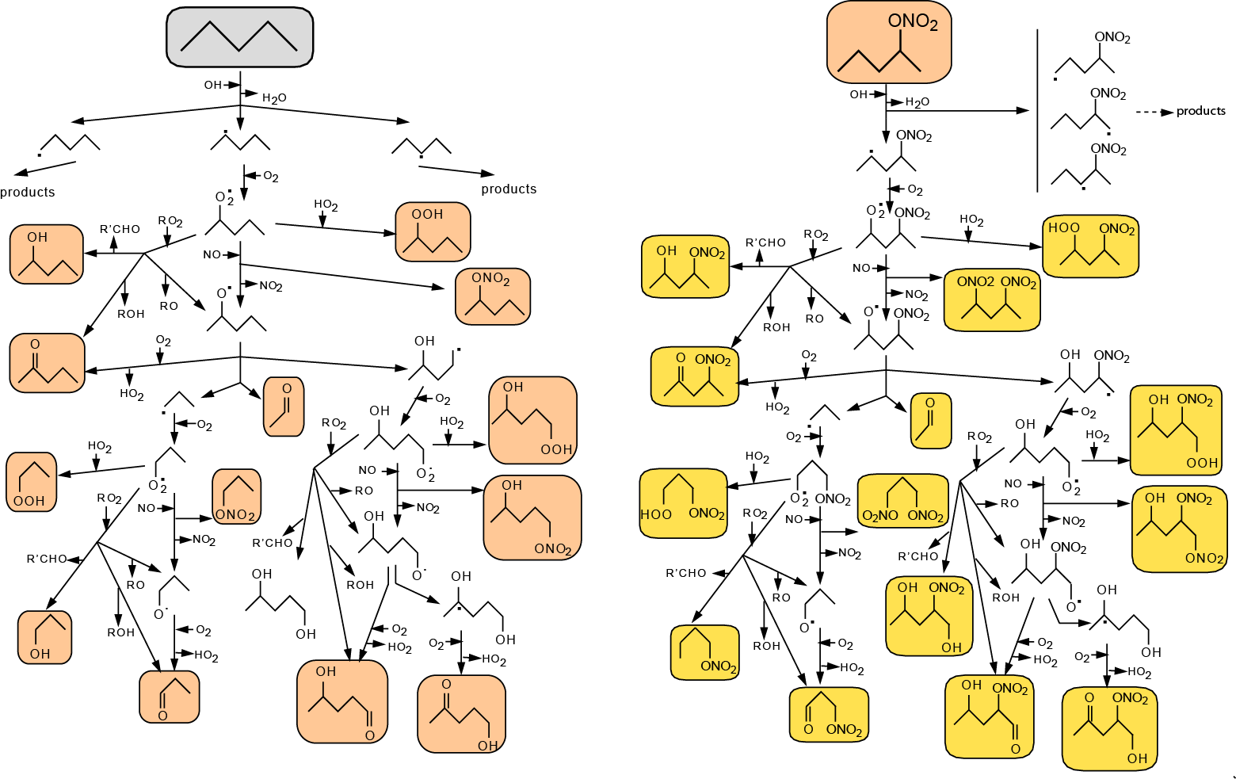
Progressive and complex oxidation of organics
Oxidized Volatile Organic Compounds
Gaseous oxidation
Volatile Organic Compounds
How to bring this complexity to air quality models?
CO₂
Parent
Hydrocarbon
1st Generation
Species
2nd Generation
Species

Slide 11
How I Learned to Stop Worrying and Love the Complexity
Master Chemical Mechanism (Jenkin et al., 1997; 15yrs 2-3people ?)
143 precursors from C₁ to C₁₂
17000 reactions of 6700 species
Simplified!
CLEPS (Mouchel-Vallon et al., 2017; 2yrs 2people)
Cloud oxidation of C₁-C₄ products from isoprene oxidation
1315 reactions involving 717 chemical species
Simplified!
Handwritten detailed mechanisms: high potential for errors and time consuming (creation and maintenance)

Slide 12
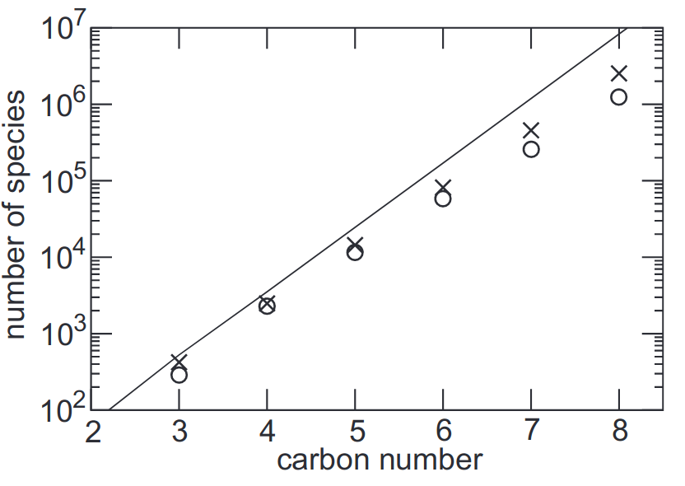
How I Learned to Stop Worrying and Love the Complexity
Master Chemical Mechanism (Jenkin et al., 1997; 15yrs 2-3people ?)
143 precursors from C₁ to C₁₂
17000 reactions of 6700 species
Simplified!
CLEPS (Mouchel-Vallon et al., 2017; 2yrs 2people)
Cloud oxidation of C₁-C₄ products from isoprene oxidation
1315 reactions involving 717 chemical species
Simplified!
Handwritten detailed mechanisms: high potential for errors and time consuming (creation and maintenance)
Potential number of distinct species in a full oxidation mechanism as a function of the size of the precursor
Aumont et al. (2005)

Slide 13
We need to go faster
Writing the chemical mechanism
Solving the ODEs in a (3D) model

Slide 14
Automating boring things
Systematic and repeated oxidation steps
Generator for Explicit Chemistry and Kinetics of Organics in the Atmosphere
(GECKO-A, Aumont et al., 2005)

Slide 15
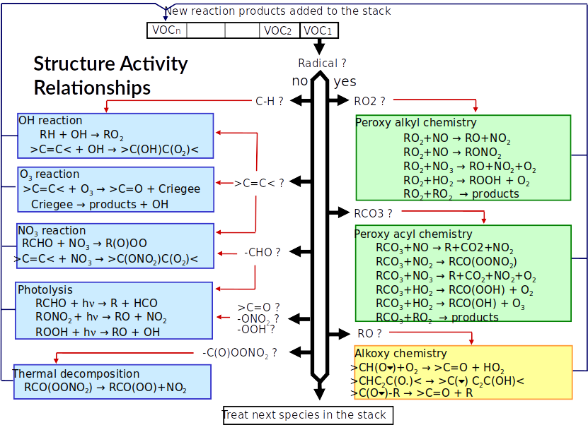
Automating boring things
Aumont et al., 2005

Slide 16
Accelerating things
Writing the chemical mechanism
Solving the ODEs in a (3D) model
GECKO-A
12 biogenic, 53 anthropogenic precursors
Simulating 2 days in 2 grid cells
≈ 36 hours on 16 cores
23 million reactions involving 4.4 million species
(Mouchel-Vallon et al., 2020)
Machine learning?

Slide 17
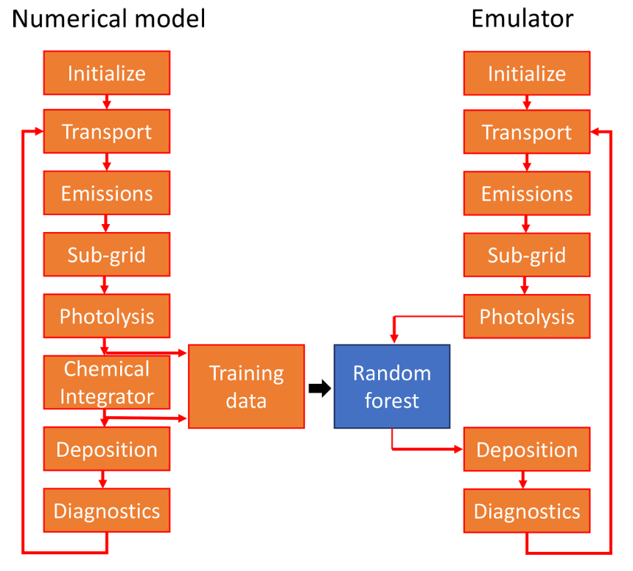
Emulating atmospheric chemistry
Use GECKO-A 0D explicit simulations as training dataset
Emulate the behavior of the detailed model with machine learning
Neural Networks (NN)
Random Forest (RF)
Computationally expensive

Slide 18
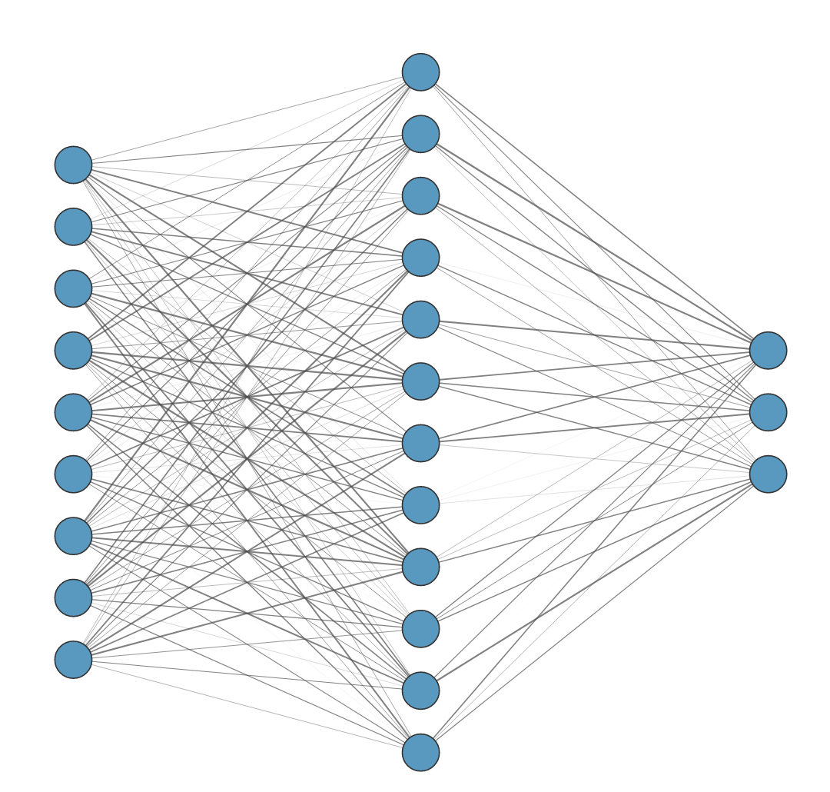
NN approach for predicting time-series of concentrations
1. Multi-layer perceptron MLP model
Inputs
Hidden layer
Precursor (t_{i})
Outputs
SOG (t_{i})
SOA (t_{i})
T (t_{i})
Precursor (t_{i+1})
SZA (t_{i})
SOG (t_{i+1})
Pre-existing OA (t_{i})
SOA (t_{i+1})
OH (t_{i})
…
O₃ (t_{i})
NOx (t_{i})
1748 neurons
Schreck et al. JAMES 2022: Neural network emulation of the formation of OA based on the explicit GECKO-A chemistry model

Slide 19
NN approach for predicting time-series of concentrations
1. Multi-layer perceptron MLP model
2. Gated-recurrent unit GRU model
Inputs
Hidden layer
Precursor (t_{i})
Outputs
SOG (t_{i})
SOA (t_{i})
T (t_{i})
Precursor (t_{i+1})
SZA (t_{i})
SOG (t_{i+1})
Pre-existing OA (t_{i})
Gated Recurrent Unit (GRU)
SOA (t_{i+1})
OH (t_{i})
…
O₃ (t_{i})
NOx (t_{i})
Hidden state h(t_{i-1})
Hidden state h(t_{i})
1748 neurons
Schreck et al. JAMES 2022: Neural network emulation of the formation of OA based on the explicit GECKO-A chemistry model

Slide 20
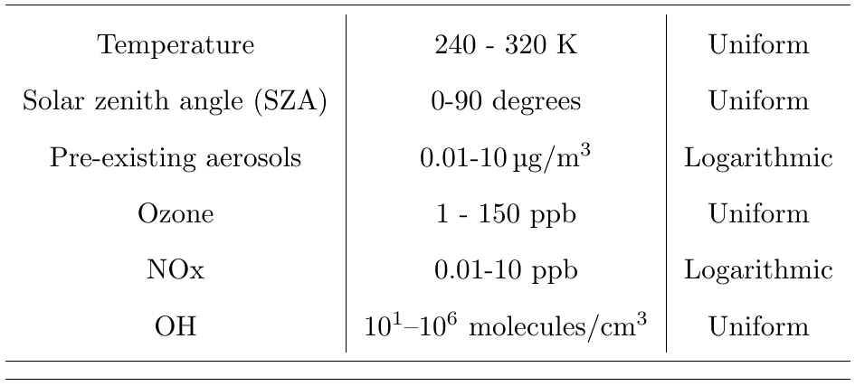
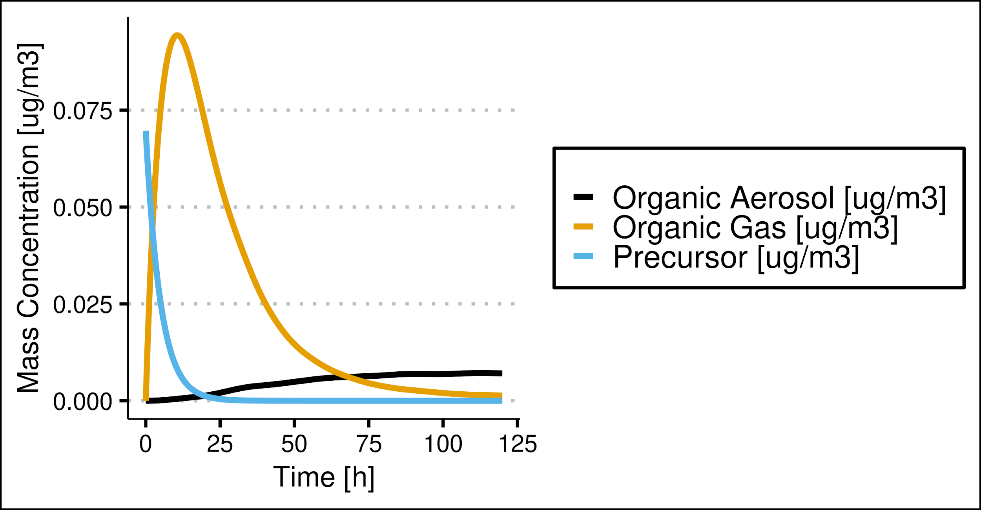
Generate Neural Network training dataset with GECKO-A
3 precursors: toluene, dodecane, a-pinene
Random environmental conditions
No diurnal variations
Initial precursor amounts of 10 ppt, 0.1 and 1 ppb
2,000 random experiments for each precursor
5 days / 5 minutes output
2.9 × 10⁶ samples (80% training, 20% validation)
Schreck et al., JAMES, 2022

Slide 21
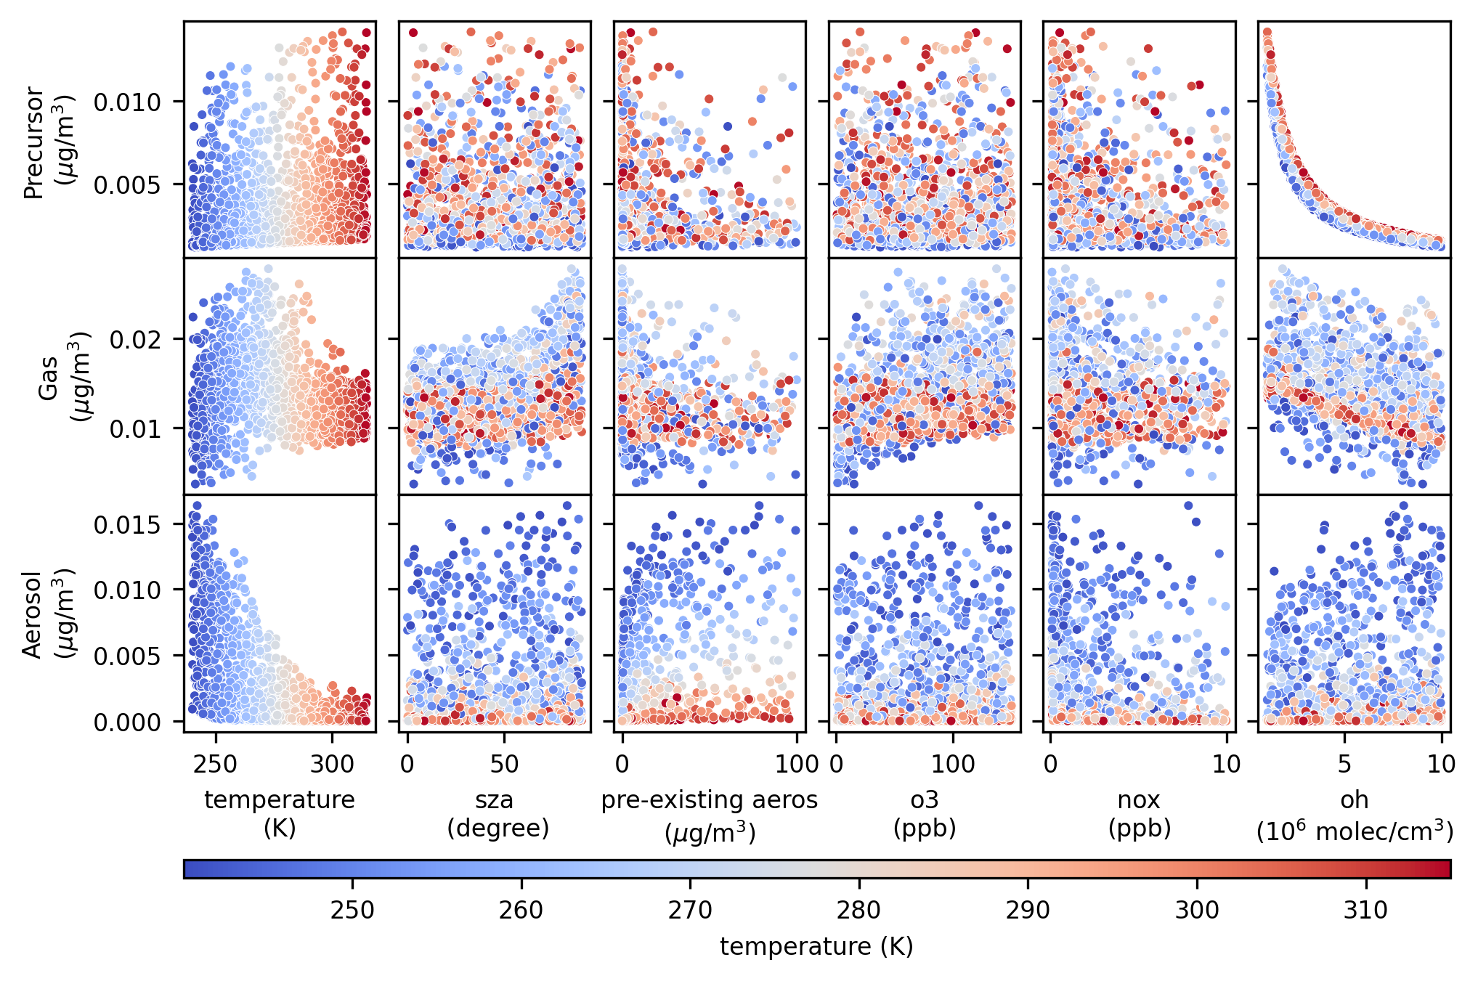
Neural Network training dataset
OH ↑
Precursor ↓
Organic gas ↓
Organic aerosol ↑
Targets
Effect of T on condensation
Predictors
Schreck et al., JAMES, 2022

Slide 22
Multi-Layer Perceptron vs. Gated-Recurrent Unit network
30-ensemble member predictions for Toluene
Multi-layer perceptron
Gated-recurrent unit
GECKO-A true
NN mean, 30 members
GECKO-A true
NN mean, 30 members
GECKO-A true
NN mean, 30 members
Precursor exponential decay well captured
GRU performs better but is challenging to implement in a 3D model
Schreck et al., JAMES, 2022

Slide 23
Application in a box model for diurnally varying conditions
GECKO-A vs. GECKO-MLP
Neural Networks trained on datasets built under constant conditions cannot reproduce realistic diurnal cycles
Raises the question of the representativeness of the training data sets

Slide 24
Computational gain GECKO-A vs. GECKO-NN
For Toluene, GECKO-NN is 4×10² times faster than GECKO-A on CPU, and 10⁴ times faster on GPU
Ratio of GECKO-A / GECKO-NN
Timing per 5min timestep

Slide 25
Random Forest approach
P(t_{i})
G(t_{i})
A(t_{i})
E(t_{i})
Inputs :
Precursor concentration
Gas organic concentration
Aerosol organic concentration
Temperature
Solar zenith angle
Pre-existing aerosol
O₃
NOx
OH
P(t_{i})
Tree 1
Tree 2
Tree N
G(t_{i})
A(t_{i})
…
E(t_{i})
Prediction 1
Prediction 2
Prediction N
Averaging predictions
Output :
Gas organic concentration
Aerosol organic concentration
G(t_{i+1})
A(t_{i+1})
G(t_{i+1})
A(t_{i+1})
Mouchel‐Vallon & Hodzic, JGR, 2023:
Toward emulating an explicit organic chemistry mechanism with random forest models.

Slide 26
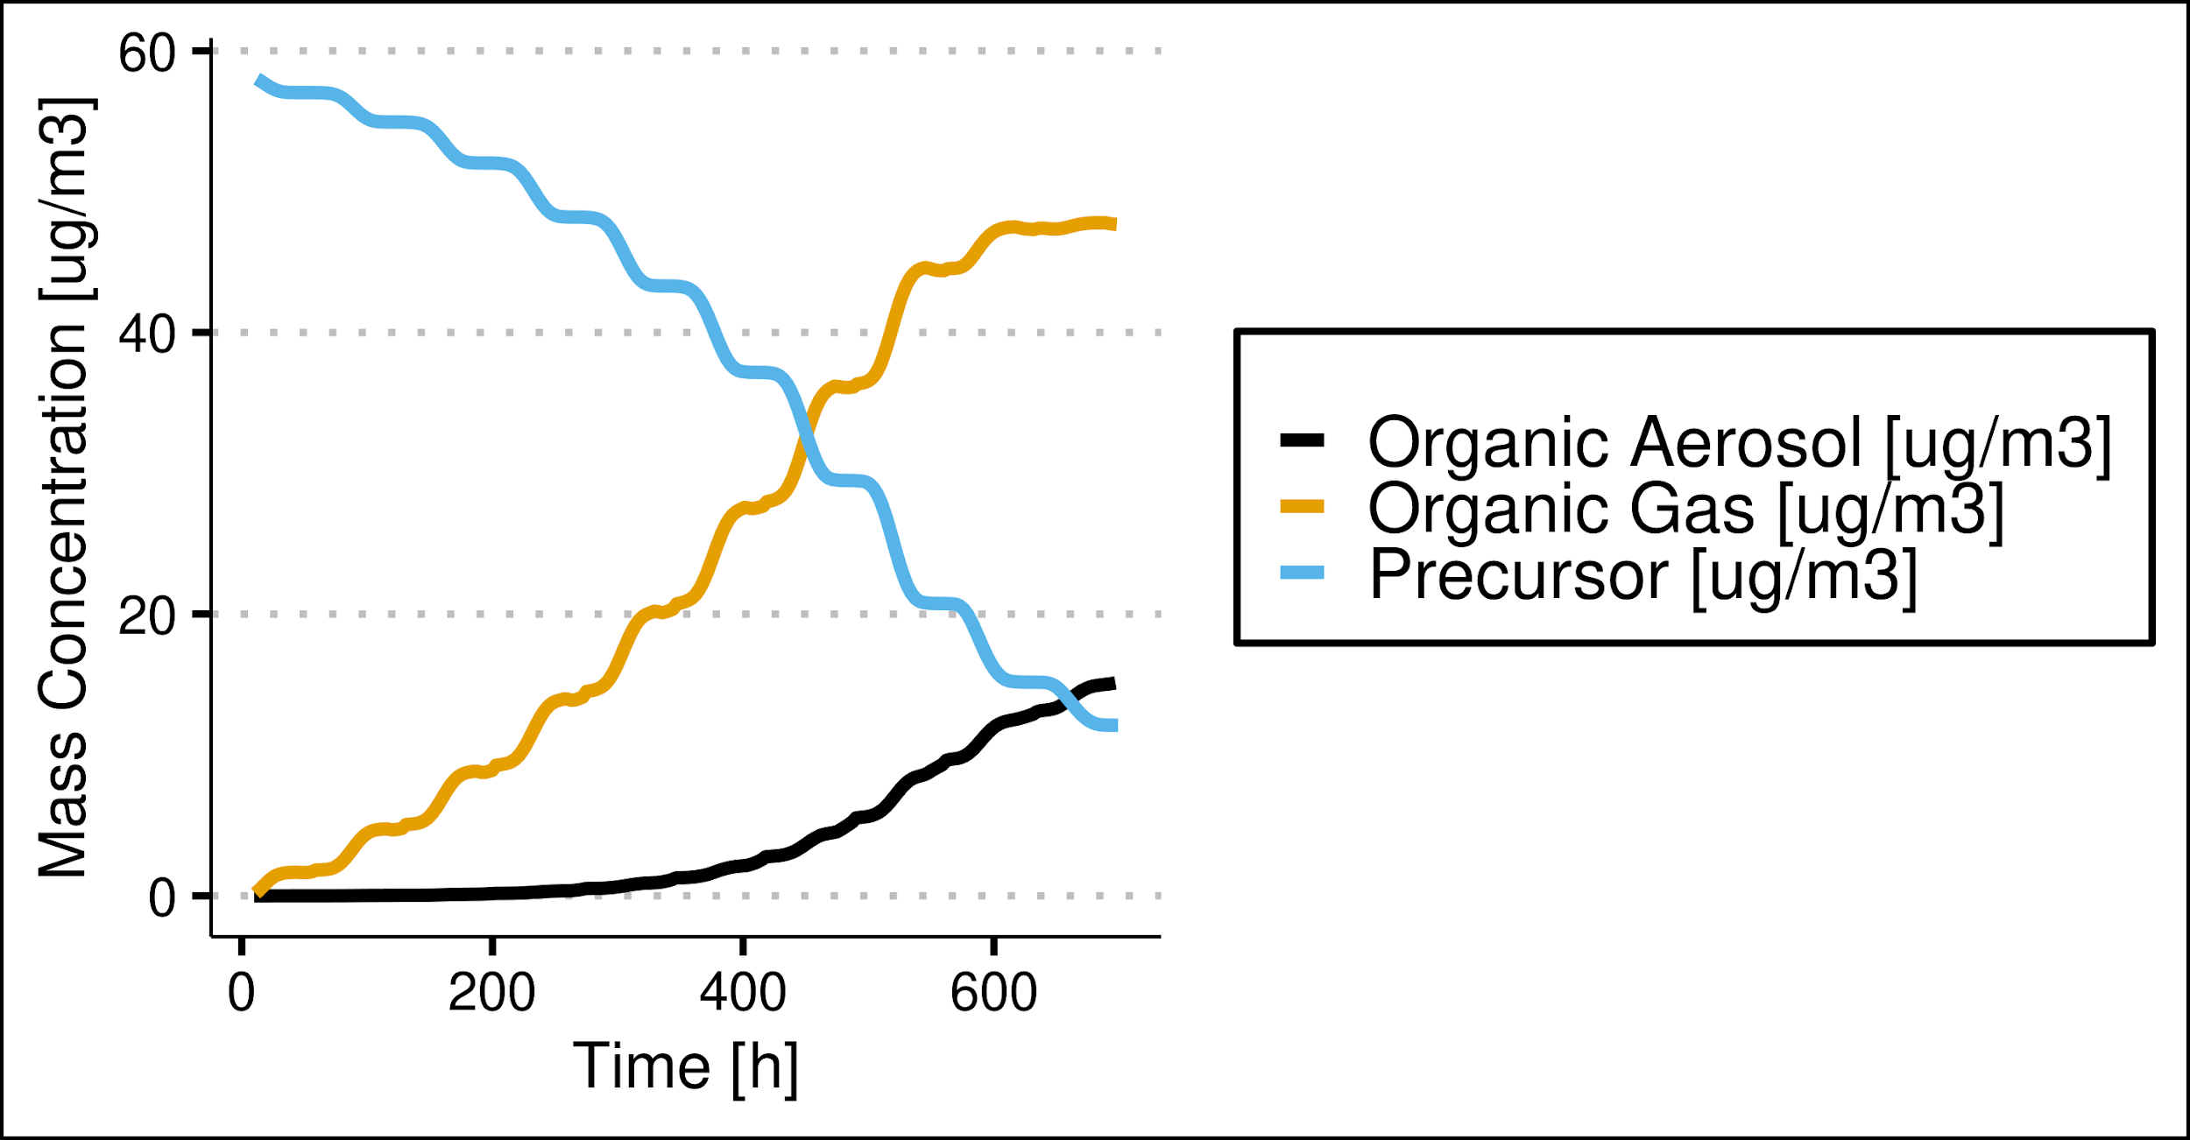
Random Forest: Realistic training dataset
2 precursors: toluene, dodecane
Random environmental conditions
With diurnal variations
Random initial precursor concentration
From 3D model tropospheric ranges
Only 2 targets
10 days / 5 min output
1×10⁶ samples/precursor
0 60 120 240

Slide 27
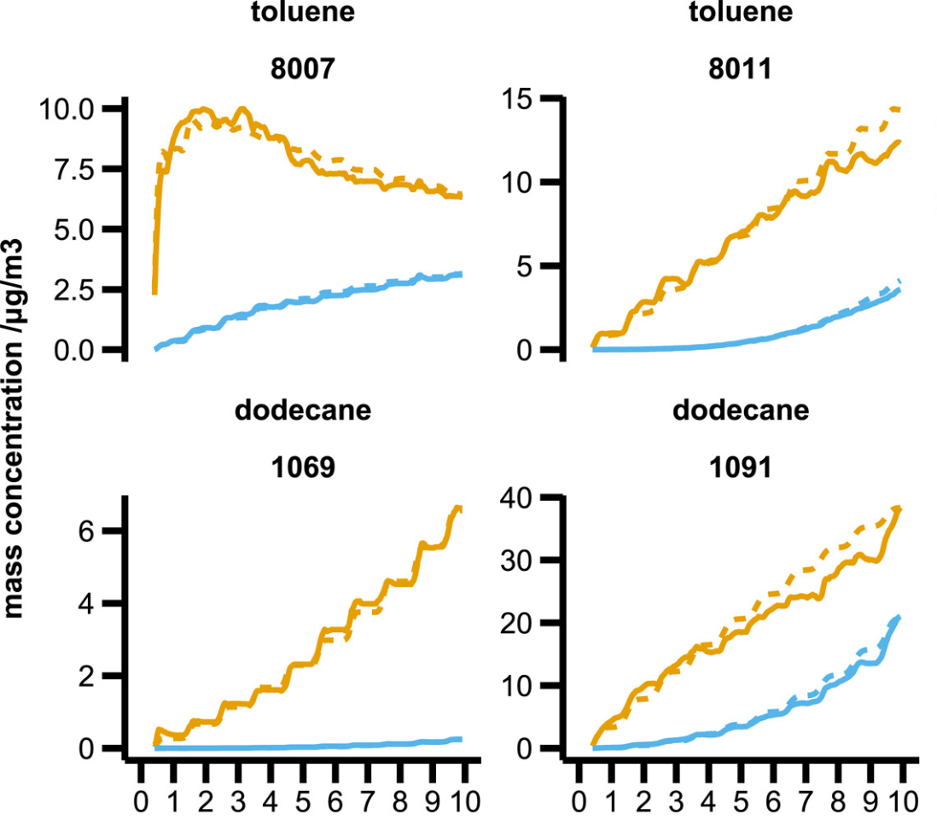
Random Forest results: examples
organic gases
GECKO-A
RF perform similarly to NN
The training set allows reproducing the diurnal cycles
organic aerosol
Random Forest
time /day

Slide 28
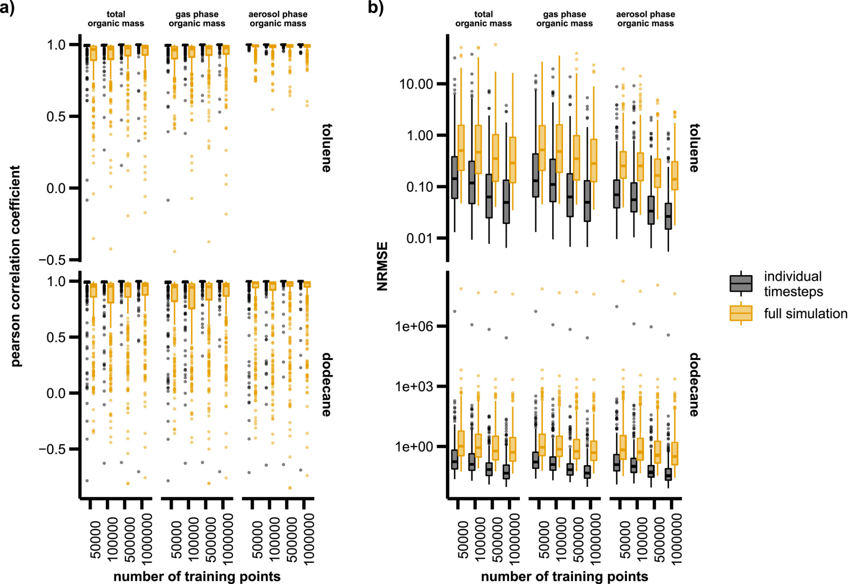
Random Forest results: performance
diminishing returns of increasing the size of the training sample
Increasing the number of training samples improves performance
error accumulation

Slide 29
Random Forest results: errors distribution
RO₂ + NO
RO₂ + HO₂
increasing error
Little sensitivity of errors to the aerosol quantity to predict (seed, yield, mass)
Errors sensitive to NOx regime and OH mixing ratios: underrepresented regimes in training set

Slide 30
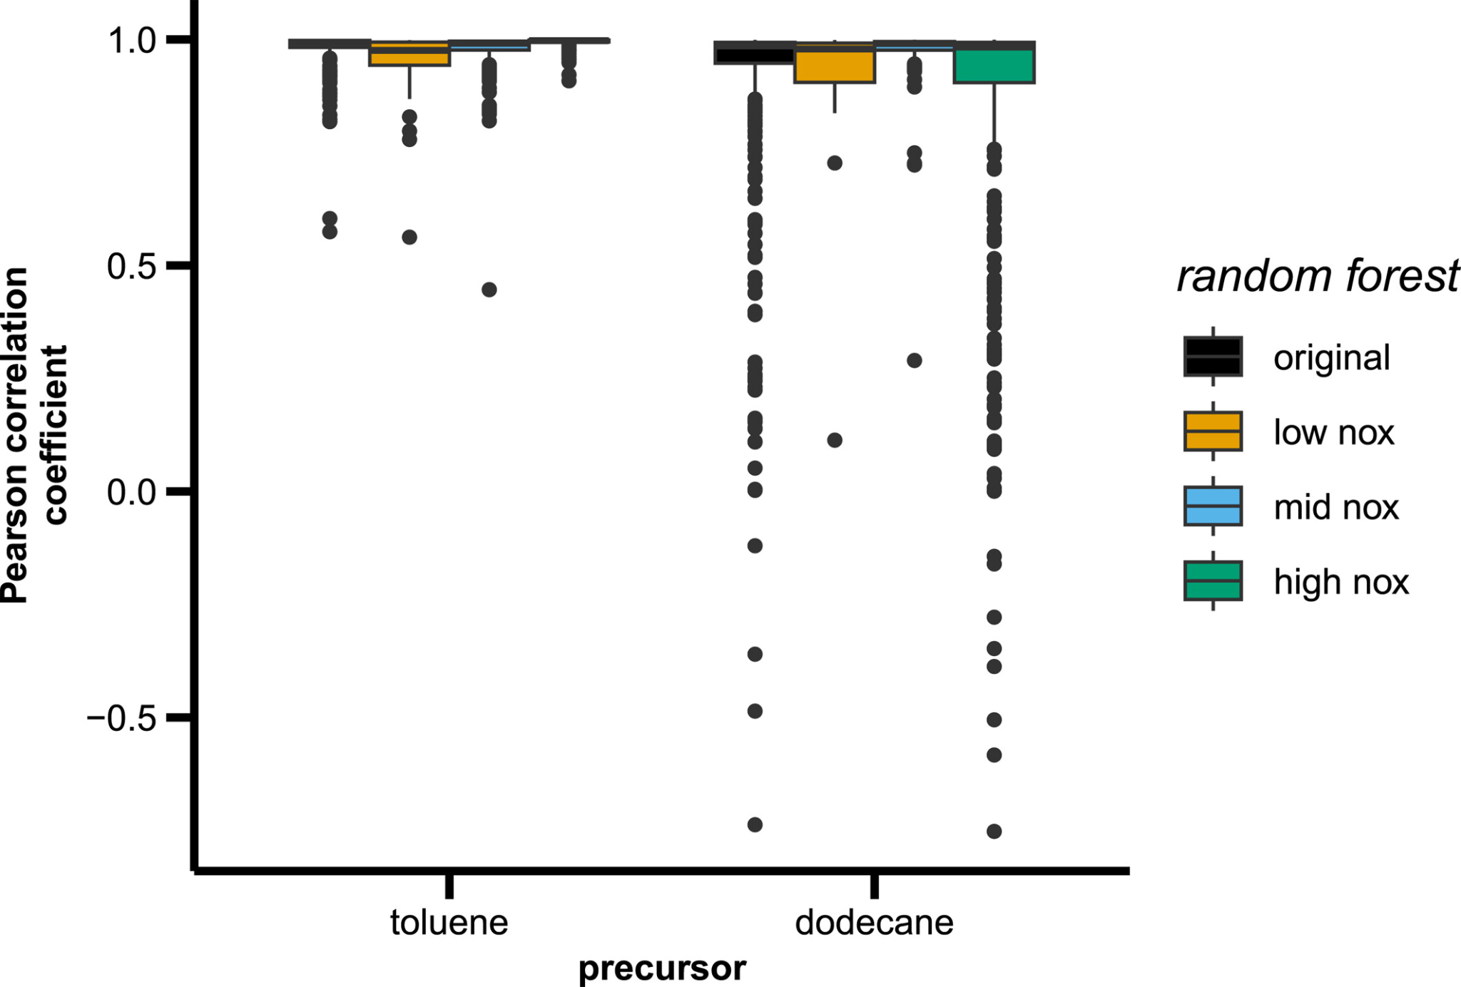
Random Forest results: specializing random forests
Do performances improve if the range of chemical regimes to predict is reduced?
# training points
toluene | dodecane
1×10⁵ | 7×10⁴
6×10⁵ | 3×10⁵
4×10⁵ | 7×10⁵
Specialization requires more or better constructed training data

Slide 31
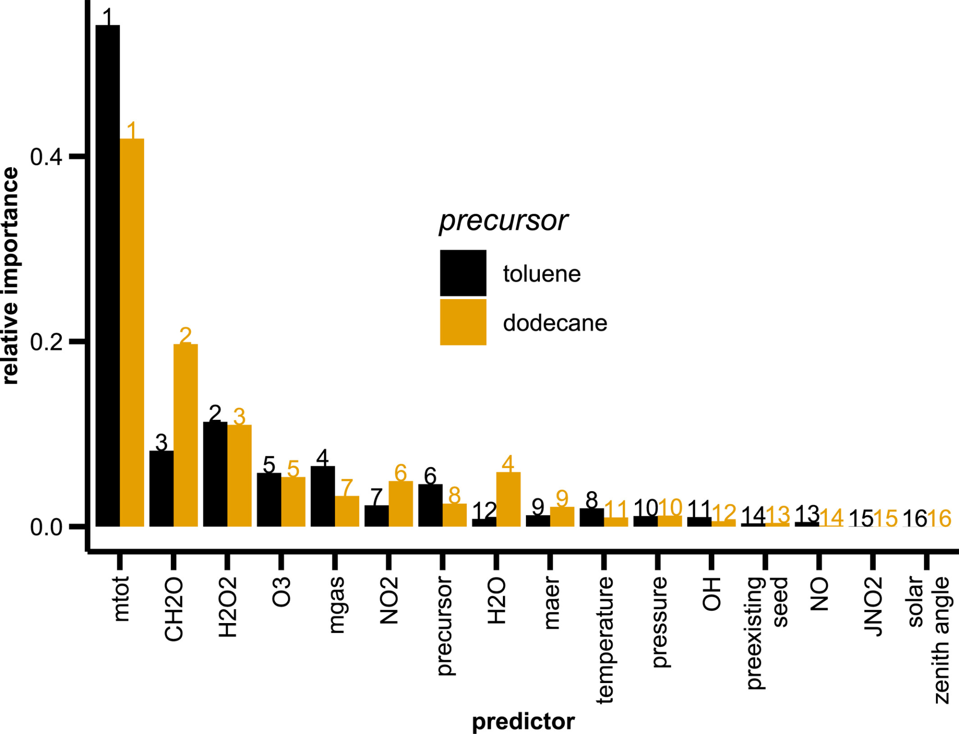
Random Forest results: predictors relative importance
The importance of predictors (mean decrease impurity) is similar for both species
Distribution of importance and predictive ability among correlated variables

Slide 32
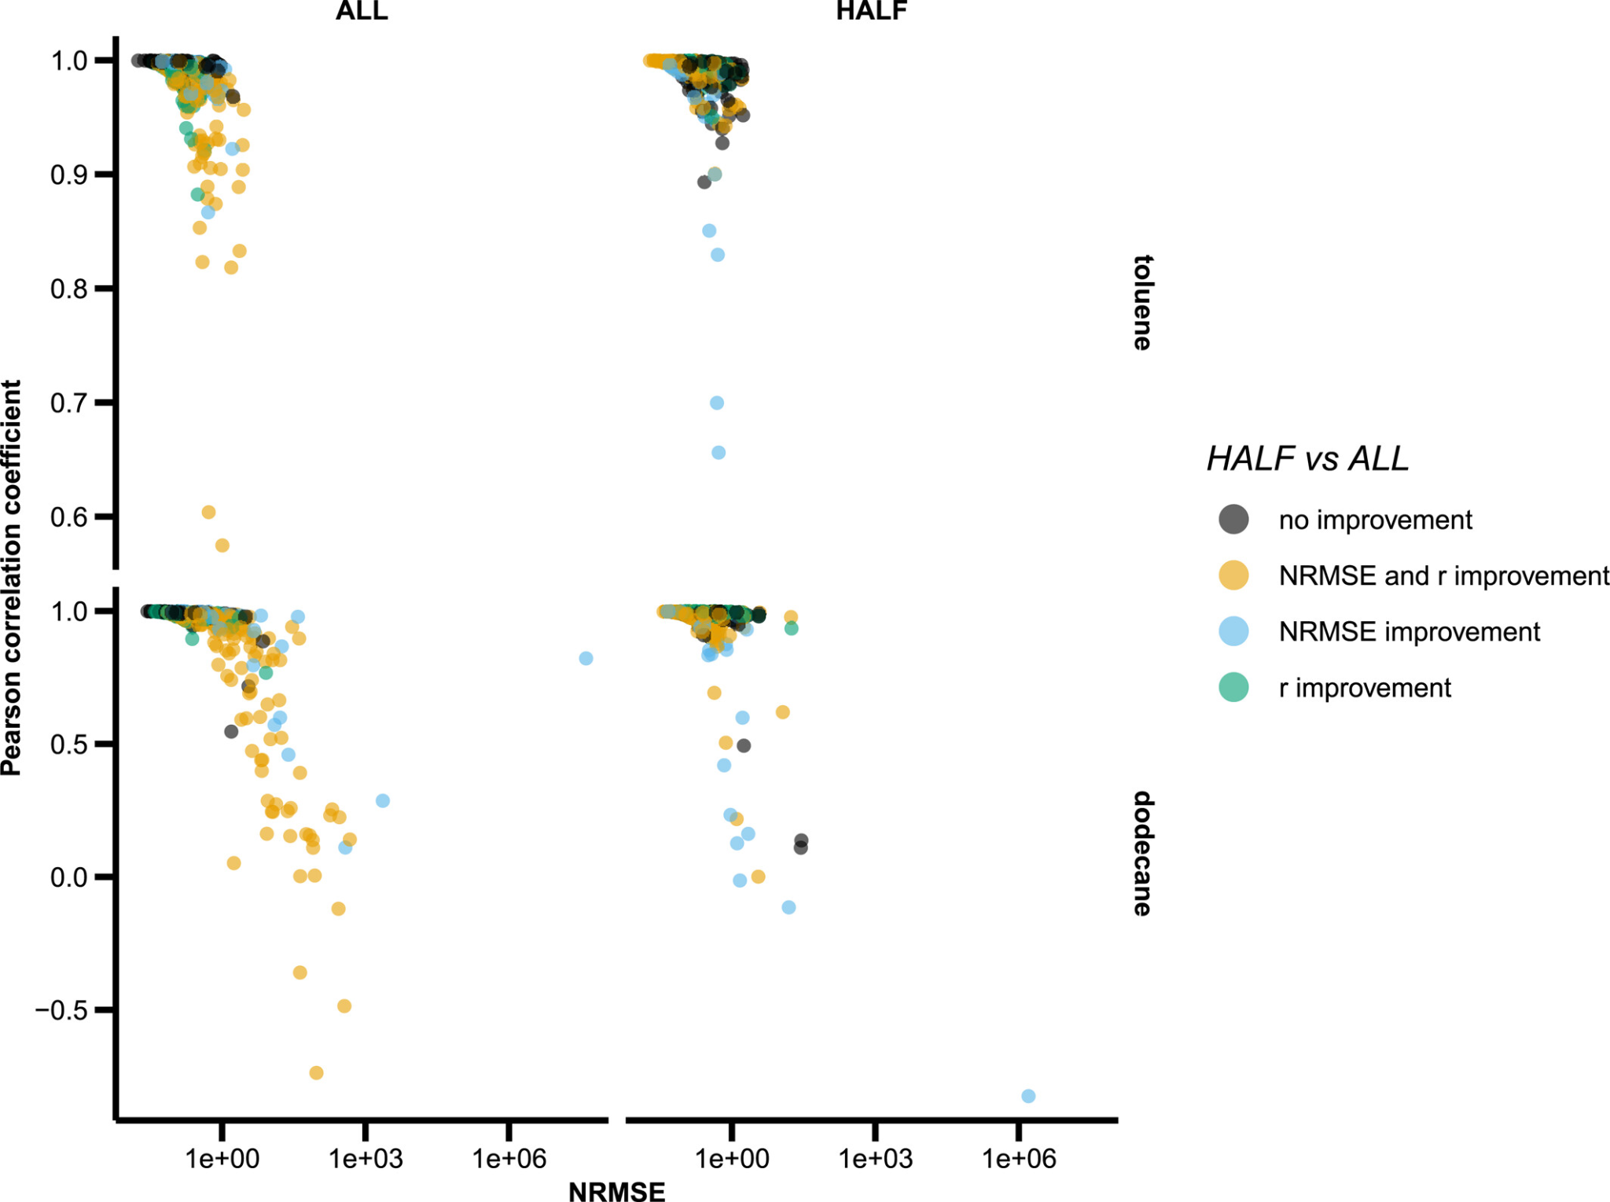
Random Forest results: reducing the number of predictors
Do performances improve if the number of predictor is reduced?
Reducing the number of (correlated?) predictors is beneficial for the worst performing simulations
Importance of selecting predictors and dimensionality reduction

Slide 33
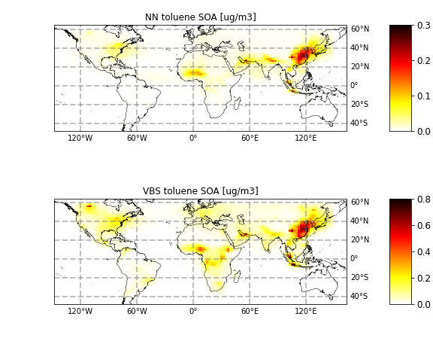
First tests in a global model: VBS vs. GECKO-NN
Implementing GECKO-NN in Geos-Chem
GEOS-Chem Monthly average Toluene SOA (May 2016)
GECKO-NN-MLP
GECKO-NN simulations are
stable over several months
within a factor of 2 of the VBS parametrization for Toluene-SOA.
ug/m3
VBS Hodzic et al., 2016
ug/m3

Slide 34
Conclusions and Outlook
It is possible to emulate the behavior of detailed atmospheric chemistry models with machine learning
Long term stability can be achieved for recurrent neural networks with GRU
The training dataset must be carefully constructed to cover all environmental conditions
Random forests can perform similarly to NN+GRU
Predictors selection is crucial
Current and future works at BSC
Bring the complexity of organic chemistry to air quality models, built on the development of detailed Spanish emissions
Explore ML use, with lessons learned from this work: start again from the basics and systematic exploration by (i) progressively increasing chemical complexity (from toy mechanisms to GECKO-A complexity) and (ii) testing multiple families of ML techniques (RF, NN, GraphNet …)
Implementation in the MONARCH air quality model

Slide 35
Thank you for your attention
camille.mouchel@bsc.es

