Slide 1
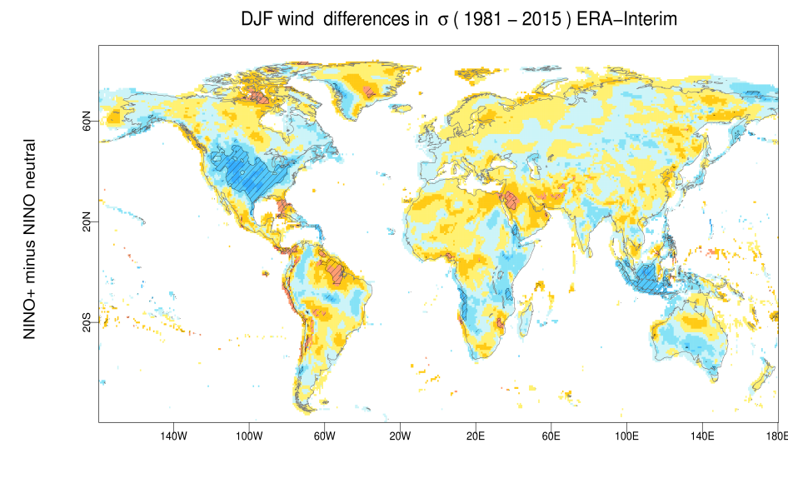
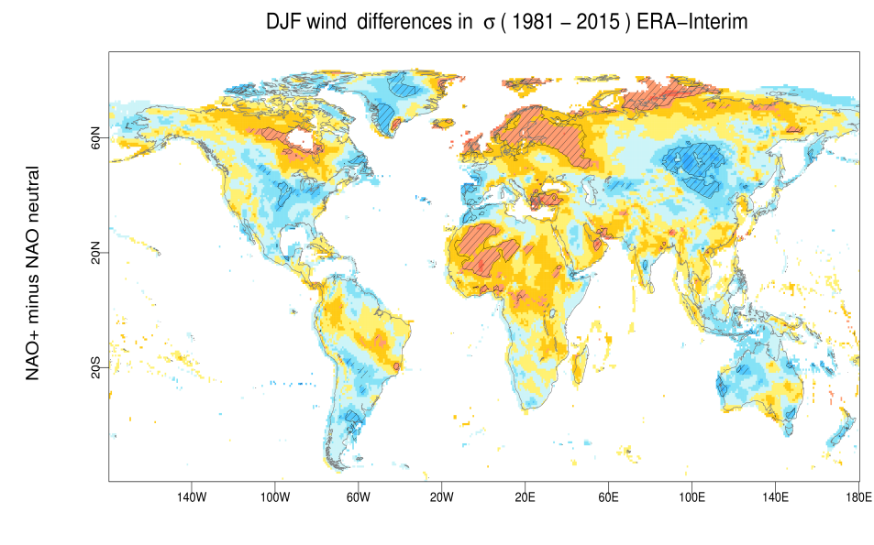
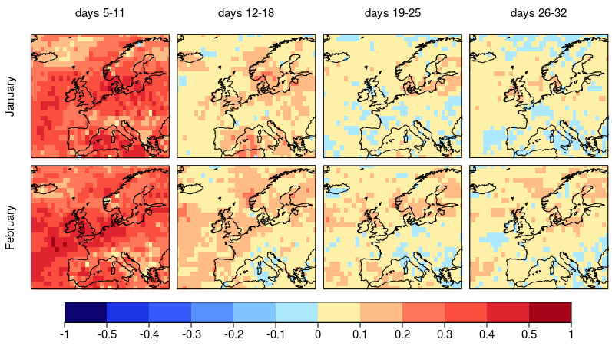
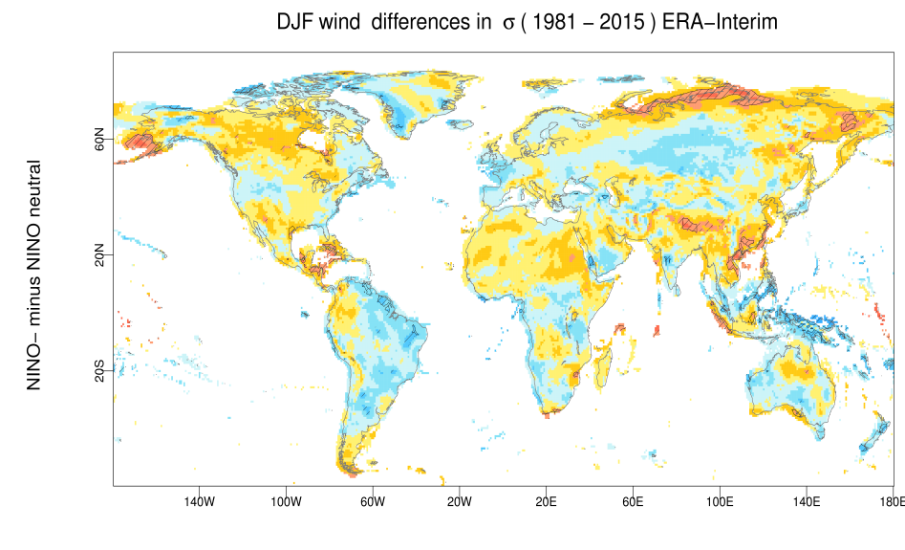
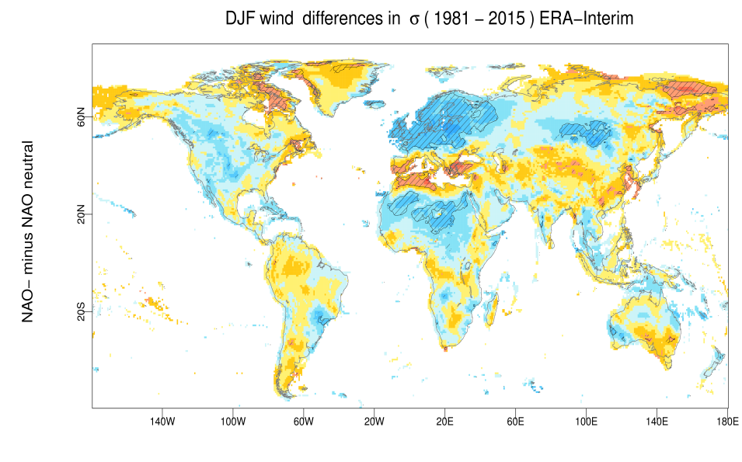
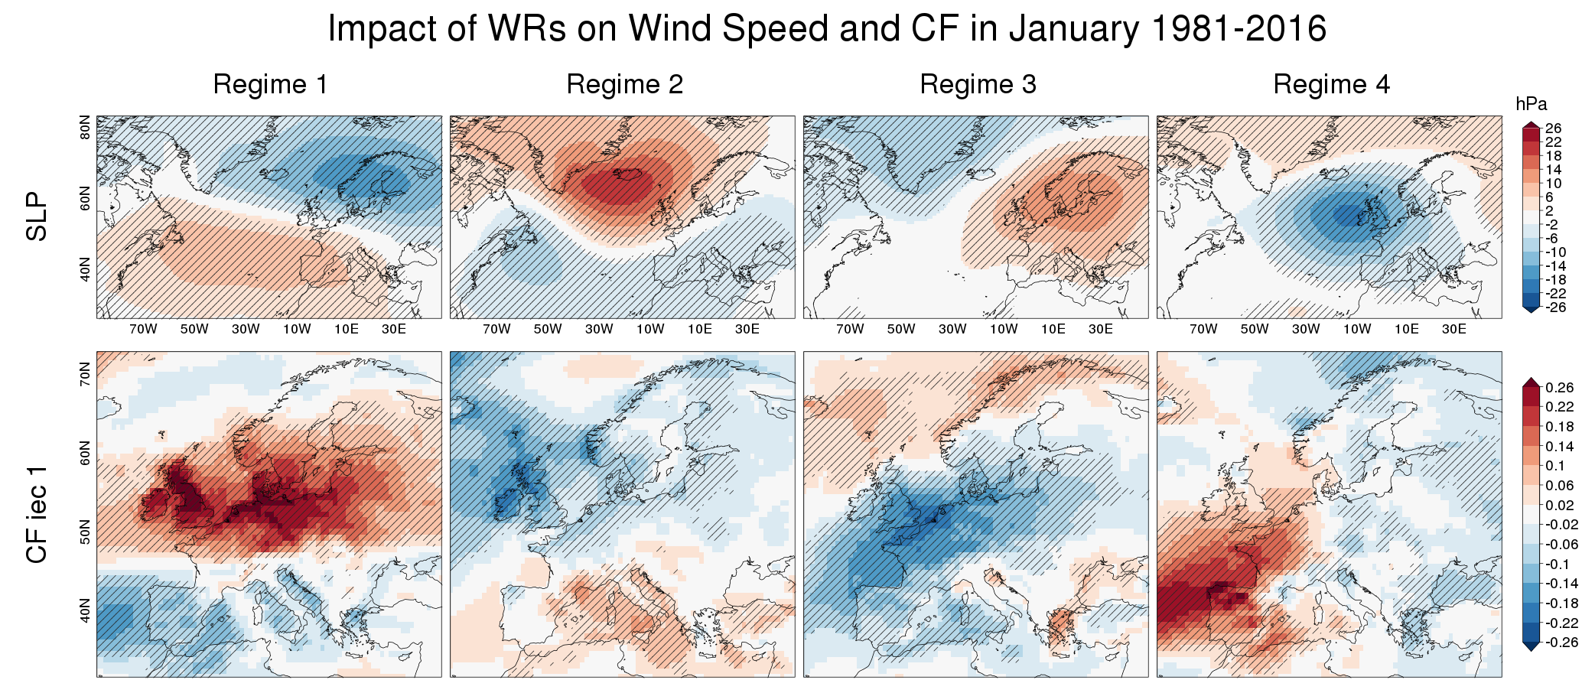
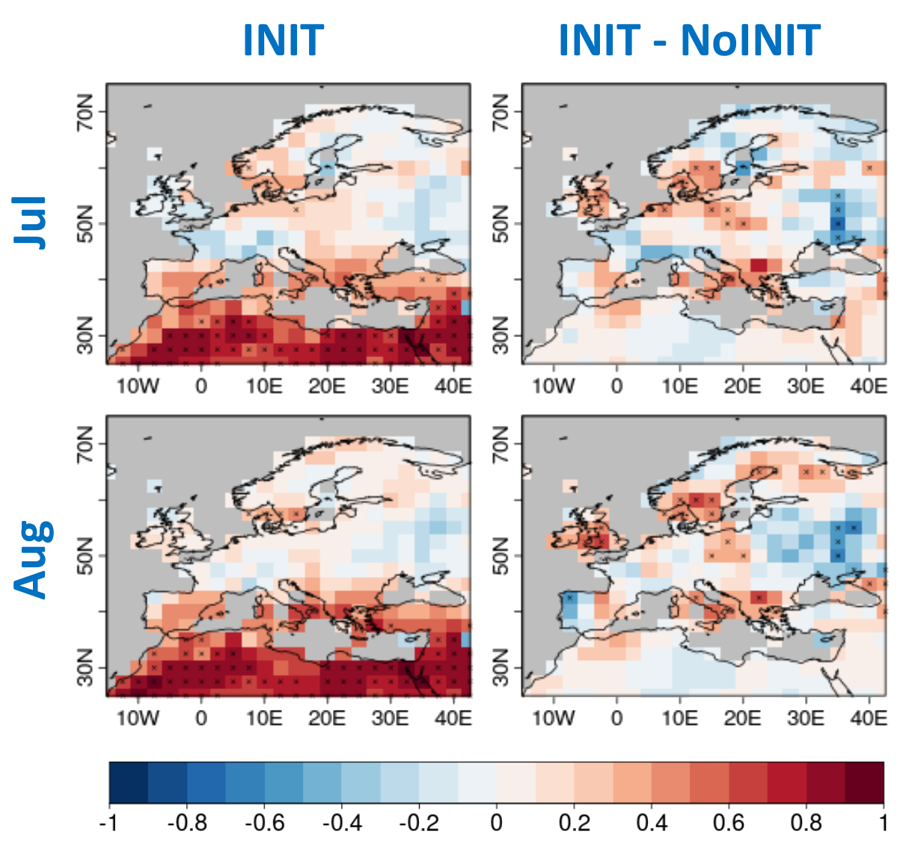
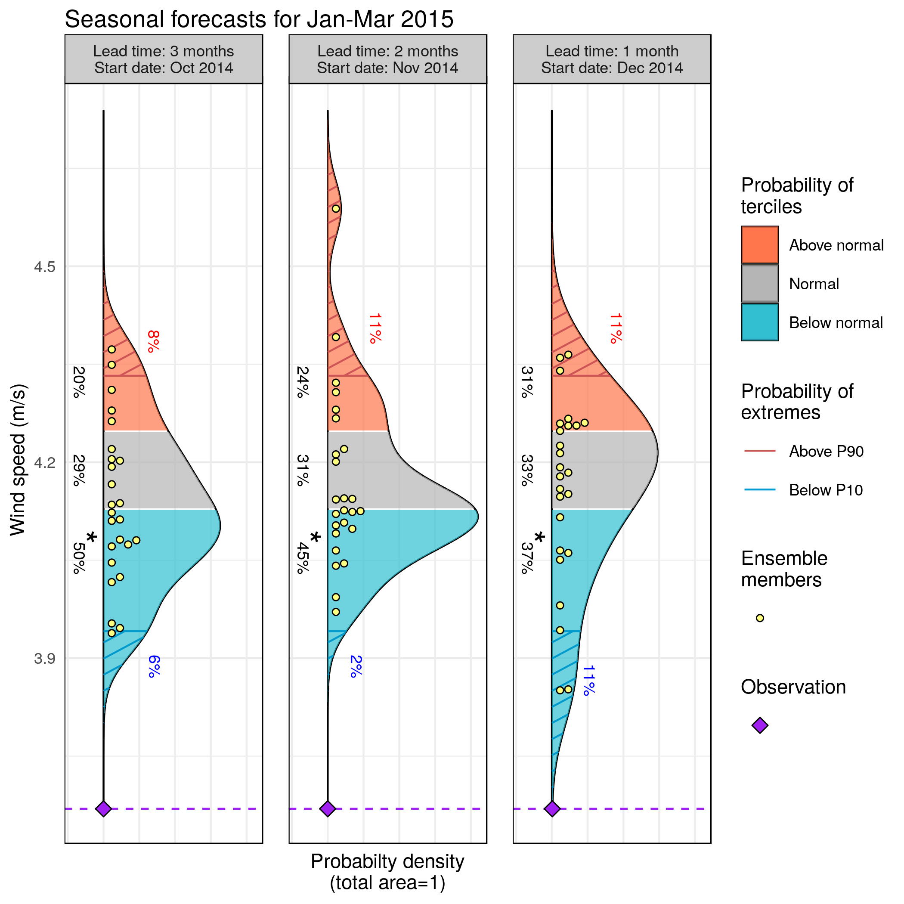
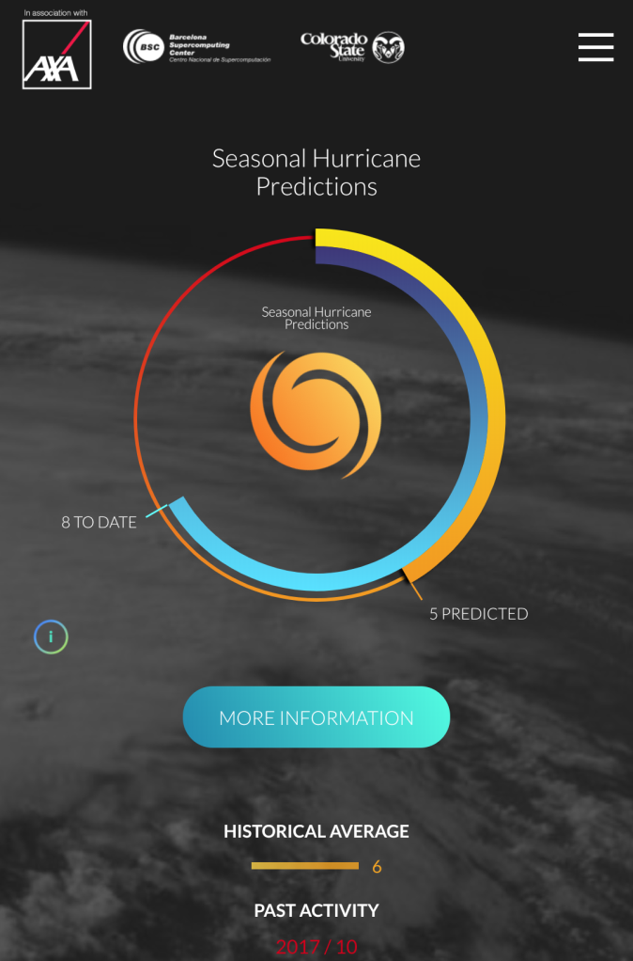
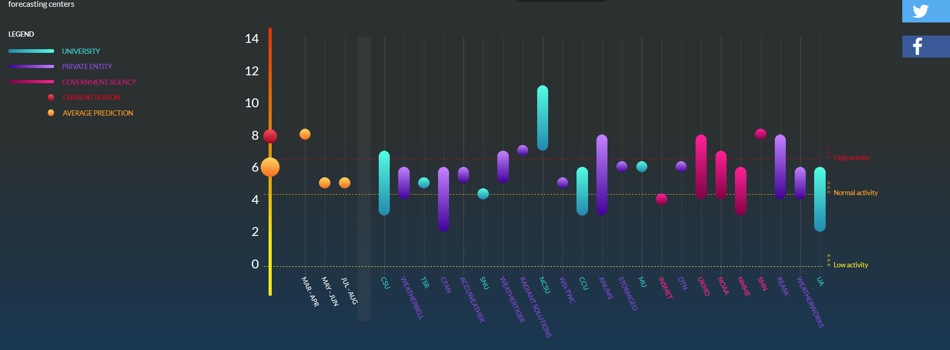
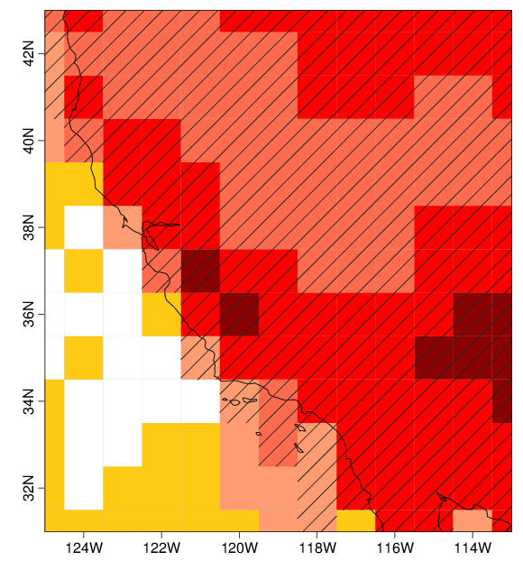
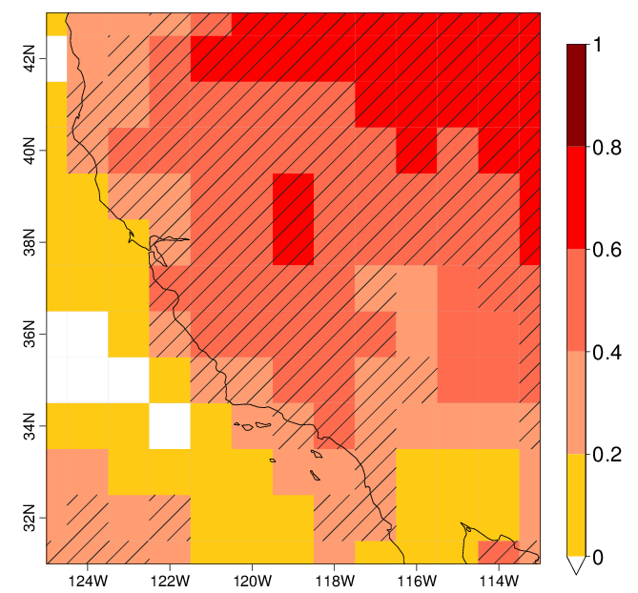
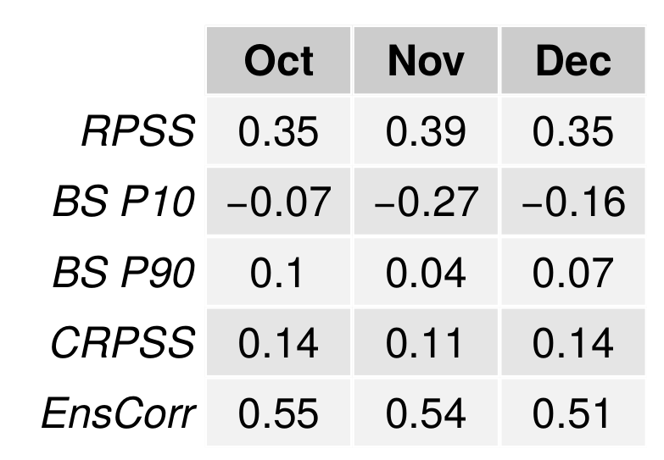
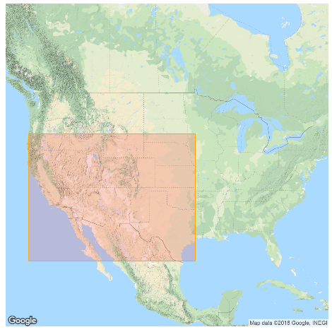
Subseasonal-to-Decadal Climate Forecast applications
Poster PA11D-0819
Francisco J. Doblas-Reyes^{1,2}, Llorenç Lledó¹, Albert Soret¹, Louis-Philippe Caron¹, Nicola Cortesi¹, Verónica Torralba¹, Isadora Christel¹, Marta Terrado¹, Balakrishnan Solaraju¹, Etienne Tourigny¹, Nube González-Reviriego¹, Andrea Manrique-Suñén¹, Raül Marcos¹, Jaume Ramon¹, Marco Turco¹ and Dragana Bojovic¹
¹Earth Sciences Department, Barcelona Supercomputing Center (BSC), Spain , ²Institució Catalana de Recerca i Estudis Avançats (ICREA), Spain
Introduction
How climate variability impacts wind power generation?
What is the skill of wind forecasts 1 to 4 weeks ahead?
Subseasonal-to-decadal (S2D) climate forecasts are able to provide valuable information across a range of socioeconomic sectors (energy, water management, agriculture, health, insurance, forest fires) through tailored climate services.
The impact of climate variability at weekly, monthly, seasonal or multi-annual time scales on socioeconomic sectors can be evaluated employing past records from Reanalysis datasets. Both ECVs and impact indicators can be used.
Subseasonal predictions of wind speed can be employed, for instance, to schedule wind turbine maintenance tasks in the less windy week of the next month. But can those predictions be trusted? The quality of any climate prediction needs to be assessed with probabilistic ensemble metrics. Ranked Probability Skill Score (RPSS) measures the quality of a product presented in form of tercile probabilities. The merits of a specific prediction are always compared to a baseline forecast, typically a climatological forecast.
Hours
Days
Weeks
Months
Seasons
Years
Decades
Centuries
NINO +
NAO +
Fig 2: The impact of NINO3.4 and NAO indexes on 10-m wind speed in DJF is evaluated from the ERA-Interim reanalysis for the period 1981-2015 with a stratification. Red areas indicate an increase of wind speed and blue areas show a decrease. Hatched areas show where the relationship is significant at a 95% confidence level. Quantifying climate impacts is a first step to valorise climate predictions and is essential to engage users in the co-production of climate information.
METEOROLOGICAL FORECASTS
SUBSEASONAL PREDICTION
SEASONAL PREDICTION
DECADAL
PREDICTION
CLIMATE
PROJECTIONS
Fig 5: RPSS of subseasonal wind speed forecasts issued in January (top row) and February (bottom row) for four different lead times. Positive values (yellow and red) indicate better performance than a climatological forecast. The highest skills are seen for the first week, but positive values can be seen up to four weeks ahead in some regions.
USER ENGAGEMENT DIAGRAM
From climate data to climate information:
Applied research in climate services at BSC makes use of operational dynamical S2D forecast systems (both from WMO producing centres and in-house simulations) to provide tailored information that fits specific user requirements. Essential steps to convert climate data into usable information are:
Predictions systems have biases, therefore all predictions need to be bias adjusted.
Predictability and forecast quality have to be always estimated from hindcasts when delivering a forecast.
Decision-making is better informed with tailored impact indicators derived from model outputs than just essential climate variables (ECV).
From climate information to climate knowledge:
Climate services transform climate information into action oriented knowledge, featuring co-design and co-development as essential elements. Climate services require a transdisciplinary approach, involving different scientific profiles –from climate to social scientists– in dialogue with users, which facilitates mutual learning.
NINO -
NAO -
(m/s)
Fig 3: A Weather Regimes classification over Europe for the month of January has been computed from daily-mean sea level pressures. Four synoptic patterns have been identified (top row), and the anomalies in wind power production associated to each cluster have been derived (bottom row). The potential for electricity generation is indicated by capacity factor .
Can droughts be predicted years in advance?
Drought events strongly impact ecosystems and human societies and can lead to extensive agricultural losses. Standardized Precipitation Evapotranspiration Index (SPEI) forecasts, based on the simultaneous use of precipitation and temperature data, can be used to anticipate those events 2 to 5 years in advance. Decadal predictions offer the potential to narrow the uncertainty range with respect to non-initialised climate projections.
How much energy will wind farms produce next season?
estimates obtained from ERA-Interim wind speeds. Hatched areas indicate statistical significance at a 99% confidence level.
Anticipating wind power production for the upcoming months is key in a context of growth of renewable energy in the electricity mix. For instance, in 2015 the majority of wind farms in the United States were short of production and revenues due to a prolonged lack of wind. Seasonal predictions have proven skillful in the region and could have been used to anticipate the wind stilling.
How many hurricanes can we expect for the coming season?
Tropical cyclones rate as the primary meteorological phenomena in the context of causing destruction and economic losses. As such, forecasting the upcoming level of hurricane activity is a prime concern for the (re-)insurance sector. The BSC has partnered with the Colorado State University and XL Catlin to offer a platform offering the most up-to-date view of upcoming Atlantic hurricane activity.
Fig 6: Ensemble-mean correlation coefficients of the SPEI6 index for July and August averaged over forecast years 2 to 5. The first column corresponds to the correlation of the initialized decadal simulations (INIT) while the second column shows the difference in correlation between initialized and non-initialized climate simulations (INIT-NoINIT) performed with the EC-Earth decadal forecast system. Dotted grids represent values statistically significant at 95% confidence level for SPEI6.
Fig 1: Seasonal predictions of average wind speed in the south-western part of the United States for the first three months of 2015, issued in October, November and December of 2014. Yellow dots are individual ensemble members, coloured areas show the probability for each tercile category (below normal, normal and above normal) and scratched areas correspond to extreme categories. The raw forecasts from the ECMWF SEAS5 system have been bias-adjusted to correct the mean, variance and ensemble spread. Skill score estimates associated to this particular forecast are provided below, with a map of the region of interest.
Can we anticipate an active forest fire season?
The Canadian Fire Weather Index (FWI) is used to quantify the potential intensity of a wildfire in function of daily temperature, precipitation, relative humidity and wind. Seasonal predictions of wildfire risk by means of FWI can inform of potentially dangerous conditions in the months to come.
www.seasonalhurricanepredictions.org
Fig 7: Anomaly correlation of monthly-mean FWI forecasts from ECMWF SEAS5 initialized in May 1st and valid for May (left) and June (right) when compared to reanalysis-derived (ERA-Interim) FWI values over California. Hatches indicate statistical significance.
Fig 4: The seasonal hurricane predictions website platform collects information from many sources and displays the number of predicted hurricanes for the next season.
The research leading to these results has received funding from the EU H2020 Framework Program under grant agreements GA690462 (ERA4CS), GA776787 (S2S4E), GA776613 (EUCP), GA776467 (MED-GOLD), GA641811 (IMPREX), GA748750 (SPFireSD) and from the Ministerio de Economía y Competitividad (MINECO) as part of the CLINSA project (CGL2017-85791-R).
This poster can be downloaded at https://earth.bsc.es/wiki/doku.php?id=library:external:posters
Corresponding author: llledo@bsc.es

