Slide 1
Impact of model resolution on the representation of deep-water formation and its link with the AMOC
Eneko Martin-Martinez – 22/02/2024 – EERIE Science Hour #8 eneko.martin@bsc.es

Slide 2
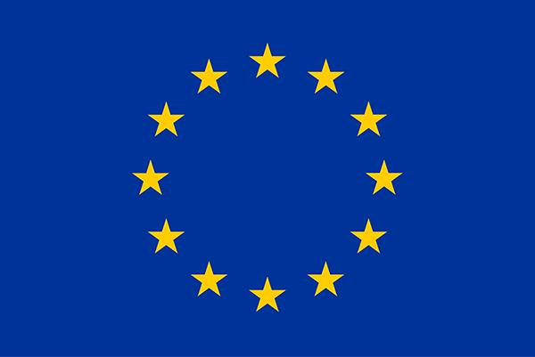
EERIE funding
This project has received funding from the European Union’s Horizon Europe research and innovation programme under Grant Agreement No. 101081383
All UK Partners in EERIE are funded by UK Research and Innovation (UKRI) under the UK government’s Horizon Europe funding guarantee (grant numbers 10057890, 10049639, 10040510, 10040984).
ETH Zürich’s contribution to EERIE is funded by the Swiss State Secretariat for Education, Research and Innovation (SERI) under contract #22.00366.

Slide 3
Personal funding
EMM has received funding from the grant PRE2021-097163 funded by MCIN/AEI/10.13039/501100011033 and by ESF Investing in your future.
EMM and other partners have received funding from the Spanish Science and Innovation Ministry (Ministerio de Ciencia e Innovación) via the STREAM project (PID2020-114746GB-I00).

Slide 4
Working colleagues
Eneko
Martin-Martinez
First stage researcher
Amanda
Frigola
Recognised researcher
Daria
Kuznetsova
Research engineer
Saskia
Loosveldt-Tomas
Research engineer
Eduardo
Moreno-Chamarro
Established researcher
Pablo
Ortega
CVC group coleader
Margarida
Samsó Cabré
Research engineer
Pierre-Antoine
Bretonnière
Senior research engineer

Slide 5
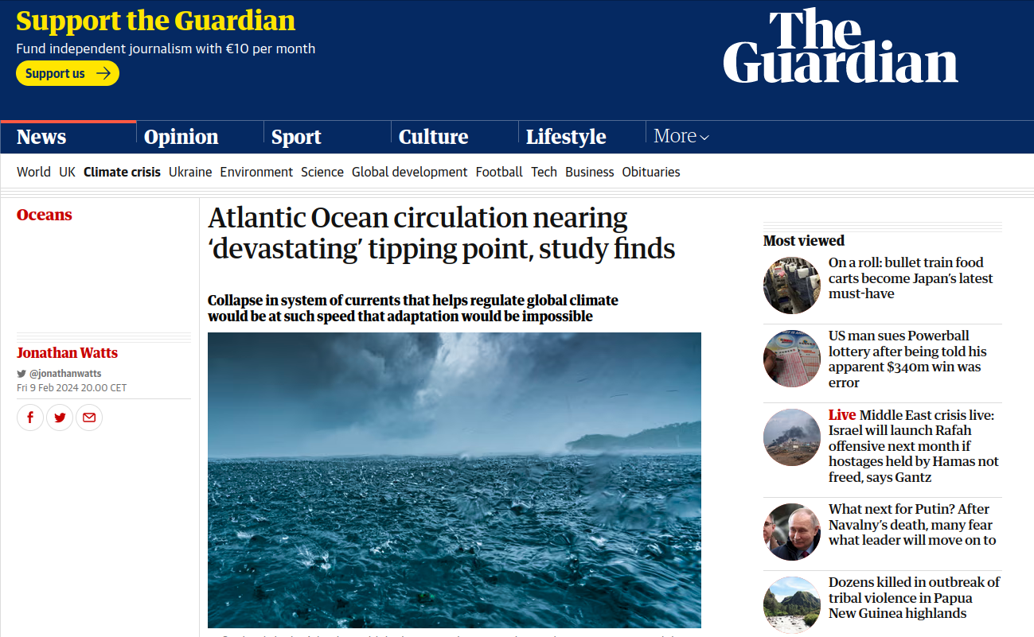
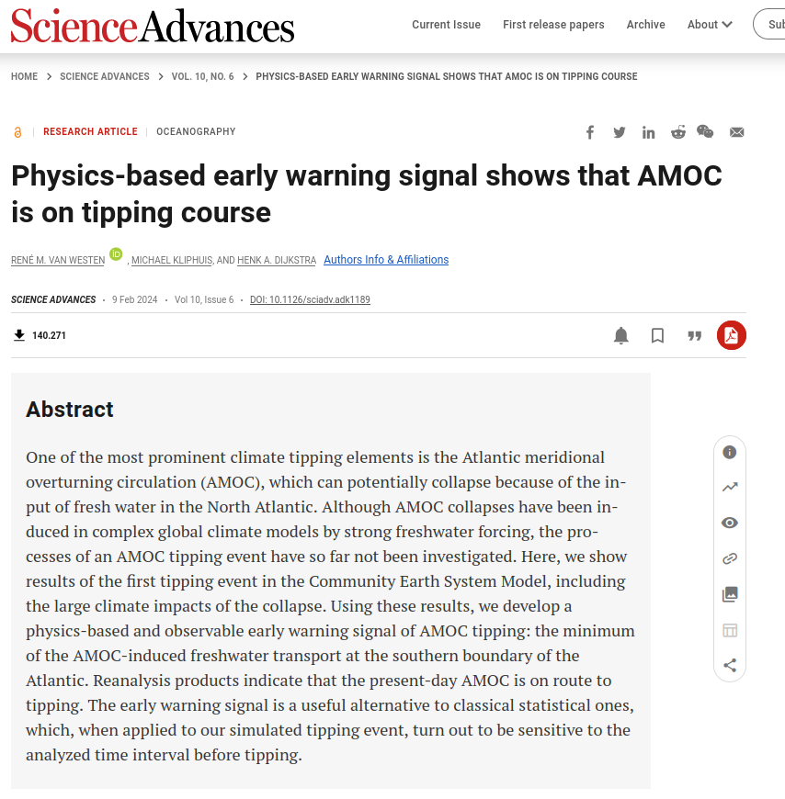
AMOC slowdown state-of-the-art
to eddy or not to eddy?
Notes:
Introduction about the AMOC Recent paper on AMOC tipping point (René M. van Westen):
They develop an early warning indicator to find an AMOC tipping event with CESM; version 1.0.5. This version, used for CMIP5, has horizontal resolutions of 1° for the ocean/sea ice and 2° for the atmosphere/land components
The model they use doesn’t resolve the mesoscale -> no eddies

Slide 6
Why are eddies relevant?
They can transport water masses to remote regions
These water masses impact the mean state and variability of the ocean
Those changes may impact the deep water mixing and, thus, the AMOC
⪅ 100 km
⪅ 1 month
Notes:
Eddies are particular features from ocean mesoscale, usually we parametrize their effects in the ESM as the standard resolutions (~1º) cannot resolve them
They have a length scale of 100km or smaller
Time scale of 1 month or smaller
They are very important to transport water masses with different properties (such as salinity or temperature) to remote regions
They impact in this way in the mean state and variability of the ocean. This is, in fact, what EERIE’s WP6 aims to study
Those impacts may also influence the deep water mixing, which can motivate the AMOC

Slide 7
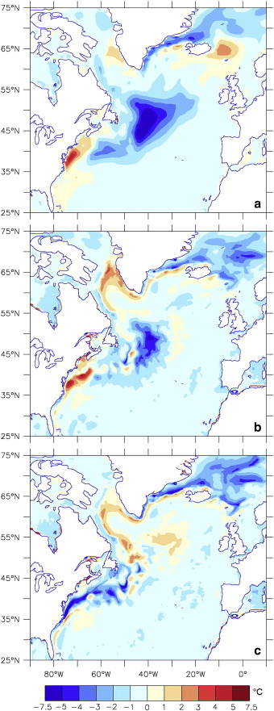
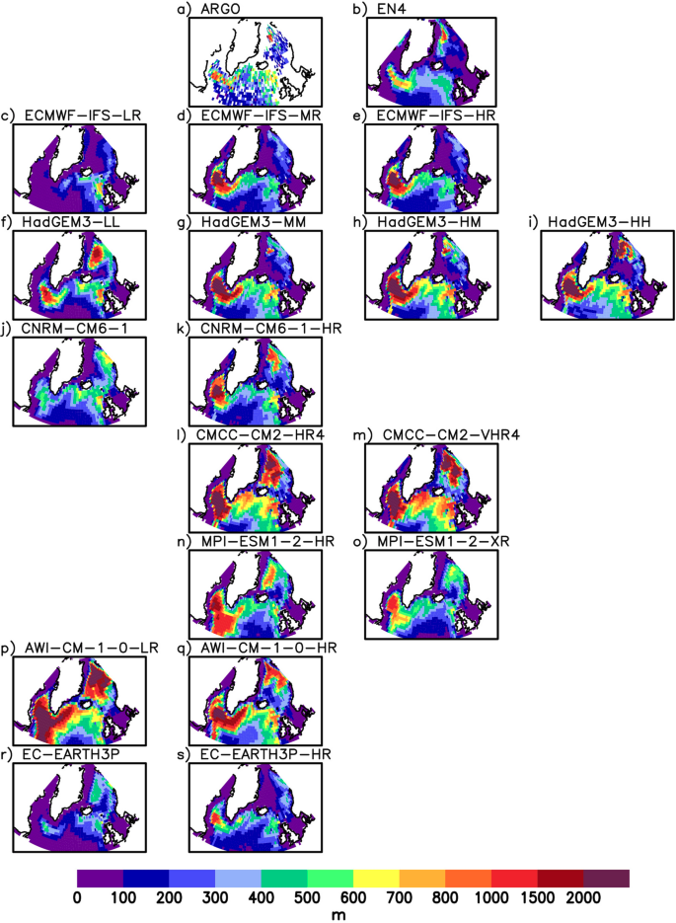
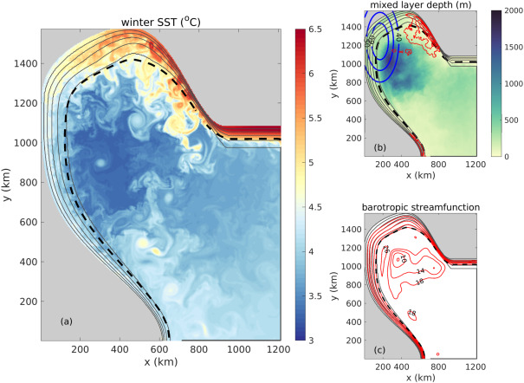
Some eddy-rich studies
Deeper mixing in the Labrador Sea
Eddies are essential in boundary-interior exchanges
Bias correction
(Georgiou et al., 2020)
Improve air-sea interactions
(Marzocchi et al., 2015)
(Koenigk et al., 2021)
(Moreno-Chamarro et al., 2021)
Notes:
Alice Marzocchi :
Ocean forced model. Bias between satellite observations (Reynolds product) for SST for ORCA1, ORCA025 and ORCA12 The main remaining differences between ORCA12 and the observational dataset are confined to the boundary regions (e.g. along the US coast north of Cape Hatteras). However, rather than being a model bias, this could also reflect the model's ability to simulate fine scale features of the circulation (such as boundary currents and sharp SST fronts) that are absent from the Reynolds dataset. Toben Koenigk:
ESMs. High-resolution models show more realistic ocean stratification in the Labrador Sea than the standard resolution models, however, they generally overestimate the convection. The results indicate that the representation of sub-grid scale mixing processes might be imperfect in the models and contribute to the biases in deep convection. Since in more than half of the models, the Labrador Sea convection is important for the Atlantic Meridional Overturning Circulation (AMOC), this raises questions about the future behavior of the AMOC in the models. Sotiria Georgiou:
Regional ocean model (lagrangian + eulerian study)
This study further highlights that the export of dense water masses, which is governed by the eddy activity in the basin, yields export timescales that are usually longer than a year. This underlines the necessity of resolving the mesoscale features required to capture the interior–boundary current exchange in order to correctly represent the export of the LSW.
Eduardo Moreno-Chamarro:
ESM.
This study finds that due to the reduction of the bias on the position of the GulfStream current, shifted nord, and the finner resolution in the atmosphere, the air sea interaction was improved in the North Atlantic, leading to a strong regional ocean surface warming that intensifies air–sea heat fluxes and baroclinicity. For this then to translate into a strengthening of North Atlantic extratropical cyclone activity.

Slide 8
Notes:
EERIE aims to work with a new generation of eddy-rich ESM
But it is not the first neither the only project doing that PRIMAVERA project November 2015 - July 2020 aimed to improve the resolution in several ESM

Slide 9
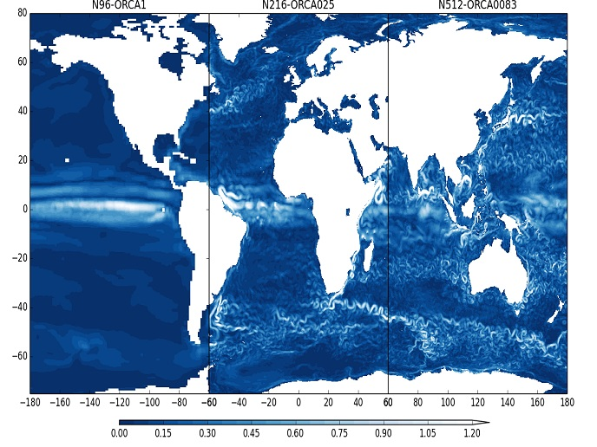
PRIMAVERA project’s outputs
Source: PRIMAVERA Gallery (courtesy of Malcolm Roberts)
Notes:
Ocean surface currents from HadGEM3-based global coupled (atmosphere-ocean/sea-ice) models at three different resolutions - (left) 130km-1 degree, (middle) 60km-1/4 degree, (right) 25km-1/12 degree (courtesy of Malcolm Roberts) :
IFS cy36r4 (TL1279, linearly reduced Gaussian grid equivalent to 2560 x 1280 longitude/latitude; 91 levels; top level 0.01 hPa)

Slide 10
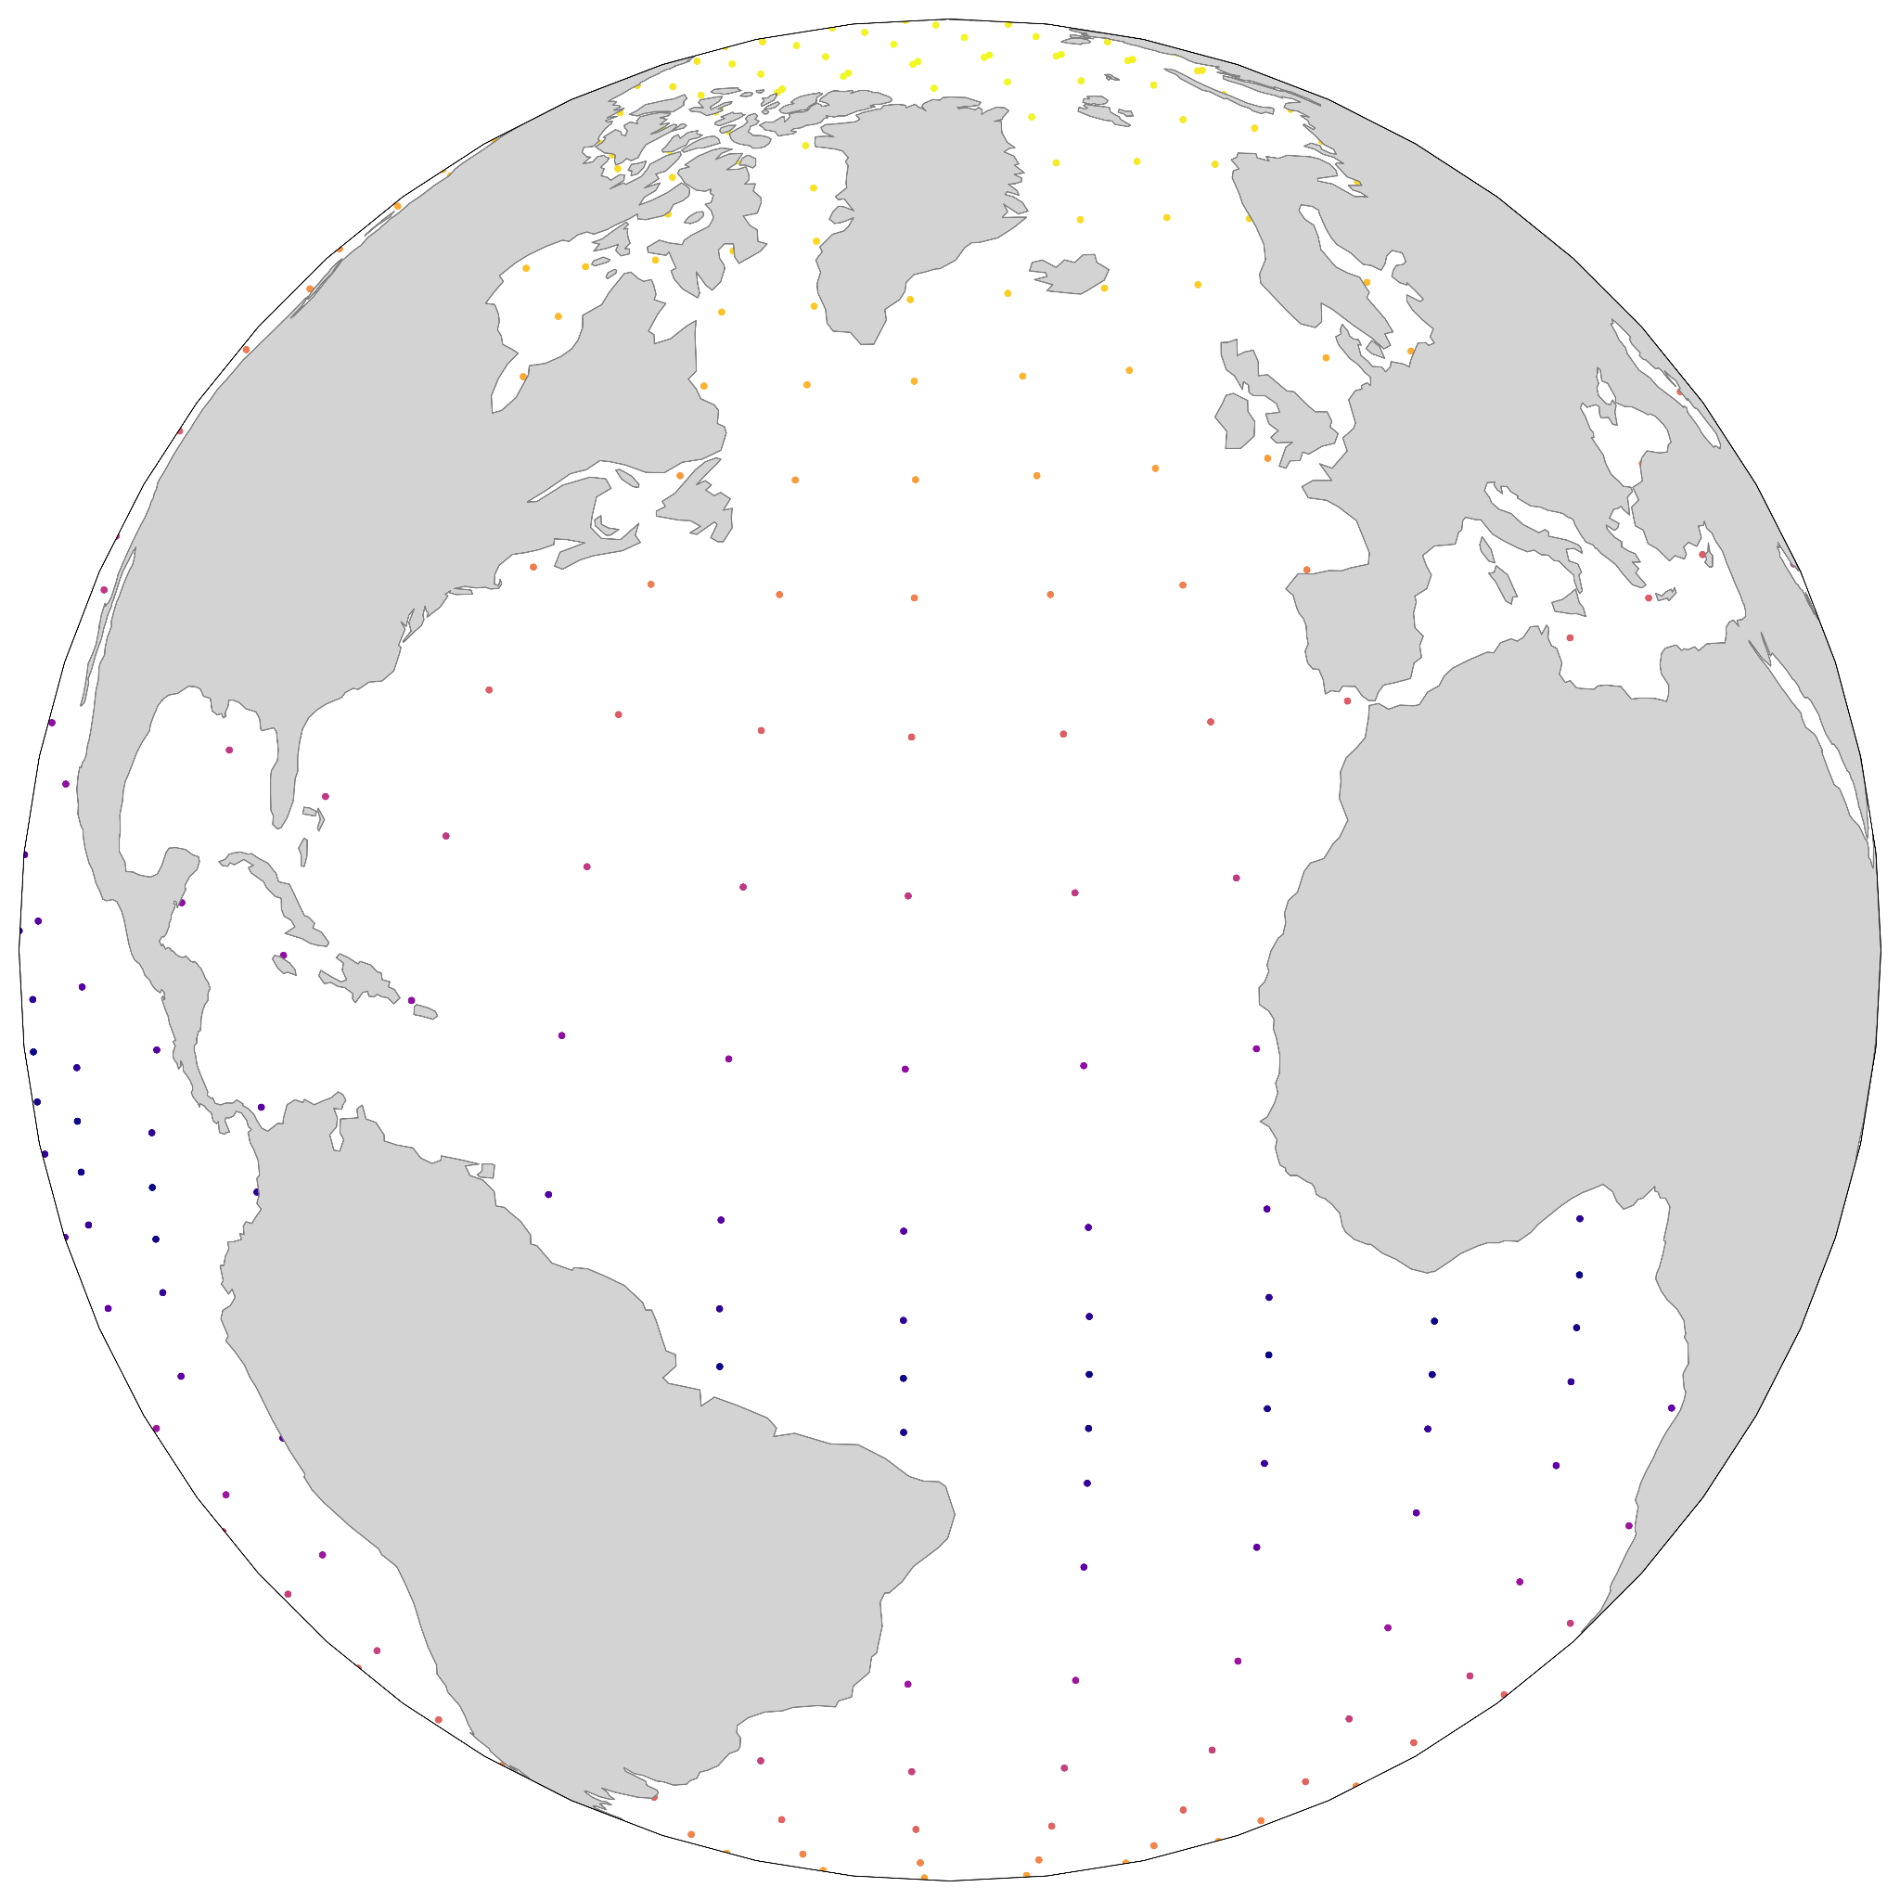
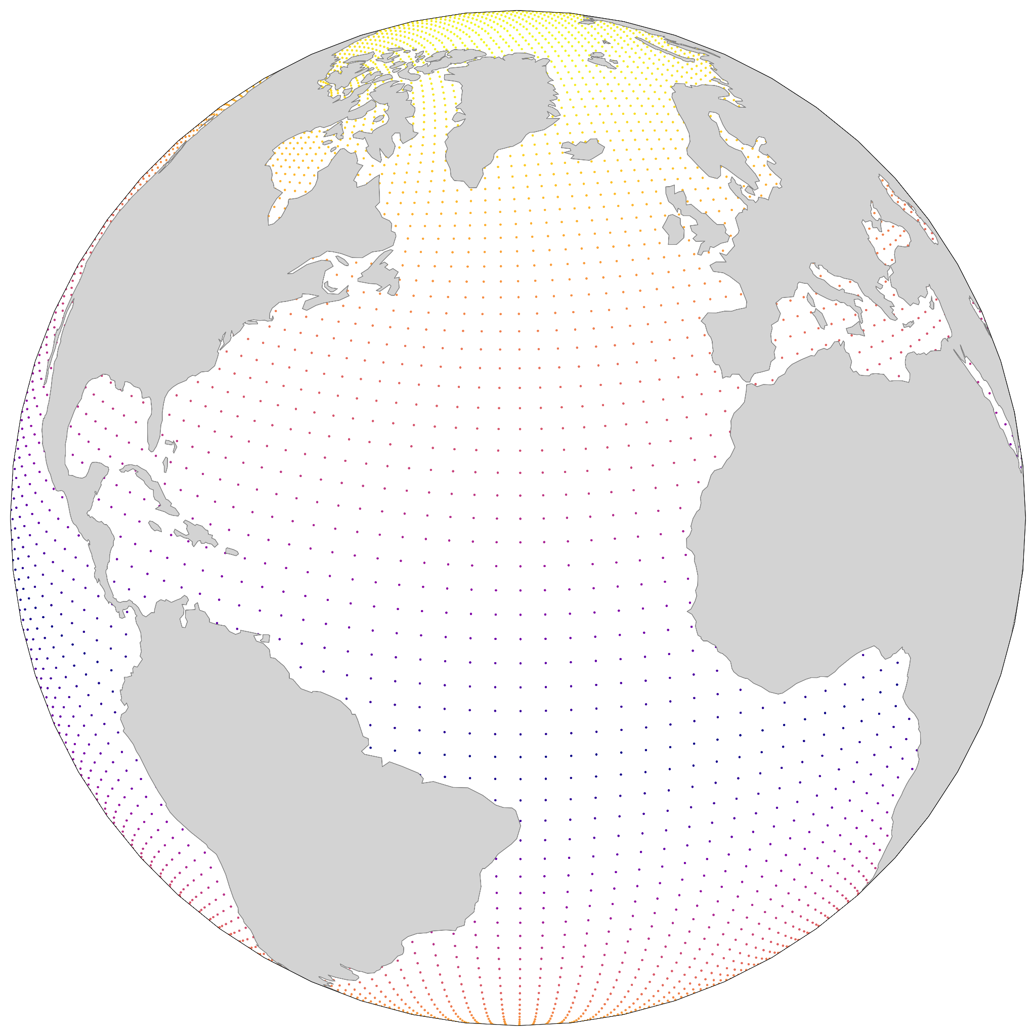
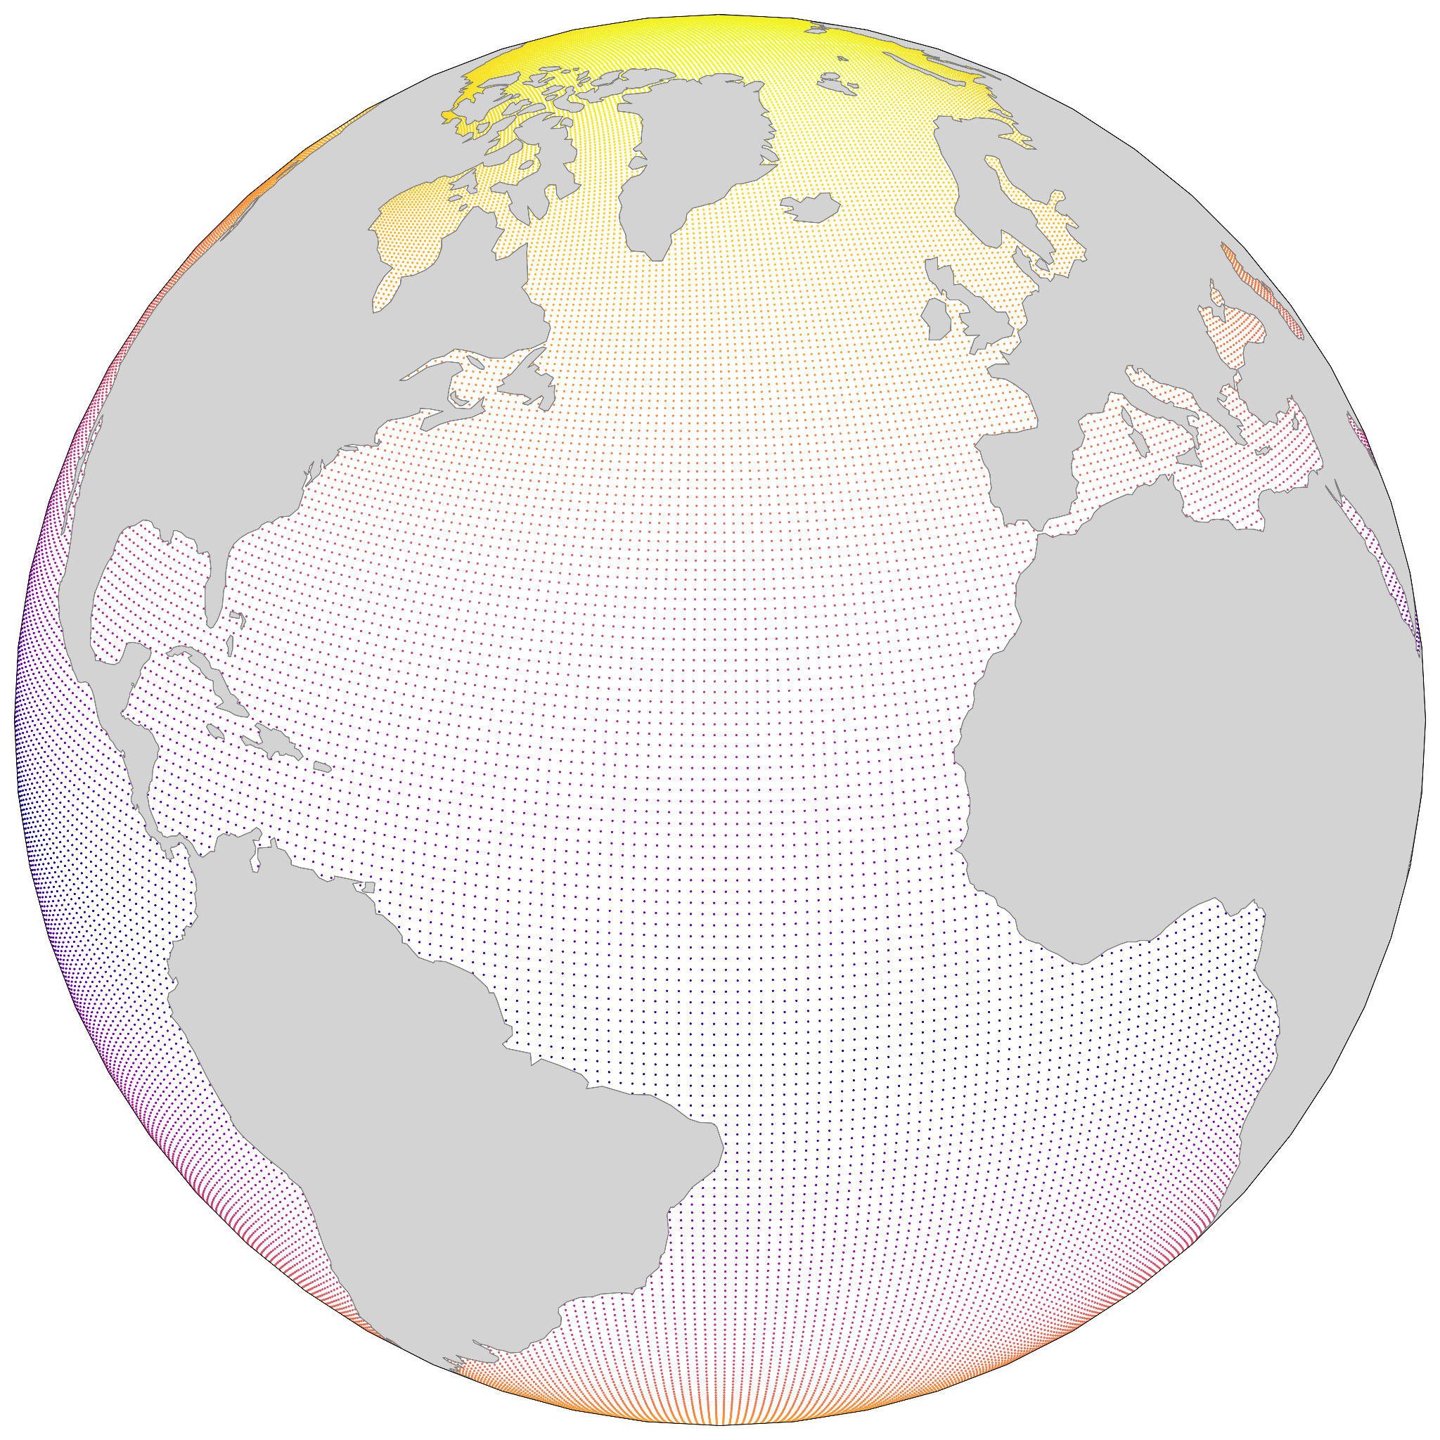
PRIMAVERA project’s EC-Earth models
EC-Earth3P
70km ~ Atmosphere
100km ~ Ocean
EC-Earth3P-HR
35km ~ Atmosphere
25km ~ Ocean
EC-Earth3P-VHR
14km ~ Atmosphere
8km ~ Ocean
Notes:
EC-Earth3P
ORCA1 T255
IFS cy36r4 (TL255, linearly reduced Gaussian grid equivalent to 512 x 256 longitude/latitude; 91 levels; top level 0.01 hPa)
NEMO3.6 (ORCA1 tripolar primarily 1 degree with meridional refinement down to 1/3 degree in the tropics; 362 x 292 longitude/latitude; 75 levels; top grid cell 0-1 m)
EC-Earth3P-HR
ORCA025 T511
IFS cy36r4 (TL511, linearly reduced Gaussian grid equivalent to 1024 x 512 longitude/latitude; 91 levels; top level 0.01 hPa)
EC-Earth3P-VHR
ORCA12 T1279
IFS cy36r4 (TL1279, linearly reduced Gaussian grid equivalent to 2560 x 1280 longitude/latitude; 91 levels; top level 0.01 hPa)

Slide 11
Model set-up
HighResMIP protocol
1950-control
76 years long
Notes:
High Resolution Model Intercomparison Project described Haarsma et al (2016)
1950 fixed forcing conditions
76 years long, originally there were more but were discarded to avoid model drift

Slide 12
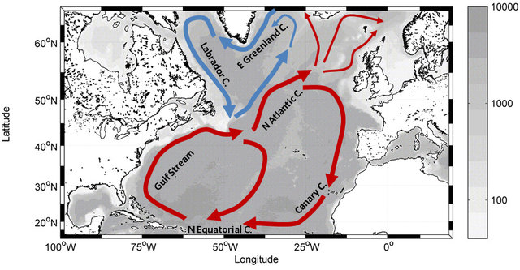
Main circulation in the North Atlantic
SPG: Subpolar Gyre
Labrador sea
Irminger sea
STG: Subtropical Gyre
Cape Farewell
Newfoundland
.SPG.
Cape Hatteras
Flemish Cap
.STG.
Source: Berx & Payne (2016)
Notes:
Main surface ocean currents in the North Atlantic

Slide 13
Analysis summary
Atmospheric forcing
Mean stratification
Deep water formation
Salinity
advection
AMOC
Zonal density gradient
Notes:
Atmospheric forcing and salinity advection may provoke changes on the mean stratification profile in some key regions in the subpolar gyre of the northatlantic. These changes may impact the deep water mixing which will lead to anomalies in the zonal density gradient.
Which impacts the Atlantic Meridional Overturning Circulation

Slide 14
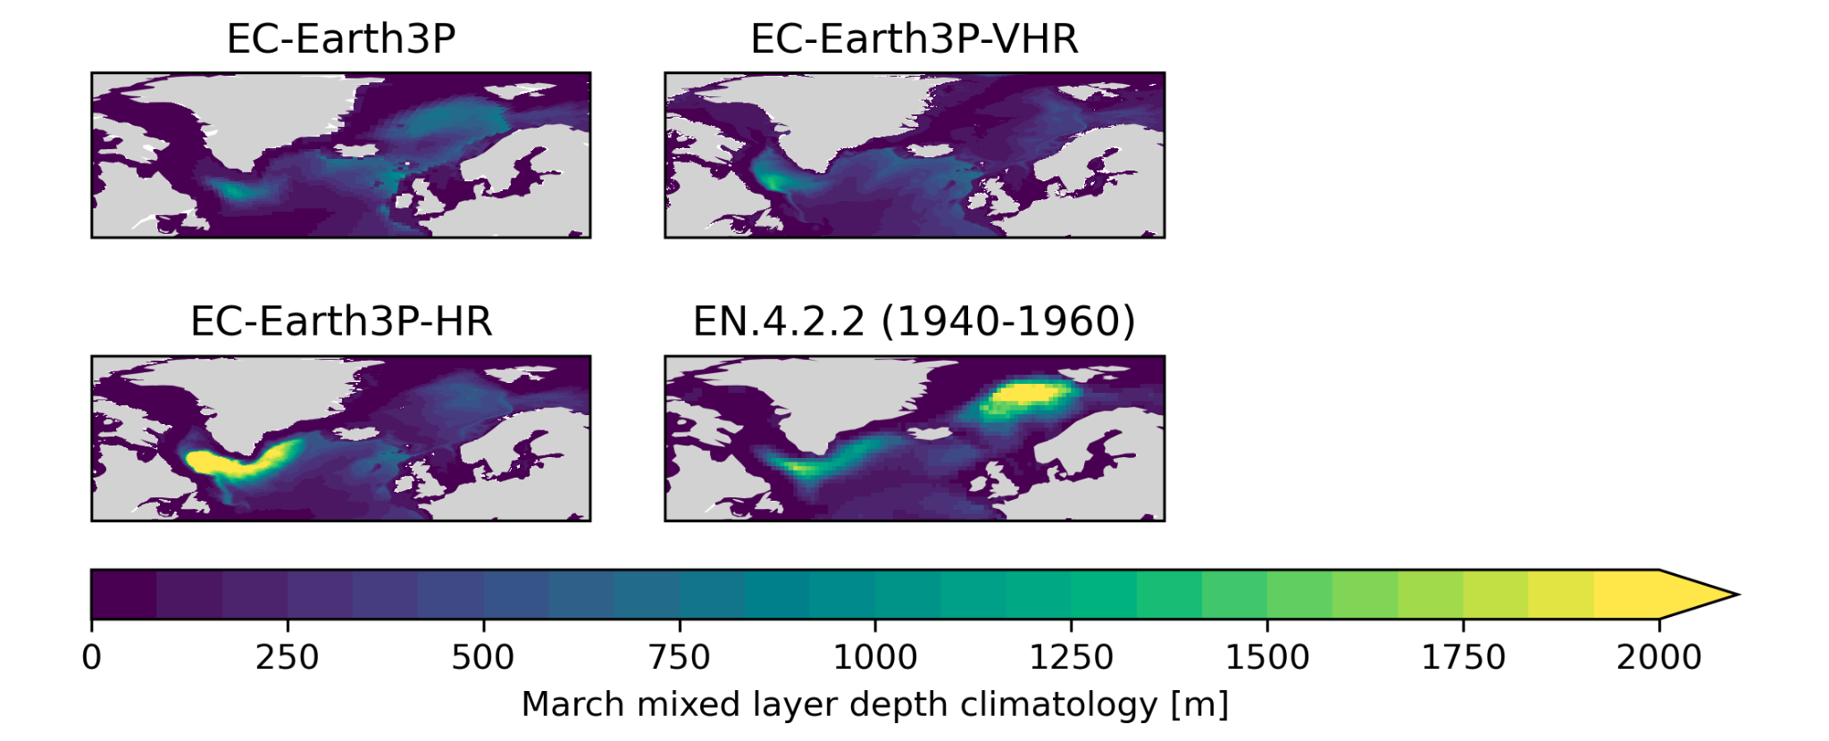
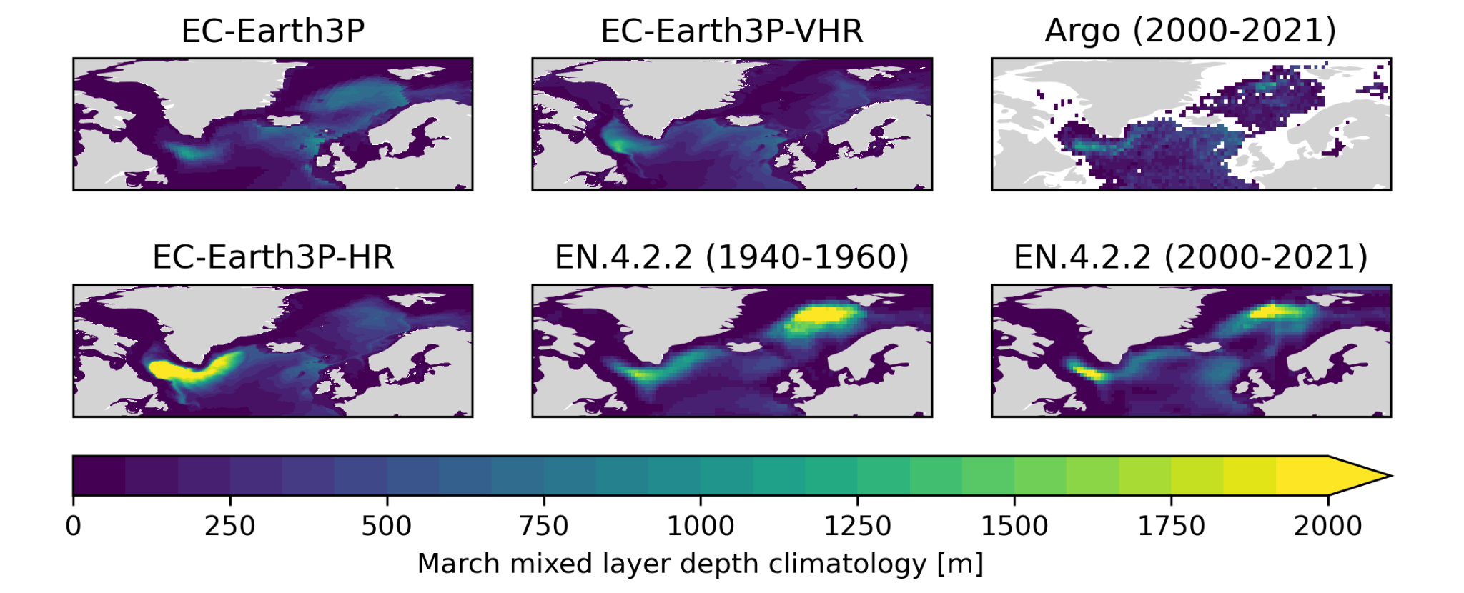
Mixing in the North Atlantic
March mixed layer (MLD) depth climatology
Notes:
Mix layer depth has been computed with monthly temperature and salinity data, using TEOS-10 equation to compute sigma0 and later computing the MLD using the density threshold algorithm (0.03kg/m3 from 10m)
EC-Earth3P-HR shows deeper mixing climatology as was shown by Koenigk et al. (2021).
EC-Earth3P-VHR shows more realistic mixing in the Labrador Sea
EC-Earth3P no mixing in LS due to sea ice cover bias
Any of the model shows deep mixing in the Nordic seas (sea ice there)
EN4 could have biases due to the interpolation on time and depth of the observations

Slide 15
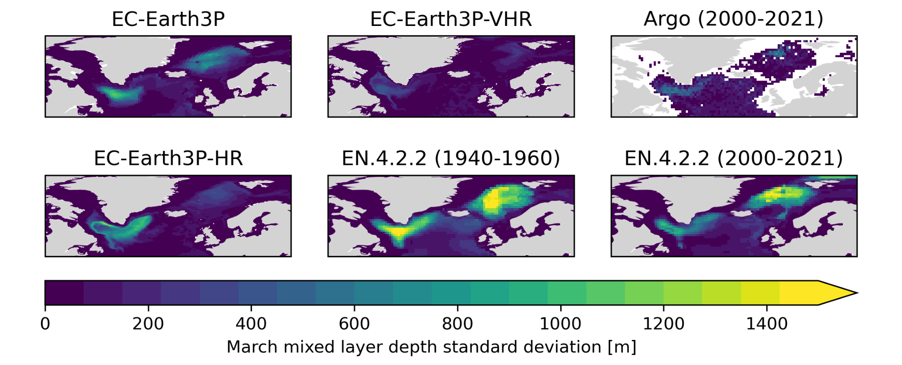
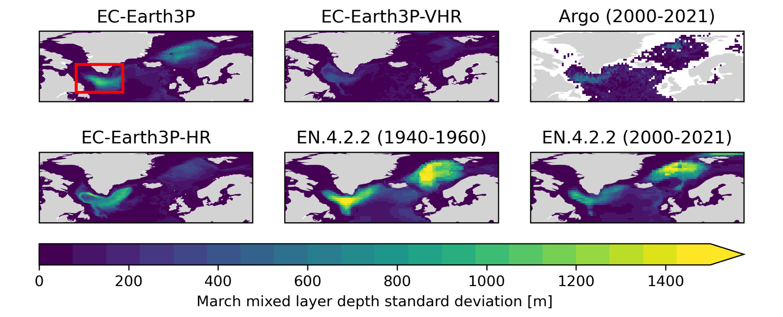
Mixing in the North Atlantic
March mixed layer depth (MLD) standard deviation
Notes:
EC-Earth3P and EC-Earth3P-HR show similar variability
EC-Earth3P-VHR has lower variability
EN4 to strong variability, probably could be mixed with measurement errors We take the box in red in the Labrador sea (also taking a small portion of Irminger sea, to compute the average timeseries and vertical profiles

Slide 16
Vertical profiles in the Subpolar Gyre
Mean climatology in the Labrador sea in DJFM
Notes:
EC-Earth3P vertical profile seems to have less bias respect to EN4 in the surface. However, there are bigger bias in salinity and temperature, which are compensated
EC-Earth3P-VHR shows greater stratification than EC-Earth3P-HR and seems to be less biased

Slide 17
Vertical profiles in the Subpolar Gyre
Regression between March MLD series and DJFM profiles in the Labrador sea
Notes:
Regression of the vertical profiles against MLD show the quantity of anomaly needed to produce 1 m of mixed layer depth
In EC-Earth3P-VHR, being less stratified, it is easier to overcome the stratification, which translates to the bigger MLD
Density regression is consistent with salinity, however temperature shows different patterns

Slide 18
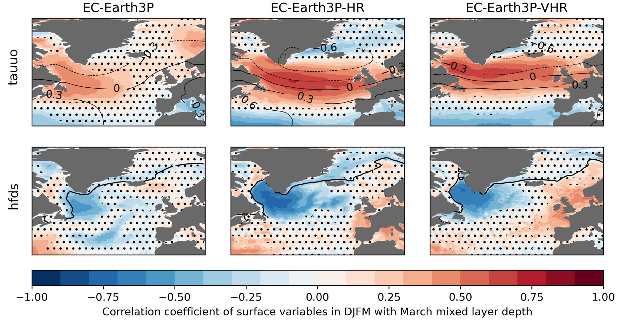
Mixing drivers in the North Atlantic
Correlation of DJFM wind-stress and heat-flux with MLD series
Notes:
First row shows correlation of the eastward wind stress in winter (DJFM) with March MLD timeseries, we can notice a NAO pattern in the highest resolution models, NAO+ enhancing mixing and NAO- diminishing it.
Contours show the correlation of the MLD timeseries with PSL, which show greater pressure gradients in those models. Leads to intensification in meridional winds
This effect cools down the ocean. The second row shows the heat flux in the ocean surface (positive means heat absorbed and negative heat released) There is a loss of heat flux in the Labrador sea and irminger leading to mixing. We see that the heat loss in EC-Earth3P doesn’t fully enter in the Labrdor see, the contour line shows the 15% od sea ice concentration, which explain the bias of this model

Slide 19
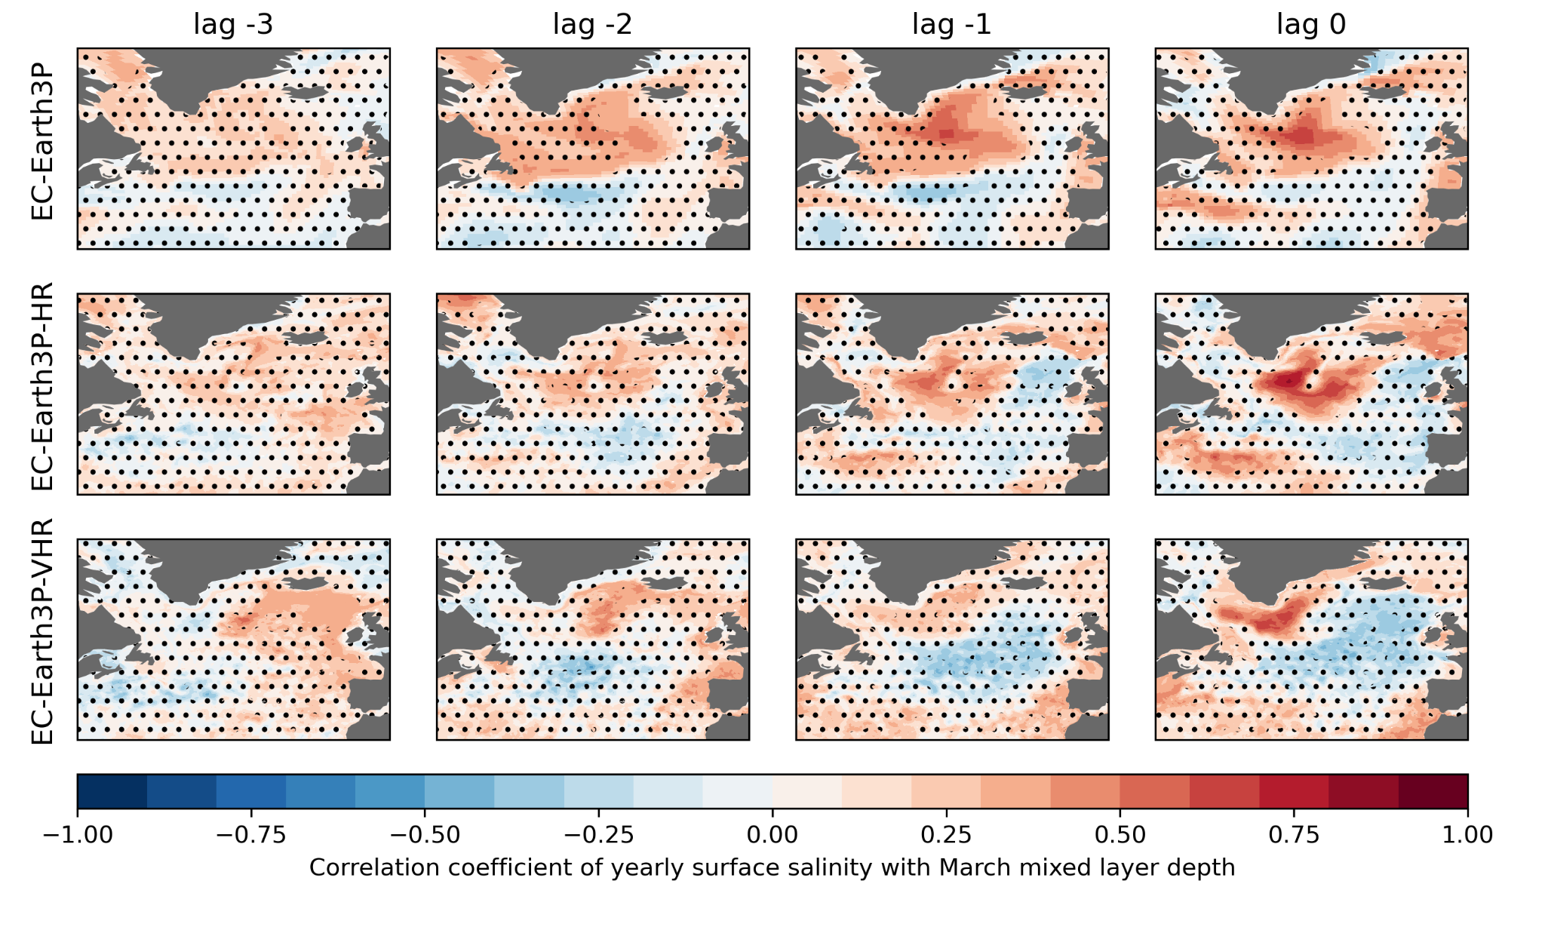
Mixing drivers in the North Atlantic
Correlation of SOS with MLD series
Notes:
Annual average correlations shows how salinity advected can influence the mixing. Salinity anomalies are propagated from 2 or 3 years before, from east to west by the mean flow of the Subpolar Gyre.

Slide 20
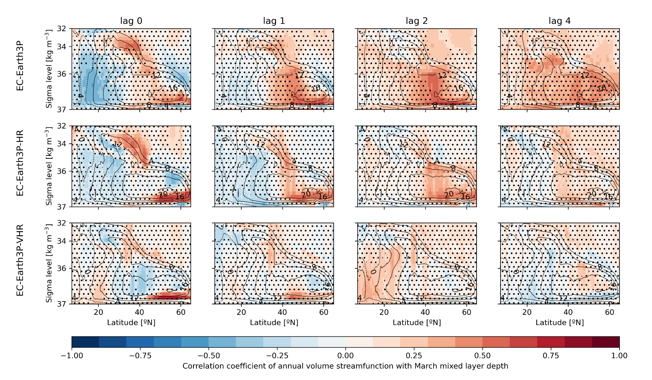
AMOC response to mixing
Correlation of MOC with MLD series
Notes:
We computed the overturning volume streamfunction and remove from it the ekman transport and return
You can see the results in sigma space, contourlines show the climatology, while the colormap is the correlatio of the STF with March MLD
When increasing the resolution the persistence of the signal is losts, as well as the propagation to the lower latitudes

Slide 21
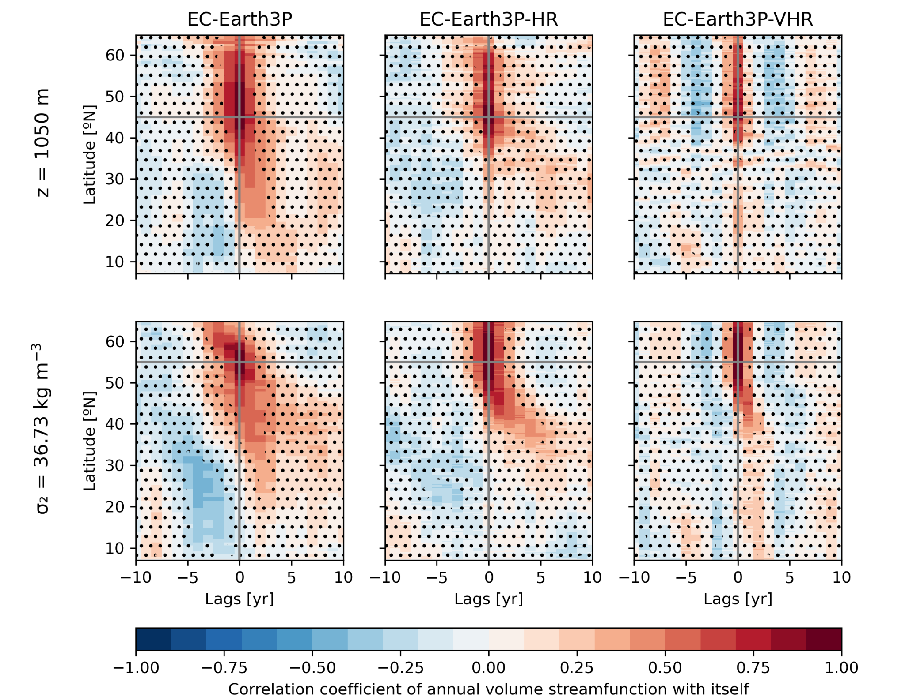
AMOC latitudinal coherence
Correlation of MOC at fixed depth with MOC at fixed depth and latitude
Notes:
We correlate overturning stream function at fixed depth (1050m top row, and 36.73 kg m-3 bottom row) with itself at fixed latitude, This can explain how the MOC is connected and its latitudinal coherence
There are important differences across resolutions both in terms of speed and pathways
EC-Earth3P-VHR seems to show a fast propagation toward 10ºN in the 2nd-3rd years We have in general a change of propagation pattern at 35ºN (Cape Hatteras) where is expected to change the propagation of anomalies from advection to coastal kelvin wave speed (Rong Zhang 2010)

Slide 22
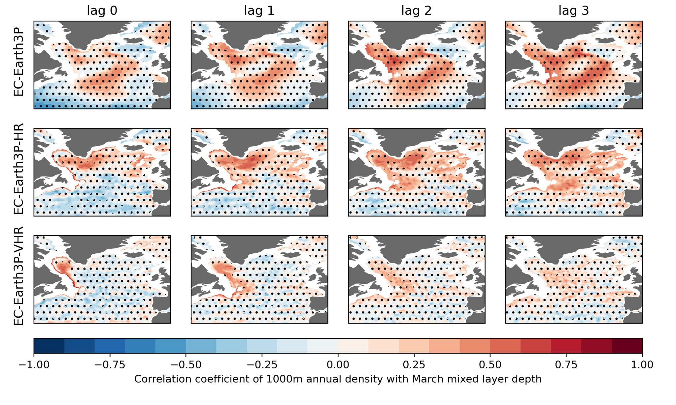
Deep ocean density anomalies propagation
Correlation of density at 1000m with MLD series
Notes:
We can see density anomalies at 1000m depth propagating along the boundary current around Newfoundland (Flemish Cap)

Slide 23
Conclusions
The drivers and impacts of Labrador Sea convection are sensitive to the model resolution
The mean Labrador Sea stratification and MLD are more realistic in the eddy-resolving version of EC-Earth3P
The NAO exerts a stronger influence on Labrador MLD in the eddy-resolving and eddy-permitting versions of EC-Earth3P
The advection of salinity anomalies by the mean SPG circulations seems to also play an important driving role in the eddy-resolving one
We identify important differences across resolutions both in terms of speed and pathways for the propagation of Labrador Sea density anomalies along the Western Boundary Currents, which ultimately impact the coherence of the AMOC changes across latitudes

Slide 24
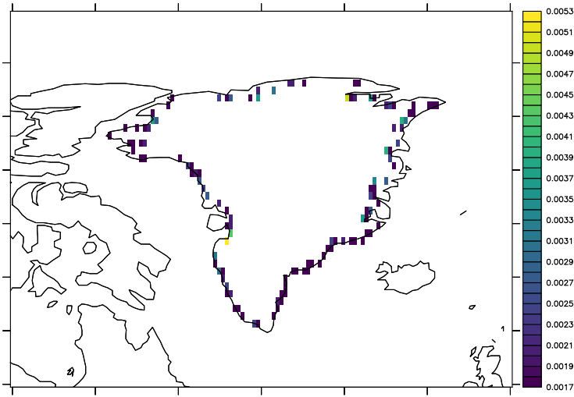
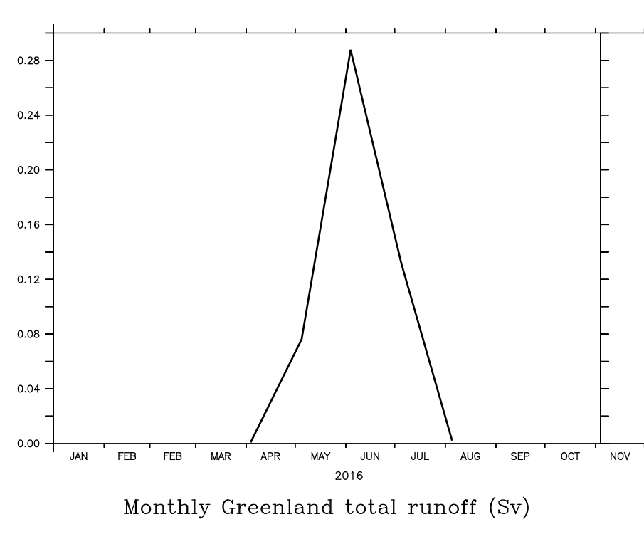
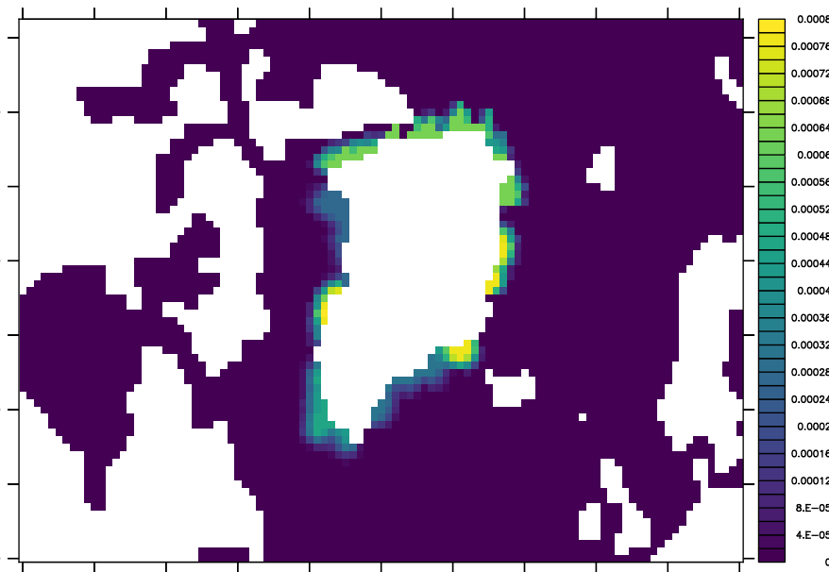
How about water-hosing?
Three ensemble members
For 21 years, starting from different AMOC states
Branching off from a 1950-control
Amount of freshwater
Idealized setup:
0.1 Sv distributed spatially and over the year
Spatial and seasonal distribution
Based on Bamber et al. (2018)
1958–2018 climatological mean
July runoff (Sv). Output by NEMO.
Implemented by E. Moreno-Chamarro for EC-Earth3P-VHR

Slide 25
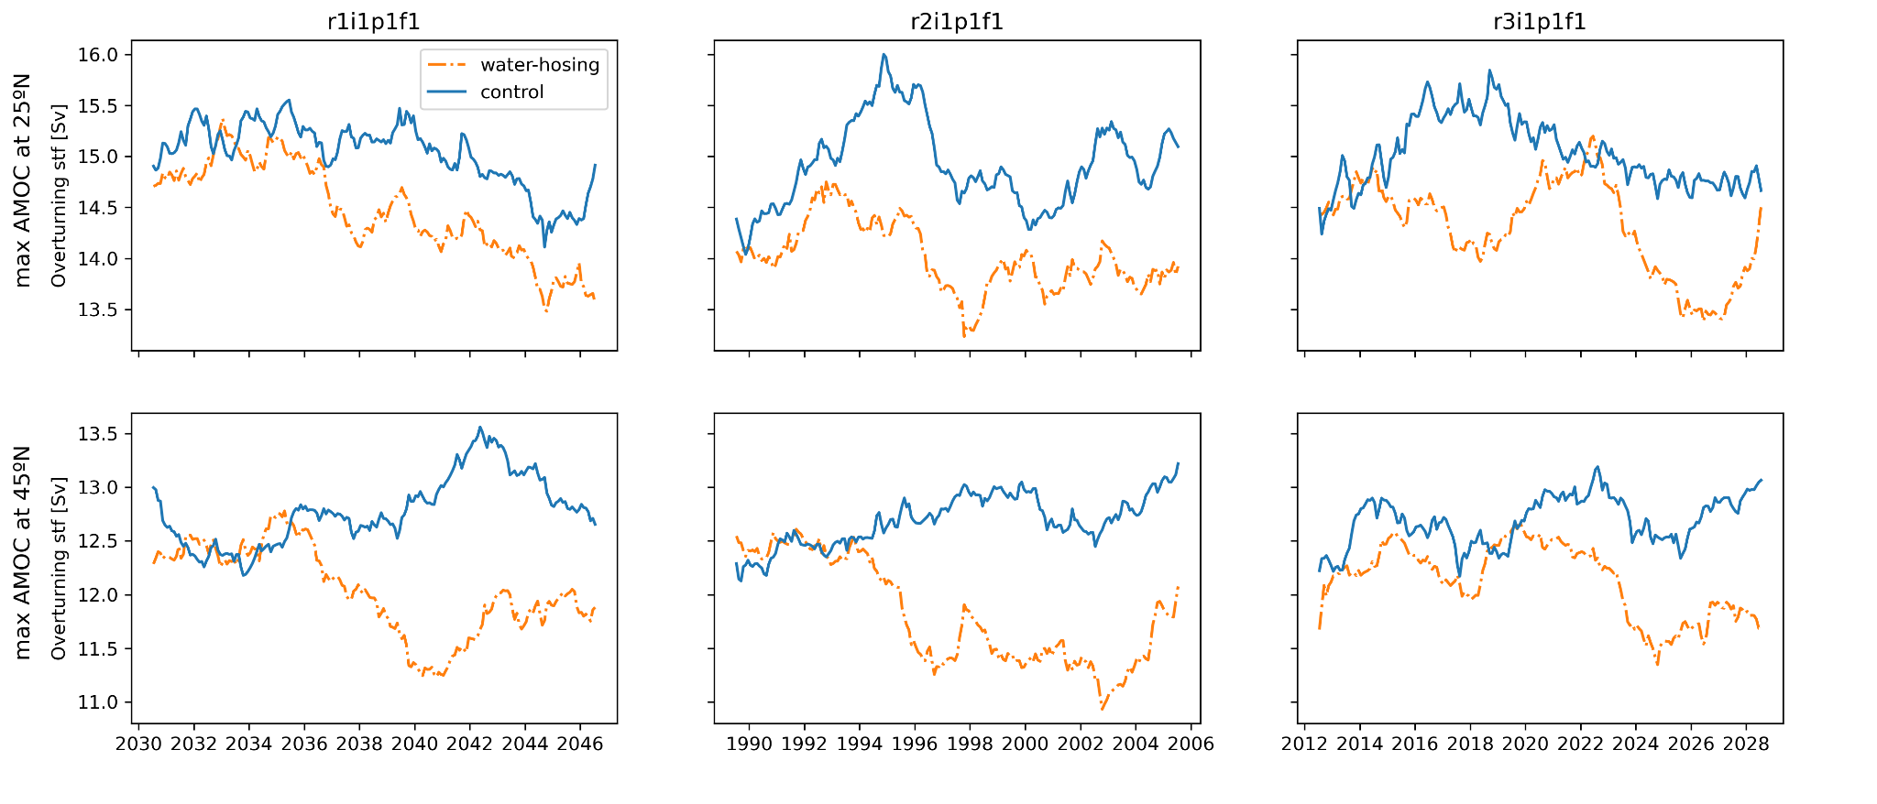
Impact of water-hosing on the AMOC
maxMOC with 5-years low-pass-filter at 25ºN and 45ºN
Notes:
Plots of overturning stream function (in depth space and including Ekman transport)
We seem to have a trend in slowdown of the AMOC (5-years moving average), however it can be mixed with internal (decadal) variability
The intensity of the water-hosing may not be enough to produce a tipping point in a 20-year period (need to input stronger WS in WP8)

Slide 26
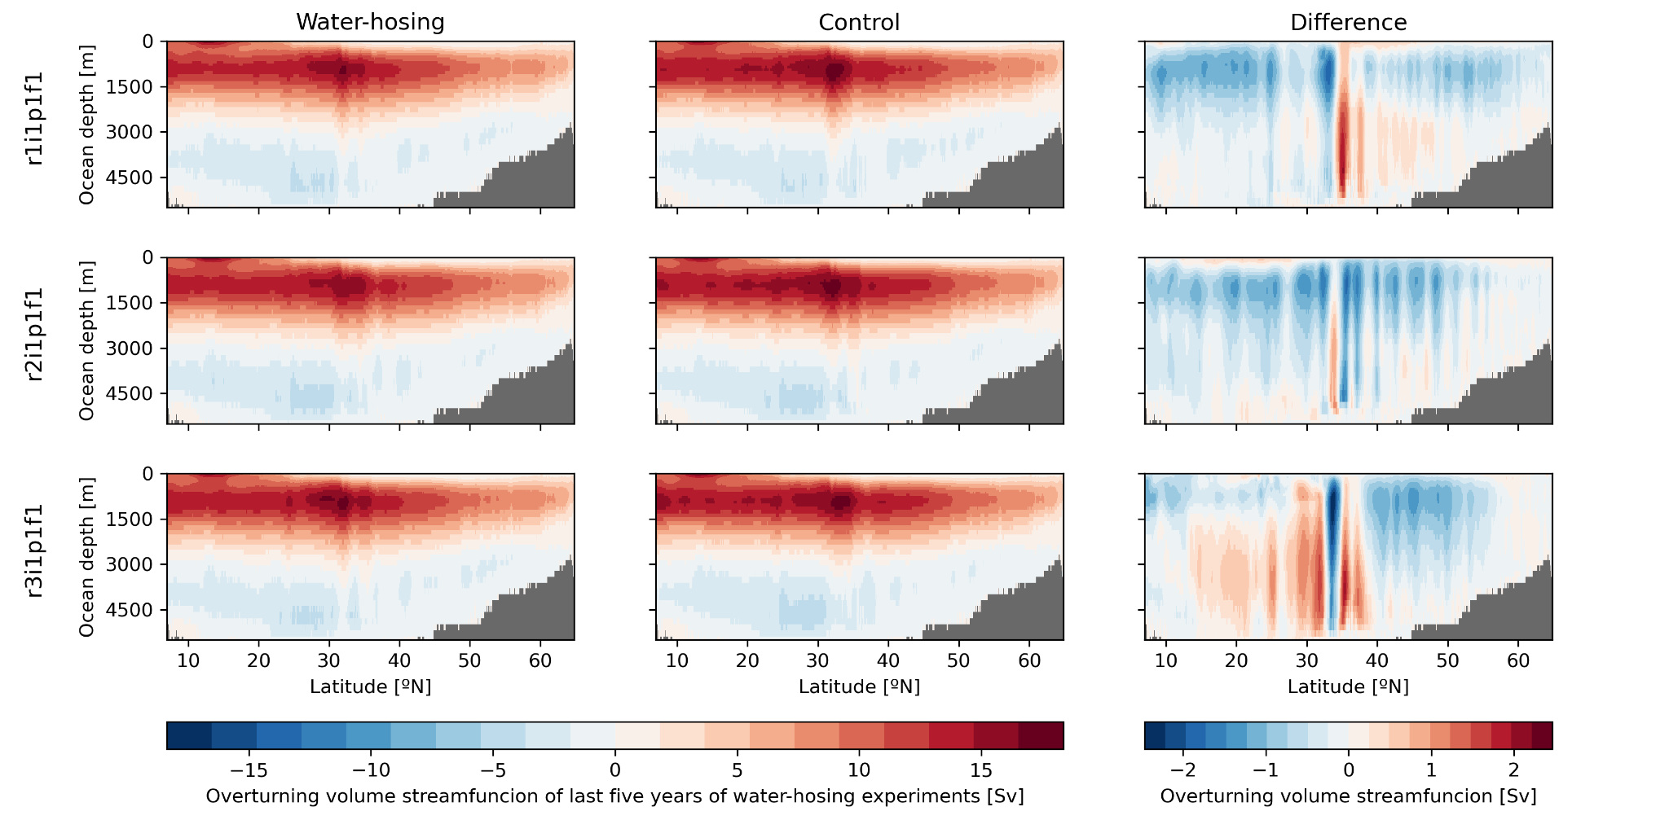
Impact of water-hosing on the AMOC
MOC of the last five years of the water-hosing experiments
Notes:
The three members show a global slowdown of the AMOC around to 0.5 and 1 Sv in most of the NA.
We have a weird pattern around 35ºN (Cape Hatteras) where we also have changes in the AMOC propagation

Slide 27
Future work
Studying water-hosing impact on the AMOC in the sigma-space
Investigating how the meltwater fluxes ultimately influence water mass transformation and the vertical mixing
Studying salinity anomalies propagation in the subpolar gyre
…

Slide 28
Thank you!
Eneko Martin-Martinez – 22/02/2024 – EERIE Science Hour #8 eneko.martin@bsc.es

Slide 29
Don’t miss!!!
Science Hour #8 - April 2024
WP7 - Impact of the ocean mesoscale on climate variability and teleconnections
TBC: check our website and social media
Notes:
Advertising SH next month, in charge of WP7 (Impact of the ocean mesoscale on climate variability and teleconnections.), date topic and speaker to be decided, check EERIE’s website and social media

Slide 30
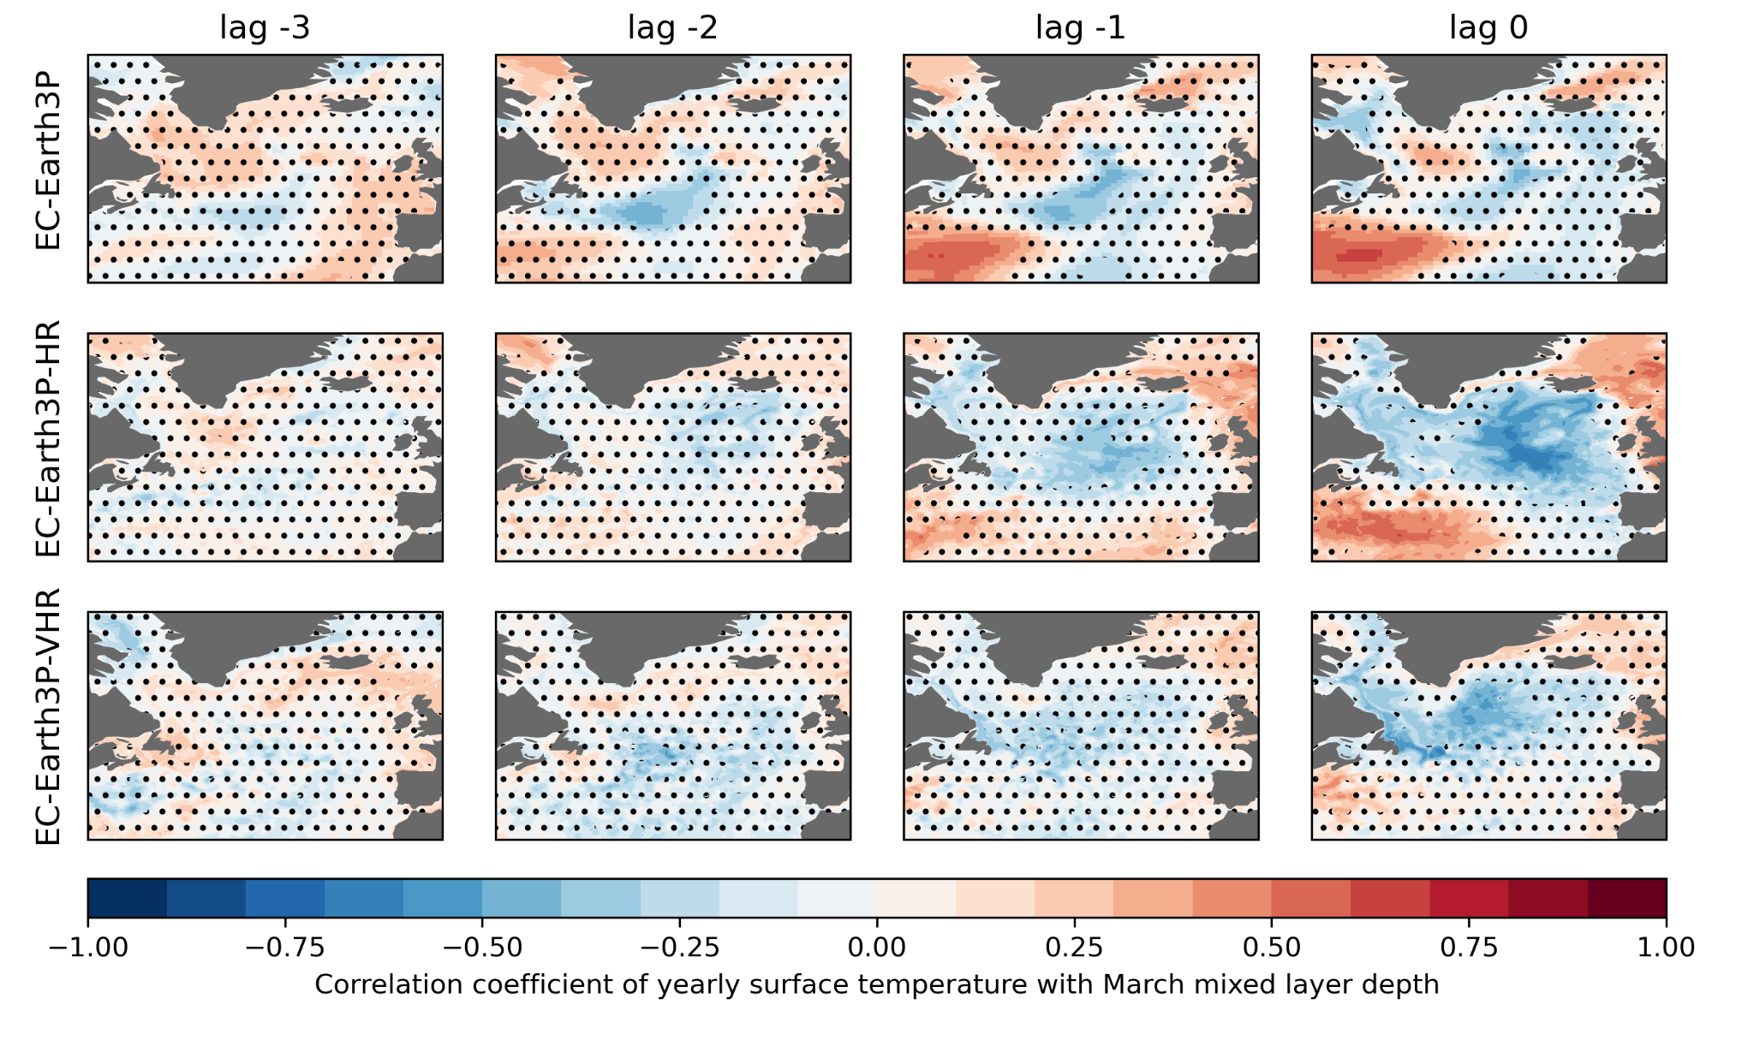
Mixing drivers in the North Atlantic
Correlation of TOS with MLD series

Slide 31
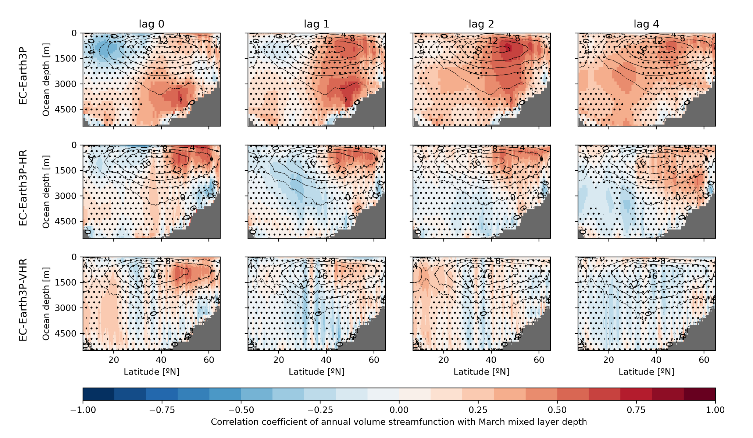
AMOC response to mixing
Correlation of MOC with MLD series

Slide 32
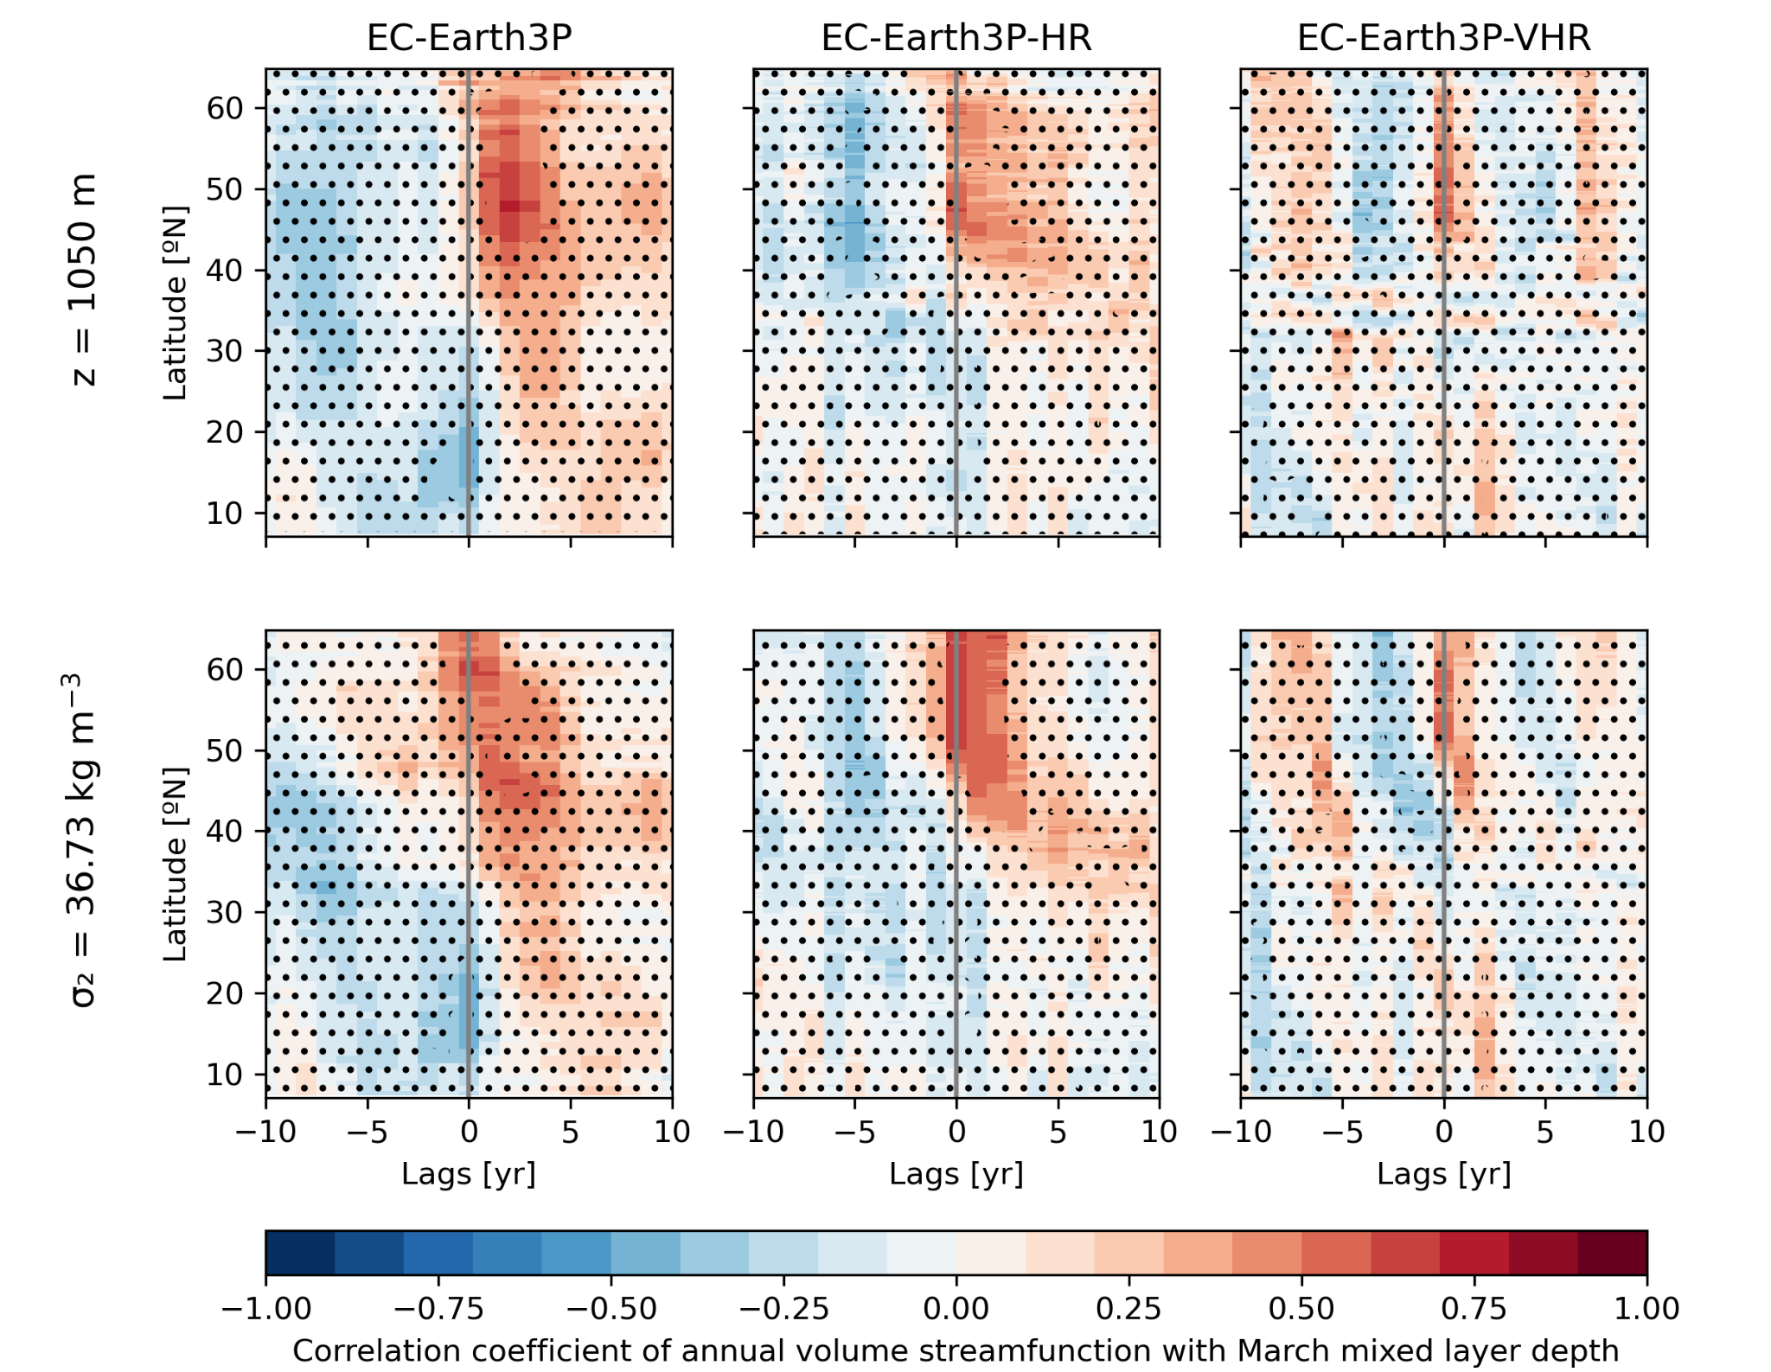
AMOC response to mixing
Correlation of MOC at fixed depth with MLD series
Notes:
We see now the correlation of the overturning stream function at fixed depth (1050m top row, and 36.73 kg m-3 bottom row).
Each model shows a different propagation pattern. Sigma space seems the one giving more information as we can see propagation clearly in EC-Earth3P-HR

