Slide 1
Barcelona, 20/02/2017
s2dverification update meeting
20/02/2017
Mailing list:
s2dverification@bsc.es
Wiki:
https://earth.bsc.es/wiki/doku.php?id=tools:s2dverification

Slide 2
Outline
News in v2.8.0
Working with file-per-chunk until v2.9.0
Other issues
Recent and ongoing developments
Future plans
New Load (v2.9.0)
Compatibility break (v3.0.0)

Slide 3
News in v2.8.0
Licence change from GPL-3 to LGPL-3
New veriApply compatible score functions
.BrierScore, .Corr, .RMS, .RMSSS, .RatioRMS, .RatioSDRMS and .Trend
You can check examples of each in ?BrierScore, ?Corr, ...
# Take the data and compute anomalies
data <- Load('tos', 'i00k', 'erainterim', paste0(1985:2005, '1101'),
leadtimemax = 6, output = 'lonlat')
ano <- Ano_CrossValid(data$mod, data$obs)
# Corr in the classical way
corr <- Corr(Mean1Dim(ano$ano_exp, 2), Mean1Dim(ano$ano_obs, 2))
# Corr with multicore Corr2 <- s2dverification:::.Corr
require(easyVerification)
corr2 <- veriApply(“Corr2”, ano$ano_exp, Mean1Dim(ano$ano_obs, 2),
ensdim = 2, tdim = 3, parallel = TRUE)
90 sec.
40 sec.

Slide 4
News in v2.8.0
Added warning in Load when extrapolating
CDORemap, to interpolate R arrays with CDO
data <- Load('tos', 'i00k', NULL, '19851101',
leadtimemax = 1, output = 'lonlat',
grid = 'r1000x500')
* Loading... This may take several minutes...
! Warning: the dataset with index 1 in 'exp' is originally on a grid coarser than the common grid and it has been extrapolated. Check the results carefully. It is recommended to specify as common grid the coarsest grid among all requested datasets via the parameter 'grid'.
# Minimal array interpolation
tas <- array(1:50, dim = c(25, 50))
names(dim(tas)) <- c('lat', 'lon')
lon <- seq(0, 360 - 360/50, length.out = 50)
lat <- seq(-90, 90, length.out = 25)
tas2 <- CDORemap(tas, lon, lat, 'r200x100', 'bil', TRUE)
dim(tas2$data_array)
lat lon
100 200

Slide 5
News in v2.8.0
ArrayToNetCDF, to save R arrays with metadata in NetCDF files
# Multiple arrays can be provided in a list
a <- array(1:400, dim = c(5, 10, 4, 2))
names(dim(a)) <- c('lat', 'lon', 'time', 'var')
ArrayToNetCDF(list(tos = a, prlr = a), 'tmp.nc')
> ncdump -h tmp.nc
netcdf tmp {
dimensions:
lat = 5 ;
lon = 10 ;
time = UNLIMITED ; // (4 currently)
variables:
float tos_1(time, lon, lat) ;
float tos_2(time, lon, lat) ;
float prlr_1(time, lon, lat) ;
float prlr_2(time, lon, lat) ;
}

Slide 6
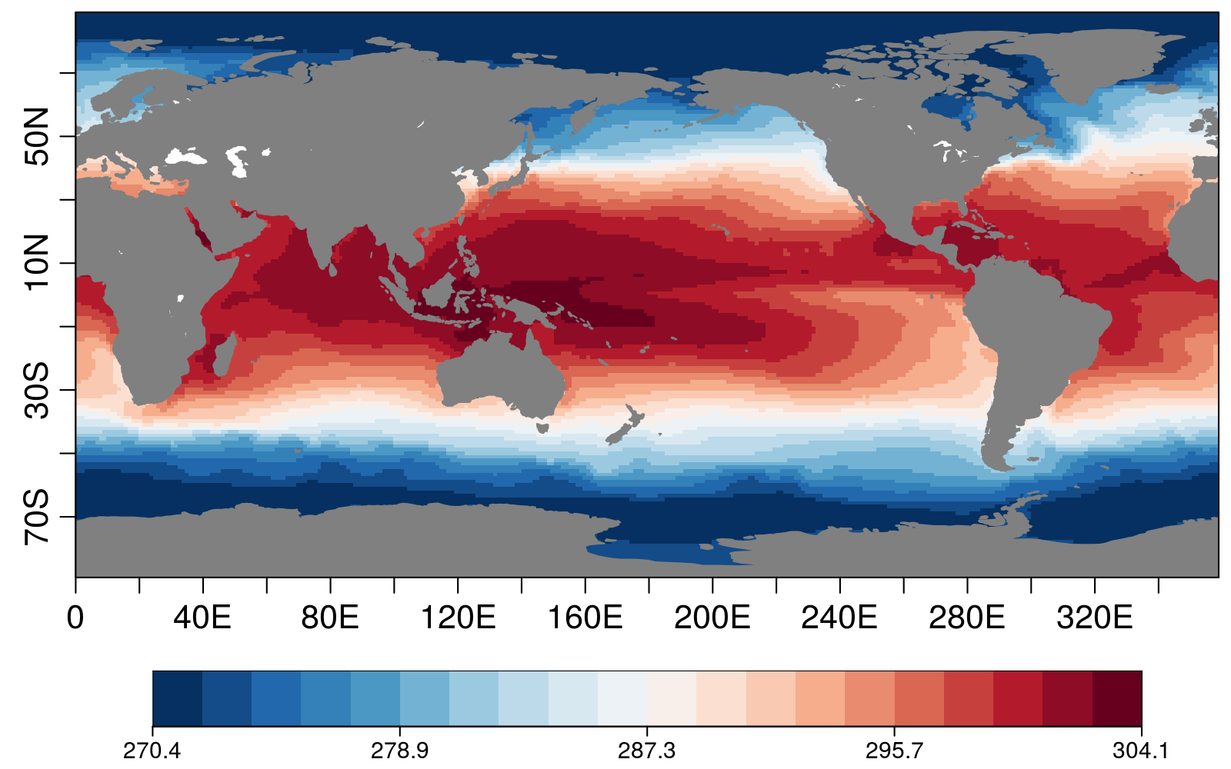
News in v2.8.0
Colour-blind friendly colour bars
# Take the data and compute anomalies
data <- Load('tos', 'i00k', NULL, '19851101',
leadtimemax = 1, output = 'lonlat')
PlotEquiMap(data$mod[1, 1, 1, 1, , ], data$lon, data$lat)

Slide 7
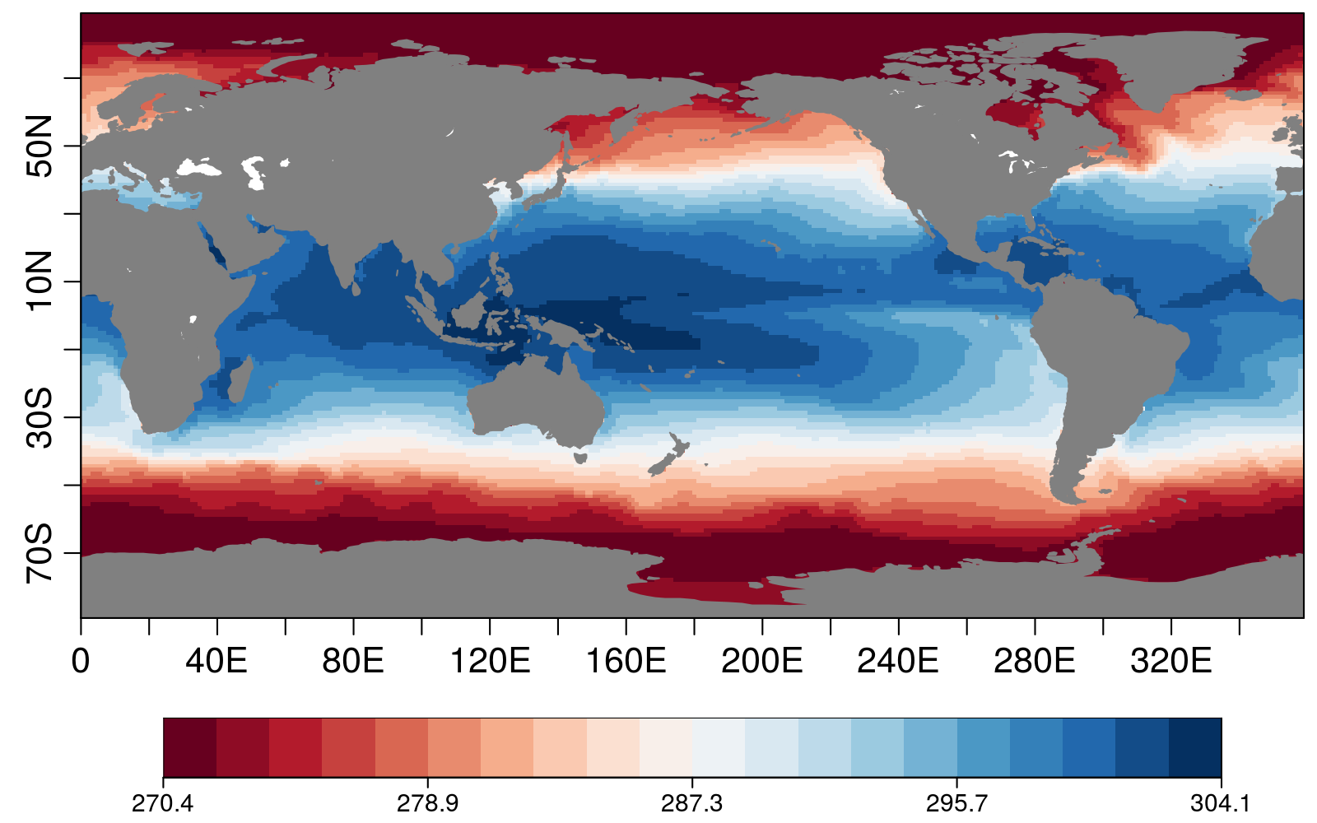
News in v2.8.0
Colour-blind friendly colour bars
# Take the data and compute anomalies
data <- Load('tos', 'i00k', NULL, '19851101',
leadtimemax = 1, output = 'lonlat')
PlotEquiMap(data$mod[1, 1, 1, 1, , ], data$lon, data$lat,
color_fun = clim.palette('redblue'))

Slide 8
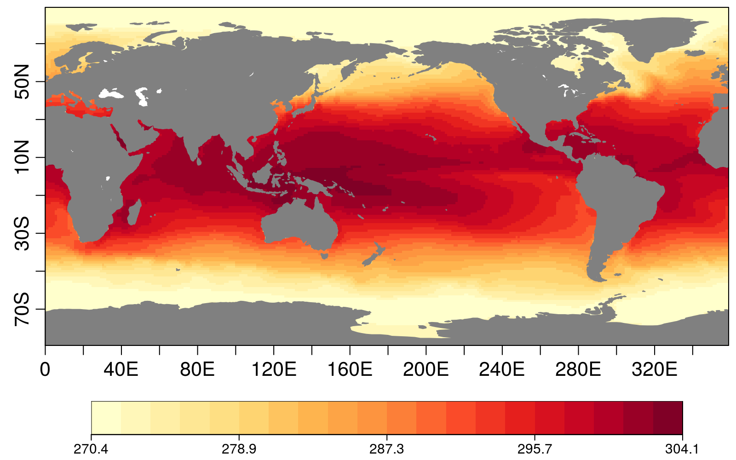
News in v2.8.0
Colour-blind friendly colour bars
# Take the data and compute anomalies
data <- Load('tos', 'i00k', NULL, '19851101',
leadtimemax = 1, output = 'lonlat')
PlotEquiMap(data$mod[1, 1, 1, 1, , ], data$lon, data$lat,
color_fun = clim.palette('yellowred'))

Slide 9
Working with file-per-chunk until v2.9.0
Two options:
Using current version of Load() multiple times and merging results
Script in /shared/earth/software/scripts/LoadChunks.R
Specify manually the path patterns
Specify manually names of members and chunks for each s. date
Specify manually the number of forecast time-steps per chunk
Using new Load in the branch develop-load-enh, still under development and with missing features
source('/shared/earth/software/scripts/LoadMembersChunks.R')
new_exp <- paste0('/esarchive/exp/ecearth/t00p/monthly_mean/',
'$VAR_NAME$_f6h/$VAR_NAME$_Omon_EC-EARTH3_t00p_',
'S$START_DATE$_$MEMBER$_$CHUNK$.nc')
members <- list('19900101' = 'r1i1p1')
chunks <- list('19900101' = c('199001-199001', '199002-199002'))
data <- LoadMembersChunks('tos', new_exp, 'erainterim', '19900101',
members, chunks, ftimes_per_chunk = 1,
output = 'lonlat')

Slide 10
Other issues
How to modify s2dverification functions
Sometimes if you copy and modify the code of a s2dv function it stops working
It is because some s2dv functions depend on ‘internal’ s2dv functions
It can be fixed by loading the Utils.R file in your new code:
If you only need to do a small temporary change:
source('~/s2dverification/R/Utils.R') PlotAno <- function(................) { ............... your modifications ............... }
library(s2verification)
fix(PlotAno)

Slide 11
Other issues
Other issues?

Slide 12
Recent and ongoing developments
Development strategy: https://earth.bsc.es/wiki/doku.php?id=tools:s2dverification#development
Create branch, push your code, create merge request, assign two testers.
Ongoing developments:
Chloé’s correlation difference?
Nicola’s enhancements in PlotEquiMap?
Martin’s enhancements in PlotStereoMap and PlotSection
François’ JoCoMo matrix?
Verónica’s hatching?
Omar’s filled oceans in PlotEquiMap
Omar’s function to compute reliability
Verónica + Llorenç PlotMostLikelyTercile?
???
? = branch does not exist

Slide 13
Recent and ongoing developments
Omar: Chloés correlation difference is stuck because of a bug in the package psych, which it relies upon.
All: Let’s contact psych developers and keep going with the initial plan.
All: Vero’s hatching PlotEquiMap will be added in a new branch in the git project
Nico + Omar: Filled oceans relied on an external tools. We will try to look for an alternative when doing the release of v3.0.0.
Omar: Has developed s2dv-compatible functions to calculate ensemble inflation.
Javi: Derive-x and derive-y functions. To be added in s2dv? Or in a new separate package?
Nico: These will be added in a new branch for now.

Slide 14
Recent and ongoing developments
Pending branches to test
Branch names | Pending testers | Deadline
develop-RMSE_boot | Chloé, Omar | ?
develop-SeaIceModes | ?, ? | ?
develop-AreaWeights | Chloé, ? | ?
develop-PlotClim | Nico + Alasdair to add | v3.0.0
develop_contours_plotsection | Nico + Alasdair to add | v3.0.0
develop_filled_oceans | Nico + Alasdair to add | v3.0.0
develop_calibrate | ?, ? | ?

Slide 15
Future plans
New Load (v2.9.0)
Will be much more general
Will be called e.g. CubeLoad
Load will call CubeLoad inside
Interface to Load will not change
You will be able to use CubeLoad directly for advanced cases
Compatibility break (v3.0.0)
Will use common metadata model with QA4Seas and downscaleR
Metadata will be propagated and accordingly modified
You will be able to use the functions with simple arrays as now
PlotTimeSeries will be made available
Score functions will use veriApply by default
Some design issues will be solved: it will be easier to use, no need for some tricks to communicate between functions
Package name will change to s2dv

Slide 16
Other questions?

Slide 17
Thanks

