Slide 1
Lisboa, 29 Sep 2016
Autosubmit, Cylc and ecFlow
Domingo Manubens

Slide 2
Outline
M4 HR introduction (D9.6)
Autosubmit
Cylc
ecFlow
Assessment report (D9.3)
Features compared
Autosubmit roadmap

Slide 3
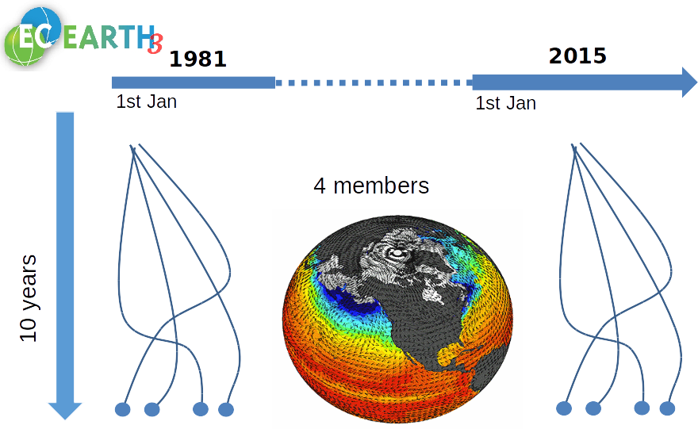
Multi-member climate experiment
~ 12000 CHPSY

Slide 4
Multiple HPC infrastructures

Slide 5
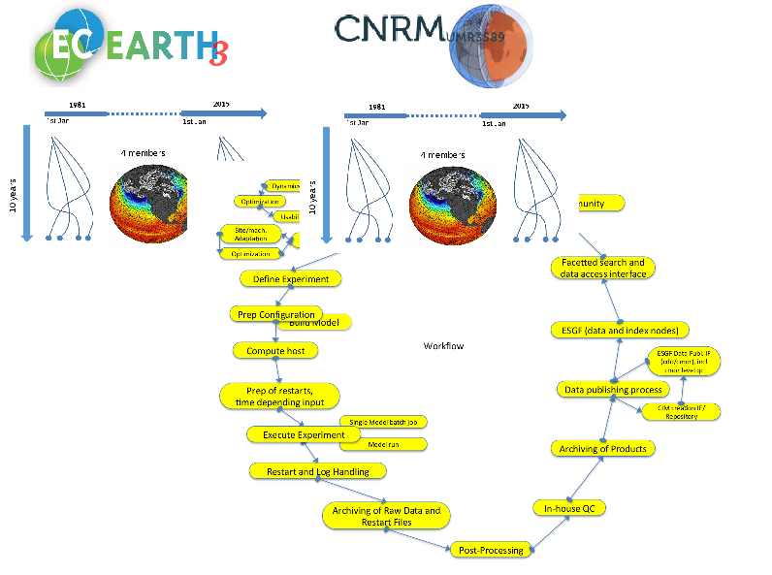
Multi-model multi-member climate experiment workflow (D9.6) (WiP)
“Demonstrator”: performance metrics
for both HR models
at BSC/SMHI/CERFACS based on Balaji et al. 2016

Slide 6
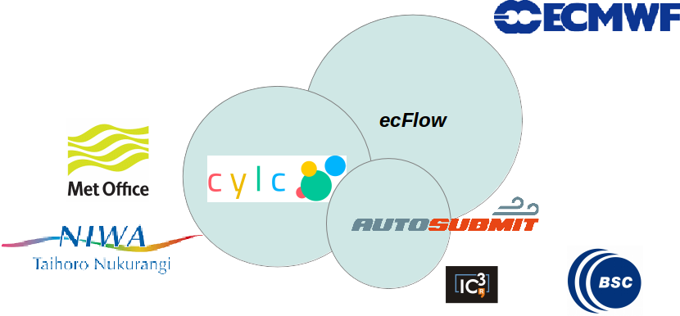
Workflow tools appropriate for M4 HR
The three scheduling and submission systems have been tested and evaluated with regard to the suitability for multi-model multi-member high resolution (M4 HR) experiments (D9.3)

Slide 7
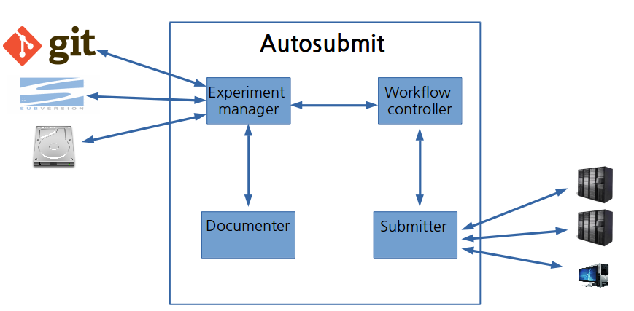
Autosubmit technical infrastructure

Slide 8
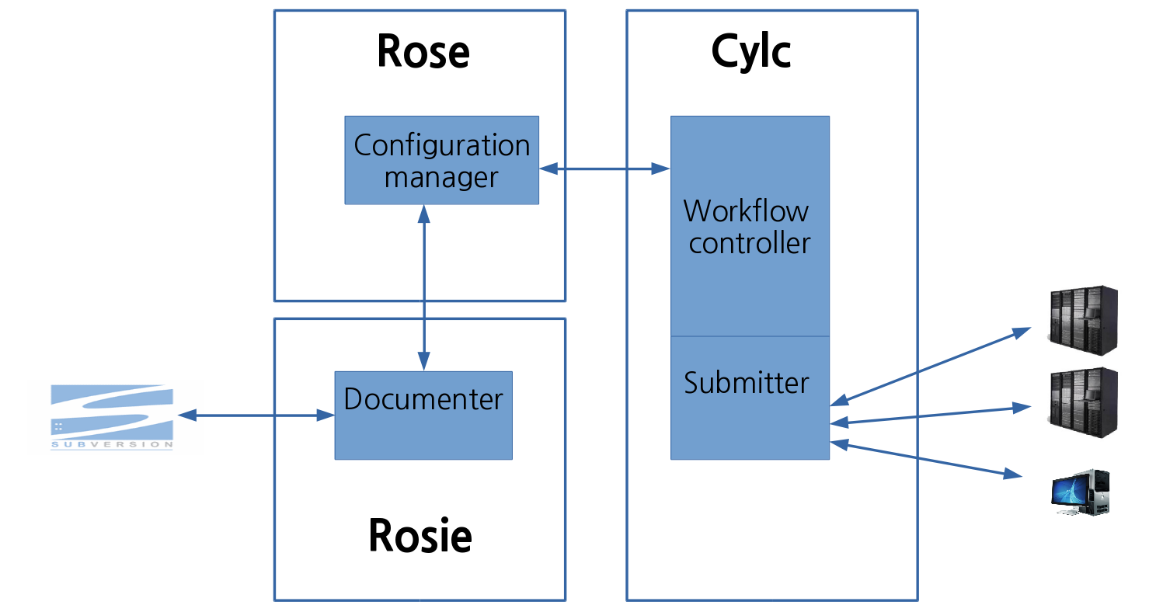
Cylc technical infrastructure

Slide 9
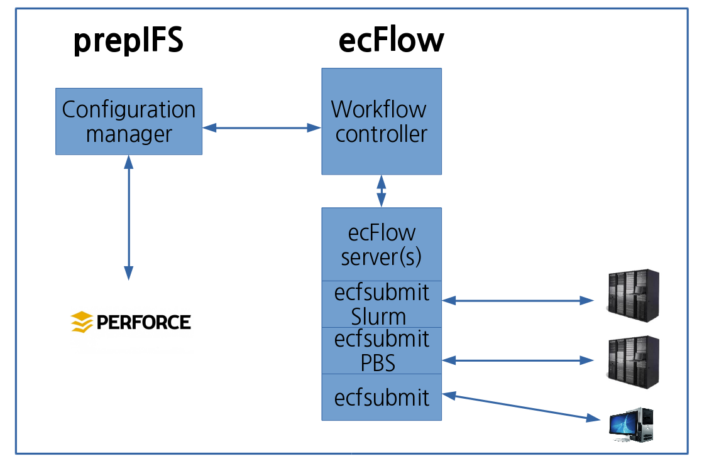
ecFlow technical infrastructure

Slide 10
Assessment report on Autosubmit, Cylc and ecFlow (D9.3)
Focus on workflow control and submission systems

Slide 11
Assessment report on Autosubmit, Cylc and ecFlow (D9.3)
Part 1: Compared features:
- Portability
- Task communication
- Support for remote platforms
- Support for different workload managers
- Fault tolerance
- Support for automated error recovery
- Support for date/time cycling
- Monitoring and intervention tools
- Support for generated workflows
- Scalability
Document available here: https://goo.gl/IKqIjV

Slide 12
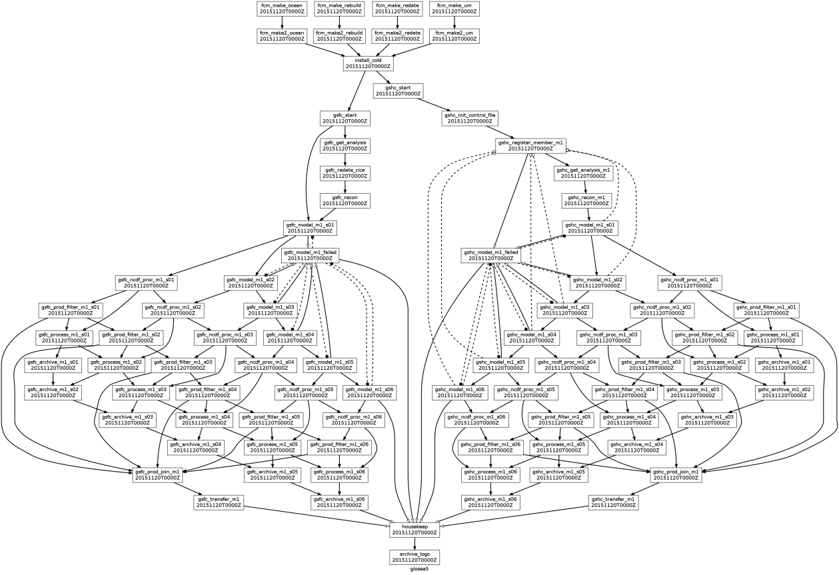
Assessment report on Autosubmit, Cylc and ecFlow (D9.3)
Part 2: A GloSea5 workflow prototype has been defined and run with Autosubmit, Cylc and ecFlow

Slide 13
Drawbacks
Portability
ecFlow
Client / server installation
Task communication
ecFlow
Restrictive firewalls issue
Not always possible to run server in login nodes
(4) Support for remote platforms / Support for workload managers
ecFlow
Restrictive firewalls issues
Scripts for LoadLeveler (adapted for PBS, Sun/Oracle Grid Engine and Slurm)

Slide 14
Drawbacks
(6) Fault tolerance / Automated recovery error
All tools acceptable features
Support for date / time cycling
Autosubmit
No families
No clock time triggered tasks
Monitoring and intervention tools
Autosubmit
No GUI

Slide 15
Drawbacks
Support for generated workflows
Autosubmit
CONF. FILE
Cylc
CONF. FILE + JINJA2
Scalability
All tools reasonable scalability

Slide 16
Summary

Slide 17
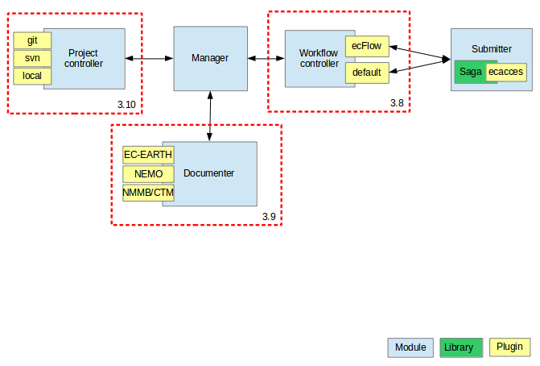
Roadmap

Slide 18
Q & A

Slide 19
Thank you!
For further information please contact
joan.lopez@bsc.es
domingo.manubens@bsc.es

