Slide 1
Improving Ocean Model Computational Performance by using Mixed-Precision Approaches
Oriol Tintó, Mario Acosta, Miguel Castrillo,
Kim Serradell, Francisco J. Doblas-Reyes
Computational Earth Sciences
14/06/2019
PASC19 - High-Resolution Weather and Climate Simulations
Notes:
In the framework of the Centre of Excellence in Simulation of Weather and Climate in Europe (ESiWACE), a ground-breaking configuration for EC-Earth - a European community Earth-System Model – has been developed. In the atmosphere, the horizontal domain is based on a spectral truncation of the atmospheric model (IFS) at T1279 together with 91 vertical levels. The ocean component (NEMO) is run on the so-called ORCA12 tripolar (cartesian) grid at a horizontal resolution of about 1/12°, with 75 vertical levels. In this talk, we will present the work done to develop this configuration, the computational challenges faced and the usage of the Barcelona Supercomputing Center (BSC) performance tools to analyse and profile the code. Finally, we will present some computational improvements regarding code execution and improved I/O management, currently developed in the Computational Earth Sciences team (CES) to increase the performance of this configuration.

Slide 2
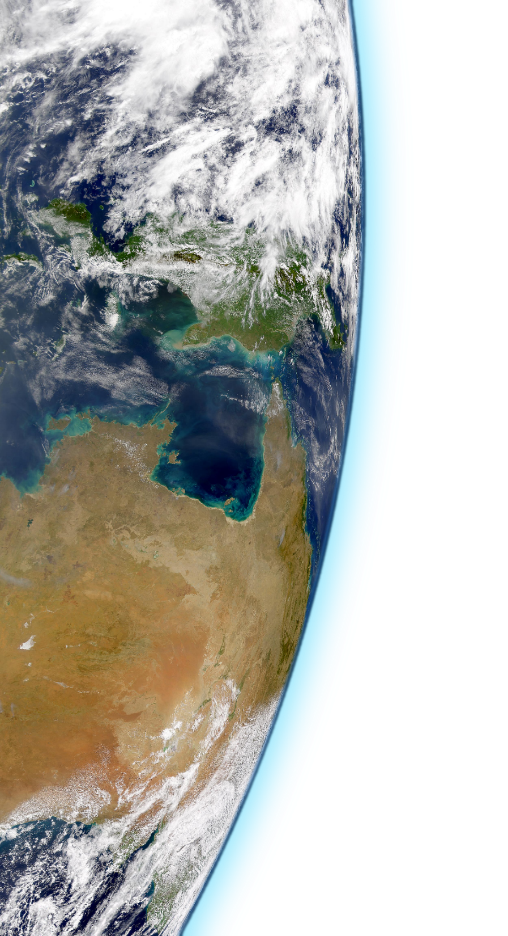
Outline
Why?
How?

Slide 3
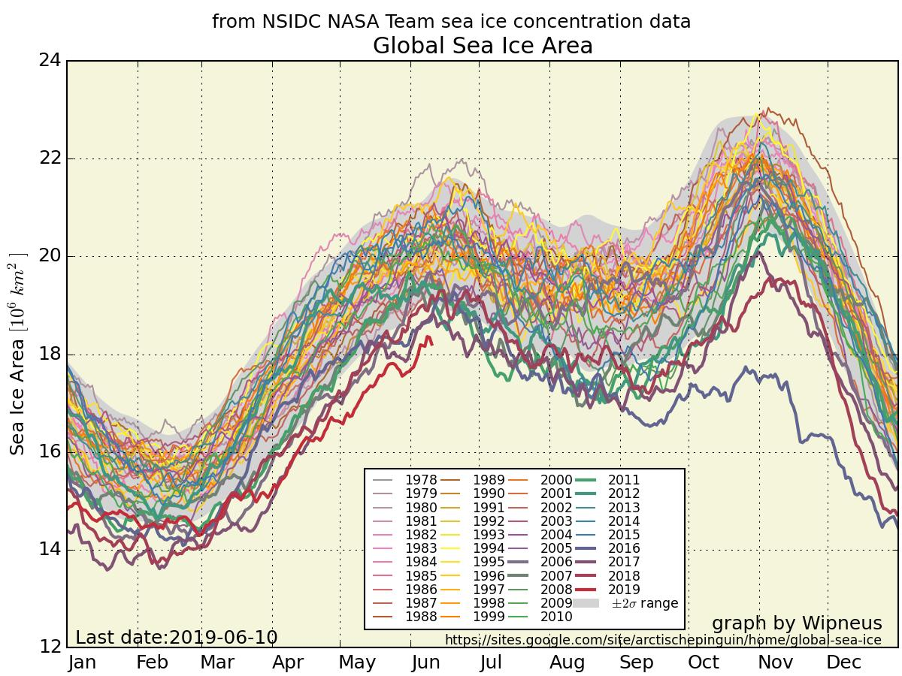
Why models?

Slide 4
Why mixed precision?

Slide 5
96 processes
NEMO - Double Precision
Time

Slide 6
96 processes
NEMO - Double Precision
Time
The trace corresponds to a single time-step
NEMO 4.0 Ocean-only
ORCA025 -> global ¼ º ~ 27km at equator
Each color represents a different routine

Slide 7
Double Precision
Single Precision

Slide 8
Double Precision
Single Precision*
1.66x Speed-up

Slide 9
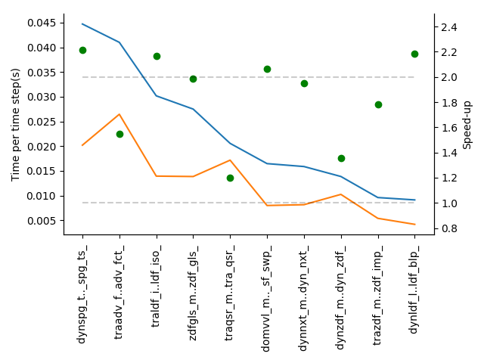
Double
Single

Slide 10
Double
Single

Slide 11
dynspg traadv traldf zdfgls traqsr

Slide 12
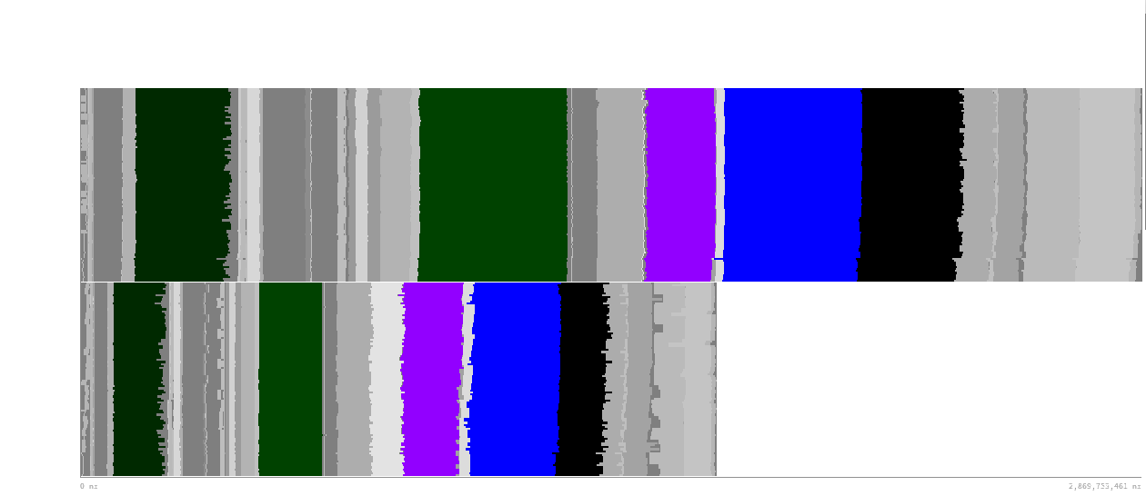
dynspg traadv traldf zdfgls traqsr

Slide 13
dynspg traadv traldf zdfgls traqsr

Slide 14
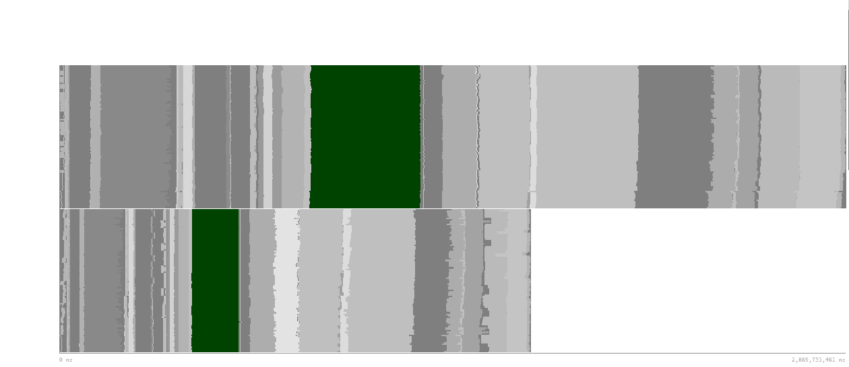
dynspg traadv traldf zdfgls traqsr

Slide 15
dynspg traadv traldf zdfgls traqsr
Speed-up 2.2x
Iteration time

Slide 16
dynspg traadv traldf zdfgls traqsr
Speed-up 2.2x
Total Instructions
Iteration time

Slide 17
dynspg traadv traldf zdfgls traqsr
Speed-up 2.2x
Total Instructions
Cycles per Instruction
Iteration time

Slide 18
dynspg traadv traldf zdfgls traqsr
Speed-up 2.2x
Total Instructions
Cycles per Instruction
L3 miss per Instruction
Iteration time

Slide 19
dynspg traadv traldf zdfgls traqsr

Slide 20
dynspg traadv traldf zdfgls traqsr

Slide 21
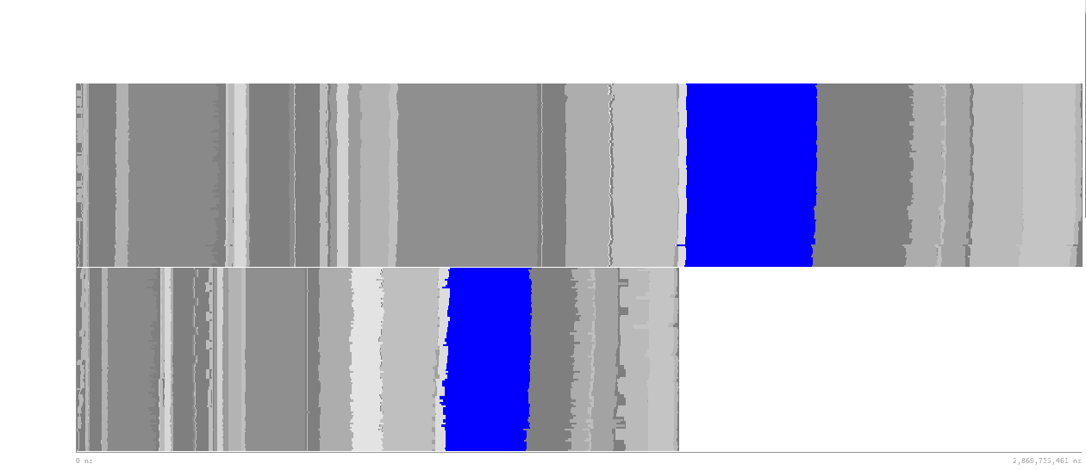
dynspg traadv traldf zdfgls traqsr

Slide 22
dynspg traadv traldf zdfgls traqsr
Speed-up 1.6x
Iteration time

Slide 23
dynspg traadv traldf zdfgls traqsr
Speed-up 1.6x
Total Instructions
Iteration time

Slide 24
dynspg traadv traldf zdfgls traqsr
Speed-up 1.6x
Total Instructions
Cycles per Instruction
Iteration time

Slide 25
dynspg traadv traldf zdfgls traqsr
Speed-up 1.6x
Total Instructions
Cycles per Instruction
L3 miss per Instruction
Iteration time

Slide 26
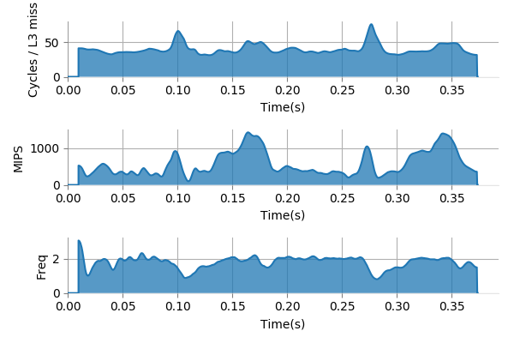
dynspg traadv traldf zdfgls traqsr
Speed-up 1.6x

Slide 27
dynspg traadv traldf zdfgls traqsr

Slide 28
dynspg traadv traldf zdfgls traqsr

Slide 29
dynspg traadv traldf zdfgls traqsr

Slide 30
dynspg traadv traldf zdfgls traqsr
Speed-up 2.2x
Total Instructions
Cycles per Instruction
L3 miss per Instruction
Iteration time

Slide 31
dynspg traadv traldf zdfgls traqsr

Slide 32
dynspg traadv traldf zdfgls traqsr

Slide 33
dynspg traadv traldf zdfgls traqsr

Slide 34
dynspg traadv traldf zdfgls traqsr
Speed-up 2.0x
Total Instructions
Cycles per Instruction
L3 miss per Instruction
Iteration time

Slide 35
dynspg traadv traldf zdfgls traqsr

Slide 36
dynspg traadv traldf zdfgls traqsr

Slide 37
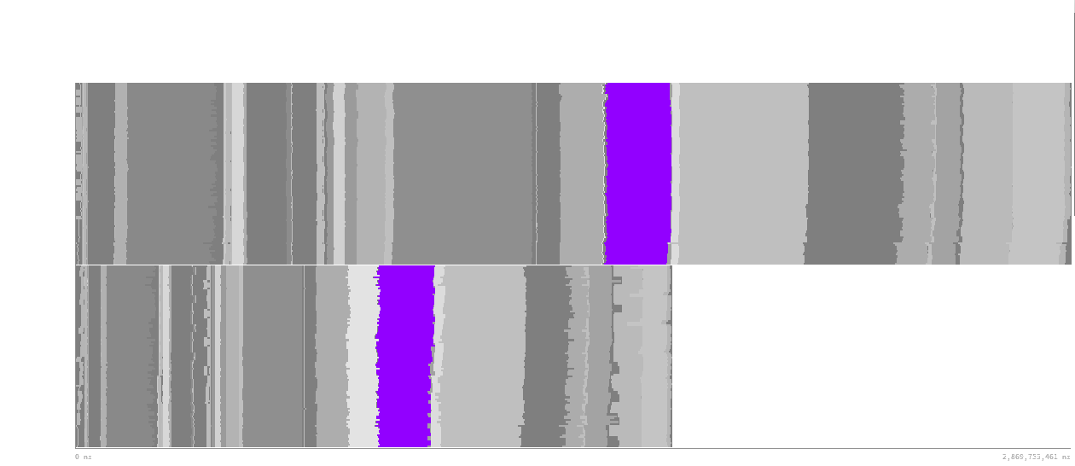
dynspg traadv traldf zdfgls traqsr

Slide 38
dynspg traadv traldf zdfgls traqsr
Speed-up 1.2x
Iteration time

Slide 39
dynspg traadv traldf zdfgls traqsr
Speed-up 1.2x
Total Instructions
Iteration time

Slide 40
dynspg traadv traldf zdfgls traqsr
Speed-up 1.2x
Total Instructions
Cycles per Instruction
Iteration time

Slide 41
dynspg traadv traldf zdfgls traqsr
Speed-up 1.2x
Total Instructions
Cycles per Instruction
L3 miss per Instruction
Iteration time

Slide 42
dynspg traadv traldf zdfgls traqsr
Speed-up 1.2x
Total Instructions
Cycles per Instruction
L3 miss per Instruction
Iteration time
∝

Slide 43
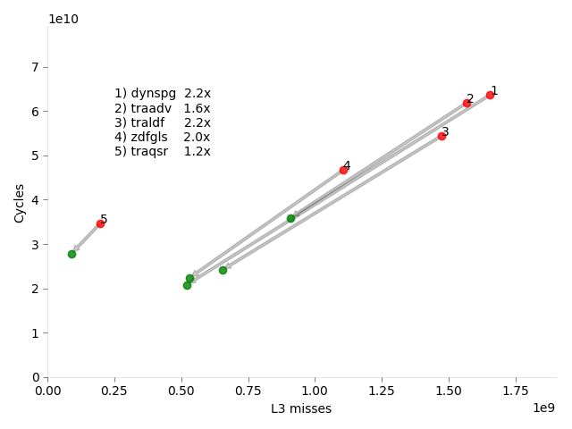
What happens with traqsr?

Slide 44
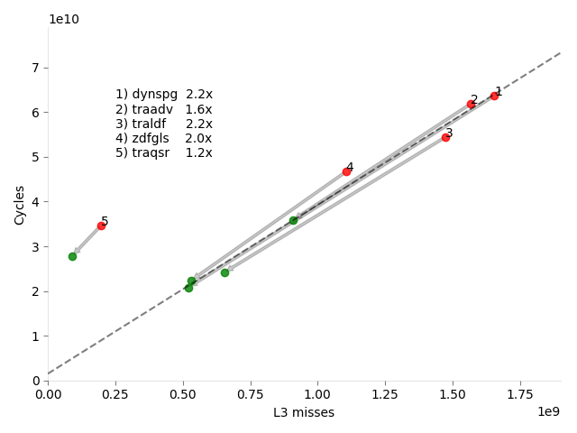
What happens with traqsr?
r2=0.99

Slide 45
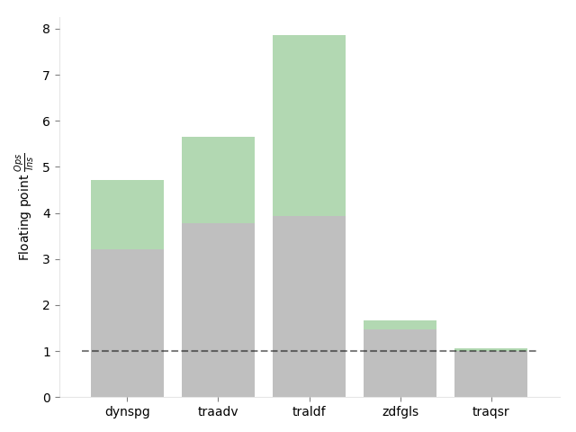
What happens with traqsr?

Slide 46
What happens with traqsr?
Not vectorized at all!

Slide 47
What happens with traqsr?
r2=0.99
What happens if we remove -fp-model precise?

Slide 48
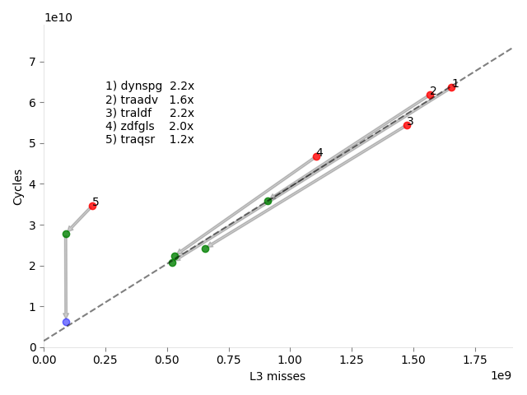
What happens with traqsr?
r2=0.99
What happens if we remove -fp-model precise?

Slide 49
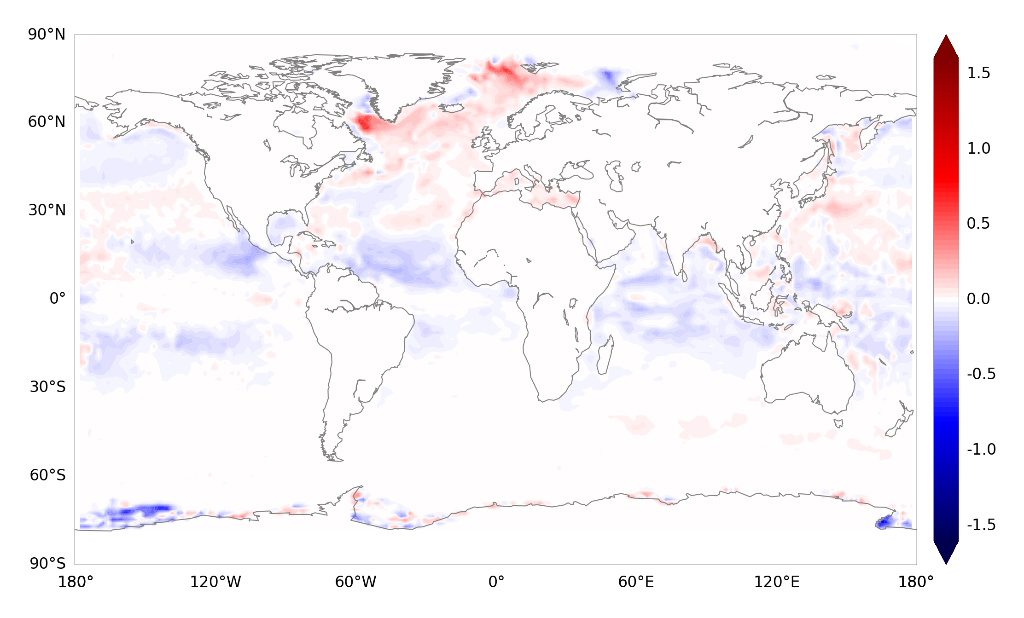
But what about the results?
Difference between double- and single-precision monthly mean of sea-surface temperature for the first month of simulation.

Slide 50
But what about the results?

Slide 51
Risks of low precision
Solution?
Precision Analysis!
source: http://www-users.math.umn.edu/~arnold/disasters/ariane.html

Slide 52
NEMO Precision Analysis

Slide 53
Precision Analysis
How can we find which variables need to be kept in double-precision to maintain the accuracy of the results?

Slide 54
Analysis Algorithm
[0 1 2 3 4 5 6 7 8 9]

Slide 55
Analysis Algorithm
[0 1 2 3 4 5 6 7 8 9]
[0 1 2 3 4]
[5 6 7 8 9]

Slide 56
Analysis Algorithm
[0 1 2 3 4 5 6 7 8 9]
[0 1 2 3 4]
[5 6 7 8 9]
[0 1 2]
[3 4]

Slide 57
Analysis Algorithm
[0 1 2 3 4 5 6 7 8 9]
[0 1 2 3 4]
[5 6 7 8 9]
[0 1 2]
[3 4]
[3]
[4]

Slide 58
Analysis Algorithm
[0 1 2 3 4 5 6 7 8 9]
[0 1 2 3 4]
[5 6 7 8 9]
[0 1 2]
[3 4]
[3]
[4]

Slide 59
Analysis Algorithm
[0 1 2 3 4 5 6 7 8 9]
[0 1 2 3 4]
[5 6 7 8 9]
[0 1 2]
[3 4]
[3]
[4]

Slide 60
Analysis Algorithm
[0 1 2 3 4 5 6 7 8 9]
[0 1 2 3 4]
[5 6 7 8 9]
[0 1 2]
[3 4]
[3]
[4]

Slide 61
Analysis Algorithm
[0 1 2 3 4 5 6 7 8 9]
[0 1 2 3 4]
[5 6 7 8 9]
[0 1 2]
[3 4]
[3]
[4]

Slide 62
Analysis Algorithm
[0 1 2 3 4 5 6 7 8 9]
[0 1 2 3 4]
[5 6 7 8 9]
[0 1 2]
[3 4]
[3]
[4]

Slide 63
Analysis Algorithm
[0 1 2 3 4 5 6 7 8 9]
[0 1 2 3 4]
[5 6 7 8 9]
[0 1 2]
[3 4]
[3]
[4]
Variable 4 must be kept in double-precision.

Slide 64
Analysis Algorithm
[0 1 2 3 4 5 6 7 8 9]
[0 1 2 3 4]
[5 6 7 8 9]
[0 1 2]
[3 4]
[3]
[4]

Slide 65
Analysis Algorithm
[0 1 2 3 4 5 6 7 8 9]
[0 1 2 3 4]
[5 6 7 8 9]
[0 1 2]
[3 4]
[3]
[4]

Slide 66
Analysis Algorithm
[0 1 2 3 4 5 6 7 8 9]
[0 1 2 3 4]
[5 6 7 8 9]
[0 1 2]
?
>
[3 4]
[3]
[4]

Slide 67
Analysis Algorithm
[0 1 2 3 4 5 6 7 8 9]
[0 1 2 3 4]
[5 6 7 8 9]
[0 1 2]+[3]
[3 4]
[0 1]+[3]
[2]+[3]
[3]
[4]

Slide 68
Analysis Algorithm
[0 1 2 3 4 5 6 7 8 9]
[0 1 2 3 4]
[5 6 7 8 9]
[0 1 2]+[3]
[3 4]
[0 1]+[3]
[2]+[3]
[3]
[4]

Slide 69
Analysis Algorithm
[0 1 2 3 4 5 6 7 8 9]
[0 1 2 3 4]
[5 6 7 8 9]
[0 1 2]+[3]
[3 4]
[0 1]+[3]
[2]+[3]
[3]
[4]

Slide 70
Analysis Algorithm
[0 1 2 3 4 5 6 7 8 9]
[0 1 2 3 4]
[5 6 7 8 9]
[0 1 2]+[3]
[3 4]
[0 1]+[3]
[2]+[3]
[3]
[4]
Variables 2 and 4 must be kept in double-precision.
More info: How to use mixed precision in ocean models. https://www.geosci-model-dev-discuss.net/gmd-2019-20/

Slide 71
Precision Analysis
How can we find which variables need to be kept in double-precision to maintain the accuracy of the results?:
How can we measure the effect of reducing the precision of an arbitrary set of variables?
How can we verify the accuracy of the results?

Slide 72
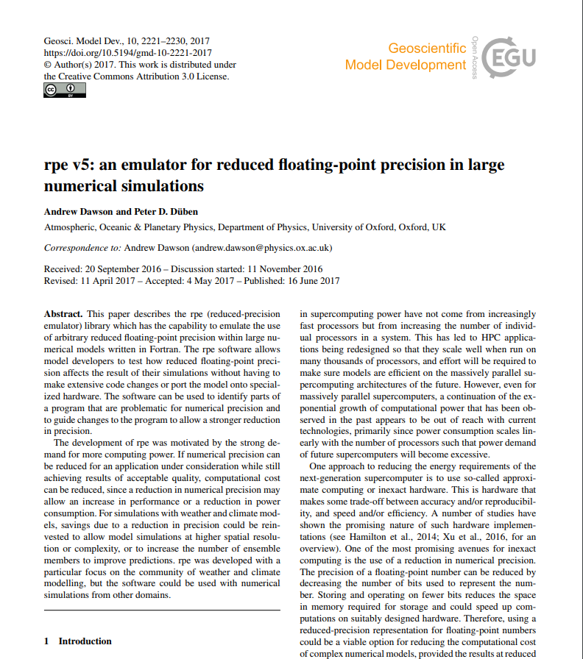
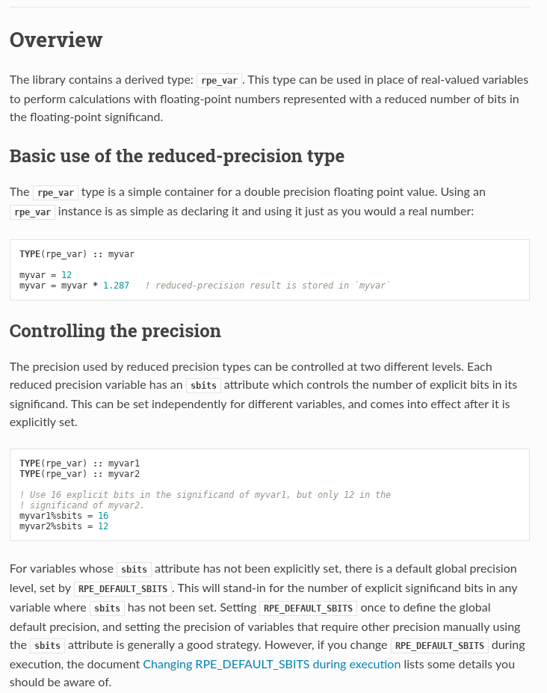
Reduced Precision Emulator

Slide 73
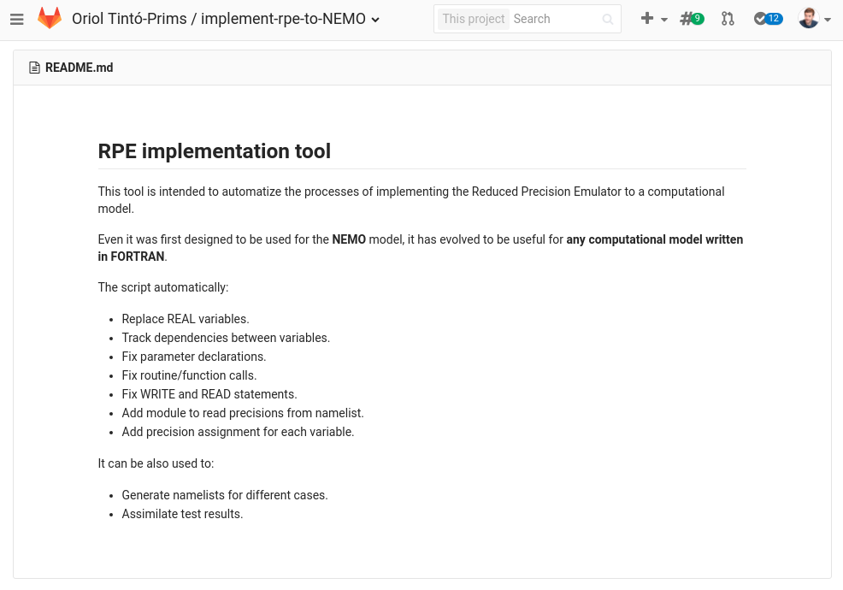
Implementing the emulator
A Python tool to automate the implementation process was created.

Slide 74
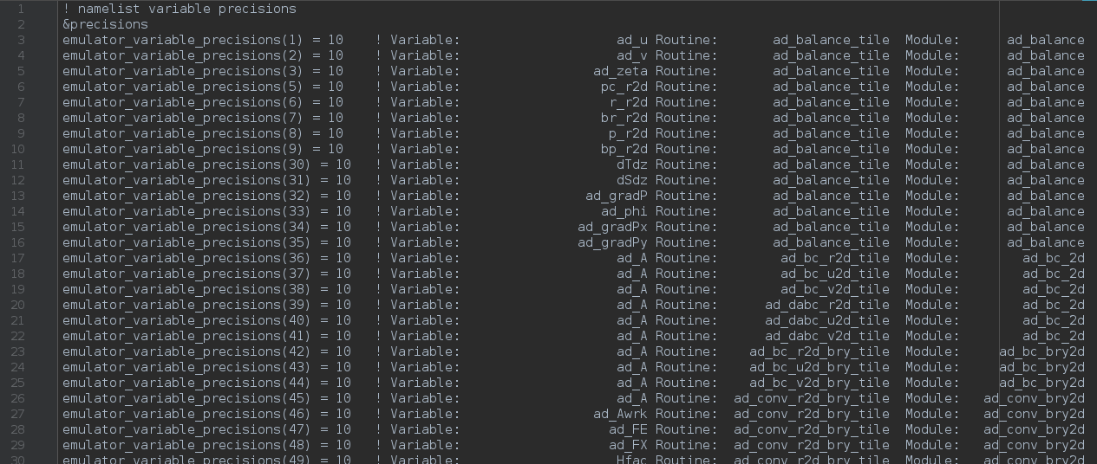
RPE in NEMO:
What we can do with it?
With a single binary, we can specify the number of significant bits used for each real variable declaration within the code through a namelist.

Slide 75
Precision Analysis
How can we find which variables need to be kept in double-precision to maintain the accuracy of the results?:
How can we measure the effect of reducing the precision of an arbitrary set of variables?
How can we verify the accuracy of the results?

Slide 76
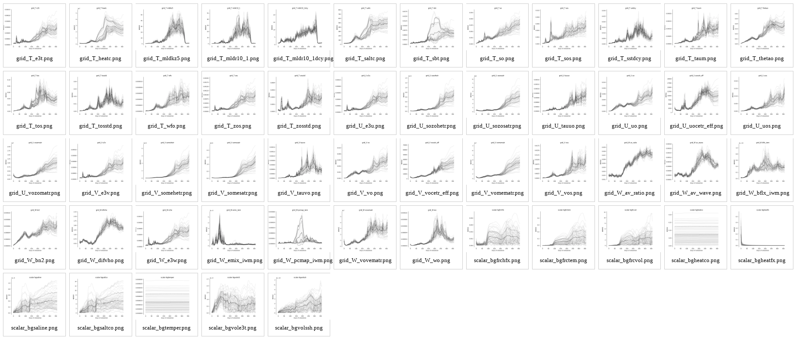
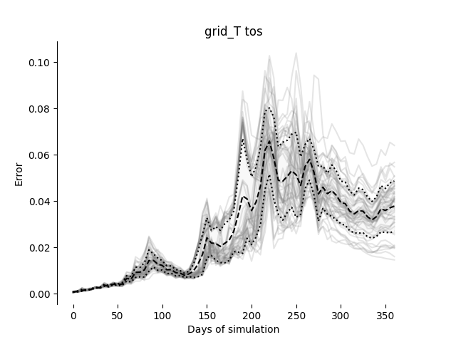
Verifying NEMO
Initial conditions perturbed with white noise in the 3D temperature field.
Evaluating 53 output variables.

Slide 77
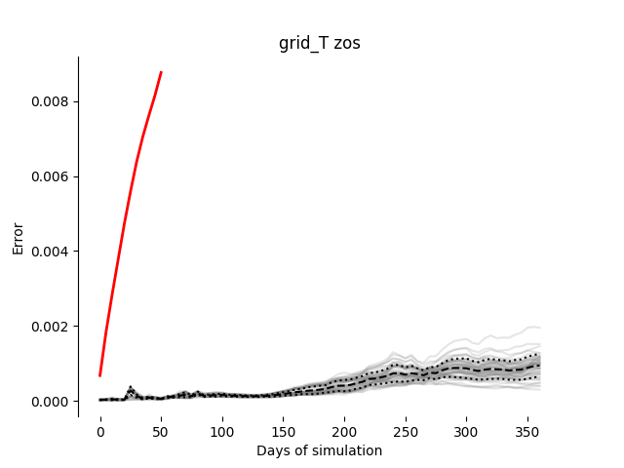
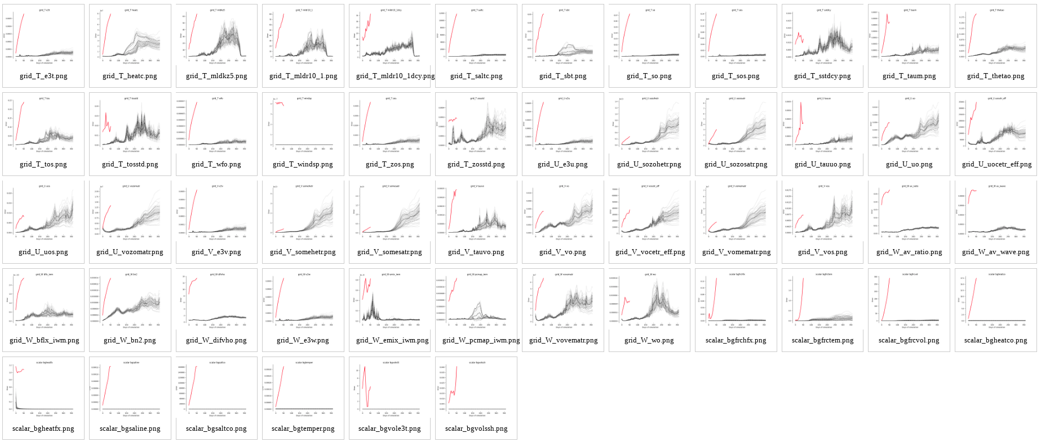
Verifying NEMO
Example: Everything in single precision:

Slide 78
Precision Analysis
How can we find which variables need to be kept in double-precision to maintain the accuracy of the results?:
How can we measure the effect of reducing the precision of an arbitrary set of variables?
How can we verify the accuracy of the results?
And now what?

Slide 79
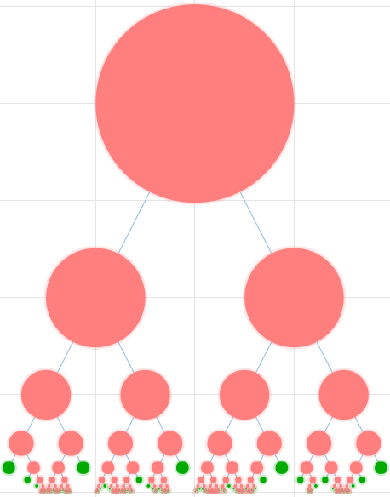
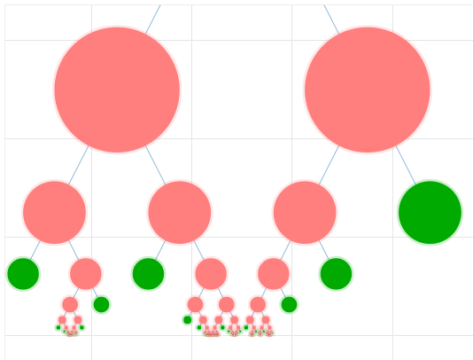
Precision Analysis: NEMO

Slide 80
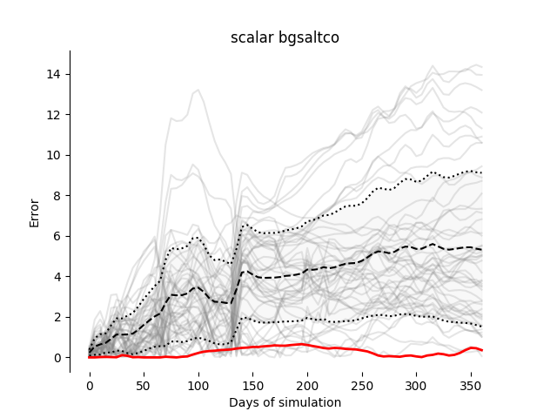
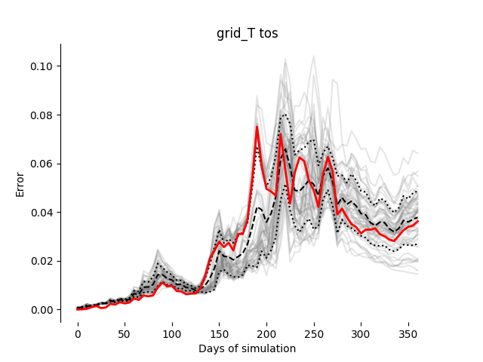
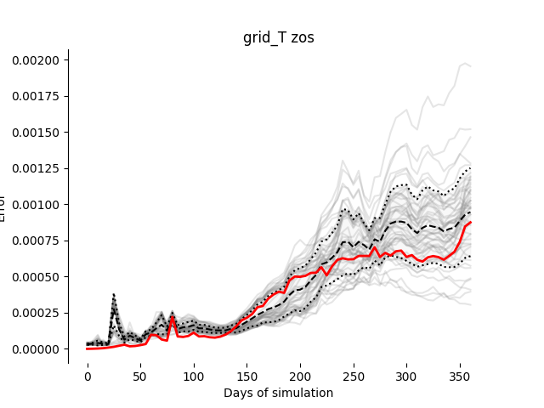
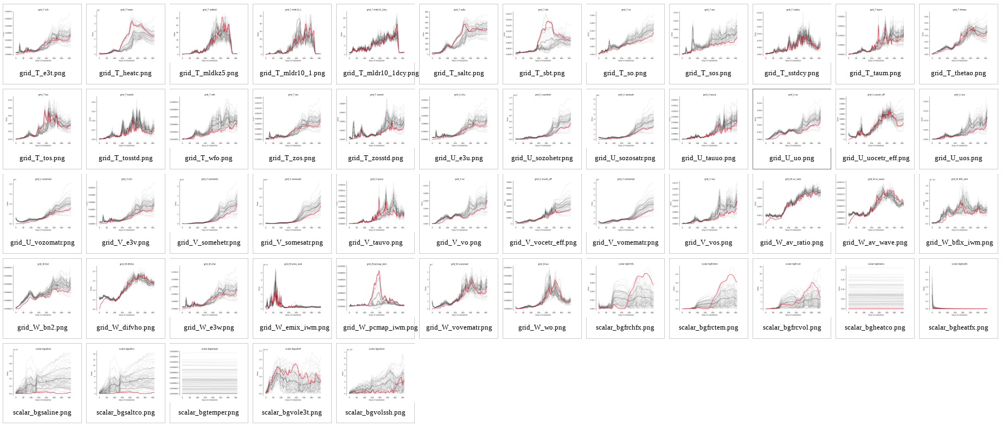
Results (1)
Using this verification test to run the analysis algorithm on a small part of the code:

Slide 81
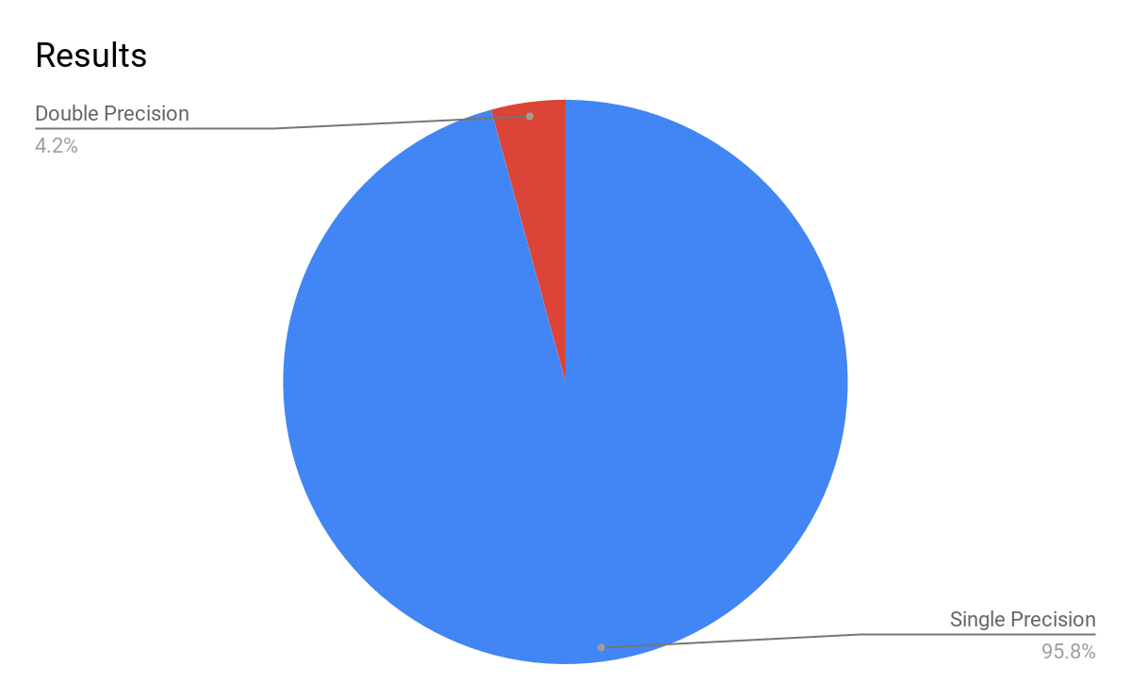
Results(2)
Using the old verification test on the full model:

Slide 82
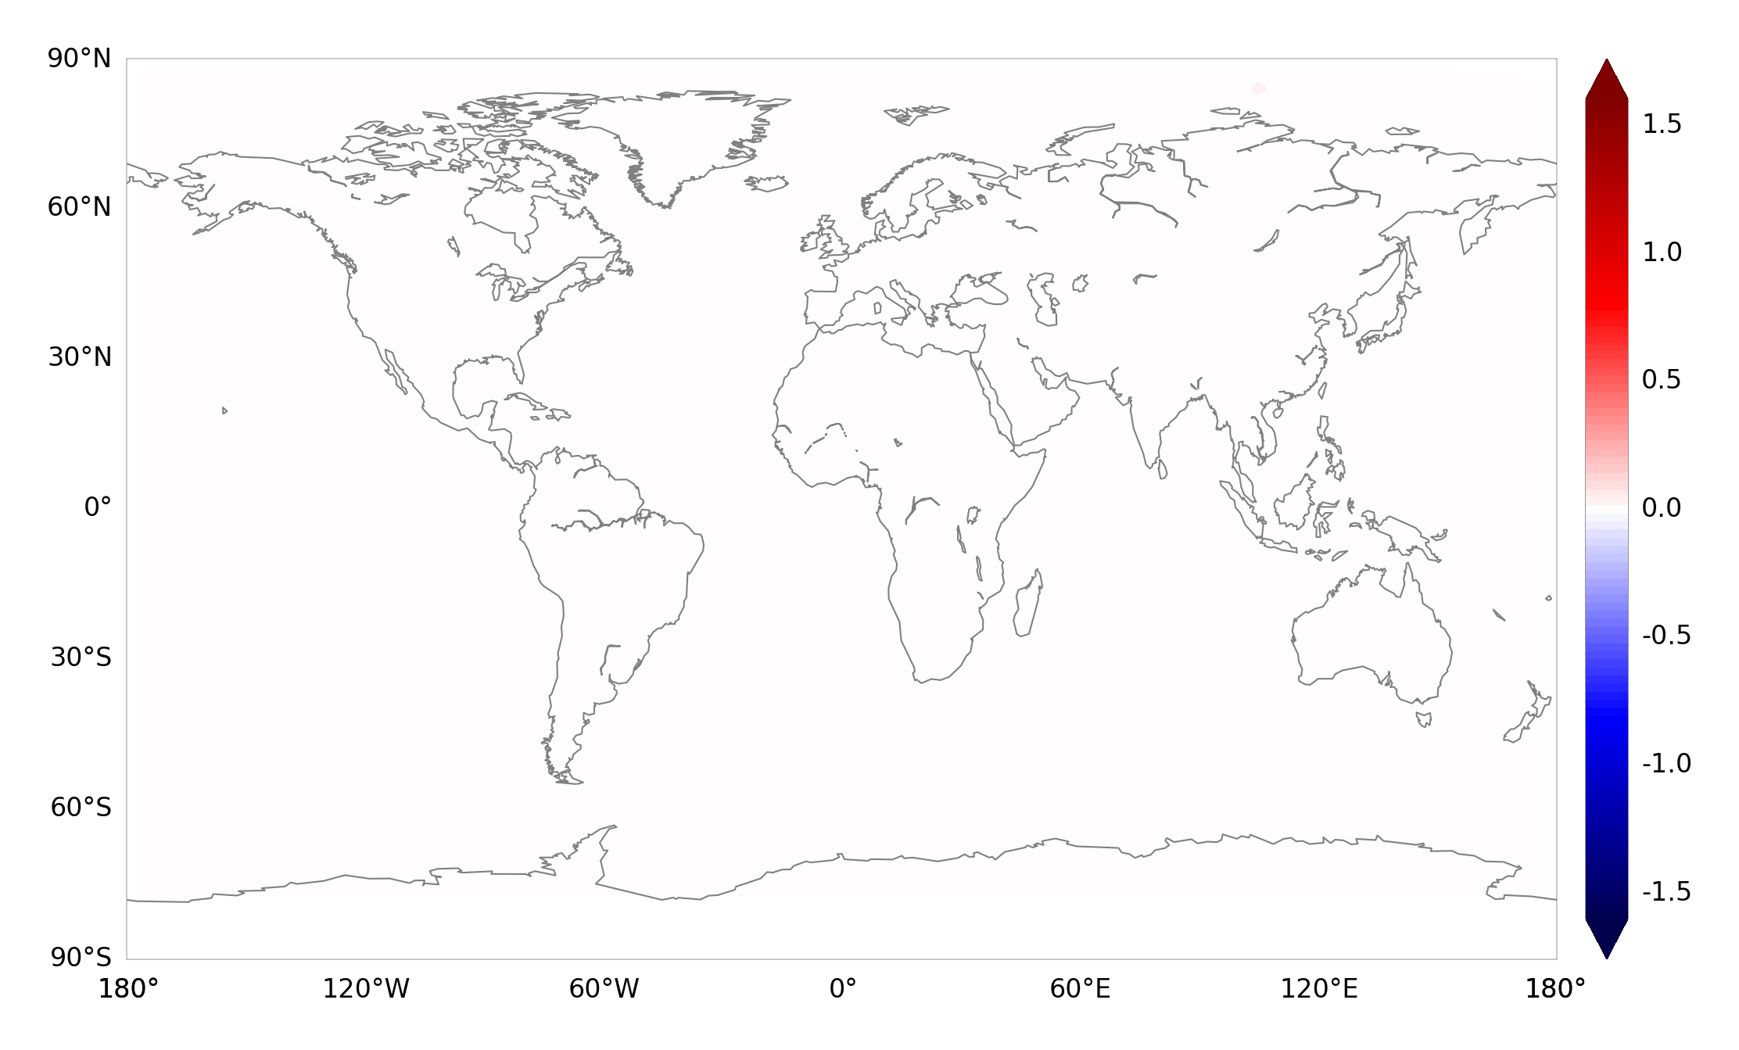
But what about the outputs?
Difference between double- and mixed-precision monthly mean of sea-surface temperature for the first month of simulation.

Slide 83
But what about the outputs?

Slide 84
Conclusions
Optimizing usage of numerical precision gives performance benefits.
We can find which variables require double precision.
There’s a huge room for reducing the numerical precision in NEMO.

Slide 85
Ongoing work
Performance in Mixed-precision?
Transferability between different cases?
Other ways of verifying the results?
Reducing even more the precision for future architectures?

Slide 86
Thank you!
The research leading to these results has received funding from the EU H2020 Framework Programme under grant agreement H2020 GA 675191.
The content of this presentation reflects only the author’s view. The European Commission is not responsible for any use that may be made of the information it contains.
oriol.tinto@bsc.es

Slide 87
Bonus track:
How much a code can benefit from single precision?

Slide 88
Bonus track:
How much a code can benefit from single precision?
Double Precision
Single Precision

Slide 89
Bonus track:
How much a code can benefit from single precision?
Double Precision
Single Precision

Slide 90
Bonus track:
How much a code can benefit from single precision?
Double Precision
Single Precision
Double Precision
50% cores per node
200% nodes

