Slide 1
Kim Serradell
Computational Earth Sciences Group
High Performance Innovation Conference
Barcelona, 30th March 2020
The project ESiWACE2 has received funding from the European Union’s Horizon 2020 research and innovation programme under grant agreement No 823988
This material reflects only the author's view and the Commission is not responsible for any use that may be made of the information it contains.

Slide 2
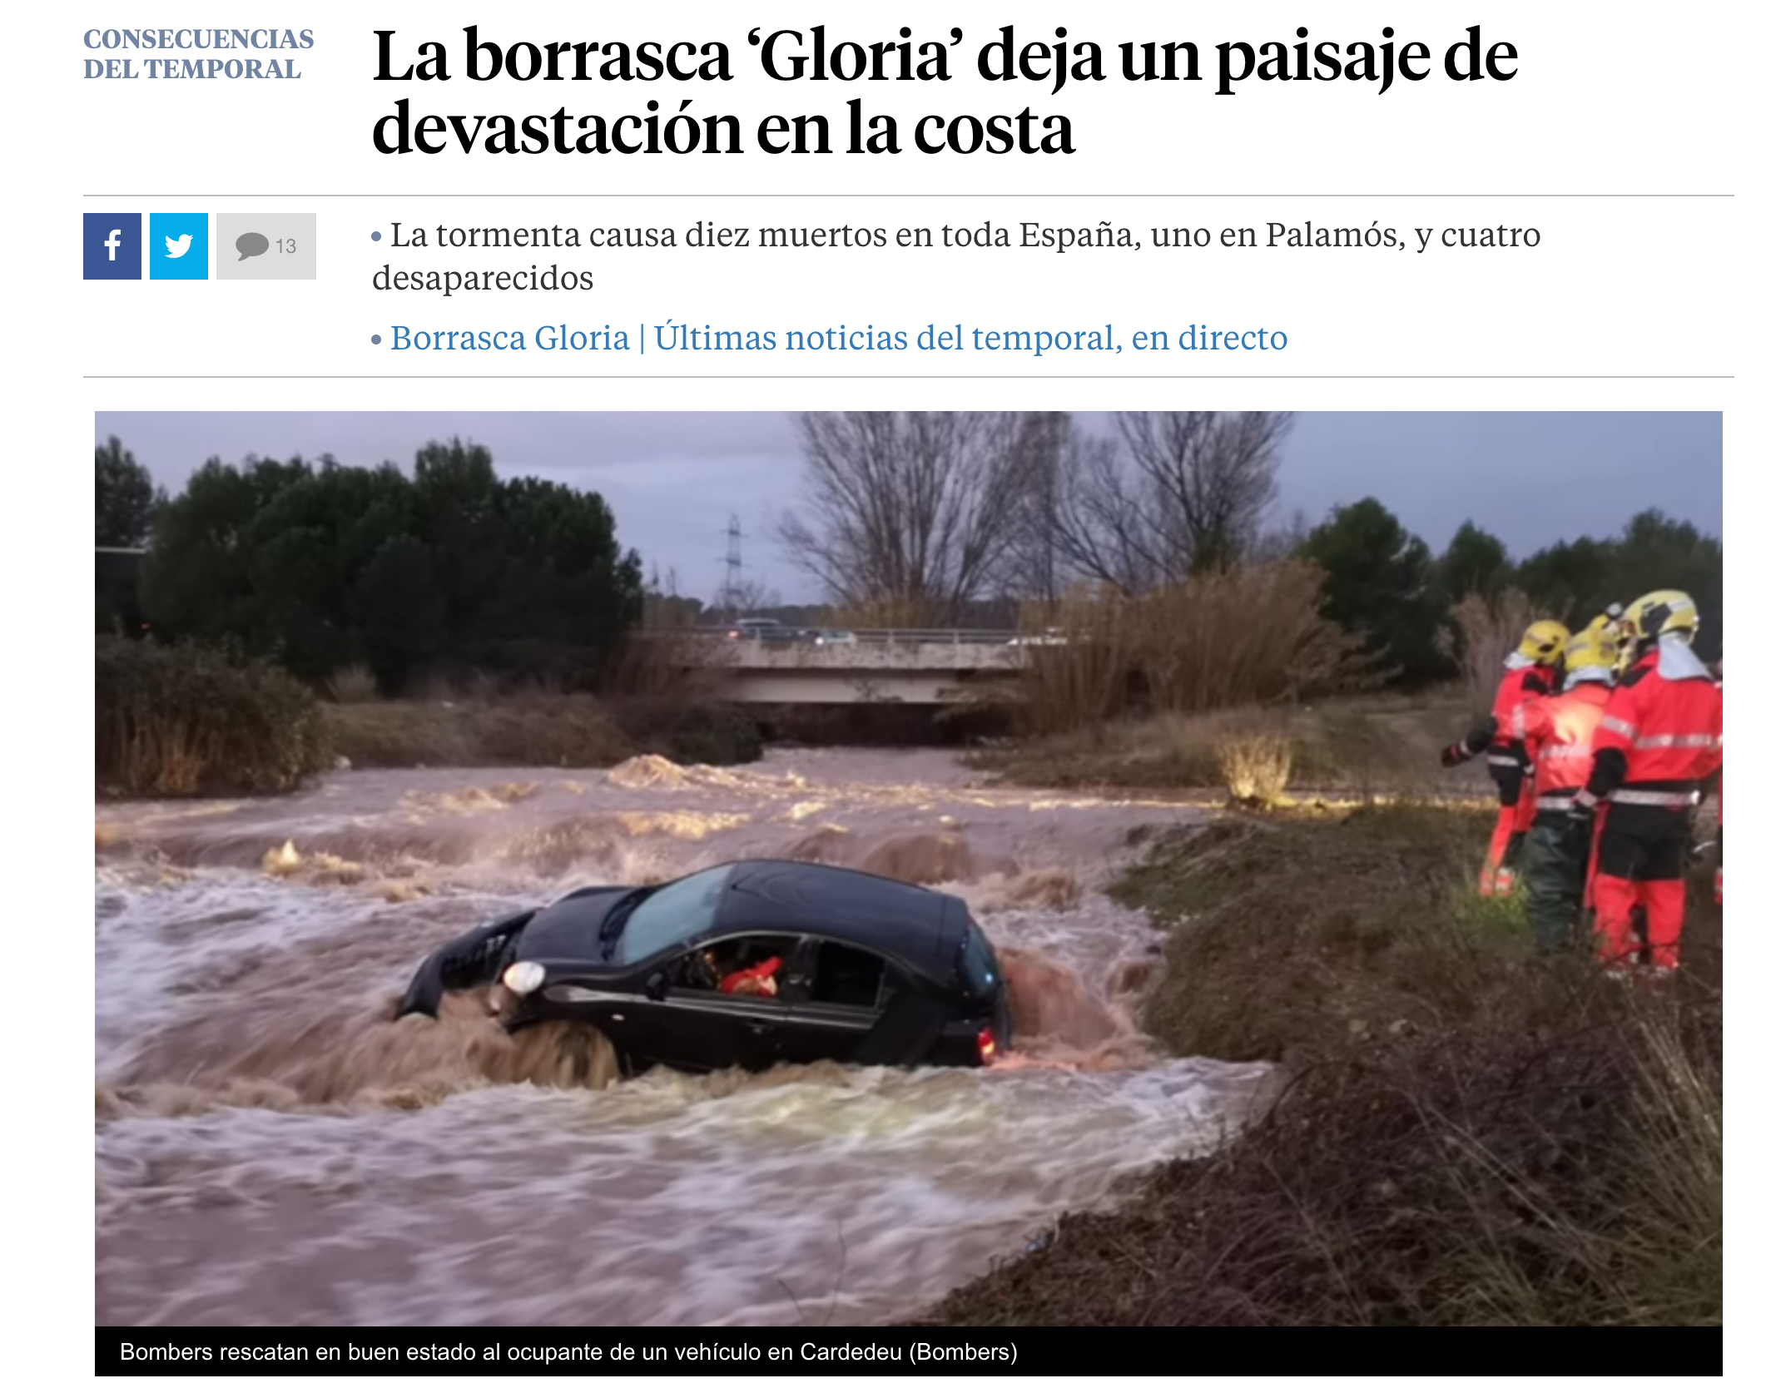
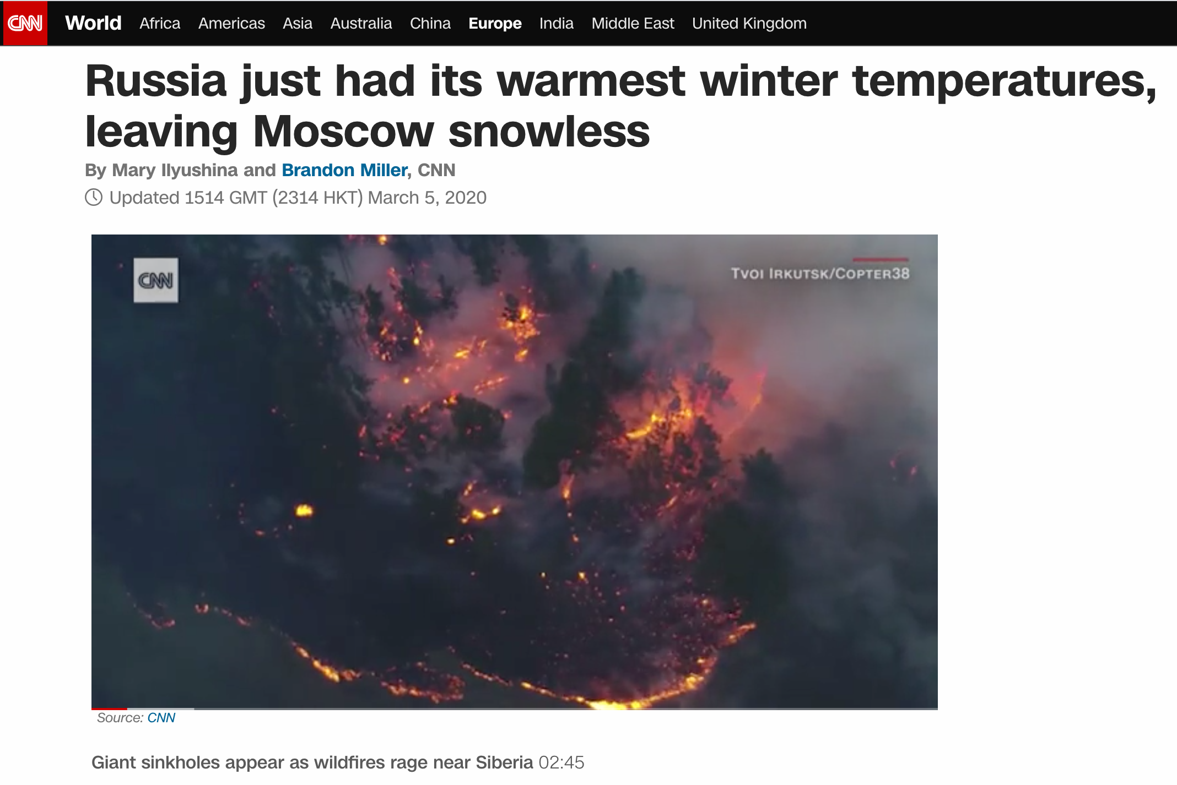
Motivation: Climate change and extreme events

Slide 3
Climate/weather in European HPC Ecosystem
H2020 FET-project
One of 10 funded Centers of Excellence
Notes:
Bild aus EU-Präsentationen, welches die drei Säulen zeigt. Die CoE sind unten in grün

Slide 4
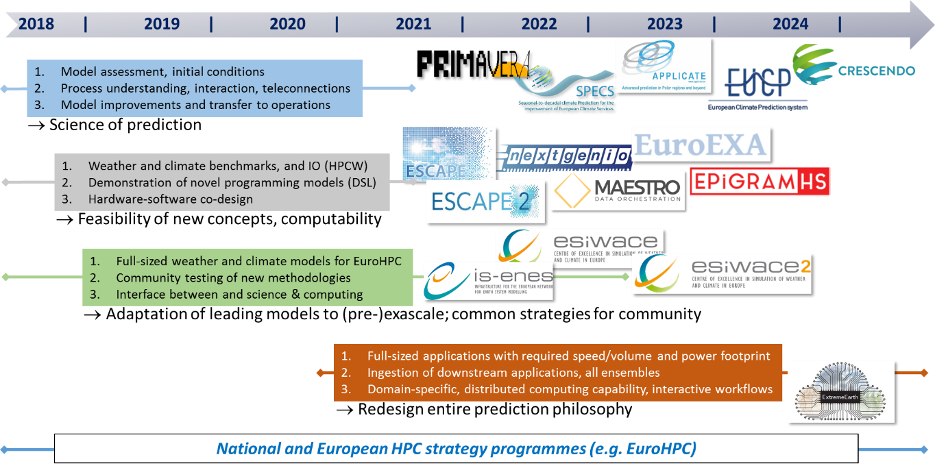
Selected weather/climate science and computational science projects funded by and proposed to the European Commission
Notes:
(zu WP 7) ESiWACE ist Teil einer größeren Strategie. (INFRASTUKTUR-Zeile: IS-ENES[1,2,3] macht CMIP, etc. ESiWACE[1,2] HPC und HiRes

Slide 5
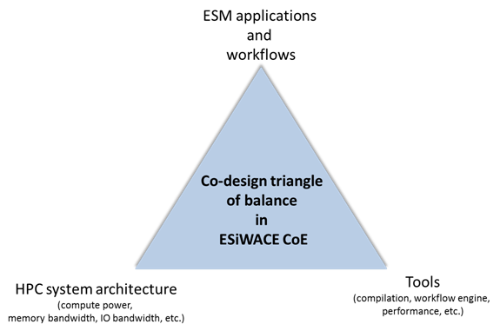
Cross-disciplinarity:
Partners from Weather, Climate, HPC, Industry
BULL optimization of NEMO for improving performance scalability at high resolution.
Seagate development of the Clovis/Mero Object store backend for ESDM.
ARM tools development guided by the ESM community requirements.

Slide 6
Key objectives
Key objectives:
Evolution:
Enable leading European weather and climate models to leverage the available performance of pre-exascale systems with regard to both compute and data capacity in 2021.
Revolution:
Prepare the weather and climate community to be able to make use of exascale systems when they become available
Notes:
Objectives

Slide 7
ESiWACE 2 work packages
WP1 Cutting Edge Resolution in Earth system modelling
WP2 Establish and watch new technologies for the community
WP3 HPC services to prepare the weather and climate community for the pre-exascale
WP4 Data Handling at Scale
WP5 Data post-processing, analytics and visualisation
WP6 Community engagement and Training
WP7 Coordination, Management and Dissemination
Notes:
Work packages

Slide 8
WP1: Cutting Edge Resolution in Earth system modelling
WP1 will develop coupled weather and climate models in unprecedented technical quality and performance as well as the organisational framework to assess their scientific performance.
Lead: Peter Dueben ECMWF; Kim Serradell, BSC;
Extend the ESiWACE 1km demonstrator approach to production type configurations: For fixed SYPD (=1) + full IO push resolution as high as technically feasible. Tentative goal:
EC-Earth: 16 km (TL1279) atmosphere coupled to a 1/12 degree (~8 km) ocean
ECMWF: 5 km (TCo1999) atmosphere coupled to a ¼ degree (25 km) ocean
ICON-ESM: 5 km atmosphere coupled to a 5 km ocean, aiming at higher resolutions for the ocean
The IPSL model: 10 km atmosphere coupled to a 1/12 degree (~8 km) ocean
Reach out to global high-res community (via DYAMOND); provide the necessary infrastructure for light weight model intercomparison

Slide 9
WP2: Establish and watch new technologies for the community
WP2 will establish, evaluate and watch new technologies to prepare climate and weather simulation for the exascale era.
Lead: Rupert Ford, STFC; Carlos Osuna, MeteoSwiss
Establish DSLs in the community
Evaluate Concurrent Components to improve performance
Evaluate Containers to port Earth system models to new hardware
Watch emerging technologies (e.g. via Oxford machine learning workshop)
Notes:
WP2

Slide 10
WP3: HPC services to prepare the W&C community for pre-exascale
WP3 will develop and provide services to improve performance and portability of climate codes with respect to existing and upcoming tier1 and tier0 computers..
Lead: Ben van Werhoven, NLeSC; Erwan Raffin, Bull/ATOS
Open call for service requests to organise support for existing Earth system models that target the European pre-exascale systems planned for 2021
Model portability and refactoring
Coupling, IO and workflows
Weather and climate benchmarking
“HPCW” (V1.0 developed by ESCAPE-2)

Slide 11
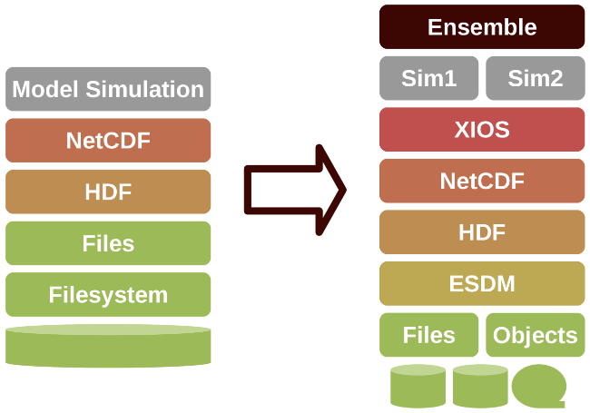
WP4 and WP5: Data Handling at Scale
WP4 will provide the necessary toolchain to handle data at pre-exa-scale and exa-scale, for single simulations, and ensembles
Lead: Bryan Lawrence, UREAD; Julian Kunkel, UREAD
WP5 will enhance the tools to analyse and visualise these data
Lead: Sandro Fiore, CMCC; Niklas Röber, DKRZ
Control Workflow via CYLC Meta-scheduler
Handle data via Earth-System-Data Middleware (ESDM, non POSIX)
In-situ and asynchronous approaches to analytics and visualisation
Notes:
Ggf noch WP4 und 5 erwähnen

Slide 12
WP6: Community engagement and Training
WP6 will link ESiWACE2 to the weather and climate community and the European HPC ecosystem
Lead: Sylvie Joussaume, CNRS-IPSL; Sophie Valcke, CERFACS
Community engagement
HPC Workshops
HPC task force
Interface to PRACE
OASIS3-MCT
High performance Data Analytics
Container Hackathon
Summer school in HPC for weather and climate
Training and Schools
IO and HPC awareness
DSL
C++ for HPC

Slide 13
BSC activities
in ESiWACE

Slide 14
EC-Earth Climate Model
29 partner institutes
8 core partners
KNMI, AEMET, DMI, Met Éireann, FMI, IPMA, CNR-DTA, SMHI
Workgroups Technical Tuning
Atmospheric Composition and Land Ocean
Millennium scale studies CMIP6
Kim Serradell, BSC: A m,ajor benefit created through ESiWACE: create a framework where different institutions can work together to technically improve a community model like EC-Earth

Slide 15
EC-Earth T1279-ORCA12 in MareNostrum4
Operational global, coupled ~10 km simulations (T1279 - ORCA12):
EC-Earth 3.2 (IFS36r4 + NEMO 3.6 + OASIS3-MCT)
5,040 MPI tasks - 0.44 SYPD, 160 SDPD
3,209 NEMO
1,584 IFS
69 XIOS
1 runoff mapper
MareNostrum4 @ BSC
100 year exp
~40M ch !!!

Slide 16
ORCA36 scalability (MN4)
NEMO Ocean Model
ORCA36 scalability – Double precision vs Single precision – Grand challenge
71% of MN4
PROCESSES (CORES)

Slide 17
Performance analysis
Since 1991
Based on traces
Open Source: https://tools.bsc.es
Extrae: Package that generates Paraver trace-files for a post-mortem analysis
Paraver: Trace visualization and analysis browser
Dimemas: Message passing simulator

Slide 18
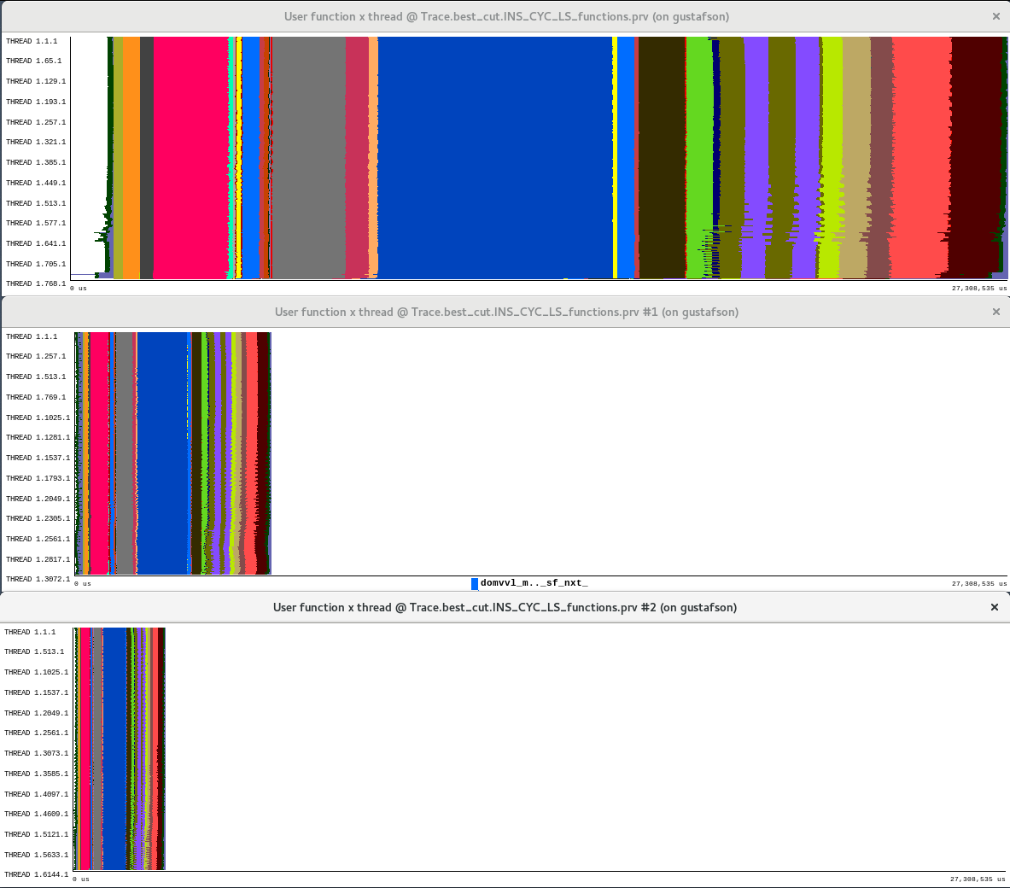
ORCA36 Performance analysis
768
3,072
6,144
t

Slide 19
Comparison of EC-Earth simulations' using different resolutions

