Slide 1
High Performance Computing for
Earth System Models: Optimization & Profiling
Pablo Ortega, Miguel Castrillo and Mario Acosta
Earth Sciences Department

Slide 2
High Performance Computing in Earth Sciences
Earth System Models (ESMs) are sophisticated tools with continuously increasing complexity:
More components of Earth System are included
Finer Spatial and Temporal resolutions
This increase in complexity has only been possible thanks to the important parallel advances in HPC

Slide 3
A climate modeling Timeline
Inclusion of new components
From the 4th National Climate Assessment (US), Volume I
Allowed the representation of new climate and biogeochemical processes
Improved the ESMs ability to represent the real world
Provides a new framework to investigate the interactions between the different components

Slide 4
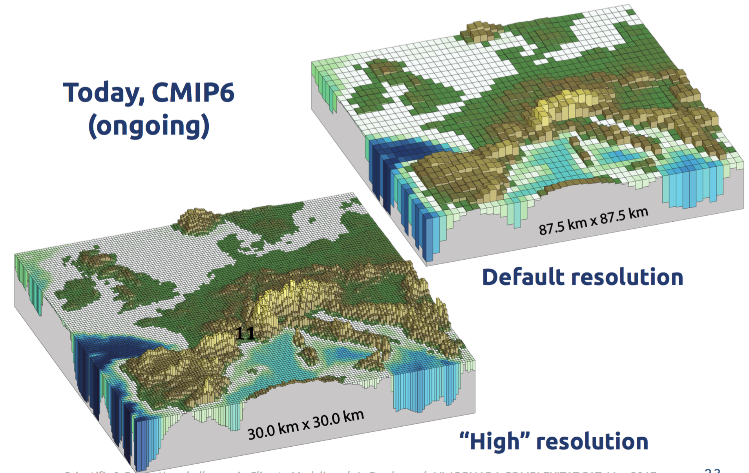
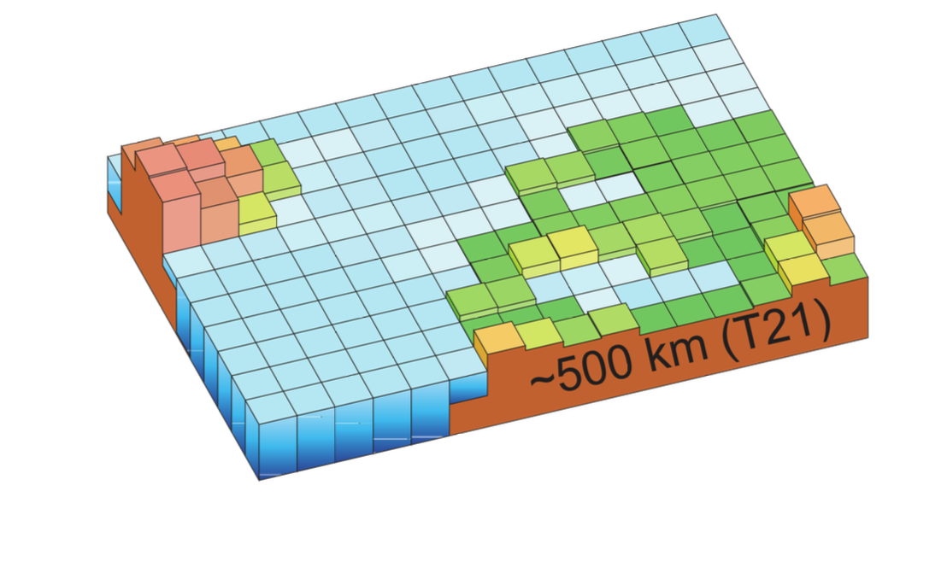
A climate modeling Timeline
Increase in spatial resolution: Atmosphere
Typical climate model in 90s
Today
Default resolution
“High” resolution
Achieving higher resolutions is essential to better represent orography, and its effect on climate (i.e. in precipitation)

Slide 5
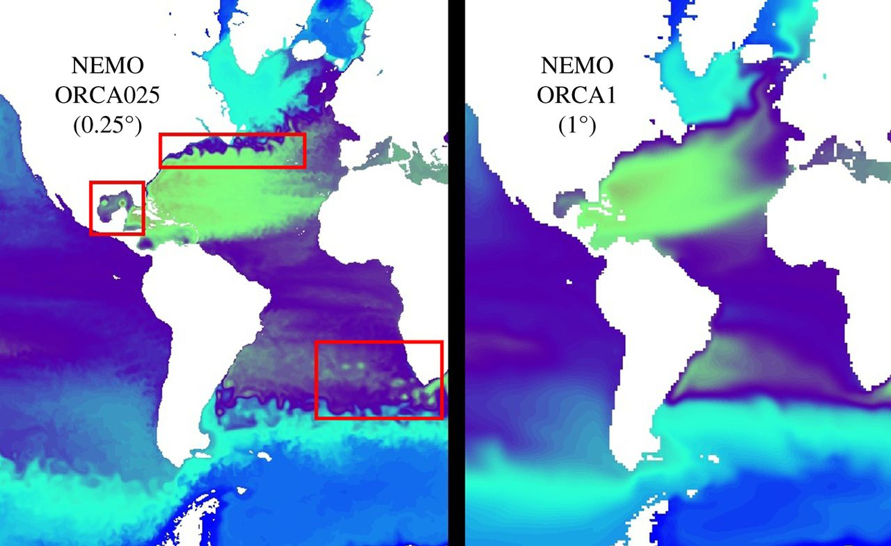
A climate modeling Timeline
Increase in spatial resolution: Ocean
High Resolution (0.25°) Eddy-permitting
Standard
Resolution (1°)
“Ultra-High” resolution:
Eddy-resolving
Today
The improvements in ocean resolution translate in a better representation of eddies and ocean currents, which are key to describe realistically decadal variability in the ocean

Slide 6
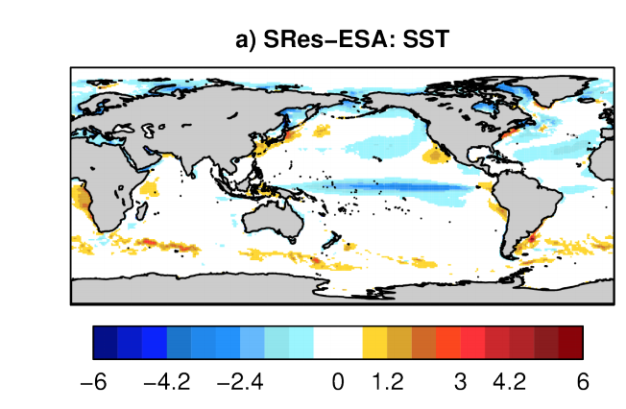
A climate modeling Timeline
Impact of resolution on model biases
From Prodhomme et al (2016)
SR: Oce 1°/ Atm 70km
BIAS in SST [SR minus OBS]

Slide 7
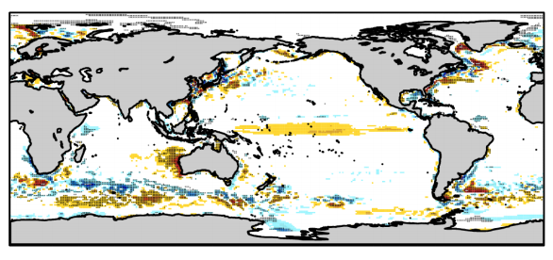
A climate modeling Timeline
Impact of resolution on model biases
From Prodhomme et al (2016)
SR: Oce 1°/ Atm 70km
BIAS in SST [SR minus OBS]
IR: Oce 0.25°/ Atm 70km
Diff in SST [IR minus SR]

Slide 8
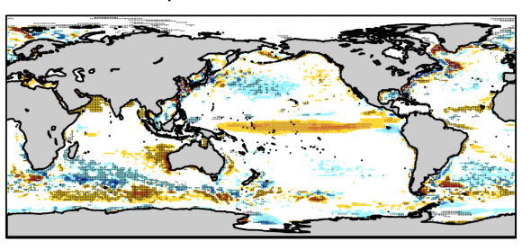
A climate modeling Timeline
Impact of resolution on model biases
From Prodhomme et al (2016)
SR: Oce 1°/ Atm 70km
BIAS in SST [SR minus OBS]
IR: Oce 0.25°/ Atm 70km
Diff in SST [HR minus SR]
HR: Oce 0.25°/ Atm 40km

Slide 9
A climate modeling Timeline
Impact of resolution on model biases
From Prodhomme et al (2016)
SR: Oce 1°/ Atm 70km
BIAS in SST [SR minus OBS]
The increases in resolution subsequently reduce the model biases
IR: Oce 0.25°/ Atm 70km
Diff in SST [HR minus SR]
HR: Oce 0.25°/ Atm 40km

Slide 10
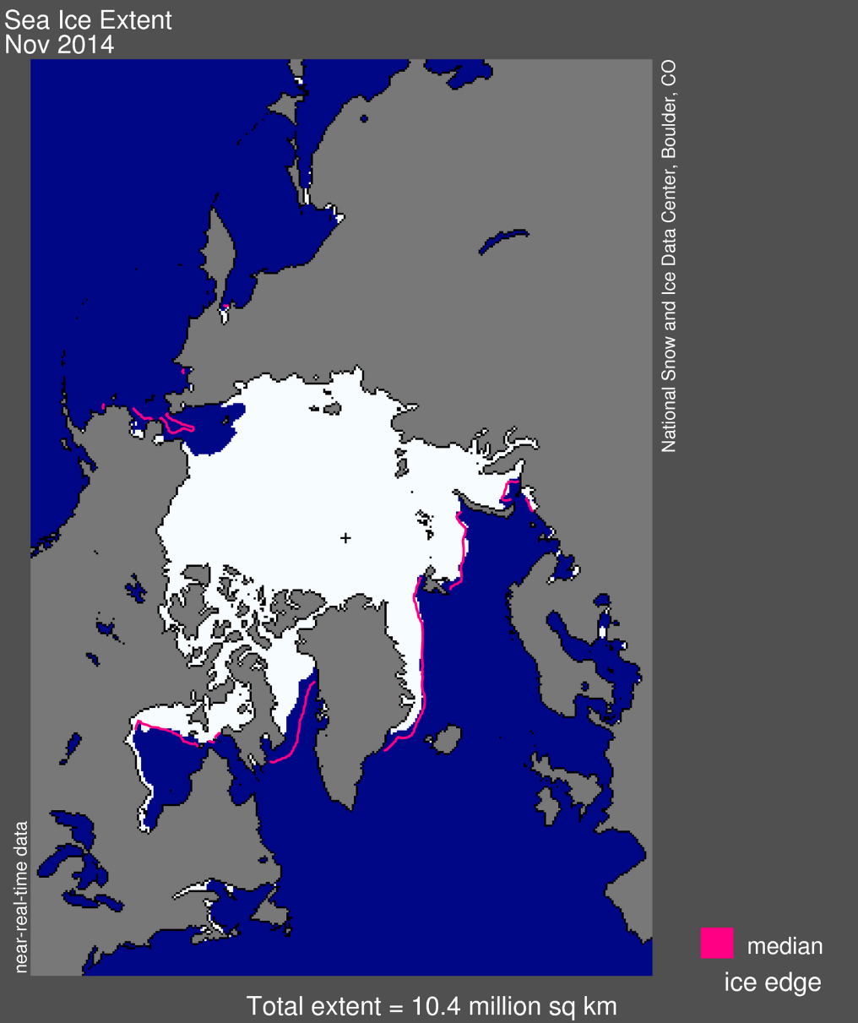
Goal of the collaboration
Reducing the model biases in the NICAM-LETKF model
using HR sea ice reconstruction with EC-Earth

Slide 11
Porting the model to other architectures
MPMD run: different models, different needs
Model | I/O server | Output lib
IFS (atmosphere) | Not used in EC-Earth | GRIB
NEMO (ocean) | XIOS | NetCDF/HDF5
Different systems, different features
Facility | Endianness | RAM/Core | Pre-compiled libs linking
Marenostrum IV | Little endian | 2 GB | Both static & dynamic
Mira | Big endian | 1 GB | Static
K | Big endian | 2 GB | Static

Slide 12
Porting the model to other architectures
Our experience in ALCF (Mira). Similar changes for RIKKEN (K).
MareNostrum IV
MareNostrum IV
GribAPI
./configure \
--disable-jpeg
./configure \
--build=ppc64-redhat-linux \
--host=powerpc64-bgq-linux \
CC=mpicc \
CFLAGS="-O3" \
FC=mpif90 \
FCFLAGS="-O3" \
F77=mpif77 \
FFLAGS="-O3" \
--disable-jpeg \
--enable-shared=no
GribEX
IFS linking
IFS headers
IFS compiling

Slide 13
Porting the model to other architectures
Our experience in ALCF (Mira). Similar changes for RIKKEN (K).
MareNostrum IV
MareNostrum IV
GribAPI
#ifdef LITTLE_ENDIAN
return ((*centre*1000000) + (*subcentre*1000) + (*number & 0xff));
#else
return ((*centre*1000000) + (*subcentre*1000) + ((*number>>shift) & 0xff));
#endif
#undef LITTLE_ENDIAN
#ifdef LITTLE_ENDIAN
return ((*centre*1000000) + (*subcentre*1000) + (*number & 0xff));
#else
return ((*centre*1000000) + (*subcentre*1000) + ((*number>>shift) & 0xff));
#endif
GribEX
IFS linking
IFS headers
IFS compiling

Slide 14
Porting the model to other architectures
Our experience in ALCF (Mira). Similar changes for RIKKEN (K).
MareNostrum IV
MareNostrum IV
GribAPI
-L/gpfs/mira-fs1/projects/EXCEL/models/ecearth/v3.1/sources/sources/ifs-36r4/lib -lifs -ltrans -lsurf -lifsalgor -lifsaux -lifs -ldummy
-L/gpfs/mira-fs1/projects/EXCEL/models/ecearth/v3.1/sources/sources/oasis3/ecconf/lib -lpsmile.MPI1 -lmpp_io -lclim.MPI1
-L/soft/libraries/netcdf/current/cnk-gcc/current/lib -lnetcdff -lnetcdf -lpnetcdf -lhdf5_hl -lhdf5 -ldl -lz
-L/projects/EXCEL/opt/grib_api-1.14.0/cnk-gcc/lib -lgrib_api_f90 -lgrib_api
-L/projects/EXCEL/opt/emos_000392/cnk-gcc/ -lemosR64
-L/soft/libraries/alcf/current/gcc/LAPACK/lib -llapack
-L/gpfs/mira-fs1/projects/EXCEL/models/ecearth/v3.1/sources/sources/ifs-36r4/lib -lifs -lifsaux -lifsalgor -ltrans -lifsalgor -lsurf -lifsaux -lifs -ldummy -L/gpfs/mira-fs1/projects/EXCEL/models/ecearth/v3.1/sources/sources/oasis3/ecconf/lib -lpsmile.MPI1 -lmpp_io -lclim.MPI1 -L/soft/libraries/netcdf/current/cnk-gcc/current/lib -lnetcdff -lnetcdf -L/soft/libraries/pnetcdf/current/cnk-gcc/current/lib -lpnetcdf -L/soft/libraries/hdf5/current/cnk-gcc/current/lib -lhdf5_hl -lhdf5 -ldl -L/soft/libraries/alcf/current/gcc/ZLIB/lib -lz -lm -L/projects/EXCEL/opt/grib_api-1.14.0/cnk-gcc/lib -lgrib_api_f90 -lgrib_api -L/projects/EXCEL/opt/emos_000392/cnk-gcc/ -lemosR64 -L/soft/libraries/alcf/current/gcc/LAPACK/lib -llapack -L/soft/libraries/alcf/current/gcc/BLAS/lib -lblas
GribEX
IFS linking
IFS headers
IFS compiling

Slide 15
Porting the model to other architectures
Our experience in ALCF (Mira). Similar changes for RIKKEN (K).
MareNostrum IV
MareNostrum IV
GribAPI
undefined reference to `gethwm’
#if defined(CRAY) && !defined(SV2)
#define gethwm GETHWM
#else
#define gethwm gethwm_
#if defined(CRAY) && !defined(SV2)
#define gethwm GETHWM
#else
#define gethwm gethwm
GribEX
IFS linking
IFS headers
IFS compiling

Slide 16
Porting the model to other architectures
Our experience in ALCF (Mira). Similar changes for RIKKEN (K).
MareNostrum IV
MareNostrum IV
GribAPI
TOC relocation error (R_PPC64_TOC16)
-mc-model=medium
GribEX
IFS linking
IFS headers
IFS compiling

Slide 17
Workflow management

Slide 18
High Performance Computing in Earth Sciences
Earth System Models (ESMs) are sophisticated tools with continuously increasing complexity:
More components of Earth System are included
Finer Spatial and Temporal resolutions
This increase in complexity could be developed thanks to the important parallel advances in HPC

Slide 19
A workflow for Earth System models
Model setup
Deployment on remote HPC
Initial data pre-processing
Configure experiment
Set up platform-specific files
Prepare run scripts
Tar and send model files / Synchronize updated files
Compile the model
Choose and deploy the initial data
Pre-process initial conditions / restarts
Simulation
Output data post-processing
Verification & diagnostics
Find a proper domain decomposition
Run simulation
Assimilation / synchronize jobs
Post-process / normalize output data
Archive restarts / output files
Transfer results to local
Generate diagnostics
Generate plots

Slide 20
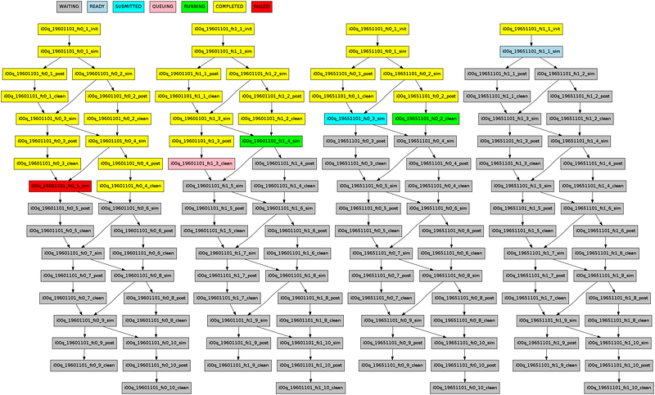
Workflow managers: motivation
Workflow managers are essential to carry out production experiments in an efficient way
Deal with workflow complexity
Ensure robustness & portability
Usability → Scientists more productive

Slide 21
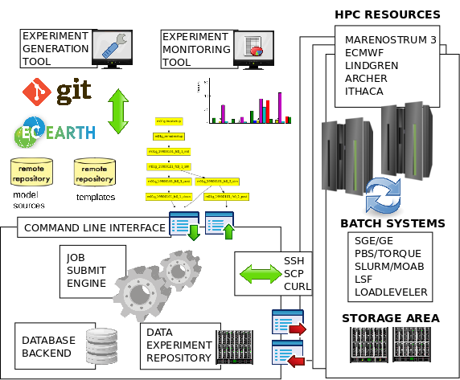
Autosubmit
A versatile tool to manage Weather and Climate Experiments in diverse Supercomputing Environments: https://pypi.python.org/pypi/autosubmit

Slide 22
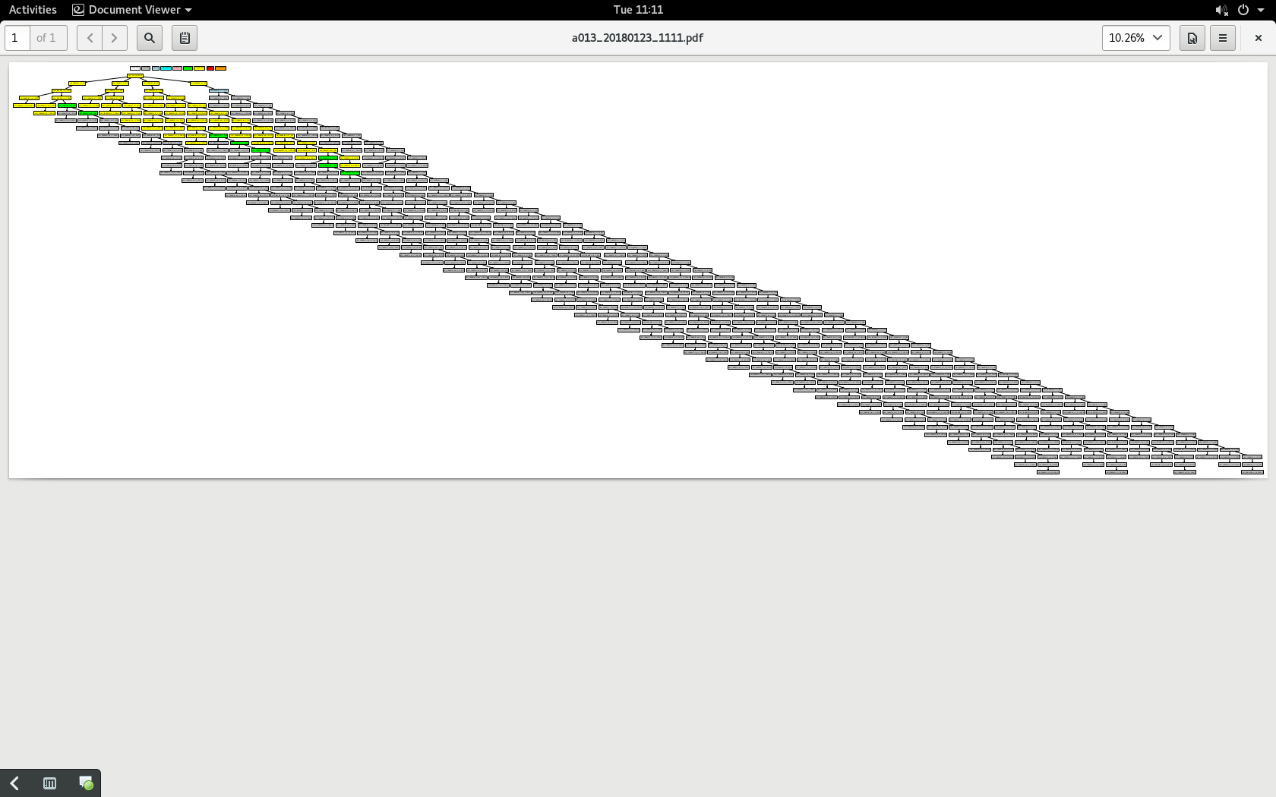
Autosubmit: lessons learned
Workflows are getting more and more complex
Workflow managers are required to improve in order to deal with this complexity

Slide 23
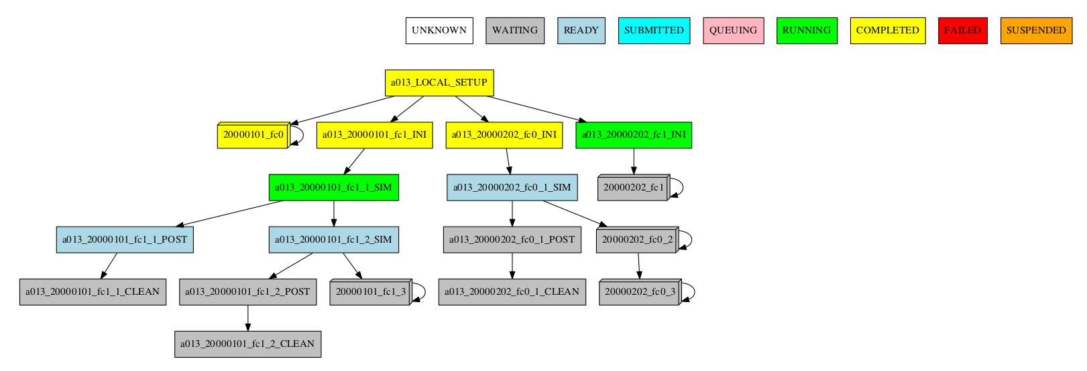
Autosubmit v3.10: Visualization
Improvements in the graph visualization of the workflow, by grouping jobs by date, member, chunk, split; or automatically.
Automatic behavior:
Collapsing jobs sharing status.
Hide groups:
Showing the more relevant information.

Slide 24
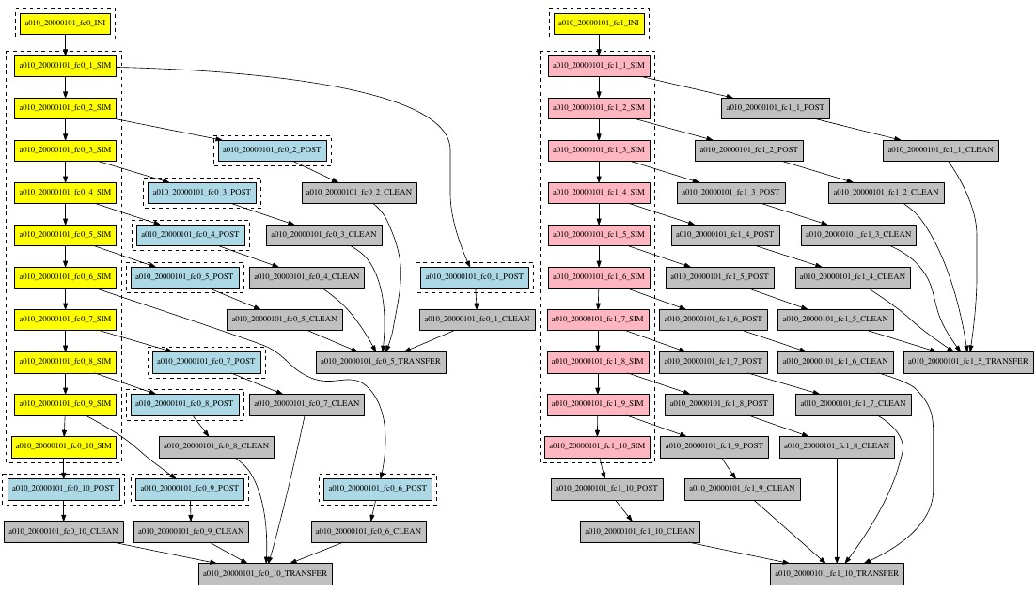
Autosubmit: Wrapper
Motivation: to improve throughput by reducing queueing time through wrapping different jobs together.

Slide 25
Auto-EC-Earth testing: continuous integration
Goal: To be able to run the last EC-Earth version, use new features, merge latest developments smoothly
v3.2.3
r4737-bsc_trunk
r4820-bsc_nemo
trunk
rXXX-feature
Every week: run a set of LR tests
coupled
forced atmosphere
forced ocean
bsc_trunk (trunk)
bsc_nemo (NEMO production)
MN4 (BSC)
cca (ECMWF)

Slide 26
Auto-EC-Earth testing: release tests
For every verison release: run a complete set of tests
nord3 | CCA | MN4 | resolution | type | details
t02c | t00u | t00q | T255L91-ORCA1L75-LIM3 | coupled | start from restart
 |  | t00v | T255L91-ORCA1L75-LIM3 | coupled | atmos. nudging
 |  | t011 | T255L91-ORCA1L75-LIM3 | coupled | sppt
 | t00s | t00o | T255L91-ORCA1L75-LIM3 | coupled | cold start
 | t01d | t00z | ORCA1L75-LIM3 | nemo | cold start
 |  | t01j | ORCA1L75-LIM3 | nemo | cold start ocean nudging
 | t01e | t00r | T511L91-ORCA025L75-LIM3 | coupled | start from restart
 |  | t01o | ORCA025L75-LIM3 | nemo | cold start
 | t01b | t00y | T511L91 | ifs | cold start
 | t00t | t00p | T511L91-ORCA025L75-LIM3 | coupled | cold start

Slide 27
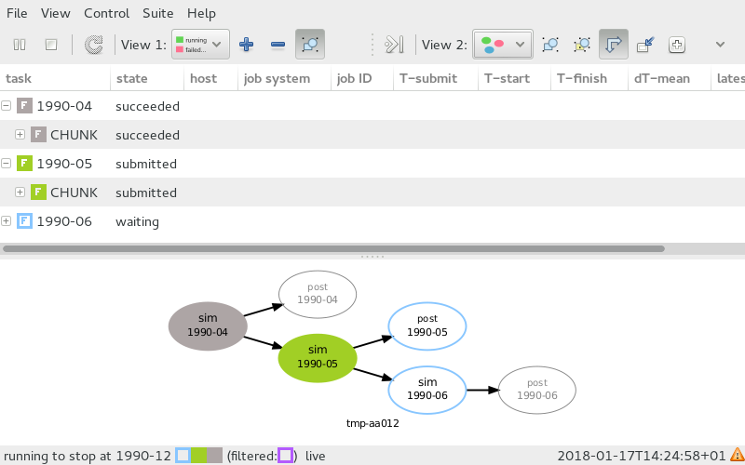
Cylc
First proof of concept → NEMO standalone integrations
Testing different interfaces and configurations: Rosie go, Rose Config Edit & Rose Stem

Slide 28
Earth System Model performance

Slide 29
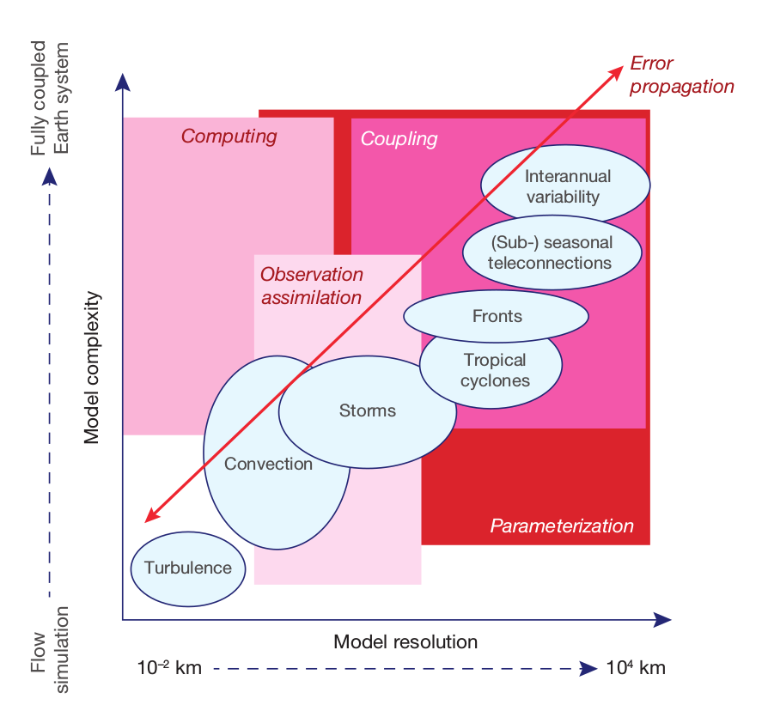
HPC Challenges

Slide 30
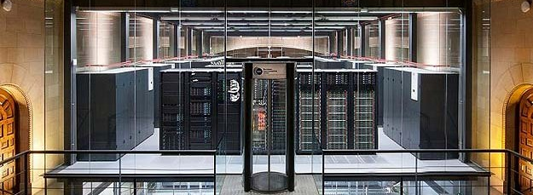
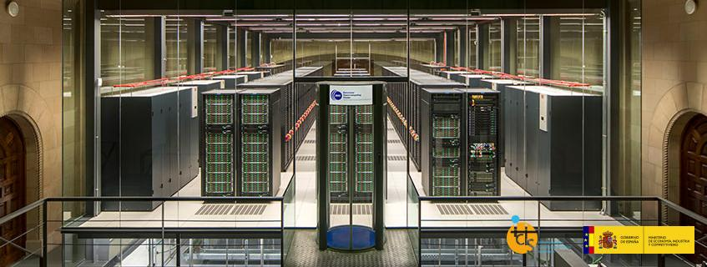
Marenostrum IV
MareNostrum IV in operation since July 2017
One of the first HPCs featuring new Intel Scalable Processors
 | MareNostrum III | MareNostrum IV
Processor | Intel Xeon E5-2670 2.6 GHz | Intel Xeon Platinum 8160 2.1 GHz
#Cores per socket | 8 | 24
#Sockets | 2 | 2
Memory | 32Gb DDR3-1600 2 GB/core | 96Gb DDR4-2667 2 GB/core
Interconnection | Infiniband FDR10 10Gb | Intel Omni-Path 100Gb
MareNostrum III - 11,15 petaFLOPS
MareNostrum IV - 11,15 petaFLOPS

Slide 31
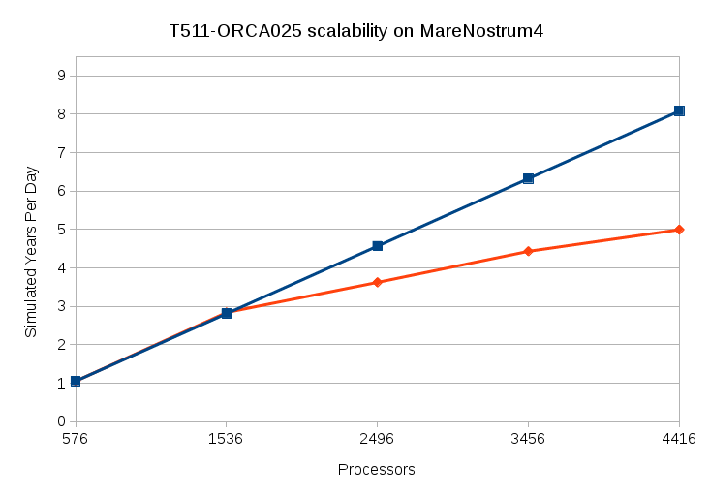
EC-Earth scalability on MN4
Scalability for EC-Earth trunk with default output configuration

Slide 32
Performance Analysis
1
4
28

Slide 33
Optimizations for NEMO
Diagnostic for NEMO:
Scalability is constrained by:
1) Algorithms with too much communication
2) Sub-optimal implementation
Actions taken
Improve communication implementation to reduce number of point-to-point messages
Reduce number of collectives

Slide 34
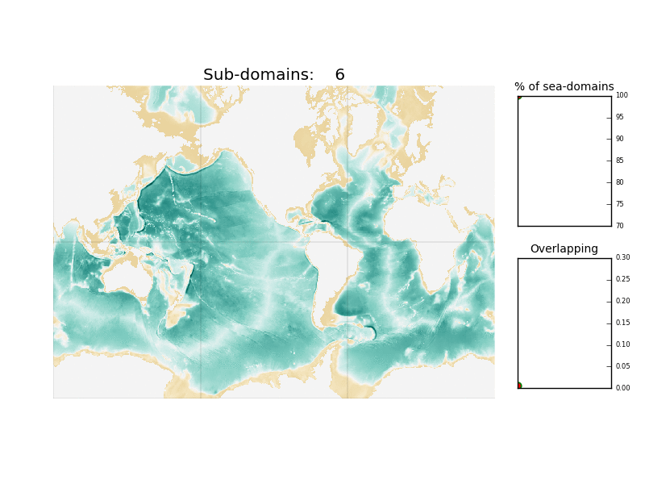
Optimizations for NEMO
ELPiN allows to find proper namelist parameters to exclude land-only processes in NEMO simulations

Slide 35
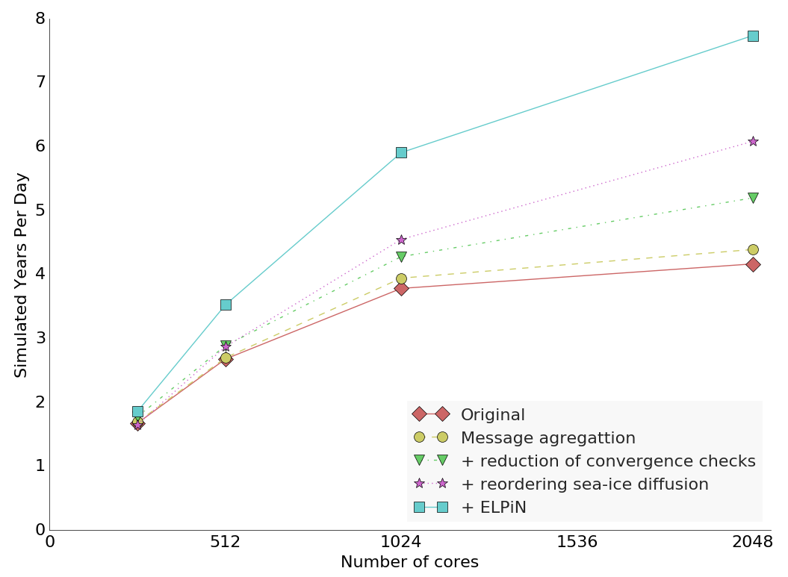
Optimizations for NEMO
Impact of proposed optimizations on
ORCA1/4º + LIM3 simulations (27km global)

Slide 36
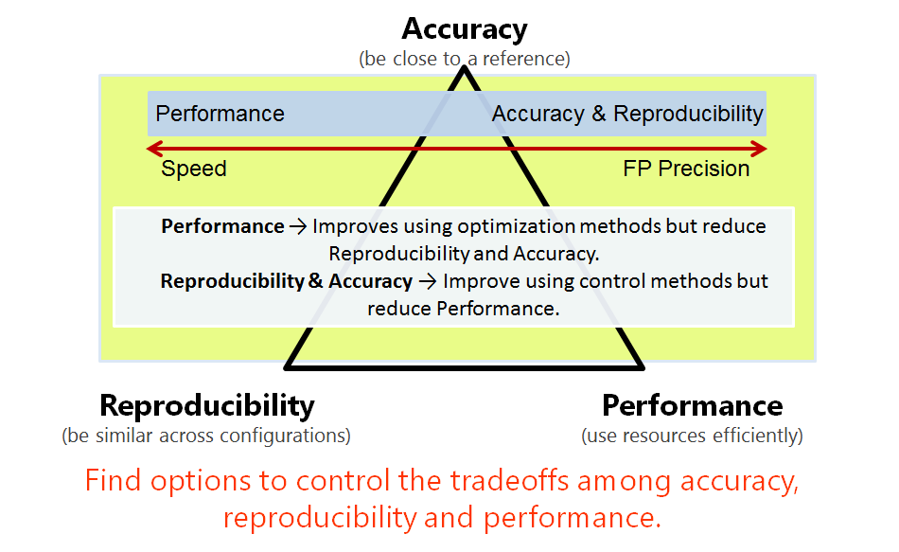
Results Verification

Slide 37
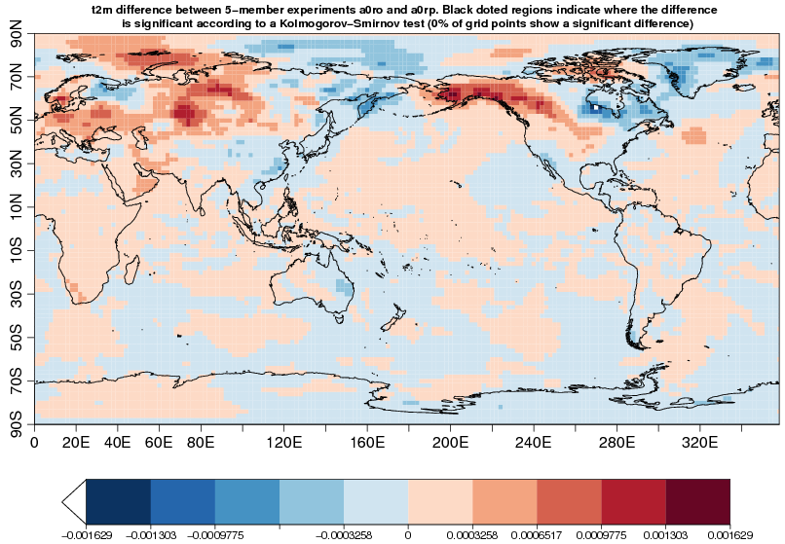
Reproducibility
Compare to CMIP5 results to evaluate the accuracy and between two experiments to evaluate the reproducibility

Slide 38
Thank you
YourEmail@bsc.es

