Slide 1
Barcelona, 1 February 2016
Modelling Urban Air Quality (MUAQ)
A proposal for the 2016-2019 BSC Severo Ochoa Programme
Earth Sciences, CASE and Computer Sciences Departments
Albert Soret, Arnau Folch, David Carrera,
Oriol Jorba, Marc Guevara and Francisco Doblas-Reyes

Slide 2
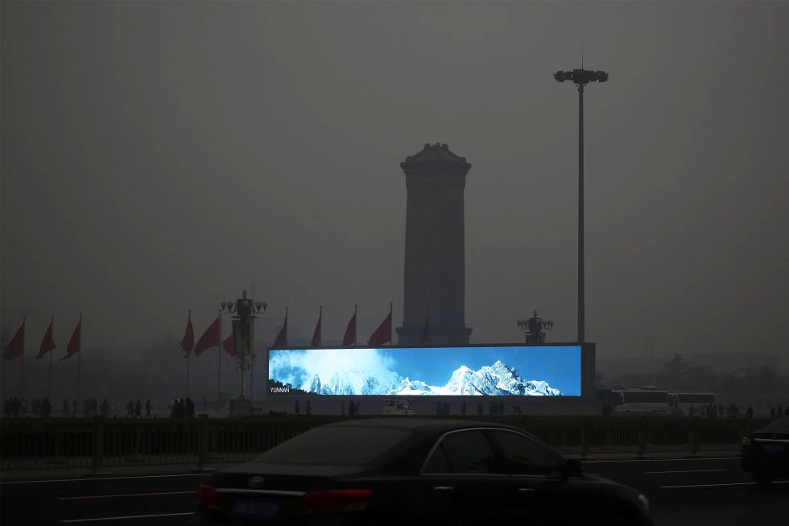
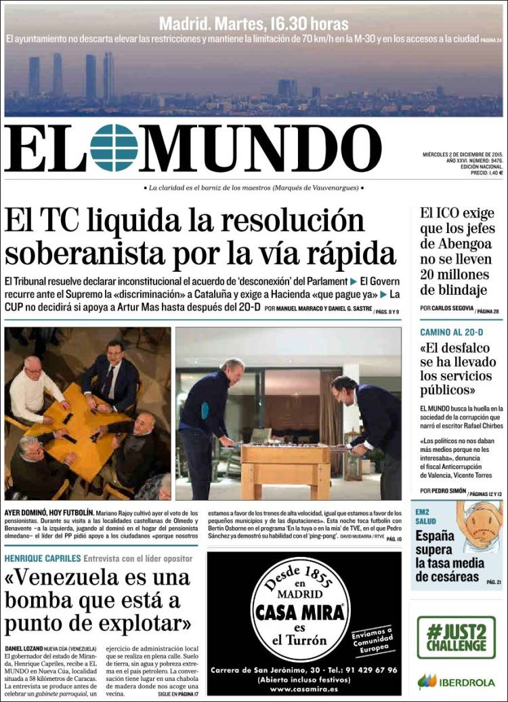
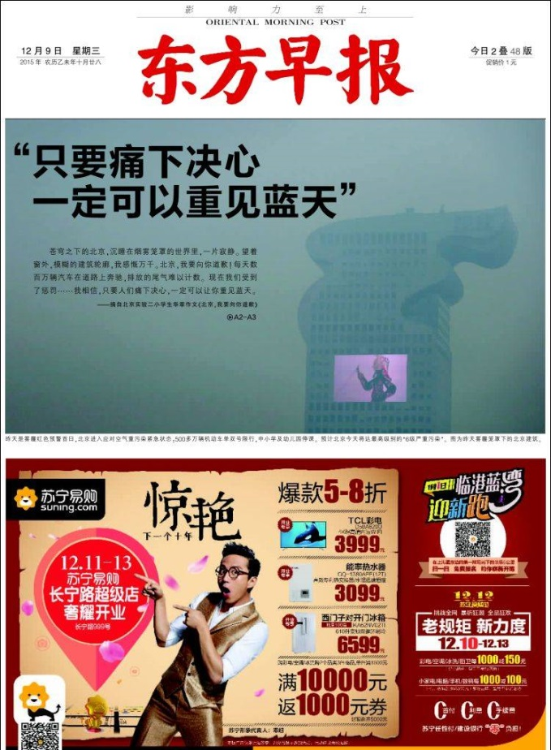
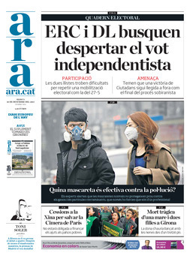

Slide 3
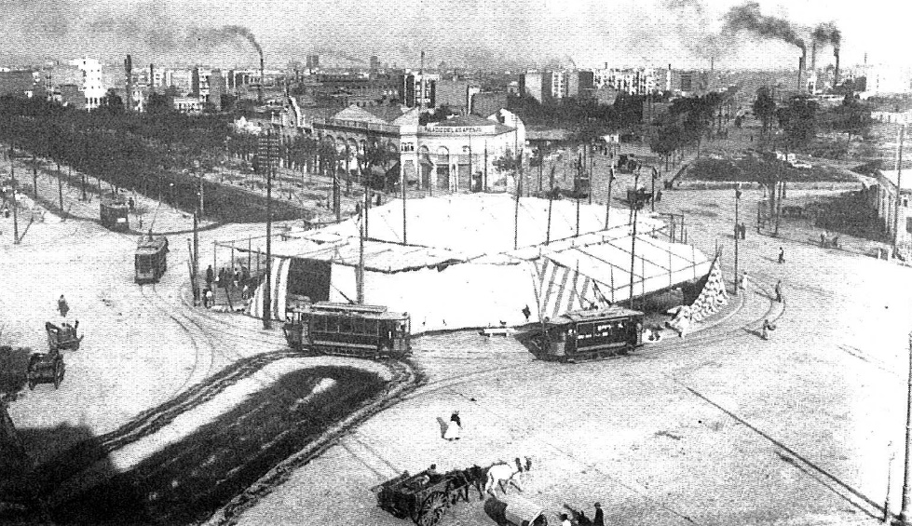
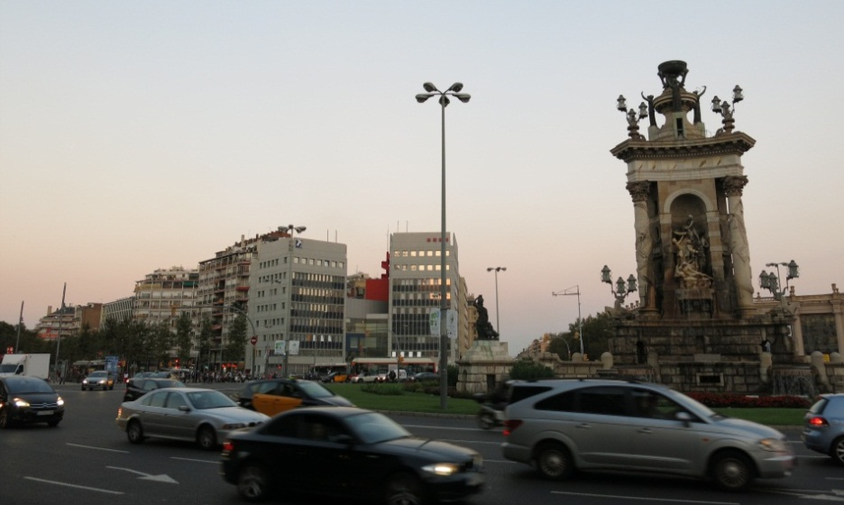
Urban air pollution. Causes
Plaça Espanya, Barcelona (1908)
Plaça Espanya, Barcelona (2014)
C/ Gran de Gràcia, Barcelona (1908)
C/ Gran de Gràcia, Barcelona (2014)

Slide 4
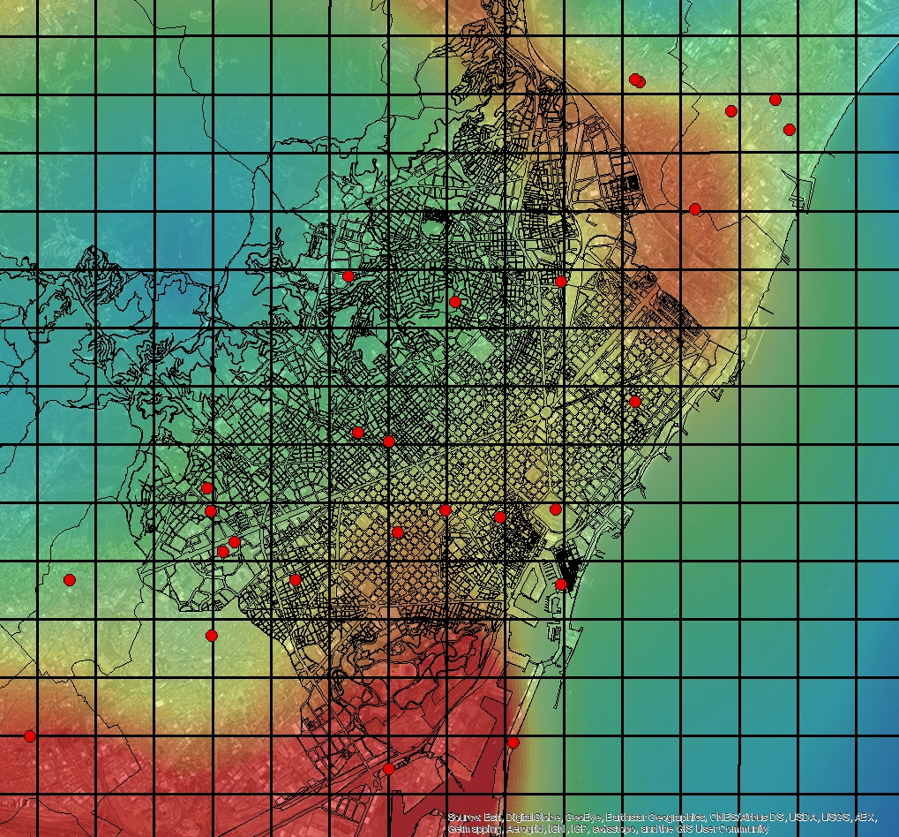
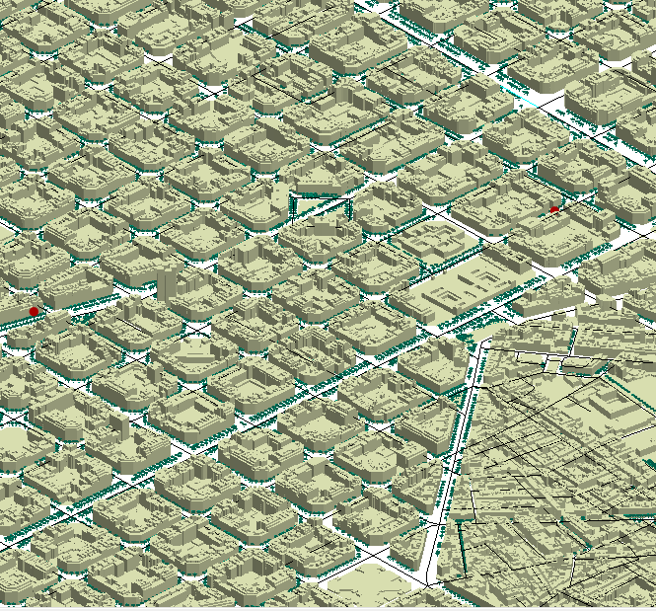
Air quality management tools: concept
Where we are now
Where we want to go
NO₂ [µg.m⁻³]
Objective | To develop, for the first time, an air quality model based on a CFD coupled to an atmospheric chemistry model at city scale enhanced by the use of Big Data technologies to assess urban air quality.

Slide 5
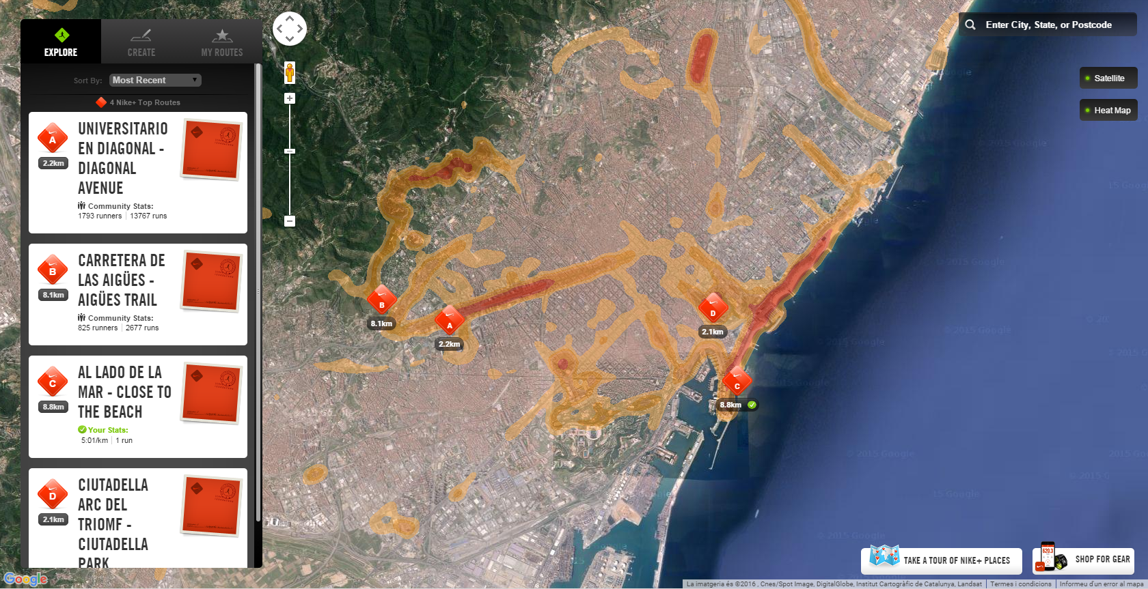
Air quality management tools: example of use case
NIKE+ RUNNING APP

Slide 6
Inter-departamental effort
MUAQ
Air quality
Wind
Sensors
Emissions

Slide 7
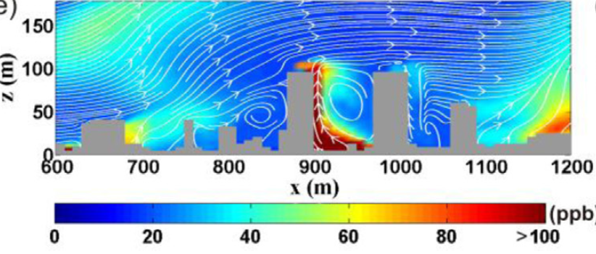
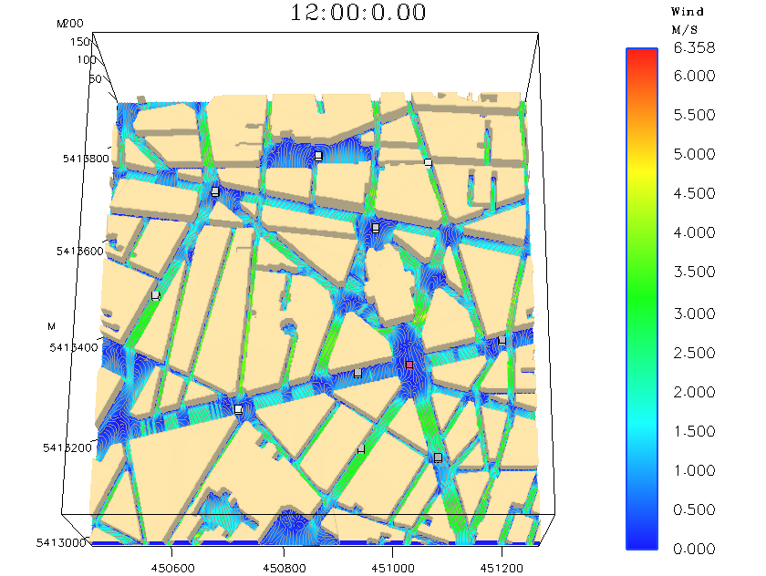
CASE: Street-level wind and transport simulations
Challenge and Novelty
High-resolution (10m) urban mesh based on LIDAR data.
High-resolution modelling ( ~10m) by downscaling regional meteorological simulations to urban levels.
CFD (Alya) runs and downscaling strategies based on transfer functions for the wind field.
Synergies
Aligned with H2020 lighthouse project (GrowSmarter, www.grow-smarter.eu).

Slide 8
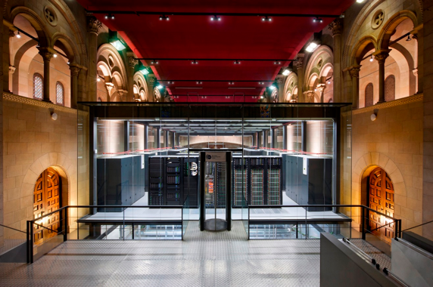
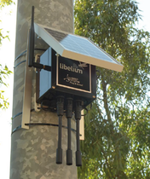
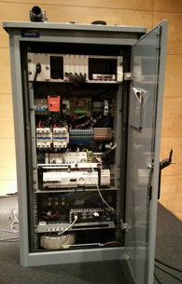
CS: Scalable data collection and processing
Challenges and Novelty:
Efficient collection and processing of sensor generated data
Requires efficient real-time data analytics under constrained network conditions
Manage large Volumes of Data
Sampling 10Hz ~720MB/day ~ 90GB/h city-wide ~2TB/day (3000 cabinets)
Leverage air quality models to pro-actively suggest changes in the city infrastructure
How can we distribute the model and the city smartness across locations?
Emission Modeling
Track Emission
Sources
Local Analytics
Air Quality Modelling
Data Collection
(sensors)
Validation
Calibration
Actuation
Engine
Synergies:
City Council and Cellnex
Unique opportunity
Barcelona pioneering this field
Cisco Fog Lighthouse +
servIoTicy

Slide 9
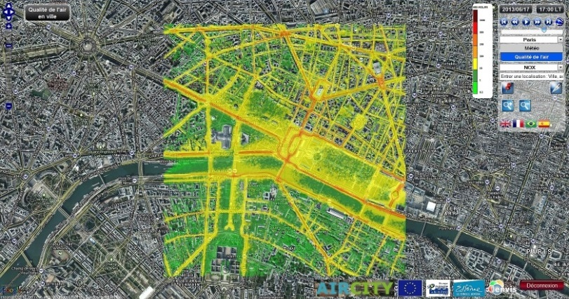
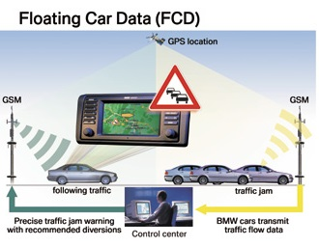
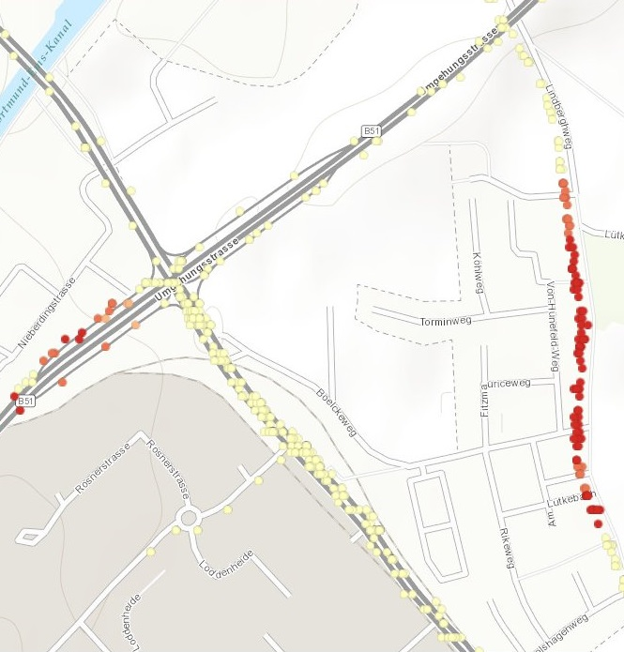
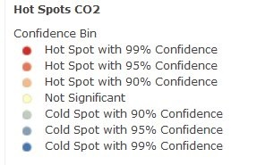
ES: Detailed emission and air quality modelling
Challenges and Novelty:
Emission models based on crowd-sourced data
Vehicle activity data using Floating Car Data (FCD)
Maritime activity data using Automatic Identification Systems (AIS)
Air quality modelling
Simulation of chemical and transport processes at the street level
Activity data
Emission modelling
Synergies:
Public administrations
Port authorities
Research health centres
Mobility managers

Slide 10
Summary of resources and budget
Human:
ES : 96 PM (2 postdocs x 4 years) + 36 PM (PhD in-kind ES)
CASE: 48 PM (2 postdocs x 2 years) + 12 PM (vis.+mesh in-kind CASE)
CS: 36 PM (1 developer x 3 years)
PM and outreach: 2 PM/year
TOTAL: 188 PM (approx. 240 k€/year)
Infrastructure, supercomputing resources (approx.):
ES : 2 Mh/year (runs using up to 5,000 CPUs) Need of dedicated queues
CASE: 2 Mh/year (runs using up to 5,000 CPUs) Need of dedicated queues
CS: --
TOTAL: 4 Mh/year (substantial disk space also required)
Others:
ES : None
CASE: None
CS: 40 k€ to acquire sensors for model calibration
TOTAL: 40 k€
TOTAL: 250 k€/year

Slide 11
Why this project has to be founded?
Strategic positioning of the BSC in an emerging and inter-displinary area with high impact on the society.
Address health and smart sustainable policies in urban environments.
In line with current tendencies of using new in-situ observatories (e.g. floating car data) to strength air quality modelling capabilities.
Industrial companies are interested in air quality data for Smart Cities applications (e.g. Vodafone Ciudad Conectada)

Slide 12
Objective and impact
Objective | To develop, for the first time, an air quality model based on a CFD coupled to an atmospheric chemistry model at city scale enhanced by the use of Big Data technologies to assess urban air quality.
Impact | To achieve a strategic, cutting-edge position in a rapidly re-emerging area with a high societal impact through a strong inter-departmental collaboration.

Slide 13
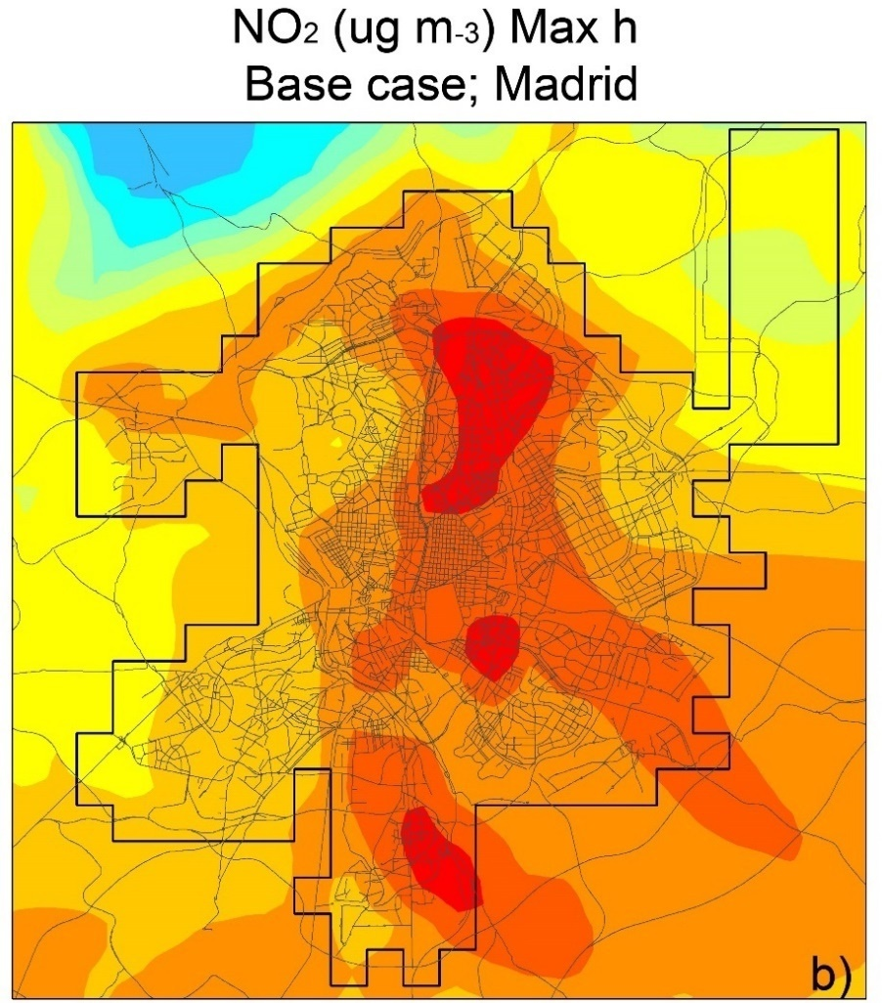
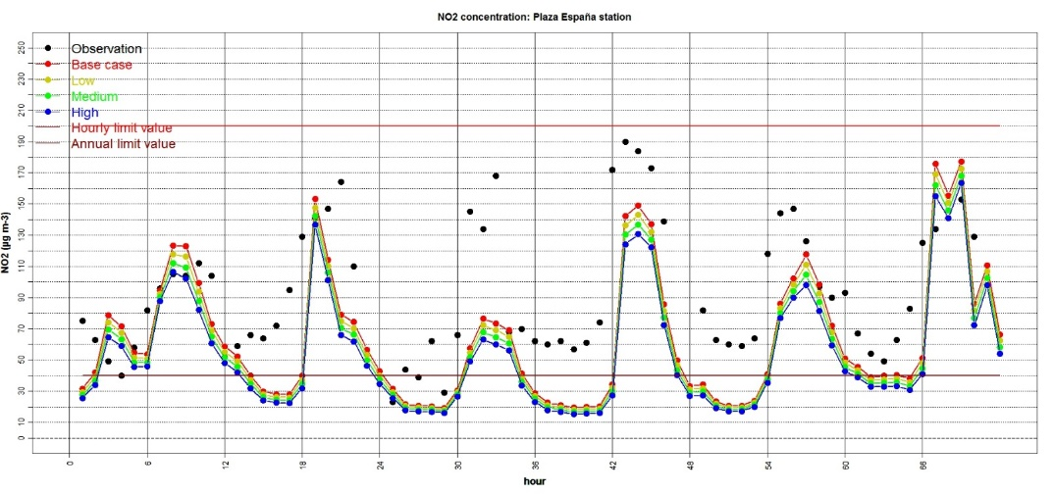
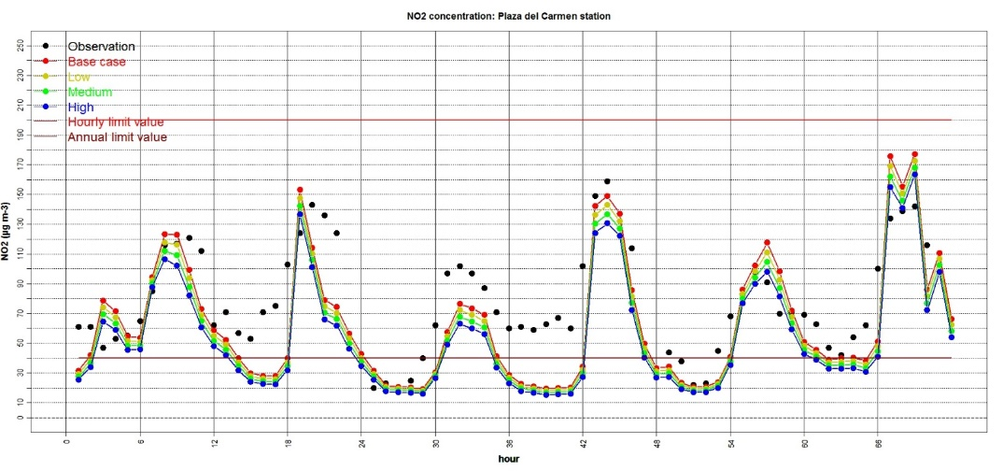
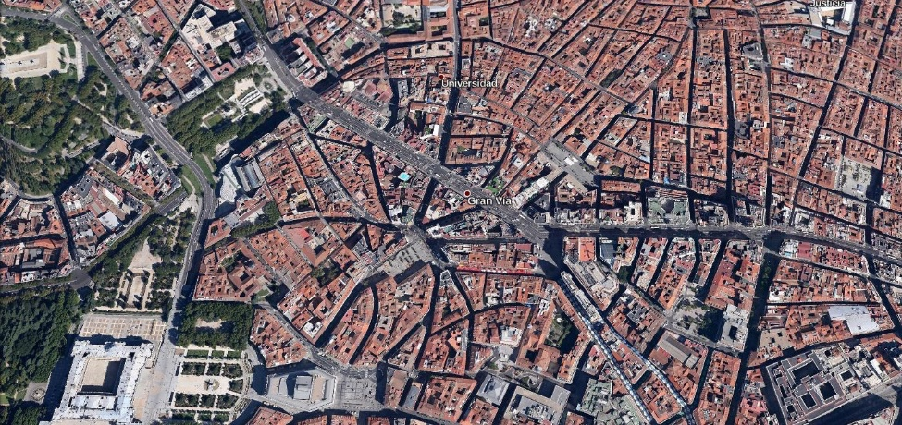
Rationale
1) Mesoscale models (current solutions) show a satisfactory performance to simulate background concentrations (e.g. Plaza del Carmen).
2) However, they are not able to reproduce street-level strong concentration gradients (e.g. Plaza España located close to Gran Via); purpose-built tools are needed.
NO₂ hourly concentration. Plaza de España station
NO₂ hourly concentration. Plaza del Carmen station
Notes:
Rationale
Urban areas present strong concentration gradients that cannot be reproduced by mesoscale models.

Slide 14
Project Description
Pilot area of study | Barcelona from the airport to Badalona and east of Collserola, starting with a first pilot at the Glories district.
Resolution | Spatial: 10m (~100M nodes CFD mesh for the case of Barcelona) Time step: <10 seconds. Temporal resolution of the output: hourly
Study period | The prototype will be tested and evaluated on a few selected past events
Methodology | Downscaling of regional air quality to street-level concentrations by means of microscale wind and pollutant transport modeling. Use multiple, real time (whenever possible) sources of data from an urban environment (sensors, models).
Impacts | Improve our understanding of stret-level processes within urban environments. Address health and smart sustainable policies in urban environments.
Research questions | Can the estimation of main air pollutant concentrations be improved at the street level? Can more targeted air quality information be provided for exposure studies? How to make the most of emerging smart sensor deployments and new approaches to information discovery and display?

Slide 15
Outcomes and strategic positioning
Expected outcomes | Emission model with nearly real-time estimation of traffic emissions. Microscale model based on Alya to simulate pollutant dispersion and chemistry at street level that can be transposed to other cities. Mid-term: assessment of urban environments for healthy and sustainable urban planning (scenarios). Mid-term: high-resolution nowcasting of air pollution at urban level. Long-term: hourly forecast of air pollution at urban level
Expected benefits for BSC | Science: positioning in a re-emerging area, capitalising on a strong inter-departmental collaboration. Outreach: design of products with high social and media impacts, opportunity for popular involvement (e.g. a measurement campaign using air quality sensors involving BSC staff, UPC students, etc. is planned) and for gaining social visibility.
Stakeholders (a selection) | Public administration: Barcelona city council, Generalitat. Research health centres: CREAL, ISCIII Telecommunication companies: CELNEX (Abertis) Mobility managers: Barcelona city council, TMB, RACC Urban ecology and sustainable development: ICTA
Strategic positioning | Engage other research centres for leading consortia to apply to future H2020 and other national, European and international instruments. Leading position for future H2020 calls: SC5-19-2017: Coordination of citizens’ observatories initiatives; MG-7.3-2017: The port of the future.

Slide 16
State of the art. What the community is doing in modelling urban pollution?
TECNIAIRE Project: UPM and CIEMAT are working in the development of a CFD for air quality. Their objective is to develop a model to simulate specific streets and crossroads in Madrid. Funded by the Spanish Ministry (MAGRAMA).
Added value: the BSC-OS2 project simulates the whole city to develop a comprehensive tool (i.e. considers remote impacts) for air quality planning purposes.
TNO: Development of their own microscale model, the URBIS model (Gaussian). In their new strategic plan their objective is to use smart sensors but no CFD.
Added value: the BSC-OS2 project combines both a detailed microscale model based on a CFD approach coupled to a chemistry model and innovative data-capturing technologies.
Kwak et al., 2015 This work presents a CFD model for air quality implemented in Seoul. The domain of study is only a high-rise building area, and the period of study is only 6 hours.
Added value: the BSC-OS2 project unique interdisciplinary team will allow (thanks to its scalability) the simulation of several days to analyse different patterns and differences between day and night.

Slide 17
Project structure
Earth Sciences Dep.
Computer Sciences Dep.
CASE Dep.
WP1
WP3
WP2
Mesoscale model experiment
Meteorology (CFD)
Transport (CFD)
Emission model
FCD*
Sensors
Gaussian model experiment
Photochemistry
CFD model experiment
Evaluation
User engagement, applied communication and dissemination
Visualization
Big data back-ends for earth sciences
WP4
Define future cases of study.
Proof of concept: modelling tool forecast air urban quality
*Floating car data for on-road and maritime transport

Slide 18
Gantt chart
Gantt Chart |  | M1-6 | M7-12 | M13-18 | M19-24 | M25-30 | M31-36 | M37-42 | M43-48
WP1. Mesoscale and Gaussian experiments
1.1 Mesoscale model
1.2 Gaussian model
WP2. Efficient emission modelling
2.1. First emission inventory
2.2. Sensors for emission inventory purpose. FCD
2.3. Detailed emission inventory; use FCD.
WP3. CFD air quality experiment
3.1. Pre-processing (meshing strategies)
3.2. CFD and transport module
3.3 Air quality module (chemistry)
3.4 CFD model experiment
WP4. User engagement/comm./dissemination
4.1 Big data back-ends for earth sciences
4.2 Visualization
4.3 Define future cases of study. Proof of concept.
Earth Sciences Dep.
Computer Sciences Dep.
CASE Dep.

Slide 19
WP1. Mesoscale and Gaussian experiments
WP1 | Mesoscale and Gaussian experiments
Participants | Earth Sciences Department
Objectives | Define the period of study. Perform mesoscale model simulations. Apply current strategies to simulate microscale processes (Gaussian models). Evaluate model results (both: mesoscale models and microscale models based on Gaussian approximations) with current observational data sets (air quality monitoring stations). To establish a model benchmark.
Integration with the rest of the project | The results of this WP will provide initial and boundary conditions for WP2 (meteorological information to properly estimate emissions) and WP3 (air quality and meteorological). Model results will be evaluated with available air quality observations in Barcelona to establish the skill of current mesoscale models to properly reproduce air quality levels at street levels. This evaluation will help to assess current model performance to depict street level concentration gradients (WP4).
Means required | 1 PhD student during 3 years (36 PM). In-kind contribution from BSC-ES 1 postdoc (12 PM).

Slide 20
WP2. Efficient emission modelling
WP2 | Efficient modeling of emissions
Participants | Computer Sciences and Earth Sciences Departments
Objectives | Compile and process crowd-sourced data: Vehicle activity data (traffic volume, speed, fleet composition) using information from Floating Car Data (FCD). Maritime activity data (vessel location, speed) using information from Automatic identification systems Sensor deployments in the street as a BSC pilot Development of a traffic and a maritime emission model Estimate very high resolution (10m) hourly urban emissions
Integration with the rest of the project | The emissions estimated in this WP will be used to perform the micro-scale model simulation in WP3 and WP4. The emission results will be compared with other current state-of-the-art methods used to estimated emissions.
Means required | 1 postdoc for 4 years (48 PM) (emission model) 1 developer for 1.5 years (18 PM) (sensors)

Slide 21
WP3. CFD air quality experiments
WP3 | CFD air quality experiments
Participants | CASE and Earth Sciences Departments
Objectives | High-resolution (10m) urban mesh based on LIDAR data. CFD (Alya) runs and downscaling strategies based on transfer functions for the wind field. Implement the pollutant transport module. Implement the air quality module following the model chain of the NMMB model. Perform microscale model simulations for the period of study. Evaluate new air quality sensors with current the observational network. Evaluate model performance to simulate street-level concentration gradients and related hourly maximum levels.
Integration with the rest of the project | This WP will focus on the implementation of the software and will perform the CFD model experiment. Strong coordination with WP1 (mesoscale modelling) and WP2 (emission inventory) is required.
Means required | 2 postdocs during 2 years (48 PM) (meteorology and transport) 1 postdoc during 2 years (24 PM) (chemistry)

Slide 22
WP4. User engagement, communication and dissemination
WP4 | User engagement, applied communication and dissemination
Participants | Earth Sciences, CASE and Computer Sciences Departments
Objectives | Integration with high-performance scalable data back-ends for the model data (NoSQL, Document oriented) Visualization strategies. Define future cases of study. Explore the applicability of the system to assess the impact of: punctual accidents in industrial sites, unexpected emissions due to port activities. Proof of concept: modelling tool forecast air urban quality Disseminate the project ideas and results adapting the message to each audience. Engage with all the interested parts, to receive end-user feedback and interaction, promote capacity building and project co-design according to the real needs of the
Integration with the project | The purpose of this WP is to achieve the expected social impact of the results from the previous WP.
Means required | Project management and outreach: 2 (PM)/year. 1 developer during 1.5 years (18 PM) (data back-end) 1 postdoc during 1 year (12 PM) (case studies) 1 postdoc during 1 year (12 PM) (Visualization and mesh in-kind CASE)

Slide 23
Summary of resources and budget
Human:
ES : 96 PM (2 postdocs x 4 years) + 36 PM (PhD in-kind ES)
CASE: 48 PM (2 postdocs x 2 years) + 12 PM (vis.+mesh in-kind CASE)
CS: 36 PM (1 developer x 3 years)
PM and outreach: 2 PM/year
TOTAL: 188 PM (approx. 240 k€/year)
Infrastructure, supercomputing resources (approx.):
ES : 2 Mh/year (runs using up to 5,000 CPUs) Need of dedicated queues
CASE: 2 Mh/year (runs using up to 5,000 CPUs) Need of dedicated queues
CS: --
TOTAL: 4 Mh/year (substantial disk space also required)
Others:
ES : None
CASE: None
CS: 40 k€ to acquire sensors for model calibration
TOTAL: 40 k€
TOTAL: 250 k€/year

