Slide 1
BSC Update: MONARCH model
Oriol Jorba, Carlos Pérez-García Pando, Vincenzo Obiso, Enza DiTomaso, Sara Basart, Marc Guevara, María Gonçalves, María Teresa Pay, Carles Tena, Francesca Macchia, Miriam Olid, Kim Serradell
Atmospheric Composition Group
Barcelona Supercomputing Center
7/06/2018
10th ICAP WG meeting - Exeter (UK)

Slide 2
Contents
Overview MONARCH model and updates on BSC forecast
Multiscale capability of MONARCH model
Intensive optical properties evaluation
Data Assimilation work

Slide 3
Overview MONARCH model and updates on BSC forecast

Slide 4
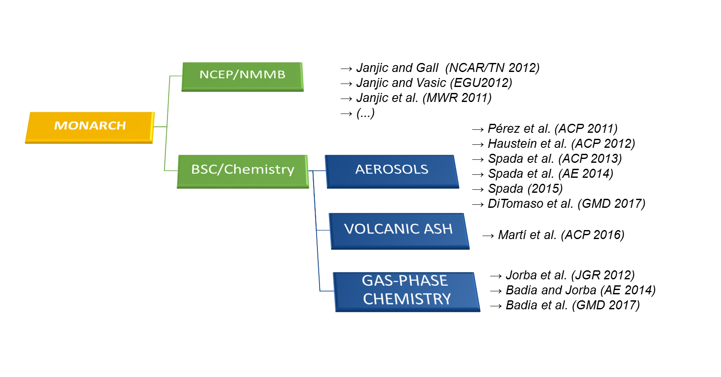
The MONARCH model
· Multiscale: global to regional (up to 1km) scales allowed
· Fully on-line coupling: weather-chemistry feedback processes allowed
· Enhancement with a data assimilation system
Dust module is known as NMMB/BSC-Dust

Slide 5
Aerosols
Sectional
dust (DU)
sea-salt (SS)
Bulk
Black Carbon (BC)
Organic Aerosols (OA)
Primary Organic Aerosols (POA)
Secondary organic aerosols (SOA)
4 gaseous tracers (OH, O3, TERP, ISOP). Online emission (MEGAN)
4 aerosol-phase hydrophilic tracers
2-product scheme of Tsigaridis and Kanakidou (2007)
Oxidation by OH and O3 and gas-particle partitioning
Anthropogenic SOA from Toluene and Xylene under development
Sulfate (SU):
4 additional prognostic tracers (SO2, DMS, H2O2, H2SO4)
3 online or climatological oxidants (OH, O3, HO2)
gas-phase oxidation of SO2, DMS and H202 by OH
aqueous-phase oxidation by H202 and O3
Nitrate (NO3) and Ammonium (NH4): as calculated by EQSAM thermodynamic
equilibrium model but not evaluated yet

Slide 6
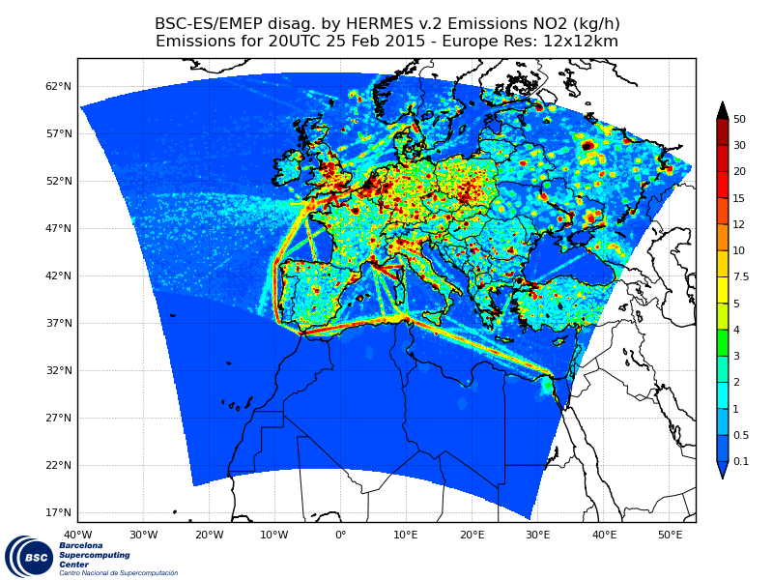
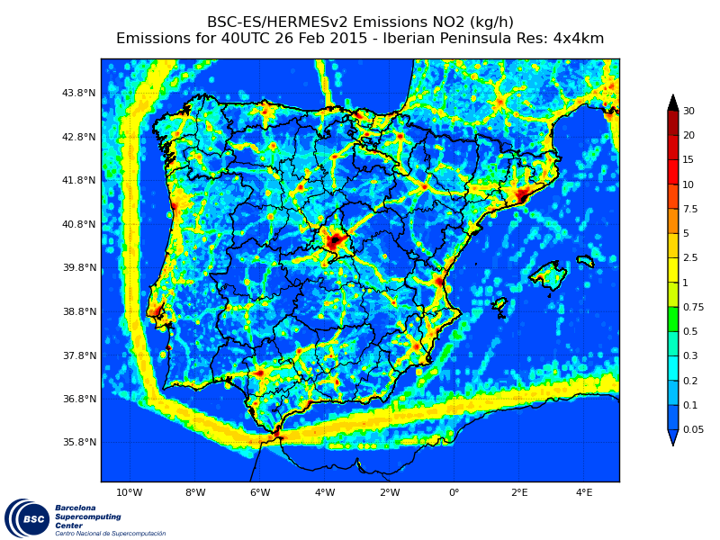
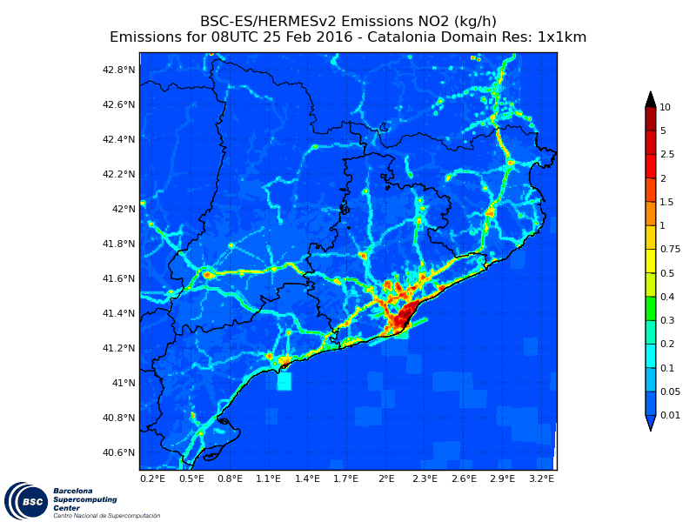
MONARCH - Emissions
HERMES 3.0: A multiscale emission modelling
A stand-alone tool for simulating emissions on a user-defined grid for global, regional and urban air quality models.
Users can select, combine and scale multiple inventories through a flexible configuration file to obtain hourly gridded emissions.
Spanish bottom-up emission inventory (street level emissions)
Guevara et al., in preparation

Slide 7
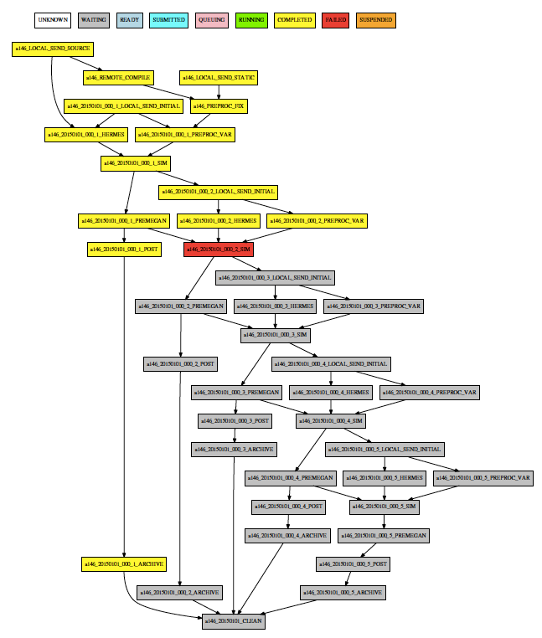
Autosubmit workflow manager
Workflow manager developed at BSC
Manages all the tasks associated to a model experiment
Submits jobs in HPC systems and post-process results in local machine
Flexible to configure and easy to modify dependencies
Forecast systems of BSC ported to Autosubmit

Slide 8
BSC Current forecasts and plans
CURRENT FORECASTING – DEVELOPED/AVAILABLE – UNDER DEVELOPMENT - PLANNED
DOMAIN | GLOBAL (ICAP) | REGIONAL North Africa, Middle East and Europe (SDS-WAS) | REGIONAL Europe/Iberian Peninsula/Urban Areas (CALIOPE)
Model | MONARCH | MONARCH | CMAQ (DREAM for dust) MONARCH
Status | QO | O | O
Meteorology | Inline: NMMB | Inline: NMMB | Offline: WRF-ARW Inline: NMMB nesting
Resolution | 1.4x1 deg 0.7x0.5 deg | 0.1x0.1 deg 0.03x0.03 deg | 0.1x0.1 / 0.04x0.04 / 0.01 x0.01
levels | 24 48 | 40 60-70 | 30 60-70
DA | LETKF | LETKF | NA LETKF
Assimilated Obs | MODIS DT+DB (DU) MODIS DT+DB (ALL) | MODIS DT+DB (DU) | NA MODIS DT+DB (ALL)
Aerosol Species | DU, SS, BC, POA, SOA bio, SOA anthro, SU, NI | DU | CMAQ (AERO5) MONARCH aerosols
Gas phase chemistry | CBM-IV CB05 ONLINE and CLIMATOLOGY |  | CB05 CB05
Emissions | HERMES 3.0 (HTAP v2) MEGAN ONLINE |  | EMEP, MEGAN / HERMES, MEGAN/ HERMES MEGAN
Bio. Burn. Emissions | GFAS NRT |  | NA NRT

Slide 9
Multiscale capability of MONARCH model

Slide 10
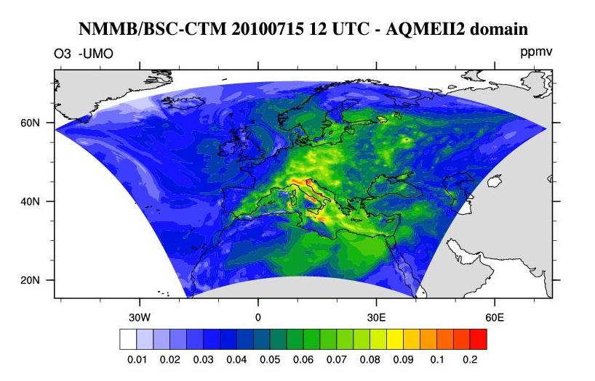
MONARCH - BSC forecasts
Global
Regional
20100715 at 12UTC
BDFC and SDS-WAS dust forecast
It will be operational at
MONARCH contributes to the ICAP global forecast aerosol multi-model ensemble http://icap.atmos.und.edu
CALIOPE (www.bsc.es/caliope)
AQ Forecast System for EU and Spain
And more products in: http://www.bsc.es/ess/

Slide 11
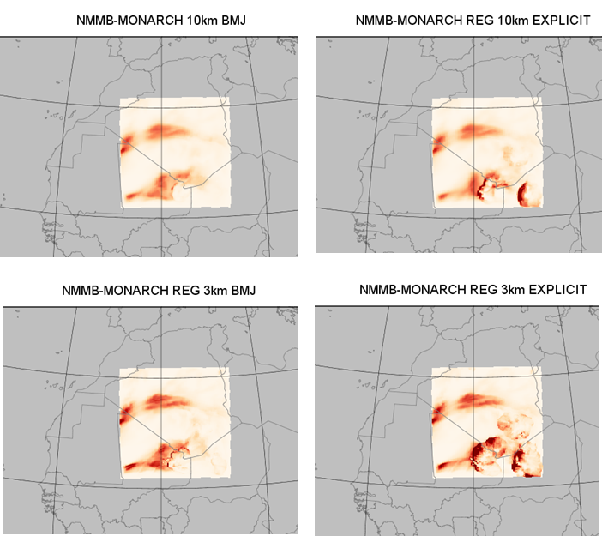
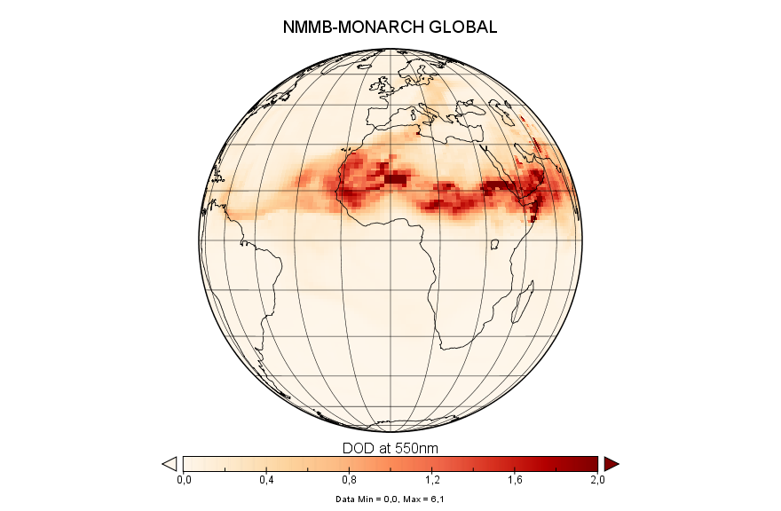
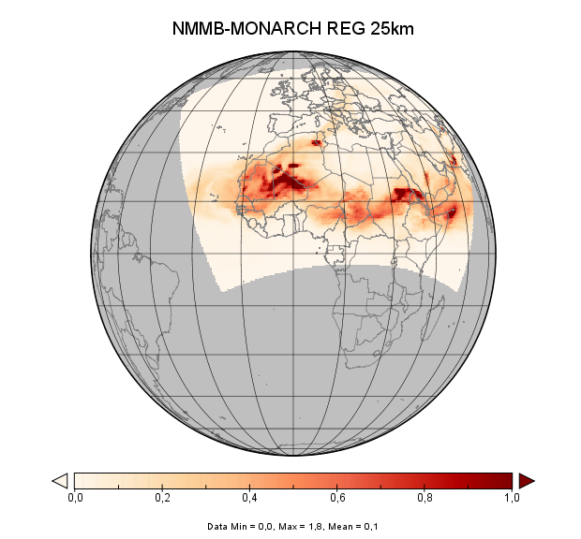
Mineral dust forecasting at wide range of spatial scales
14 July 2011 at 18h – Haboob development

Slide 12
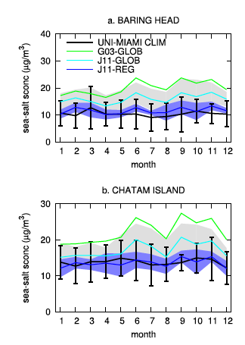
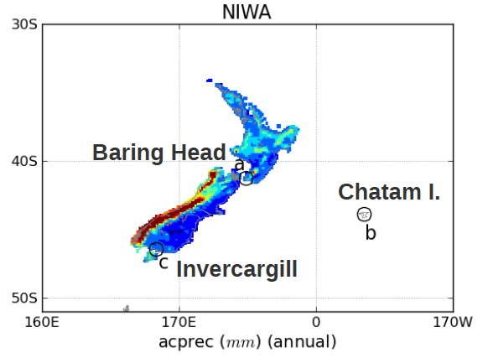
On the evaluation of global sea-salt aerosol models at
coastal/orographic sites (Spada et al., 2015)
Global run (1º x 1.4º, 2002.2006)
Regional run (0.1º x 0.1º, 2002-2006)
Two sea salt emission schemes:
Gong (2003) function of wind speed
Jaeglé et al. (2011) function of wind speed and sst

Slide 13
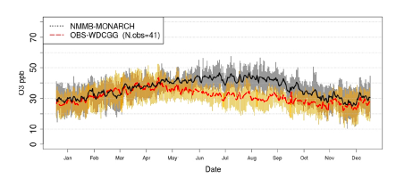
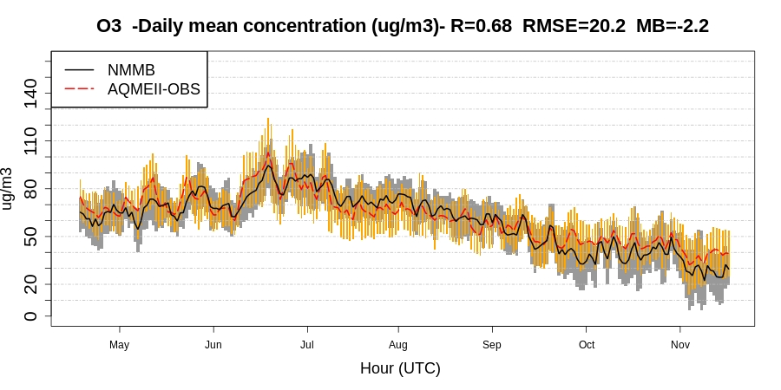
Impact of scales on surface ozone using full chemistry CB05
Badia et al., 2017
Global domain
Same physics and chemistry
Badia and Jorba, 2014
Regional domain
Notes:
Several studies focused on evaluating aerosol optical depth
Not many evaluation of intensive properites: single scattering albedo (Qscat/(Qscat+Qabs)) and asymmetry parameter (forward scattering/all scattering)
Here we present an evaluation of a global aerosol model of omega and g
And will discuss the impact of using updated refractive indexes

Slide 14
Intensive optical properties evaluation

Slide 15
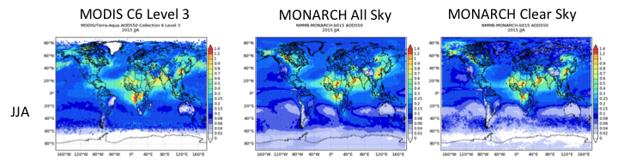
AOD evaluation: AERONET, MODIS
AOD AERONET
Notes:
Several studies focused on evaluating aerosol optical depth
Not many evaluation of intensive properties: single scattering albedo (Qscat/(Qscat+Qabs)) and asymmetry parameter (forward scattering/all scattering)
Here we present an evaluation of a global aerosol model of omega and g
And will discuss the impact of using updated refractive indexes

Slide 16
Aerosol intensive optical properties evaluation (Obiso, 2018)
CONTEXT AND OBJECTIVES
Aerosol intensive optical properties: few and uncertain model evaluations [1,2,3,4]
Evaluation of full online aerosol-radiation coupling in NMMB-MONARCH
Single scattering albedo (ω) and asymmetry factor (g) against observations
Impact of new refractive indexes on model performance
MONARCH Global aerosol parameterization: 5 major aerosols
Optical properties of aerosols in radiation from OPAC database
Global domain simulations: lon x lat = 1.4ºx1.0º and 48 vertical layers
5-years period (2012-2016): spinup (1 year) and meteo initialization (24h, FNL)
1.Myhre et al. [2013a]; 2.Lacagnina et al. [2015]; 3.Takemura et al. [2002]; 4.Curci et al. [2015]
Notes:
Several studies focused on evaluating aerosol optical depth
Not many evaluation of intensive properites: single scattering albedo (Qscat/(Qscat+Qabs)) and asymmetry parameter (forward scattering/all scattering)
Here we present an evaluation of a global aerosol model of omega and g
And will discuss the impact of using updated refractive indexes

Slide 17
New refractive indexes
Updating microphysics (PTB case) [1]:
New refractive indexes at ~0.550 µm from recent literature
 | DU [2] | SS [3] | POM [4] (anthropogenic) | BrC [5,6] (biom. burn.) | SOA [7,8] (biog. prec.) | BC [9] | SU [10]
nr¹ | 1.53 ↓ 1.531 (~) | 1.5 ↓ 1.557 (+3.8%) | 1.53 ↓ 1.501 (-1.9%) | 1.53 ↓ 1.535 (~) | 1.53 ↓ 1.486 (-2.9%) | 1.75 ↓ 1.85 (+5.7%) | 1.43 ↓ 1.546 (+8.1%)
ni¹ | 0.0055 ↓ 0.0025 (-54.5%) | 0.00000001 ↓ 0.00000001 (~) | 0.006 ↓ 0.00000001 (~ -100%) | 0.006 ↓ 0.03 (+400%) | 0.006 ↓ 0.000025 (~ -100%) | 0.44 ↓ 0.71 (+61.4%) | 0.00000001 ↓ 0.00000001 (~)
ω ▲
g ▼(coarse)
τ ▲ (fine)
g ▼
τ ▼
ω ▲
g ▲
τ ▲
g ▼
1.Hansen and Travis [1974]; 2.Denjean et al. [2016]; 3.Irshad et al. [2009]; 4.Shepherd et al. [2017]; 5.Tang et al. [2016]
6.Kirchstetter et al. [2004]; 7.Nakayama et al. [2012]; 8.Liu et al. [2013]; 9.Bond and Bergstrom [2006]; 10.Freedman et al. [2009]
Notes:
We have implemented the new refractive indexes for dust, sea salt, white organic matter and sulfate.
These changes seem to go on the good direction to correct some of the biases initially detected.

Slide 18
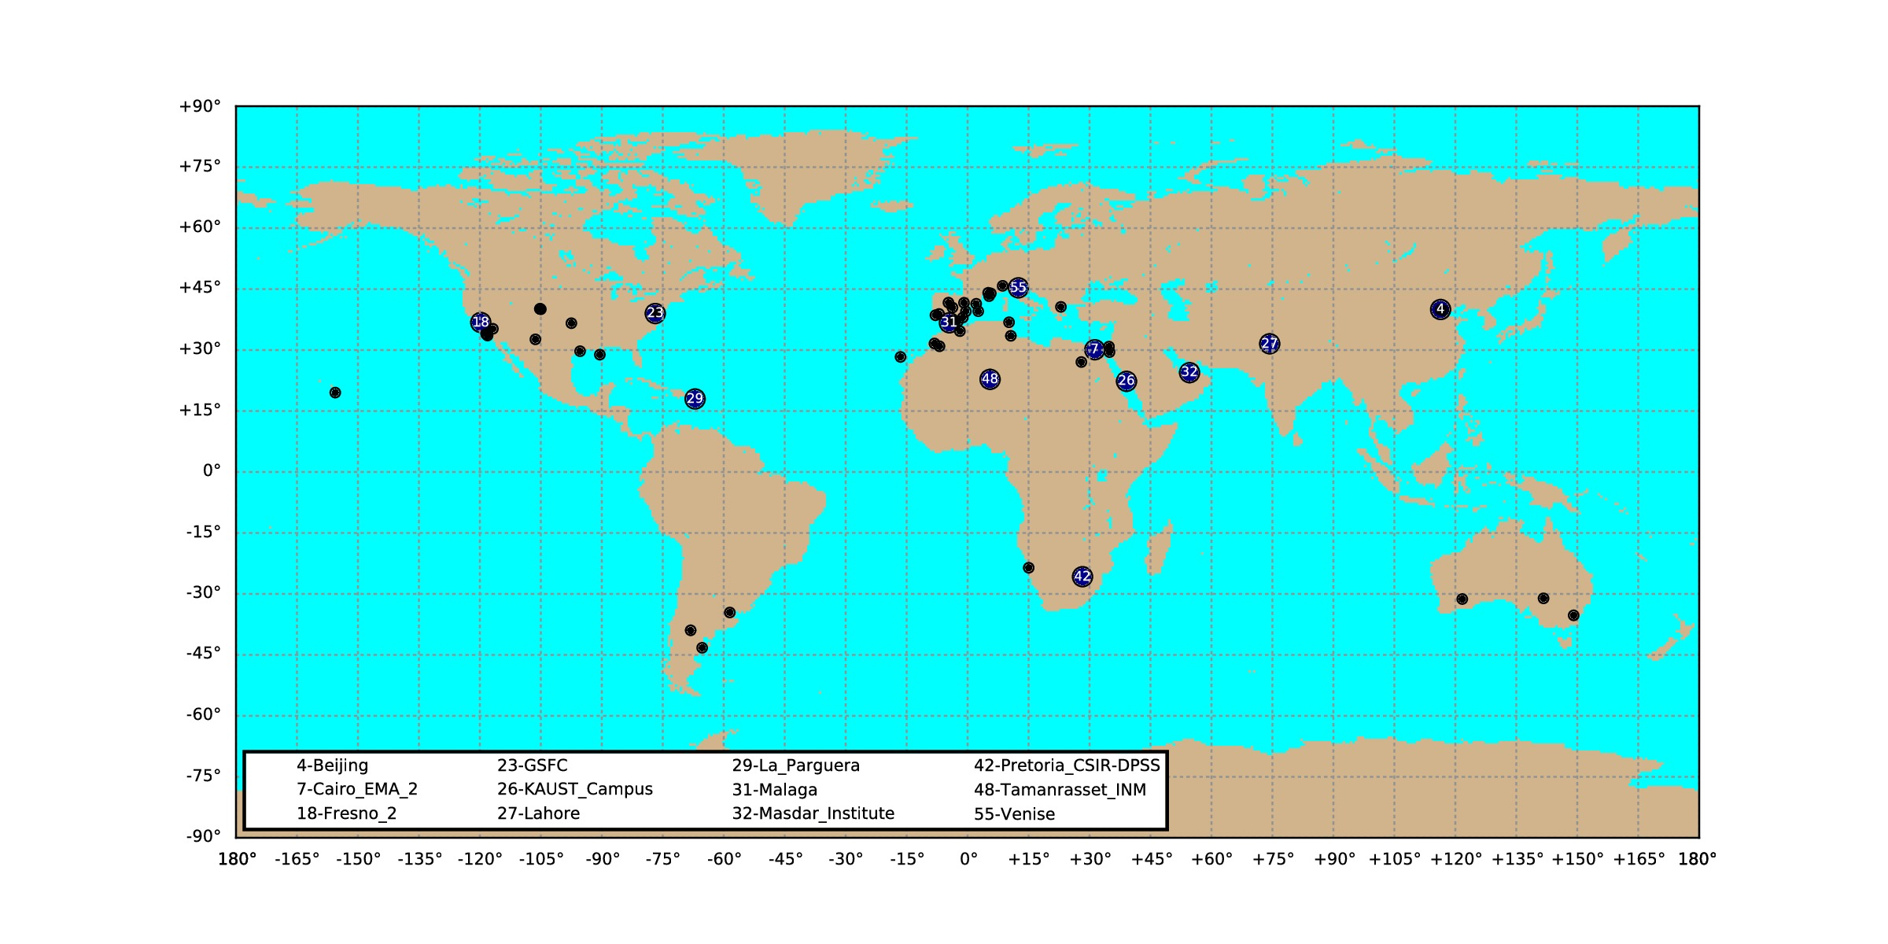
Observations of τ, ω, g
Sun-photometers AERONET Version 2.0 [1,2]
Screened Level 1.5: Level 2 quality without optical depth filter: τ440 > 0.4 [3]
59 stations (full set): 20 data (daily τ, ω, g at 0.550 µm) per month (2012-2016)
12 stations (subset): i) observed τ, ii) dominant species, iii) geographical distribution
Fresno_2
GSFC
urban/
anthropogenic
Beijing
Lahore
large urban
Cairo_EMA_2
KAUST_Campus
Masdar_Institute
Tamanrasset_INM
deserts/urban
La_Parguera
coastal
1.Holben et al. [1998]; 2.Holben et al. [2006]; 3.Li et al. [2014]
Notes:
From the 59 stations, we have selected some of them to analyze in detail the performance of the model
In this talk, I will show results of Cairo and Kaust as stations dominated by the presence of mineral dust, La parguera as a station affected by sea salt, and Bejing, Fresno and GSFC as stations affected by anthropogenic aerosols (sulfate, black carbon and organic matter).

Slide 19
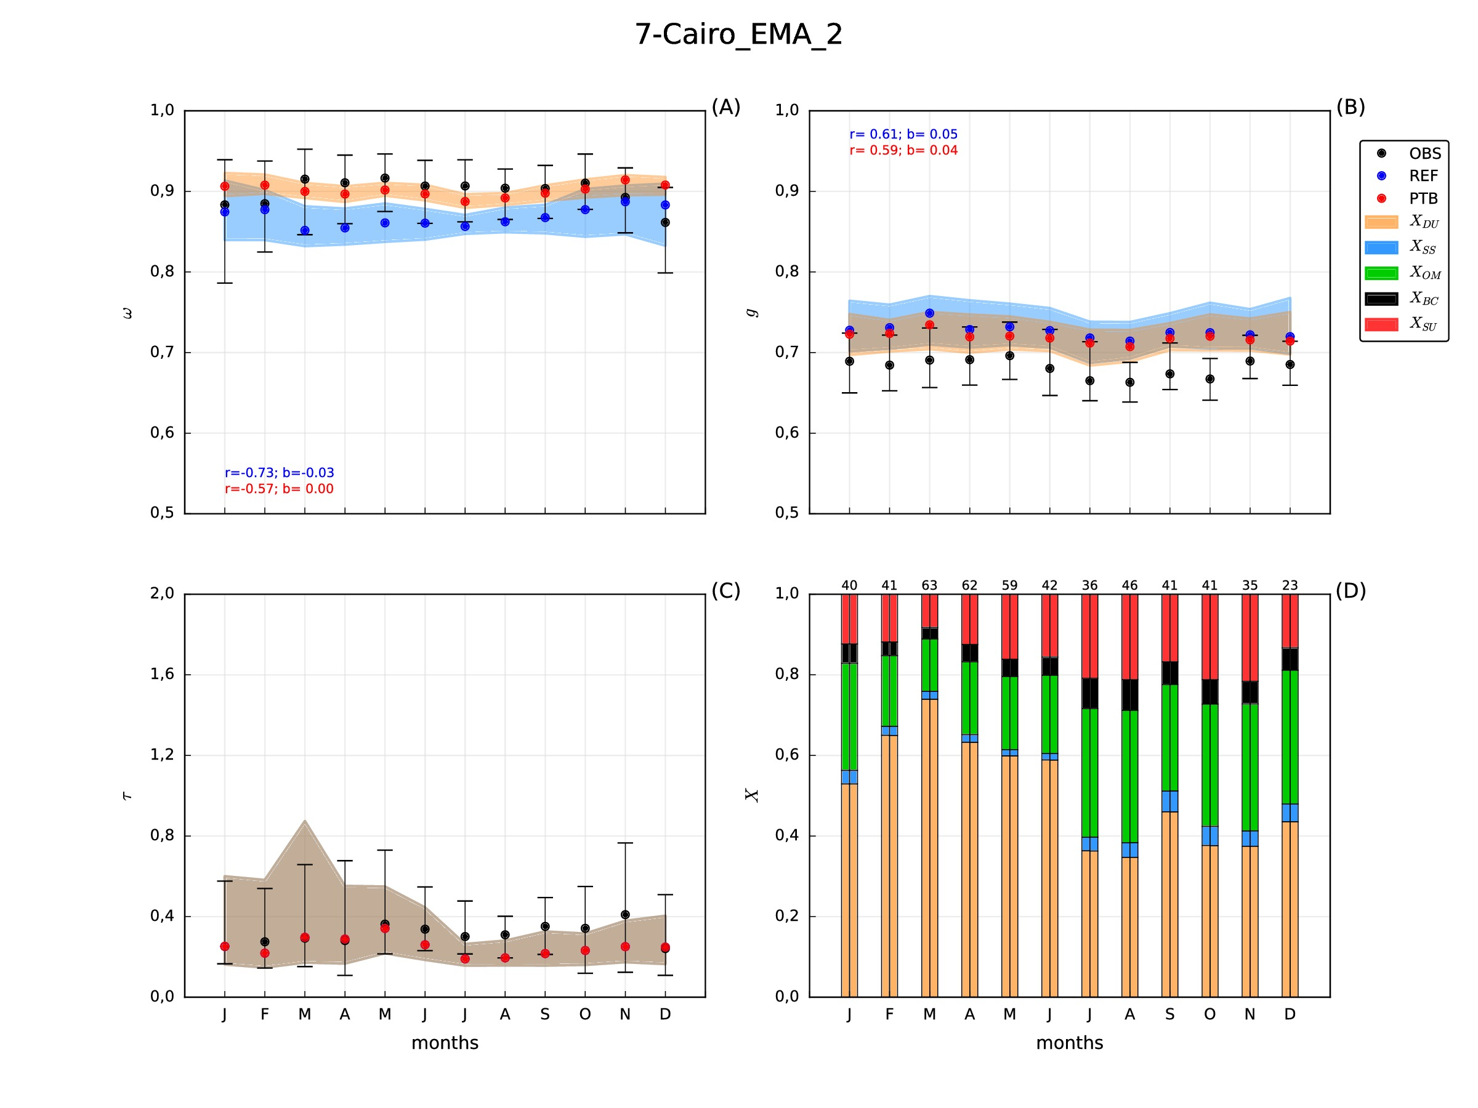
Results: Impact of new refractive indexes
J
F
M
A
M
J
J
A
S
O
N
D
J
F
M
A
M
J
J
A
S
O
N
D
 | ω | g
corr. variation | +0.16 | -0.02
bias variation | +0.03 | -0.01
New refractive index for DU and SS
Strong ω increases ↔ DU peaks
Slight g decreases ↔ DU peaks
Further g reduction → more fine DU?
Notes:
Here we show the results for Cairo station. The blue dots and shaded region is the initial results and the red dots and brownish shade is the new simulation with updated refractive indexes.
Results seems to be much more in agreement now concerning both omega and g.
A much less absorbing mineral dust seems to be much more realistic than what we had initially.
The new results still show an overestimation of g which make us think that we still lack of fine dust in the atmosphere. Being this a common problem of all mineral dust models, the life of fine particles are usually underestimated.

Slide 20
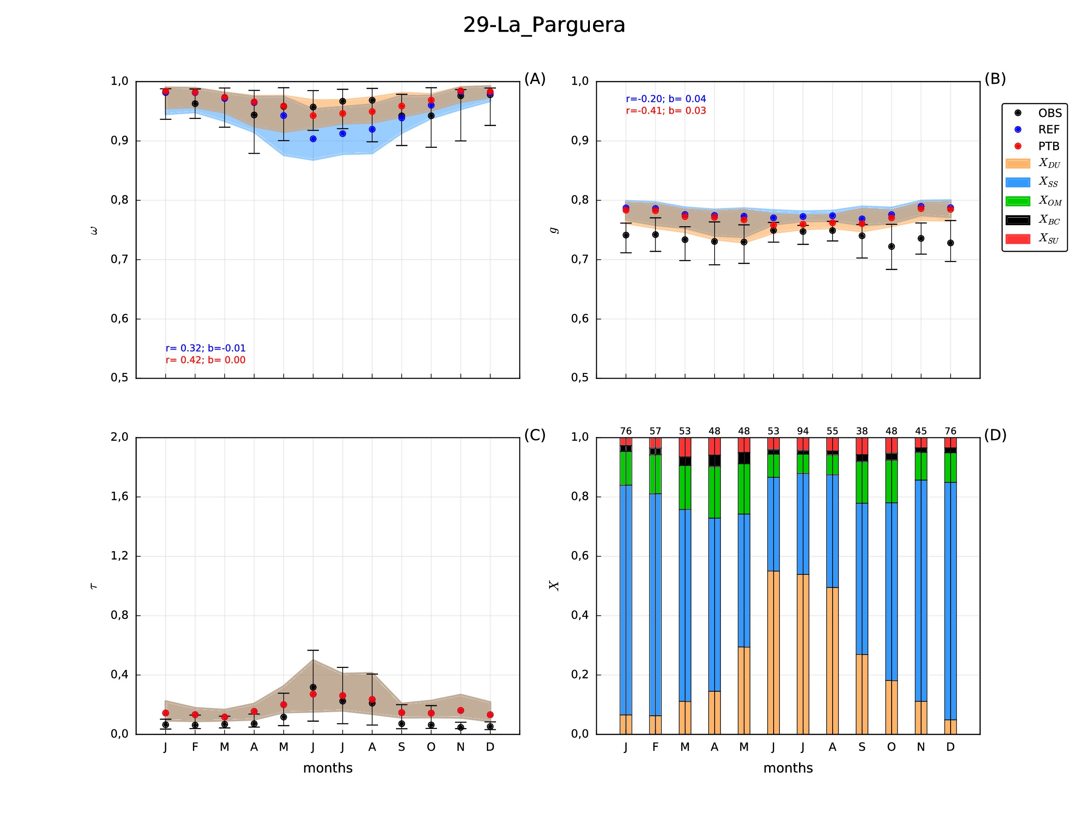
Results: Impact of new refractive indexes
J
F
M
A
M
J
J
A
S
O
N
D
J
F
M
A
M
J
J
A
S
O
N
D
 | ω | g
corr. variation | +0.10 | -0.21
bias variation | +0.01 | -0.01
New refractive index for DU and SS
Stronger ω/g variations ↔ summer DU
Negligible ω/g variations due to SS
Further g reduction → more fine species?
Notes:
The new results in la Parguera also shows an impressive improvement with the new less absorbing mineral dust, while g doesn’t show much changes.
We think that to reduce g we need more fine species both from sea salt and dust.

Slide 21
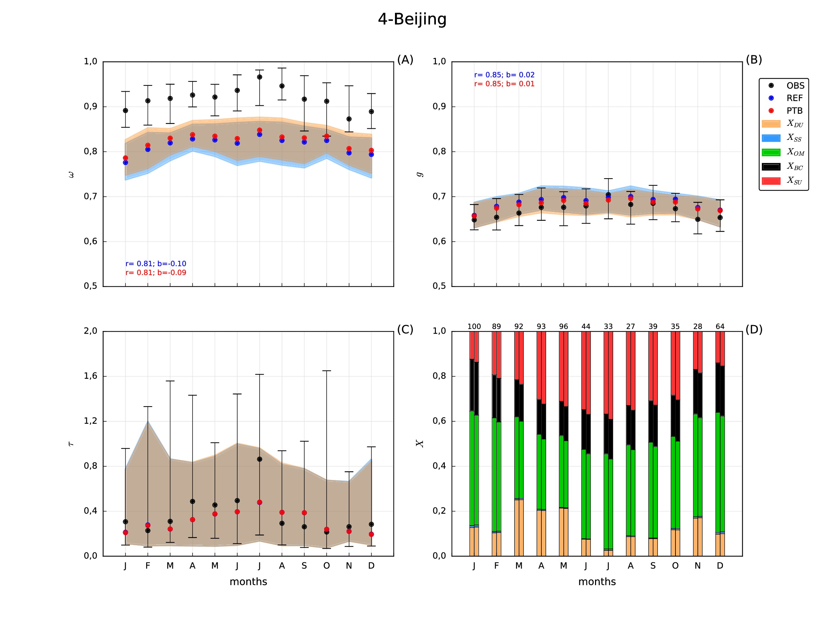
Results: Impact of new refractive indexes
J
F
M
A
M
J
J
A
S
O
N
D
J
F
M
A
M
J
J
A
S
O
N
D
 | ω | g
corr. variation | 0 | 0
bias variation | +0.01 | -0.01
New refractive index for OM and SU
Slight ω increases ↔ OM+SU changes
Slight g decreases ↔ SU changes
Stronger ω increases → less BC?
Notes:
To finalize, the new refractive indexes in the station of Beijing doesn’t have a huge impact.
We think that the problem is the fraction of Black Carbon, which will make revisit our implementation and emissions of BC used in our runs.

Slide 22
Data assimilation work

Slide 23
DustClim Project
Produce a high resolution dust reanalysis for Northern Africa, Middle East and Europe covering the satellite era of quantitative aerosol information, and develop dust-related services tailored to specific socio-economic sectors.
PI: Sara Basart
Period: 2017-2020
Notes:
One of the main focii of the DA activities has been the preparation of the system for high resolution multi-year simulations to be run for DustClim
DustClim is a 3 year project from the ERA4CS initiative with Sara Basart as PI. The aim is to produce a dust reanalysis at 0.1x0.1 deg resolution and develop dust-related services for the energy sector, aviation and AQ.
Reanalysis domain: BDFC
Reanalysis period: MODIS era
Partners: Aemet, CNRS, CNR, FMI, BSC

Slide 24
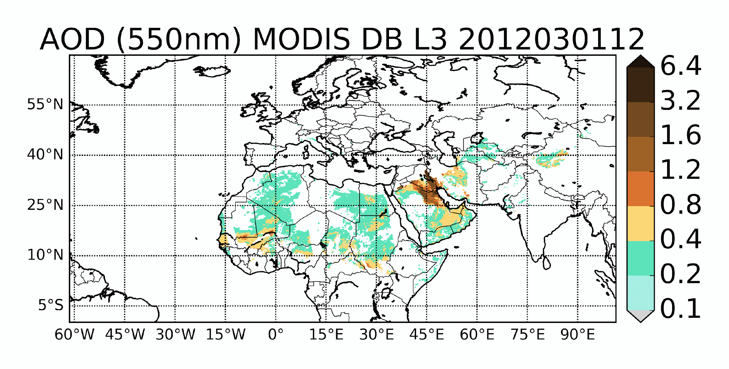
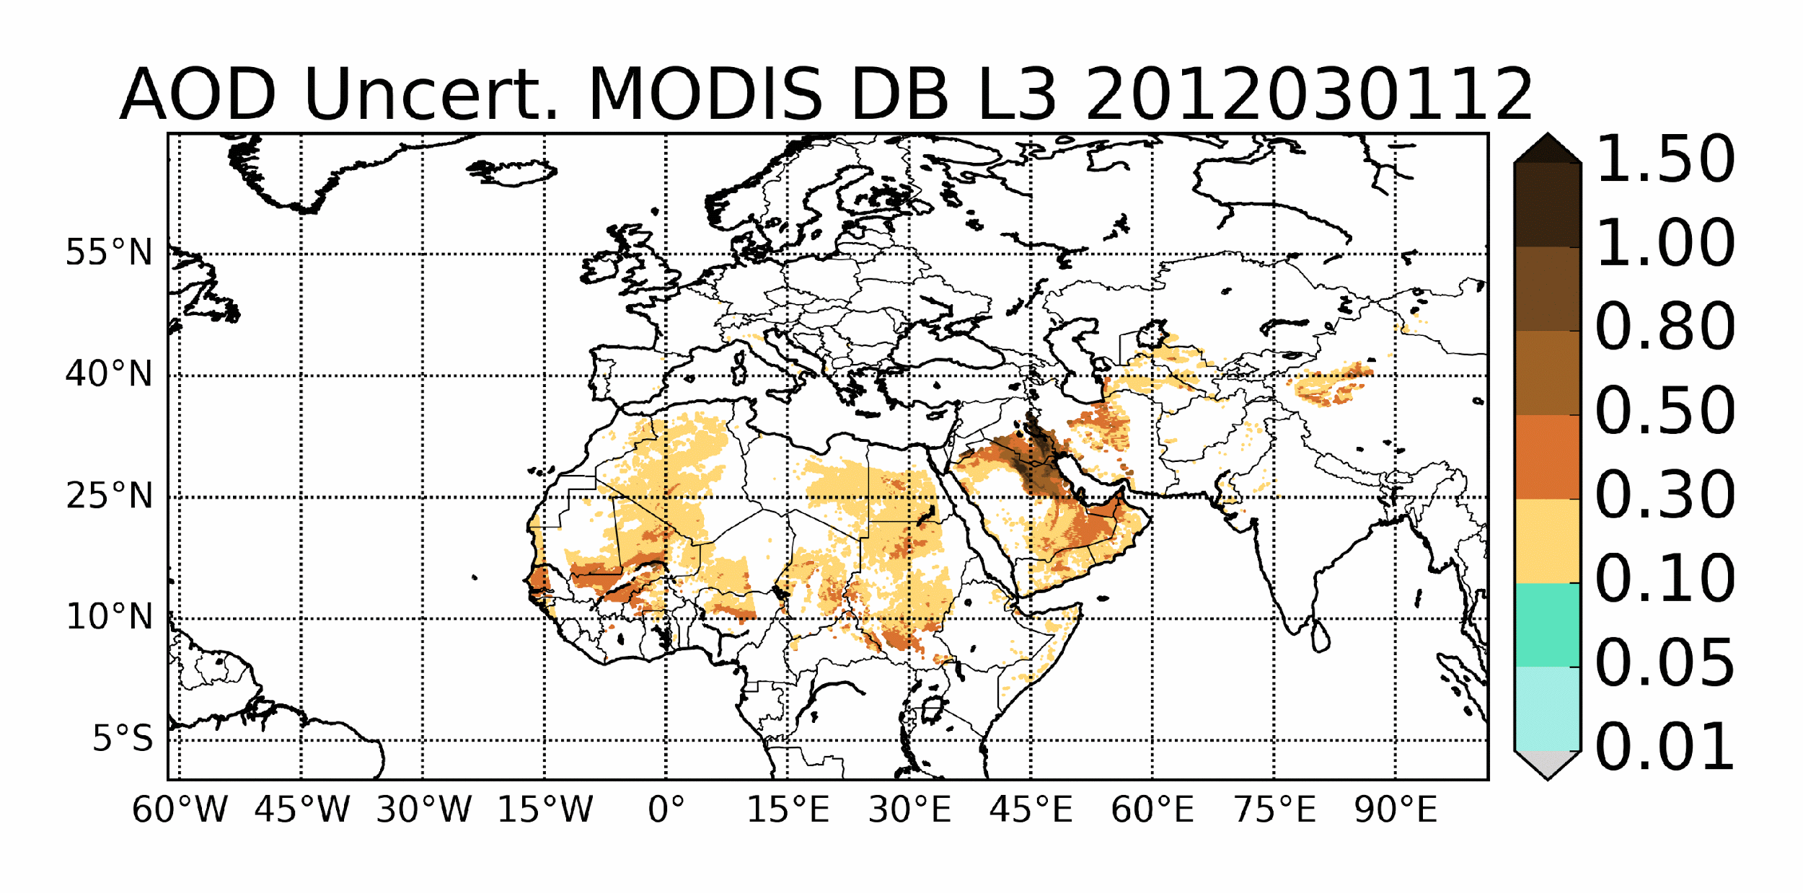
First test simulations: assimilated obs
MODIS Deep Blue, L2 C6
AE, ω filter, coarse AOD retrieval
highest quality flag (Ginoux et al., 2012; Pu & Ginoux 2017)
uncertainty model based on Sayer et al., 2014
Notes:
The analysis of the previous slide is based on the assimilation of coarse Deep Blue observations produced by Paul Ginoux.
The uncertainty for them has been characterized using Sayer method for Deep Blue

Slide 25
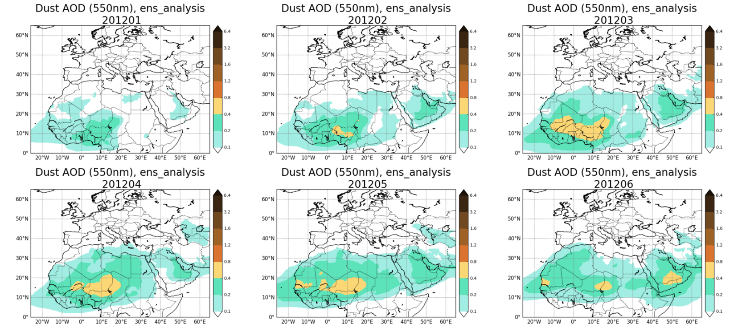
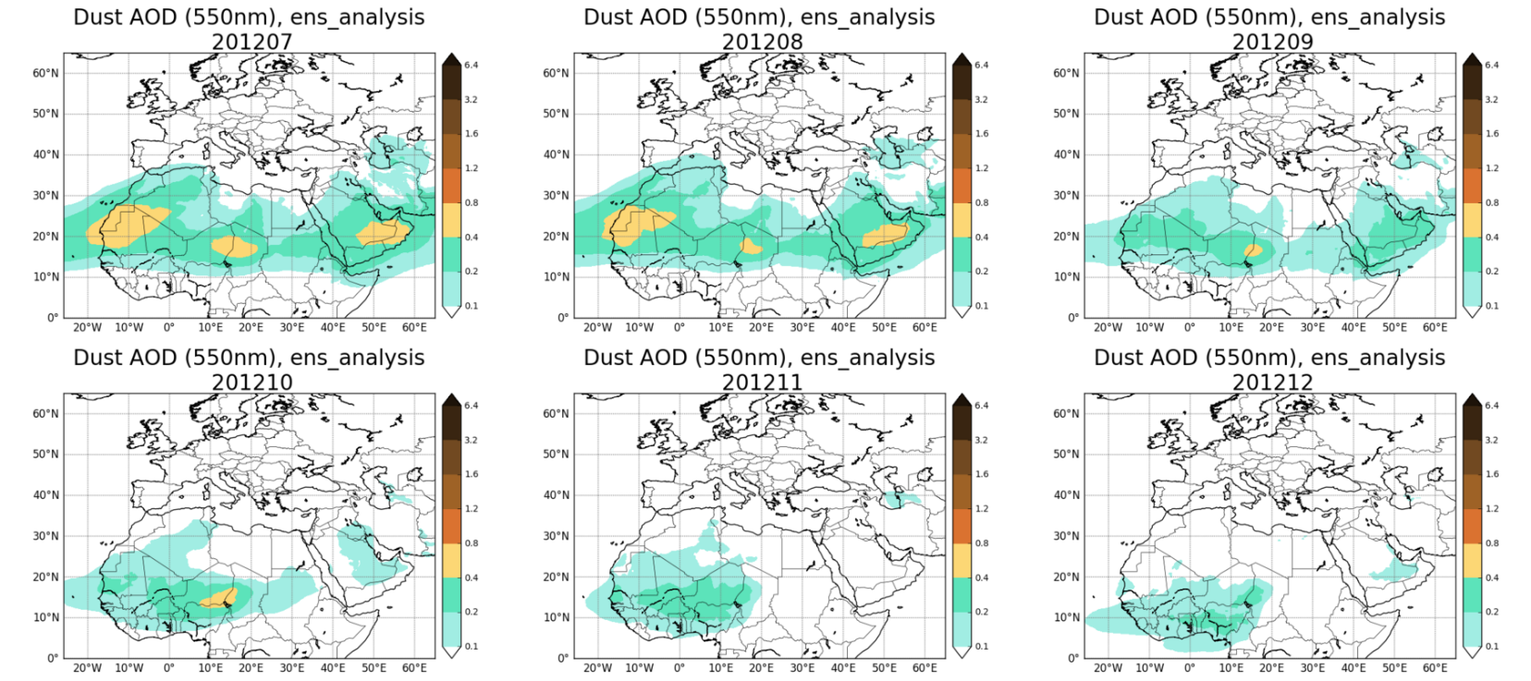
First test simulations: monthly analyses
Year 2012
Resolution 0.1º
Next tasks:
- close-to-optimal configuration for the ensemble
- tuning of DA parameters
- treatment of the observations.
Notes:
Feasibility of 0.1x0.1 ENS-DA runs has been proved for 1 year of simulations
Here monthly averages of dust AOD analyses at 0.1x0.1 are shown for the different months of 2012
This is a preliminary test on which to build the next tasks of the project: close-to-optimal configuration for the ensemble, the tuning of DA parameters, and for the treatment of the observations.

Slide 26
Aerosol_cci project
IMARS
LMD
MAPIR
ULB
IASI dust AOD
observations available day time and night time
over ocean and over land (desert)
10 μm: detection of dust aerosol coarse mode (infrared wavelengths and ‘‘V’’ shaped depression of the Brightness Temperature)
pixel level uncertainty
Notes:
We have performed a user case study for the ESA climate change initiative on the assimilation of IASI dust AOD, which are retrievals done in the thermal infrared
Aim of the study: showcase their potential to improve prediction and monitoring of mineral dust
IASI provides valuable information on aerosol properties, in particular observations are available night and day time, over ocean and land, are sensitive to coarse absorbing particles
A characterization of observation uncertainty is provided at pixel-level by the retrieval teams
IASI is suited for long-term evolution (IASI-1, 2, 3 + IASI-NG-1, 2, 3 )
Retrieval from 4 different algorithms have been used provided by Universite Libre de Bruxelles, BIRA-IASB, Laboratoire de Meteorologie Dynamique, DLR

Slide 27
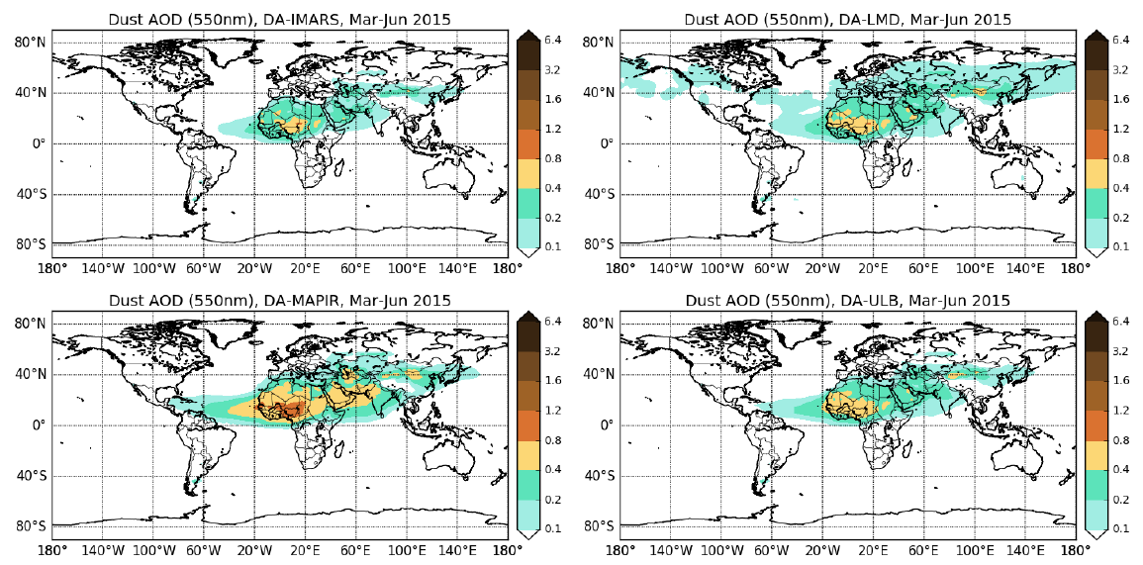
Aerosol_cci: IASI analyses
Updates: case study completed with the latest version of products provided by the retrieval teams and over an extended period (Mar-Jun 2015)
IMARS
LMD
MAPIR
ULB
Overall all the retrievals tend to produce an analysis that underestimates dust AOD (close to sources), with the exception of MAPIR;
The assimilation of the IMARS product produces the least encouraging scores;
The assimilation of LMD product is globally overall neutral (but with improvement in the correlation to AERONET in the Atlantic transport);
Slightly reduced RMSE and higher correlation coefficients than the Control experiment are reported globally for the DA-MAPIR and DA-ULB experiments.
Notes:
Updates on this study from what was presented at the last ICAP meeting are that:
the study has been completed using the latest product version delivered by the retrieval teams at the end of the aerosol_cci project. Retrieval algorithm improvements were in fact still on-going
The period of study has been extended to Mar-Jun 2015
Here mean analyses are shown over the study period for the 4 different algorithm as produced at the end of the project.
The 4 algorithm showed different skills
The university of Bruxelles’ one (ULB retrievals) shows the greatest potential
Some are not mature yet (IMARS in particular)
A bug has been discovered in one of them (MAPIR) that they plan to correct

Slide 28
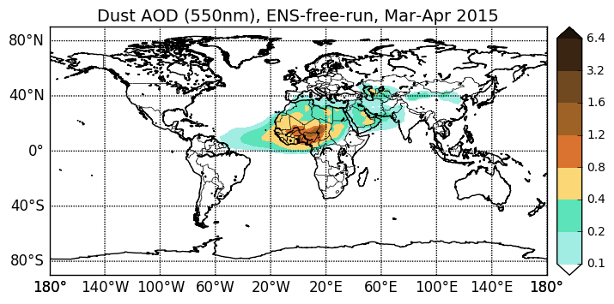
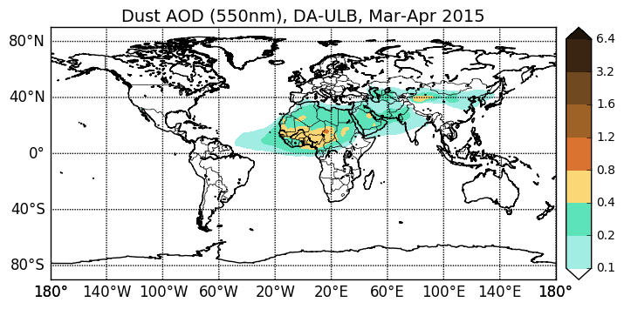
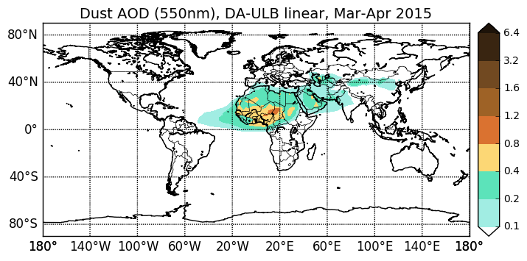
Exercise on observation uncertainty
Free-run
ULB AOD_unc
Linear: AOD_unc = 0.1 + 0.54 * AOD
Constant: AOD_unc = 0.35
Relevant impact of the observation error characterization
Further studies on the characterization of observation uncertainty for DA are needed
Notes:
We have performed an exercise on varying the observation uncertainty using three different estimations:
Provided by the data provider
Linear in AOD (similar to the one used for Deep Blue)
A mere constant value
A relevant impact on the analysis is observed, we wish to investigate this further.

Slide 29
Thank you!
7/06/2018
10th ICAP WG meeting - Exeter (UK)

