Slide 1
Aerosol intensive optical properties in the NMMB-MONARCH model
Vincenzo Obiso¹ , Oriol Jorba¹, Carlos Pérez-García Pando¹ and Marco Pandolfi²
¹Barcelona Supercomputing Center
²Institute of Environmental Assessment and Water Research
17/05/2018
36th ITM - Ottawa (Canada)
Notes:
Collaboration between BSC, Spanish Research Council

Slide 2
Aerosol intensive optical properties in the NMMB-MONARCH
CONTEXT AND OBJECTIVES
Aerosol intensive optical properties: few and uncertain model evaluations [1,2,3,4]
Evaluation of full online aerosol-radiation coupling in NMMB-MONARCH
Single scattering albedo (ω) and asymmetry factor (g) against observations
Impact of new refractive indexes on model performance
1.Myhre et al. [2013a]; 2.Lacagnina et al. [2015]; 3.Takemura et al. [2002]; 4.Curci et al. [2015]
Notes:
Several studies focused on evaluating aerosol optical depth
Not many evaluation of intensive properites: single scattering albedo (Qscat/(Qscat+Qabs)) and asymmetry parameter (forward scattering/all scattering)
Here we present an evaluation of a global aerosol model of omega and g
And will discuss the impact of using updated refractive indexes

Slide 3
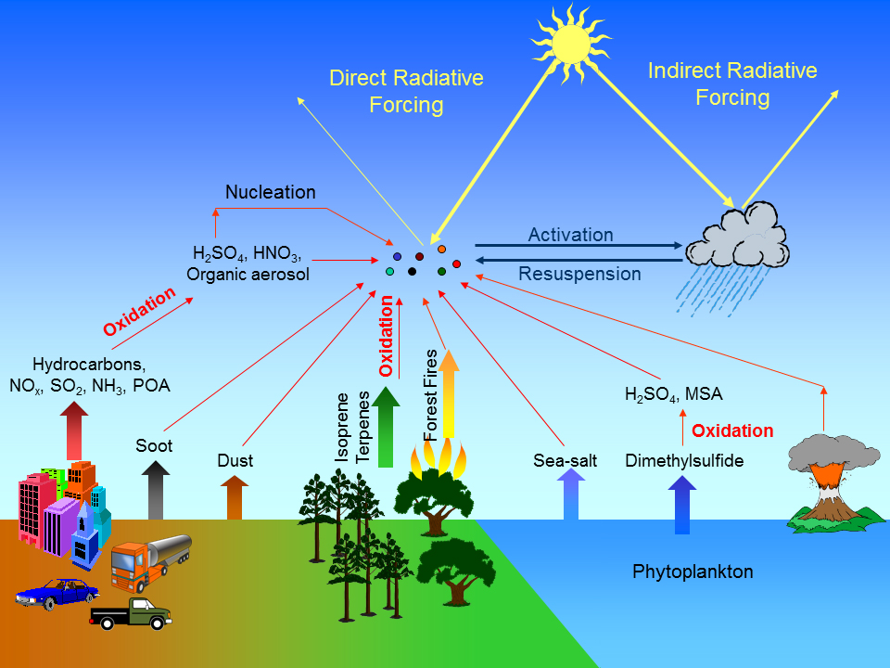
Introduction
Atmospheric aerosols: solid/liquid particles suspended in air [1]
Aerosol impact on meteorology and climate [2]
Direct effect: Aerosol-Radiation Interaction (ARI)
Semi-direct effect: atmosphere responses to ARI
Indirect effect: Aerosol-Cloud Interaction (ACI)
1.Jacobson [2005]; 2.Boucher et al. [2013]
Notes:
As we know, aerosols in the atmosphere can scatter or absorb radiation (direct effect) or act as cloud condensation nuclei or ice nucleai (indirect effect)
There are already observations of the opticals properties of aerosols (optical depth, single scattering albedo, and asymetry parameter)
Depeding how aerosols are represented the impact of aerosols on the radiative balance can be significantly different.
For that, we propose an evaluation of a global aerosol model with sunphotometer observations

Slide 4
Methodology: NMMB-MONARCH model
NMMB-MONARCH [1,2,3,4,5]
¹Multiscale Online Nonhydrostatic AtmospheRe CHemistry:
online integrated meteorology-chemistry model for short- and mid-term CWF
Meteorological core: NMMB [6]
Wide range of spatio-temporal scales
Aerosol module (global configuration):
5 aerosol species (natural and anthropogenic origin)
Gas-phase module (global configuration):
9 precursors for secondary aerosol formation
1.Pérez et al. [2011]; 2.Jorba et al. [2012]; 3.Spada et al. [2013]; 4.Spada [2015]; 5.Badia et al. [2017]; 6.Janjic and Gall [2012]
Notes:
The modelling tool that we will use is the model NMMB-MONARCH
It is a multiscale online atmospheric – chemistry model that considers the interaction of aerosols with the radiation
The system uses the NMMB meteorological model and has a simplified mass-based aerosol scheme for global applications.
The global aerosol configuration traces some gas-phase species for the formation of secondary aerosols.

Slide 5
Methodology: NMMB-MONARCH model
Aerosol processes implemented in the model [1,2]
horizontal
advection
turbulence
production
sinks:
sedimentation
dry deposition
wet deposition
Global aerosol parameterization [1,2]: GOCART [3] → OPAC [4]
Mineral dust
8 size bins (PB)
Online emission
Sea salt
8 size bins (PH)
Online emission
Organic matter
6 modes (POM+SOA: PB/PH)
Offline emission (POM)
Online formation (SOA)
Black carbon
2 modes (PB/PH)
Offline emission
Sulfate
1 mode (PH)
Online formation
MIAM
SSAM
WASO
SOOT
SUSO
1.Pérez et al. [2011]; 2.Spada [2015]; 3.Chin et al. [2002]; 4.Hess et al. [1998]
Notes:
The model solves the life cycle of mineral dust, sea salt, organic matter, black carbon and sulfate in bins or bulk approaches.
Mineral dust is assumed hydrophobic, sea salt and sulfate hydorphilic and BC and OM have an hydrophobic bin and an hydrophilic bin.
The optical properties of the aerosols are derived from the Chin et al. 2002 which is based on the OPAC database.
The OPAC database has been used widely in most aerosol models.

Slide 6
Methodology: Aerosol-radiation coupling
Radiation scheme
Optical tool
+
RRTMG [1,2]
Glob./reg. models [3]
Layer optical properties
scattering/extinction
forward/backward
Codes [4]
T-Matrix: non-spherical
Mie: spherical
Optical tables
61 wavelengths (OPAC)
7 RH levels, 8 bins
1.Iacono et al. [2008]; 2.Mlawer et al. [1997]; 3.Iacono [2011]; 4.Mishchenko et al. [2002]; 5.Pérez et al. [2011]
Notes:
The radiation parameterization of MONARCH is the RRTMG which considers the effect of clouds, aerosols and some trace gases in the radiative balance
We have used an optical tool to compute the extiction efficiency, single scattering albedo and asymetry parameter for the aerosols of MONARCH for 61 wavelengths and 7 relative humidities

Slide 7
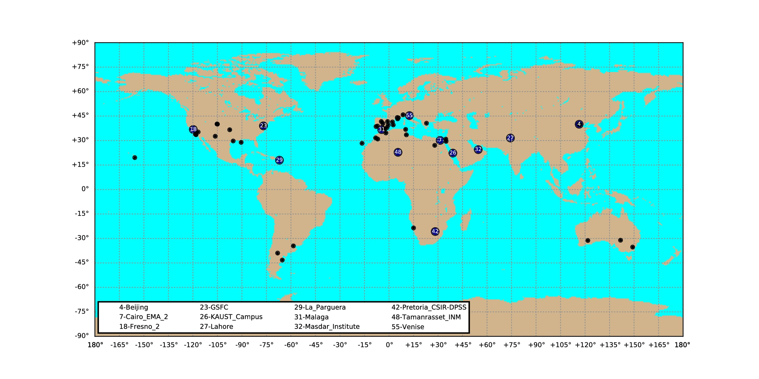
Methodology: Observations of τ, ω, g
Sun-photometers AERONET Version 2.0 [1,2]
Screened Level 1.5: Level 2 quality without optical depth filter: τ440 > 0.4 [3]
59 stations (full set): 20 data (daily τ, ω, g at 0.550 µm) per month (2012-2016)
12 stations (subset): i) observed τ, ii) dominant species, iii) geographical distribution
1.Holben et al. [1998]; 2.Holben et al. [2006]; 3.Li et al. [2014]
Notes:
The objective of the work is to evaluate the optical properties of the integrated atmospheric column of MONARCH aerosols with AERONET observations
For that, we have used the screened level 1.5 that has the level 2 quality without the filter on optical depth over 0.4 to avoid loosing too many observations under situations where the aerosol concentration in the atmosphere are below that number and AERONET still provides valuable information to study.
We have analyzed the period 2012-2015 of AERONET stations and we have selected 59 stations with 20 good data per month.

Slide 8
Methodology: Observations
Sun-photometers AERONET Version 2.0 [1,2]
Screened Level 1.5: Level 2 quality without optical depth filter: τ440 > 0.4 [3]
59 stations (full set): 20 data (daily τ, ω, g at 0.550 µm) per month (2012-2016)
12 stations (subset): i) observed τ, ii) dominant species, iii) geographical distribution
Fresno_2
GSFC
urban/
anthropogenic
Beijing
Lahore
large urban
Cairo_EMA_2
KAUST_Campus
Masdar_Institute
Tamanrasset_INM
deserts/urban
La_Parguera
coastal
1.Holben et al. [1998]; 2.Holben et al. [2006]; 3.Li et al. [2014]
Notes:
From the 59 stations, we have selected some of them to analyze in detail the performance of the model
In this talk, I will show results of Cairo and Kaust as stations dominated by the presence of mineral dust, La parguera as a station affected by sea salt, and Bejing, Fresno and GSFC as stations affected by anthropogenic aerosols (sulfate, black carbon and organic matter).

Slide 9
Model simulations
NMMB-MONARCH simulations
Global domain simulations: lonxlat = 1.4ºx1.0º and 48 vertical layers
5-years period (2012-2016): spinup (1 year) and meteo initialization (24h, FNL)
Full online coupling: simulated τ, ω, g at 0.550 µm from RRTMG
- mineral dust (DU), sea salt (SS), organic matter (OM), black carbon (BC), sulfate (SU)
- dynamic mass concentrations + optical tables (REF case)
Emissions:
- anthropogenic (OC, BC, SO2) → HTAP_v2.2 [1]
- biomass burning (OC, BC, SO2, dimethylsulfide) → GFASv1.2 [2]
- domestic waste open burning (OC, BC, SO2) → [3]
- dimethylsulfide from oceans → MOZART-4 [4]
- biogenic SOA precursors → MEGAN v2.04 [5]
1.Janssens-Maenhout et al. [2015]; 2.Kaiser et al. [2012]; 3.Wiedinmyer et al. [2014]; 4. http://cdp.ucar.edu; 5.Guenther et al. [2006]
Notes:
The model experiment characteristics are detailed in this slide.
We configured MONARCH in its global aerosol configuration with a resolution of 1º and 48 vertical layers.
We simulated 2012-2016 years with the model and we extracted the simulated optical depth, single scattering albedo and the asymmetry parameter a 550 nm.
We used the emissions from HTAP_v2.2 for OC, BC and SO2, emissions of biomass burning from GFASv1.2, domestic waste open burning emissions, DMS from oceans and biogenic SOA precursors from MEGAN.

Slide 10
Notes:
Here we can see some example of specific stations.
The upper panels shows the fraction of each aerosol in the monthly mean optical depth, the middle panels show the single scattering albedo monthly mean, and in the bottom we show the asymmetry parameter. The model is the blue points with the sigma in shaded blue and the observations from aeronet in black dots.
For Cairo and Kaust, stations clearly dominated by mineral dust, we can see that during the dust peaks in spring and summer the model absorption increases but the observations don’t tell the same remaining with an omega over 0.9. The asymmetry parameter of the model is overestimated across the whole annual cycle but with quite good correlation. This seems to indicate that we are missing some fine particles in the atmosphere and our mineral dust is too absorbing.

Slide 11
Notes:
La Parguera station is clearly dominated by the sea salt aerosols but during summer it is affected by mineral dust transport from the Atlantic.
The effect of dust in the model is clear in the single scattering albedo, increasing the bias during summer, again this is clearly pointing in the direction that the OPCA characteristic of mineral dust is too abosrbing.
On the other side, the months where sea salt dominates, the model agrees very well with observations with a very scattering mixture.
G is again overestimated across the whole year, specially during the periods where we have more sea salt fractions. It seems that a missing of fine particles (for example fine sea salt or white organics) is the main contribution to the positive g mean bias in winter months.

Slide 12
Notes:
Finally, in the case of stations affected mostly by anthropogenic pollution we have a strong underestimation of omega while g is quite good. The good g is in agreement with the presence of small particles, but our aerosols seems to bee too much absorbing pointing again to the idea that our model is overestimating Black Carbon. For the case of Fresno, some problems with wildfires could also explain some of the problems.

Slide 13
Notes:
Finally GSFC shows that the presence of more sulfate and less black carbon and organic reduces the bias in omega but negatively impacts on the asymmetry parameter.
This makes us think that our model lacks of some fines species there.

Slide 14
Results: New refractive indexes
Updating microphysics (PTB case) [1]:
New refractive indexes at ~0.550 µm from recent literature
 | DU [2] | SS [3] | POM [4] (anthropogenic) | BrC [5,6] (biom. burn.) | SOA [7,8] (biog. prec.) | BC [9] | SU [10]
nr¹ | 1.53 ↓ 1.531 (~) | 1.5 ↓ 1.557 (+3.8%) | 1.53 ↓ 1.501 (-1.9%) | 1.53 ↓ 1.535 (~) | 1.53 ↓ 1.486 (-2.9%) | 1.75 ↓ 1.85 (+5.7%) | 1.43 ↓ 1.546 (+8.1%)
ni¹ | 0.0055 ↓ 0.0025 (-54.5%) | 0.00000001 ↓ 0.00000001 (~) | 0.006 ↓ 0.00000001 (~ -100%) | 0.006 ↓ 0.03 (+400%) | 0.006 ↓ 0.000025 (~ -100%) | 0.44 ↓ 0.71 (+61.4%) | 0.00000001 ↓ 0.00000001 (~)
1.Hansen and Travis [1974]; 2.Denjean et al. [2016]; 3.Irshad et al. [2009]; 4.Shepherd et al. [2017]; 5.Tang et al. [2016]
6.Kirchstetter et al. [2004]; 7.Nakayama et al. [2012]; 8.Liu et al. [2013]; 9.Bond and Bergstrom [2006]; 10.Freedman et al. [2009]
Notes:
From the results shown, its clear that the optical properties used from OPAC requires an update.
We have done a literature review on refractive indexes for different types of aerosols. Here we show what we have found and how the real and imaginary parts of the refractive index used in our model from OPAC change.
As expected, recent literature suggest that dust is less absorbing, a decrease of the 50% of the imaginary part.
Sea salt quite correct what OPAC proposes.
Organic is a much complex problem having different types of them with quite different imaginary parts (POM, BrC and SOA biogenic).
For BC, OPAC is still underestimating the imaginary part, that clearly indicates that our model has problem with too much BC in the atmosphere and not a problem on the refractive index assumed.
And finally for sulfate recent studies agrees quite well with opac.

Slide 15
Results: New refractive indexes
Updating microphysics (PTB case) [1]:
New refractive indexes at ~0.550 µm from recent literature
 | DU [2] | SS [3] | POM [4] (anthropogenic) | BrC [5,6] (biom. burn.) | SOA [7,8] (biog. prec.) | BC [9] | SU [10]
nr¹ | 1.53 ↓ 1.531 (~) | 1.5 ↓ 1.557 (+3.8%) | 1.53 ↓ 1.501 (-1.9%) | 1.53 ↓ 1.535 (~) | 1.53 ↓ 1.486 (-2.9%) | 1.75 ↓ 1.85 (+5.7%) | 1.43 ↓ 1.546 (+8.1%)
ni¹ | 0.0055 ↓ 0.0025 (-54.5%) | 0.00000001 ↓ 0.00000001 (~) | 0.006 ↓ 0.00000001 (~ -100%) | 0.006 ↓ 0.03 (+400%) | 0.006 ↓ 0.000025 (~ -100%) | 0.44 ↓ 0.71 (+61.4%) | 0.00000001 ↓ 0.00000001 (~)
1.Hansen and Travis [1974]; 2.Denjean et al. [2016]; 3.Irshad et al. [2009]; 4.Shepherd et al. [2017]; 5.Tang et al. [2016]
6.Kirchstetter et al. [2004]; 7.Nakayama et al. [2012]; 8.Liu et al. [2013]; 9.Bond and Bergstrom [2006]; 10.Freedman et al. [2009]
Notes:
Considering the limitation in our model to deal with BrC and the identified problem with BC, we have not implemented any change in absorging organics and we have keep BC as it is, although recent literature suggest that it is even more abosrbing than what opac suggests.

Slide 16
Results: New refractive indexes
Updating microphysics (PTB case) [1]:
New refractive indexes at ~0.550 µm from recent literature
 | DU [2] | SS [3] | POM [4] (anthropogenic) | BrC [5,6] (biom. burn.) | SOA [7,8] (biog. prec.) | BC [9] | SU [10]
nr¹ | 1.53 ↓ 1.531 (~) | 1.5 ↓ 1.557 (+3.8%) | 1.53 ↓ 1.501 (-1.9%) | 1.53 ↓ 1.535 (~) | 1.53 ↓ 1.486 (-2.9%) | 1.75 ↓ 1.85 (+5.7%) | 1.43 ↓ 1.546 (+8.1%)
ni¹ | 0.0055 ↓ 0.0025 (-54.5%) | 0.00000001 ↓ 0.00000001 (~) | 0.006 ↓ 0.00000001 (~ -100%) | 0.006 ↓ 0.03 (+400%) | 0.006 ↓ 0.000025 (~ -100%) | 0.44 ↓ 0.71 (+61.4%) | 0.00000001 ↓ 0.00000001 (~)
ω ▲
g ▼(coarse)
τ ▲ (fine)
g ▼
τ ▼
ω ▲
g ▲
τ ▲
g ▼
1.Hansen and Travis [1974]; 2.Denjean et al. [2016]; 3.Irshad et al. [2009]; 4.Shepherd et al. [2017]; 5.Tang et al. [2016]
6.Kirchstetter et al. [2004]; 7.Nakayama et al. [2012]; 8.Liu et al. [2013]; 9.Bond and Bergstrom [2006]; 10.Freedman et al. [2009]
Notes:
We have implemented the new refractive indexes for dust, sea salt, white organic matter and sulfate.
These changes seem to go on the good direction to correct some of the biases initially detected.

Slide 17
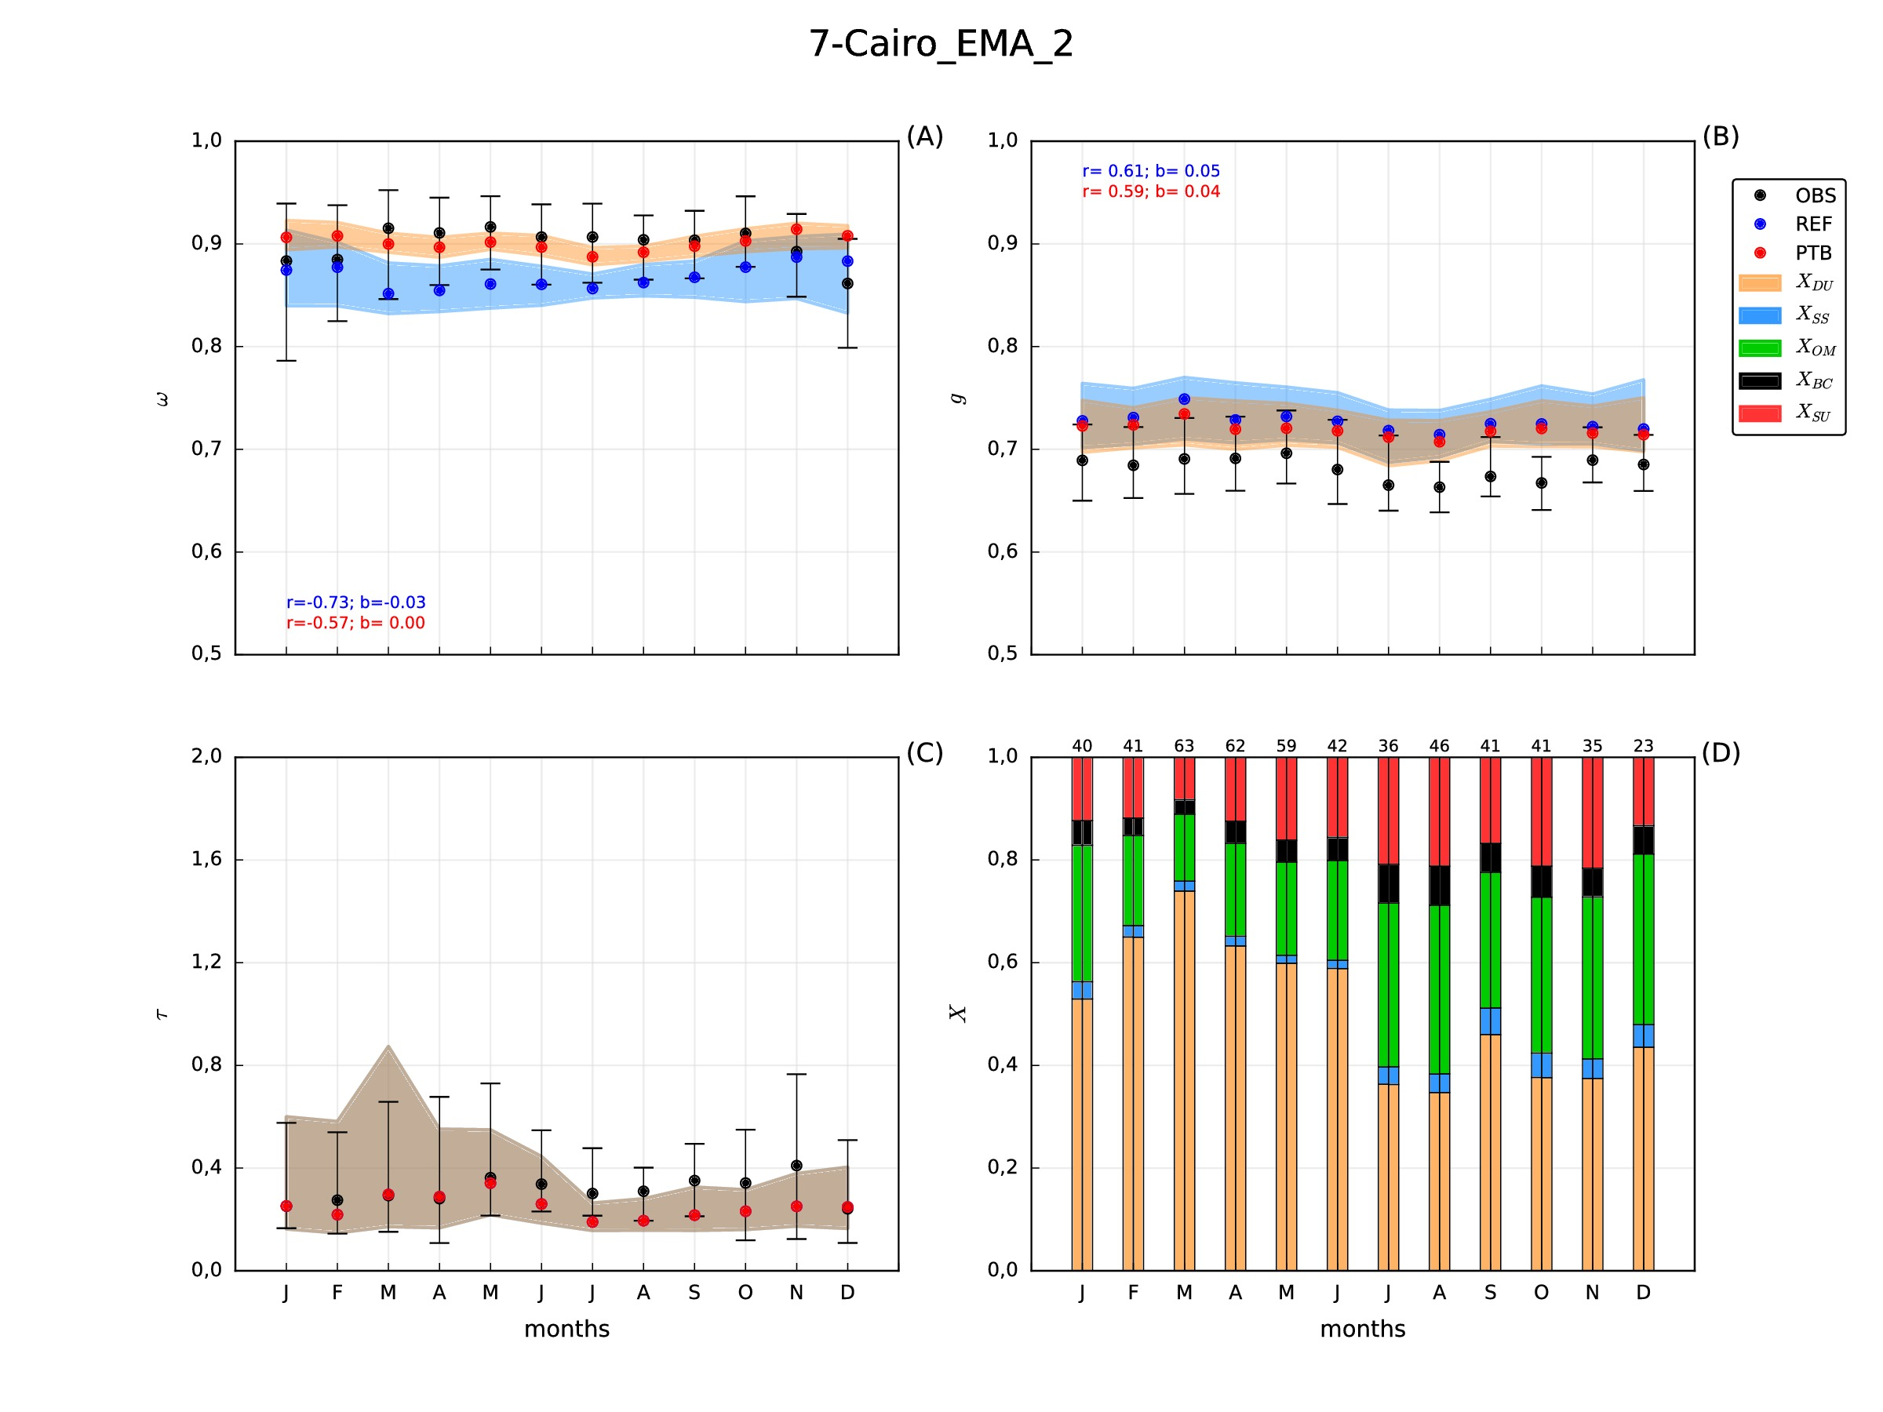
Results: Impact of new refractive indexes
J
F
M
A
M
J
J
A
S
O
N
D
J
F
M
A
M
J
J
A
S
O
N
D
 | ω | g
corr. variation | +0.16 | -0.02
bias variation | +0.03 | -0.01
New refractive index for DU and SS
Strong ω increases ↔ DU peaks
Slight g decreases ↔ DU peaks
Further g reduction → more fine DU?
Notes:
Here we show the results for Cairo station. The blue dots and shaded region is the initial results and the red dots and brownish shade is the new simulation with updated refractive indexes.
Results seems to be much more in agreement now concerning both omega and g.
A much less absorbing mineral dust seems to be much more realistic than what we had initially.
The new results still show an overestimation of g which make us think that we still lack of fine dust in the atmosphere. Being this a common problem of all mineral dust models, the life of fine particles are usually underestimated.

Slide 18
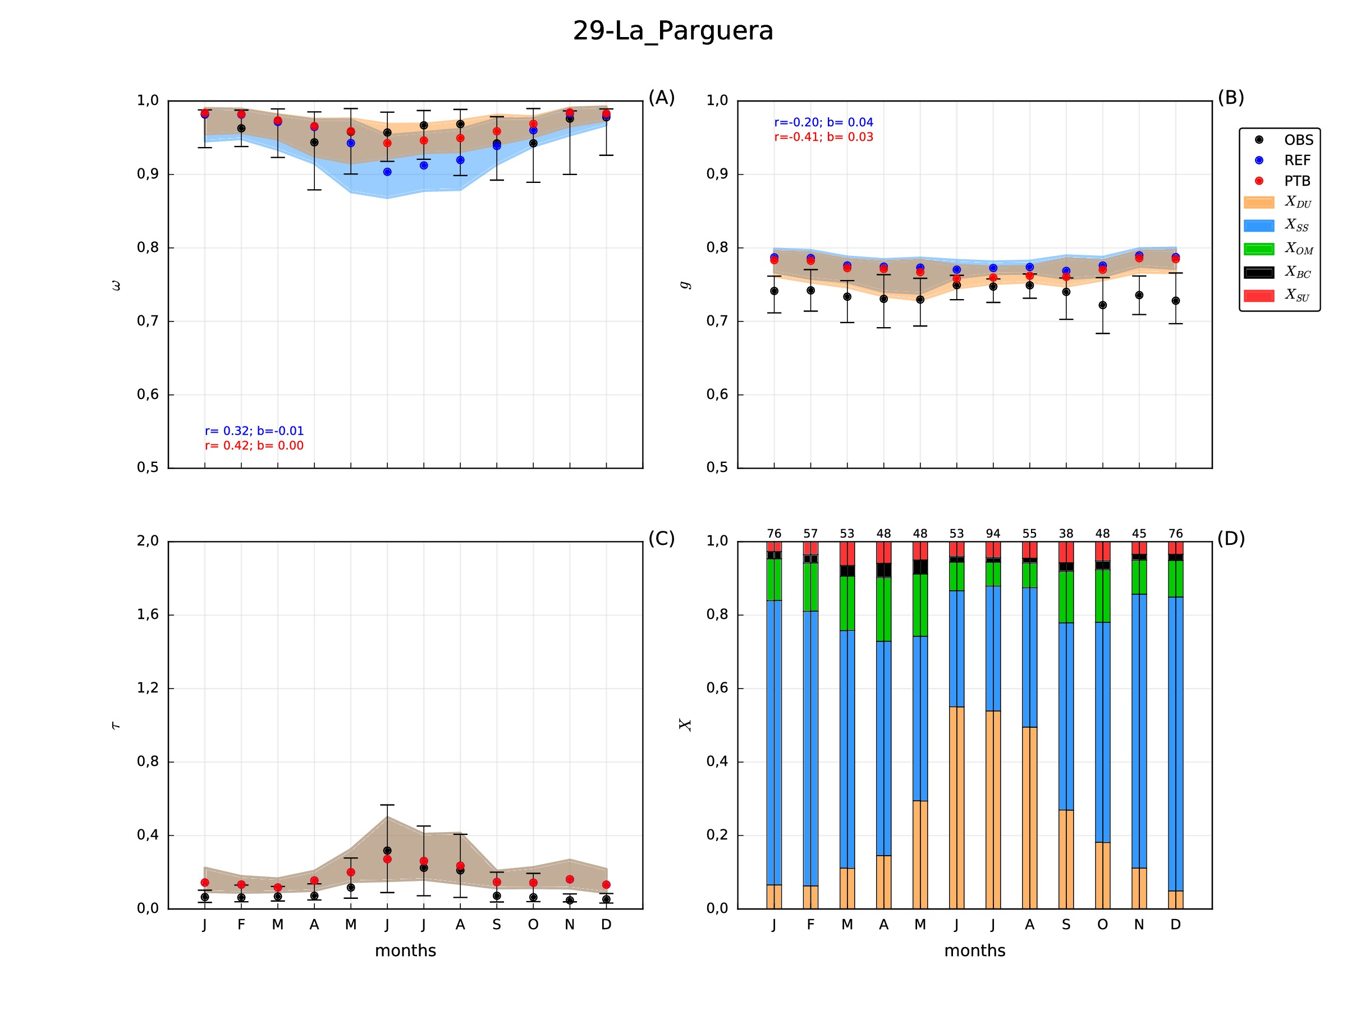
Results: Impact of new refractive indexes
J
F
M
A
M
J
J
A
S
O
N
D
J
F
M
A
M
J
J
A
S
O
N
D
 | ω | g
corr. variation | +0.10 | -0.21
bias variation | +0.01 | -0.01
New refractive index for DU and SS
Stronger ω/g variations ↔ summer DU
Negligible ω/g variations due to SS
Further g reduction → more fine species?
Notes:
The new results in la Parguera also shows an impressive improvement with the new less absorbing mineral dust, while g doesn’t show much changes.
We think that to reduce g we need more fine species both from sea salt and dust.

Slide 19
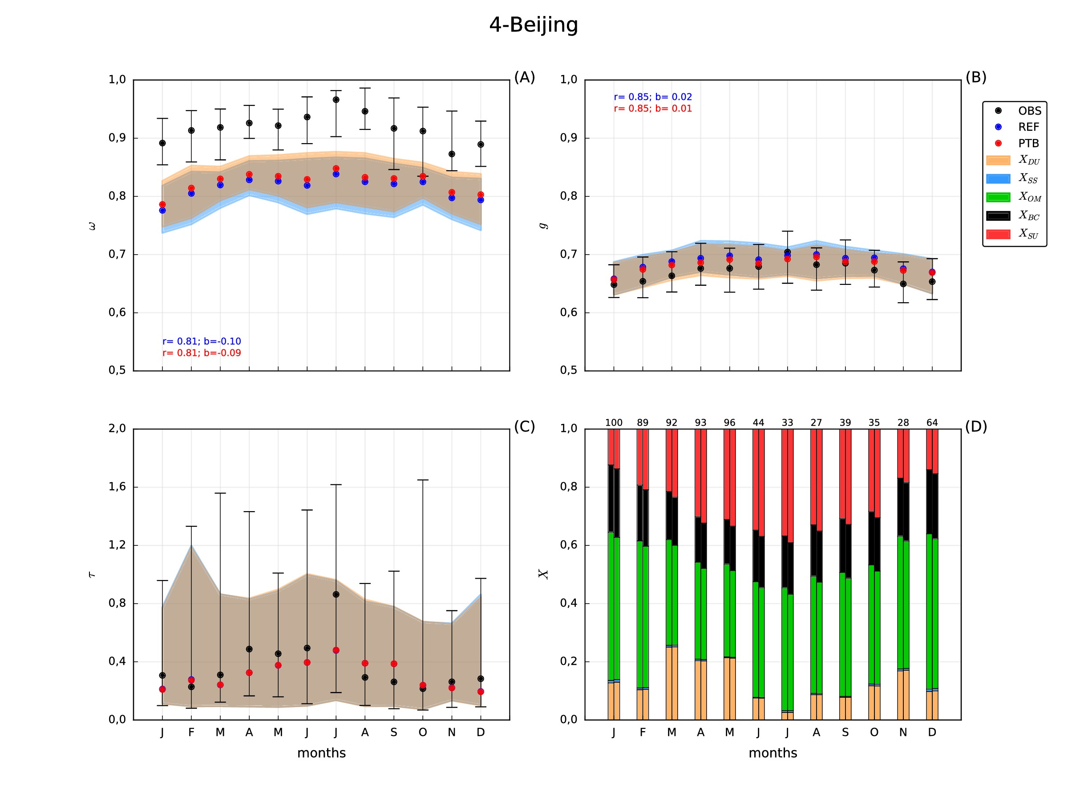
Results: Impact of new refractive indexes
J
F
M
A
M
J
J
A
S
O
N
D
J
F
M
A
M
J
J
A
S
O
N
D
 | ω | g
corr. variation | 0 | 0
bias variation | +0.01 | -0.01
New refractive index for OM and SU
Slight ω increases ↔ OM+SU changes
Slight g decreases ↔ SU changes
Stronger ω increases → less BC?
Notes:
To finalize, the new refractive indexes in the station of Beijing doesn’t have a huge impact.
We think that the problem is the fraction of Black Carbon, which will make revisit our implementation and emissions of BC used in our runs.

Slide 20
Aerosol intensive optical properties in the NMMB-MONARCH
CONCLUSIONS
Model underestimates observed ω and overestimates observed g
Annual cycles are better captured for anthropogenic species
Notes:
So, the concluding remarks we found that our model tends to underestimate omega and overstimate g and it show the best annual cycles for anthropogenic species.

Slide 21
Aerosol intensive optical properties in the NMMB-MONARCH
CONCLUSIONS
Model underestimates observed ω and overestimates observed g
Annual cycles are better captured for anthropogenic species
New refractive indexes partially correct model systematic biases
Lower imaginary part for DU and OM, higher real part for SU
Notes:
The update on refractive indexes has partially correct some of the systematic biases of our model.

Slide 22
Aerosol intensive optical properties in the NMMB-MONARCH
CONCLUSIONS
Model underestimates observed ω and overestimates observed g
Annual cycles are better captured for anthropogenic species
New refractive indexes partially correct model systematic biases
Lower imaginary part for DU and OM, higher real part for SU
Too high fine/coarse DU close to dust sources
Too high BC fractions in urban areas
Lack of fine and scattering species (nitrate?)
Notes:
The analysis of intensive optical properties provides very valuable information to improve model representation of aerosols.
With this analysis we have identified that our system has too high fine to coarse dust close to dust sources,
We have too high BC fractions in urban aeras
And we are lacking of fine scattering particles. The lack of nitrate in our current global system could improve that.

Slide 23
Thank you!
Acknowledgments
Severo Ochoa Program, awarded by the Spanish Government [grant: SEV-2011-0067]
Spanish Ministry of Economy and Competitiveness [’FPI SO’ grant: SVP-2013-067953]
ACTRIS Research Infrastructure Project of the European Union’s Horizon 2020 research and innovation programme [grant agreement: No. 654169]
V. Obiso has been partially funded by the AXA Chair on Sand and Dust Storms
High Performance Computer resources of the “Red Española de Supercomputación” (AECT-2017-1-0008).
17/05/2018
36th ITM - Ottawa (Canada)

Slide 24
Results: Global analysis 59 stations
Full set of stations (REF case)
Stations dominated by DU (16)
ω underestimated (cycle missed)
g overestimated (cycle partially captured)
too much absorbing, low fine/coarse
Stations dominated by OM (16)
ω underestimated (cycle well captured)
g overestimated (cycle very well captured)
too much absorbing, high BC
 | ω | g
corr. (r) | -0.32 | 0.24
bias (b) | -0.035 | 0.05
 | ω | g
r | 0.535 | 0.755
b | -0.045 | 0.015
Stations dominated by SS (4)
ω overestimated (cycle not clear)
g overestimated (cycle not clear)
too high coarse fractions
Stations dominated by SU (2)
ω underestimated (cycle well captured)
g overestimated (cycle not clear)
too low fractions, too high g
 | ω | g
r | -0.17 | 0.13
b | 0.065 | 0.045
 | ω | g
r | 0.71 | 0.16
b | -0.025 | 0.07
Notes:
The initial results from the 59 stations used are summarized here. We show the correlation and bias of omega and g monthly mean values of the model compared with aeronet observations.
The stations dominated by DU show a systematic underestimation of the single scattering albedo and a positive bias in the asymmtery parameter. This suggest that our initial characterization of the dust aerosol is too absorbing and we may have a low fine to coarse ratio.
For stations dominated by sea salt, we see an overestimation of both omega and g, suggesting that our sea salt aerosol in the atmosphere may bee too coarse.
Moving to places dominated by OM, the model underestimates omega but with a good correlation, and overestimated g also with good correlation. Suggesting that our mixtures with presence of organic matter are too absorbing in the model. This could be produced by an overestimation of the mass of BC in our model.
Finally, in stations with a high contribution of sulfate, the model underestimates omega but with very good correlation and overestimates g. Considering that sulfate is a scattering aerosol this could indicate that our model has a too low fractions of fine particles.

