Slide 1
Climate predictions for site selection: a new generation of risk management tools
Speaker: Albert Soret ³
Senior Researcher, Co-leader of the services group
Author: Verónica Torralba Fernandez¹, Melanie Davis¹, Francisco Doblas-Reyes^{1,2,3}, Nube Gonzalez-Reviriego¹
1 Climate Forecasting Unit, Catalan Institute of Climate Science
2 Institució Catalana de Recerca i Estudis Avançats (ICREA)
3 Barcelona Supercomputing Center (BSC)
Resource Assessment 2015, 2-3 June 2015, Helsinki, Finland
NEWA
New European Wind Atlas
Notes:
Melanie, Coordinator of Climate & Energy Research Projects
IC3
CFU
Forecasting future climate over monthly to decadal timescales
Future forecast of average conditions, not retrospective assessment to predict future
Relatively new area of research, supported by EU projects
SPECS – coordinates IC3
Current site selection practices use the retrospective wind speed climatology, with an assumption that the past will also represent the future. Recent advances in climate predictions can provide a more informative view by modeling future wind over months to decades: they use both an analysis of the past climate system, as well as its current state at the specific time when the prediction is created to provide a probability of different future outcomes, with an indication as to which will be the most likely.
It has been demonstrated that climate predictions can improve upon using climatology at some spatial and temporal scales, so decision makers now have a new set of climate risk management tools that can strengthen their decision making, but are they ready to use them?
Climate predictions come with a new set of challenges for end users: information is often un-tailored and hard to understand or apply in a decision-making context. A new generation of European projects, including NEWA, SPECS and EUPORIAS aim to address these challenges and support the development of a new realm of climate services and tools using climate predictions. Here we will present the state-of-the-art in wind speed and power prediction methodologies, to include: initialisation of ensemble simulations; post-processing using bias correction or calibration and validation to assess the prediction skill, as well as new climate prediction visualisation tools and interfaces tailored to the energy sector.

Slide 2
Introduction Methods Results Summary Future work
Initial-value problems (weather forecasting) to forced boundary condition problem (climate projections)
Climate forecasts (sub-seasonal, seasonal and decadal) in the middle
Meehl et al. (2009)

Slide 3
Introduction Methods Results Summary Future work
Wind power variability at monthly to decadal time scales has not been traditionally taken into account in wind power facilities planning and management
In other sectors as hydropower or electricity generation and demand balance, climate information on seasonal-to-interannuel time scales have already been illustrated for management decisions.
Hydroelectric power management
Electricity demand
Notes:
Wind resource is one of the fastest growing and most volatile forms of electric power generation, improved forecast beyond the first tow weeks of renewable power generation can improve the strategic and operational management of renewable power during the pre- and post-construction phase.

Slide 4
Introduction Methods Results Summary Future work
MONTHLY TO SEASONAL TIMESCALES
Energy producers: Resource management strategies
Energy traders: Resource effects on markets
Wind farm operators: Planning for maintenance works
Wind farm investors: Optimise return on investments
ANNUAL TO DECADAL TIMESCALES
Wind farm planners: Site selection
Wind farm investors: Evaluate return on investments
Policy makers: Understand changes to energy mix
Notes:
To assess these needs it is need to further tailor, validate, harmonise and improve the presentation and communication of climate information for all timescales in the past and in the future.

Slide 5
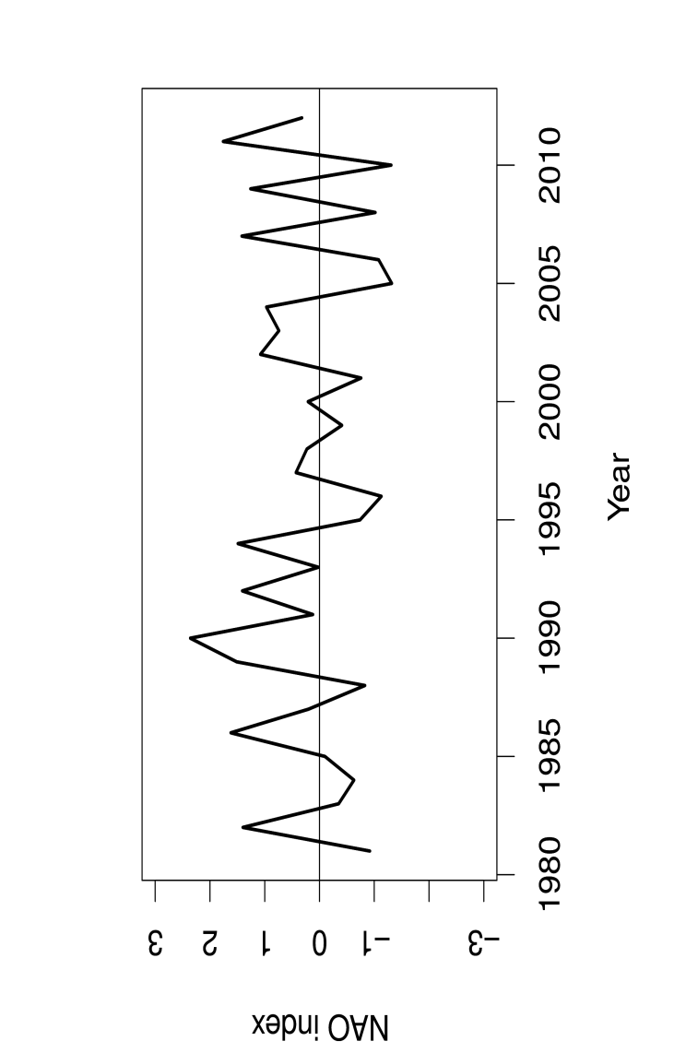
Introduction Methods Results Summary Future work
NAO Index
Impact of NAO on Wind Speed and Capacity Factor
Differences with NAO + and NAO - conditions
10m wind speed “observations”: ERA-Interim
Boreal winter season period 1981-2012
Wind Speed (m/s)
Capacity Factor (%)
Objective: To compute the forecasts of wind power generation (capacity factor) to be able to inform users and allow them to take calculated, precautionary action with a potential cost savings to their operations.

Slide 6
Introduction Methods Results Summary Future work
CHALLENGE : models don’t provide capacity factor forecasts.
The wind power can be estimated from predictions of wind speeds and temperatures at the surface.
Limitations:
The wind turbines are at 100m so 10m wind speed must be scaled up.
Seasonal/monthly means of wind speed and temperature masks sub-seasonal/daily variability.
Notes:
Daily variability is not captured

Slide 7
Introduction Methods Results Summary Future work
PREDICTIONS OF CAPACITY FACTOR
POTENTIAL SOLUTION: The wind power can be estimated from predictions of wind speeds and temperatures at the surface.
Forecasts
Past Observations
10m Wind Speed
2m Temperature
10m Wind Speed
2m Temperature
7

Slide 8
Introduction Methods Results Summary Future work
PREDICTIONS OF CAPACITY FACTOR
Corrected forecasts
10m Wind Speed
2m Temperature
Post-processing
Forecasts
Past Observations
10m Wind Speed
2m Temperature
10m Wind Speed
2m Temperature
8

Slide 9
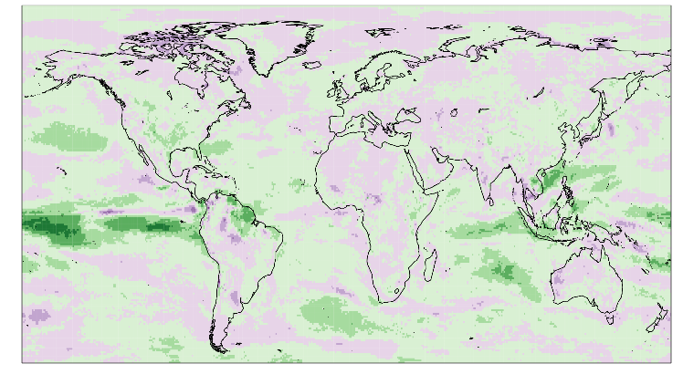
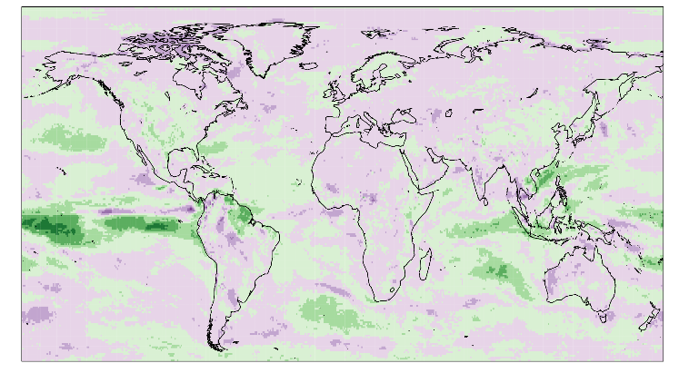
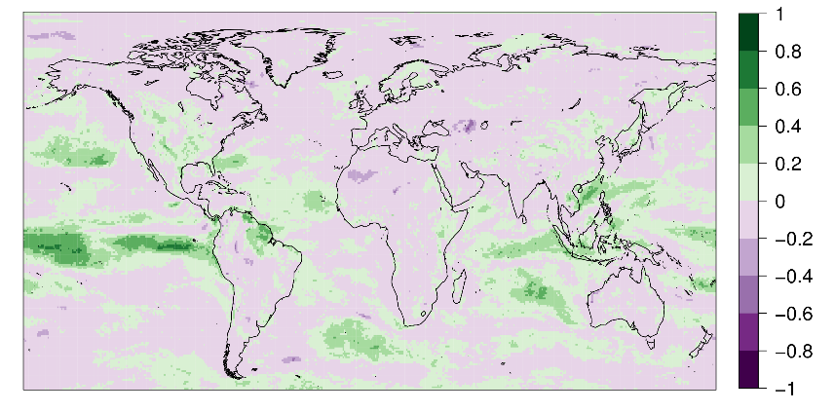
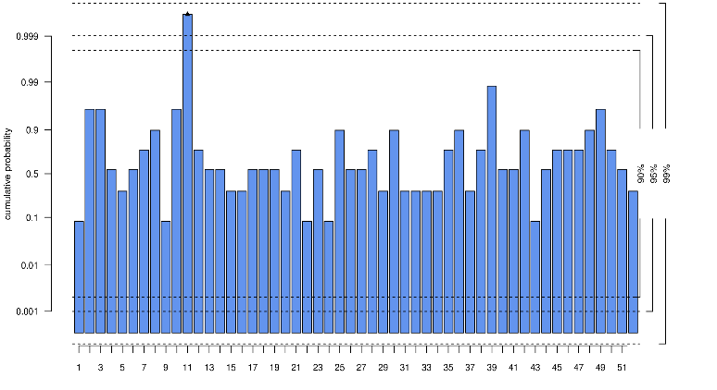
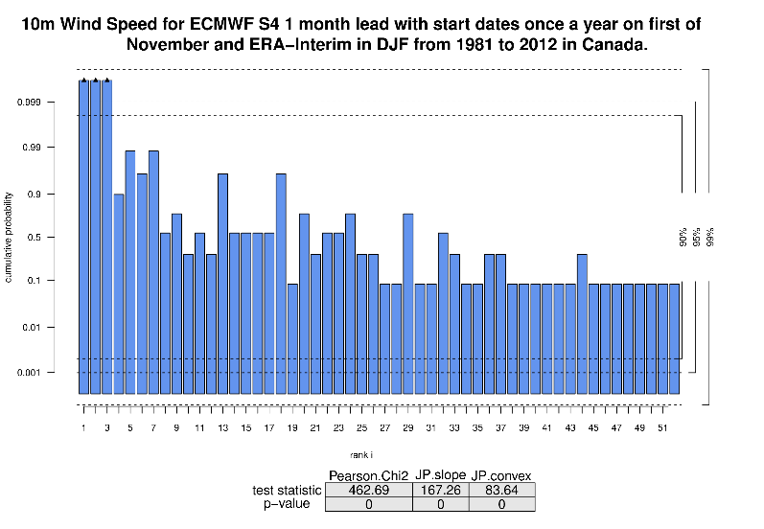
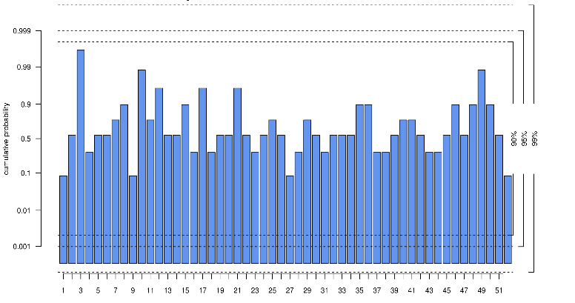
Introduction Methods Results Summary Future work
10m Wind Speed
ECMWF S4 1 month lead and ERA Interim
in DJF (1981-2013)
Forecast quality assessment
Raw data
Simple bias correction
Calibration
RPSS
Region of Canada
Rank Histograms
Cumulative probability
Cumulative probability
Cumulative probability
Cumulative probability
Cumulative probability
Cumulative probability
Cumulative probability
Rank i
Rank i
Rank i
9

Slide 10
Introduction Methods Results Summary Future work
PREDICTIONS OF CAPACITY FACTOR
Corrected forecasts
Past Observations
10m Wind Speed
2m Temperature
10m Wind Speed
2m Temperature
Capacity factor
Post-processing
MacLeod’s methodology
Forecasts
Past Observations
10m Wind Speed
2m Temperature
10m Wind Speed
2m Temperature
10

Slide 11
Introduction Methods Results Summary Future work
PREDICTIONS OF CAPACITY FACTOR
Multivariate regression
Corrected forecasts
Past Observations
10m Wind Speed
2m Temperature
10m Wind Speed
2m Temperature
Capacity factor
Post-processing
MacLeod’s methodology
Forecasts
Past Observations
10m Wind Speed
2m Temperature
10m Wind Speed
2m Temperature
11

Slide 12
Introduction Methods Results Summary Future work
Multivariate regression
How can we get a prediction of the capacity factor with a multivariate regression?
Past observations of CF , WS and T are fitted to a multivariate regression and the coefficients A, B and C are obtained.
CF (WS,T) = A WS + B T + C
Predictions of WS and T in the target period are introduced in the expression with the coefficients A, B, C and the output is the forecast of the capacity factor.
1
2
13

Slide 13
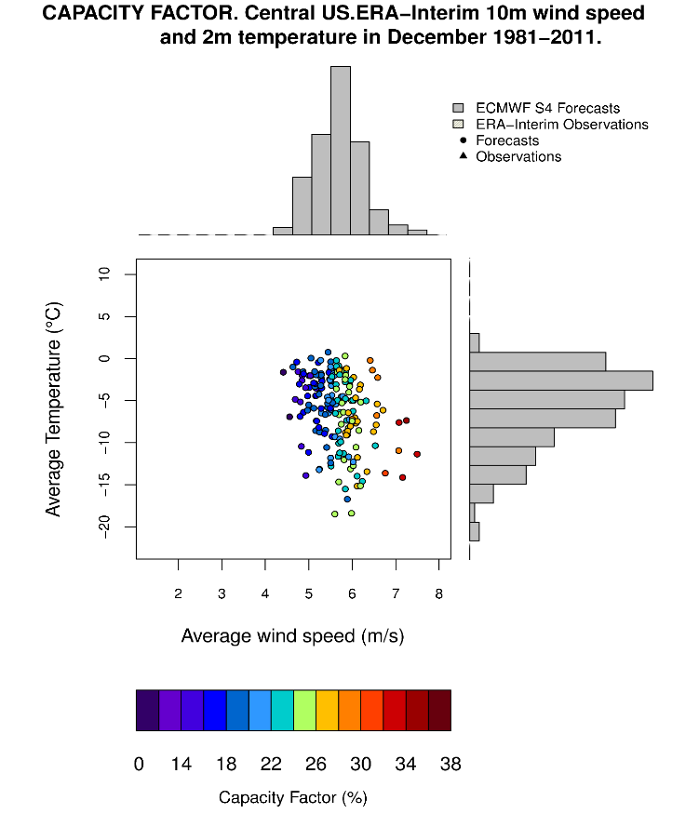
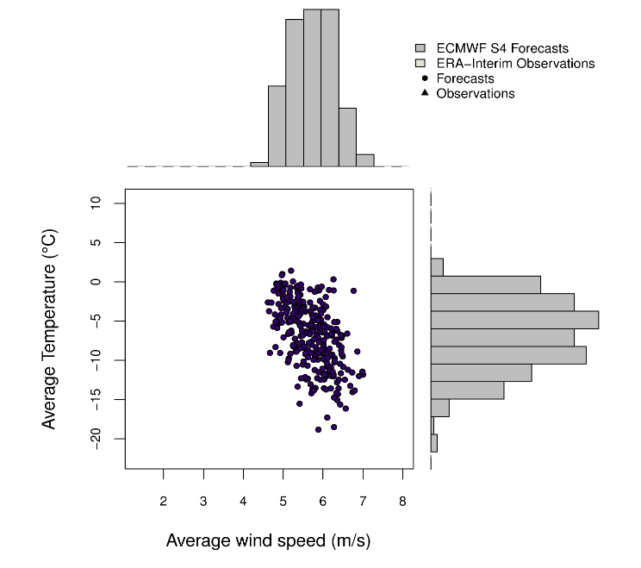
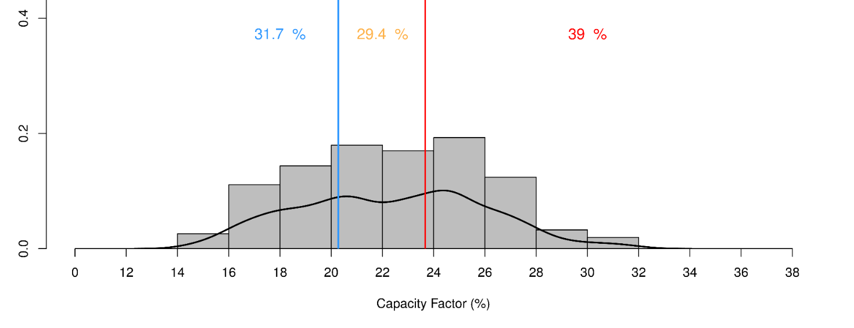
Introduction Methods Results Summary Future work
Multivariate regression
Central US
region
1
Past observations of CF.
December (1981-2011)
Forecasts of WS
and T. Simple bias correction.
December (2012)
2
Forecast of capacity factor for December 2012
13

Slide 14
Introduction Methods Results Summary Future work
14

Slide 15
Introduction Data Methods Results Summary Future work
Recent advances in climate predictions can provide a more informative view by modelling future wind.
Bias correction is fundamental for climate services, but comes at the cost of a reduction in forecast quality.
For end-users in the wind power industry transforming climate variables (wind speed and temperature) into capacity factor is essential.
Wind speed influence over the capacity factor is higher than temperature.

Slide 16
Introduction Data Methods Results Summary Future work
Assess climate predictions impacts on the wind energy sector at different time scales, from weeks to decades.
Evaluate different methods of post-processing forecasts to reduce the uncertainty and provide usable climate information.

Slide 17
Thank you!

Slide 18
Introduction Methods Results Summary Future work
Bias correction
Simple method
Calibration
Inflation method
$f_{corrected}=\left(f−f_{clim}\right)\frac{s_{ref}}{s_{clim}}+{ref}_{clim}$
$$f_{corrected}=αf_{em}+βf_{diff}$$
$$α=abs(ρ)\frac{s_{ref}}{s_{clim}}$$
$$β=\sqrt{1−(ρ^{2})}\frac{s_{ref}}{s_{e}}$$
$f$: forecast
$f_{clim}$ : climatology of the ensemble mean
$s_{ref}$ : standard deviation of the reference
$s_{clim}$ : standard deviation of the ensemble mean
${ref}_{clim}$ : climatology of the reference
$f_{em}$: ensemble mean of the forecast
$f_{diff}$ :difference of the ensemble member with the ensemble mean
$ρ$ : correlation between the ensemble mean and the reference
$s_{ref}$ : standard deviation of the reference
$s_{clim}$ : standard deviation of the ensemble mean $s_{e}$: standard deviation of the anomalies of all ensemble members calculated with respect to corresponding (i.e., same start date and lead time) the ensemble mean.
Both methods are applied in ‘One-year out cross-validated’ mode

Slide 19
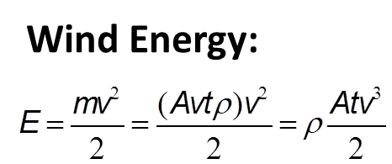
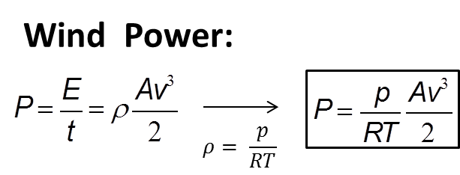
Introduction Methods Results Summary Future work
Estimation of observational Capacity Factor
p : surface pressure
R : ideal gas constant
T: temperature
v : wind speed
A : area of turbine perpendicular to wind direction
Ideal gas law
Capacity Factor
CF (%)$= \frac{P}{P_{turbine}}$
Power output curve from technical turbine specifications: Vestas 2.0 MW
Assumptions
$u$: wind speed at $z$ vertical height
$u_{r}$: wind speed at a reference height $z^{r}$
$α$ : empirically derived constant ($α=\frac{1}{7}$ for dry air over land at neutral stability conditions)

Slide 20
Introduction Methods Results Summary Future work
Impact Surfaces
What is an impact surface?
They are a tool to visualise an impact variable in a discretized ‘climate space’ (Dave MacLeod, Oxford University).
How can we get a prediction of the capacity factor from them?
Past observations of CF , WS and T are discretized and represented in an impact surface.
Predictions in the target period of WS and T are discretized and represented in an impact surface.
Each box of the two impact surfaces are combined to provide the capacity factor prediction.
1
2
3

Slide 21
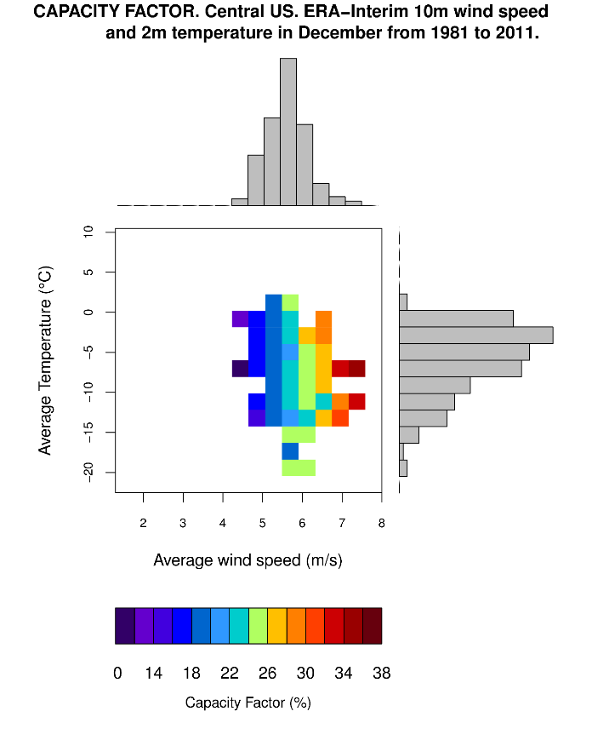
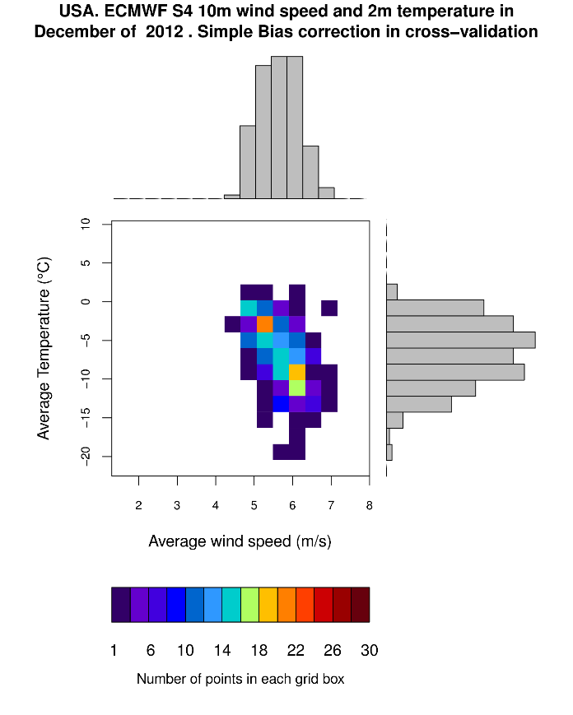
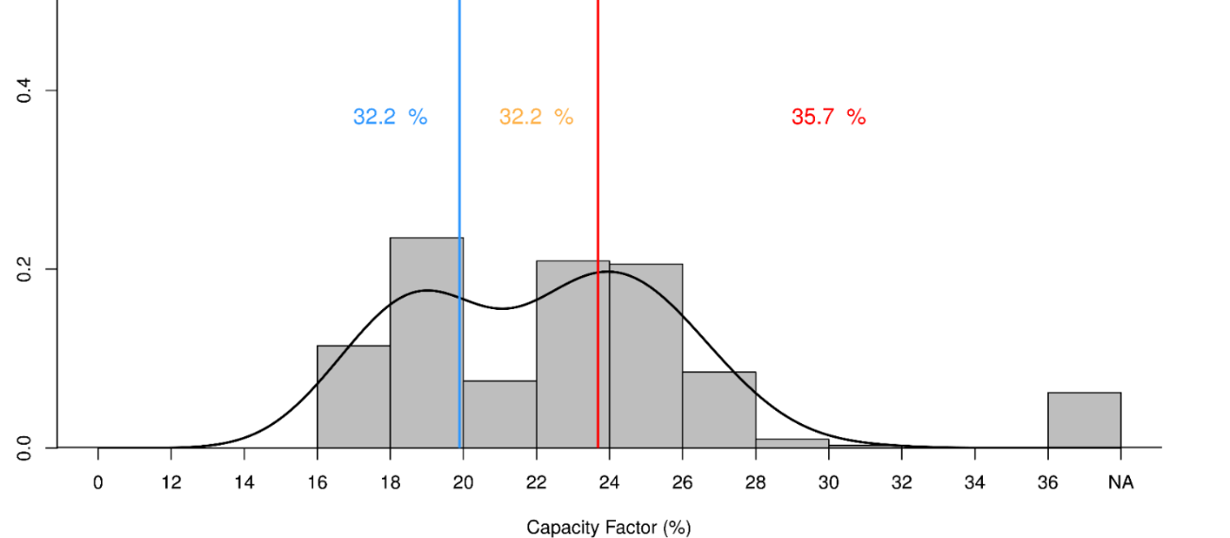
Introduction Methods Results Summary Future work
Impact Surfaces
Central US
region
1
2
Past observations of CF.
December (1981-2011)
Simple bias correction.
WS and T bias corrected forecasts.
December (2012)
3
Forecast of capacity factor for December 2012
N/A values !!!

