Slide 1
Chapel Hill, 28 September 2017
CALIOPE-urban:​ coupling​​ R-LINE​ with​ ​ CMAQ​ for​​ urban​ ​air​ quality​​ forecasts​​ over
Barcelona
Jaime Benavides in collaboration with Michelle Snyder
Supervisors: Albert Soret, Marc Guevara
and Oriol Jorba
Notes:
‹#›
‹#›

Slide 2
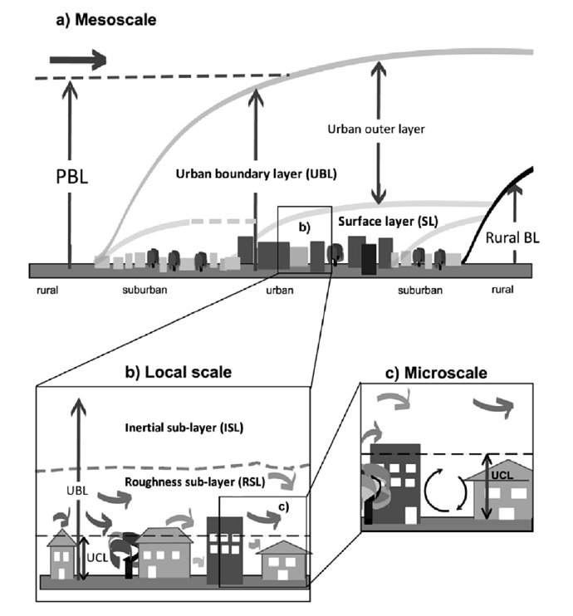
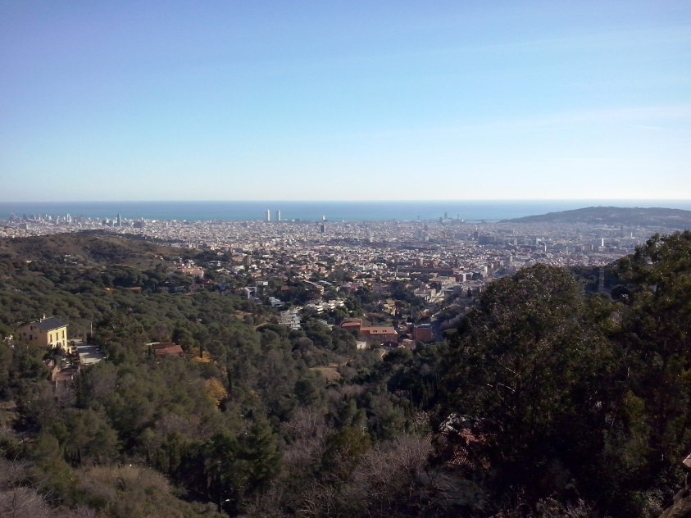
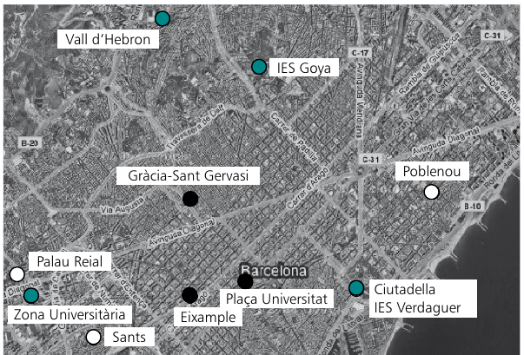
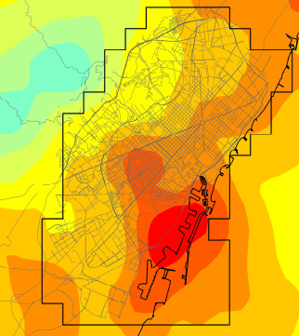
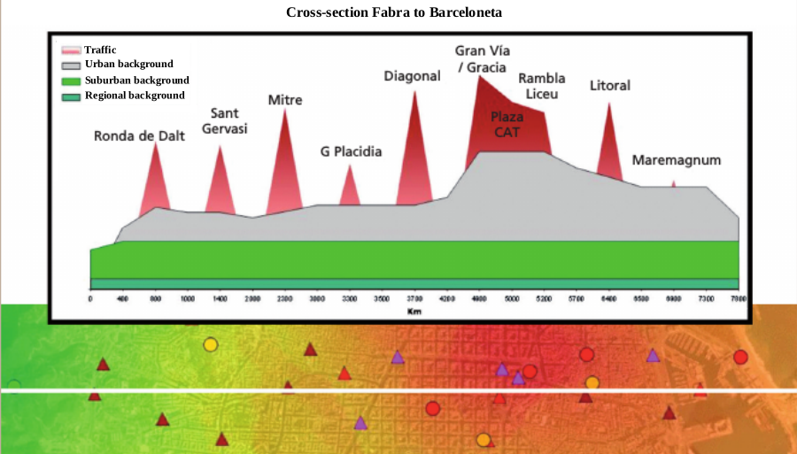
Introduction
Modelling street scale air quality
Abstraction
Level
Reality
Observation
Mesoscale level
Street level
Lateb et al. (2016)
Soret et al. (2014)
Querol et al. (2012)

Slide 3
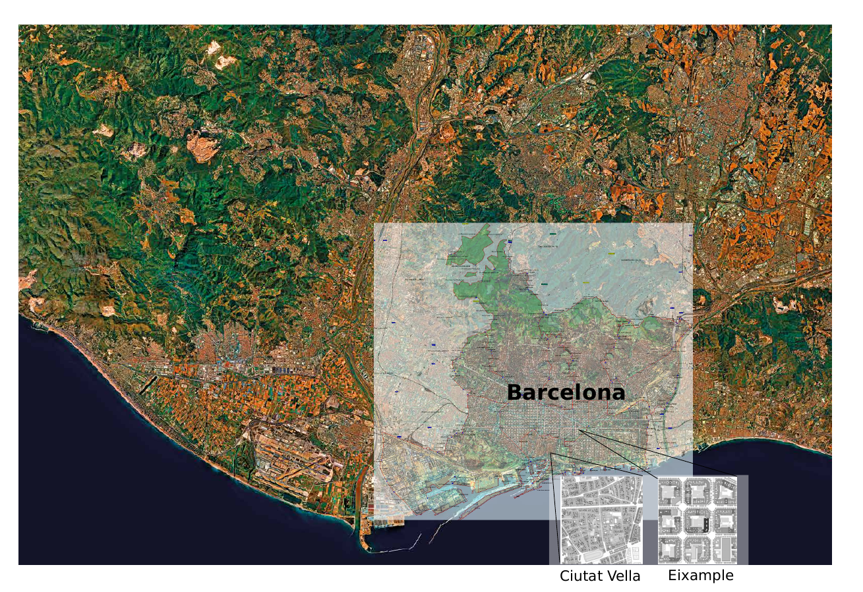
Introduction
Area of study: Barcelona
1.6 million inhabitants
6,100 passenger cars/km²
64% of passenger cars are diesel
Veh/day 2015 main roads: 817,417 (+1.7%, 15/14)

Slide 4
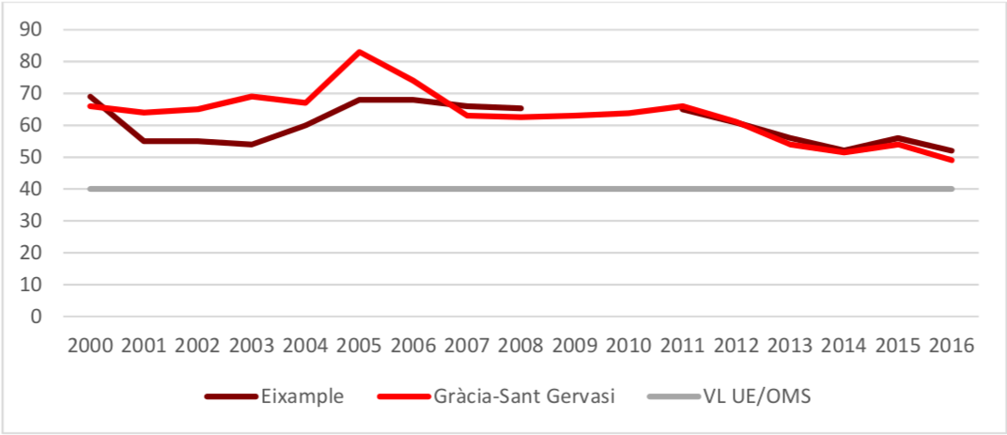
Introduction
NO2 levels in Barcelona (2000-2016)
NO2 annual mean variation at traffic stations in μg/m3
EU and WHO limit
Agència de Salut Pública de Barcelona (ASPB, 2017)

Slide 5
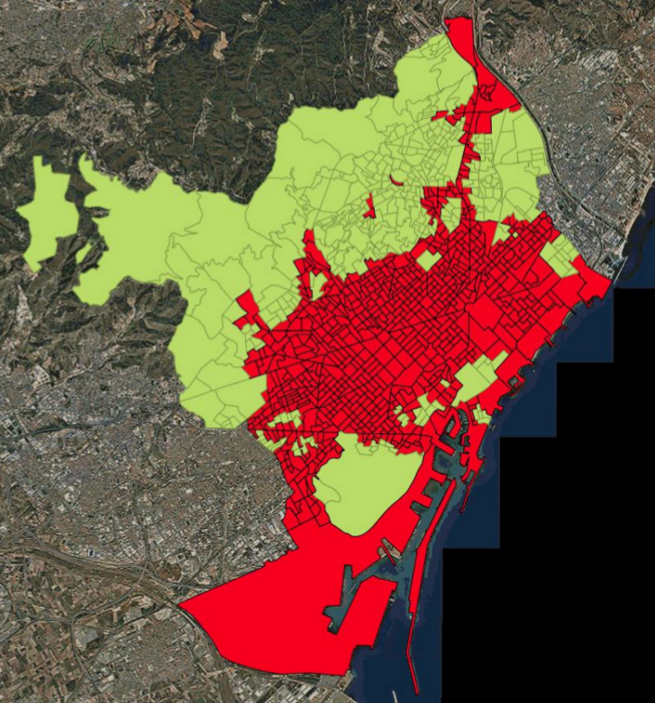
Introduction
Exposure to NO₂ levels in Barcelona in 2016
68% population exposed
to > 40 μg/m3
annual mean in 2016
ASPB (2017)
Street level predictions are needed to inform citizens

Slide 6
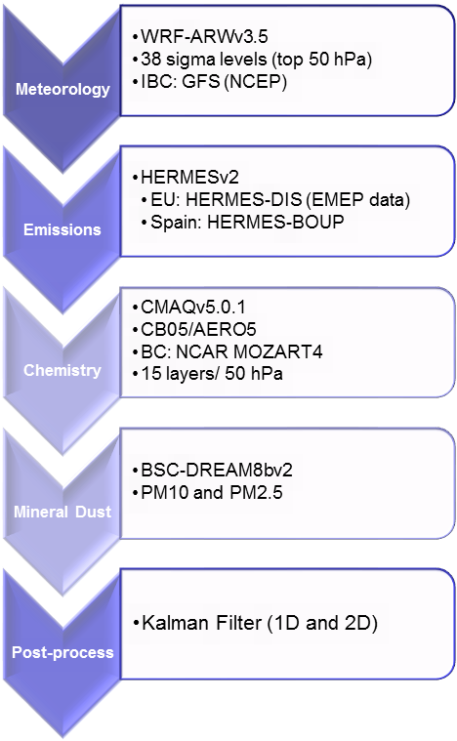
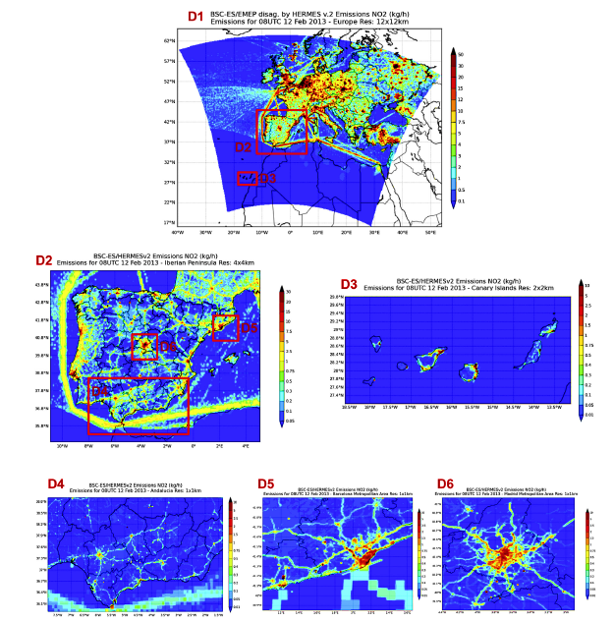
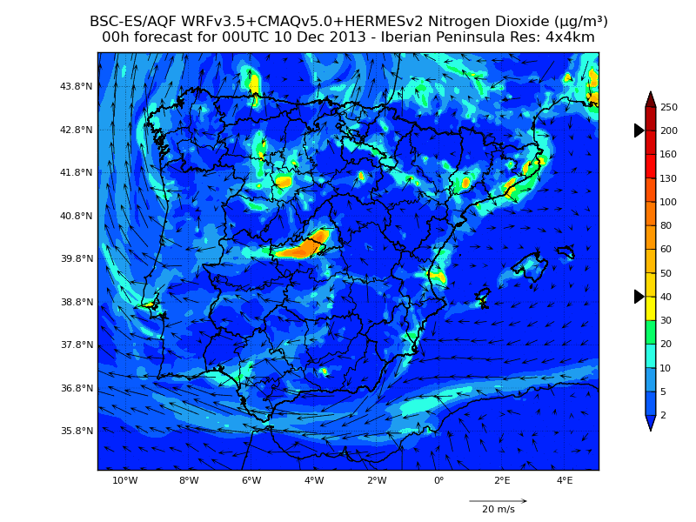
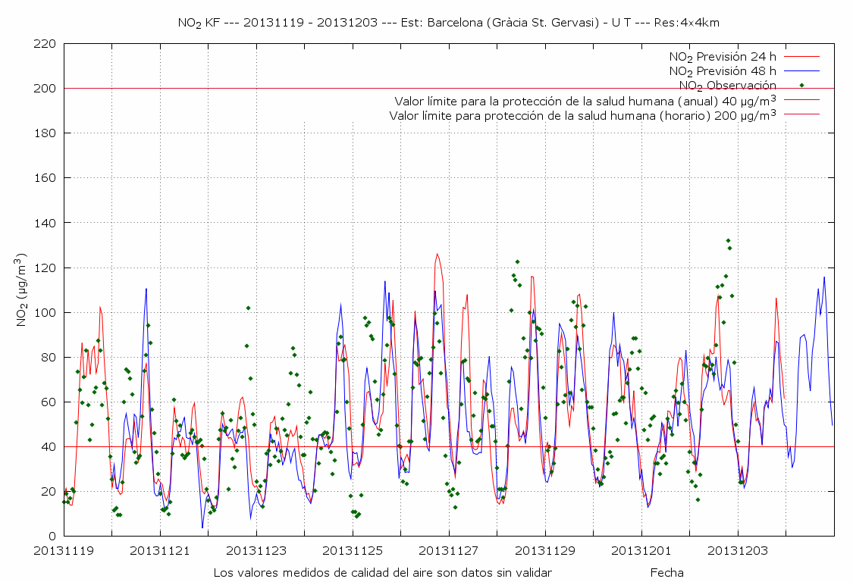
CALIOPE: Air Quality Forecasting System
12 km x 12 km
4 km x 4 km
1 km x 1 km
Pronosticos
‹#›

Slide 7
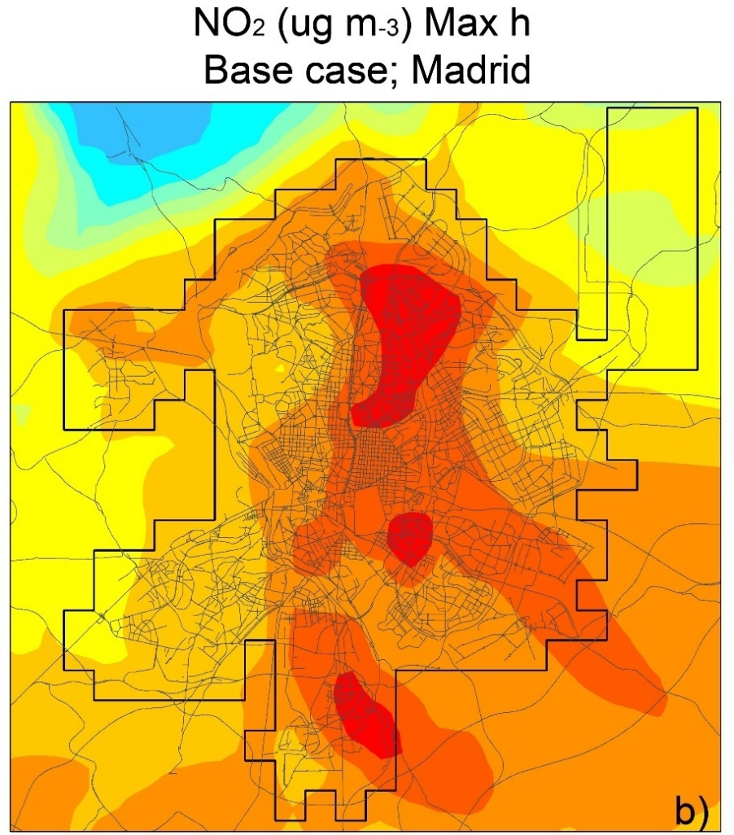
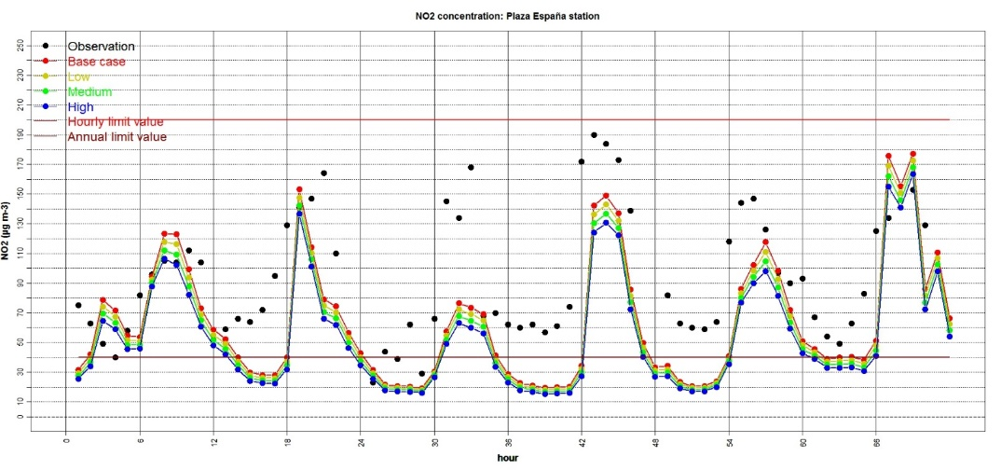
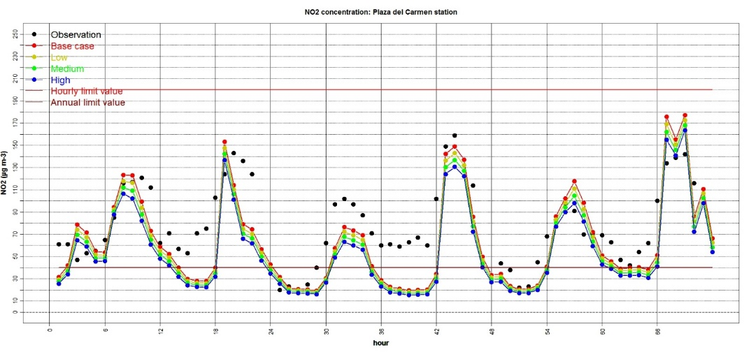
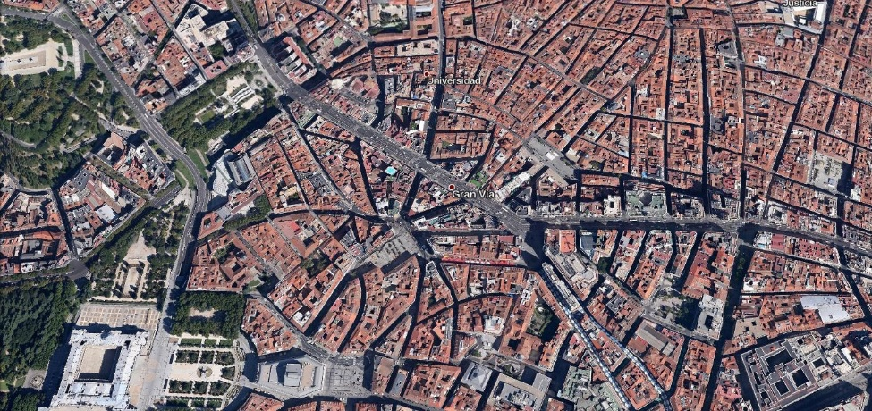
Introduction
Problem definition
NO₂ hourly concentration. Plaza de España station (traffic)
NO₂ hourly concentration. Plaza del Carmen station (background)
Soret et al. (2014)
Notes:
‹#›
‹#›

Slide 8
Introduction
Objective and research questions
Main objective:
To estimate NO2 concentrations at street level in Barcelona using a combination of CALIOPE-AQFS with a street scale air quality model.
Research questions:
1. What street scale model should be used to estimate NO2 concentrations at street level over Barcelona?
2. How should the street scale model be combined with CALIOPE-AQFS?
3. How accurate are output concentrations given by the developed system compared to CALIOPE-AQFS and monitoring station observations?

Slide 9
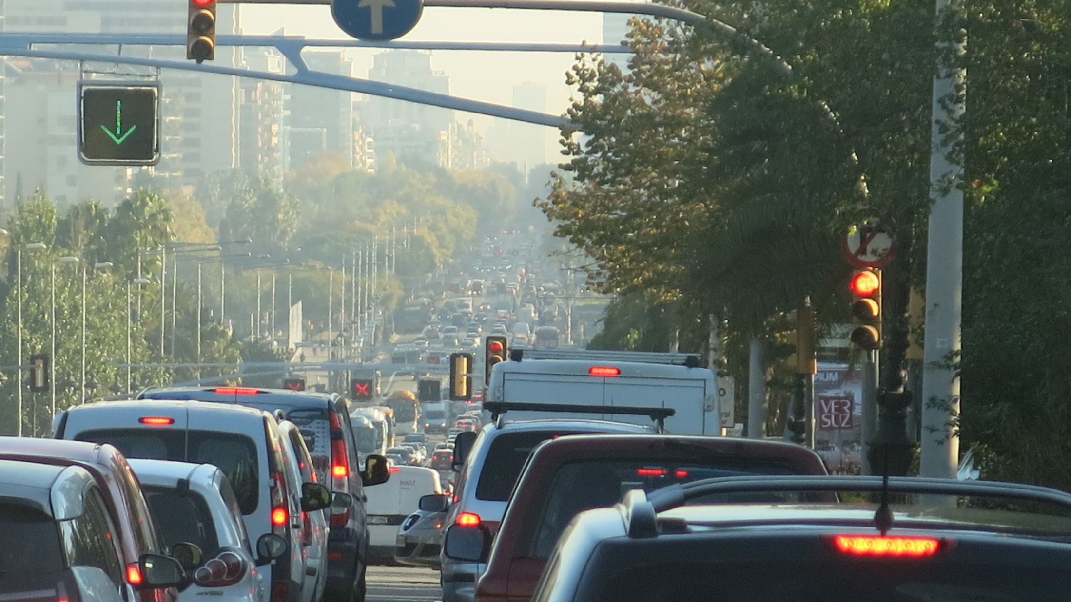
Methodologies
Source: Carlos Orti (2015)

Slide 10
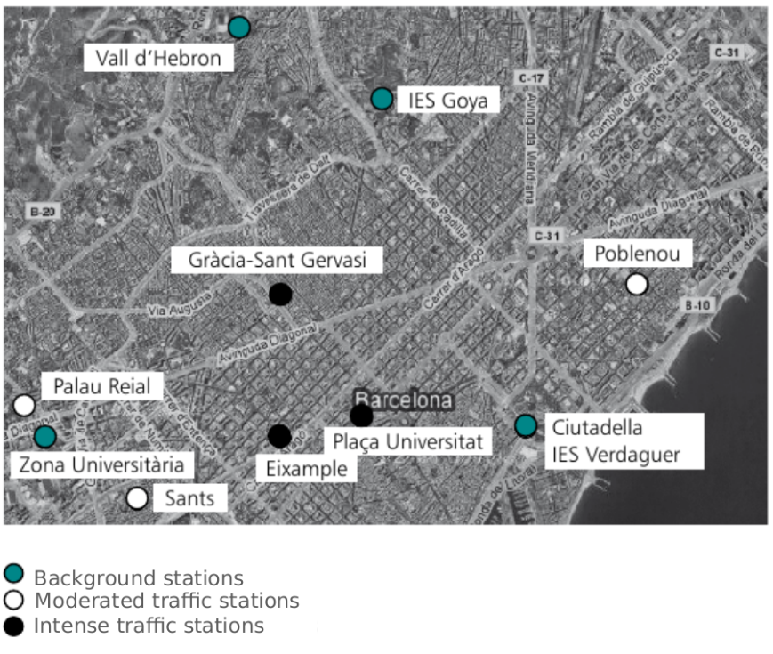
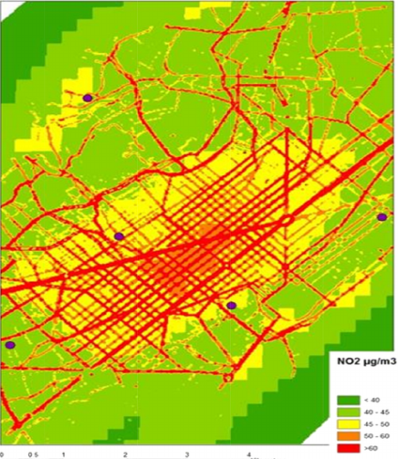
Methodologies
​ Scarce​ ​data​ ​for​ ​evaluation​ ​of​ ​the​ ​model
10 AQ monitoring stations available,
3 of them intense traffic stations
and only 3 meteorological stations
Exposure of general population and
occurrence of higher concentrations
Not well represented
Duyzer et al. (2015)
Observations from monitoring stations in Barcelona
Model performance evaluation statistics (Carslaw et al., 2013)
Fraction of predictions within a factor or two
Mean bias
Root mean squared error
Correlation coefficient
Coefficient of Efficiency
…
Notes:
‹#›
‹#›

Slide 11
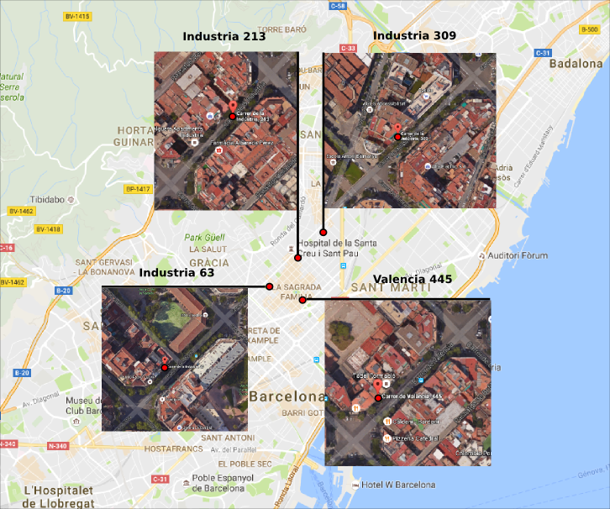
Methodologies
Experimental campaign in April 2013
Meteorological and air quality measures. Amato et al. (2014)
April 2013 presents a 7-day air pollution episode
Notes:
‹#›
‹#›
‹#›

Slide 12
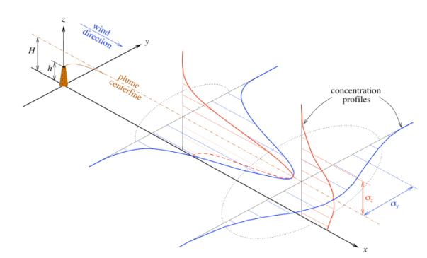
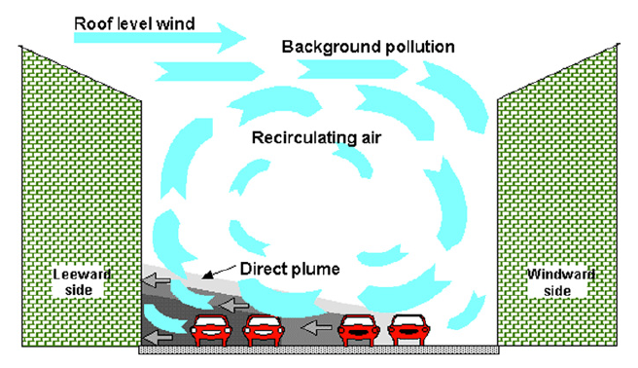
Methodologies
What street scale model?
R-LINE
(Snyder et al., 2013)
OSPM
(Berkowicz et al., 1997)
Gaussian plume
Street canyon
Line source dispersion
and chemistry
Building-induced turbulence
Access to source code
Applied to whole cities
Combined with
mesoscale AQMS

Slide 13
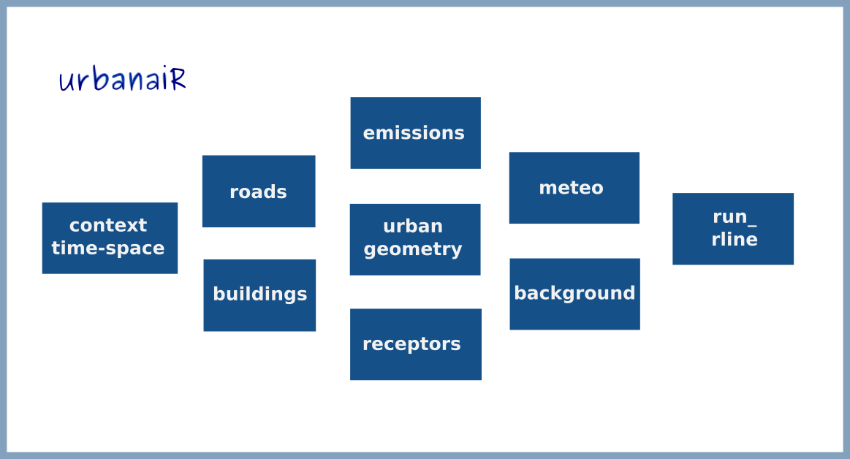
Methodologies
CALIOPE-Urban workflow​

Slide 14
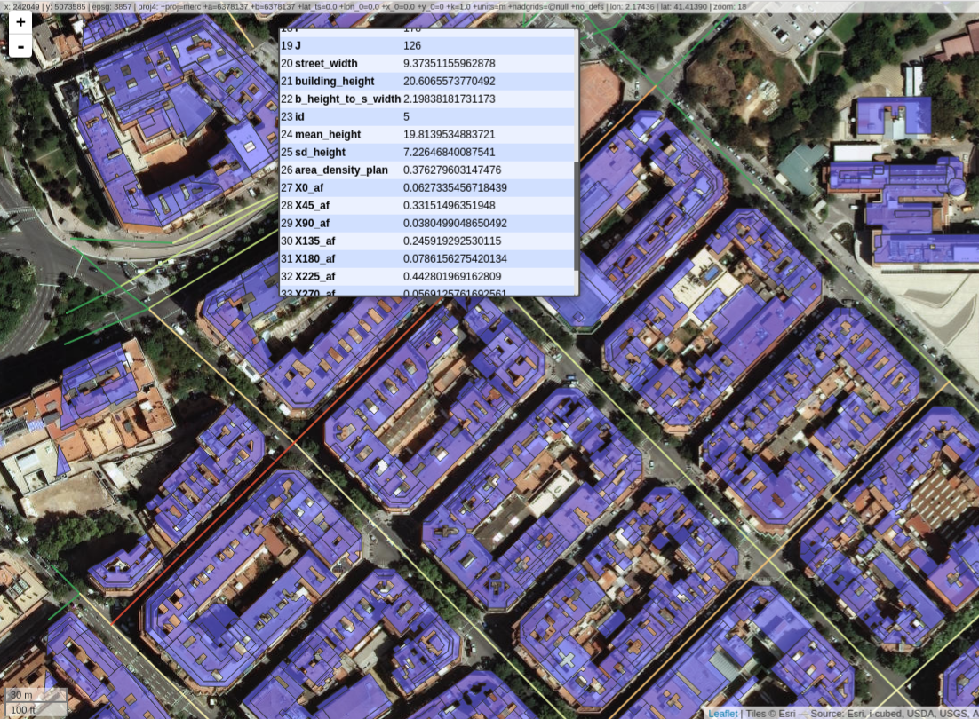
Methodologies
Urban geometry
Estimate building height to street width ratio, mean building height...

Slide 15
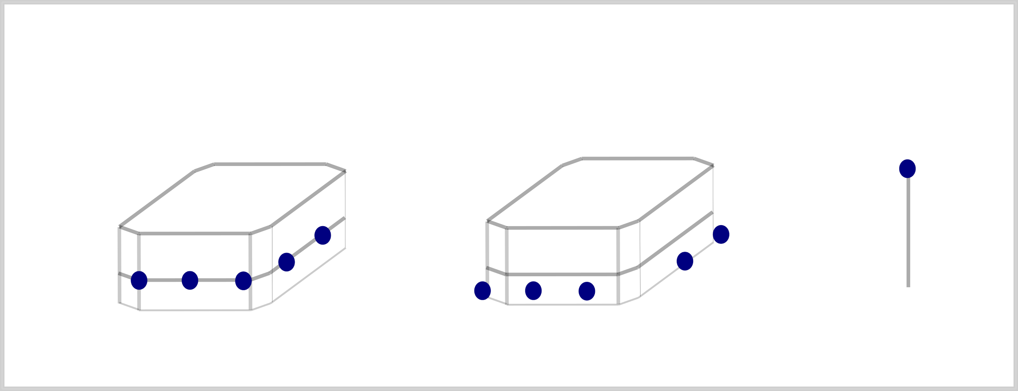
Methodologies
Receptors
3 options
Along building facades
any distance in between
At any distance from building
facades
Specific coordinates

Slide 16
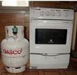
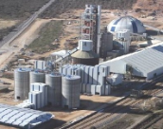
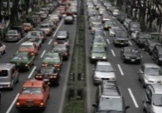
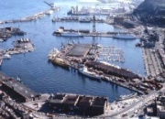
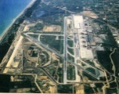
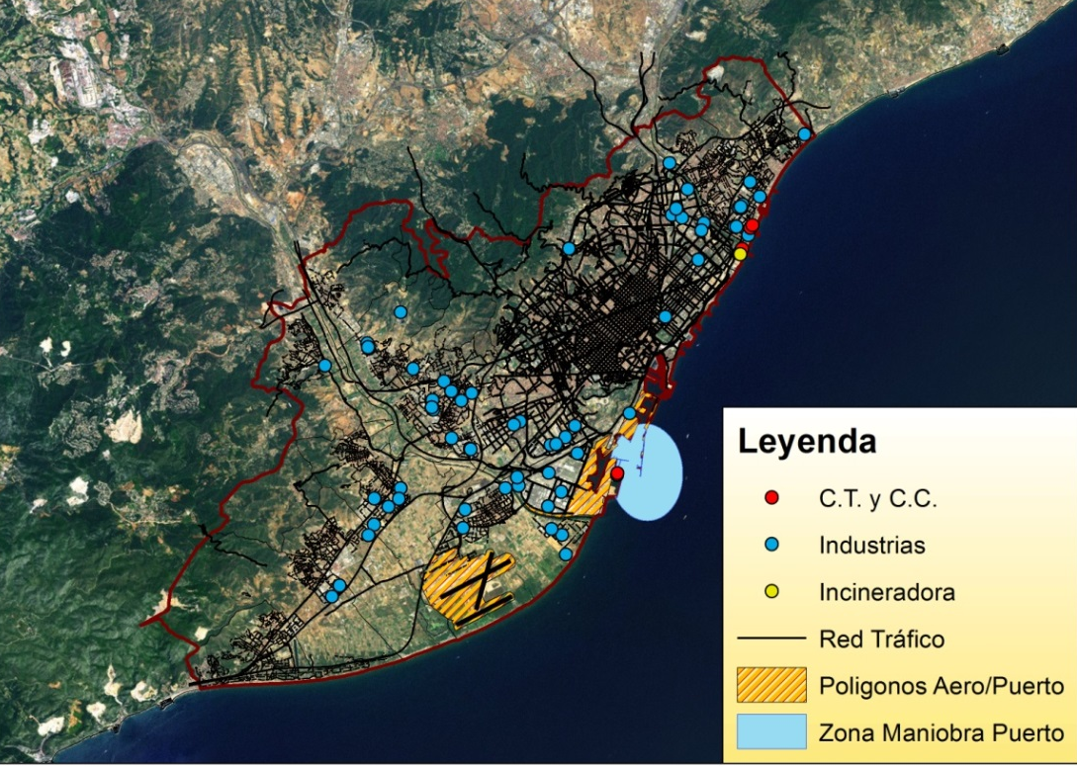
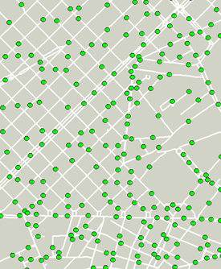
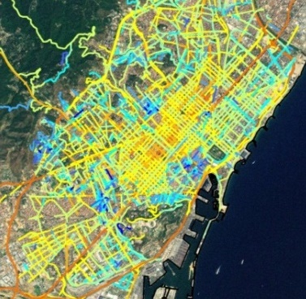
Methodologies
Emissions: HERMES model
Bottom-up emission model for Spain (resolution: 1x1 km² x1h)
Baldasano et al. (2008); Guevara et al. (2013)
Road transport, emission estimation:
COPERT → Exhaust emissions (hot&cold), evaporative emissions, tyre/break/road wear
Resuspension (Pay et al., 2010)
Updated for years 2011, 2012, 2013 and 2014
Energy plants (C.C. Besós and
Port de Barcelona)
Incineration RSU (Besós)
Industries
Port
Airport
Road transport

Slide 17
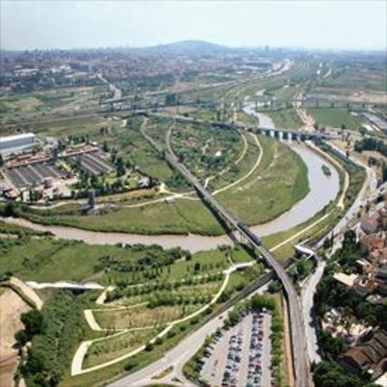
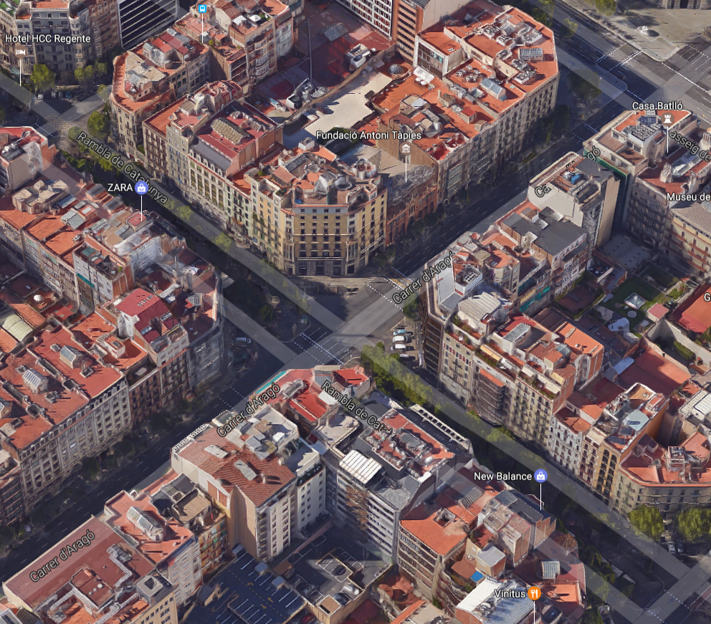
Methodologies
Meteorology: ​Adaptation of​ ​R-LINE​ ​to​ ​Barcelona​
R-LINE world view
open terrain, one meteorological input
Barcelona reality
complex terrain, each street specific meteorological patterns

Slide 18
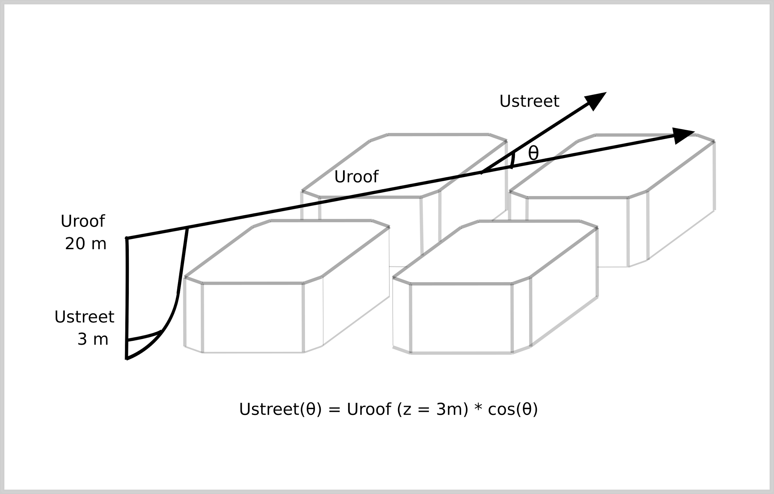
Methodologies
Meteorology: ​Adaptation of​ ​R-LINE​ ​to​ ​Barcelona​
Adapt WRF wind to street level using RLINE (Snyder et al. 2013) local meteorology extension for each street segment:
Estimates local meteorological parameters (z0 and dh) using street geometry
Re-calculates atmospheric stability parameters (ustar and Monin-Obukhov length)
Adjust meteorology to obtain wind conditions
Spatially averaged velocity over street is function of cos(θ). Soulhac et al. (2008)
Notes:
‹#›
‹#›
‹#›

Slide 19
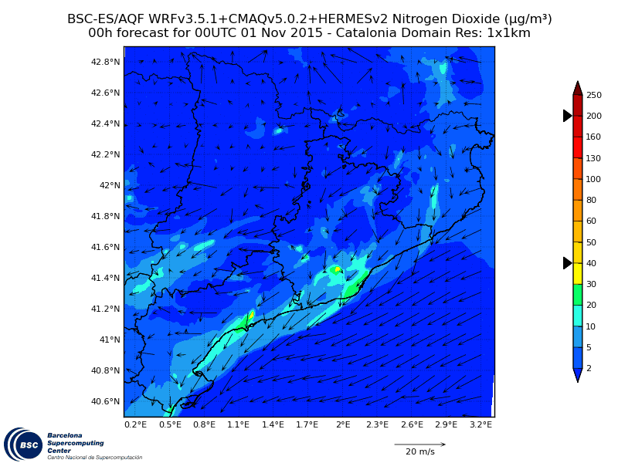
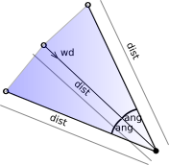
Methodologies
Background contributions: Triangle method
High spatial (1x1 km²) and
temporal resolution (1h)
over Barcelona
Select concentrations from CMAQ depending on the wind speed and direction provided by WRF.

Slide 20
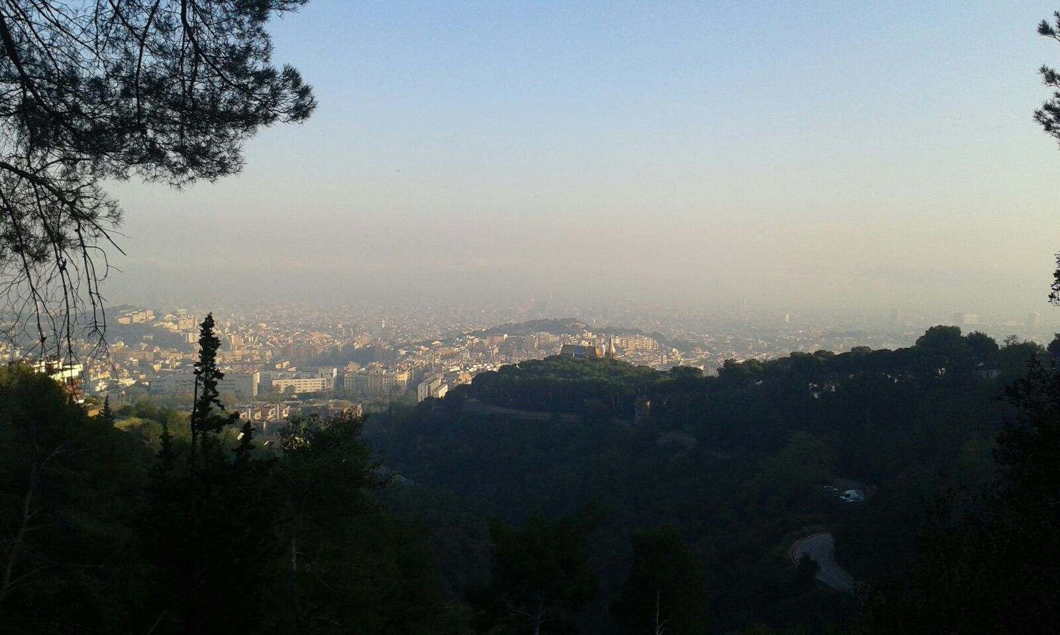
Results
Source: Carlos Orti (2015)

Slide 21
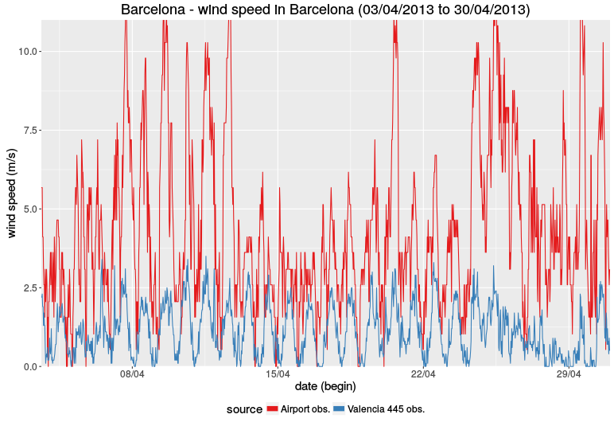
Results
Periods with different meteorological conditions
1-11
12-18
19-30
Notes:
‹#›
‹#›
‹#›

Slide 22
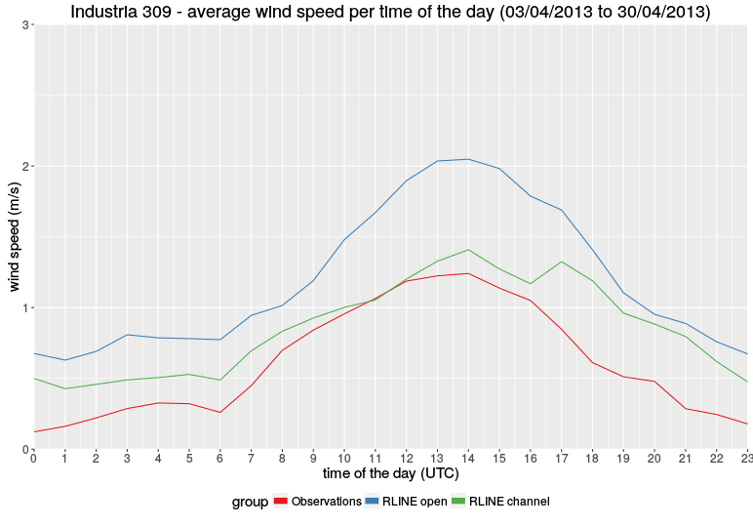
Results
Meteorology: Wind channelled vs open terrain
Notes:
‹#›
‹#›
‹#›

Slide 23
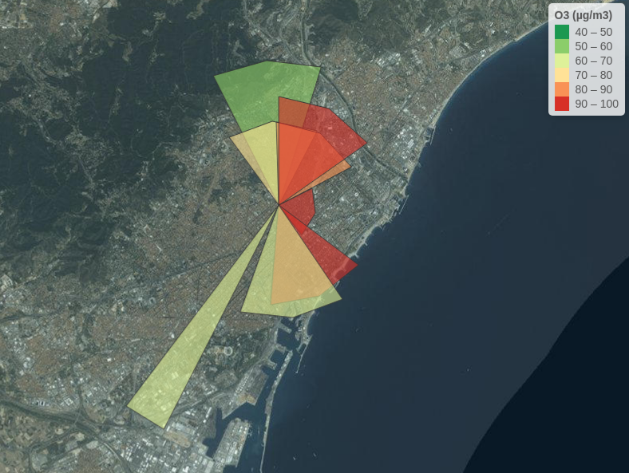
Methodologies
Background contributions: Triangle method

Slide 24
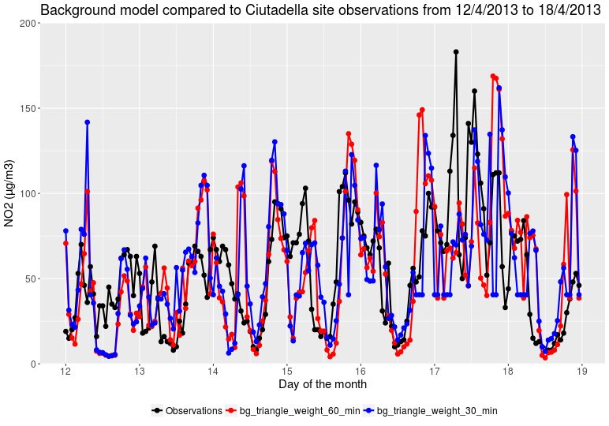
Results
NO₂ Background concentrations

Slide 25
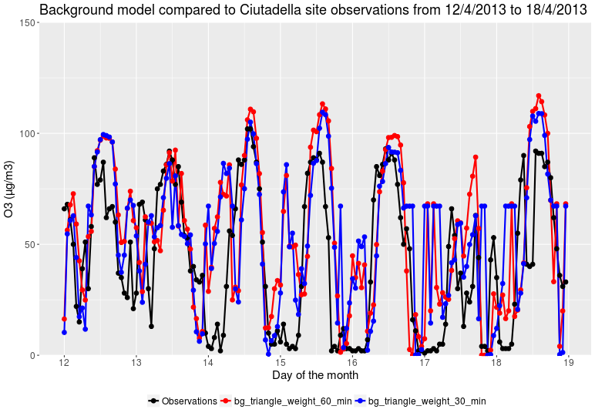
Results
O₃ Background concentrations

Slide 26
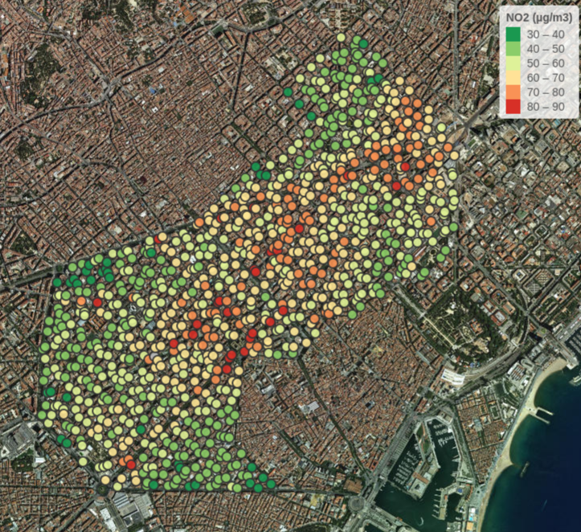
Results
CALIOPE-Urban over Eixample District

Slide 27
Results
CMAQ vs R-LINE NO₂ levels comparison
Period: April 2013
Industria road 213 site
R-LINE configuration:
local meteorology
triangle background
all emission sources
in context
executed over 1 km²
Industria road 309 site
Valencia road 445 site

Slide 28
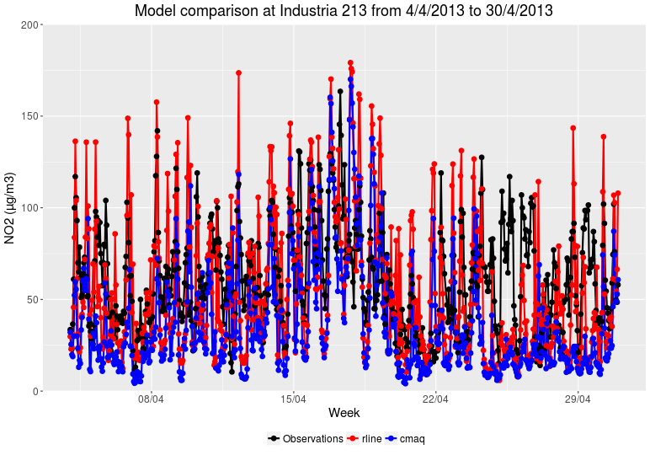
Results
CMAQ vs R-LINE NO₂ levels comparison

Slide 29
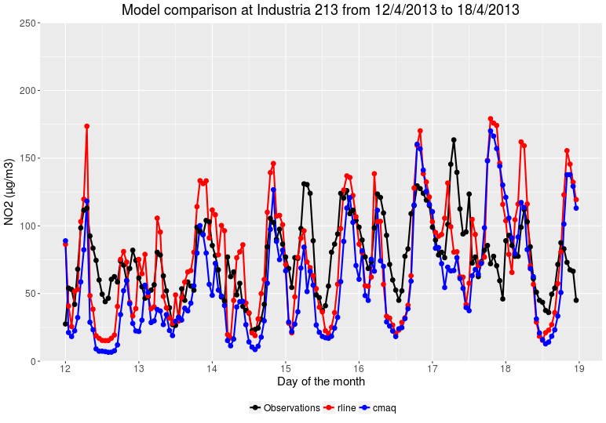
Results
CMAQ vs R-LINE NO₂ levels comparison

Slide 30
Conclusions
Meteorology
R-LINE extended to consider buildings when estimating street
meteorological parameters
Background concentrations
Triangle method developed to couple CMAQ with R-LINE:
Avoids double-counting emissions
Uses directly CMAQ outputs as input without re-executing CMAQ
CALIOPE-Urban
Reproduces well diurnal pattern
Morning and evening peaks well estimated in general but some days
concentration too high
Slightly improves CMAQ results in experimental campaign sites and
provides a more detailed spatial pattern
Notes:
‹#›
‹#›
‹#›

Slide 31
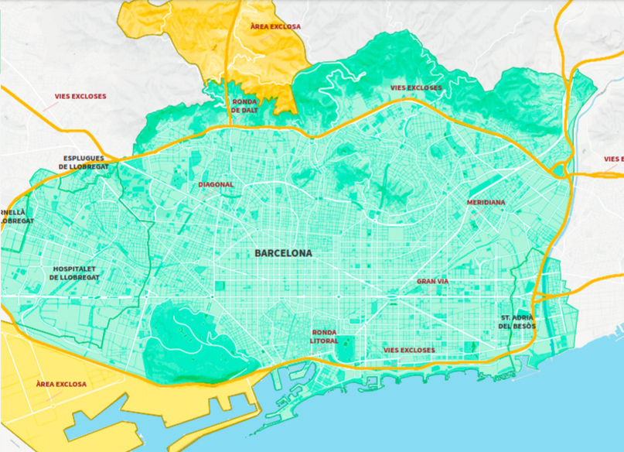
Future work
Application: Political measure evaluation
Barcelona City Government (2017)
Notes:
‹#›
‹#›

Slide 32
Thank you members of Institute for the Environment at UNC
for your
collaboration

