Slide 1
Copernicus Atmosphere – Regional Production BSC CAMS_50.II Kick-off meeting
Barcelona Supercomputing Center
The MONARCH model
Barcelona - November 14th, 2018

Slide 2
Agenda
Overview CAMS50 and CAMS European regional air quality ensemble
Brief update on the status of MONARCH
CAMS50 requirements:
Domain definition: compatibility with BDFC and CALIOPE domains
Initial and Boundary conditions: IFS forecast, CAMS chemistry
Emissions from CAMS81-regional (specific meeting Tuesday 20 November 10h - WG EMISSIONS)
Targeted pollutants: first year and at the end of the contract
Analysis and reanalysis of surface concentrations
MONARCH configuration:
Gas-phase Chemical mechanism: CB05 and extensions for DMS
Aerosol mechanism
Pollen mechanism
Evaluation of the model for 2015
Workplan 1st year
1st deliverable: demonstrate the fullfillment of CAMS50 requirements on domain, emissions and IC/BC conditions.
2nd deliverable: hindcast simulation of O3, NO2 and PM10

Slide 3
1. Overview CAMS50 and CAMS European regional air quality ensemble
http://www.regional.atmosphere.copernicus.eu

Slide 4
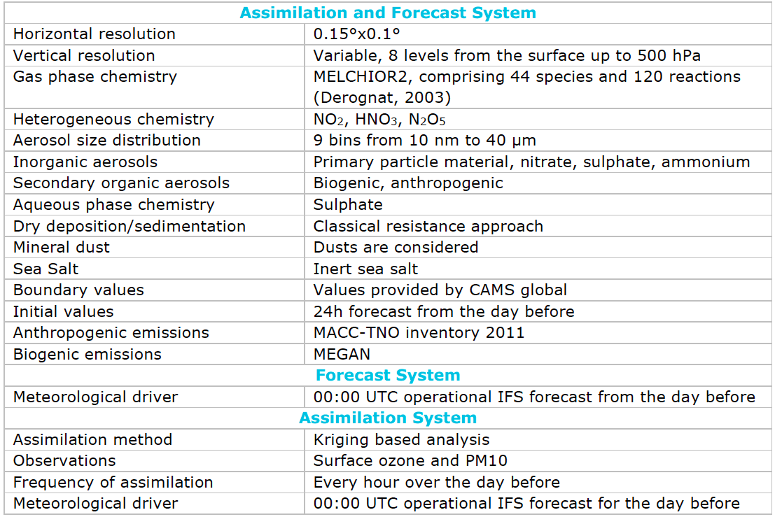
1. Overview CAMS50 and CAMS European regional air quality ensemble
CHIMERE

Slide 5
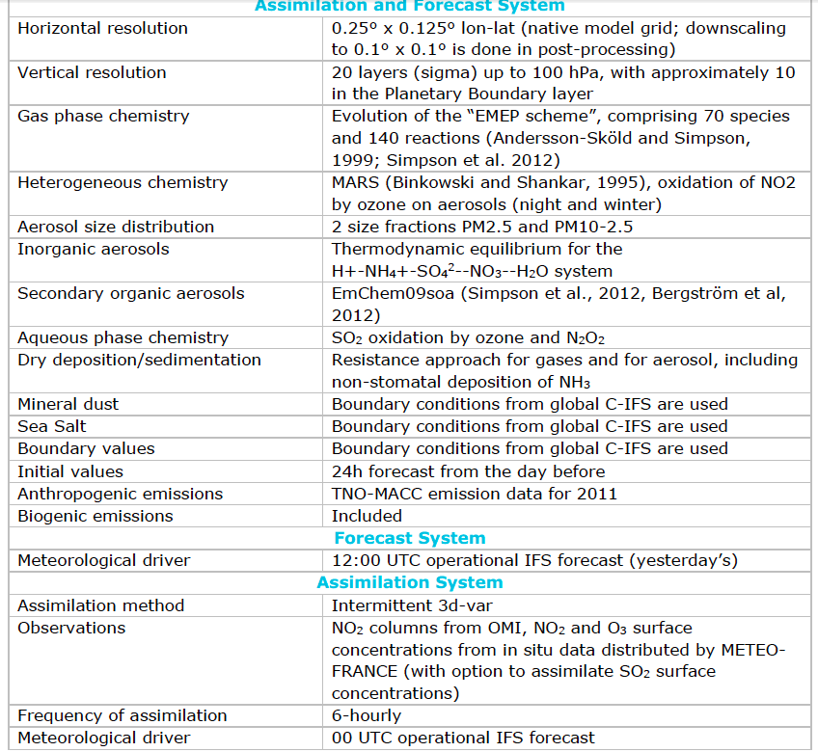
1. Overview CAMS50 and CAMS European regional air quality ensemble
EMEP

Slide 6
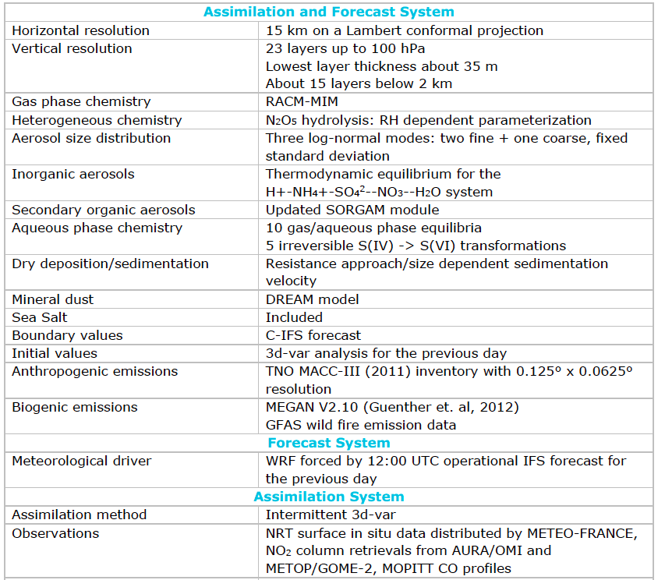
1. Overview CAMS50 and CAMS European regional air quality ensemble
EURAD-IM

Slide 7
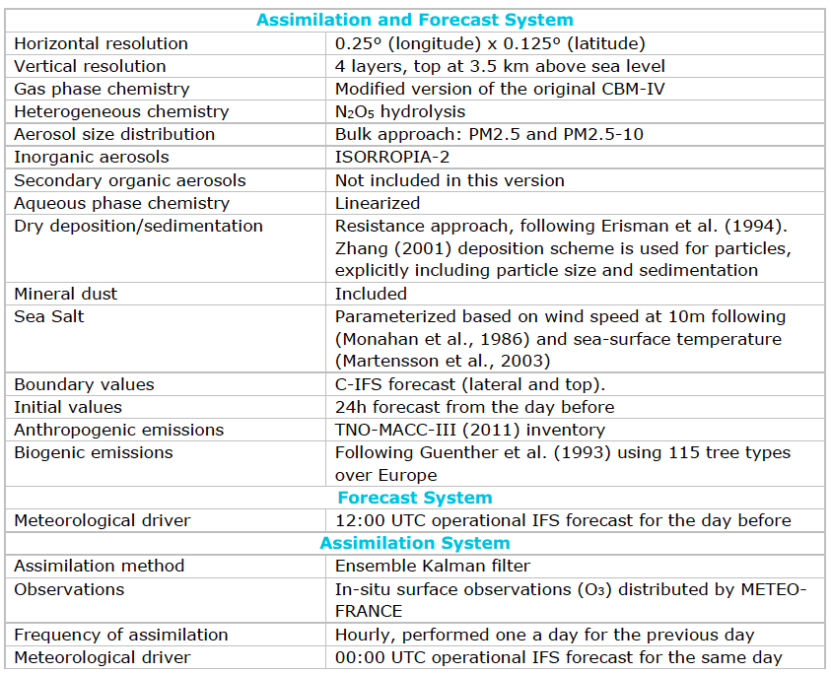
1. Overview CAMS50 and CAMS European regional air quality ensemble
LOTOS-EUROS

Slide 8
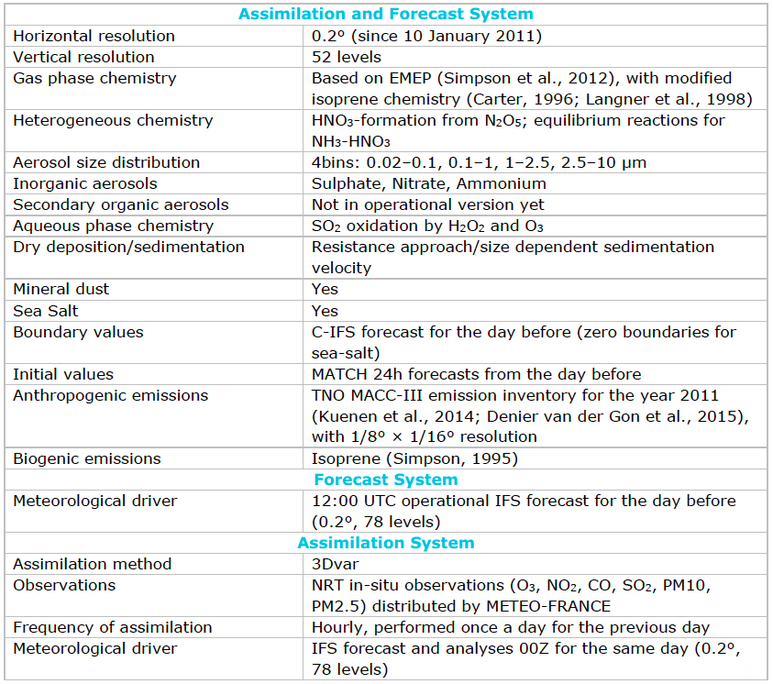
1. Overview CAMS50 and CAMS European regional air quality ensemble
MATCH

Slide 9
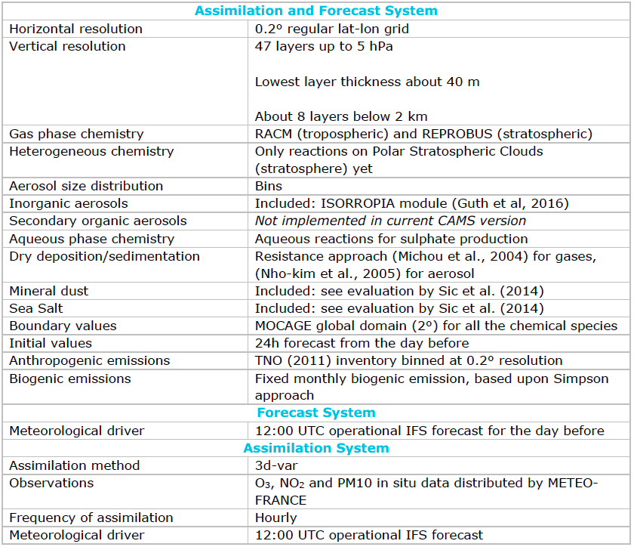
1. Overview CAMS50 and CAMS European regional air quality ensemble
MOCAGE

Slide 10
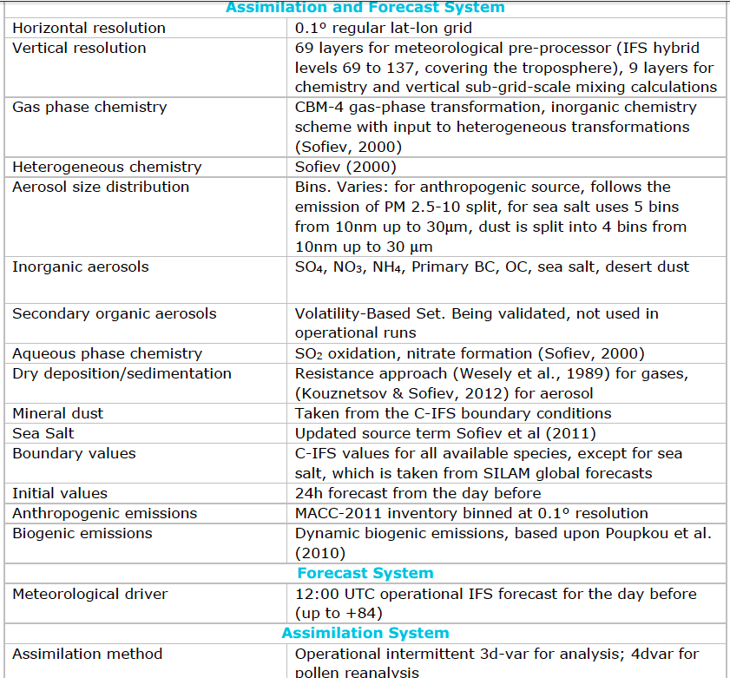
1. Overview CAMS50 and CAMS European regional air quality ensemble
SILAM

Slide 11
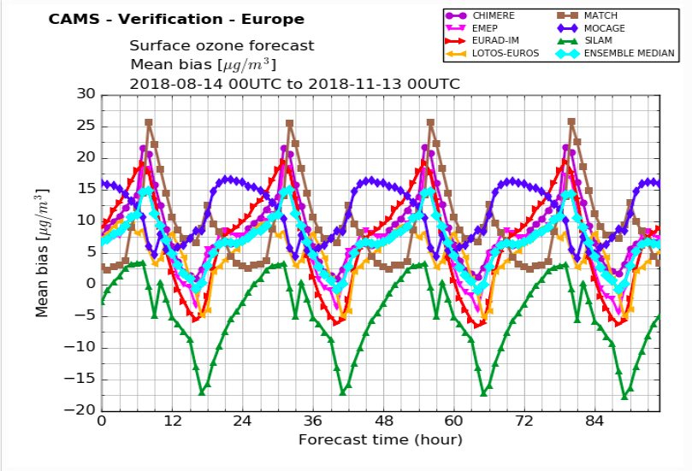
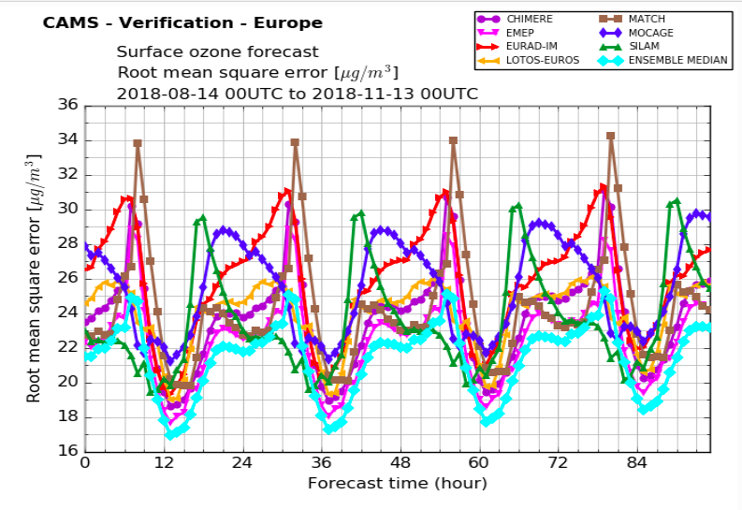
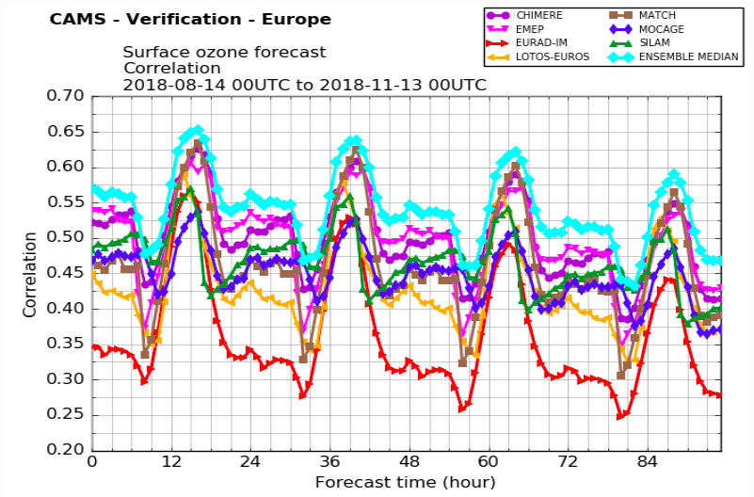
1. Overview CAMS50 and CAMS European regional air quality ensemble

Slide 12
2. Brief update on the status of MONARCH
Main characteristics of the forecast and assimilation systems.
MONARCH model setup for CAMS_50.II:
On-line model: meteorological driver NMMB
0.2º x 0.2º x 48 layers, domain covering Europe and Northern Africa
Chemistry: CB05 chemistry – primary aerosols (dust, sea salt, BC, POM, PSO4, PNO3, PNH4) - EQSAM secondary inorganic aerosols – SOA Two product scheme – no pollens.
Assimilation system: not operational, LETKF - AOD and LIDAR.
Post-processing: Kalman Filter in measurement stations and data fusion 2D Kriging.
Emissions: in-house HERMESv3 emission model and MEGANv2.1 biogenic on-line emission model.

Slide 13
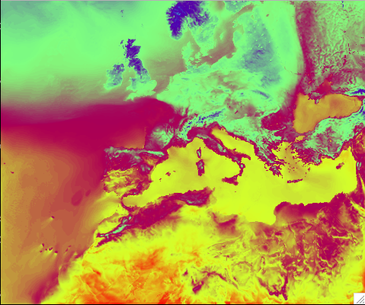
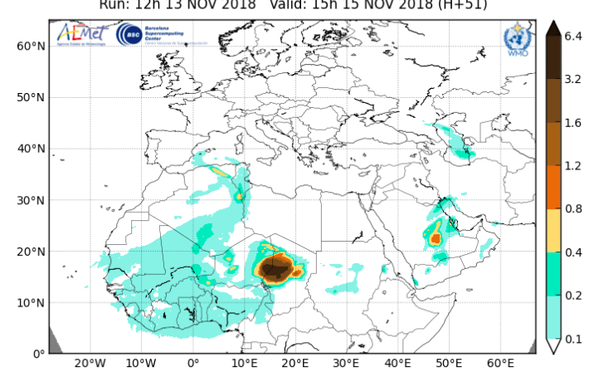
3. CAMS requirements: Domain definition
• The domain covered must be at least (25°W-45°E, 30°N-72°N)
CALIOPE
BDFC

Slide 14
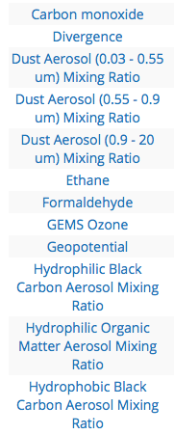
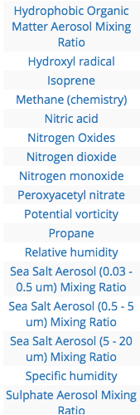
3. CAMS requirements: Initial and boundary conditions
IFS forecast: 16km x 16km – 137 sigma levels or n pressure levels
Main limitation is the downloading time from MARS
CAMS chemistry: 40km x 40km – 60 sigma levels or 17 pressure levels
CB05 + aerosols

Slide 15
3. CAMS requirements: Emissions
Emissions from CAMS81-regional + GFAS (hourly or daily??)
Specific meeting Tuesday 20 November 10h – (WG EMISSIONS)

Slide 16
3. CAMS requirements: Targeted pollutants
Targeted pollutants:
First year: O3, NO2, NO, PM10, PM2.5, SO2, CO, NH3, PANs, NMVOC.
End of the contract:
Idem
total mineral dust, total biomass burning, PM10 fraction of anthropogenic combustion primary production, PM2.5 fraction of anthropogenic combustion primary production, PM2.5 fraction of secondary organic production.
Birch, olive, grass and ragweed pollens
On eight vertical levels (surface, 50m, 250m, 500m, 1000m, 2000m, 3000m, and 5000m above ground)

Slide 17
3. CAMS requirements: Analysis and reanalysis
Analysis and reanalysis of surface concentrations
Not clear if we have to provide analysis and reanalysis at the end of the third year.
Observations from EIONET NRT for analysis and 20 day delay for EIONAT QA for reanalysis
Models use different methodologies: data assimilation 3DVAR, EnKF, Optimal Interpolation, Data fusion.

Slide 18
4. MONARCH configuration: Gas phase
Gas-phase Chemical mechanism:
Current version cb05ae5 from CMAQ5.0.2
Review updates of CB05 + extended chemistry of Cl
Add extension for DMS
Heterogeneous hydrolisis of N2O5:
Strongly controls formation of night HNO3 and NO₃⁻ mass
Implemented Riemer et al. 2003
Review Chang et al. 2016

Slide 19
4. MONARCH configuration: Aerosol mechanism
Dust: 8 bins
Sea salt: 8 bins – reduce to 5?
Black Carbon: hydrophobic/hydrophilic
Organic Matter:
Primary hydrophobic/hydrophilic
SOA scheme: simple non-volatile approach
Inorganic Matter:
Primary SO₄⁻⁻ (from anthro. and sea spray), Primary NO₃⁻, Primary NH₄⁺
Secondary from EQSAM
Coarse SO₄⁻⁻ and NO₃⁻ on dust and sea salt

Slide 20
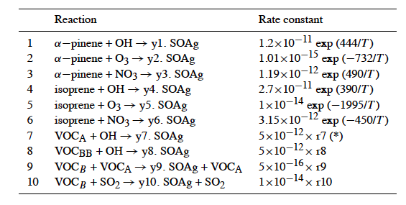
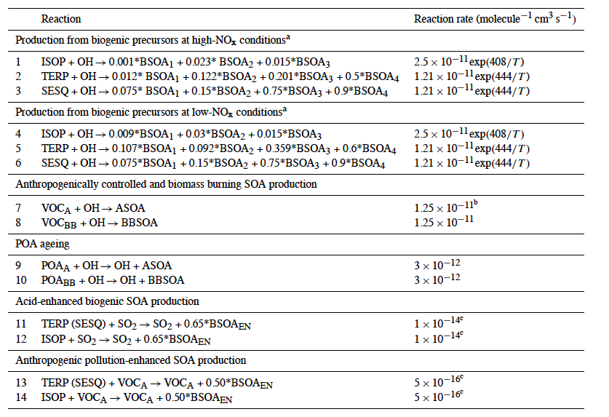
4. MONARCH configuration: SOA simple mechanism
Spracklen et al. 2011
Hodzic and Jimenez 2011
Murphy et al. 2017: CMAQ parameterized combustion SOA

Slide 21
4. MONARCH configuration: SOA simple mechanism
Geos-Chem 2017 simple scheme:
Two SOA-related tracers: SOAP (SOA precursor) and SOAS ("simple" SOA in the particle phase). The emission of SOAP is tied directly to emissions of monoterpenes, isoprene, biomass burning CO, biofuel CO, and fossil fuel CO in HEMCO, and SOAP forms SOAS on a fixed timescale of 1 day. 50% of monoterpene and isoprene SOA is emitted directly as SOAS to reduce the average formation time for this SOA.
The default yields specified in the emissions:
Monoterpenes: 5% mass yield SOAP, 5% mass yield SOAS
Isoprene: 1.5% mass yield SOAP, 1.5% mass yield SOAS
Biomass burning and biofuel: 0.013 g SOAP/(g CO emitted). As implemented in GEOS-Chem by Kim et al., 2015, based on field results from Cubison et al., 2011. Shrivastava et al., 2017 have reviewed many additional field datasets and confirmed the relatively low SOA production potential.
Fossil fuel: 0.069 g SOAP/(g CO emitted). As implemented in GEOS-Chem by Kim et al., 2015, based on results from Hayes et al. 2015, and the method proposed by Hodzic and Jimenez, 2011.

Slide 22
4. MONARCH configuration: Pollen mechanism
Emission schemes from Sofiev et al. 2015, 2017
Vegetation maps
Meteorology driven emission (wind, temperature, moisture, precipitation)
Bulk inert tracers
Water uptake:
Increase density no hygroscopic growth

Slide 23
4. MONARCH configuration: Evaluation 2015
Report EIONET
Report EBAS

Slide 24
5. Workplan 1st year
1st deliverable M6: demonstrate the fulfilment of CAMS50 requirements on domain, emissions and IC/BC conditions.
2nd deliverable M16: hindcast simulation of O3, NO2 and PM10
 | oct-18 | nov-18 | dic-18 | ene-19 | feb-19 | mar-19 | abr-19 | may-19 | jun-19 | jul-19 | ago-19 | sept-19
Domain definition at 0.1º and 0.2º
Implement SOA simple
Add sea spary sulfate emission
Heterogeneous coarse sulfate and nitrate
Simulation 2016 using GFS+HERMESv3_TNOIII at 0.1º and 0.2º
Adapt Preprocess for IFS forecast
Adapt Preprocess for CAMS aerosols
Update HERMESv3 with CAMS81_reg
Download IFS-fcst, CAMS, GFAS
Demonstration fulfillment CAMS50 |  |  |  |  |  | M1
Sensitivity hydrolisis, SOA simple, het. Coarse sul. Nitrate
Hindcast run |  |  |  |  |  |  |  |  |  |  |  | M2

