Slide 1
Near-Term Climate
Predictability and Prediction
IPCC AR6 Scoping Meeting – WGI Scene Setting
F.J. Doblas-Reyes (BSC), June-Yi Lee (ICCP)
with contributions from WGSIP, DCPP, DCVP, GC-NTCP, A. Weisheimer, E. Hawkins, J. Kinter III, B. Kirtman, N. Dunstone, M. Ménégoz, L.-P. Caron

Slide 2
Introduction
Variability, predictability and prediction are closely linked
Systems aim at predicting the relevant variability up to the level that predictability estimates suggest is possible
Predictability is non-observable and changes across time scales, variables and regions
From a policy-relevant perspective predictions count for the formulation of statements about climate variations for the next 30 years; it involves merging predictions and projections
Climate predictions allow to both phase in the internal variability and correct the forced model response
Close links exist with climate services (GFCS) as many stakeholders make decisions on interannual to interdecadal time scales -> WGII
Predictability and prediction rely on scientific coordination from WCRP’s CLIVAR, WGSIP, DCPP, GC-NTCP, as well as increasingly from WMO’s CBS

Slide 3
Subseasonal to seasonal forecasts (2 weeks-18 months)
Decadal forecasts (18 months-30 years)
Climate-change projections
Weather forecasts
Time
Initial-value driven
Boundary-condition driven
Climate Prediction
Multi-seasonal, annual, multi-annual, up to decades
Initialized forecasts of both forced and internally generated components of variability

Slide 4
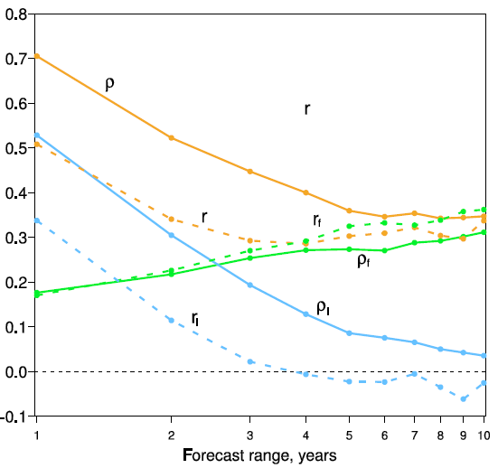
Lessons from AR5
Near-term climate information in Chapter 11
Skill in near-term climate information, while initialisation increases the skill mainly in the North Atlantic for a range of variables up to 10 years; annual, multi-annual skill for temperature, not so much for precipitation; large regional variations
The disconnect between predictability estimates (e.g. signal-to noise ratio measured by individual models) and skill was left open
Pervasive forecast drift presence, of which no use was made
Actual skill (dashed, correlation between model ensemble mean and observations)
Predictability estimate (solid, correlation between ensemble mean and ensemble members)
Orange for total, blue for initial condition and green for forced
Boer et al. (2013)

Slide 5
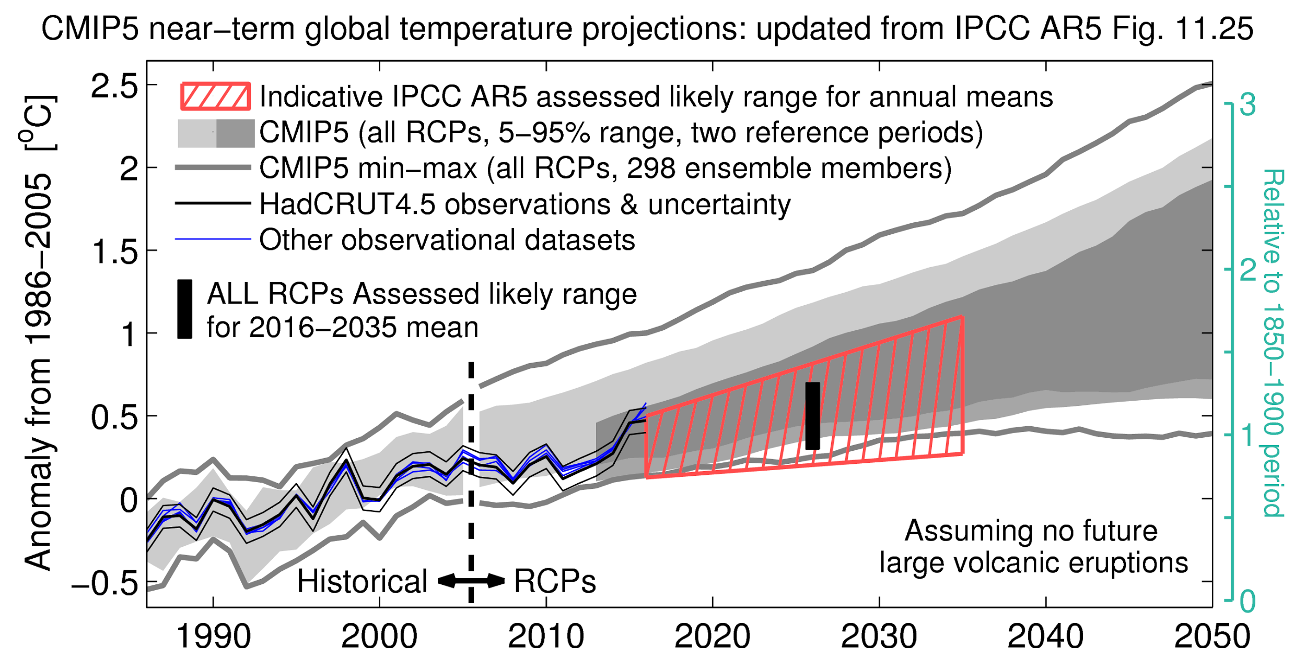
Lessons from AR5
Merging prediction/projection information (up to 2035) a challenge
The hiatus was predicted by the forecast systems and ingested by the consensus assessment
Need of data assimilation to optimise the use of the scarce data available, particularly for the pre-satellite and pre-ARGO eras
Predictions need long sequence of historical forecasts with many start dates
drift adjustment
forecast quality assessment
observational uncertainty is key
Top: Updated version of IPCC AR5 WGI Figure 11.25b with HadCRUT4.5 global-mean temperature).
Bottom: Figure 11.25a from IPCC AR5 WGI.
E. Hawkins

Slide 6
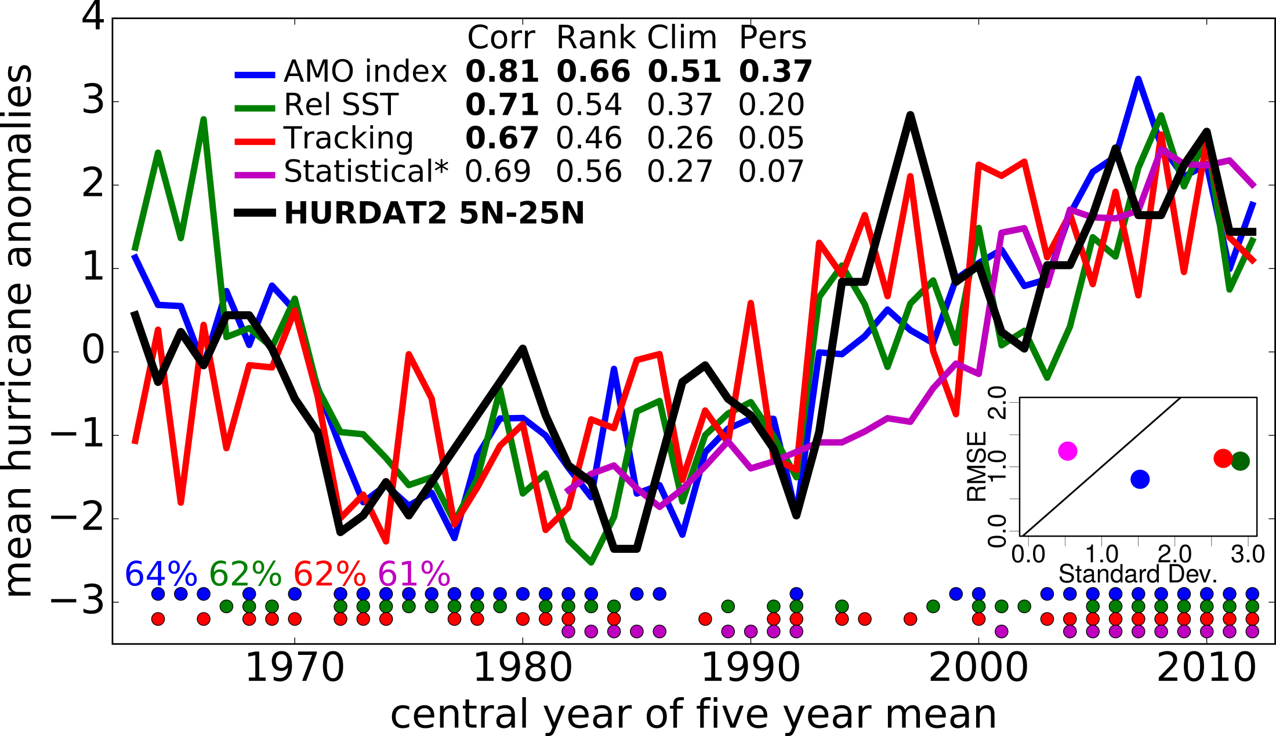
What’s new since AR5
DCPP provides, among other things, multi-model archive of hindcasts updated annually; “de facto” transpose-CMIP
Large ensembles and millenium simulations available
Drift and bias in decadal variability degrades the information
Forecast extension >10 years, still large ensembles needed
Use of climate predictions to assess risks of unobserved events in current climate (multi-breadbasket collapse)
Little attention from CORDEX
Increasing number of users (North Atlantic tropical cyclones, year 1-5 forecasts)
Caron et al. (2017)

Slide 7
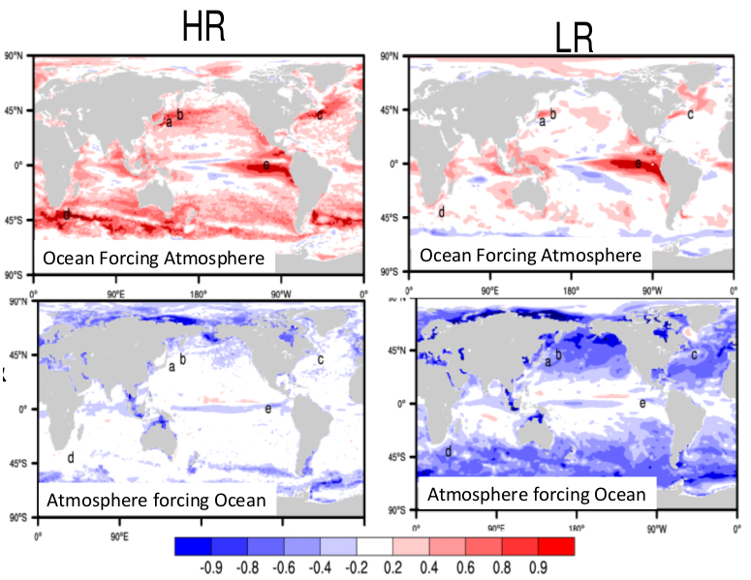
What’s new since AR5
Improved understanding of recent extreme events (during data-rich period) increases confidence in statements
Very useful empirical forecast systems
Predictability possibly being larger than current estimates as skill may be larger than predictability suggests; still a controversial idea
Higher resolution systems (e.g. eddy permitting) and larger HPC resources now available
Lagged correlation SST-heat flux in CAMS4, high (0.1º) and standard (1º) ocean resolution
B. Kirtman (2017)

Slide 8
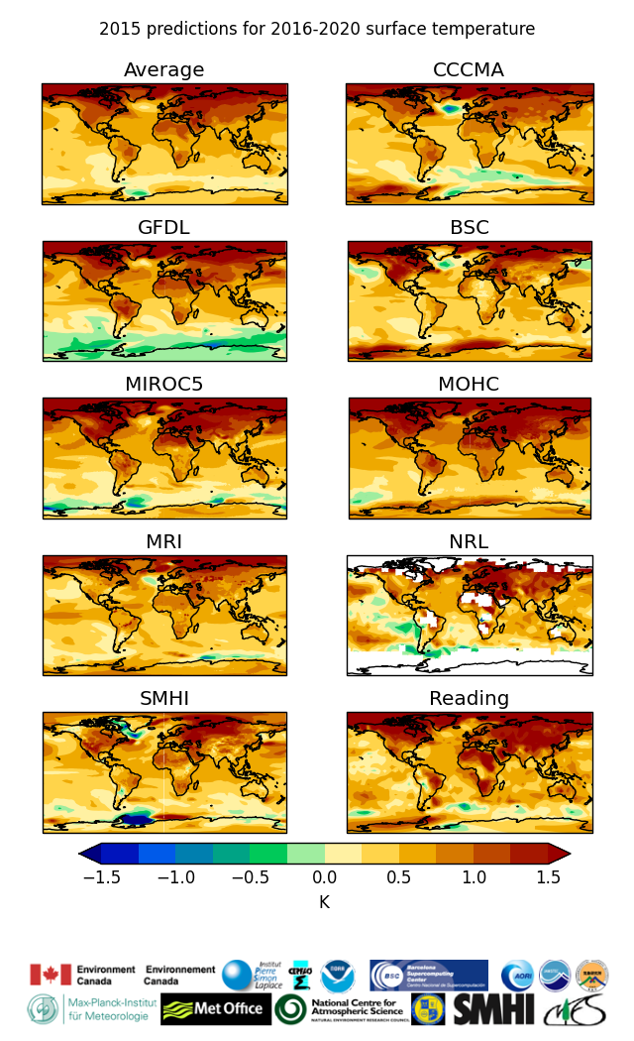
What’s new since AR5
GC-NTCP and real-time exchange of decadal predictions
promote and provide new knowledge of climate mechanisms and climate forecasting systems
produce standards, verification methods and guidance for near-term predictions
promote & support the establishment of operational decadal predictions under WMO
initiate & issue real-time “Global Annual to Decadal Climate Update” each year
GC-NTCP leads way to operationalisation of climate prediction
WMO Lead Centre for NTCP
setting standards
updated forcings required as close to real time as possible

Slide 9
Challenges for AR6
Forcings: better understanding, increased frequency, seasonal cycle and spatial variability, updated in real time; not just short- but also long-lived and water vapour feedback
Role of atmosphere, ocean, land, cryosphere on predictability
Increased focus on near-term climate information to respond to the increased number of users -> WGII
Communication of near-term statements
Coherence with model validation (initial shocks, drift and bias in decadal variability), observations, and D&A
Merging of assessments from predictions and projections for a consistent story line; not necessarily seamless modelling
Teleconnectivity (tropical-extratropical, inter-basin and land-ocean) at decadal scales
Link research and operations

Slide 10
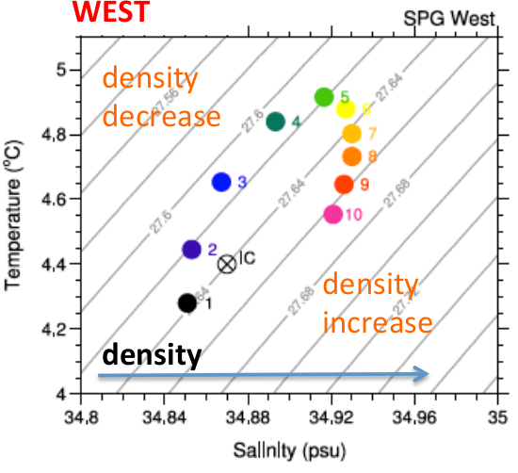
Challenges for AR6
Improve the use of information from uncertain observations, large ensembles and the millennium simulations (PAGES2K)
Test emergent constraint methodologies in the near-term
Need for reliable (or robust) probability statements, particularly for user-defined extremes
Make a better use of the drift information, including the interaction between the drift and the forced signal
Role in the global stocktake (near-term mitigation, attribution) especially after operationalisation of decadal prediction -> WGIII
Drift of the top 700 m western North Atlantic subpolar gyre in CERFACS decadal predictions
Sánchez-Gómez (2016)

Slide 11
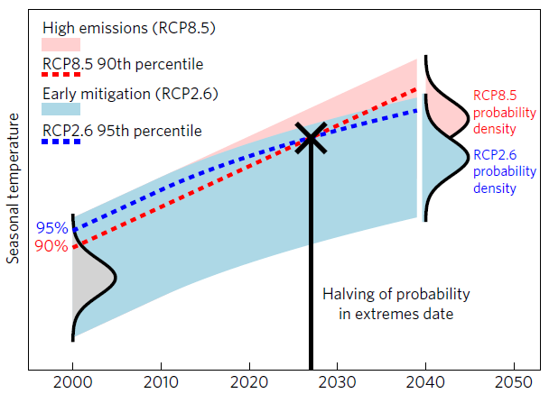
Challenges for AR6
Use climate predictions to formulate near-term regional attribution statements subject to recent past conditions
need large ensembles
impact of mitigation efforts
Short-term ocean carbon uptake to assess mitigation efficiency
consider internal variability
attribution of carbon-cycle variations (natural or anthropogenic) versus near-term scenarios with/without mitigation (impact of NDCs)
Halving of probability in extremes date: an indication of when the likelihood of extreme seasonal warmth in an emission-mitigated world is half that of the same warmth in the unmitigated world
Ciavarella et al. (2017)

Slide 12
Long version for BOG

Slide 13
Introduction
Variability, predictability and prediction are closely linked
Systems aim at predicting the relevant variability up to the level that predictability estimates suggest is possible
Predictability is non-observable and changes across time scales, variables and regions
Variability that can be expected to be predicted in the near-term: regional temperature, precipitation, ENSO, AMO, IPO, trans-basin variability, tropical circulation, sea ice, soil moisture, vegetation, ecosystem variability; extremes in all those variables and processes
The question is the timing of climate variations for the next 30 years
Model biases in simulating decadal to multi-decadal variability such as IPO and AMO affect skill -> Link to model evaluation
Decadal climate predictions allow to both phase in the internal variability and correct the forced model response
Climate prediction and event attribution are increasingly connected
Close links exist with climate services (GFCS) as many stakeholders make decisions on interannual to interdecadal time scales -> WGII
Predictability and prediction rely on scientific coordination from WCRP’s CLIVAR, WGSIP, DCPP, GC-NTCP, as well as increasingly from WMO’s CBS

Slide 14
Subseasonal to seasonal forecasts (2 weeks-18 months)
Decadal forecasts (18 months-30 years)
Climate-change projections
Weather forecasts
Time
Initial-value driven
Boundary-condition driven
Climate Prediction
Multi-seasonal, annual, multi-annual, up to decades
Initialized forecasts of both forced and internally generated components of variability

Slide 15
Lessons from AR5
Near-term climate information in Chapter 11
There is skill in near-term climate information, while initialisation increases the skill for a range of variables up to 10 years. Annual, multi-annual skill for temperature, not so much for precipitation
skill varies a great deal geographically, large impact of the “trend” for temperature
skill higher over North Atlantic than North Pacific (low skill of the IPO, although potentially for transitions)
disconnect between predictability estimates (e.g. signal-to noise ratio measured by individual models) and skill
low skill over Southern Ocean
Merging the prediction/projection information (up to 2035) a challenge
The value of initialization can be quantified by comparison with skill from uninitialized simulations using the same model and forcings
initial condition skill dominates for several years then dies away
pervasive drift presence

Slide 16
Lessons from AR5
Actual skill (dashed curve, correlation between model ensemble mean and observations)
Predictability estimate (solid curve, correlation between model ensemble mean and model ensemble members)
Orange for total, blue for initial condition and green for forced
Boer et al. (2013)

Slide 17
Lessons from AR5
Left: Updated version of IPCC AR5 WGI Figure 11.25b with the HadCRUT4.5 global-mean temperature (uncertainty in black, other observations in blue). CMIP5 model projections relative to 1986-2005 (light grey) and 2006-2012 (dark grey). The red hatching is the IPCC AR5 indicative likely range in 2016-2035 period, with the black bar being the assessed 2016-2035 average.
Right: Figure 11.25a from IPCC AR5 WGI.
E. Hawkins

Slide 18
Lessons from AR5
The hiatus was predicted by the forecast systems
Predictions need effective data assimilation to optimise the use of the scarce data available, particularly for the pre-satellite and pre-ARGO era
Predictions need long sequence of historical forecasts with many start dates
allow drift adjustment; important lessons about the physical origin of the systematic error were learnt from the drift assessments
for statistically robust forecast quality assessment (strong dependency of the observational uncertainty)
calibration of forecasts, which has a huge potential to improve the forecast quality and the usability of the forecasts in services and impact assessments
Single and multi-model assessments of CMIP5 results show
importance of general availability of results
importance of coordinated multi-model experiments

Slide 19
What’s new since AR5
CMIP6 and DCPP: DCPP provides, among other things, multi-model archive of hindcasts updated annually as basis for
systematic error and drift characterisation
skill assessment: when and where, parameters (temperature, precipitation, extremes, …), service driven
development of objective multi-model probabilistic prediction methods for reliable prediction
“de facto” transpose-CMIP
Importance of internal variability in near-term and long-term predictions/projections (possible underestimation of signal to noise ratio in models, large ensembles needed)
Model bias and drift in decadal variability degrades near-term climate information
Possibility of extension beyond 10 years, but compromise required with the need of large ensembles

Slide 20
What’s new since AR5
An increasing number of users focus on near-term time scales e.g. North Atlantic tropical cyclones (year 1-5 forecasts)
Caron et al. (2017)

Slide 21
What’s new since AR5
Higher resolution of forcings (annual frequency, better estimates of seasonal cycle and spatial variability) needed to get correct balance between simulated forced and internal variability
Improved understanding of recent extreme events (during data-rich period) increase confidence in future statements
Very useful empirical/statistical forecast systems
Use of large sets of climate predictions to assess risks of unobserved events in current climate (multi-breadbasket collapse)
Little attention from CORDEX (particularly predictions)

Slide 22
What’s new since AR5
Predictability possibly being larger than current estimates as skill may be greater than “perfect model” studies suggest, although still controversial idea
Higher resolution systems (e.g. eddy permitting) and larger HPC resources now available
Lagged correlation SST-heat flux in CAMS4, high (0.1º) and standard (1º) ocean resolution
Kirtman (2017)

Slide 23
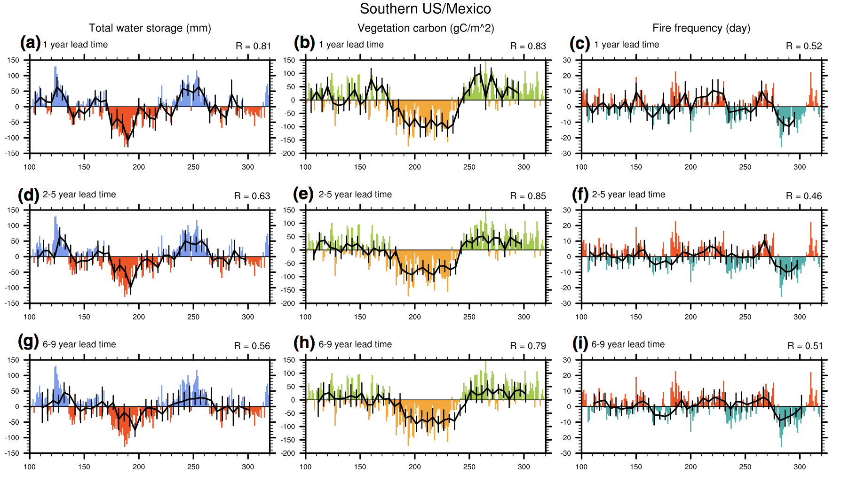
What’s new since AR5
Potential for decadal prediction of Earth System variability (Chikamoto et al , 2015)

Slide 24
Global Climate Models
(ΔX ~100 km)
Improves simulation of:
Natural decadal variability
Oceanic forcing of atmosphere
Western boundary currents
Oceanic fronts
Eastern basin SST
Tropical cyclones (path, intensity)
Regimes – storm tracks, blocking
Orographically-forced features
Fully parameterized; current CMIP-class models
~200X computing
Meso-Global Models
(ΔX_{A} ~15 km; ΔX_{O} ~8 km)
Fully parameterized; limited experiments
Anticipated for decadal prediction:
Reduced biases that mask predictability
Improved impacts of mesoscale on large-scale features of climate system
Estimates of changes in tropical cyclones
More realistic transports of heat, water
More realistic representation of ENSO
~400X computing
Cloud- & Eddy-Resolving Models (ΔX ~1 km)
Non-hydrostatic; parameterized turbulence & μ-physics; 10 years in future
Kinter III (2017)

Slide 25
What’s new since AR5
GC-NTCP and real-time exchange of decadal predictions
Promote and provide new knowledge of climate mechanisms and climate forecasting systems
Produce standards, verification methods and guidance for near-term predictions
Promote & support the establishment of operational decadal predictions under WMO
Initiate & issue real-time “Global Annual to Decadal Climate Update” each year
GC-NTCP leads way to operationalisation of climate prediction
WMO Lead Centre for NTCP
Setting standards
Updated forcings required as close to real time as possible

Slide 26
Challenges for AR6
Formulate reliable statements (and evaluate that they are reliable)
Predictability analyses on the relative role of atmosphere, ocean, land, cryosphere
Deeper understanding of the role of the forcings, not just short -lived (aerosols, ozone, solar taking account spectrum, stratospheric water), but also the spatial distribution of long lived; also consider water vapour feedback
Better understanding of the teleconnectivity (tropical-extratropical, inter-basin and land-ocean) at decadal scales

Slide 27
Challenges for AR6
Communication is key as near-term statements are validated almost in real time
Find the best way to link research and operational
Improve the use of information from both observations and the millennium simulations (PAGES2K) on decadal variability
Test the emergent constraint methodologies in the near-term, both with projections and predictions
Make a better use of the drift information, including the interaction between the drift and the forced signal
Drift of the top 700 m in the western North Atlantic subpolar gyre in the CNRM-CM5 decadal predictions
Sánchez-Gómez (2016)

Slide 28
Challenges for AR6
Use climate predictions to formulate near-term regional attribution statements subject to recent past conditions
Need large ensemble sizes
Impact of mitigation efforts
Simulate short-term ocean carbon uptake to assess mitigation efficiency
Consider internal variability
Consider attribution of carbon-cycle variations (natural or anthropogenic) versus near-term scenarios with/without mitigation (impact of commitments)
Ciavarella et al. (2017)

Slide 29
Challenges for AR6
Increased focus on information for the near term to respond to the increased number of users interested in that time scale; links to WGII
Coherence with chapters on model validation (forecasts suffer from forecast initial shocks, drift and bias in decadal variability), observations, and D&A
Merging of assessments from predictions and projections for a consistent story line; not necessarily a seamless modelling approach but a seamless probabilistic information across time scales
Need for reliable (also known as robust) probability statements, particularly for extreme (which should be defined by the range of users) events
Role in the global stocktake (near-term mitigation, attribution) especially after operationalisation of decadal prediction

Slide 30
Extra

Slide 31
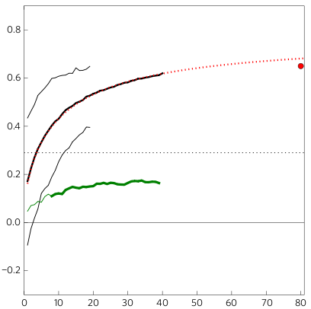
Estimating predictability
Actual skill (dashed orange curve, correlation between model ensemble mean and observations)
Potential skill (solid orange curve, correlation between model ensemble mean and model ensemble members)
Predictions of global mean temperature: potential skill > actual skill
more skill possible with improved observations / initialisation
Seasonal forecasts of North Atlantic Oscillation: actual skill > potential skill
unexpected
signal to noise ratio is too small in models
predictability of real world is unknown
Correlation skill
Model predicting real world (actual skill)
Model predicting itself (potential skill)
Correlation skill
Number of ensemble members
Boer et al 2013; Dunstone et al 2016; also Eade et al 2014; Scaife et al 2014; Shi et al 2915; Stockdale et al 2015

Slide 32
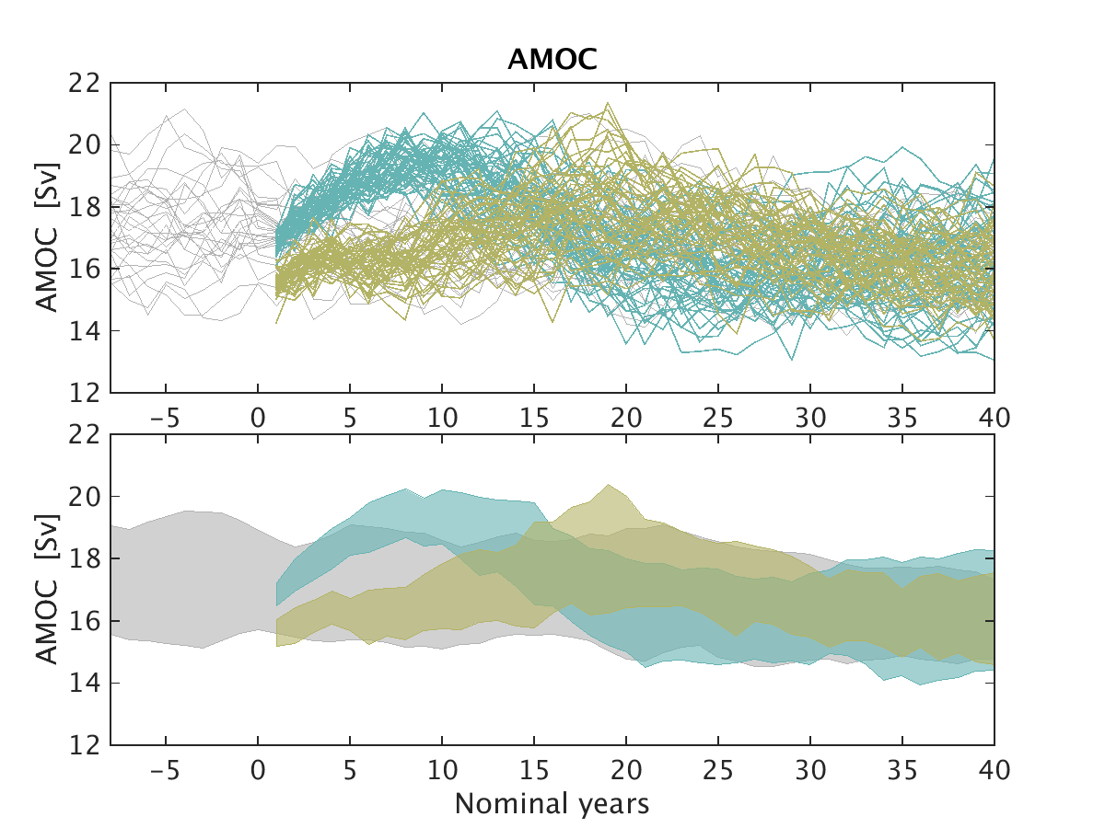
Estimating predictability

Slide 33
Additional
Interesting dichotomy emerging in literature about the relative role of external forcing vs internal variability in driving North Atlantic SST variability and hence Atlantic impacts such as multi-decadal tropical storm frequency
(external forcings (e.g. aerosols) may driver AMV by either directly changing downward SW radiation, or (more likely?) via modulating ocean circulation (e.g. AMOC) by driving multi-annual to decadal trends in atmospheric circulation/windstress (e.g. the NAO))

