Slide 1
Decision-making under a changing climate? A climate service for clean energy in Spain and beyond
COP25
Ilaria Vigo, Barcelona Supercomputing Center

Slide 2
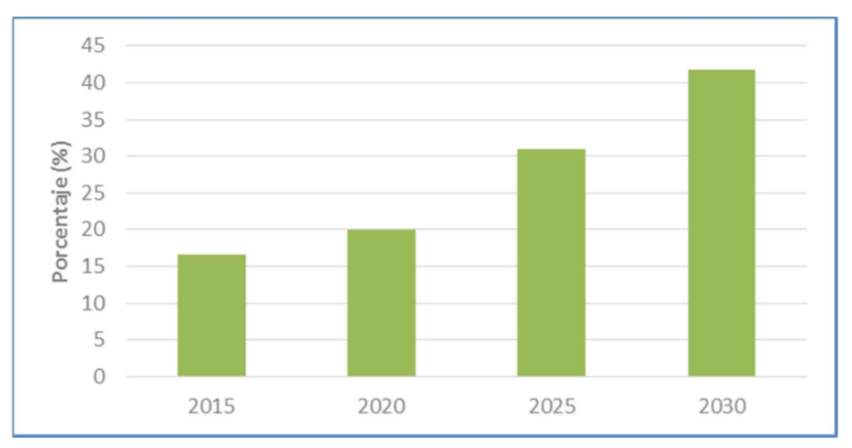
National Energy and Climate Plan | Spain 2021-2030
Goal 2030: renewable energy should account for 42% of Spanish energy needs
Contribution of renewable energies on final consumption with the set of planned measures. Source: Plan Nacional Integrado de Energía y Clima 2021-2030

Slide 3
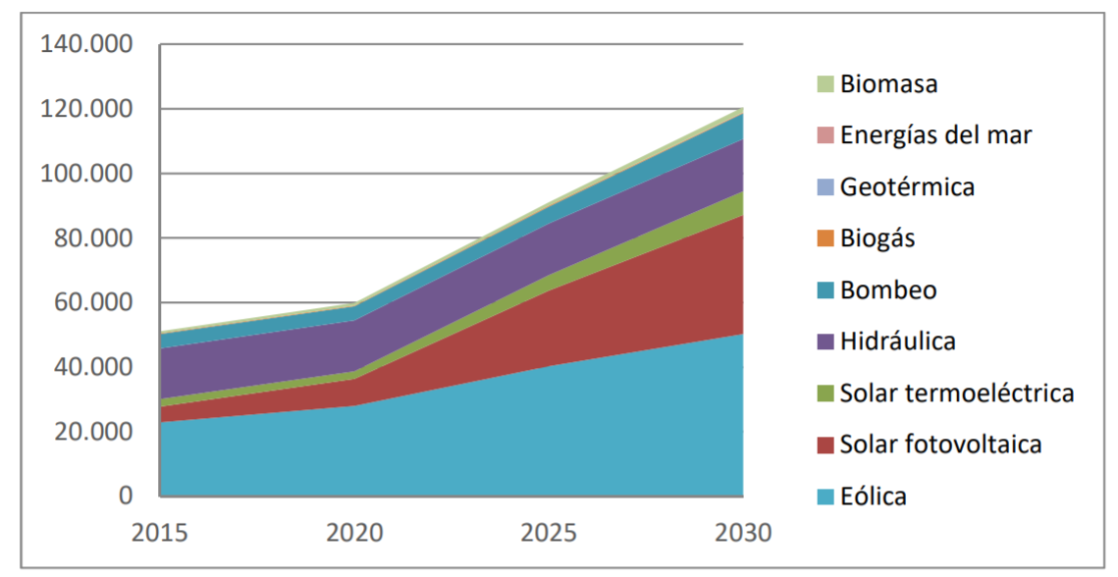
National Energy and Climate Plan | Spain 2021-2030
Evolution of installed capacity of reneable technologies (MW)
Source: Plan Nacional Integrado de Energía y Clima 2021-2030

Slide 4
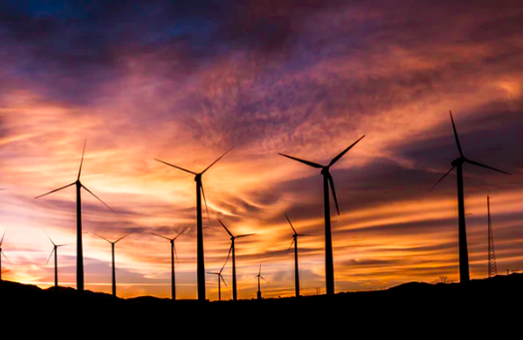

Slide 5
Link: https://youtu.be/PhbdyNnUliM

Slide 6
Examples of extreme events | Spain
Late Summer 2016
Heat wave
Wind drought
March 2018
High wind speed
High precipitation
Cold spell

Slide 7
Weather Forecast
Climate Predictions
Multidecadal and Projections
Present-15d
10 d-1 month
1 month–3 months
2-30 years
20-100 years
●
●
●
●
●
S2S4E project

Slide 8
Co-Production with industrial partners...
S2S4E
Industrial Partners
...and external stakeholders

Slide 9
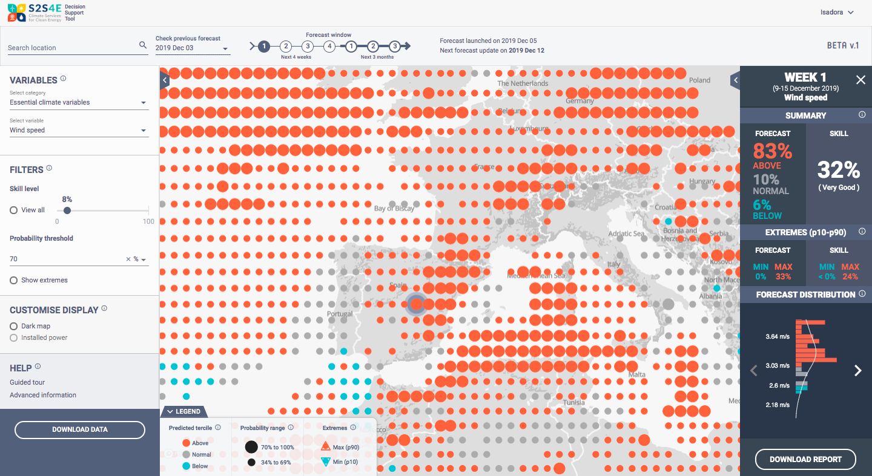
Decision Support Tool

Slide 10
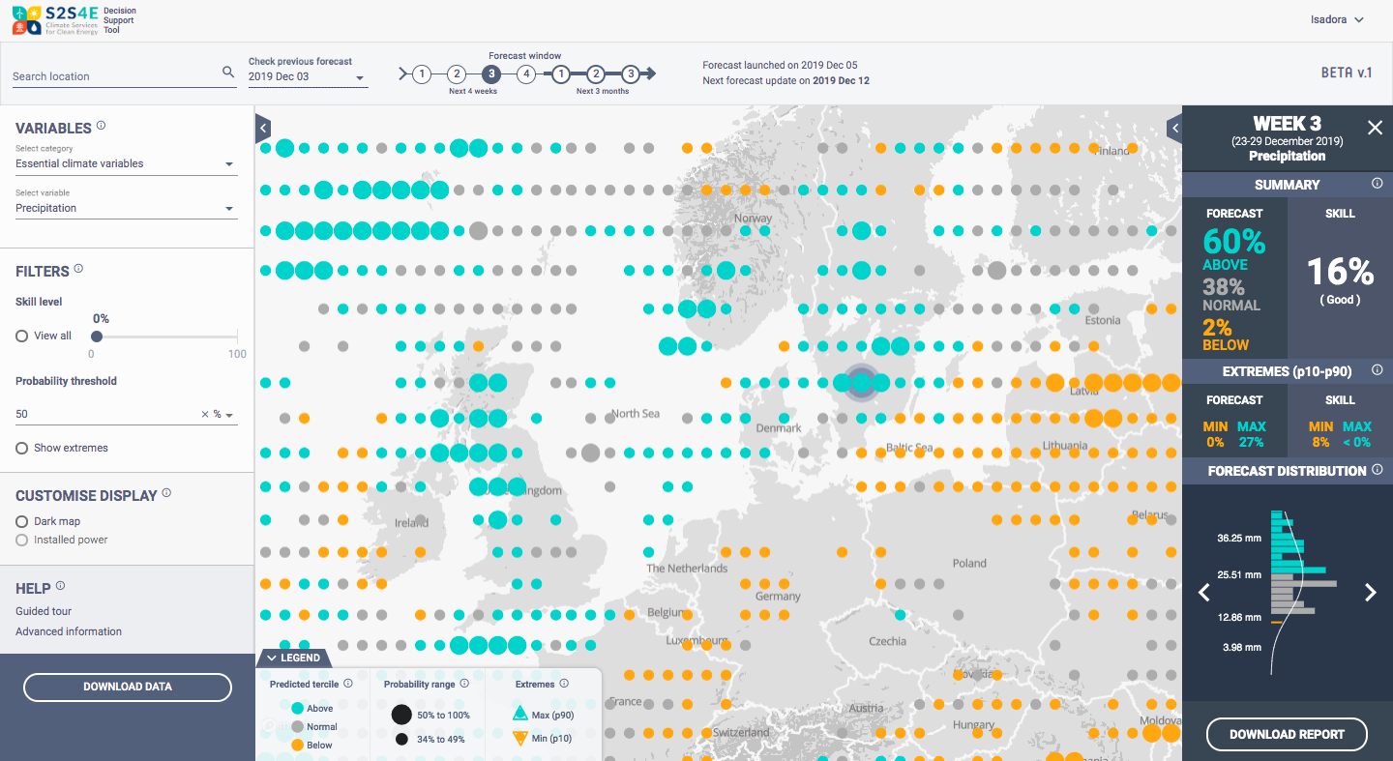
Categories
Essential Climate
Wind Energy
Solar Energy
Hydro Energy
Energy Balance
Variables
Climate variables (T, wind, precipitation, etc.)
Energy indicators (capacity factor, demand,etc.)

Slide 11
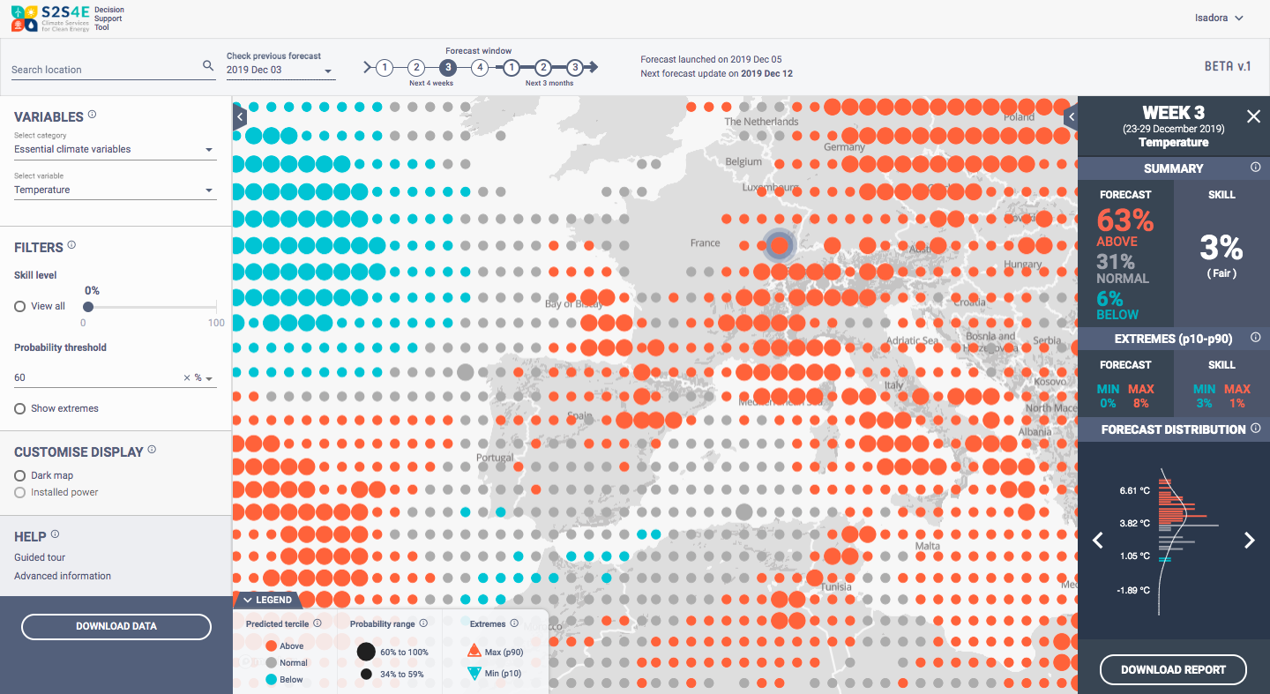
Past forecasts
for
Backtesting
Forecast for the:
next 4 weeks
next 3 months

Slide 12
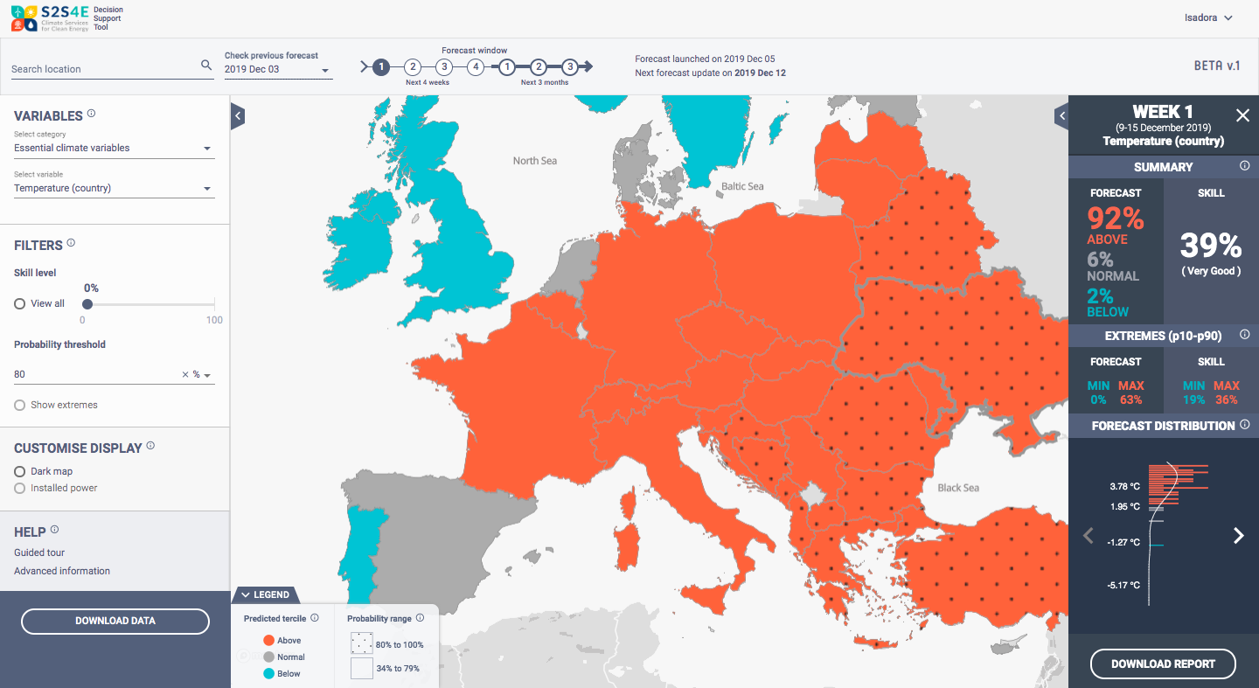
Probabilistic forecast
with a measure of accuracy

Slide 13
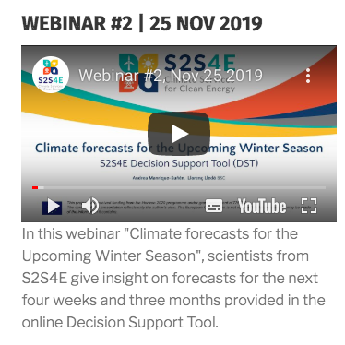
… and other services
Webinars
Monthly
outlooks
Case studies
&
Factsheets
R-package
CSTools
https://cran.r-project.org/package=CSTools

Slide 14
High snowmelt and rain in Sweden July 2015
WHAT:
Substantial snowmelt
Above normal precipitation
IMPACT:
Reservoirs filled up too early
Unproductive water release
Seasonal Forecasts
to reduce water loss

Slide 15
Cold spell and wind drought in Europe
WHAT:
Extremely low temperature
Below normal wind speed
IMPACT:
Sharp increase in electricity demand
Low wind power production
Peak in energy prices
Sub-Seasonal Forecasts
For hedging

Slide 16
Cold spell and wind drought in Europe
WHAT:
Extremely low temperature
Below normal wind speed
IMPACT:
Sharp increase in electricity demand
Low wind power production
High risk of energy imbalance in the grid
S2S
for the grid

Slide 17
Clean Energy for All Europeans package
Regulation (EU) 2019/941, 5 June 2019
On risk-preparedness in the electricity sector
…assessing seasonal and short-term adequacy, namely monthly, week-ahead to at least day-ahead adequacy…
…covering […] severe weather conditions, variable demand in particular peaks depending on weather conditions, and variability of production of energy from renewable sources;
…methodology […] shall provide for a probabilistic approach
…methodology shall take into account the specificities of each Member State's energy sector, including specific weather conditions and external circumstances.

