Slide 1
Barcelona, June 7th 2019
Impact of climate change on animals
Rachel White
Louis-Philippe Caron

Slide 2
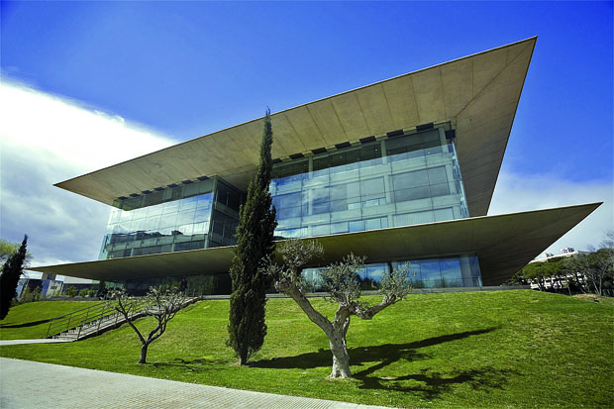
We work here

Slide 3
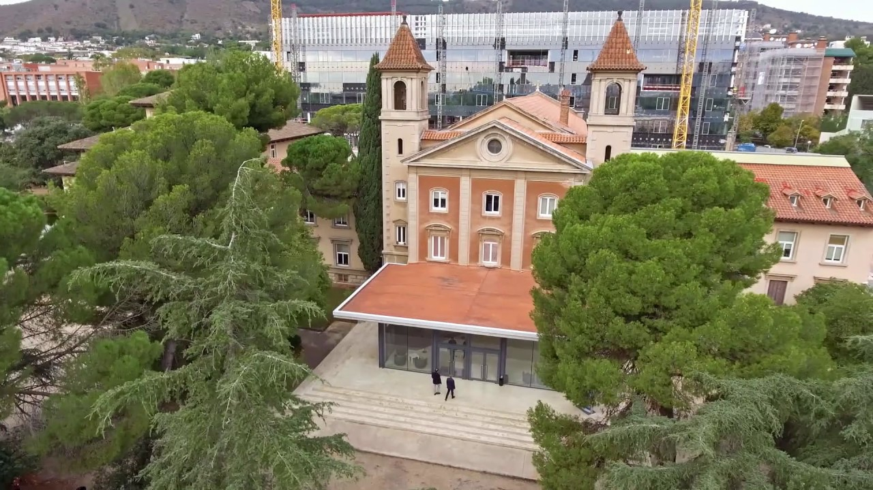
But the cool stuff is here

Slide 4
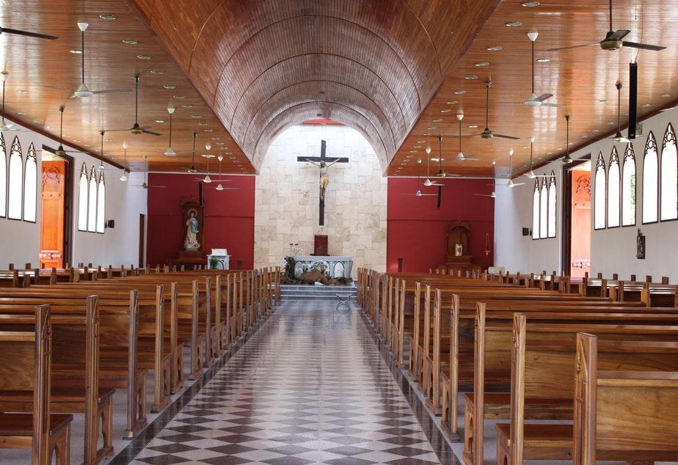
????

Slide 5
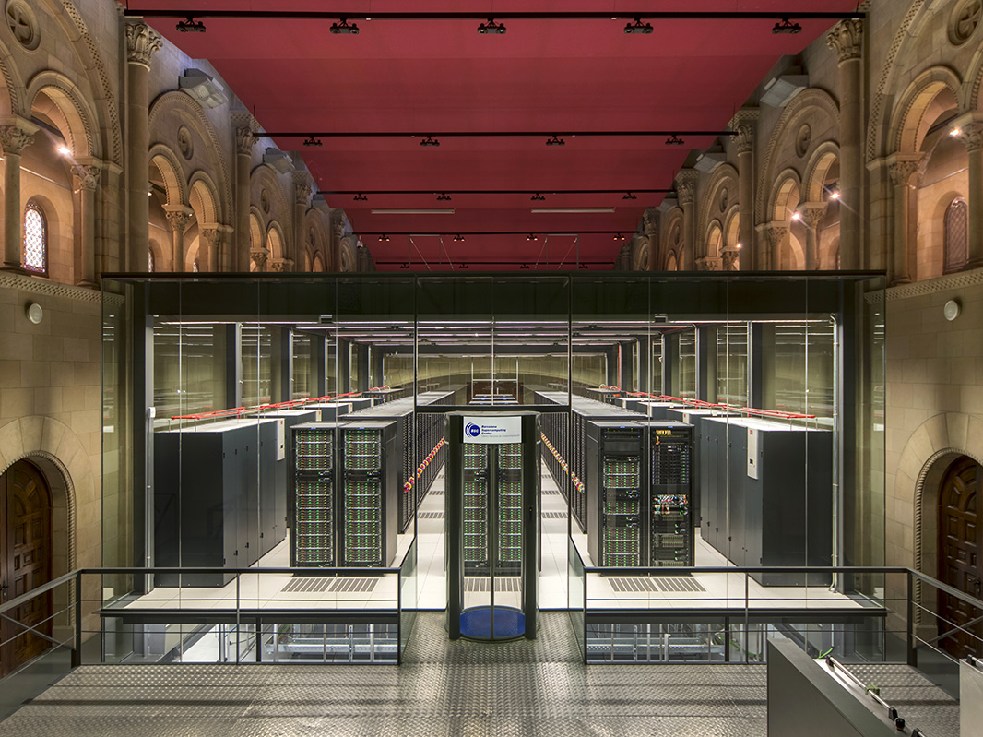
Marenostrum 4: one of the most powerful computer in the world.

Slide 6
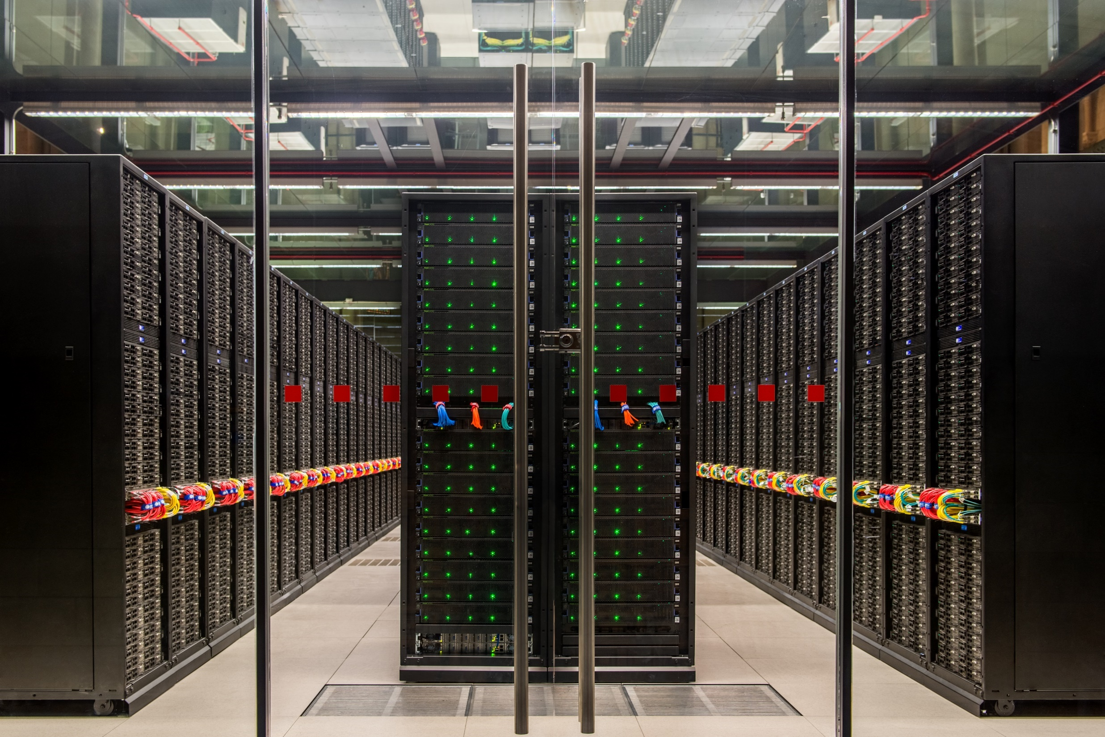
It is equivalent to 42,000 desktops.

Slide 8
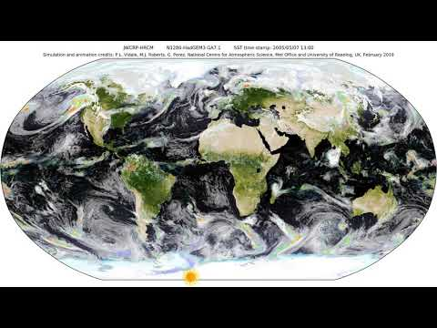

Slide 9
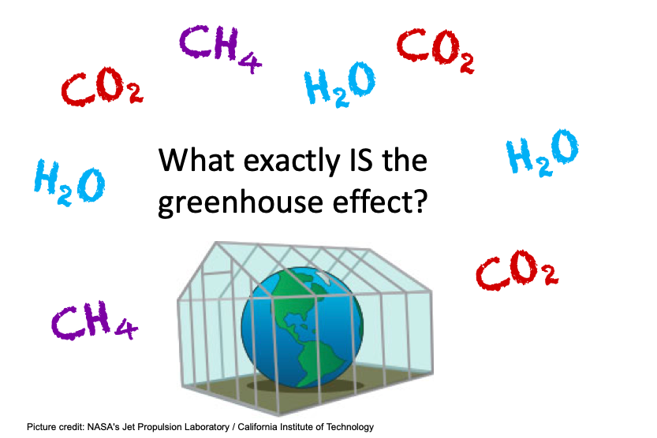
Climate change

Slide 10
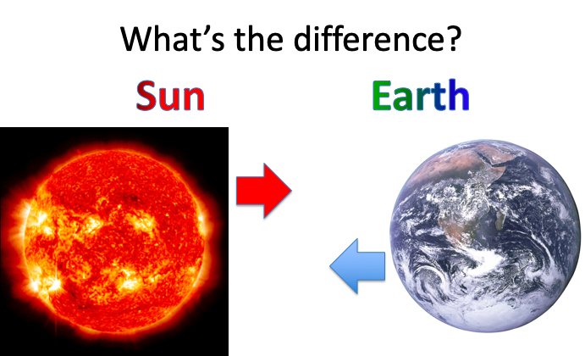
The Greenhouse Effect

Slide 11
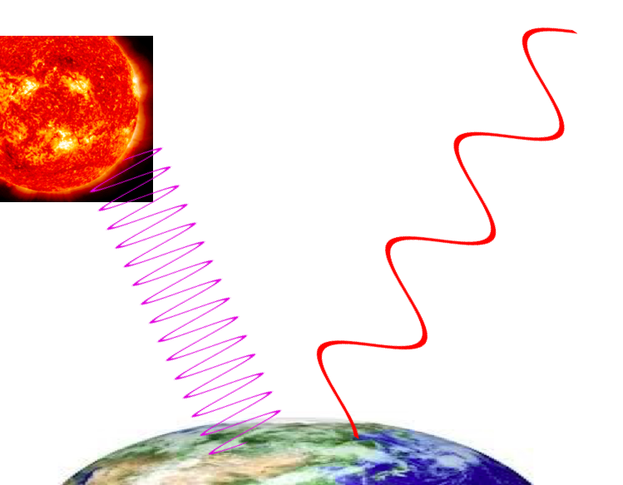
The Greenhouse Effect
Heat from the sun to Earth
Heat from the Earth to space

Slide 12
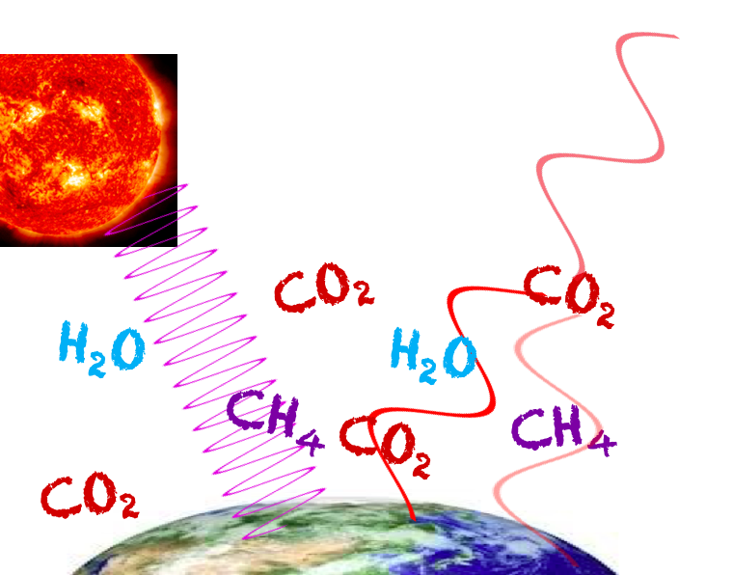
With greenhouse gases, we still have the same heat from the sun

Slide 13
But some of the heat from the Earth is trapped by the gases and comes back down to the surface

Slide 14
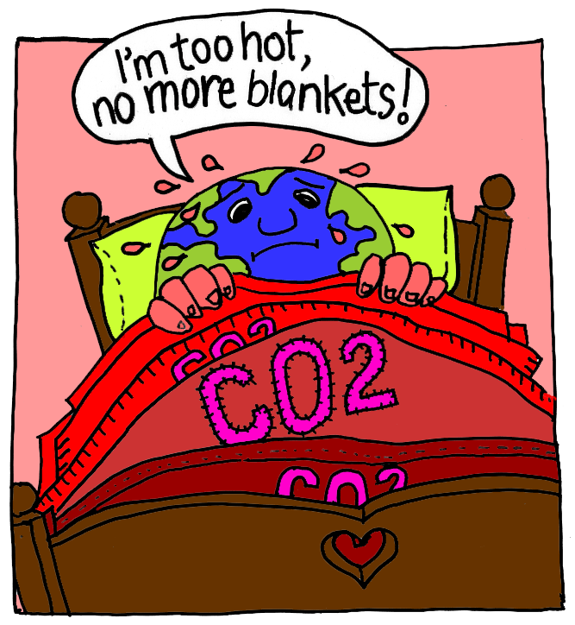
The Greenhouse Effect

Slide 15
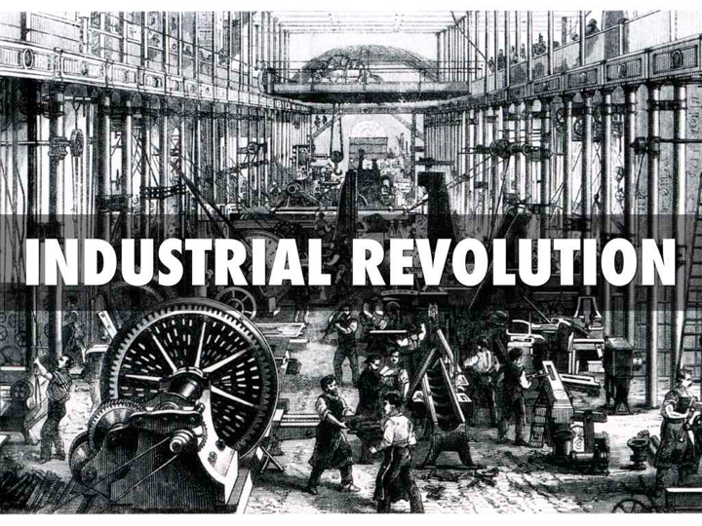
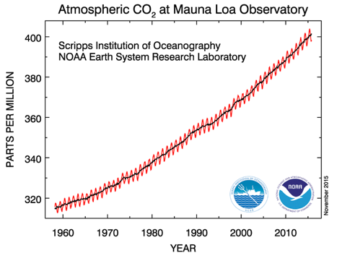
Humans and Climate Change

Slide 16
Humans and Climate Change

Slide 17
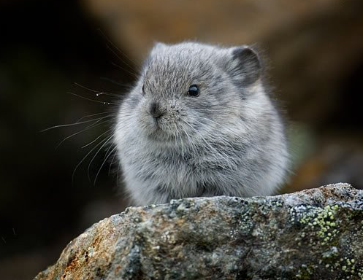
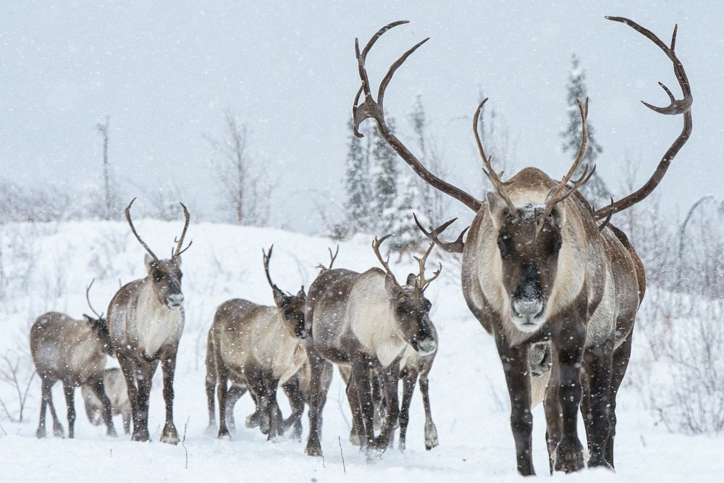
How does Climate Change affect Animals?
Time to play!

Slide 18
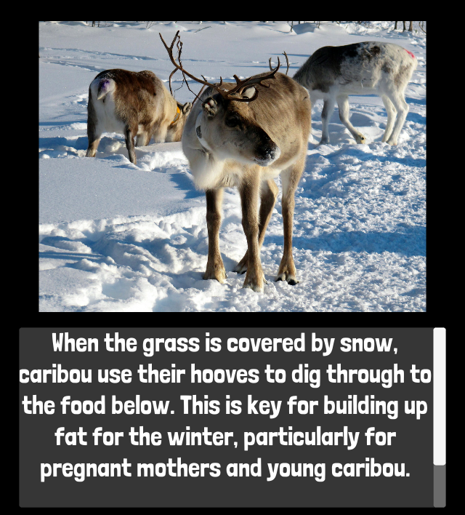
Climate Change and Animals?
What did the games teach you about:
1. How climate change may affect animals?
2. What animals can do to survive these changes?

Slide 19
Pikas and Climate Change

Slide 20
Pikas and Climate Change

Slide 21
Caribou and Climate Change

Slide 22
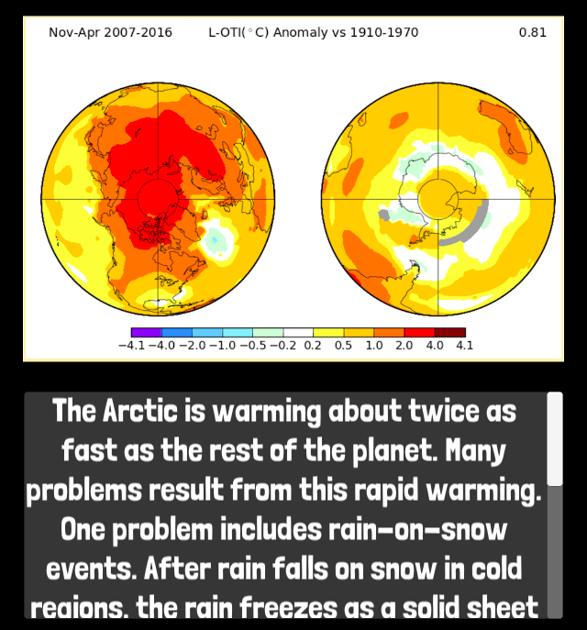
Caribou and Climate Change

Slide 23
Caribou and Climate Change

Slide 24
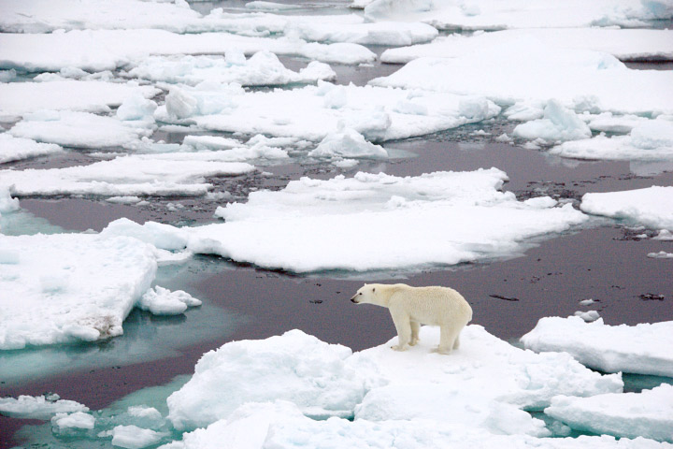
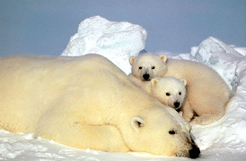
Melting sea ice
Sea ice is made when the surface of the sea freezes.
Polar bears use sea ice to hunt.
Melting sea ice is making it harder for polar bears to catch enough food

Slide 25
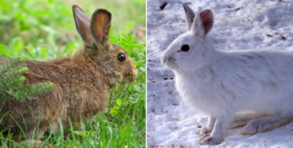
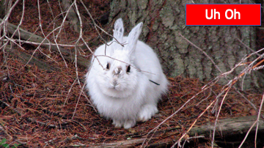
Seasonal Shifts
Many animals change their behaviour, or even their fur colour, with the seasons.
But if the snow melts earlier and earlier….

Slide 26
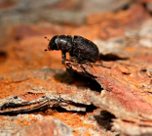
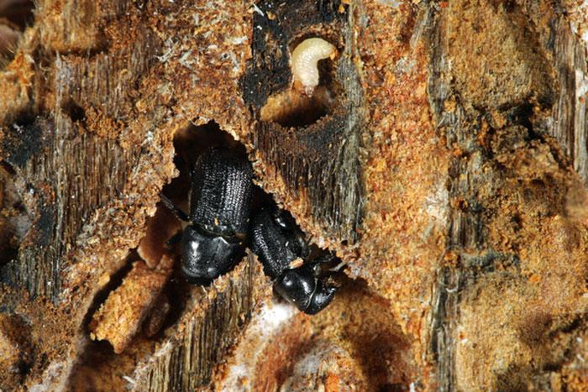
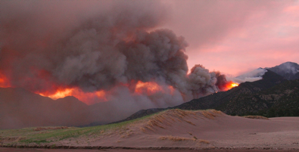
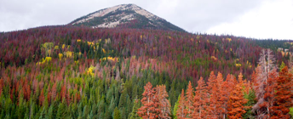
Tree deaths
Hotter temperatures are good for some ‘pests’, such as the bark beetle:
These beetles kill trees and destroy forests:

Slide 27
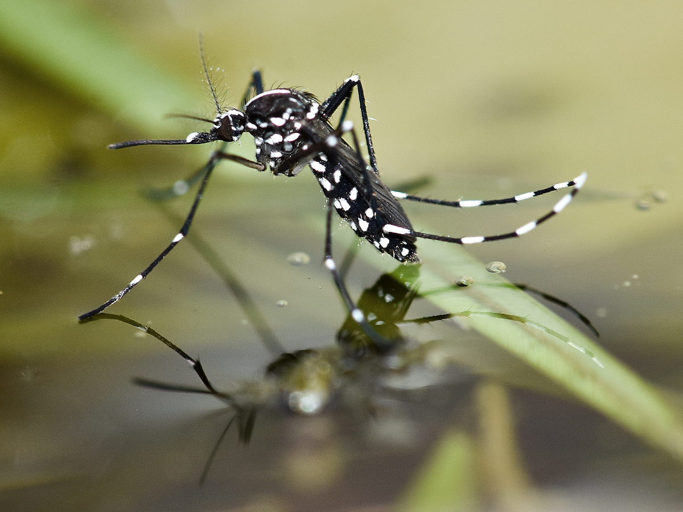
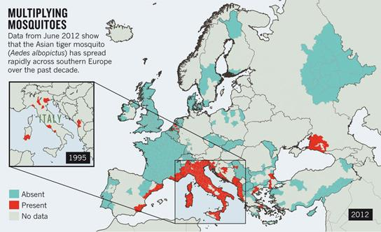
Other pests
Some insects don’t like the cold
But because it’s getting warmer...
And they don’t come alone…
Dengue
Yellow fever
Zinka

Slide 28
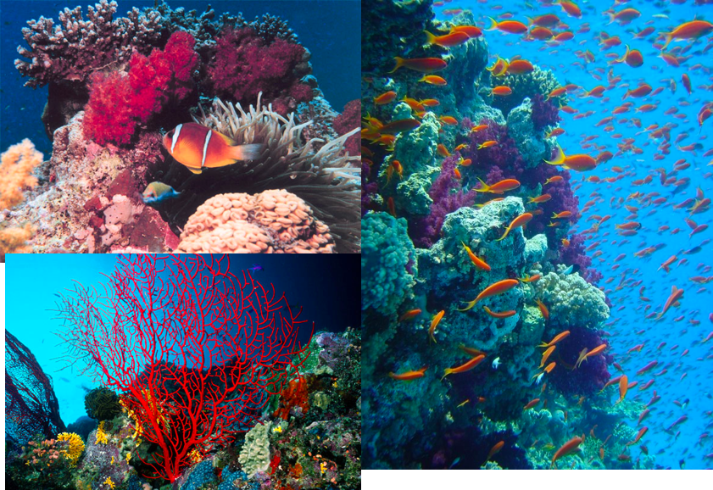
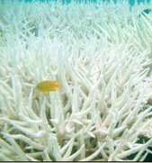
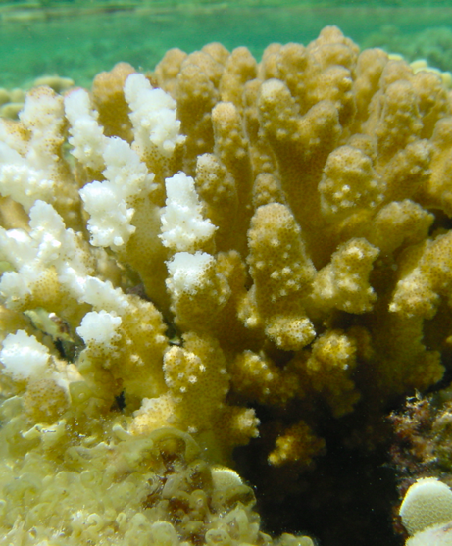
Warmer seas
Warmer oceans lead to coral ‘bleaching’
Bleached coral is still alive, but much weaker, and more likely to die

Slide 29
Questions?

