Slide 1
October 11-13, 2022
Impetus4Change (I4C)
IMPROVING NEAR-TERM CLIMATE
PREDICTIONS FOR SOCIETAL TRANSFORMATION
Coordinators: S. Sobolowski (NORCE); D. Bojovic (BSC)
Presenting: P. Ortega
EC-Earth Meeting (Lund)
Notes:
Supporting the formulation of adaptation strategies through improved climate predictions in Europe and beyond

Slide 2
The overarching objective of I4C is to improve the quality, accessibility and usability of near-term climate information and services at local to regional scales to strengthen and support end-user adaptation planning and action.
Several specific objectives work towards this overarching goal:
Improve understanding and flow of climate information through knowledge networks
Address persistent shortcomings to deliver seasonal to decadal predictions of improved quality
Develop novel methods to downscale predictions to local scales
An improved assessment of hazards translated into usable information for local risk assessments
Make advances towards the goal of end-to-end seamless climate services
Through transdisciplinary co-production approaches develop fit-for- purpose "Adaptation support packs" at municipal scales through our so-called urban Demonstrators
Ensure high impact and visibility through robust and targeted communication and engagement
Commit to Open Science through development of open access tools and exploitation of data/model outputs via relevant platforms thereby ensuring improved accessibility and usability of climate knowledge.

Slide 3
The overarching objective of I4C is to improve the quality, accessibility and usability of near-term climate information and services at local to regional scales to strengthen and support end-user adaptation planning and action.
Several specific objectives work towards this overarching goal:
Improve understanding and flow of climate information through knowledge networks
Address persistent shortcomings to deliver seasonal to decadal predictions of improved quality
Develop novel methods to downscale predictions to local scales
An improved assessment of hazards translated into usable information for local risk assessments
Make advances towards the goal of end-to-end seamless climate services
Through transdisciplinary co-production approaches develop fit-for- purpose "Adaptation support packs" at municipal scales through our so-called urban Demonstrators
Ensure high impact and visibility through robust and targeted communication and engagement
Commit to Open Science through development of open access tools and exploitation of data/model outputs via relevant platforms thereby ensuring improved accessibility and usability of climate knowledge.

Slide 4
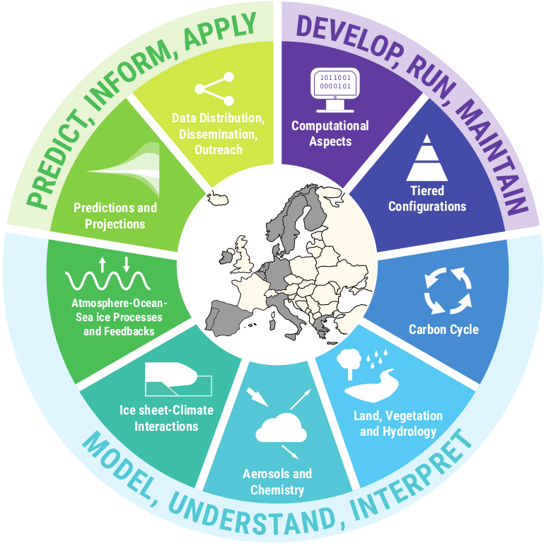
The overarching objective of I4C is to improve the quality, accessibility and usability of near-term climate information and services at local to regional scales to strengthen and support end-user adaptation planning and action.
Several specific objectives work towards this overarching goal:
Improve understanding and flow of climate information through knowledge networks
Address persistent shortcomings to deliver seasonal to decadal predictions of improved quality
Commit to Open Science through development of open access tools and exploitation of data/model outputs via relevant platforms thereby ensuring improved accessibility and usability of climate knowledge.
4

Slide 6
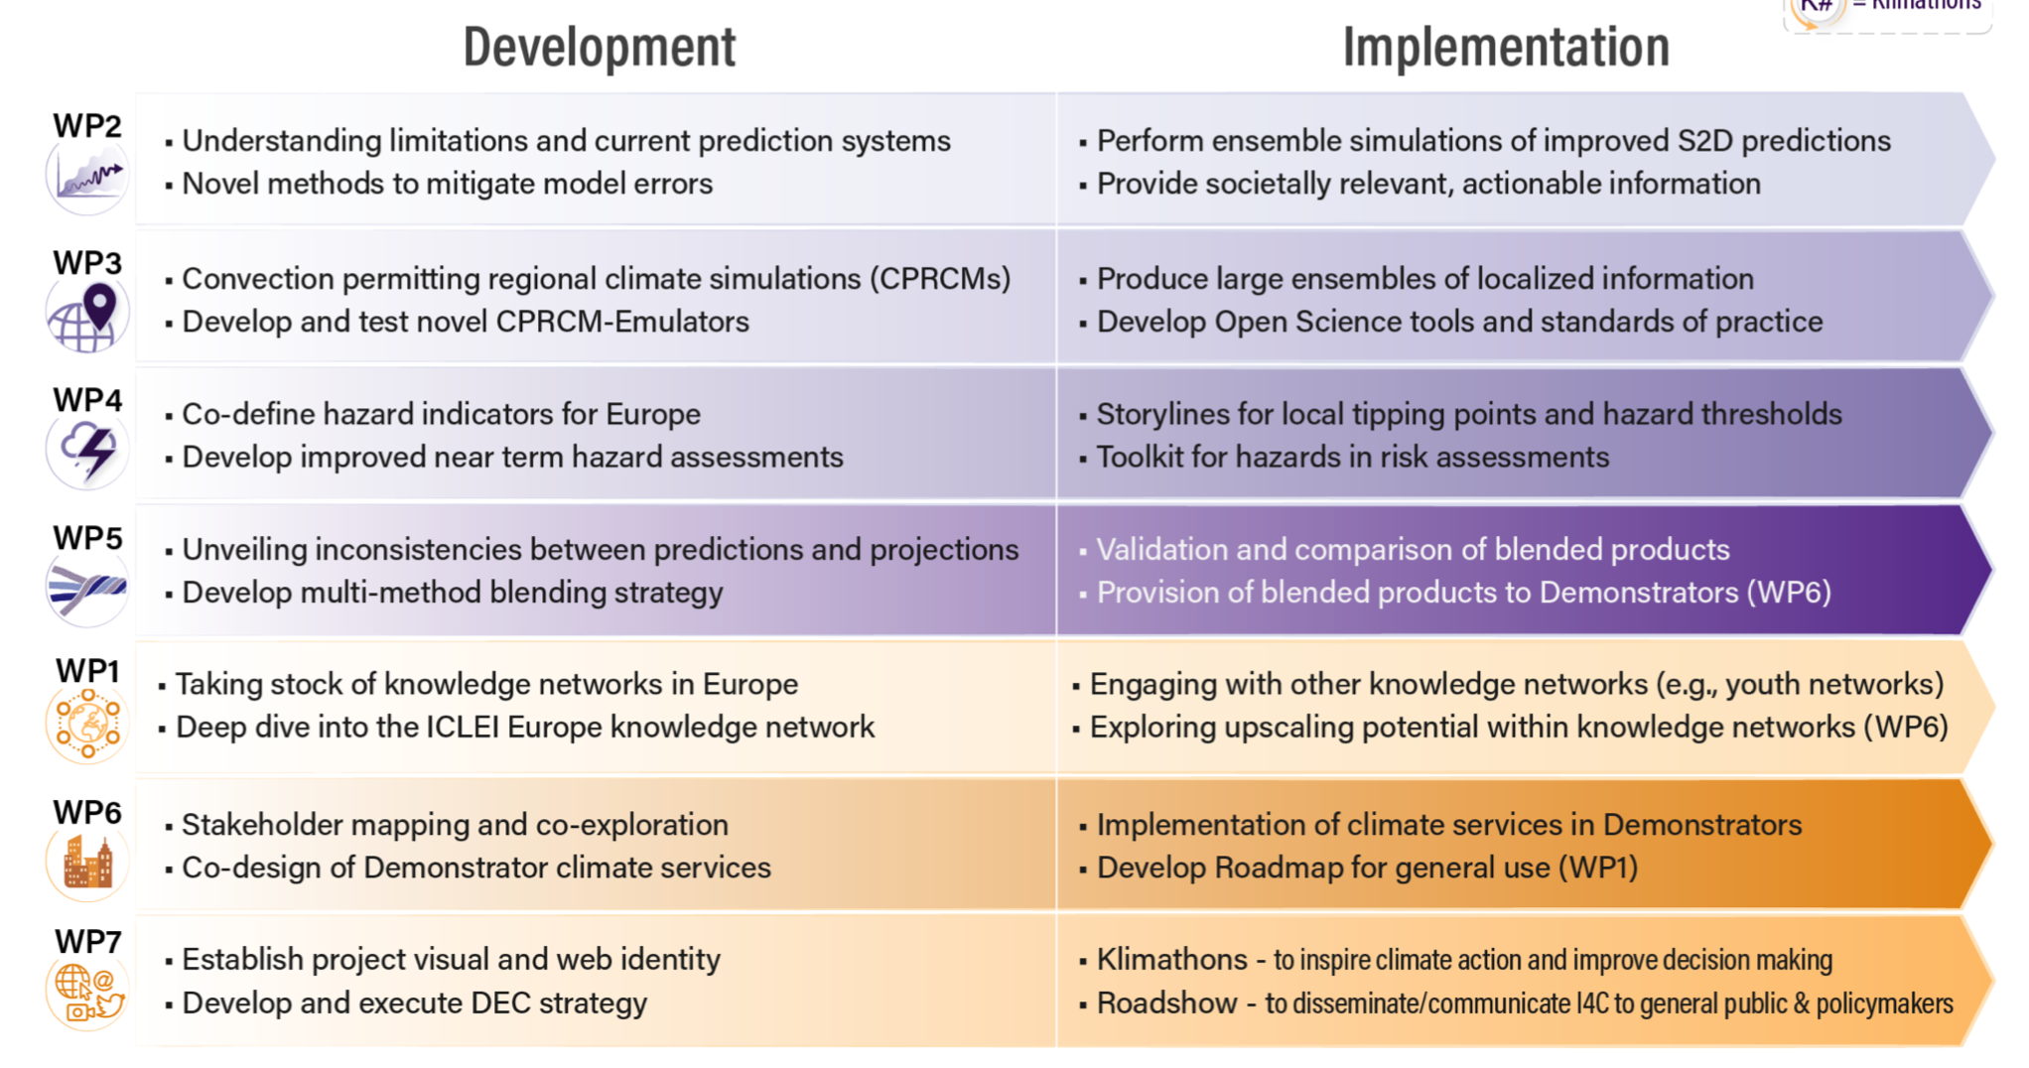

Slide 8
EU Partners Involved

Slide 9
Associated Partners (via applications to their national funding agencies)
A.M. Obukhov Institute of Atmospheric Physics RAS
EU Partners Involved

Slide 10
Several Earth System Models and prediction systems involved
Earth system models | Ocean/atmosphere | Resolutions | Applications
NorCPM | MICOM/ CAM5 | SR: 2° oce / 0.8° atm HR: 0.25° oce and atm | Supermodelling (SR) Super resolution DA (SR and HR)
EC-Earth3.3 | NEMO3.6/ IFS c36r4 | SR: 1° oce / 0.8° atm | Supermodelling (SR) Flux-correction (SR)
CNRM-ESM2.1 | NEMO3.6/ ARPEGE-Climat6.3 | SR: 1° oce / 1.5° atm | Particle-filter (SR)
MPI-ESM | MPIOM/ ECHAM6 | SR: 1 ° oce / 2° atm VHR: 0.1° oce / 1° atm | Supermodelling (SR) Eddy-resolving predictions (VHR)
CESM | POP2/ CAM5-6 | SR: 1° oce / 2 ° atm VHR: 0.1° oce / 0.25° atm | Supermodelling (SR) Eddy-resolving predictions (VHR)

Slide 11
Task 2.1 Understanding limitations in current prediction systems
Focus on decadal prediction large ensembles (DCPP + new I4C ones)
Multi-model analyses to understand impact of mean state biases and the realism of key atmospheric teleconnections on the predictive skill on different regions
Impact of model resolution on those errors
Ultimate interest on the signal-to-noise problem and predictability of extreme events (frequency/magnitude)

Slide 12
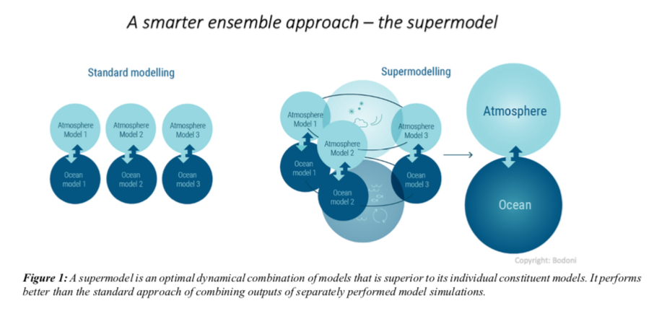
Task 2.2 Novel methods to mitigate model errors
Supermodelling
3.3
Notes:
A supermodel combines intereactively and optimally different climate models to mitigate model errors and produce a model with higher performance.
In the I4C supermodel, data assimilation will be used to connect different ocean model components

Slide 13
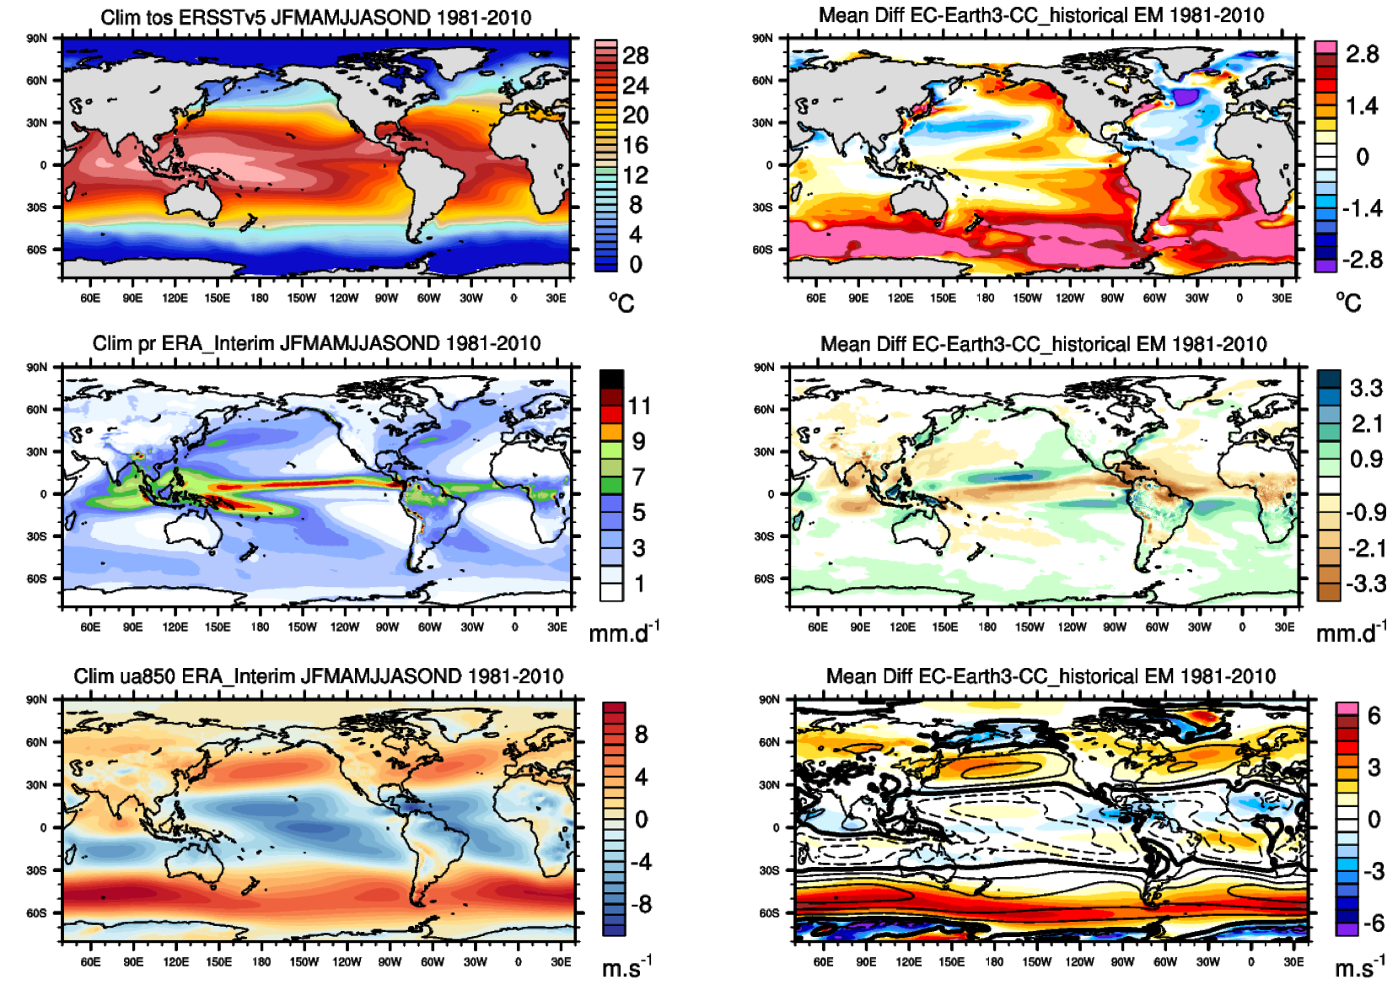
Task 2.2 Novel methods to mitigate model errors
Flux Corrected Predictions
Historical Climatologies
(1981-2010)
Annual mean biases
(EC-Earth3.3-CC)
3.3
SST
Precipitation
SLP

Slide 14
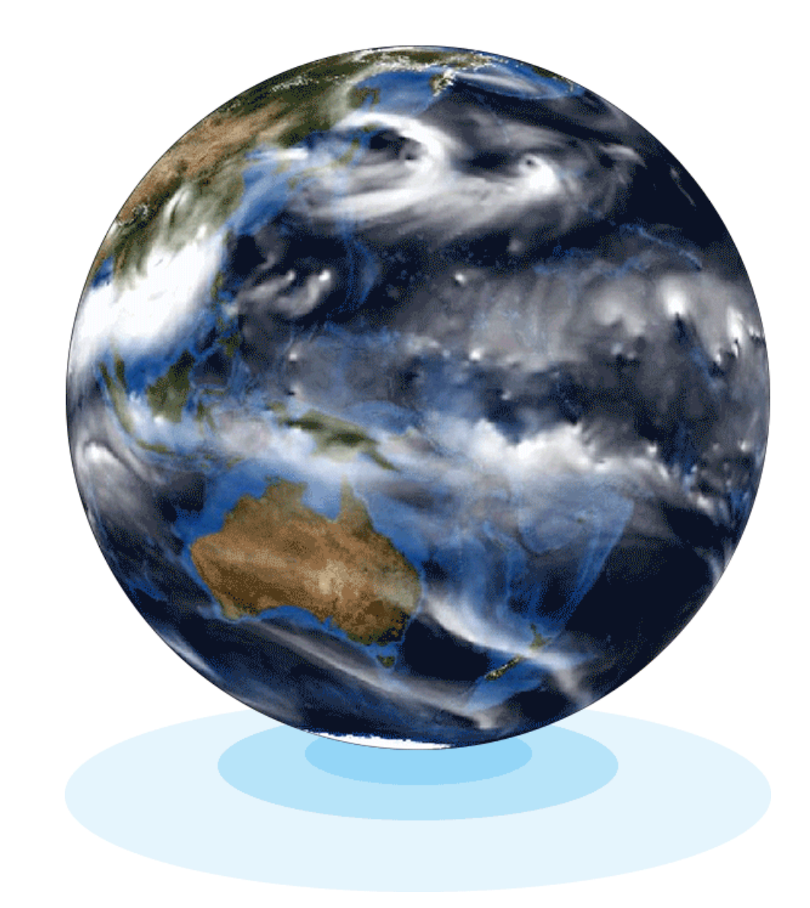
Task 2.2 Novel methods to mitigate model errors
Predictions with VHR (eddy-resolving) oceans
Performed with two systems (MPI-ESM-ER and CESM)
Both will run with VHR ocean and a coarse atmosphere
LR counterparts will be run to determine the added value of resolution
Improvements expected on the signal-to-noise problem
A super-resolution model will be developed with NorCPM via a machine-learned emulator of the HR in the LR version

Slide 15
Task 2.3 Performing/evaluating new set of improved S2D predictions
VHR Predictions
Supermodel Predictions
Flux-corrected Predictions
Will jointly contribute to other WPs

Slide 19
Improving the quality and usability of near-term climate information

Slide 22
Improved final value chain to transform data to information,
information to knowledge and knowledge to action

