Slide 1
Tropical Cyclones in PRIMAVERA HighResMIP Simulations
Louis-Philippe Caron
Baker, D Peano, P Kreussler, M Roberts, E Scoccimarro, B Vannière, PL Vidale, and many others.
May 21st, 2020

Slide 2
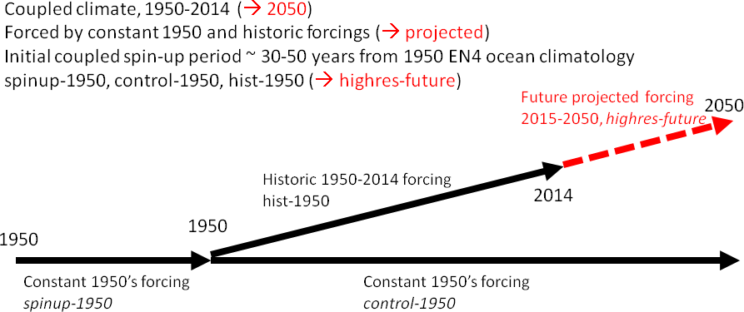
HighResMIP Protocol
7 GCMS // 2 Trackers
Notes:
SSP5-8.5 scenario (equivalent to RSP 8.5 in CMIP5)

Slide 3
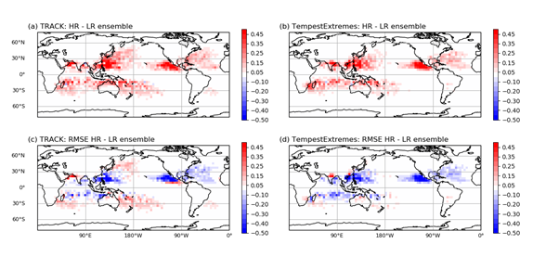
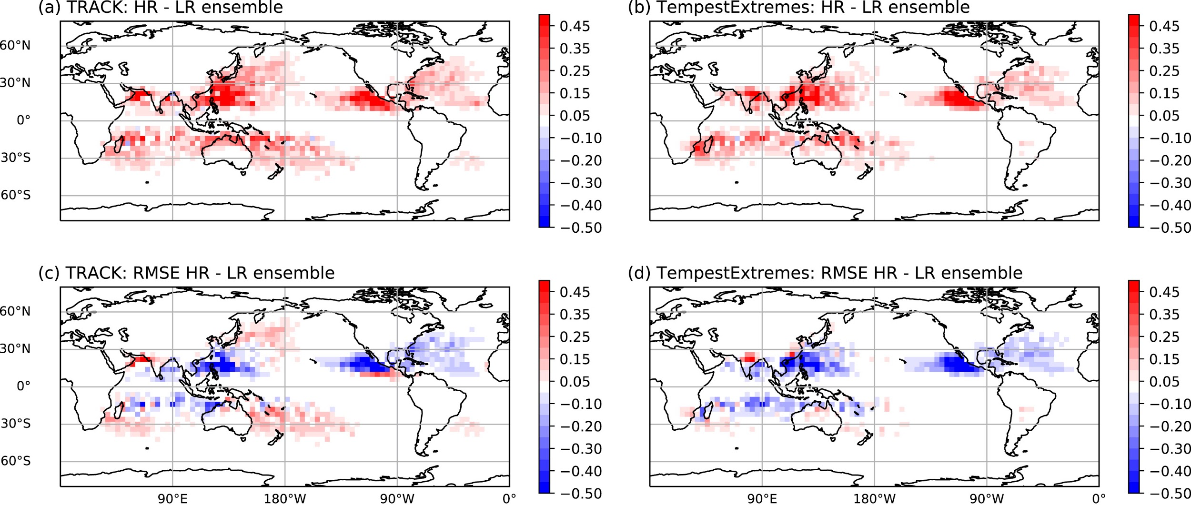
Impact of Resolution on Track Density
HR - LR
Change in RMSE
Roberts et al. (2020a)

Slide 4
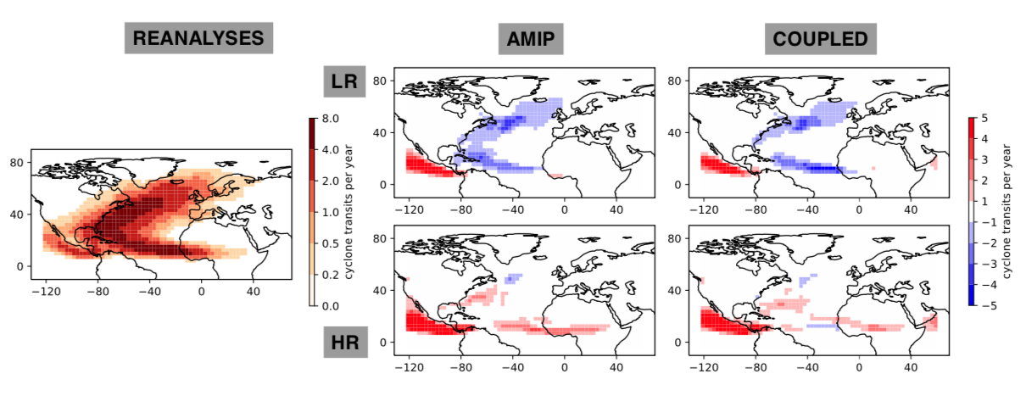
Impact of Resolution on Extra-Tropical Transitions
Credit: A. Baker
Notes:
Figure. Track density of tropical cyclones undergoing extratropical transition in reanalyses (left) and track density biases in (middle) highresSST-present and (right) hist-1950 simulations at (top) low and (bottom) high resolution. Genesis density biases are also reduced at high-resolution (not shown).

Slide 5
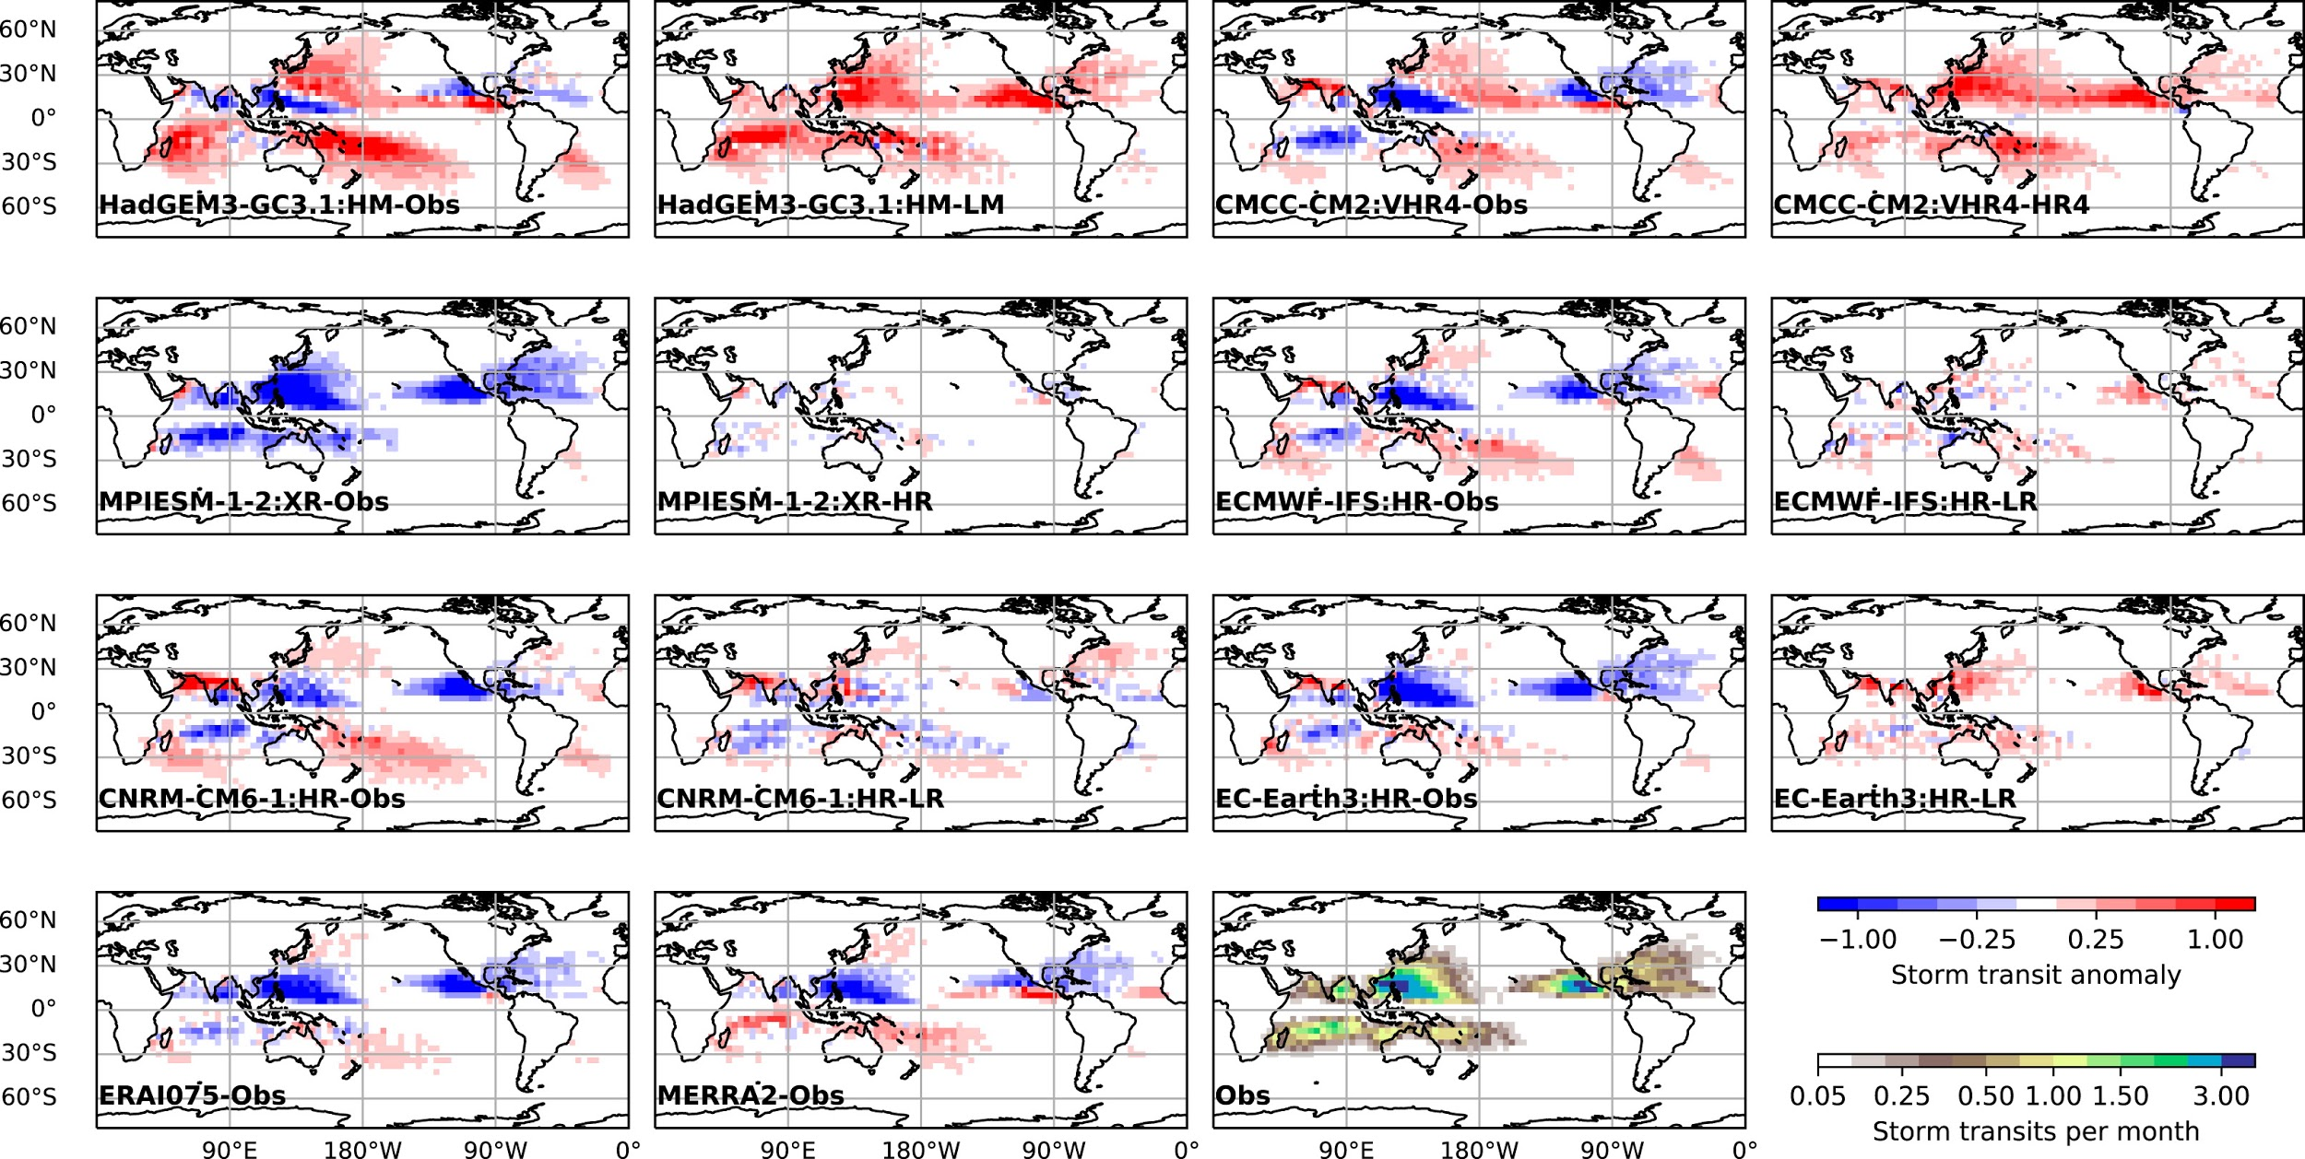
Impact of Resolution on Track Density
Roberts et al. (2020a)

Slide 6
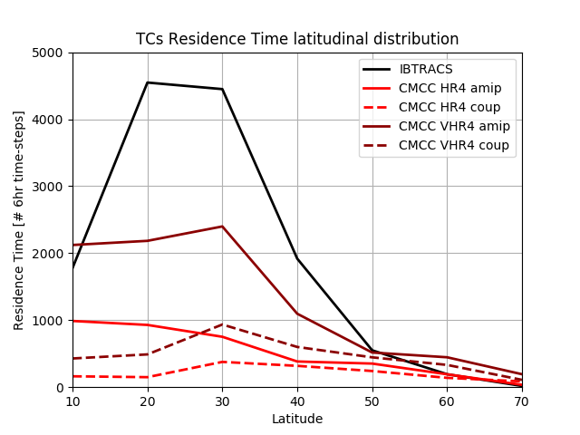
Impact of Resolution on Residence
Peano et al. (in prep)
Notes:
* The first figure (CMCC_numTCs.png) shows the latitudinal distribution of tropical cyclones' Residence Time (measured in the number of 6hr time-steps with tropical cyclones in each latitudinal band of 10 degrees, namely 5-15°N, 15-25, 25-35, 35-45, 45-55, 55-65, 65-75) in the period 1985-2014 over the North Atlantic Basin for observations (IBTRACS) and CMCC-CM2 in two PRIMAVERA simulations (hist-1950 (coupled), highresSST-present (AMIP-like)) and with two resolutions (HR4 (low-resolution configuration: ocean 1/4, atm 1), VHR4 (high-resolution configuration: ocean 1/4, atm 1/4));

Slide 7
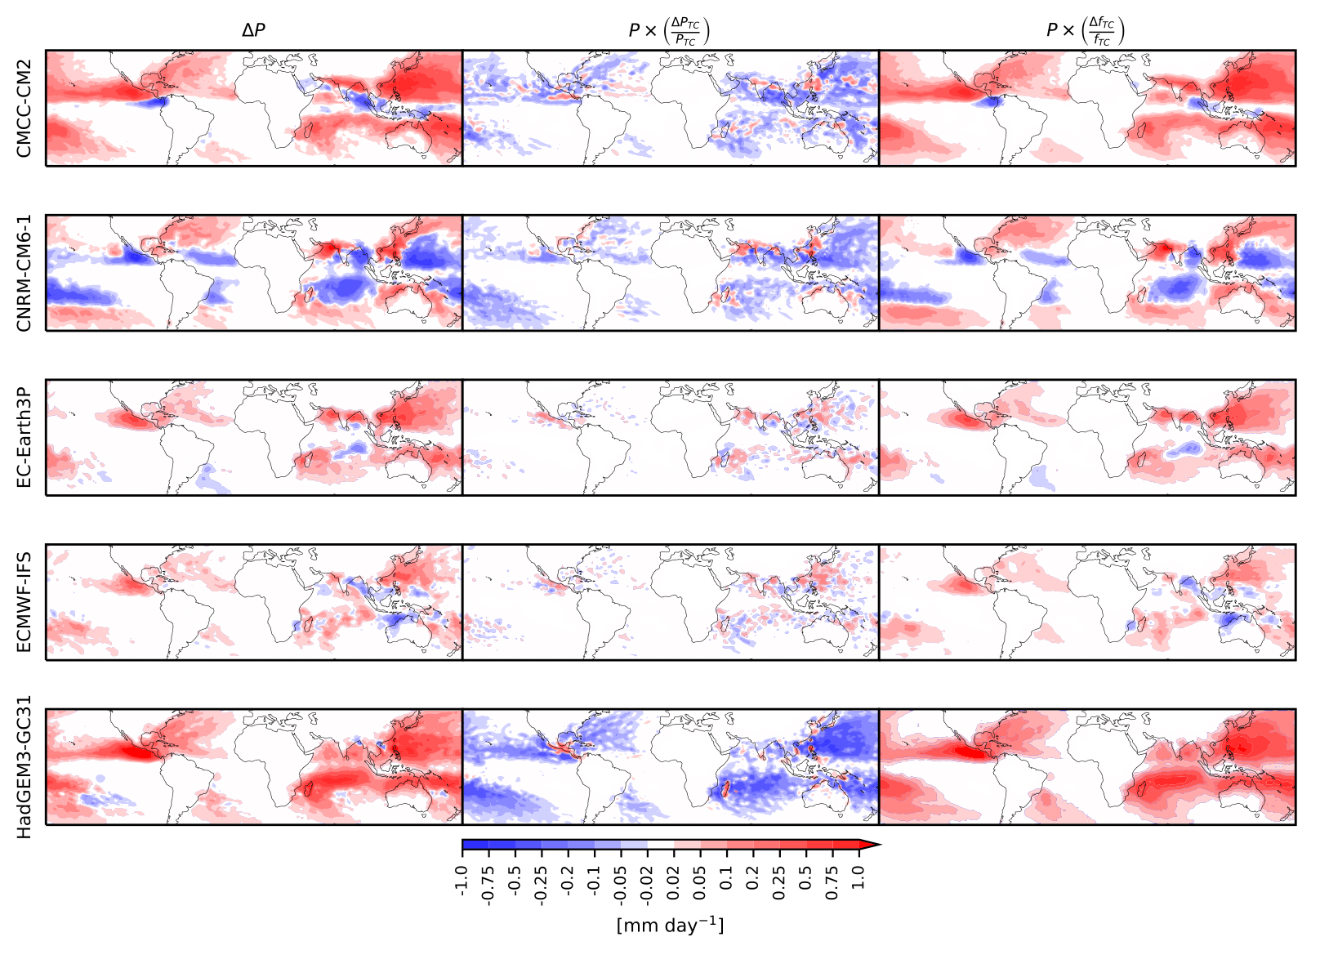
Impact of Resolution on TC-induced Precipitation
Vannière et al. (2020), under review.
Notes:
The two terms on the right-hand-side correspond respectively to the contribution of the fractional change of precipitation per tropical cyclone and the fractional change of TC frequency to the change in total precipitation associated with TCs.
We find that DP is mostly explained by the change in frequency of tropical cyclones when resolution is increased. In HadGEM3-GC31, CNRM-CM6-1 and CMCC-CM2, it is slightly offset by a decrease in the amount of precipitation per TC. This is easily understood by the reduction of frequency of low intensity TCP5° in LR, discussed previously, which leads to higher TCP5° when averaged over all bins.

Slide 8
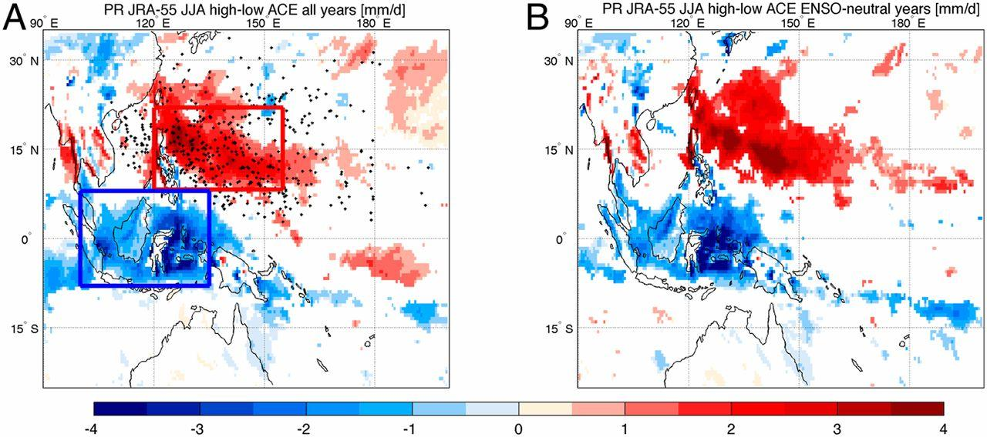
Drying of the Maritime Continent
Scoccimarro et al. (2020)
Notes:
Comparison between precipitation associated with high-ACE and low-ACE years. The difference between JJA JRA-55 precipitation associated with high-ACE (higher than the median) and low-ACE years is shown (A) considering the whole period 1979–2015 and (B) considering ENSO neutral years only. Units are millimeters per day. Black dots represent the origin of TCs observed in this period. Blue and red boxes in A mark the domain used to compute the Maritime Continent and West Pacific TC region averages, respectively. White patterns represent regions where the difference is not statistically significant.

Slide 9
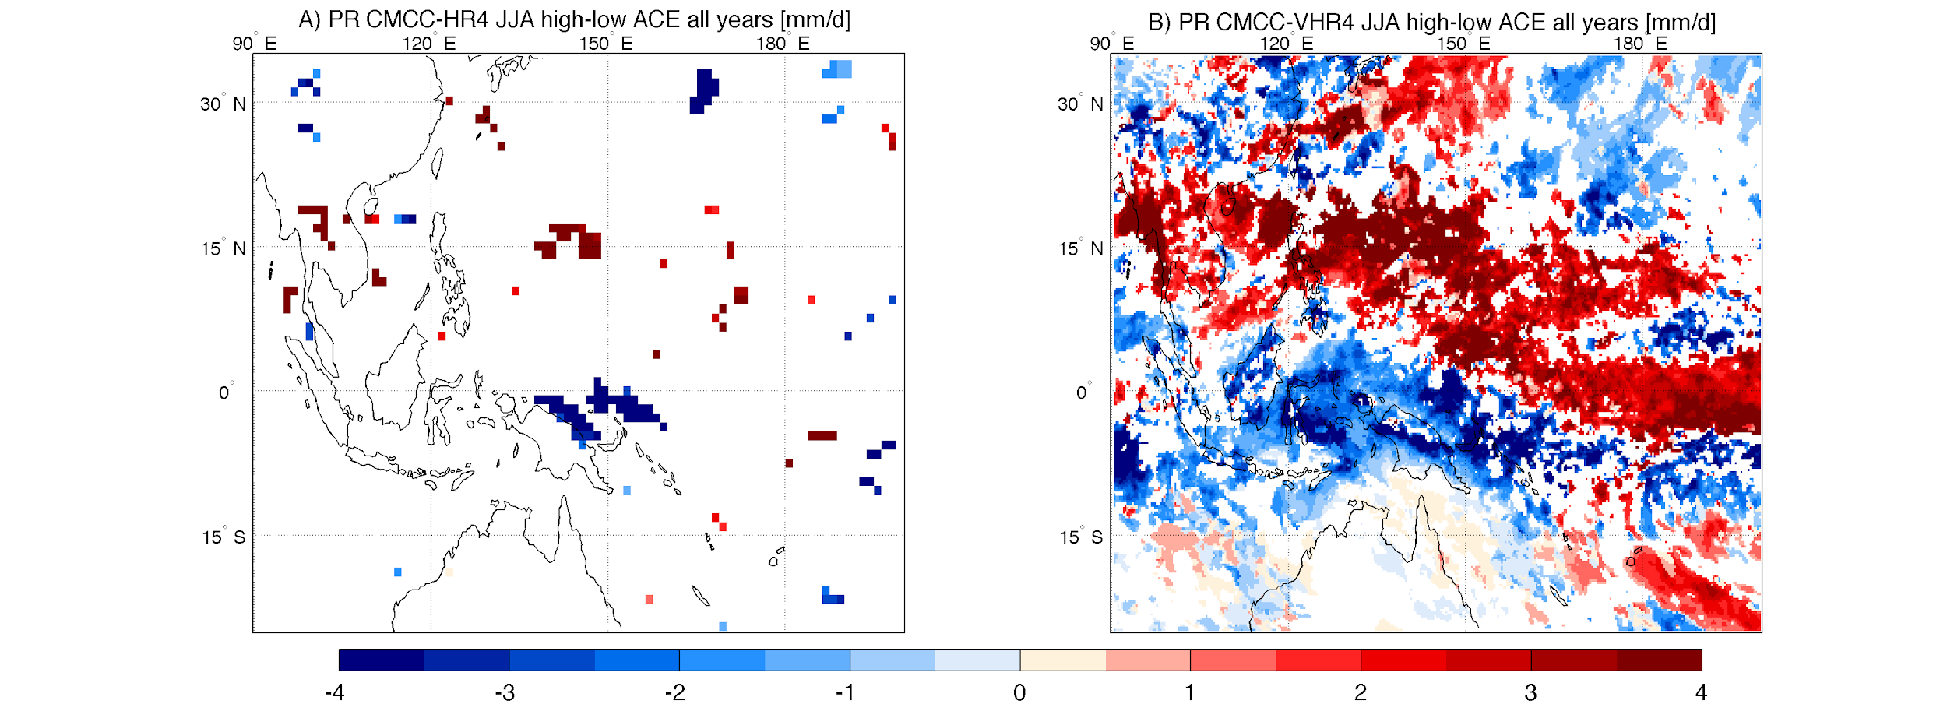
Drying of the Maritime Continent
LR
HR
Scoccimarro et al. (2020)
Notes:
Nominal Resolution: LR: 100 km HR: 25 km

Slide 10
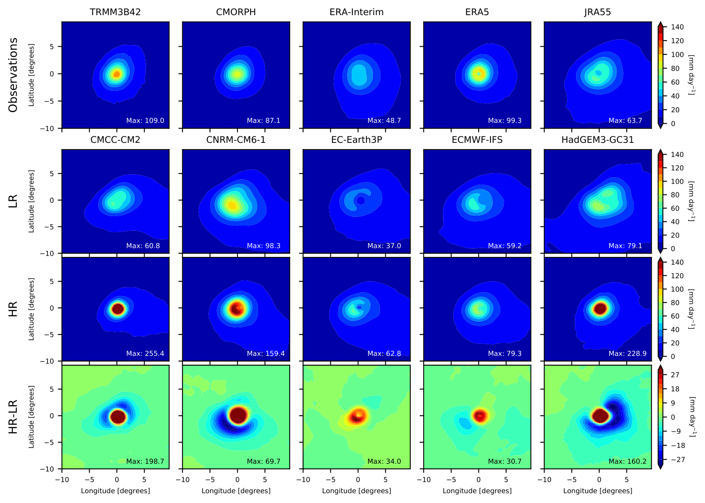
Impact of Resolution on TC-induced Precipitation
Obs
LR
HR
Vannière et al. (2020), under review
HR-LR
Notes:
composited precipitation for the 200 strongest tropical cyclones in each model over the period 1998-2014. Precipitation has been averaged over the full lifetime of all the storms. This mean view is not representative of a single tropical cyclone, which is characterized by mesoscale structures, such as spiraling rain bands; rather, it reflects the likelihood of precipitation occurring at a given distance from the center of the storm.
Per-TC precipitation simulated in GCMs, unlike TC intensity, is relatively insensitive to the grid horizontal resolution. TC precipitation has however some dependence on model formulation.

Slide 11
Impact of Resolution on Intensity
Roberts et al. (2020a)
Notes:
CNRM nominal resolution: 250 km / 50 km

Slide 12
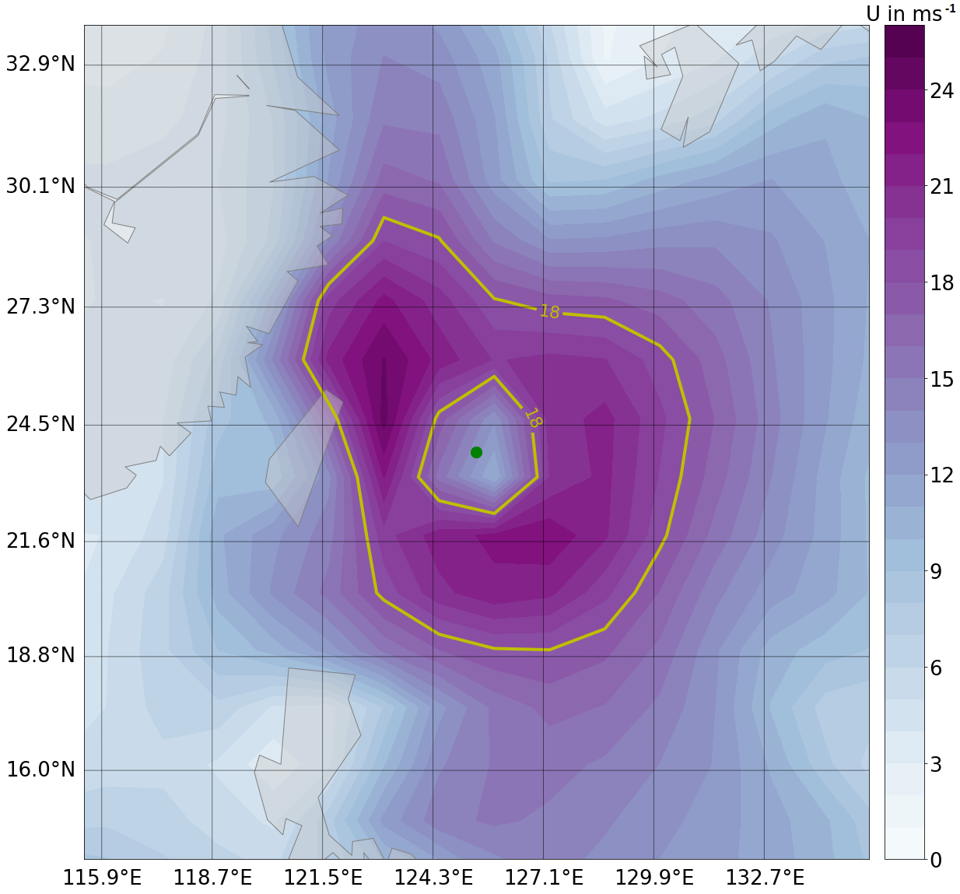
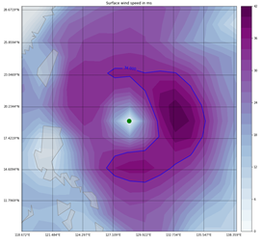
Impact of Resolution on Integrated Kinetic Energy
Correlation IKE w/ | LR | HR
maximum surface wind speed | 0.87 | 0.82
IKE area | 0.99 | 0.96
minimum MSLP | -0.78 | -0.85
Kreussler et al., in prep.

Slide 13
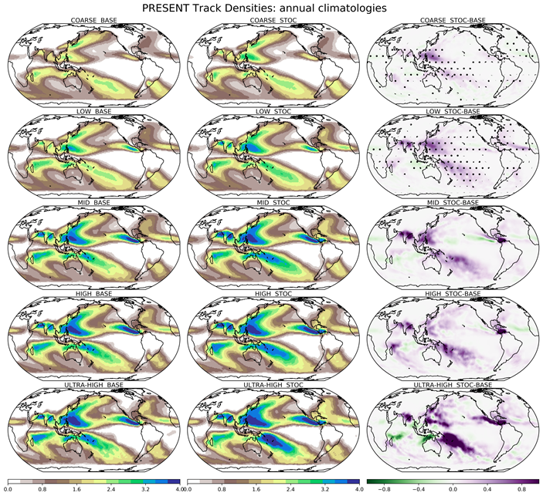
Impact of Stochastic Physics on TC track density
Up to 30% increase using SP
Vidale et al., in prep.
Notes:
Stochastic physics introduced to improve the spread and mean in ensemble NWP .
Sample the uncertainty in sub-grid scale processes (parameterised), unpredictable.
Introduce stochastic (random) noise. Two main schemes:
Stochastic Kinetic Energy Backscatter (SKEB). - Upscale propagation of KE due to missing or diffused processes
Stochastically Perturbed Parametrisation Tendencies (SPPT)- randomly perturbs the tendencies from the physical parameterisation schemes.

Slide 14
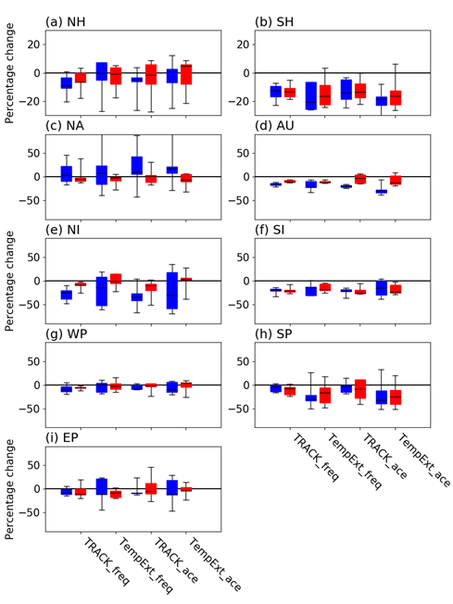
Future TC Activity
(2020-2050) - (1950-1980)
Roberts et al. (2020b), under review.

Slide 15
References
Roberts, MJ, (2020) Projected Future Changes in Tropical Cyclones using the CMIP6 HighResMIP Multi-model Ensemble. Geophys Res Lett. Under review.
Roberts, MJ (2020) Impact of model resolution on tropical cyclone simulation using the HighResMIP-PRIMAVERA multi-model ensemble. J. Clim. https://doi.org/10.1175/JCLI-D-19-0639.1
Scoccimarro et al. (2020) The typhoon-induced drying of the Maritime Continent. PNAS 117 (8) 3983-3988
Vanniere, B, (2020) The moisture budget of tropical cyclones: large scale environmental constraints and sensitivity to model horizontal resolution. J Climate. Under review.
Vidale et al. Impact of stochastic physics and model resolution on the simulation of tropical cyclones in Climate GCMs. In prep.

Slide 16
Thank you

