Slide 1
8th International Workshop on
Sand/Duststorms and Associated Dustfall
Lisbon, 1 – 4 May 2016
Mediterranean desert dust outbreaks’ direct radiative effects based on regional model simulations
A. Gkikas¹, V. Obiso¹, L. Vendrell¹, S. Basart¹, O. Jorba¹,
C.P. Garcia-Pando^{2,3}, N. Hatzianastassiou⁴, S. Gassó⁵, J.M. Baldasano^{1,5}
MDRAF
MC-IEF-Intra-European Fellowships (IEF)

Slide 2
Introduction – Aim of the study
Mediterranean is affected by desert dust outbreaks throughout the year
Spatiotemporal variability ➔ prevailing atmospheric circulation patterns and dust mobilization in the source areas (Sahara Desert, Middle East)
Interaction of dust aerosols with the incoming solar (shortwave, SW) and outgoing terrestrial (longwave, LW) radiation ➔ Perturbation of the Earth-Atmosphere system’s radiation budget
Direct, semi-direct and indirect radiative effects
Impact on atmospheric processes from short- (weather) to long-term (climate) temporal scales
Direct Radiative Effects (DREs)
Scattering and absorption of SW radiation
Absorption and re-emission of LW radiation
Consideration of dust radiative impacts ➔ Improvement of regional model weather forecasts (Pérez et al., 2006)
Calculation of DREs, induced by intense and widespread Mediterranean dust outbreaks, based on regional model simulations ➔ weather forecasts and feedbacks

Slide 3
Observational datasets
Gridded daily satellite retrievals provided at 1ºx1º spatial resolution (Level 3)
MODIS – Terra (Mar. 2000 – Feb. 2013), Collection 051 (C051)
Aerosol Optical Depth at 550nm (AOD_{550nm})
Ångström exponent (land ➔ 470 – 660nm, sea ➔ 550-865nm)
Fine Fraction
Effective radius (over sea)
Earth Probe TOMS (2000 – 2004)
Aerosol Index (AI)
OMI-Aura (2005 – 2013)
Aerosol Index (AI)
Satellite data
Baseline Surface Radiation Network (BSRN)
Downwelling shortwave (SW) and longwave (LW) radiation
Sede Boker (South Israel)
AERosol RObotic NETwork (AERONET)
Aerosol Optical Depth (AOD) at 550nm
Level 2.0
Sede Boker (South Israel)
Ground data

Slide 4
NMMB/BSC-Dust regional model
Model features
Physics schemes
Non-hydrostatic Multiscale Model NMMB (Janjic et al., 2004)
Arakawa B grid (Arakawa and Lamb, 1977)
Vertical hybrid σ-pressure coordinate system (Simmons and Burridge, 1981)
A rotated longitude-latitude coordinated system is used for regional simulations
Radiation: RRTM (Mlawer et al., 1997)
Convection: Betts-Miller-Janjic (BMJ) (Betts, 1986)
Clouds and microphysics: Ferrier (Ferrier et al., 2002)
Turbulence: Mellor-Yamada-Janjic (MYJ) (Janjic, 2001)
Land model: NCEP NOAH (Eck et al., 2003)
Aerosols
Model configuration
Dust model: Coupled with the NMMB model (Pérez et al., 2011; Haustein et al., 2012)
8 size bins (Tegen and Lacis, 1996; Pérez et al., 2006)
GOCART (Chin et al., 2002) optical properties (extinction efficiency, SSA, g)
Other aerosol types: OC, BC, SS, sulfate (2000-2007) – GOCART climatology
Horizontal: 0.25º x 0.25º
Vertical: 40 σ-pressure levels up to 50hPa
Initial and 6-hourly boundary conditions: NCEP final analyses (FNL) at 1º x 1º
Forecast range: 84 hours
Initialization: at 00UTC of the desert dust outbreak day
Forecast outputs: every 3 hours
Spin-up period: 10 days (24h reinitialization)

Slide 5
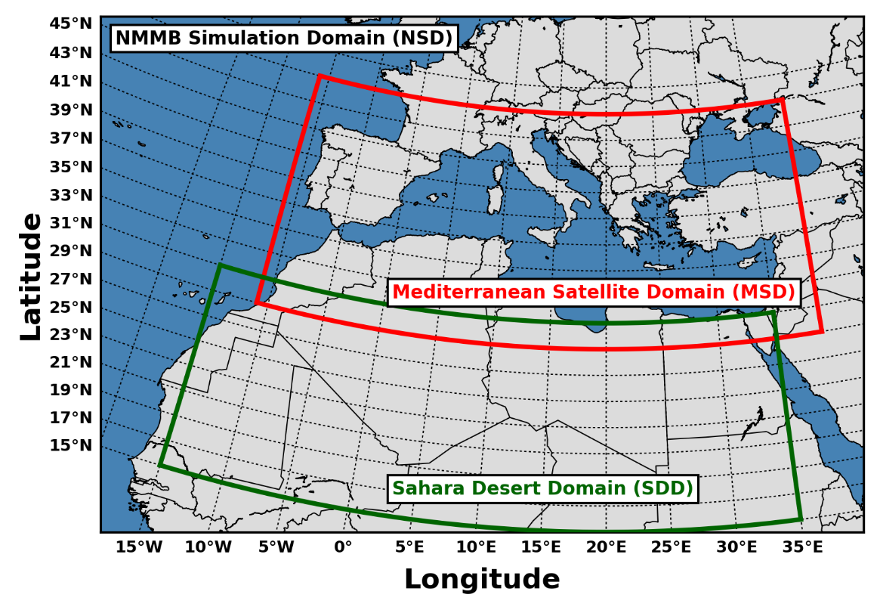
Simulation (NSD) and satellite (MSD) domains
NSD: NMMB/BSC-Dust short-term (84 h) forecasts
MSD: Identification of desert dust outbreaks

Slide 6
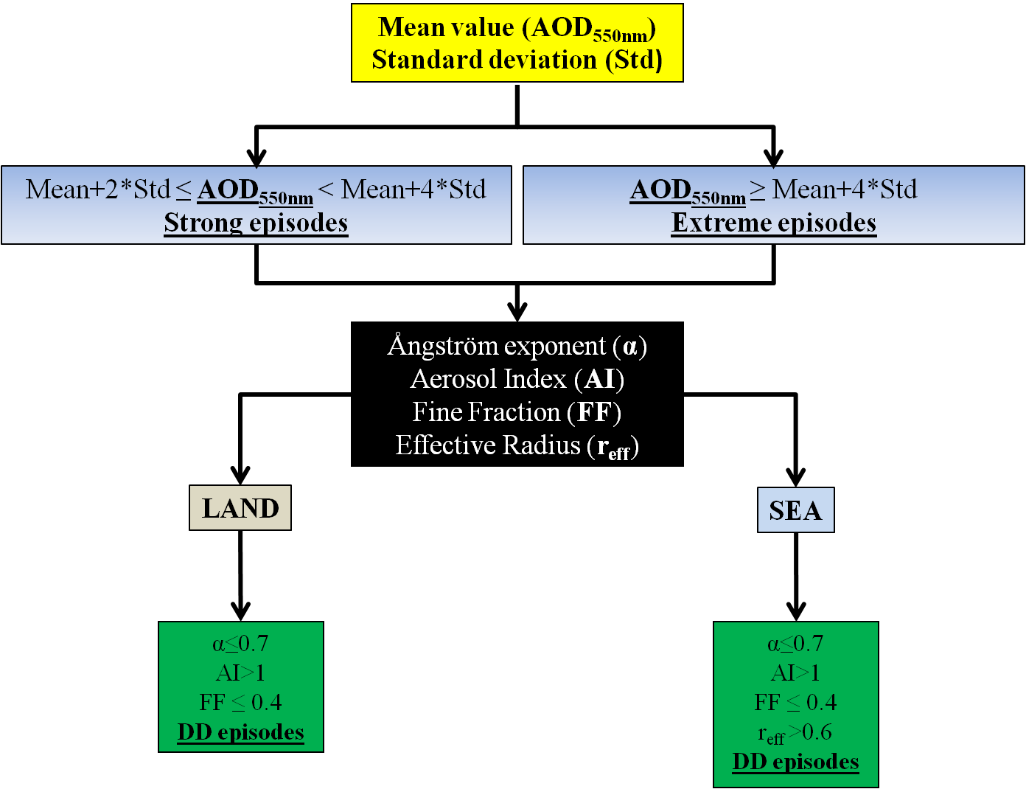
Identification of desert dust (DD) episodes at pixel level (MSD domain)
Gkikas et al. (2009; 2013; 2016)
Implementation of the satellite algorithm in each 1º x 1º grid cell
Operation period: 1 March 2000 – 28 February 2013

Slide 7
Selection of desert dust outbreaks at regional level (MSD domain)
Selection criteria
Days where at least 30 pixel-level DD episodes (either strong or extreme) have been identified by the satellite algorithm (Gkikas et al., 2012; 2015)
Calculation of the mean regional AOD considering only pixels undergoing a DD episode
Ranking of days based on dust outbreaks’ intensity (MODIS-Terra regional AOD)
20 widespread and intense Mediterranean desert dust outbreaks are analyzed
Statistics
 | Dust outbreaks | Percentage (%) | MSD Sector
Winter | 5 | 25% | Eastern – Central
Spring | 11 | 55% | Central – Eastern
Summer | 4 | 20% | Western
Autumn | 0 | 0% | -
Total | 20 | 100%
Number of DD episodes: 30 (28/7/2005) – 85 (31/7/2001)
Intensity of dust outbreaks: 0.74 (31/7/2001) – 2.96 (2/3/2005)

Slide 8
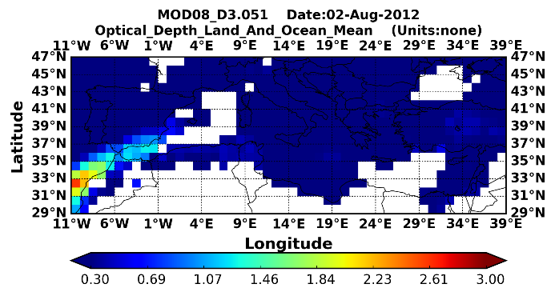
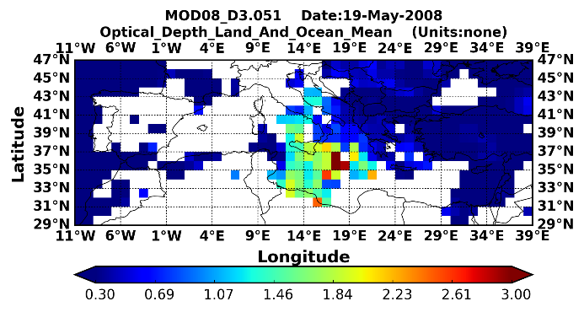
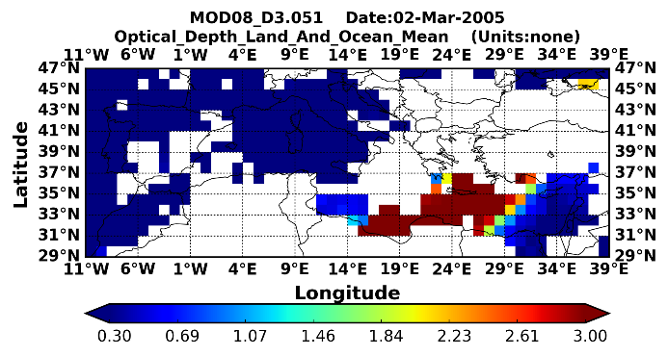
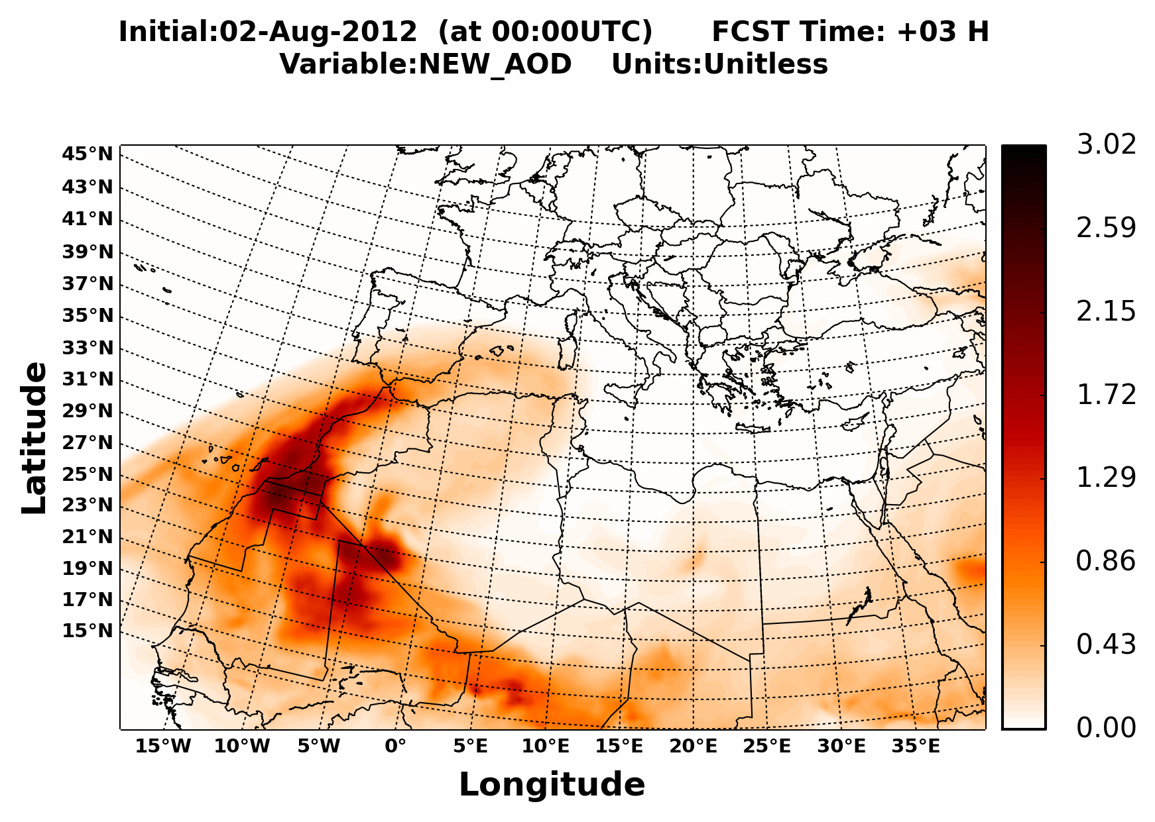
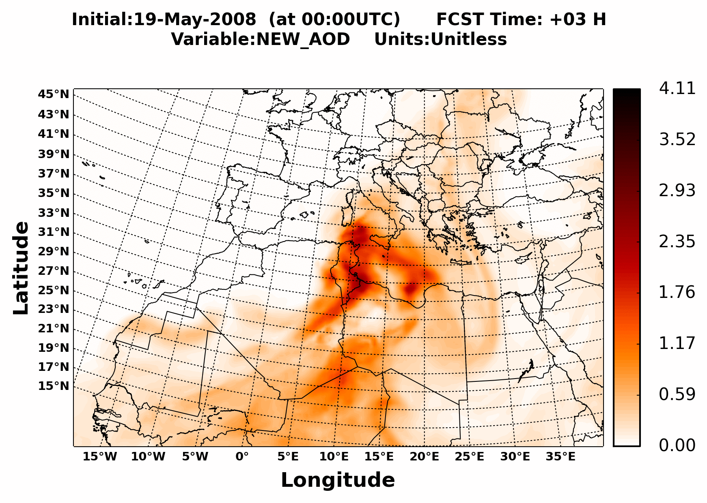
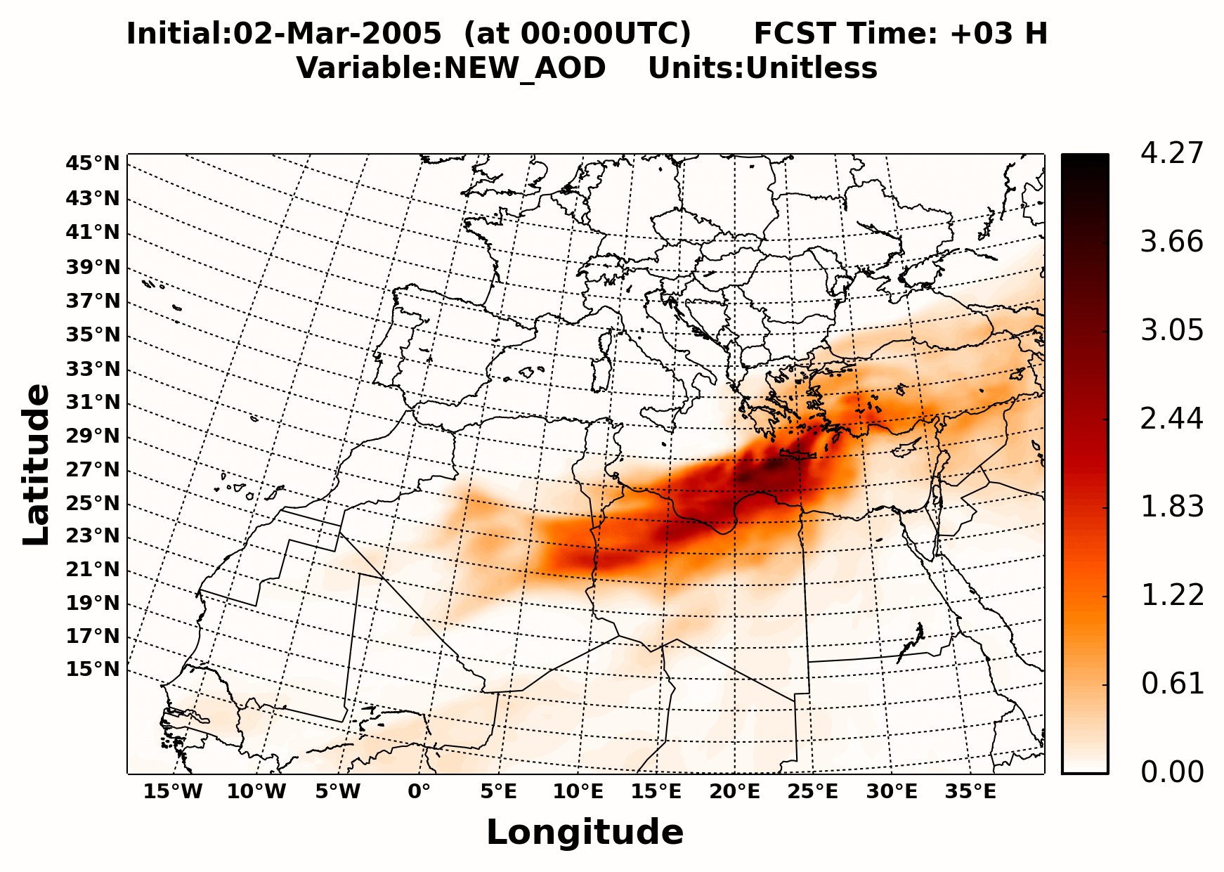
Intense dust outbreaks over the broader Mediterranean basin
2 August 2012
19 May 2008
2 March 2005
MODIS-Terra
(AOD@550)
Satellite observations of the desert dust outbreaks
NMMB
(Dust AOD@550)
NMMB short-term (84 hours) regional simulations initialized at 00 UTC of the desert dust outbreak day

Slide 9
Direct Radiative Effects (DREs)
Top of Atmosphere (TOA)
Downwelling radiation at surface (SURF)
Absorbed radiation at surface (NETSURF)
Into the Atmosphere (ATM)
RADON/RADOFF: Activated/deactivated dust-radiation interactions
Shortwave (SW), longwave (LW) and NET (SW+LW) radiation
Positive DREs indicate warming effect while negative DREs indicate cooling effect

Slide 10
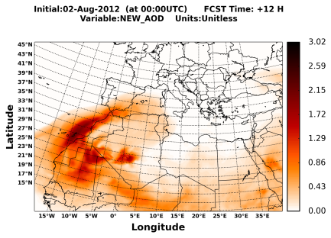
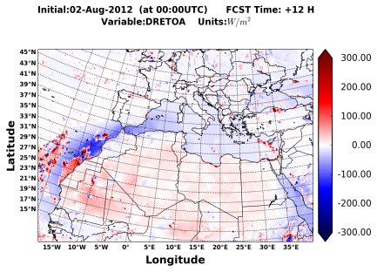
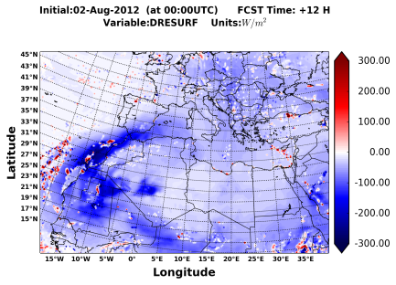
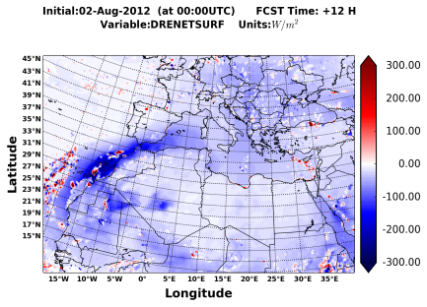
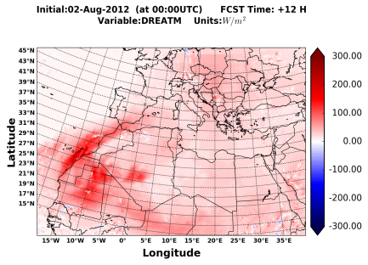
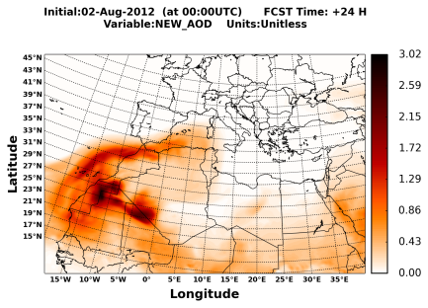
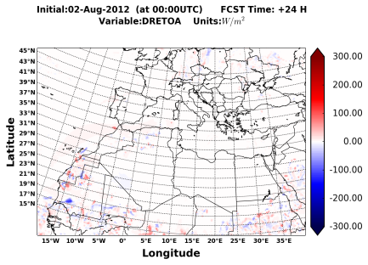
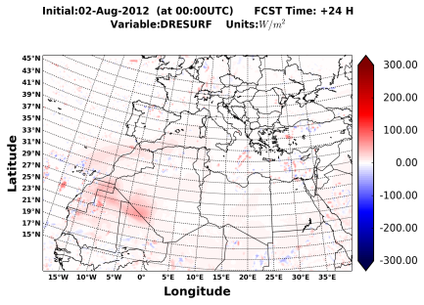
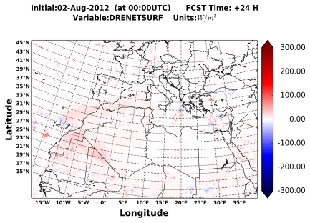
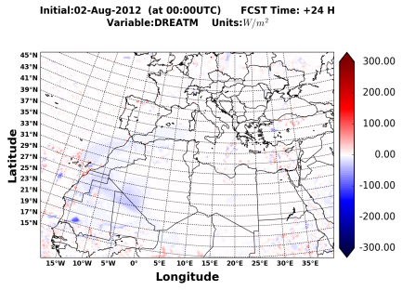
Instantaneous NET DREs based on NMMB simulations (2nd August 2012)
Dust AOD
TOA
SURF
NETSURF
ATM
+12H (Day)
+24H (Night)
TOA
Warming/cooling
over desert/sea at noon
Higher/lower albedos
SURF & NETSURF
Cooling/warming
during day/night
SW/LW effects
ATM
Warming/cooling
during day/night
SW/LW effects
Strong impacts driven by the desert dust outbreaks’ patterns

Slide 11
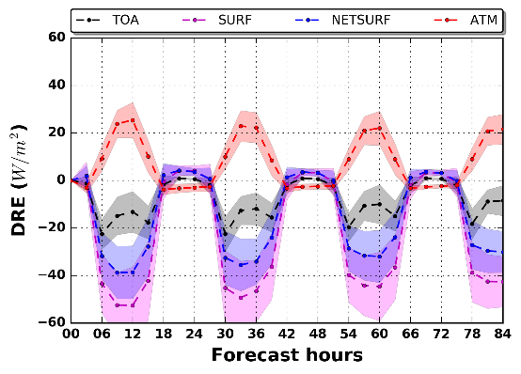
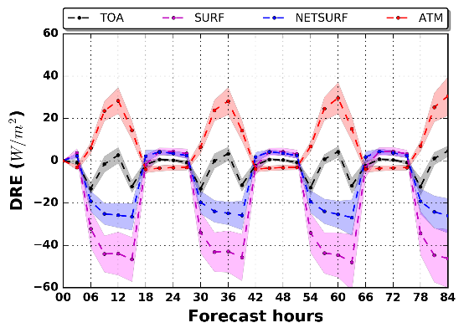
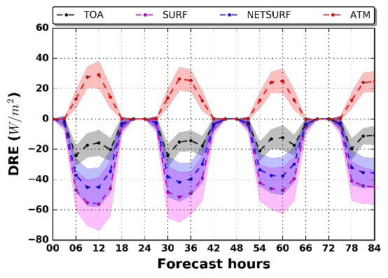
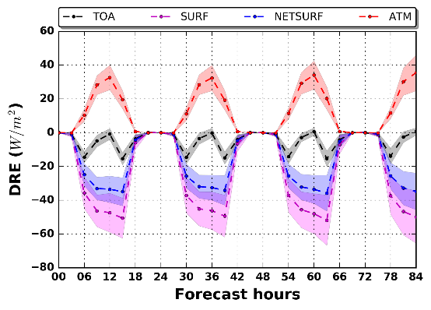
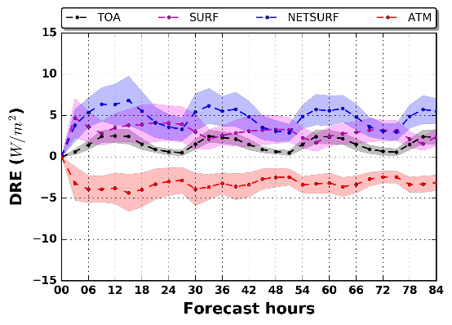
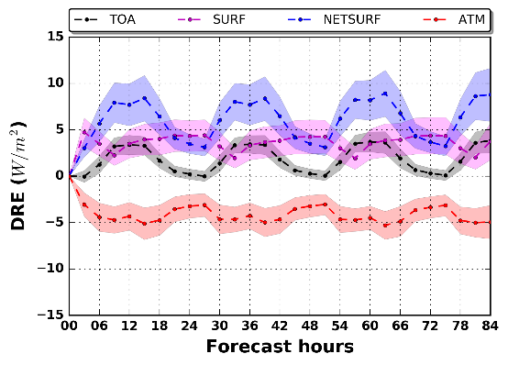
Regional DREs under clear sky conditions for the 20 desert dust outbreaks
MSD
SDD
Surface cooling
(up to 60 W/m²)
Atmospheric warming
(up to 30 W/m²)
Planetary cooling
(up to 20 W/m²)
NET (SW+LW)
Slightly higher SW DREs compared to NET DREs
SW
Reverse LW effects
of lower magnitude compared to SW ones
Predominance of
SW effects
LW
Planetary warming and cooling in SDD and MSD, respectively, at noon
Higher albedos across the Sahara desert ➔ Increase of atmospheric warming

Slide 12
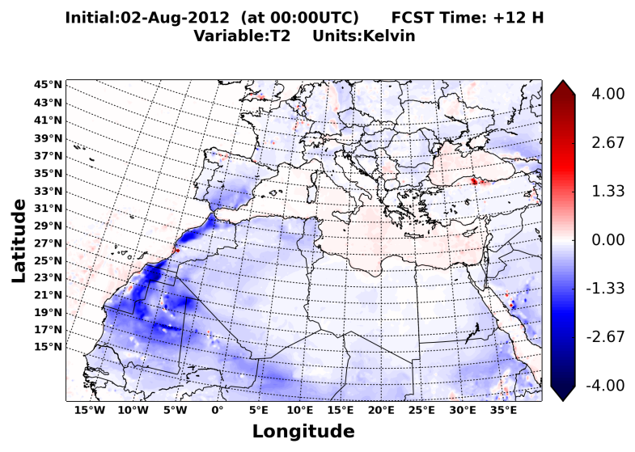
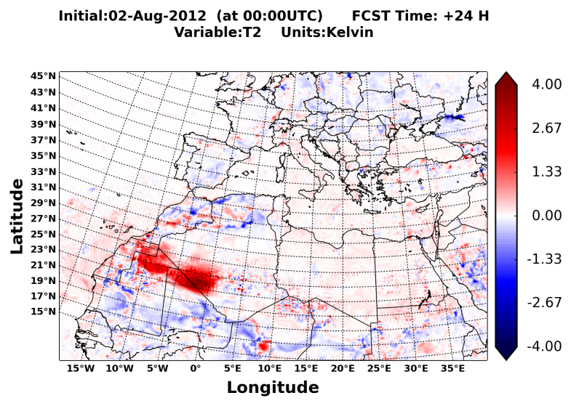
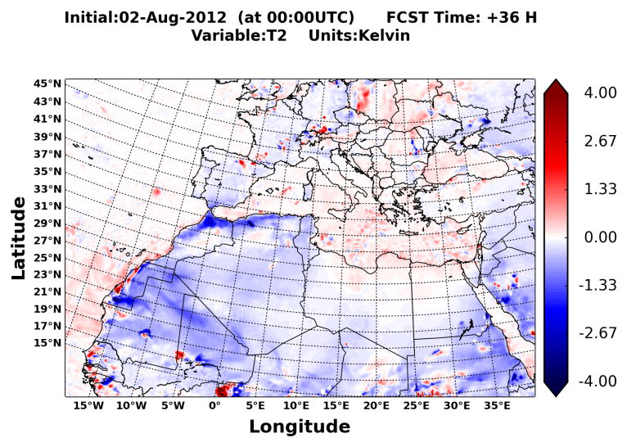
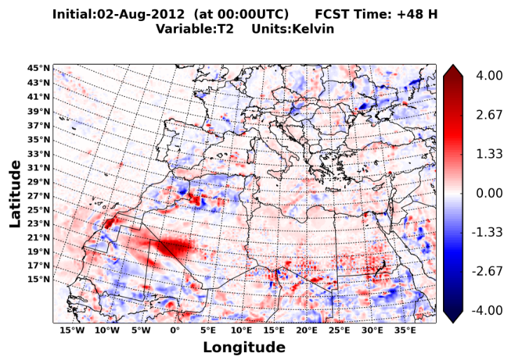
Impact on temperature at 2 meters: 2nd August 2012
Daytime
Nighttime
+12H
+24H
+36H
+48H
SW DREs ➔ Reduction of temperature at 2 meters (up to 4 ºC) during daytime
LW DREs ➔ Increase of temperature at 2 meters (up to 3-4 ºC) during nighttime
Reduction of the diurnal temperature range

Slide 13
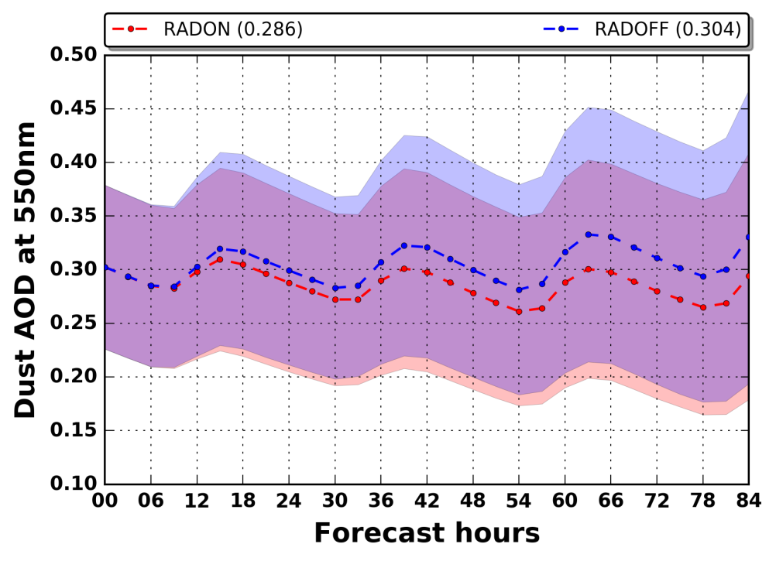
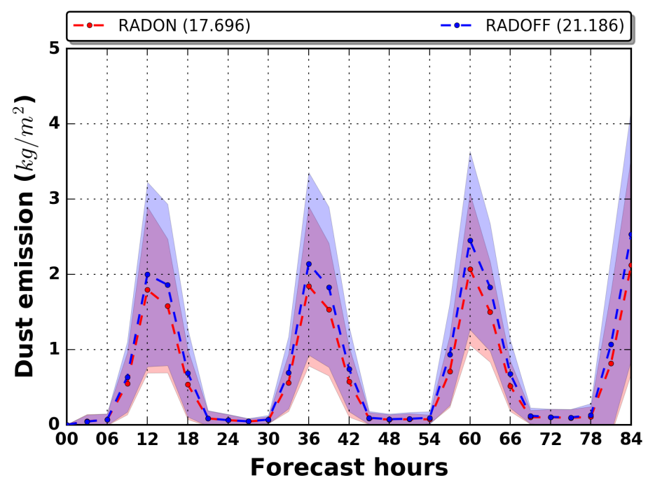
Feedbacks on dust AOD and dust emission (NSD)
Dust AOD@550
Dust emission
Dust AOD
Increasing RADOFF-RADON biases (negative feedback) for increasing forecast hours
Reduction by 6.3% of the regional (NSD) dust AOD over the forecast cycle (84 hours)
Dust emission
Reduction of dust emission at noon-late noon for the RADON simulation
Reduced outgoing surface sensible heat flux from the ground
Reduction by 19.7% of the regional (NSD) dust emission over the forecast cycle (84 hours)
Negative feedbacks on dust emission and dust AOD when dust radiative effects are considered into the numerical simulations

Slide 14
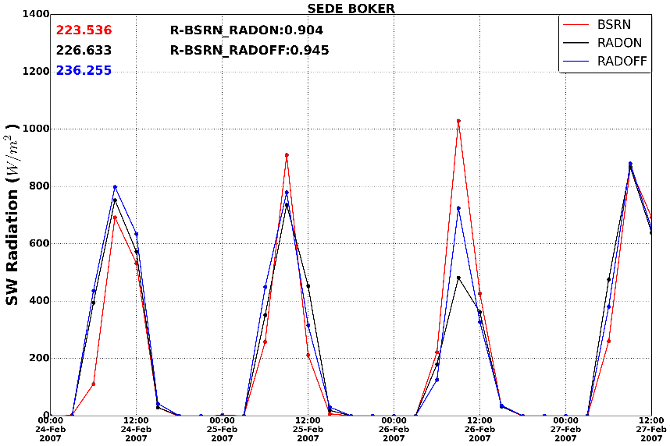
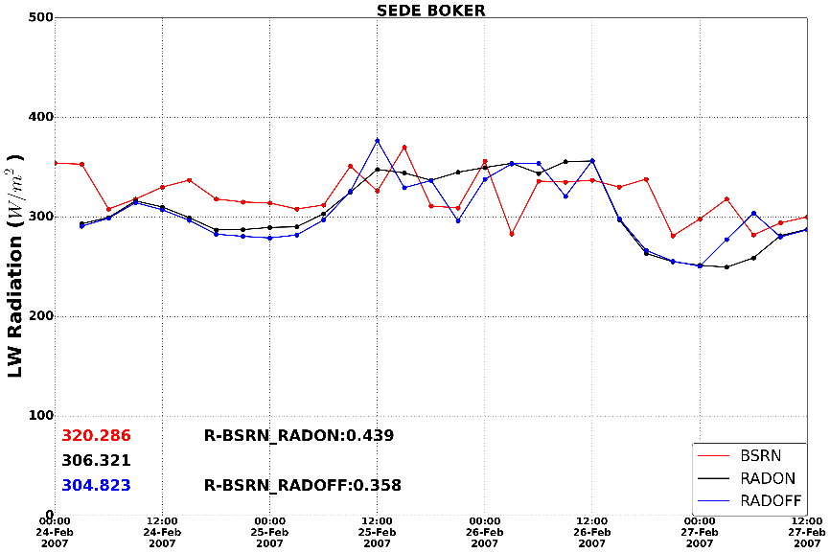
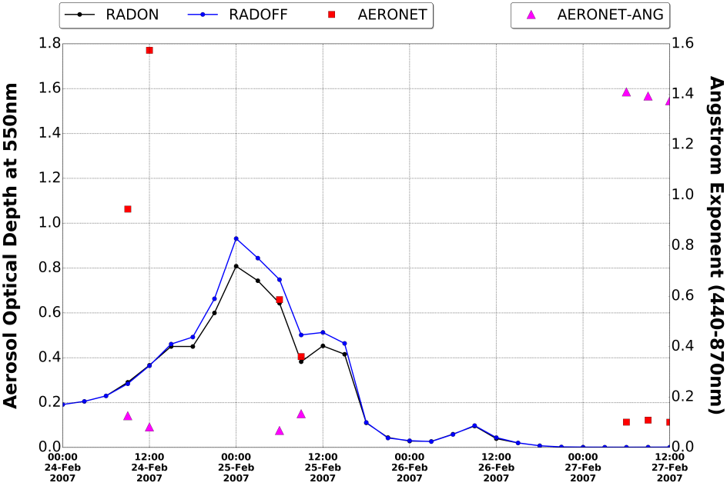
Downwelling SW and LW radiation: Comparison NMMB – BSRN
SW radiation
LW radiation
AOD@550nm
Sede Boker (Israel) | 24 Feb. 2007
Misrepresentation of the dust outbreak by the model ➔ Overestimation (by 30-40 Wm⁻²) of the SW radiation
LW effect ➔ Reduction (by 20-30 Wm⁻²) of the LW underestimation by the model (RADON)
Underestimation (by 300-600 Wm⁻²) of the SW radiation by the model ➔ Development of low clouds based on model simulations
Reduction of NMMB-BSRN differences for the RADON simulation

Slide 15
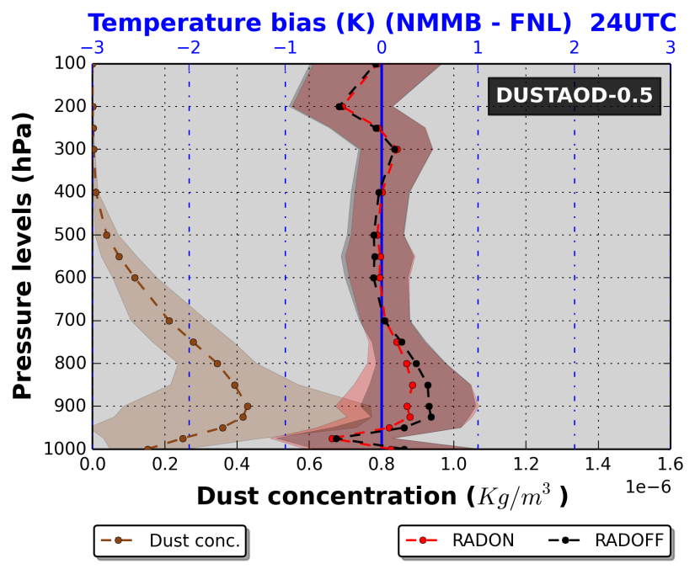
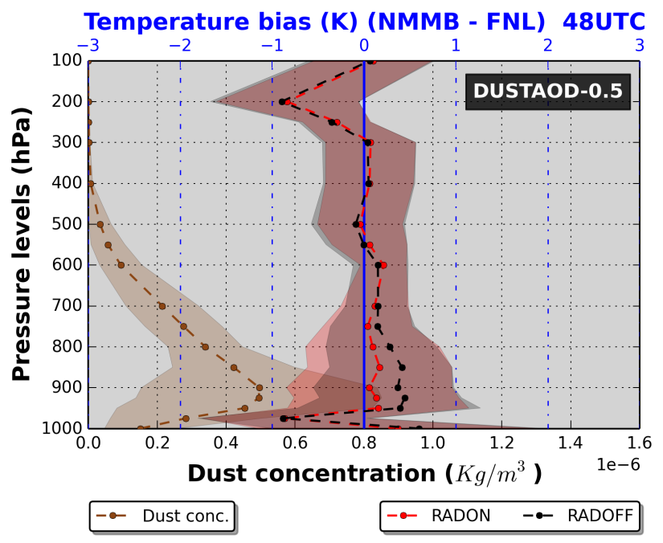
Temperature vertical profiles: Comparison NMMB – FNL (NSD)
+24H
+48H
Dust AOD ≥ 0.5
LW effect ➔ Reduction by 0.2-0.3 ºC, for the RADON simulation, of the model warm biases during nighttime

Slide 16
Conclusions
Identification of 20 intense and widespread Mediterranean dust outbreaks based on an objective and dynamic satellite algorithm
Calculation of the instantaneous DREs based on short-term (84 hours) simulations of the NMMB/BSC-Dust regional model
TOA: Cooling (up to 250 Wm⁻²)/warming (up to 50 Wm⁻²) over sea/desert at noon ➔ higher albedos across desert areas
SURF & NETSURF: Cooling (up to 300 Wm⁻²)/warming (up to 50 Wm⁻²) during daytime/nighttime ➔ SW/LW effect
ATM: Warming (up to 200 Wm⁻²)/cooling (up to 50 Wm⁻²) during daytime/nighttime ➔ SW/LW effect
Predominance of the SW effects
Reduction/increase of temperature at 2 m (by up to 4 ºC) during daytime/nighttime
Negative feedbacks on dust AOD and emission
Reduction of the NMMB-BSRN biases, for the downwelling SW and LW radiation, when dust-radiation interactions are activated (RADON simulation)
Better representation of the temperature fields during nighttime when dust radiative effects are considered into the numerical simulations (RADON simulation)

Slide 17
8th International Workshop on
Sand/Duststorms and Associated Dustfall
Lisbon, 1 – 4 May 2016
Mediterranean desert dust outbreaks’ direct radiative effects based on regional model simulations
A. Gkikas¹, V. Obiso¹, L. Vendrell¹, S. Basart¹, O. Jorba¹,
C.P. Garcia-Pando^{2,3}, N. Hatzianastassiou⁴, S. Gassó⁵, J.M. Baldasano^{1,5}
MDRAF
MC-IEF-Intra-European Fellowships (IEF)

Slide 18
Outline
Introduction – Aim of the study
Observational datasets
NMMB/BSC-Dust regional model
Identification of desert dust outbreaks, based on satellite retrievals, from grid cell to regional level
Direct Radiative Effects (DREs)
Impact on temperature at 2 meters
Feedback on dust AOD and dust emission
Assessment of the NMMB downwelling SW and LW radiation versus BSRN measurements
Assessment of the NMMB forecast temperature vertical profiles versus FNL analyses
Conclusions

Slide 19
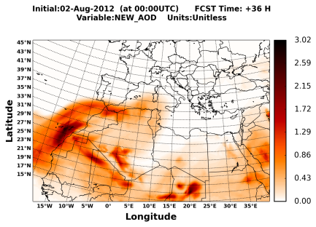
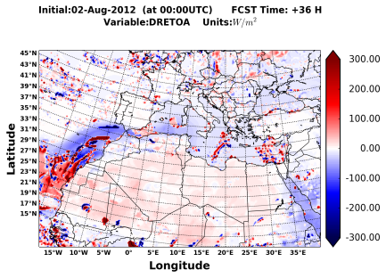
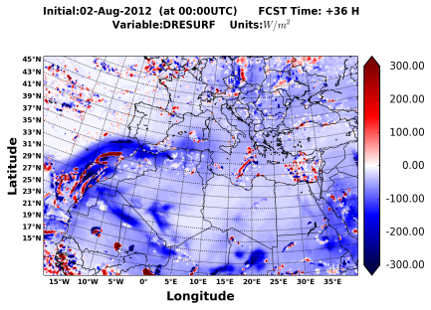
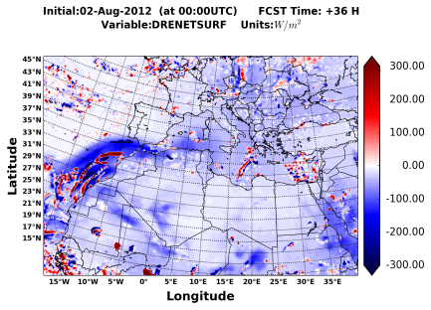
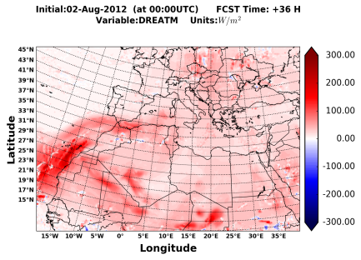
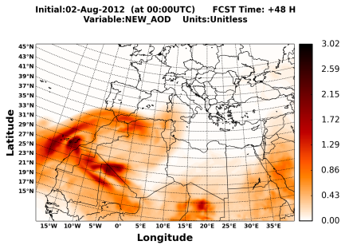
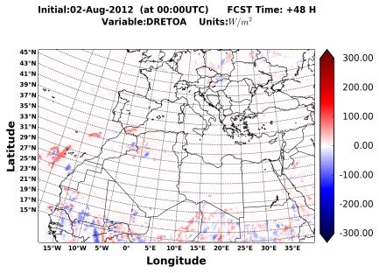
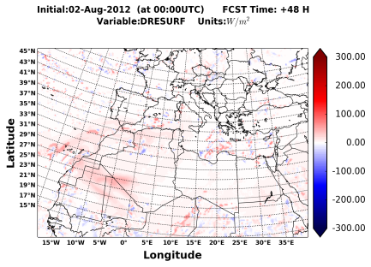
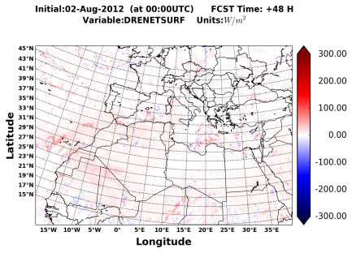
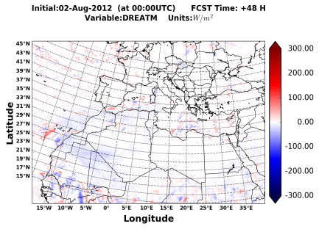
NET DREs based on NMMB/BSC-Dust model simulations (2nd August 2012)
Dust AOD
TOA
SURF
NETSURF
ATM
+12H
+24H
+36H
+48H
TOA
Warming/cooling
over desert/sea at noon
SURF & NETSURF
Cooling/warming
during day/night
ATM
Warming/cooling
during day/night

Slide 20
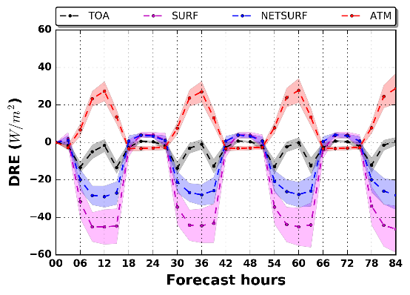
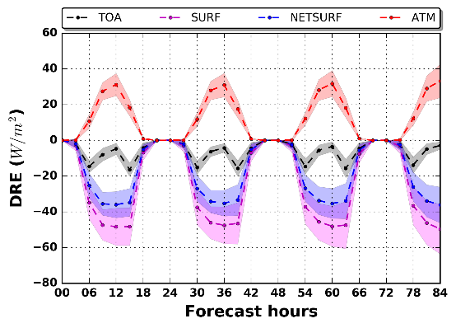
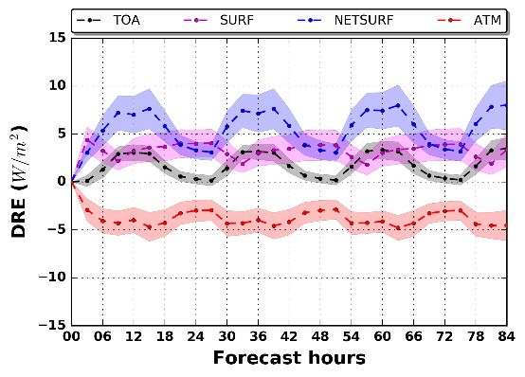
Regional DREs under clear sky conditions
NSD
MSD
SDD
Surface cooling
(up to 50 W/m²)
Atmospheric warming
(up to 30 W/m²)
Planetary cooling
(up to 18 W/m²)
NET (SW+LW)
Slightly higher SW DREs compared to NET DREs
SW
Reverse LW effects
of lower magnitude compared to SW ones
Predominance of
SW effects
LW
Planetary warming and cooling in SDD and MSD, respectively, at noon
Higher albedos across the Sahara desert ➔ Increase of atmospheric warming

Slide 21
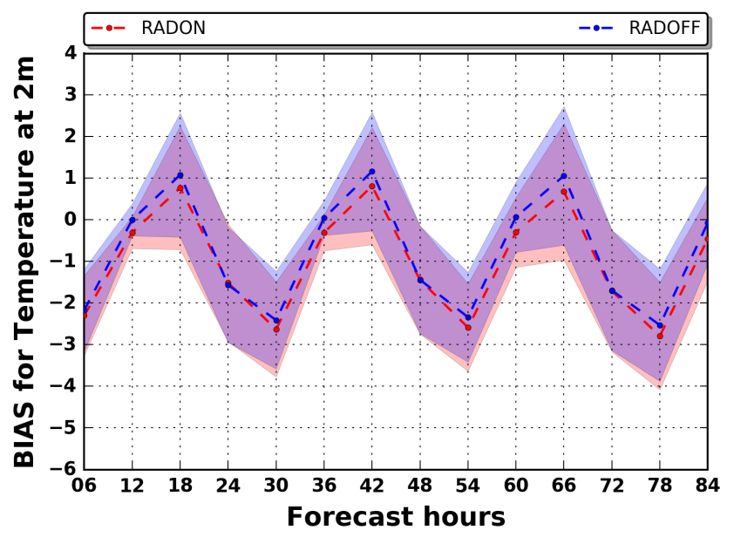
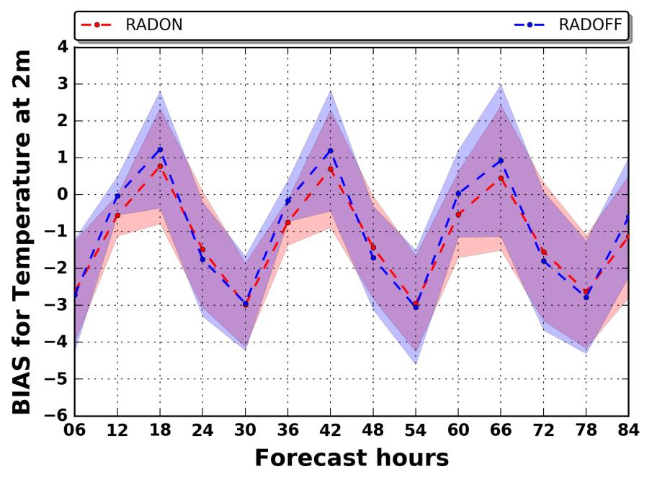
Temperature at 2 meters: Comparison NMMB – FNL (NSD)
Dust AOD ≥ 0.1
Dust AOD ≥ 0.5
Dust AOD ≥ 1.0
Consideration of land grid points
LW effect ➔ Improvement of model forecasts during nighttime, for increasing dust AOD threshold, when dust radiative effects are considered (RADON simulation)
SW effect ➔ Better performance for the RADOFF simulation at noon

Slide 22
Optical properties (GOCART and BSC)
EXT
SSA
ASYM
GOCART
BSC

Slide 23
Temperature vertical profiles: Comparison NMMB – FNL (NSD)
Daytime
Nighttime
+12H
+24H
Dust AOD ≥ 0.5
+36H
+48H
LW effect ➔ Reduction by 0.2-0.3 ºC, for the RADON simulation, of the model warm biases during nighttime

Slide 24
NMMB elevation and albedo

