Slide 1
Climate predictions for energy
Albert Soret⁽¹⁾, Llorenç Lledó⁽¹⁾, Andrea Manrique-Suñén⁽¹⁾, Verónica Torralba⁽¹⁾, Nicola Cortesi⁽¹⁾, Jaume Ramon Gamón, Nube González-Reviriego⁽¹⁾, Pierre-Antoine Bretonnière⁽¹⁾, Isadora Christel⁽¹⁾, Francisco J. Doblas-Reyes,^{(1,2)}
(1) Barcelona Supercomputing Center (BSC), Barcelona, Spain
(2) Institució Catalana de Recerca i Estudis Avançats (ICREA), Barcelona, Spain
EERA JP Wind annual event, 17th-18th September 2018,Amsterdam

Slide 2
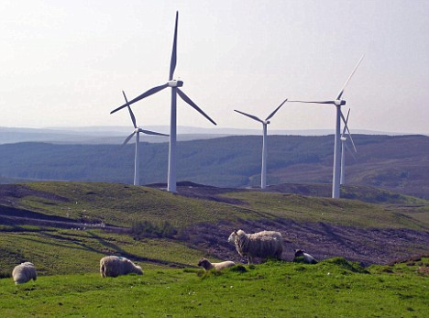
Context and motivation
Both energy supply and demand are strongly influenced by weather conditions and their evolution over time in terms of climate variability and climate change.
Notes:
Both energy supply and demand are strongly influenced by weather conditions and their evolution over time in terms of climate variability and climate change. The sensitivity of electricity demand to temperature is significant. While in northern Europe, cold spells during winter represent high-risk periods for the energy security of large areas (Ely et al., 2013), in southern Europe hot spells during summer are the source of high risk to the energy network stability (Pardo et al., 2002).
Despite cost competitive in many settings, renewable energy diffusion remains limited largely due to its variability. This works as a major barrier to renewable energies integration in electricity networks as knowledge of power output and demand forecasting beyond a few days remains poor.
The highest priority for the energy network operators is the balance between electricity demand and supply. Before the introduction of renewable energies, the demand was matched with base-load power plants (coal and nuclear) and generating plants that can be scheduled, usually hydroelectric and fossil-based power plants. This landscape has been changing rapidly with the integration of wind and solar energies into the energy mix over recent years. The increase has been particularly significant in wind energy which had rate of growth of 17% in 2014-2015 (GWEC, 2016), reaching near to 370 GW of installed capacity worldwide in 2014 (WWEA, 2015).This increase of renewable energy resources implies the introduction of new generation capacity that is dependent on a highly variable weather/climate (Spiecker and Weber, 2013).

Slide 3
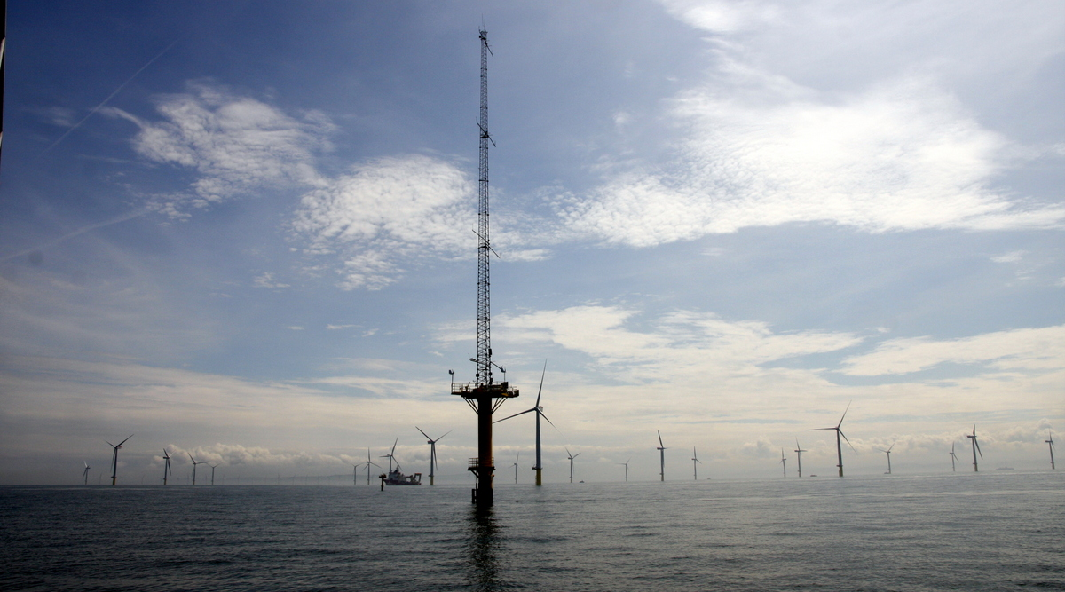
Context and motivation
Energy sector routinely uses weather forecast up to several days. Beyond this time horizon, climatological data are used.
Met mast on Gwynt y Môr offshore wind farm (source: solar wheel)
Notes:
While the energy sector has routinely been using weather forecasts of up to 15 days (Dubus, 2010), beyond this time horizon, climatological data (typically 30-year averages) are used. A common assumption in this method is that future conditions will be similar to past conditions. This assumption entails two inherent shortcomings. The first one is that past conditions can be highly variable, which can make them of limited use to forecast future ones. The second one is that climatology cannot predict events which have never happened before, e.g. extreme events, which can be particularly harmful and whose prediction is of special interest for stakeholders. Our knowledge of climatology is based on a finite sample of past events. This sample is limited in time, and doesn’t need to be fully representative of what can happen. Moreover, a climatological approach does not take into account changes in atmospheric dynamics, such as those caused by climate change. Climate change may render past conditions useless for predicting future events, as they may no longer be reproduced.

Slide 4
Climate predictions
Weather forecasts
Climate predictions
Climate-change projections
Sub-seasonal
Seasonal
Decadal
1-15 days
10-32 days
1-15 months
1-30 years
20-100 years
Time
Initial-value
driven
Boundary-condition
driven
Adapted from: Meehl et al. (2009)
Notes:
Seasonal climate forecasts occupy an intermediate zone between weather
forecasting and climate projections. They share with the numerical weather
prediction the difficulty of initializing the simulations with a realistic state of
the atmosphere and the need to periodically verify different aspects of their
quality, while additionally are burdened by uncertainties in feedback processes
that also play a central role in constraining climate projections. Seasonal predictions
have to deal also with the challenge of initializing all the components of the
climate system (ocean, sea ice, and land surface)
The boundaries
between these climate scales are loose. As this article
will illustrate, substantial overlap exists between them
because, among several other reasons, many of the
processes involved are common
Weather forecast are based in the initial conditions of the atmosphere, which is highly variable and develops a chaotic behaviour after a few days
Climate predictions are based in the initial conditions of the sea surface temperature, snow cover or sea ice, which have a slow evolution that can range from few months to years.

Slide 5
Predictability
How can we predict climate for the coming season if we cannot predict the weather next week? Slow components (sea surface temperature, soil moisture, etc.) force the atmosphere.
OCEAN
CIRCULATION
SOIL MOISTURE
ATMOSPHERE
SNOW COVER
SEA ICE EXTENT
Notes:
Even if the chaotic behaviour of the atmosphere does not allow predicting with accuracy the changing weather beyond a few days, climate predictions are feasible because atmospheric variability on monthly/seasonal time-scales is modulated by slowly-varying boundary conditions and can retain memory from internal processes with very slow damping
These atmospheric fluctuations drive substantial surface climate variability over land. Indeed, covariability between remote regions - often called teleconnections - explain a large part of Earth’s climate variations and represent an important source of climate predictability (e.g. North Atlantic Oscilation; Figure 2). Tropospheric and stratospheric pathways have been found to play a key role in connecting internally-generated and radiatively-forced anomalies at mid-latitudes, as well as in settling tropical-extratropical and polar-nonpolar interactions (e.g. Smith et al., 2012, 2016; Scaife et al., 2014). These large-scale atmospheric variability modes are usually described in terms of (low-frequency) teleconnection patterns and/or (high-frequency) weather regimes.
The feasibility of seasonal prediction largely rests
on the existence of slow, and predictable, variations
in the soil moisture, snow cover, sea-ice, and ocean
surface temperature,
2
and how the atmosphere inter-
acts and is affected by these boundary conditions. At
seasonal time scales, the storage of heat and moisture
by the ocean and the land and the presence or absence
of snow and sea ice become important factors. The
El Ni
̃
no-Southern Oscillation (ENSO
3
) is the main
process that contributes to the forecast quality on sea-
sonal time scales.
4–7
A warm sea surface temperature
anomaly (SSTA) in the tropical Pacific Ocean leads to
increased heat flux from the ocean to the atmosphere
which, if sufficiently large can alter the atmospheric
boundary layer and ultimately change the structure of
the rainfall and the release of latent heat in the tropo-
sphere. The extra latent heat release will impact the
atmospheric circulation leading to climatic anomalies
in remote regions of the globe.
At time scales shorter than a season, efforts to formu-
late forecasts at the sub-seasonal time scale have only
recently begun with the development of a Madden-
Julian Oscillation (MJO)

Slide 6
Objective

Slide 7
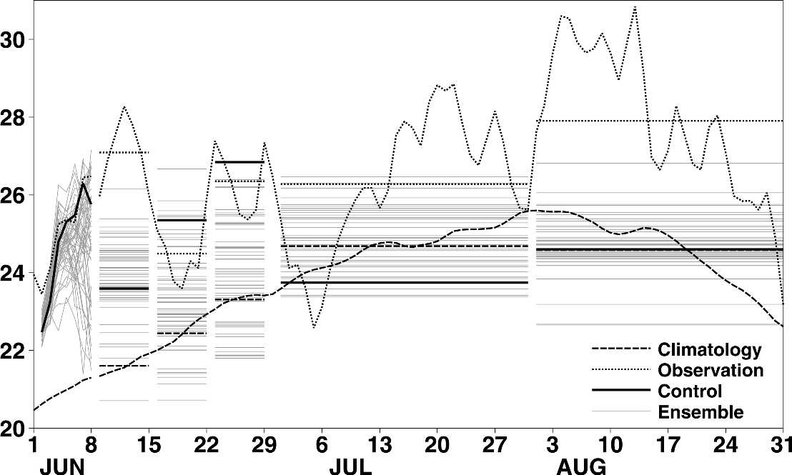
Objective
S2S4E will offer an innovative service to improve RE variability management by developing new research methods exploring the frontiers of weather conditions for future weeks and months. The main output of S2S4E will be a user co-designed Decision Support Tool (DST) that for the first time integrates sub-seasonal to seasonal (S2S) climate predictions with RE production and electricity demand.
Heat wave 2003.Prediction of temperature produced by ECMWF
Observations (dotted) and forecasts (solid) made by ECMWF at the beginning of June of European 2-m land temperatures ( C).
Source: Rodwelland-Doblas-Reyes, 2006

Slide 8
Applications
Weather forecast
Climate predictions
Climate projections or multidecadal
Sub-seasonal
Seasonal
Decadal
1-15 days
10 d-1 month
1-6 months
1-30 years
20-100 years
Time
Applications for wind/solar/hydro generation
Post-construction decisions
Energy producers:
commit energy sales for next day
Grid operators: Market prices and grid balance
Energy traders: Anticipate energy prices
Plant operators: planning for cleaning and maintenance
Post-construction decisions
Energy producers: Resource management strategies
Energy traders: Resource effects on markets
Plant operators: Planning for maintenance works, especially offshore wind O&M
Plant investors: anticipate cash flow, optimize return on investments
Pre-construction decisions
Power plant developers: Site selection. Future risks assessment.
Investors: Evaluate return on investments
Policy-makers: Asses changes to energy mix
River-basin managers: understand changes to better manage the river flow
Applications for demand
Daily operation decisions
Grid operators:
Anticipate hot/cold days.
Schedule power plants to reinforce supply.
Energy traders: Anticipate energy prices.
Mid-term planning
Grid operators:
Anticipate hotter/colder seasons Schedule power plants to reinforce supply.
Energy traders:
Anticipate energy prices.
Long-term planning
Grid operators:
Anticipate addition of more capacity. Adaptation of transmission lines
Policy-makers:
Plan addition of more capacity.
Understand changes to energy mix
S2S4E project

Slide 9
Challenges and opportunities

Slide 10
S2S Forecast range and skill
Qualitative estimate of forecast skill based on forecast range from short-range weather forecasts to long-range seasonal predictions, including potential sources of predictability. Relative skill is based on differing forecast averaging periods. (Source: White et al., 2017 )

Slide 11
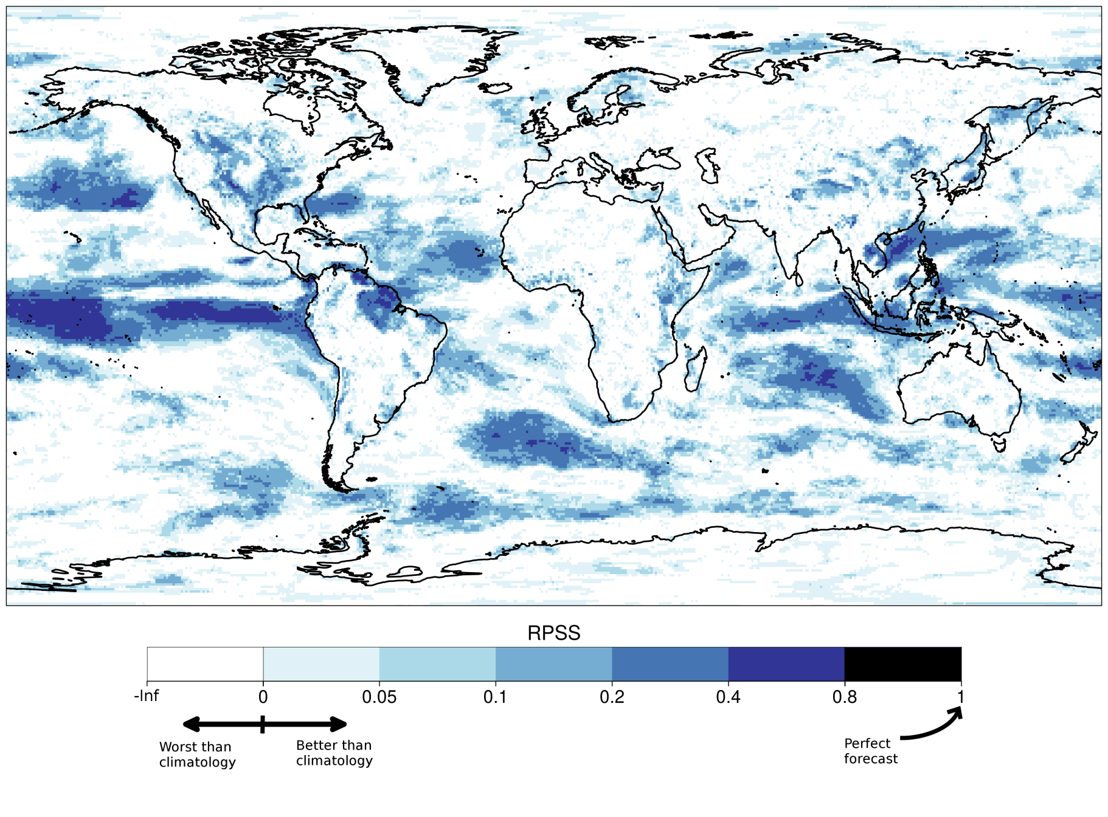
Skill
Skill assessment for DJF (1981-2013)
Displaying: Ranked Probability Skill Score [RPSS]
“A prediction has no value without an estimate of forecasting skill based on past performance”

Slide 12
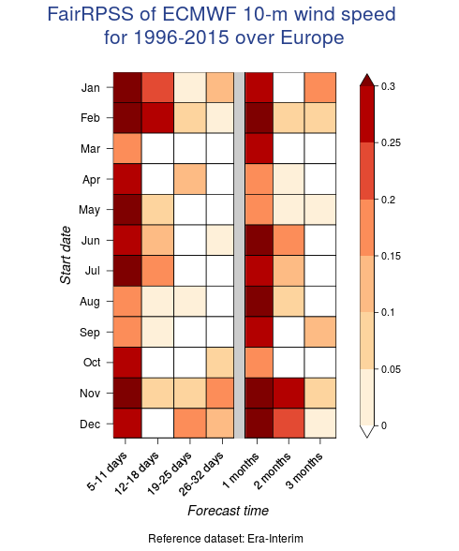
NEWA project, predictability

Slide 13
Case study: wind drought in US Lledó et al., 2018: Investigating the effects of Pacific sea surface temperatures on the wind drought of 2015 over the United States. Journal of Geophysical Research

Slide 14
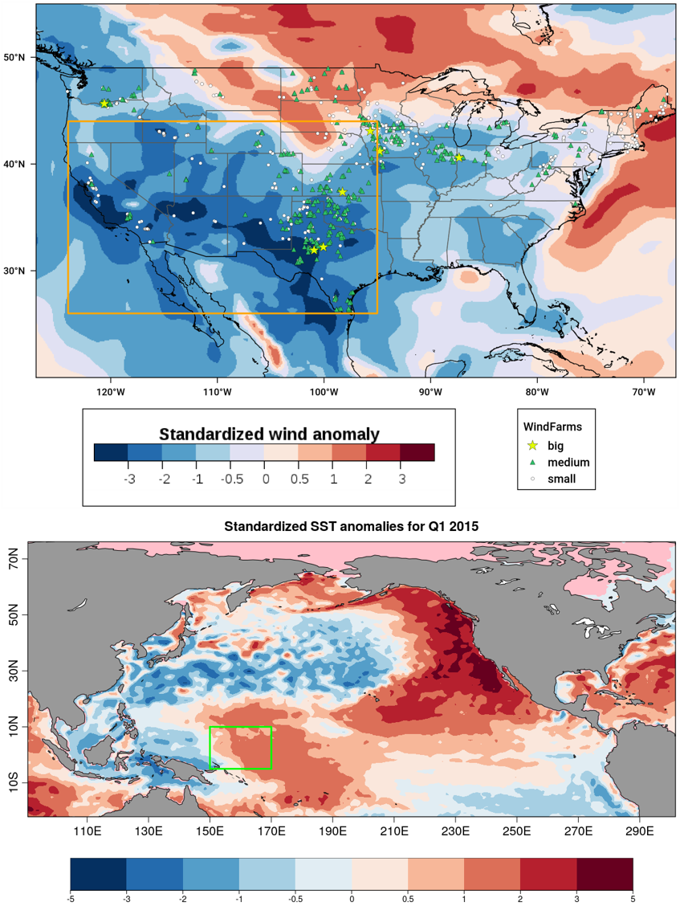
Wind drought in US
During the first quarter of 2015 the United States experienced a widespread and extended episode of low surface wind speeds. This episode had a strong impact on wind power generation. Some wind farms did not generate enough cash for their steady payments, and the value of wind farm assets decreased.
Wind speed anomalies reflecting the wind drought over the United States for the first trimester of 2015. The US wind farm fleet is also shown.

Slide 15
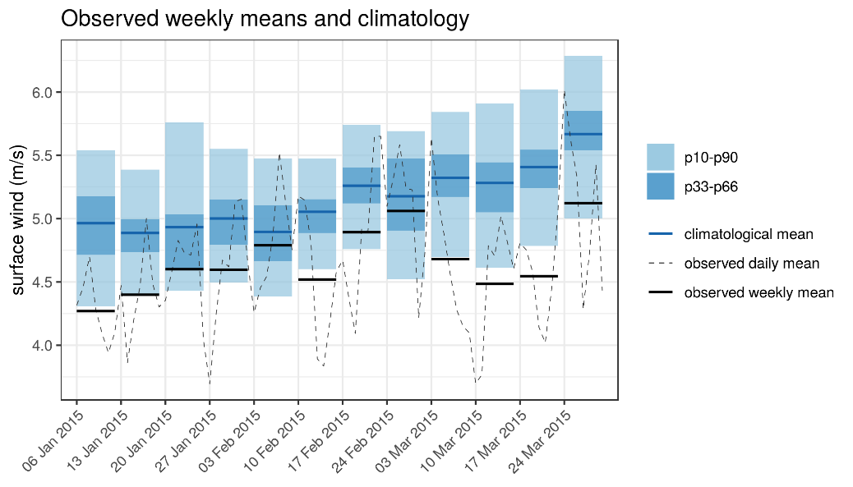
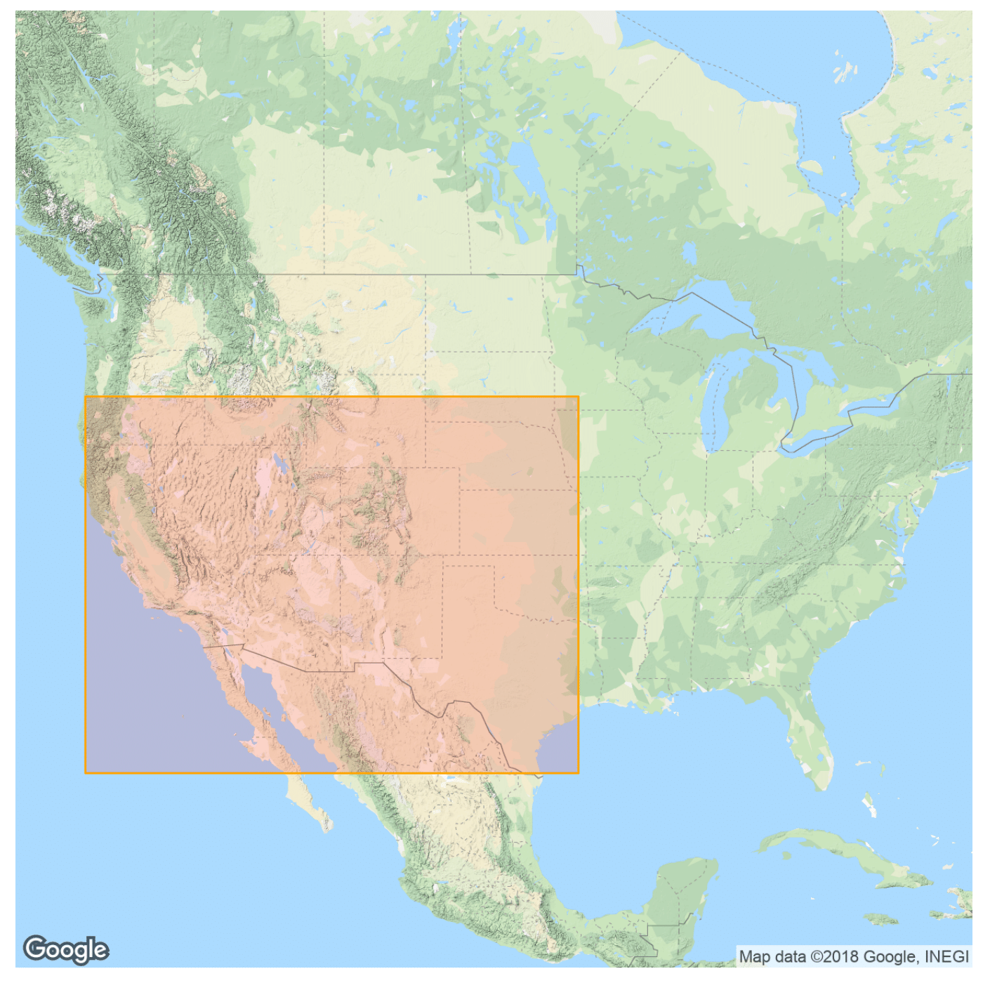
Wind drought in US
During the first quarter of 2015 the United States experienced a widespread and extended episode of low surface wind speeds. This episode had a strong impact on wind power generation. Some wind farms did not generate enough cash for their steady payments, and the value of wind farm assets decreased.

Slide 16
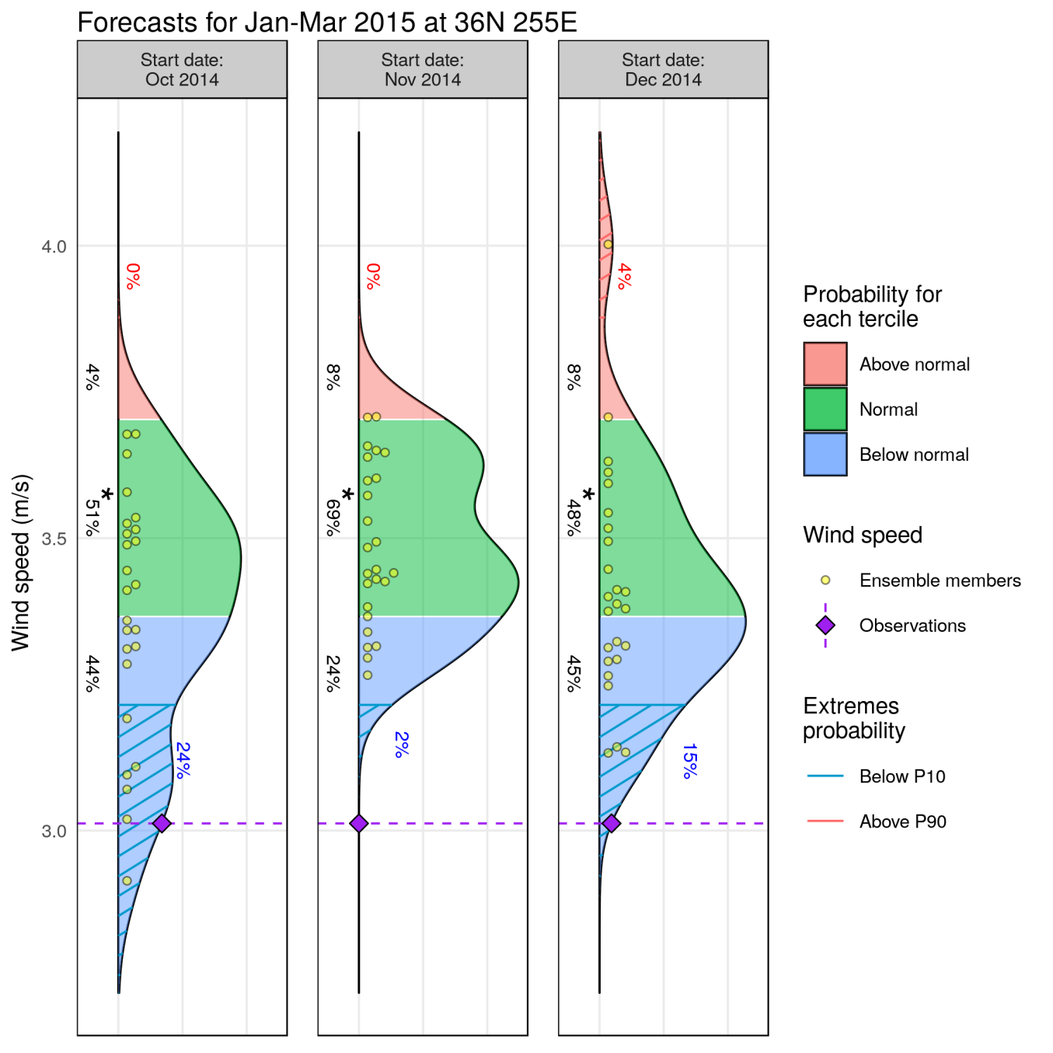
Available seasonal forecast
RPSS: 35%
RPSS: 39%
RPSS: 35%
System: ECMWF S4
Reanalysis: ERA-Interim
Bias adjusted –calibrated
Hindcast: 1993-2015
37N 105W
Which decisions would you take in view of those forecasts?

Slide 17
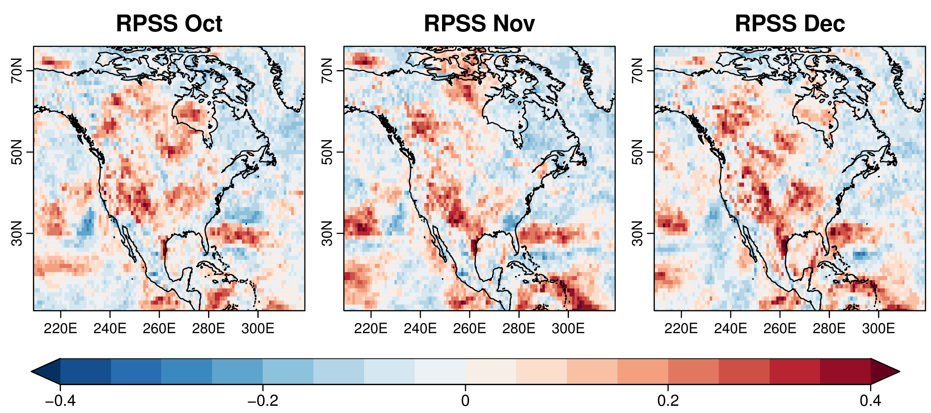
Available seasonal forecast

Slide 18
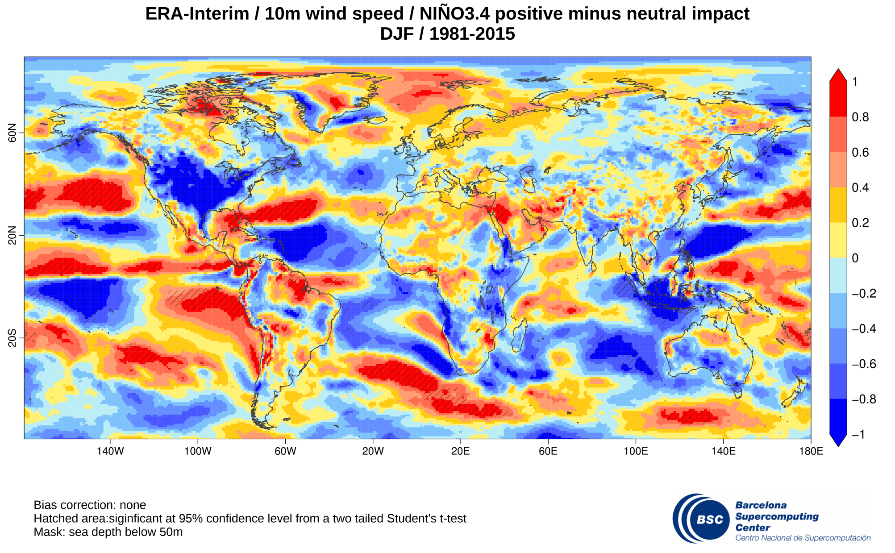
NIÑO3.4 teleconnection
Impact maps between NIÑO3.4 teleconnection index 10m wind speed from ERA-Interim reanalysis.

Slide 19
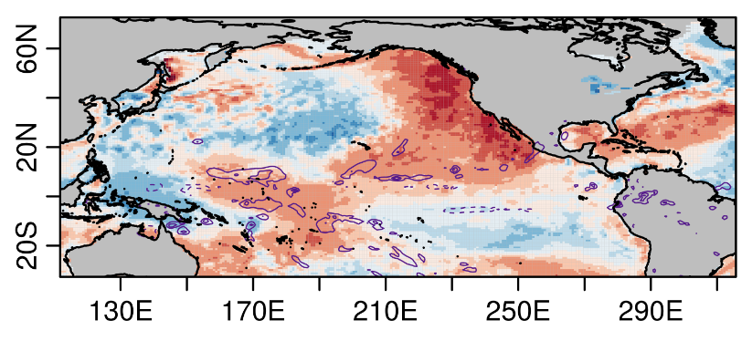
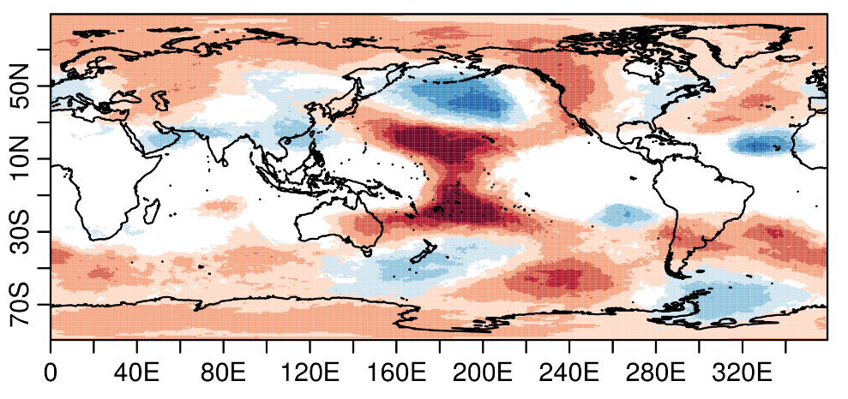
Causes
High SSTs in western tropical pacific
↓
Enhanced convection in the area
↓
Upward flow produces divergence at 200hPa
↓
Rossby wave propagates to North America
↓
Results in persistent low winds
SST and precip
January-March 2015
GH @200hPa
System: EC-EARTH
Notes:
Using retrospective climate predictions, we find that high ocean temperatures in the western tropical Pacific Ocean played a central role to establish and maintain those wind anomalies. This is not a single event. This work shows that the wind speed variability in the United States is not only dominated by El Niño but also by the ocean temperatures in this region of the Pacific.

Slide 20
Case study: heat wave and wind drought in Spain. Sep 2016

Slide 21
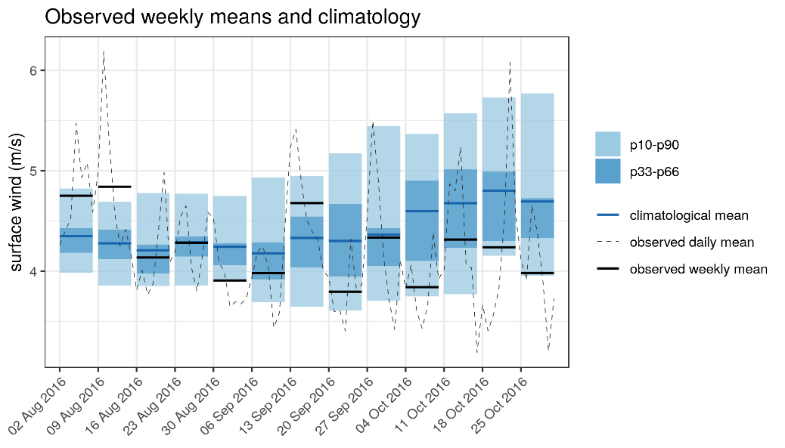
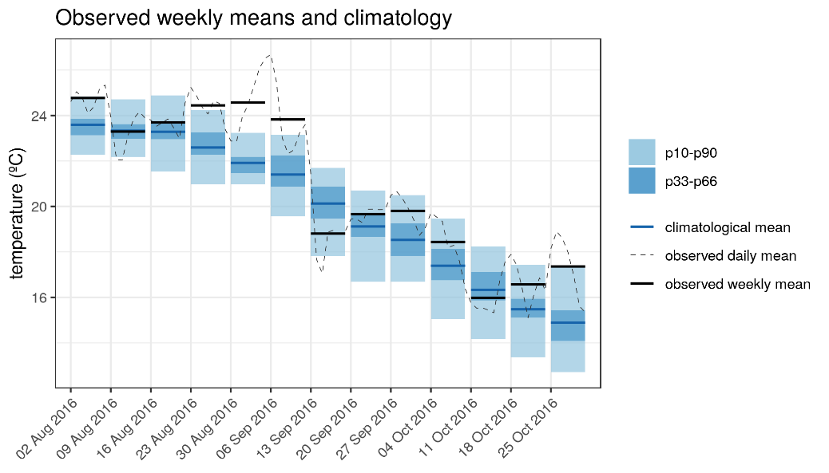
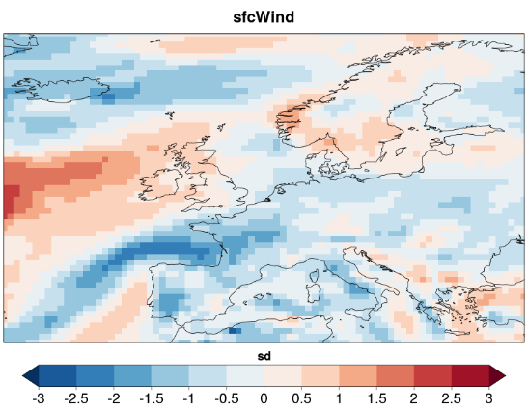
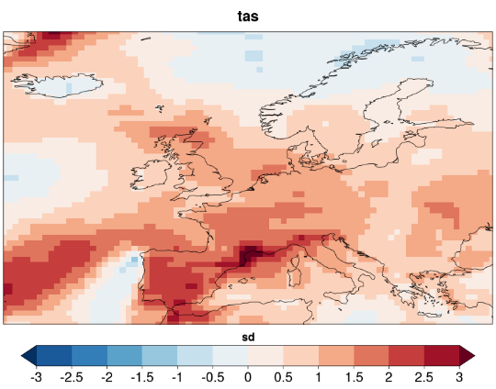
Heat wave and wind drought in Spain. Sep 2016
Surface wind and temperature standardized anomalies for the week 30/08/2016-5/09/2016.
ERA-Interim with respect to climatology (1981-2017)

Slide 22
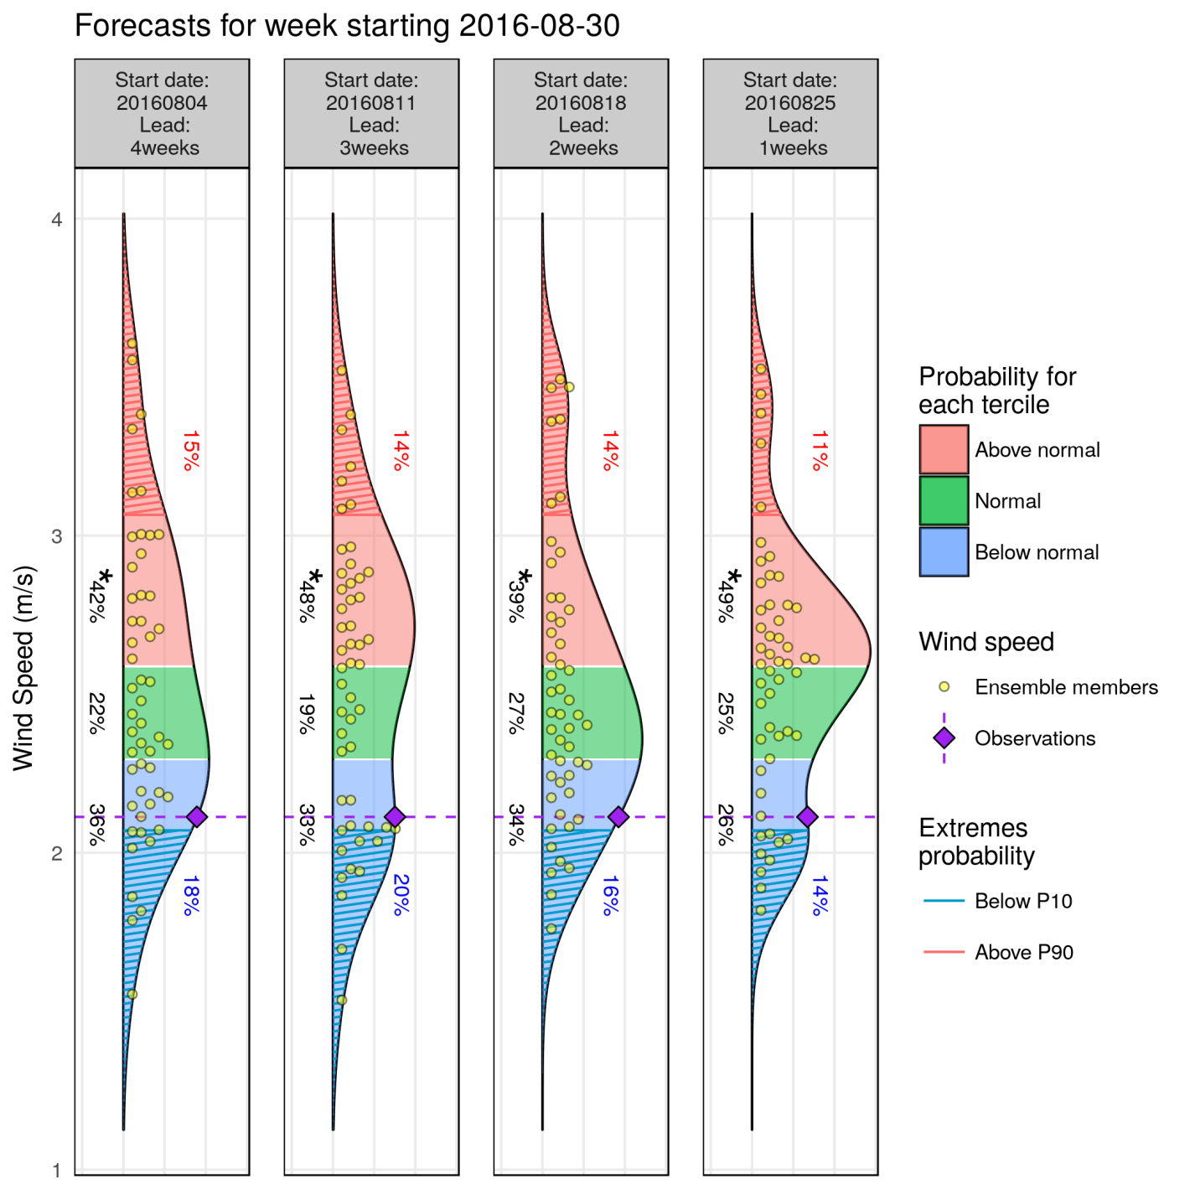
Forecast available: wind speed
System: ECMWF monthly prediction system
Reanalysis: ERA-Interim
Bias adjusted –calibrated
Hindcast: 1996-2015
Lat= 40.5 N/Lon = 358.5 E
fairRPSS: -1% -2% 2% 9%

Slide 23
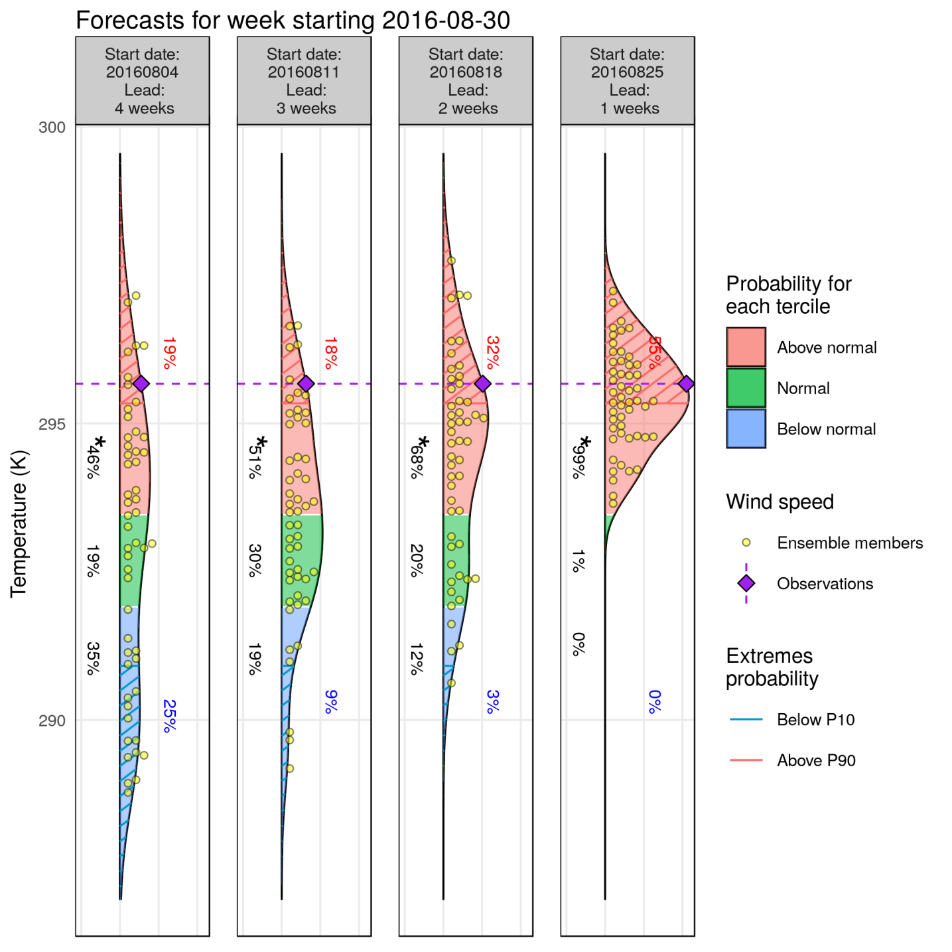
Forecast available: temperature
fairRPSS: 5% 5% 3% 42%
System: ECMWF monthly prediction system
Reanalysis: ERA-Interim
Bias adjusted –calibrated
Hindcast: 1996-2015
Lat= 40.5 N/Lon = 358.5 E

Slide 24
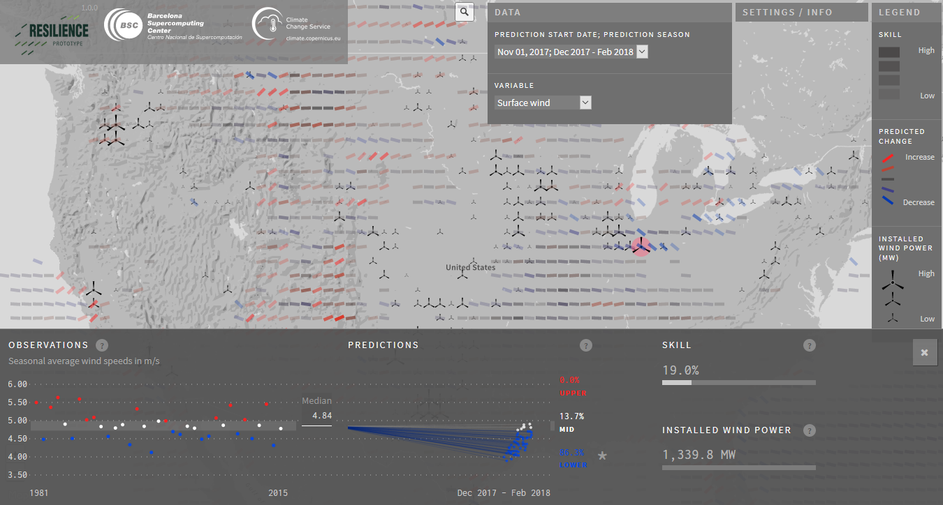
DST
http://www.bsc.es/ess/resilience/map.html

Slide 25
Final remarks
Climate prediction systems have improved in the last decade demonstrating that probabilistic forecasting can inform better decision making at some temporal scales and regions
Alongside the model development process, climate predictions need to be evaluated on past years to provide robust information before making decisions
Tailored service helpful for several applications
Interdisciplinary groups enhance the interaction with users to co-develop a service
Future work:
multi-model ensembles
to improve the utility of forecasts by incorporating skillful information of the large-scale teleconnection patterns at different time scales

Slide 26
Albert Soret Miravet: albert.soret@bsc.es www.s2s4e.eu

Slide 27
Consortium

Slide 28
Causes
Center column: monthly SLP anomalies (in hPa) corresponding to the four Euro-Atlantic clusters (weather regimes) in September over the period 1981-2016, in decreasing order of explained variance.
Right column: monthly frequency of occurrence of the four clusters in September for 1981-2016. Eventual presence of black lines indicate signiﬁcant trends.
Left column: impact of the four clusters on 10-m wind speed. Impact (in %) is relative to the average wind speed for the month of September over the period 1981-2016. Black dots indicate signiﬁcant points with a t-test at 95% conﬁdence level. (Source: JRA-55 reanalysis)

Slide 29
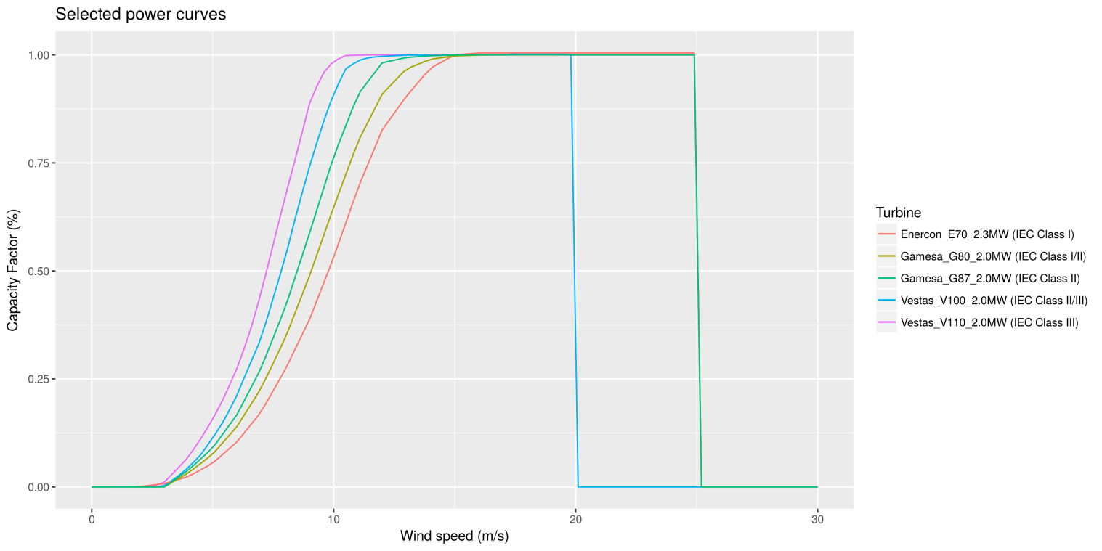
Capacity factor
Capacity factor is a good indicator of wind power generation.
Is independent of:
number of installed turbines
nameplate capacity of installed turbines
Using manufacturer power curves for three turbines representing IEC classes.
Fed with: 6-hourly model data, sheared at 100m.

Slide 30
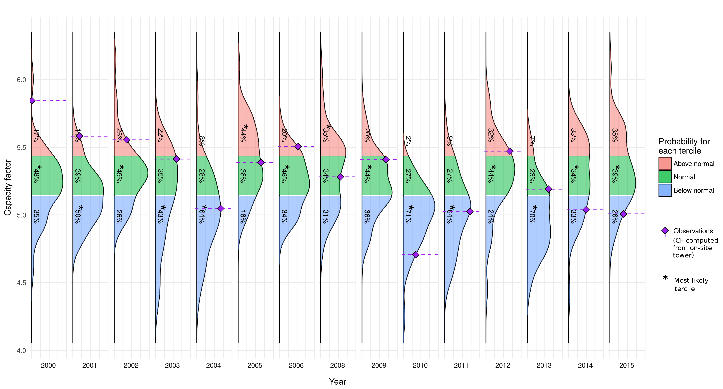
Capacity factor
Retrospective forecasts for JJA at Site1 (2000-2015)
CRPSS = -0.01
RPSS = 0.08
EnsCorr = 0.44

Slide 31
Consortium
Society: Public administration and Renewable energy cooperative
External Advisory Board
Core consortium
Energy companies
Forecasters
Transmission system operators (TSO)
Other services
Traders

Slide 32
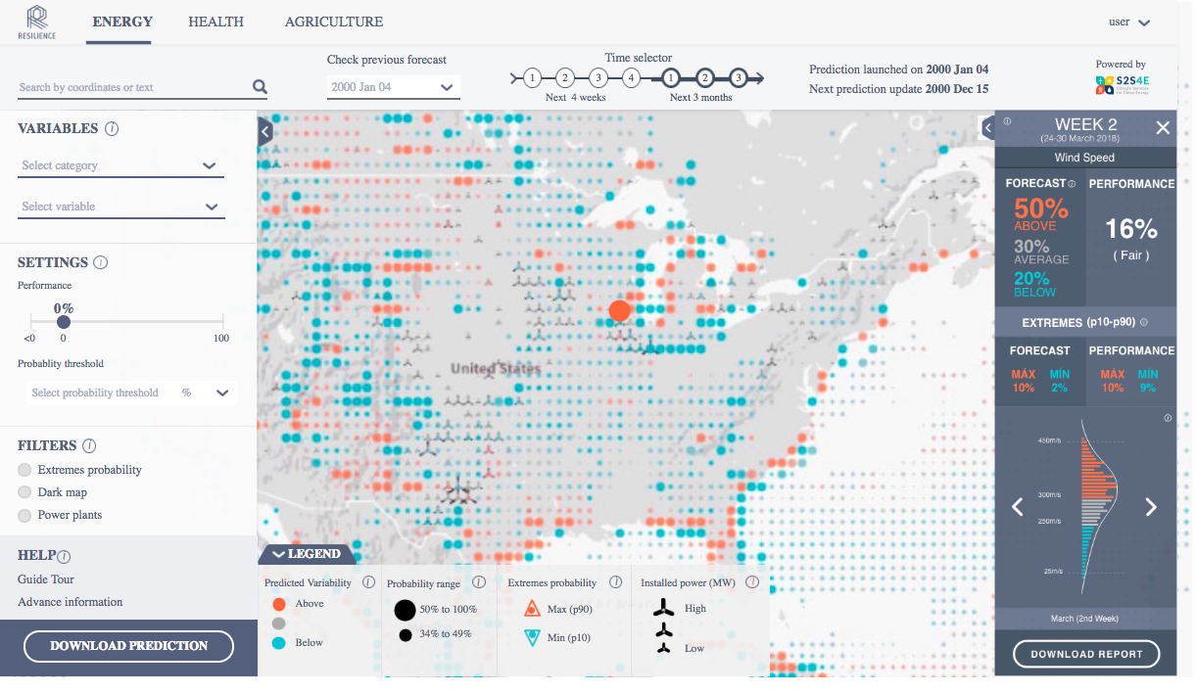
Success criteria is TRUST
http://www.bsc.es/ess/resilience/map.html

Slide 33
Synergies with other projects
SPECS and EUPORIAS
NEWA
CLIM4ENERGY and ECEM
SWICCA
QA4SEAS
INDECIS
MEDSCOPE
CLIM2POWER
ERA4CS
S2S
ClimatEurope
IMPREX
MARCO
VISCA and MEDGOLD
CLARA
SECLI FIRM
S2S4E
2017
2018
2019
2020

Slide 34
Why?
Using retrospective climate predictions, we find that high ocean temperatures in the western tropical Pacific Ocean played a central role to establish and maintain those wind anomalies. This is not a single event. This work shows that the wind speed variability in the United States is not only dominated by El Niño but also by the ocean temperatures in this region of the Pacific.
Sea surface temperature anomalies in the Pacific Ocean during the same period. The green box shows the area under study.

Slide 35
Co-development
E.g.: development of useful and tailored indicators
Power curves for three turbines representing IEC classes.

Slide 36
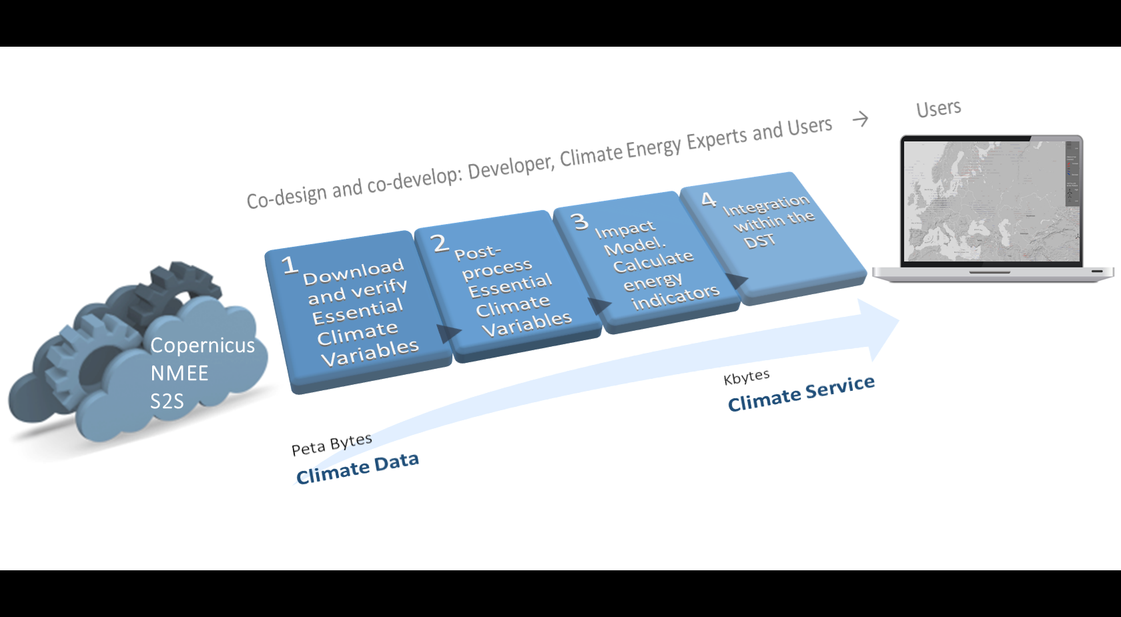
From data to service

Slide 37
Methodology and firts results

Slide 38
Methodology
Economic analysis
Assessment operational
real-time forecast
Operational real-time forecast
Improved operational real-time forecast
Define user needs
Model case studies
Improve model skill
Data integration and processing
DST
Development

Slide 39
Climate services
User: How much energy will I produce next month?
Scientist: Skill assessment, bias adjustment, probabilistic information, etc.
Notes:
Climate predictions (Figure 1) including both sub-seasonal (up to one month) and seasonal predictions (for the forthcoming months) have witnessed considerable improvements in the last decade demonstrating that probabilistic forecasting can inform better decision making at some temporal scales and regions (Alessandri et al., 2011, Doblas-Reyes et al., 2013). However, despite this improvement, climate predictions come with a new set of challenges for users: information is often un-tailored and hard to understand or apply in a decision-making context. Further research is needed to broaden our knowledge of the predictability and usability of S2S predictions and the requirements of energy companies and transmission system operators.

