Slide 1
Work Package 3 Webinar
Irene Cionni, ENEA
Llorenç Lledó, BSC
Hannah Bloomfield, UREAD

Slide 2
Introduction

Slide 3
Reanalysis benchmarking
Irene Cionni, ENEA
irene.cionni@enea.it

Slide 4
Background and Motivation: Building trust
Reanalysis data sets are employed within S2S4E project for several purpose:
1) verify and bias adjust seasonal and sub-seasonal predictions;
2) derive indicators of energy indicators and demand, and
3) understand the impact of weather regimes and teleconnection indices in the electricity generation and demand.
Evaluating the quality of the available reanalysis products that
will be used is key for credible conclusions.

Slide 5
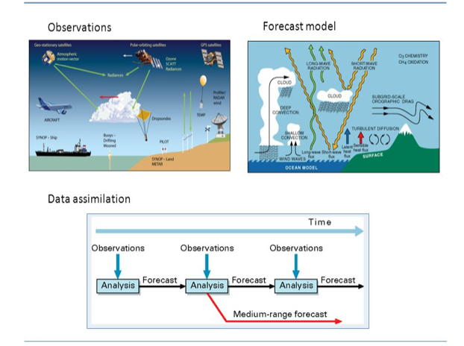
Reanalysis
Reanalysis are produced via an unchanging data assimilation scheme and model which ingest all available observations over the period being analysed. This framework provides a dynamically consistent estimate of the climate state at each time step.
PRO:
-Global datasets,consistent spatial and temporal resolution over 3 or more decades, hundreds of variables available.
-Milions of observations incorporated into stable data assimilation system enabling a number of climate processes to be studies.
-Datasets are straightforward to handle from a processing standpoint.
LIMITATIONS:
-Observational constraints, and therefore reanalysis reliability, can vary depending on the location, time period and variable considered.
-Possible spurious variability and trends due to the changes in the mix of observations, and biases in observations and model.
-Diagnostic variables relating to the hydrological cycle, such as precipitation and evaporation, should be used with extreme caution.
Source ECMWF

Slide 6
Intercomparison of reanalysis

Slide 7
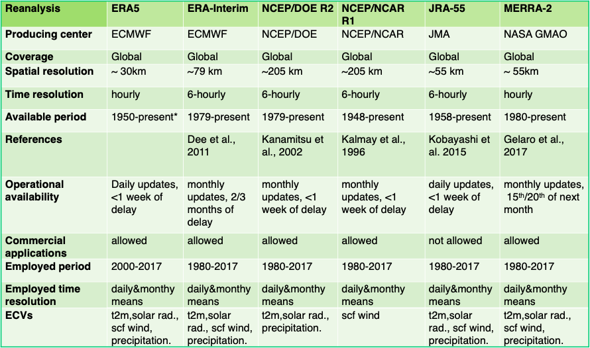
Reanalysis
Selection of four ECVs that impact the energy sector:
-2 meter temperature for energy demand;
-surface solar radiation for solar power generation;
-surface wind speed for wind power generation;
-precipitation for hydropower generation.

Slide 8
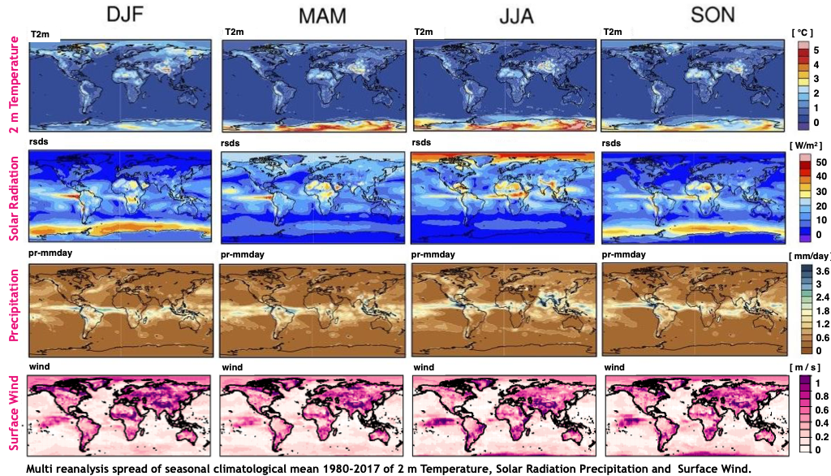
Reanalysis intercomparison
Climatology
•Temperature: The spread among the reanalysis is higher in locations with fewer assimilated data (i.e. Africa and Poles).
•Solar Radiation: Important disagreement between reanalysis over tropical regions and midlatitudes in Summer.
•Precipitation: Large spread over the ITCZ and midlatitudes lands in Summer.
•Surface Wind: Discrepancies observed for continental regions.

Slide 9
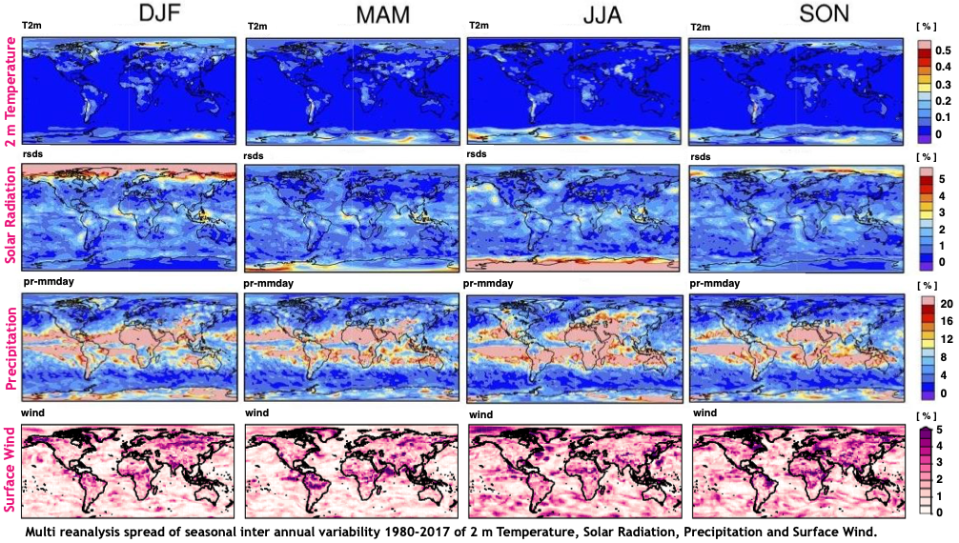
Reanalysis intercomparison
Interannual Variability
•Temperature:Larger spread of variability where the climatology is biased due to scarcity of data assimilated.
•Solar Radiation: High spread among reanalyses where the variability is higher.
•Precipitation: High spread of variability over ITCZ.
•Surface Wind: Important disagreements between reanalyses for both oceans and continents.

Slide 10
Observations employed for reanalysis verification and benchmarking

Slide 11
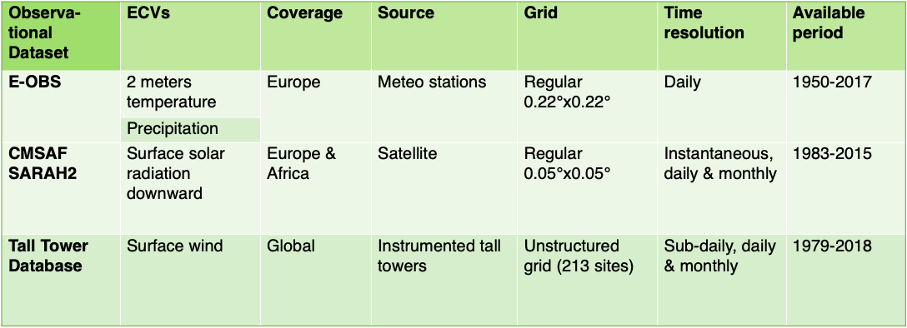
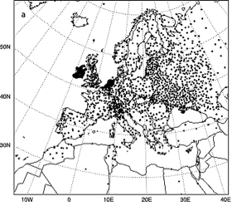
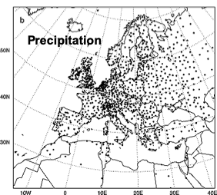
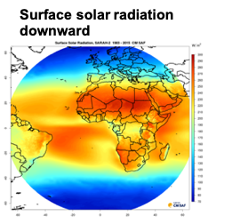
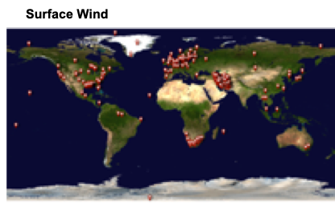
Observational Datasets
EOBS Stations
CMSAF SARAH2
Tall Tower Database

Slide 12
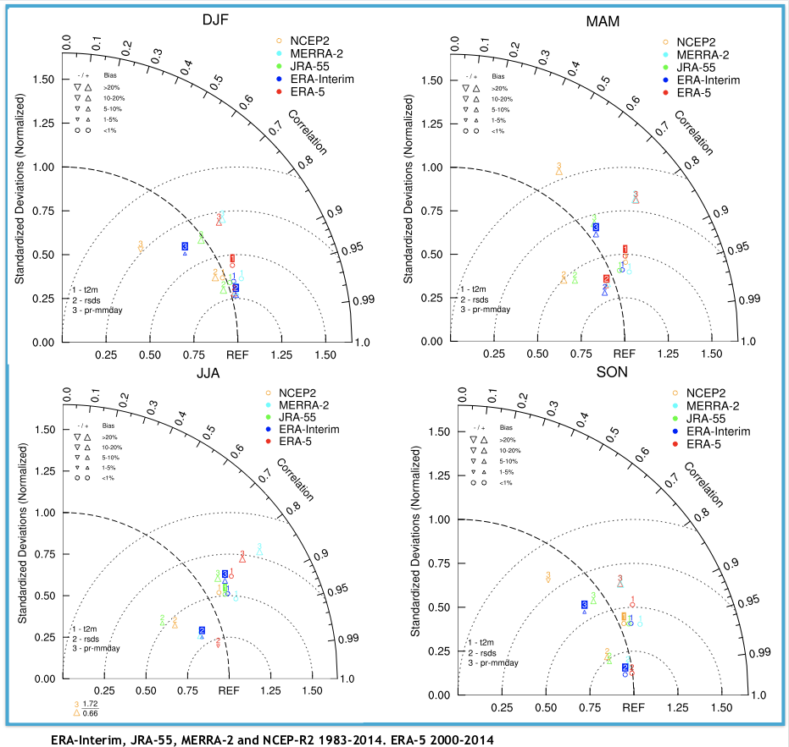
Verification with in situ and satellite observations
EOBS
&
CMSAF-SARAH2
Monthly
Taylor Diagrams of monthly
Solar Radiation vs. CMSAF -SARAH2
Temperature and Precipitation vs. EOBS.
Correlation, RMSD, Normalized Standard Deviations and Bias are evaluated.
Temporal and Spatial verification.
.

Slide 13
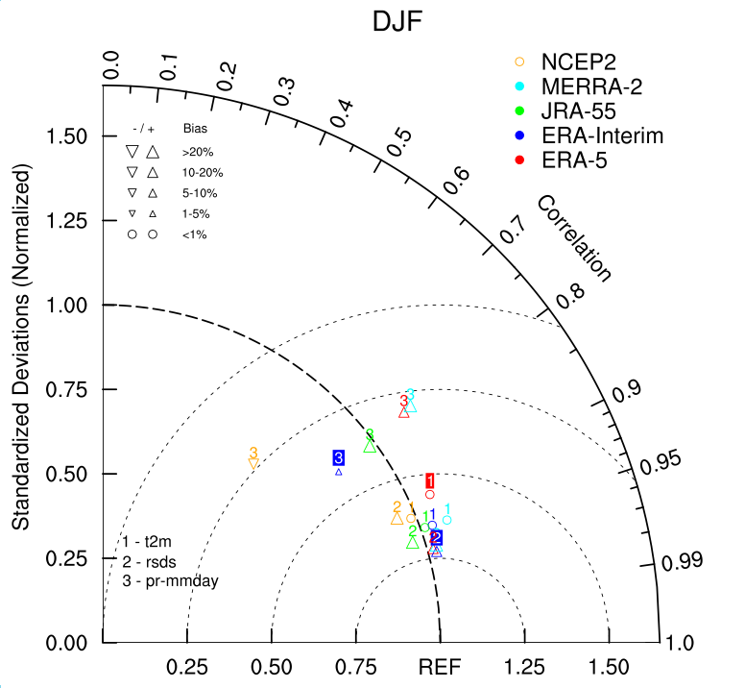
Verification with in situ and satellite observations
Taylor Diagram
A single point on the bidimensional plot indicates the ratio of the normalized variance (represented by the normalized ratio of their standard deviations), the correlation and the centered root-mean-square error between test dataset and reference data set.
Test patterns that agree well with reference pattern will lie near the black dot on the x-axis (REF).
•The standard deviation ratio of the test pattern is proportional to the radial distance from the arc at the point and the arc at the REF.
•The centered root-mean-square error between the test and reference patterns is indicated by the semicircle contours centered on the REF.
•The correlation is given by the azimuthal position of the point.
•The amplitude of the bias is indicated by the dimension of the triangle.

Slide 14
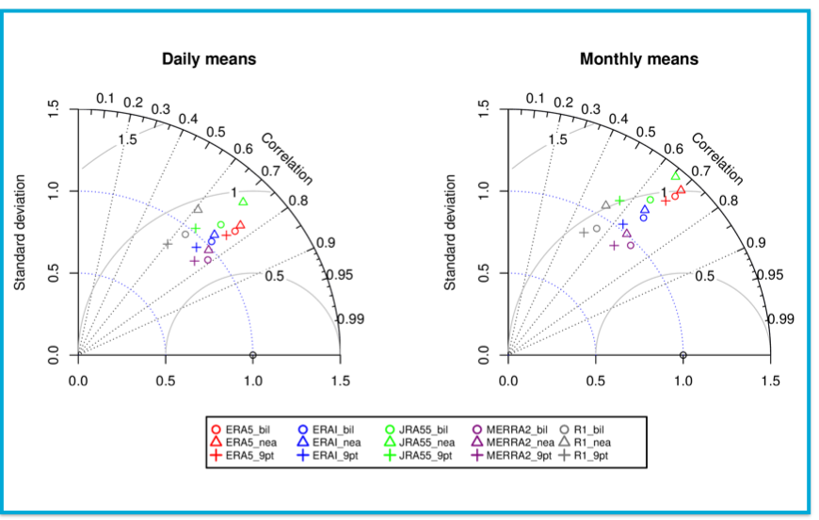
Verification with in situ observations
Tall Tower Database
Monthly & Daily
Taylor Diagrams of monthly and daily surface wind speed.
Correlation, RMSD and Normalized Standard Deviations are evaluated.
Temporal and Spatial verification.
.

Slide 15
Which reanalysis is “best” for each subsector?

Slide 16
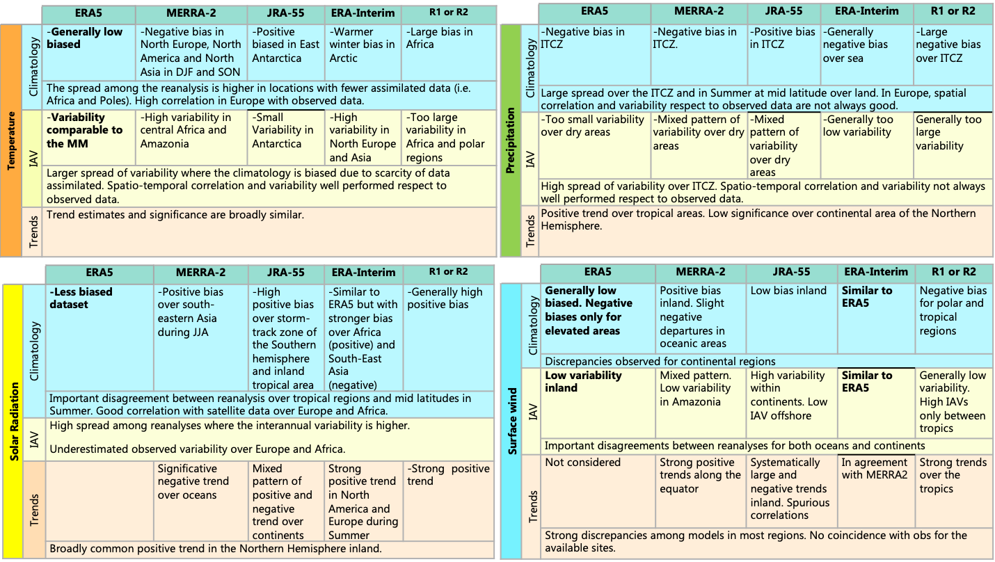

Slide 17
●Climatology and variability of assimilated variables present large differences in regions characterized by scarcity of data.
●Forecasted variables show large discrepancies over region where the role of the model parameterizations is more relevant.
●High-resolution reanalyses (i.e. ERA5) are in better agreement with observed data for temperature, solar radiation and wind speed.
Summary:

Slide 18
The impact of EuroAtlantic Teleconnections
in energy generation and demand over Europe
Llorenç Lledó, BSC
llledo@bsc.es

Slide 19
Computing EuroAtlantic Teleconnections in S2S4E

Slide 20
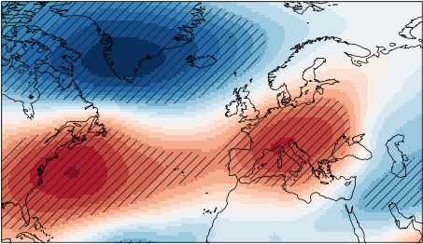
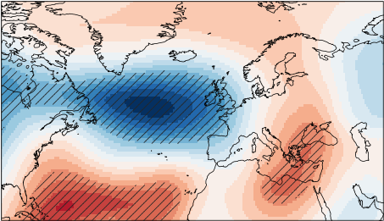
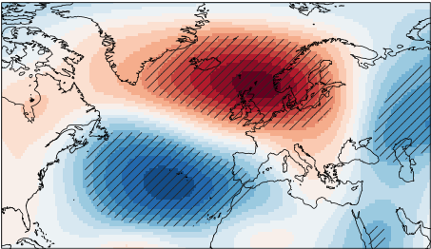
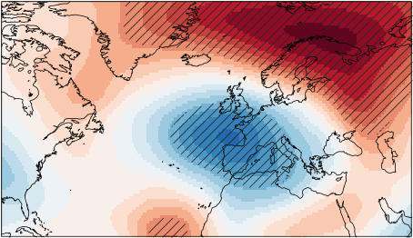
The four main EuroAtlantic Teleconnections:
NAO: North Atlantic Oscillation
EA: East Atlantic
January patterns
EAWR: East Atlantic/Western Russia
SCAND: Scandinavian pattern
Notes:
One analysis per month.
Teleconnection patterns and indices.

Slide 21
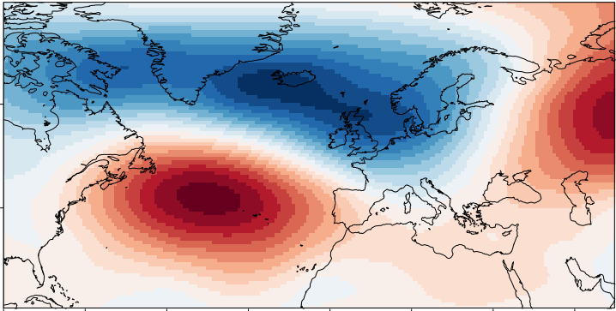
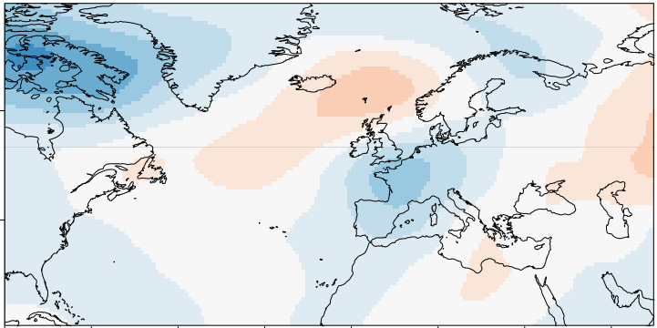
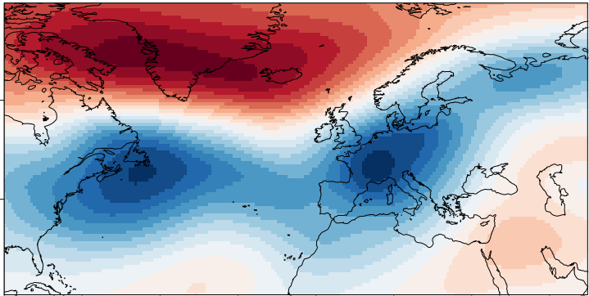
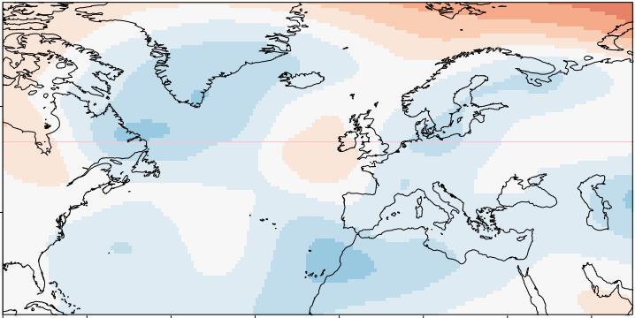
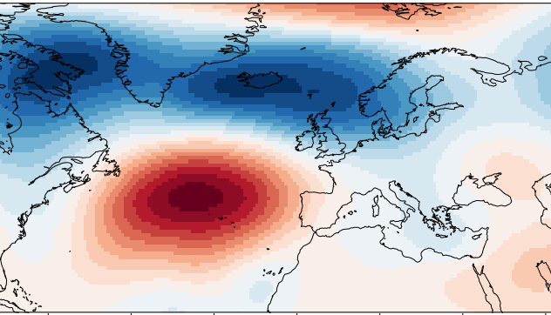
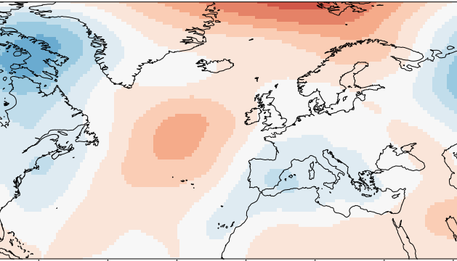
EOF: a tool for dimensionality reduction
SMALL-SCALE NOISE
ANOMALY = x*NAO + y*EA + z*EAWR + w*SCAND +
Jan 1984
= 2.2* +0.4* -0.1* +0.4* +
Jan 1985
= -1.4* +0.4* +2.4* -0.4* +
...
...
...
...
...
...
Jan 2015
= 1.5* +0.3* -0.3* +0.2* +
NAO index
Note: some concepts have been simplified for clarity,
for instance the scaling of the indices.
Notes:
A tool to summarize the monthly anomalies in only 4 numbers per year. Retain the recurrent patterns.

Slide 22
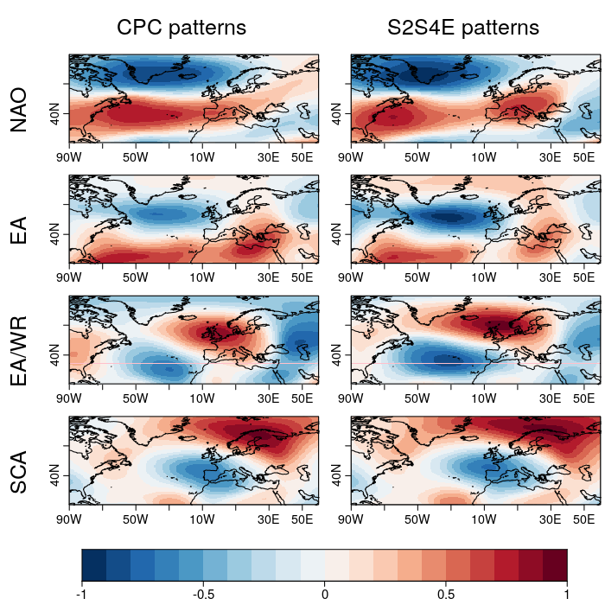
Replicating CPC results
Methodology details
Variable: monthly anomalies of geopotential height at 500 hPa
Source: ERA-interim
Period: 1981-2016
Region: 90W-60E and 20-80N
Method: Rotated EOF with varimax rotation, retaining 4 EOF modes.
Timescale: monthly (seasonal)
Transitions: for each month, the monthly anomalies of the previous and next month are also included in the REOF analysis, although only the index for the central month is used.

Slide 23
Evaluate EATC impacts on Energy generation and demand
ECVs:
wind
temperature
solar radiation
precipitation
Energy Indicators:
wind capacity factor
solar capacity factor
energy demand at country level

Slide 24
Correlation with surface wind

Slide 25
Correlation with 2m temperature

Slide 26
Correlation with solar radiation

Slide 27
Correlation with wind capacity factors
Impact in April

Slide 28
Correlation with energy demand

Slide 29
Main conclusions:
Ongoing research (WP4):
Areas of influence of the four EATC change month by month
Different impacts for different sub-sectors
NAO alone is not enough to describe impacts
Asymmetric impacts not described
Can we predict NAO, EA, SCAN months in advance?
If so, can we use that to enhance energy predictions?

Slide 30
Weather Regimes Over Europe
Hannah Bloomfield (UREAD)
h.c.bloomfield@reading.ac.uk

Slide 31
Outline
Methodologies for computing EuroAtlantic weather regimes
Impacts of the weather regimes on essential climate variables
Impacts of the weather regimes on energy indicators
Can we use weather regimes to predict energy indicators at sub-seasonal timescales?

Slide 32
What is a weather regime?
A WR is a large scale pattern of atmospheric variability.
WR’s represent gross states of the atmosphere, which change on the time-scale of days-weeks.
A WR is created by grouping meteorological features into a number of categories. (four for the Euro-Atlantic region)
WR’s are commonly calculated using machine learning techniques.

Slide 33
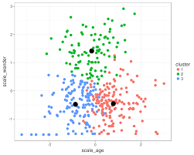
Computing EuroAtlantic Weather regimes
ERA-interim data 1981-2016
Euro-Atlantic region (27°-81°N, 85.5°W-45°E)
Daily-mean MSLP anomalies (climatology filtered to remove short-term variability)
Weight the gridded MSLP by cosine of latitude (to give an equal area weighting to each gridbox)
K-means cluster the data for each month into 4 clusters.

Slide 34
EuroAtlantic Weather regimes:
Regime 1: Dipole in pressure ‘NAO+’
Regime 2: Dipole in pressure ‘NAO-’
Regime 3: High pressure over Scandinavia
Regime 4: Low pressure over central Europe (varies a lot through the months)

Slide 35
EuroAtlantic Weather regimes:
Regime 1: Dipole in pressure ‘NAO+’
Regime 2: Dipole in pressure ‘NAO-’
Regime 3: High pressure over Scandinavia
Regime 4: Low pressure over central Europe (varies a lot through the months)

Slide 36
Impacts of Weather regimes on surface winds

Slide 37
Impacts of Weather regimes on surface radiation

Slide 38
Impacts of Weather regimes on Temperature

Slide 39
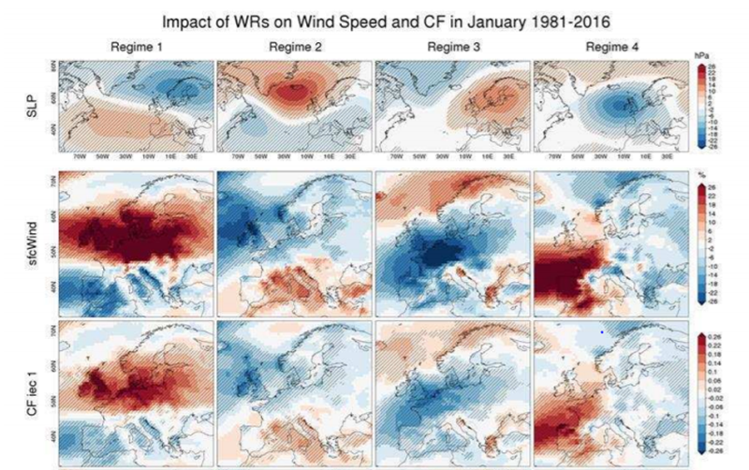
Impacts of Weather regimes on Wind Power CF

Slide 40
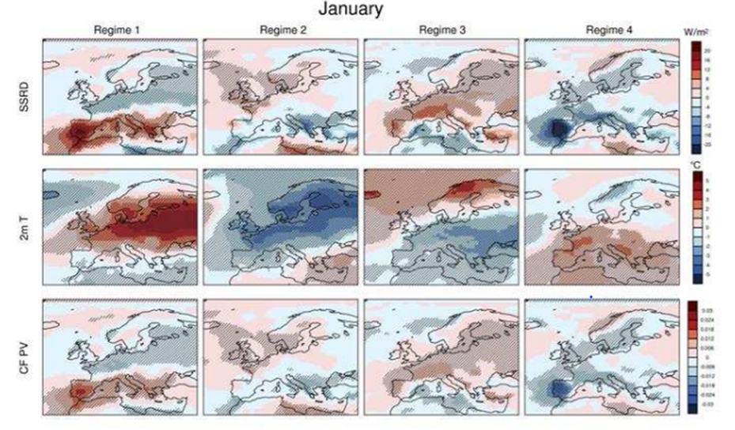
Impacts of Weather regimes on Solar Power CF

Slide 41
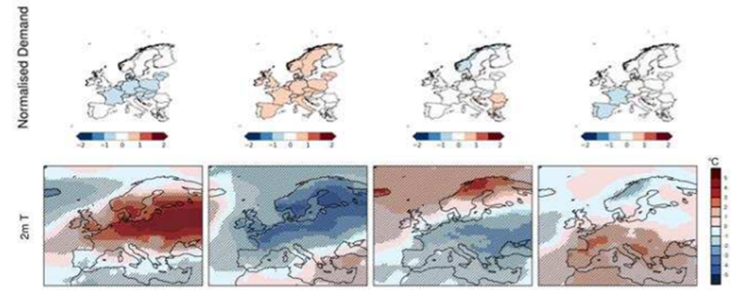
Impacts of Weather regimes on Demand
January

Slide 42
Summary
A methodology has been developed to calculate WRs for each month from filtered MSLP data.
WRs can significantly influence ECV’s and energy indicators, especially in winter months.
The spatial impact patterns of WRs 1 and 2 often exhibit a bipolar structure with a mostly north-south gradient similar to the NAO.
Future work will investigate the predictability of these regimes in sub-seasonal forecasts, and if this information can improve energy indicator predictions.
This presentation has shown the highlights of D3.2, see the document for more information (available on the wiki).

