Slide 1
Brussels, 24/05/2017
Quality Assurance for C3S Multi-model Seasonal Forecast Products
Barcelona Supercomputing Center (BSC), Universidad de Cantabria (UC-CSIC), PREDICTIA Intelligent Solutions, MeteoSwiss, University of Leeds, University of Exeter

Slide 2
Objective
Developing a strategy and software prototype for the evaluation and quality control (EQC) of C3S multi-model forecasts, taking into account the needs of a wide range of stakeholders.
Principles:
A prediction has no real value without some estimate of quality based on its past performance.
EQC is multifaceted and includes: bias, uncertainty, resolution sharpness and discrimination of the forecasts.
EQC should map the data flow to ensure full documentation and reproducibility of the products.

Slide 3
EQC prototype
A system to guide users through the EQC strategy.
Existing R packages are being unified and further improved to address the identified user needs.
High performance and reproducibility of the results are crucial.

Slide 4
Metadata model
Seasonal Model
Observation
A comprehensive metadata model has been defined to:
Ensure the traceability and reproducibility of the results
Ensure products conform to a consistent set of standards
It relies on the standard W3C RDF framework. Use of community contributed conventions has been maximized.
Data
Transformation
Subsetting and Interpolation
(data colocation)
Temporal aggregation
Temporal aggregation
Calibration
Bias correction
Validation
AUC
Outcome
Map

Slide 5
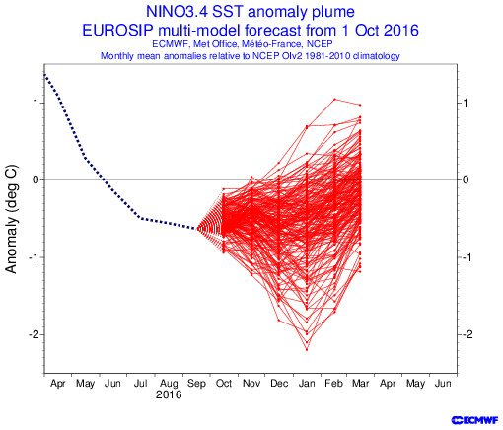
Metadata model
The metadata model information is attached to the generated products.
JPG file
The metadata is delivered
within the image
EXIF tags
Exchangeable Image File Format

Slide 6
Metadata model
Generated products can be imported.
http://demo.predictia.es/qa4seas/metadata/

Slide 7
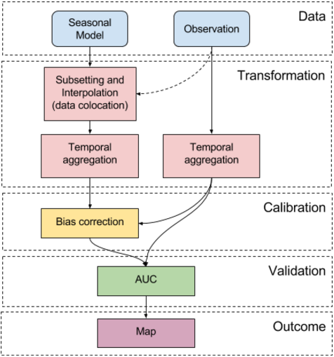
Metadata model
And the data flow is automatically displayed, with adjustable granularity.
Interactive graph with different levels of detail (show R code, show properties...)
Example: http://vowl.visualdataweb.org/webvowl/index.html

Slide 8
EQC prototype: s2dverification
CRAN

Slide 9
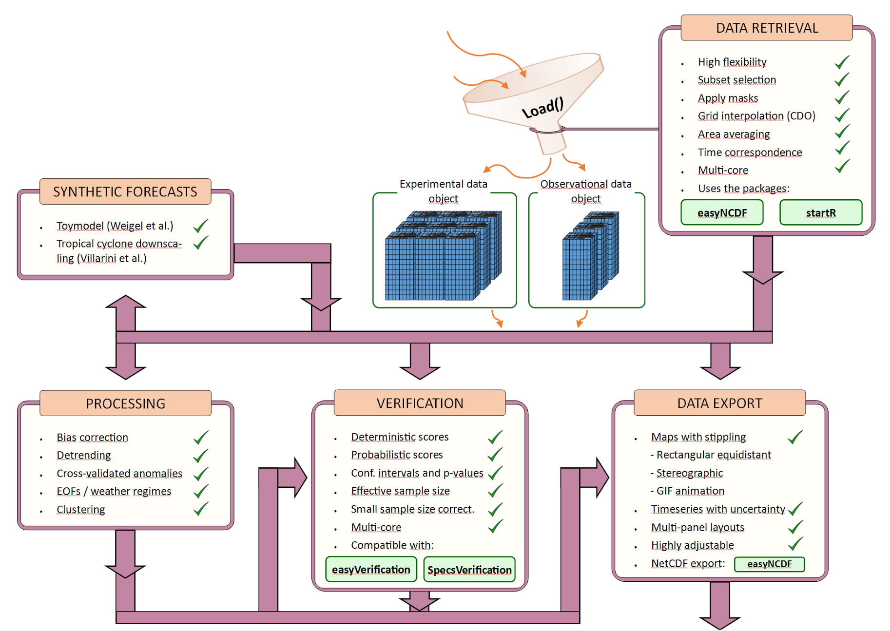
EQC prototype: s2dverification

Slide 10
EQC prototype: s2dverification
NC
NC
NC

Slide 11
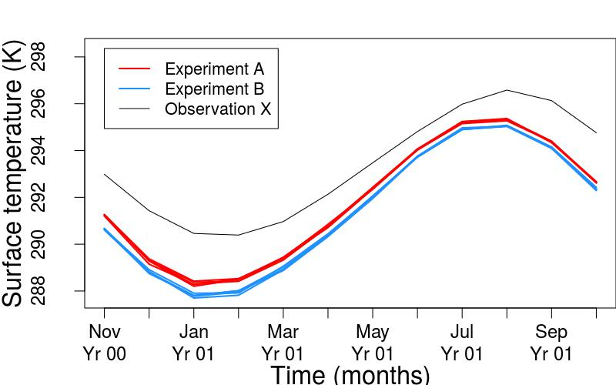
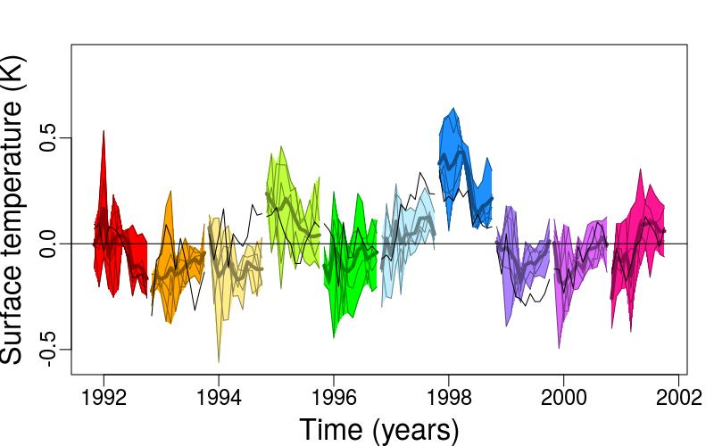
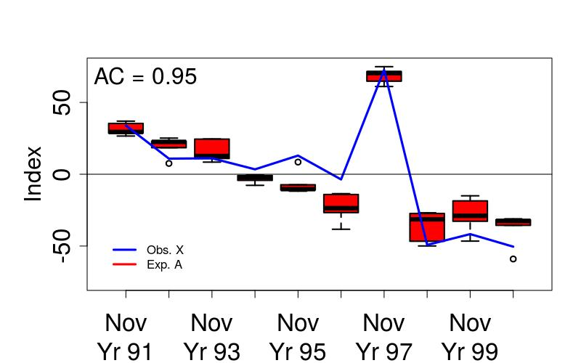
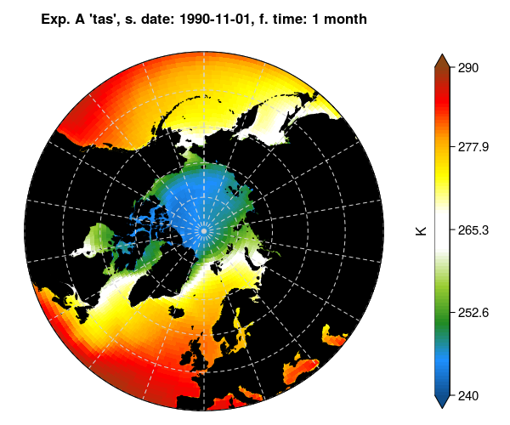
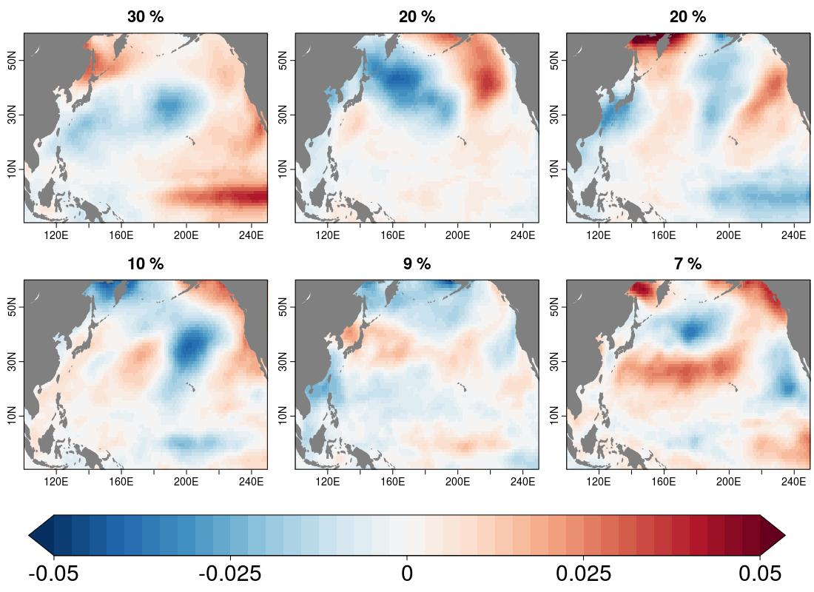
EQC prototype: s2dverification
NC
NC
NC

Slide 12
EQC prototype: s2dverification
s2dverification development prospects:
Automate the handling and propagation of metadata.
Expand parallel processing capabilities to other steps than verification.
Enhanced plotting engine.
Enhancements to the data retrieval module to handle new file formats.
A major release, s2dv 3.0.0, is expected by the end of 2017.

