Slide 1
Seasonal modulation of Sudden Stratospheric Warmings
in EC-EARTH
Froila M. Palmeiro
CMCC, Bologne 23 May 2019

Slide 2
Contents
1. Introduction
2. Model and data
3. Results
4. Concluding remarks

Slide 3
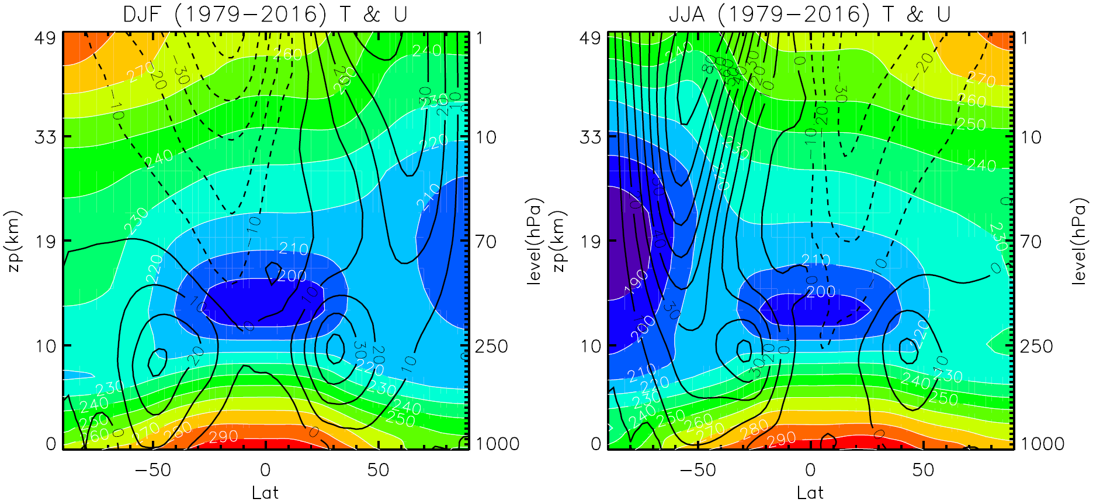
1. Introduction
The winter stratosphere
Shading: temperature, T
Black contours: zonal-mean zonal wind, U
Era Interim

Slide 4
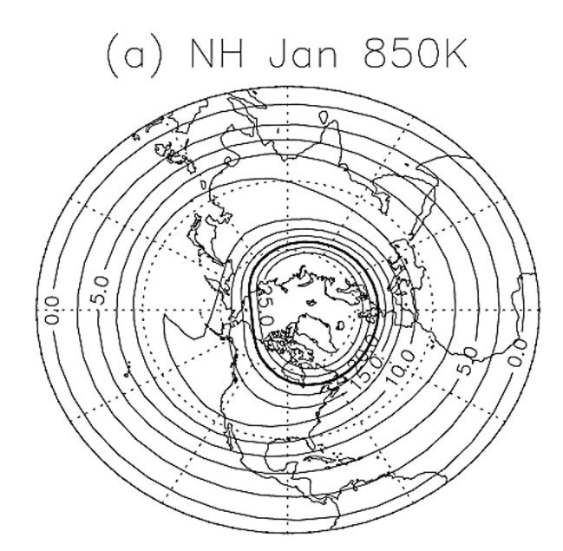
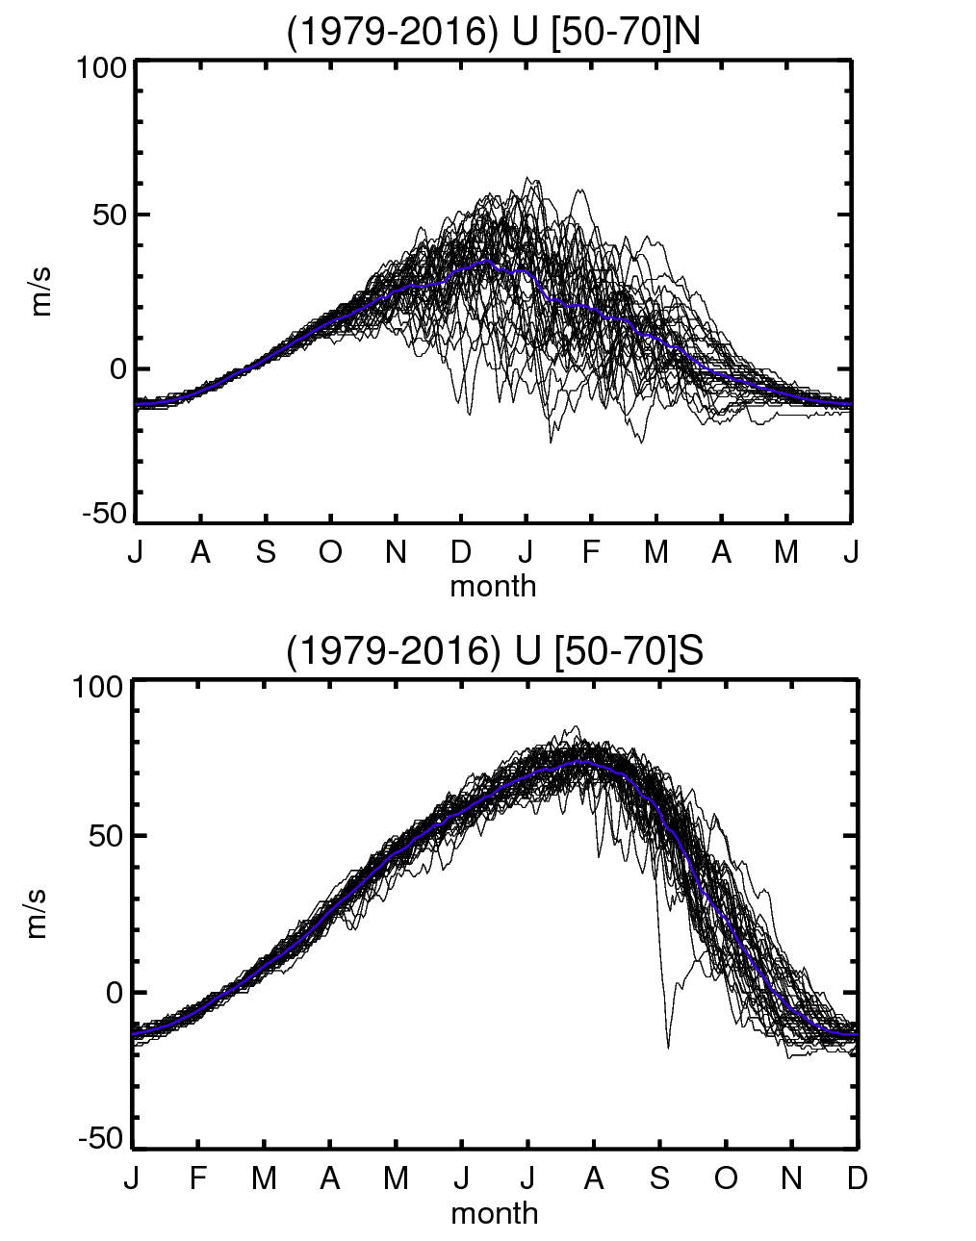
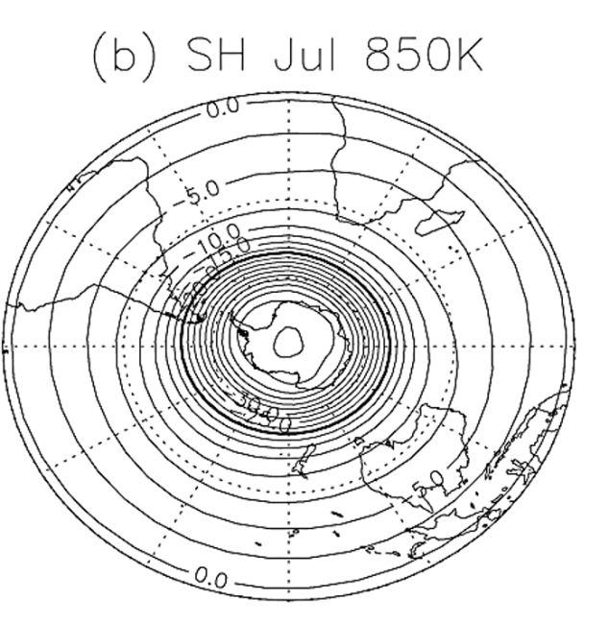
1. Introduction
The stratospheric polar vortices
SSW
SFW
Waugh and Polvani (2010)
Era Interim
4

Slide 5
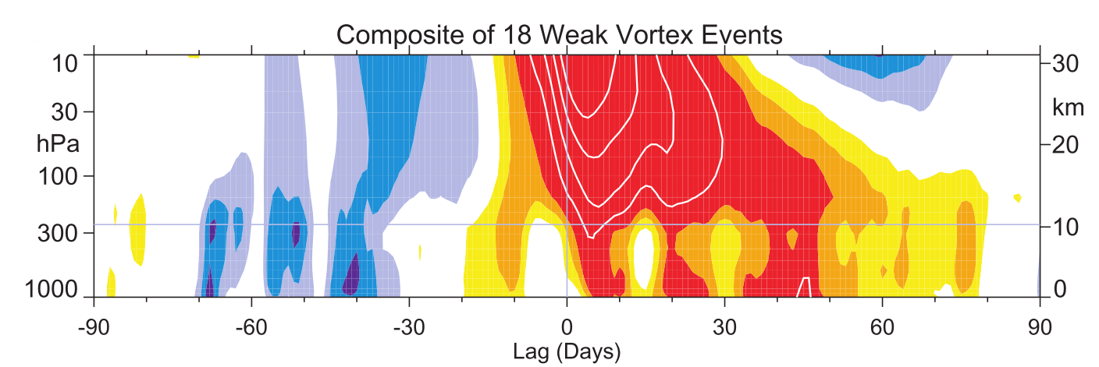
Stratosphere-troposphere coupling
1. Introduction
-> Sudden Stratospheric Warmings are the main source of variability in the polar winter stratosphere.
-> Impact on the troposphere -> Seasonal forecasts
Baldwin and Dunkerton (2001)
5

Slide 6
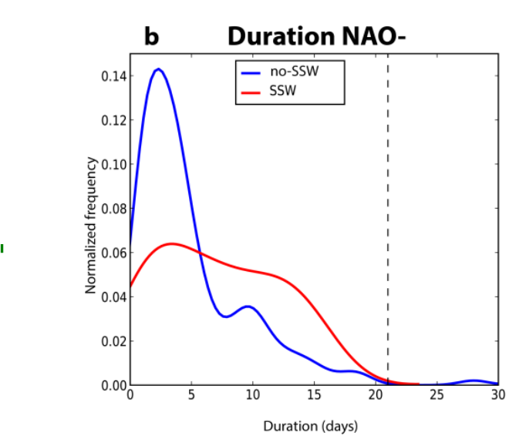
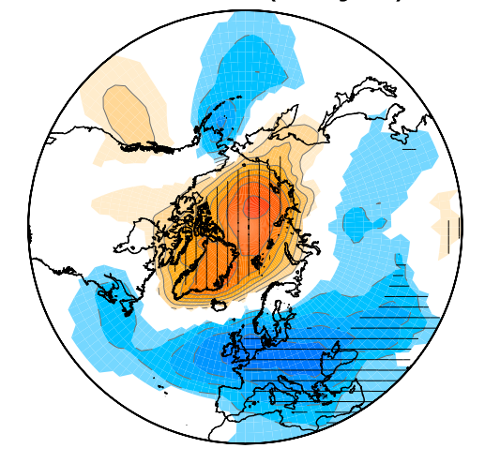
1. Introduction
Surface impact of SSWs
SLP anomalies after SSWs
Palmeiro et al. 2015
Ayarzagüena et al. 2018
Scaife et al. 2016

Slide 7
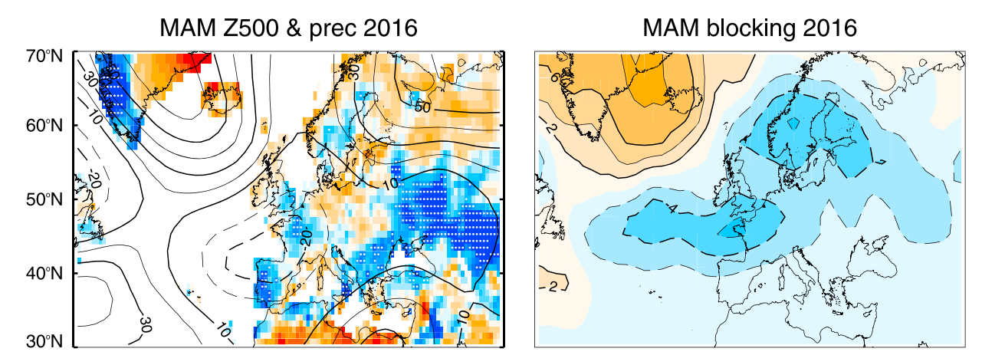
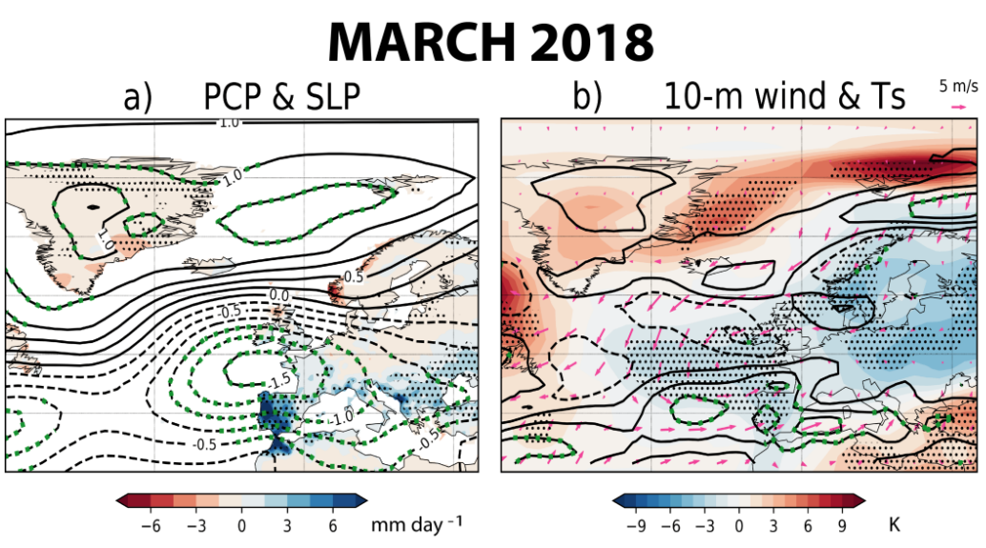
Surface impact of SSWs
1. Introduction
MAM 2016
Palmeiro et al. 2017
Ayarzagüena et al. 2018
Scaife et al. 2016
Notes:
In Portugal, renewable energies, mainly hydroelectric energy and wind power, were able to cover the entire electric production for the first time in March 2018

Slide 8
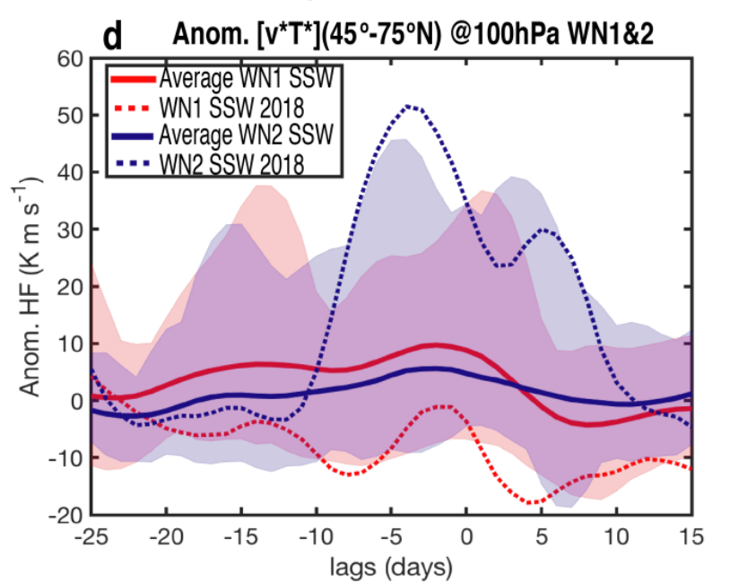
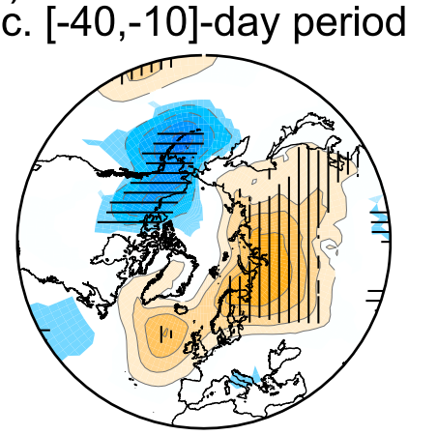
1. Introduction
Precursor signal of SSWs
SLP ANOM
Ayarzagüena et al. 2018
Palmeiro et al. 2015
Scaife et al. 2016

Slide 9
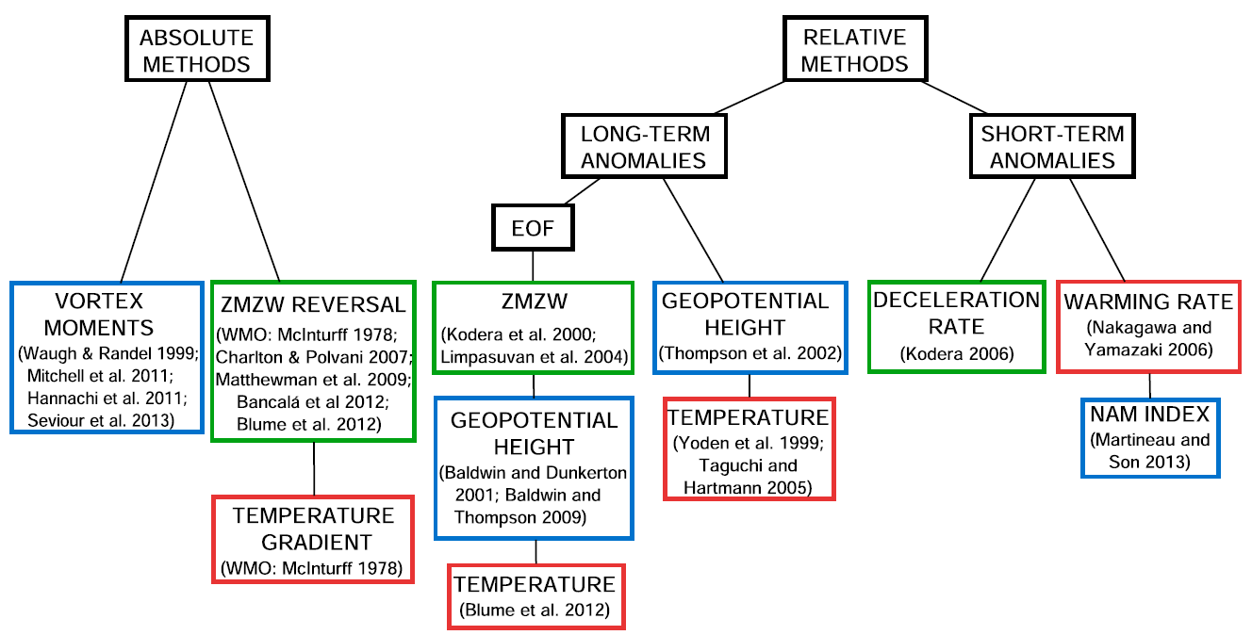
SSW definitions
1. Introduction
Different methods yield to different events detected
But, To what extent are the differences in the definitions important?
9

Slide 10
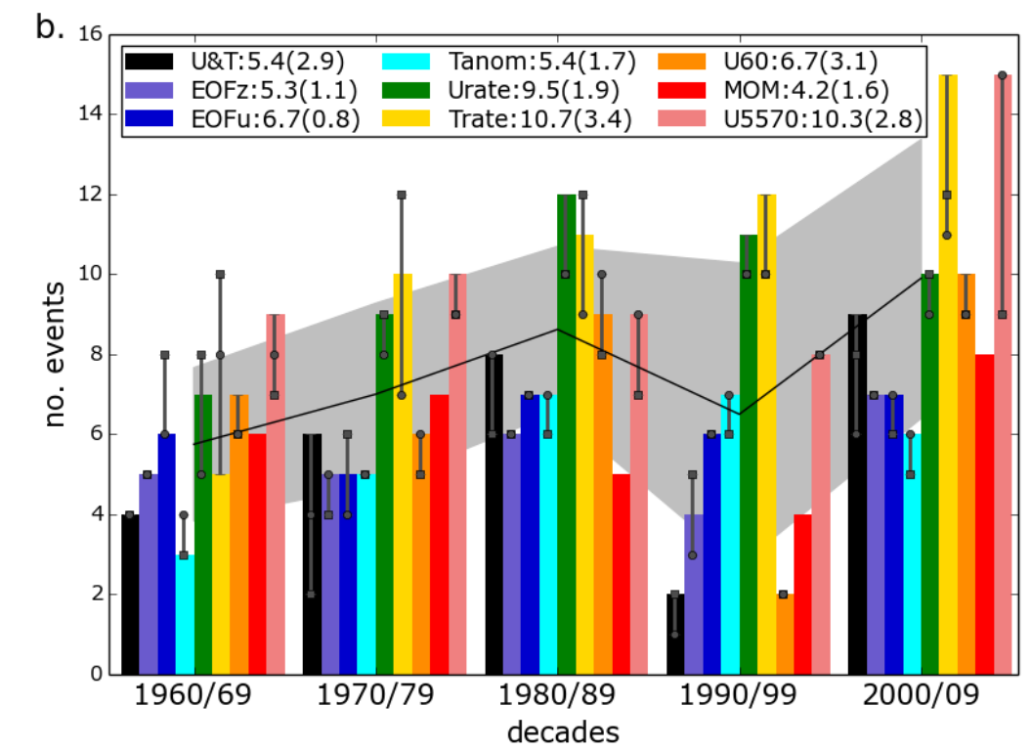
SSW decadal distribution
ERA (1960-2010)
Palmeiro et al. 2015
-> The minimum occurrence in the 90s is only significant when defining SSWs at 60 N

Slide 11
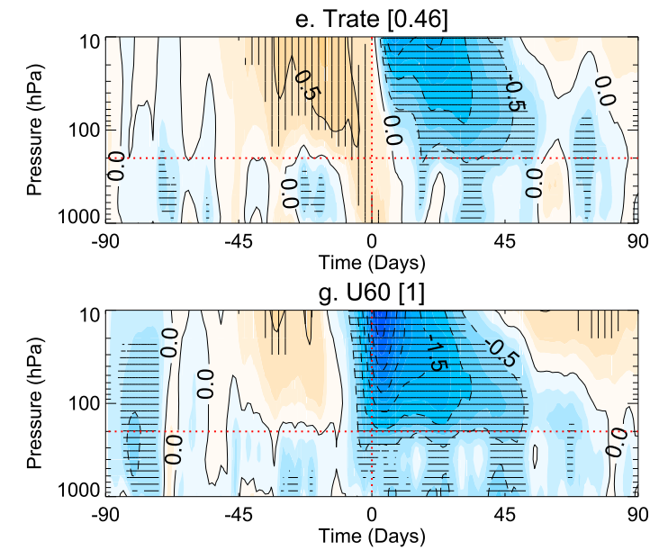
Stratosphere-Troposphere coupling
1. Introduction
10.7 ev/dec
6.7 ev/dec
10.3 ev/dec
-> Events when wind reverses are major SSWs
Palmeiro et al. 2015

Slide 12
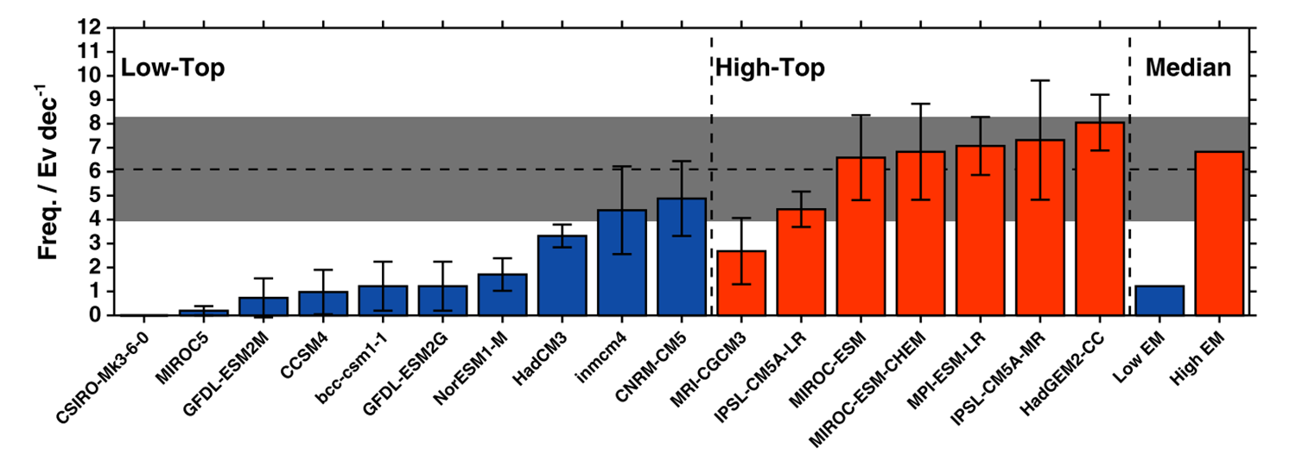
1. Introduction
How models represent SSWs?
CMIP5 Models
Charlton-Pérez et al. (2013)
12

Slide 13
EC-EARTH
2. Model and Data
2 x Ocean-coupled simulations: High-Top and Low-Top
100 winters each
Solar and GHG fixed at yr 2000
SSWs – NDJFM daily Uzm < 0
@ 10hPa in [55-70]N
*COMPARE WITH ERA-Interim

Slide 14
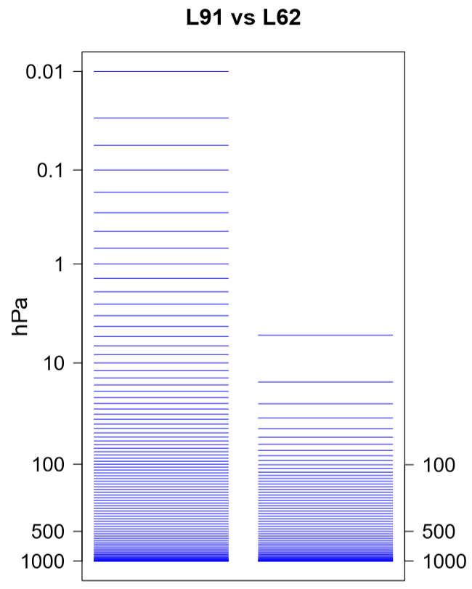
EC-EARTH
2. Model and Data
High-Top versus Low-Top
2 x Ocean-coupled simulations: High-Top and Low-Top
100 winters each
Solar and GHG fixed at yr 2000
SSWs – NDJFM daily Uzm < 0
@ 10hPa in [55-70]N
*COMPARE WITH ERA-Interim

Slide 15
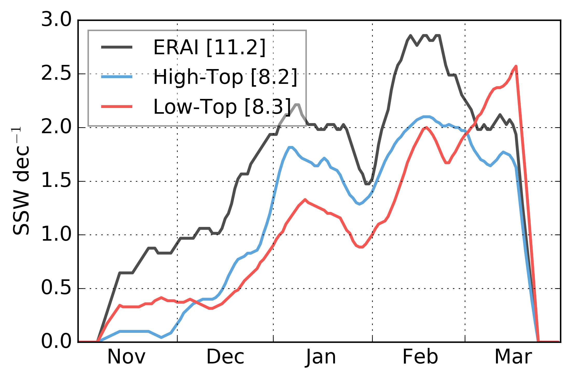
SSWs in EC-EARTH- Seasonality
3. Results
-> SSW frequency shifted to late winter in Low-Top
-> High-Top reproduces the two SSW peaks as in ERA-Interim

Slide 16
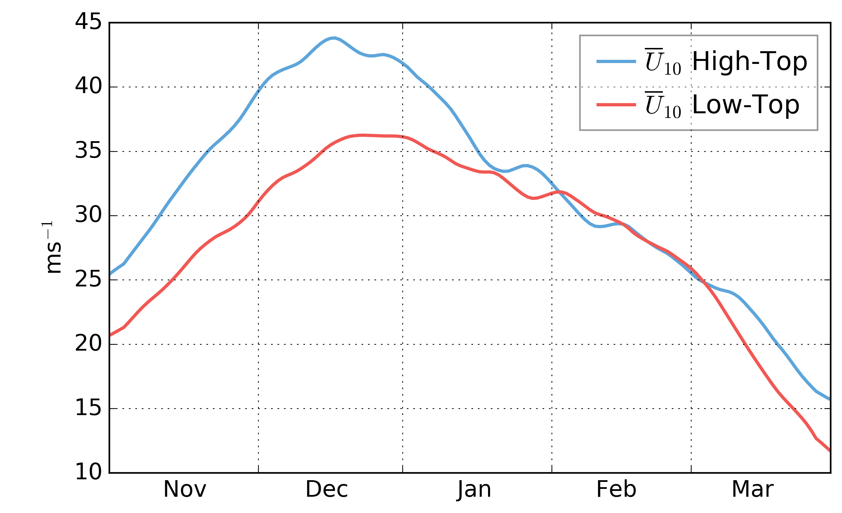
is the vortex stronger in Low-Top?
3. Results
Climatological Uzm at 65 N and 10 hPa
-> Despite showing more SSWs, the climatological stratospheric polar vortex
is stronger in High-Top in early winter.

Slide 17
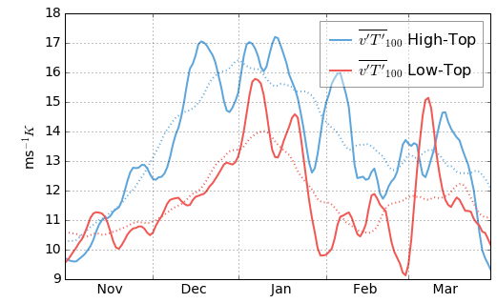
Climatological Eddy heat flux
3. Results
@ 100 hPa over [60-80] N
(a)
-> Different shapes in the seasonal distribution of the heat flux
-> High-top shows more heat flux in early winter
-> Low-top shows a peak by late winter

Slide 18
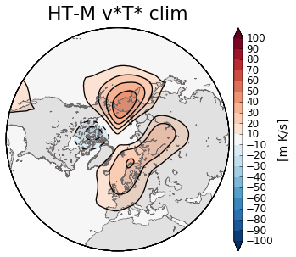
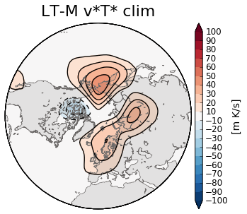
Climatological Eddy heat flux
3. Results
(a)
High-top
Low-top
MARCH
-> Different shapes in the seasonal distribution of the heat flux
-> High-top shows more heat flux in early winter
-> Low-top shows a peak by late winter

Slide 19
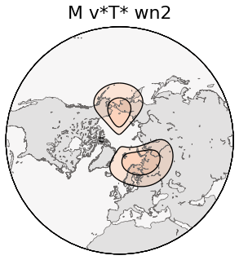
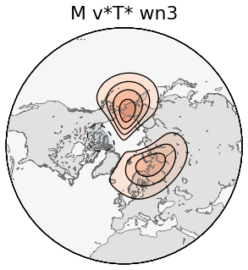
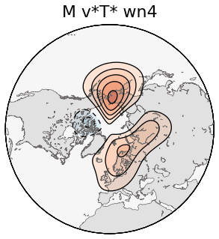
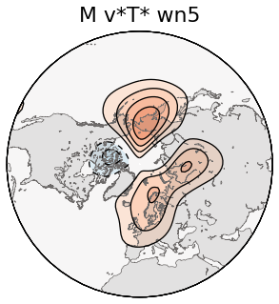
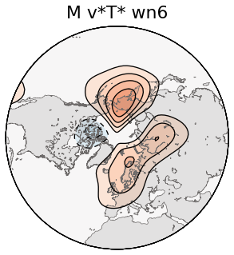
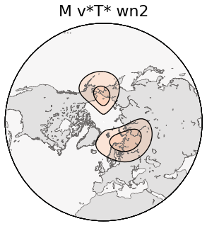
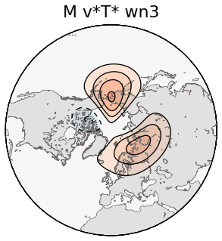
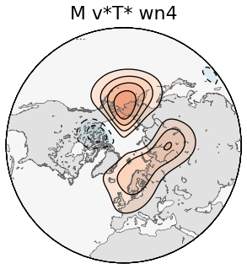
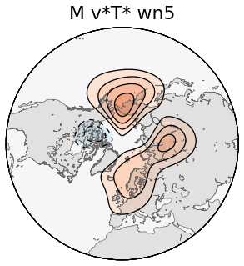
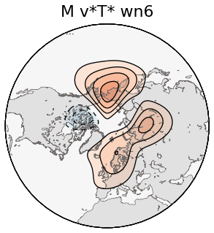
Wave number contribution
3. Results
High-Top
WN1
WN1-2
WN1-3
WN1-4
WN1-5
Low-Top
WN1
WN1-2
WN1-3
WN1-4
WN1-5

Slide 20
Wave number contribution
3. Results
High-Top
Low-Top
WN 1-2
WN 1-5

Slide 21
Wave number contribution
3. Results
High-Top
Low-Top
WN 1-2
WN 1-5
-> The double lobed shape is due to k>2
-> The late winter v’T’ peak in low-top is due to small wave contribution to the total v’T’

Slide 22
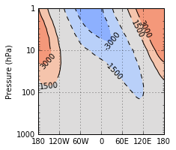
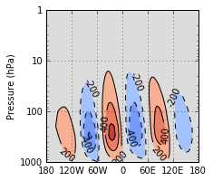
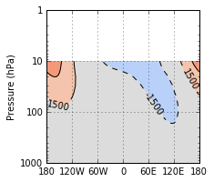
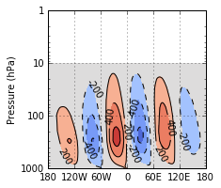
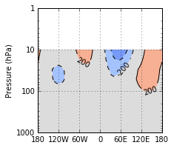
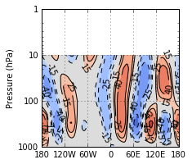
Wave amplitude
3. Results
WN1-2
WN3-5
March
High-Top
-> Large-scale waves are larger in High-Top
-> Small-scale waves are smaller in High-Top: less contribution to the HF over Central Siberia (responsible for the later winter peak in Low-Top)
Low-Top
High-top
minus
Low-Top

Slide 23
Concluding Remarks
4. Conclusions
Despite both configurations show same SSW frequency, ~8 ev/dec Vs 11ev/dec in ERA-I only High-Top shows a realistic SSW distribution while Low-Top is shifted to late winter.
The SSW tropospheric impacts in the pre/post period is also similar to Reanalysis in High-Top.
The stratospheric polar vortex is stronger in High-Top in early winter despite having more SSWs.
Differences in the SSW seasonal distribution are associated to a misrepresentation of the climatological eddy heat flux in the lower stratosphere.
The double lobed shape is due to small-scale waves
The SSW increase in late winter in Low-Top is due to an increase of the heat flux over Central Siberia associated to an overrepresentation of small-scale waves (k>2)
- A High-Top configuration is needed to obtain a realistic climatological heat flux and SSW seasonality.

Slide 24
Concluding Remarks
4. Conclusions
Despite both configurations show same SSW frequency, ~8 ev/dec Vs 11ev/dec in ERA-I only High-Top shows a realistic SSW distribution while Low-Top is shifted to late winter.
The SSW tropospheric impacts in the pre/post period is also similar to Reanalysis in High-Top.
The stratospheric polar vortex is stronger in High-Top in early winter despite having more SSWs.
Differences in the SSW seasonal distribution are associated to a misrepresentation of the climatological eddy heat flux in the lower stratosphere.
The double lobed shape is due to small-scale waves
The SSW increase in late winter in Low-Top is due to an increase of the heat flux over Central Siberia associated to an overrepresentation of small-scale waves (k>2)
- A High-Top configuration is needed to obtain a realistic climatological heat flux and SSW seasonality.
Thank you!!

Slide 25
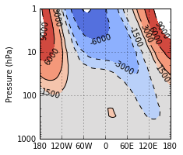
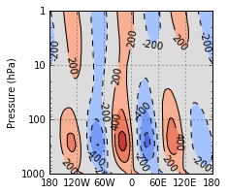
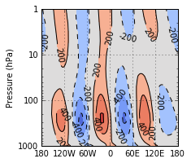
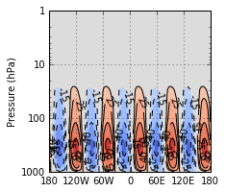
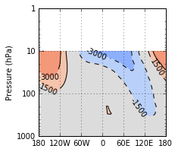
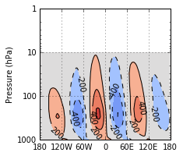
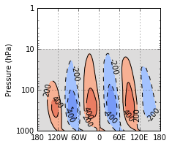
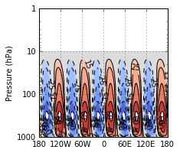
December
wn1-2
wn3-4
wn3-5
WN5

Slide 26
3. Results
(a)
(b)
(c)
(d)
(e)
(f)
(g)
(h)

Slide 27
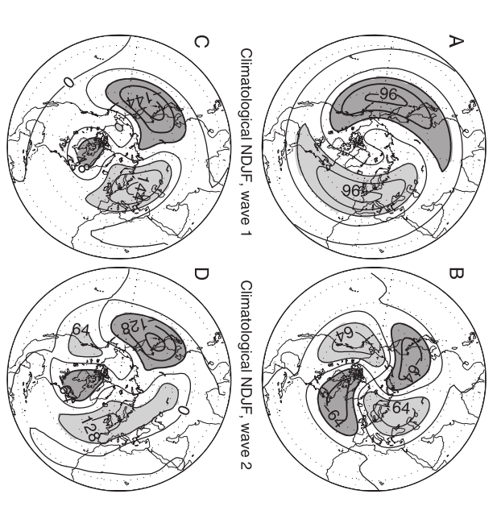
3. Results

Slide 28
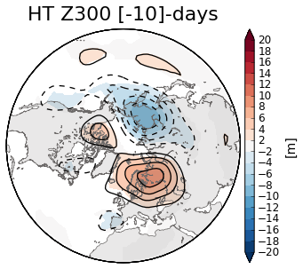
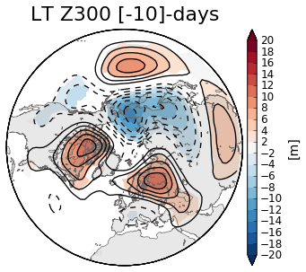
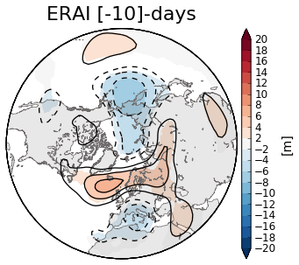
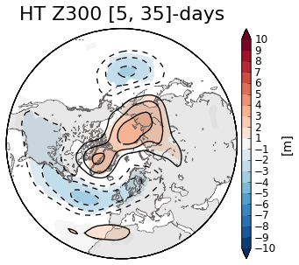
Tropospheric signatures
3. Results

