Slide 1
CLIMATE SERVICES for wind energy
user engagement
wind energy users
scientific
user-driven research
HOW EL NIÑO CAN BE USED TO IMPROVE WIND SPEED SEASONAL PREDICTABILITY?
Nube Gonzalez-Reviriego (1), Raül Marcos (1), Francisco J. Doblas-Reyes (1,2), Verónica Torralba (1), Nicola Cortesi (1), Doo Young Lee (1) and Albert Soret (1)
1 Barcelona Supercomputing Center (BSC), Barcelona, Spain
2 Institució Catalana de Recerca i Estudis Avançats (ICREA), Barcelona, Spain

Slide 2
CLIMATE SERVICES for wind energy
user engagement
wind energy users
scientific
user-driven research
HOW EL NIÑO CAN BE USED TO IMPROVE WIND SPEED SEASONAL PREDICTABILITY?
Nube Gonzalez-Reviriego (1), Raül Marcos (1), Francisco J. Doblas-Reyes (1,2), Verónica Torralba (1), Nicola Cortesi (1), Doo Young Lee (1) and Albert Soret (1)
1 Barcelona Supercomputing Center (BSC), Barcelona, Spain
2 Institució Catalana de Recerca i Estudis Avançats (ICREA), Barcelona, Spain

Slide 3
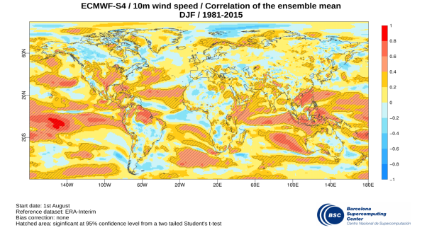
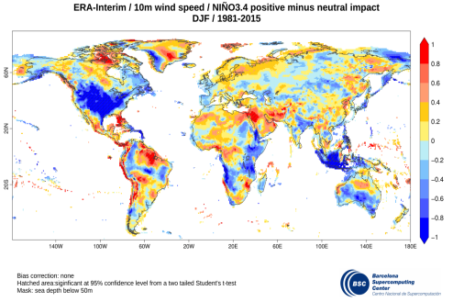
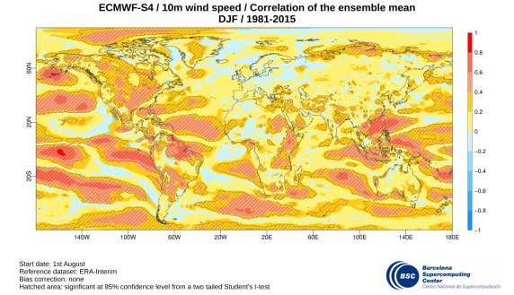
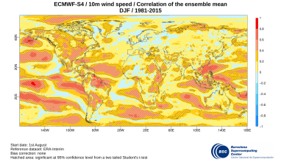
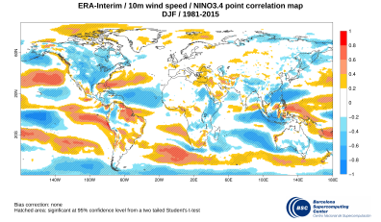
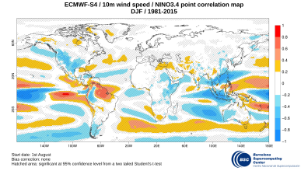
Scientific user-driven research
Specific user question: lack of wind speed skill
How scientific research can help?
Improving wind speed skill
Before and after improving wind speed skill
Why does wind speed skill improve?

Slide 4
Specific user question: lack of wind speed skill
I would like to know the prediction of the next winter wind speed over my wind farms in Canada 4 months in advance. Nevertheless, I realized that there is very low or no skill there
User

Slide 5
How scientific research can help?
Looking for sources of predictability to improve seasonal wind speed predictions: observed El Niño 3.4 index and its impact on wind speed.
Scientist

Slide 6
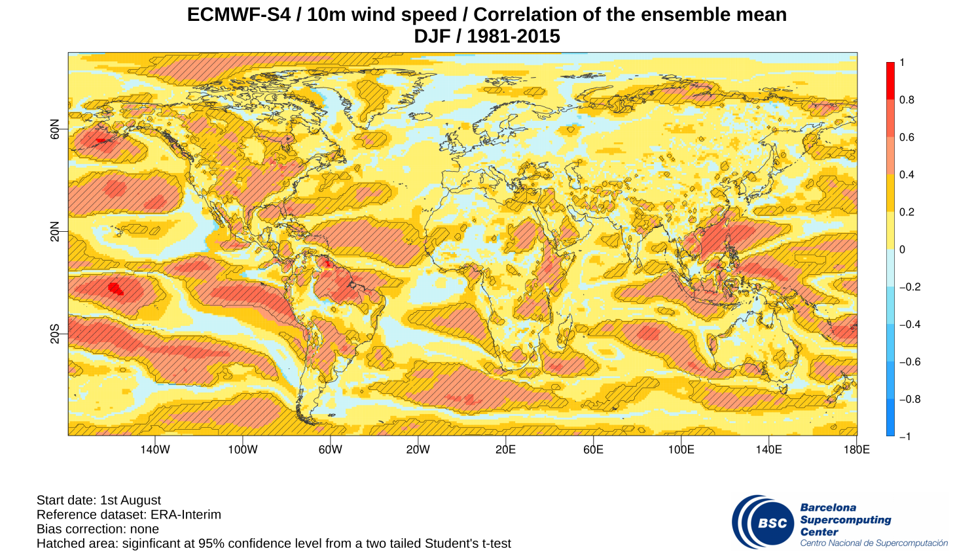
Improving wind speed skill
Method to obtain a more skillful wind speed predictions: combining the information obtained from (i) the observed relationship between El Niño index and the wind speed and (ii) seasonal predictions of El Niño index
Technical details
Scientist

Slide 7
Improving wind speed skill
X
Methods
W_{obs}: Observed wind speed
Ind_{obs}: Observed NIÑO 3.4 index
i: year of the season
W_{frc}: Predicted wind
Ind_{frc}: Predicted NIÑO 3.4 index
i: year of the season
j: lead time

Slide 8
Before and after improving wind speed skill
Before
After
10m wind speeds for DJF season obtained from ECMWF S4 seasonal predictions started on 1st August
10m wind speeds for DJF season obtained from El Niño 3.4 index predicted with ECMWF S4 forecast system. Start date 1st August
Improvement of wind speed skill over Canada

Slide 9
Why does wind speed skill improve?
The impact of El Niño 3.4 index on 10m wind speeds for DJF season over the period 1981-2015 is different from observations (ERA-Interim) and predictions (ECMWFS4) over Canada
ERA-Interim
ECMWF S4
The method for improving wind speed skill uses the observed impact of El Niño on wind speed whereas the ECMWF S4 is not able to reproduce it correctly over some areas such as Canada

Slide 10
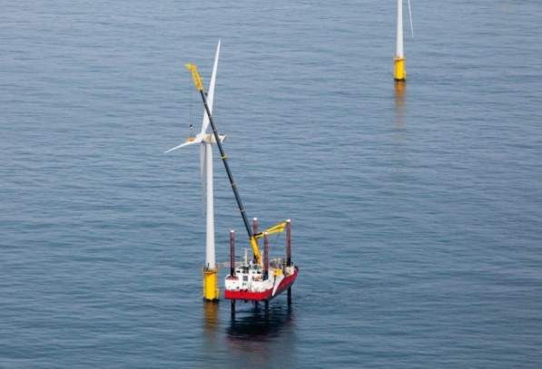
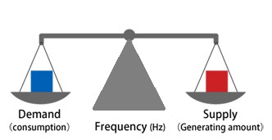
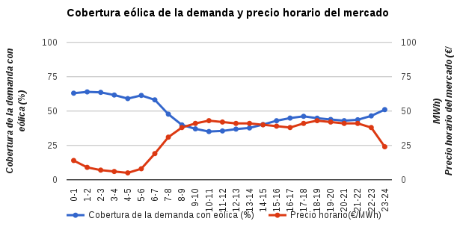
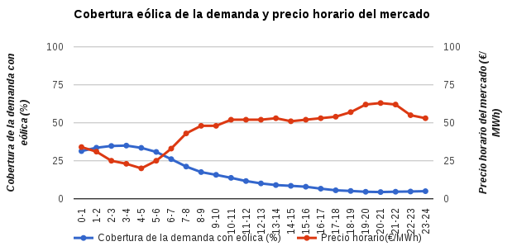
Wind energy users
Maintenance works
Grid management
Financial operations
Share of wind power supply and hourly price evolution
Hourly price in market (€/MWh)
Hourly price in market (€/MWh)
Share of wind in the electricity demand (%)
Share of wind in the electricity demand (%)

Slide 11
Maintenance works
Maintenance should be performed during less windy periods in order to minimise the risk of storms and swell conditions. For that reason estimating wind energy resources at seasonal time scales can be useful for the schedule of this works, particularly in offshore wind farms.

Slide 12
Grid management
Seasonal predictions of wind resources can potentially benefit grid operators and allow them to adapt the electric network to wind power supply. Supply and demand are the determining factors for the market and important decisions must be made in order to attain adequate load balancing between production and consumption.

Slide 13
Financial operations
Share of wind power supply and hourly price evolution
For the financial teams running the wind farm business having a budget of the energy they will produce in the coming months is of crucial importance, because this information can be used to anticipate cash flow and this can be translated in important cost savings.
Share of wind in the electricity demand (%)
Hourly price in market (€/MWh)
Share of wind in the electricity demand (%)
Hourly price in market (€/MWh)

Slide 14
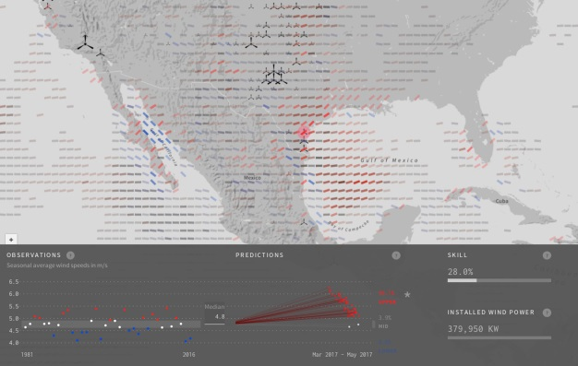
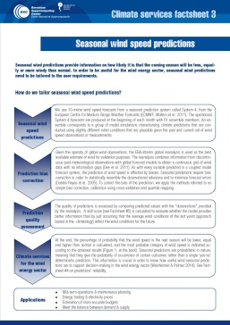
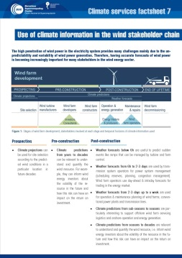
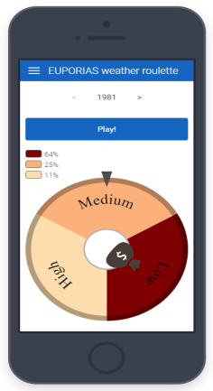
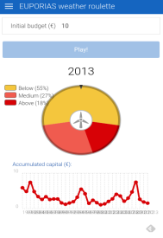
User engagement
User Interface Platform
http://www.bsc.es/ESS/arecs
RESILIENCE wind prototype
Factsheets/Case studies
Apps

Slide 15
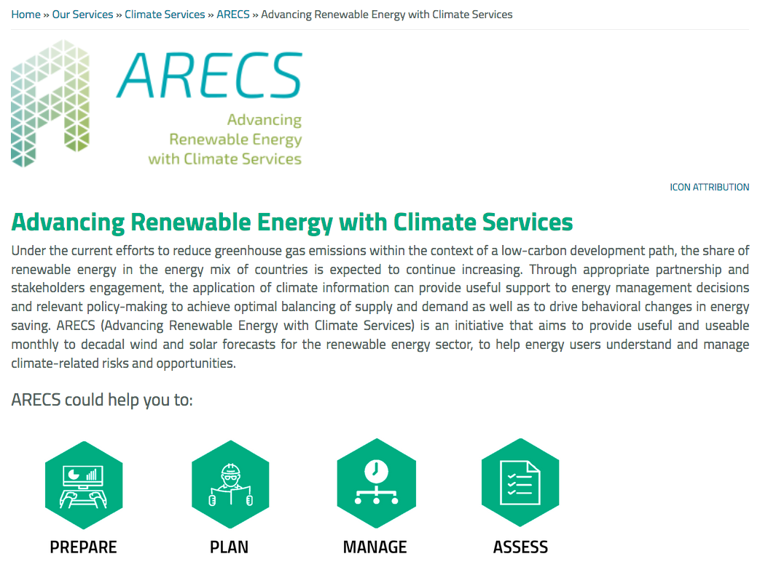
ARECS User Interface Platform
On-line User Interface Platform for energy users
Source: http://www.bsc.es/ESS/arecs

Slide 16
RESILIENCE prototype
On-line visualisation tool for the wind energy sector – RESILIENCE prototype
Joint development between scientists – designers
Provides robust information on the future variability of wind (probabilistic predictions)
Source: http://www.bsc.es/projects/earthscience/resilience/

Slide 17
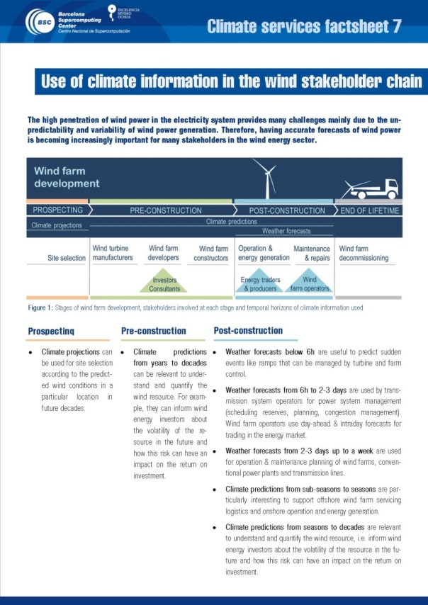
Factsheets / Case studies
Two-page factsheets describing different aspects of seasonal climate predictions that can be complex to understand by non-specialists.
Case studies from the past that are relevant for particular industrial partners and learn how information on climate predictions would have been useful to anticipate particular past key events

Slide 18
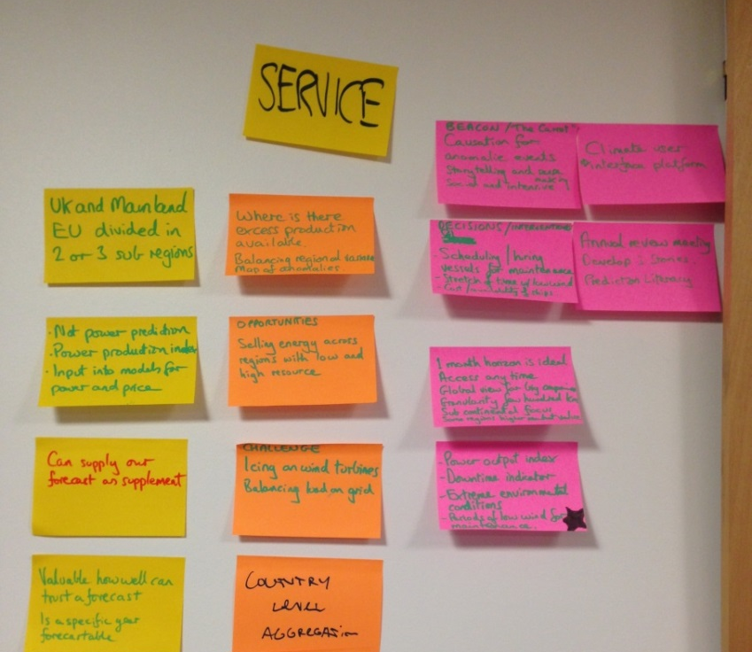
Apps
Participatory approaches for user engagement (workshops, focus groups, interviews, surveys…)
Innovative ways of reaching users
The Weather Roulette app
Source: https://play.google.com/store/apps/details?id=es.predictia.weatherroulette&hl=es

Slide 19
Thank you ! nube.gonzalez@bsc.es
X
RESILIENCE
The research leading to these results has received funding from the EU Seventh Framework Programme FP7 (2007-2013) under grant agreement GA 308291, the Ministerio de Economía y Competitividad (MINECO) under project CGL2013-41055-R and a contract for the Copernicus Climate Change Service implemented by ECMWF on behalf of the European Commission.

