Slide 1
An introduction to blending methodologies
Pablo Ortega (BSC; WP5)

Slide 2
MOTIVATION
Climate Services
Days
Weeks
Months
Years
Decades
Centuries
Stakeholders

Slide 3
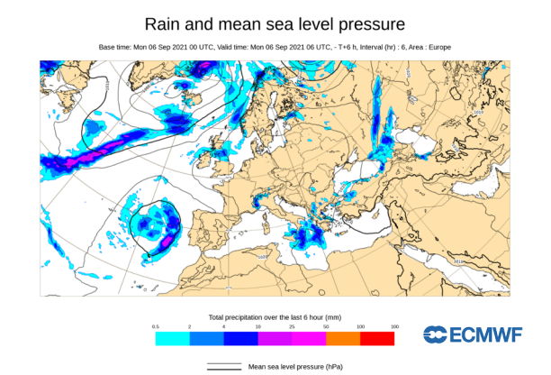
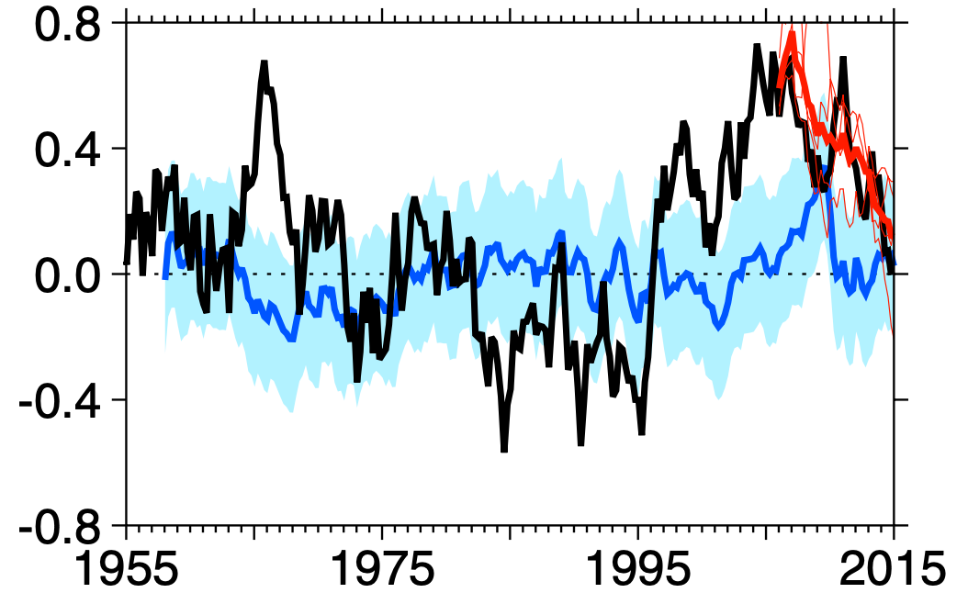
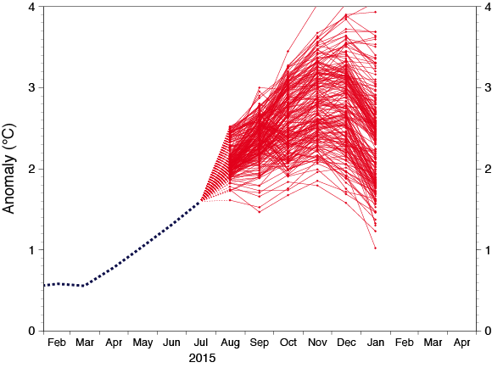
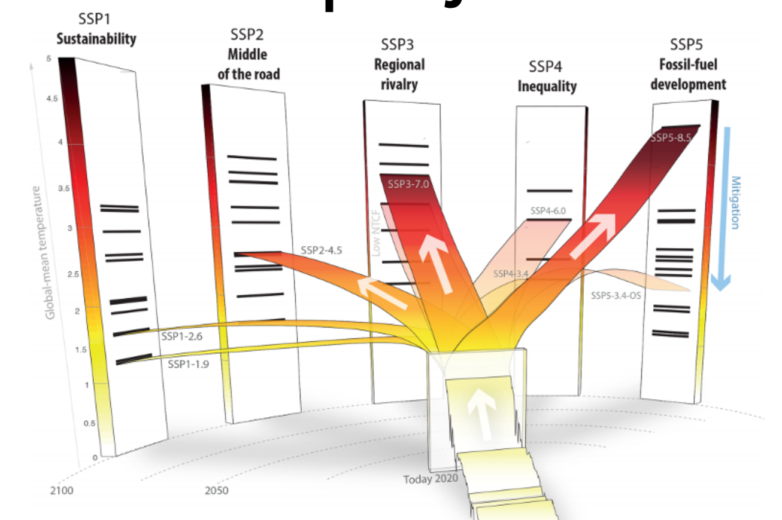
MOTIVATION
Predictions of SPG cooling
Climate Services
Robson et al. (2018)
Weather
forecasts
Subseasonal
Predictions
Seasonal
Predictions
Decadal
Climate Predictions
Climate
Projections
Days
Weeks
Months
Years
Decades
Centuries
Stakeholders
EUROSIP ENSO Plume Forecasts
Meinshausen et al. (2020)

Slide 4
SOURCES OF PREDICTABILITY
Robson et al. (2018)
Meinshausen et al. (2020)
Weather
forecasts
Subseasonal
Predictions
Seasonal
Predictions
Decadal
Climate Predictions
Climate
Projections
Days
Weeks
Months
Years
Decades
Centuries

Slide 5
SOURCES OF PREDICTABILITY
Weather
forecasts
Subseasonal
Predictions
Seasonal
Predictions
Decadal
Climate Predictions
Climate
Projections
Days
Weeks
Months
Years
Decades
Centuries
Initial Value Problem
Memory from internal processes in the climate system
Accurate constraint of the current meteorological state
©National Research Council

Slide 6
SOURCES OF PREDICTABILITY
Meinshausen et al. (2020)
Weather
forecasts
Subseasonal
Predictions
Seasonal
Predictions
Decadal
Climate Predictions
Climate
Projections
Days
Weeks
Months
Years
Decades
Centuries
Boundary Value Problem
Effects upon climate of
external radiative forcings
Good guess of future changes in the forcing factors
©European Environment Agency
©NASA/SDO

Slide 7
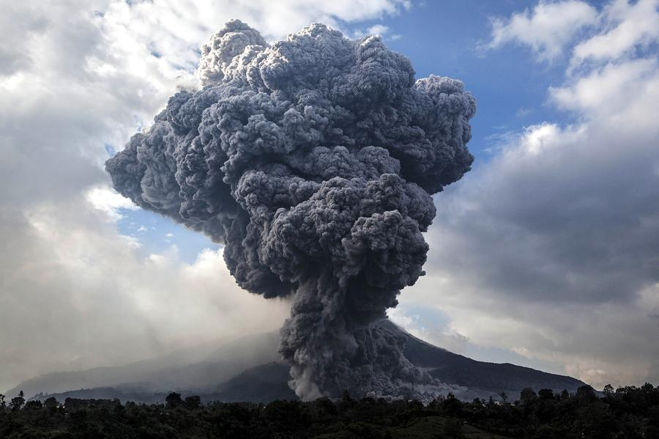
SOURCES OF PREDICTABILITY
Robson et al. (2018)
Weather
forecasts
Subseasonal
Predictions
Seasonal
Predictions
Decadal
Climate Predictions
Climate
Projections
Days
Weeks
Months
Years
Decades
Centuries
Boundary Value Problem
Effects upon climate of
external radiative forcings
Initial Value Problem
Memory from internal processes in the climate system
©European Environment Agency
©Ulet IfansastiGetty Images

Slide 8
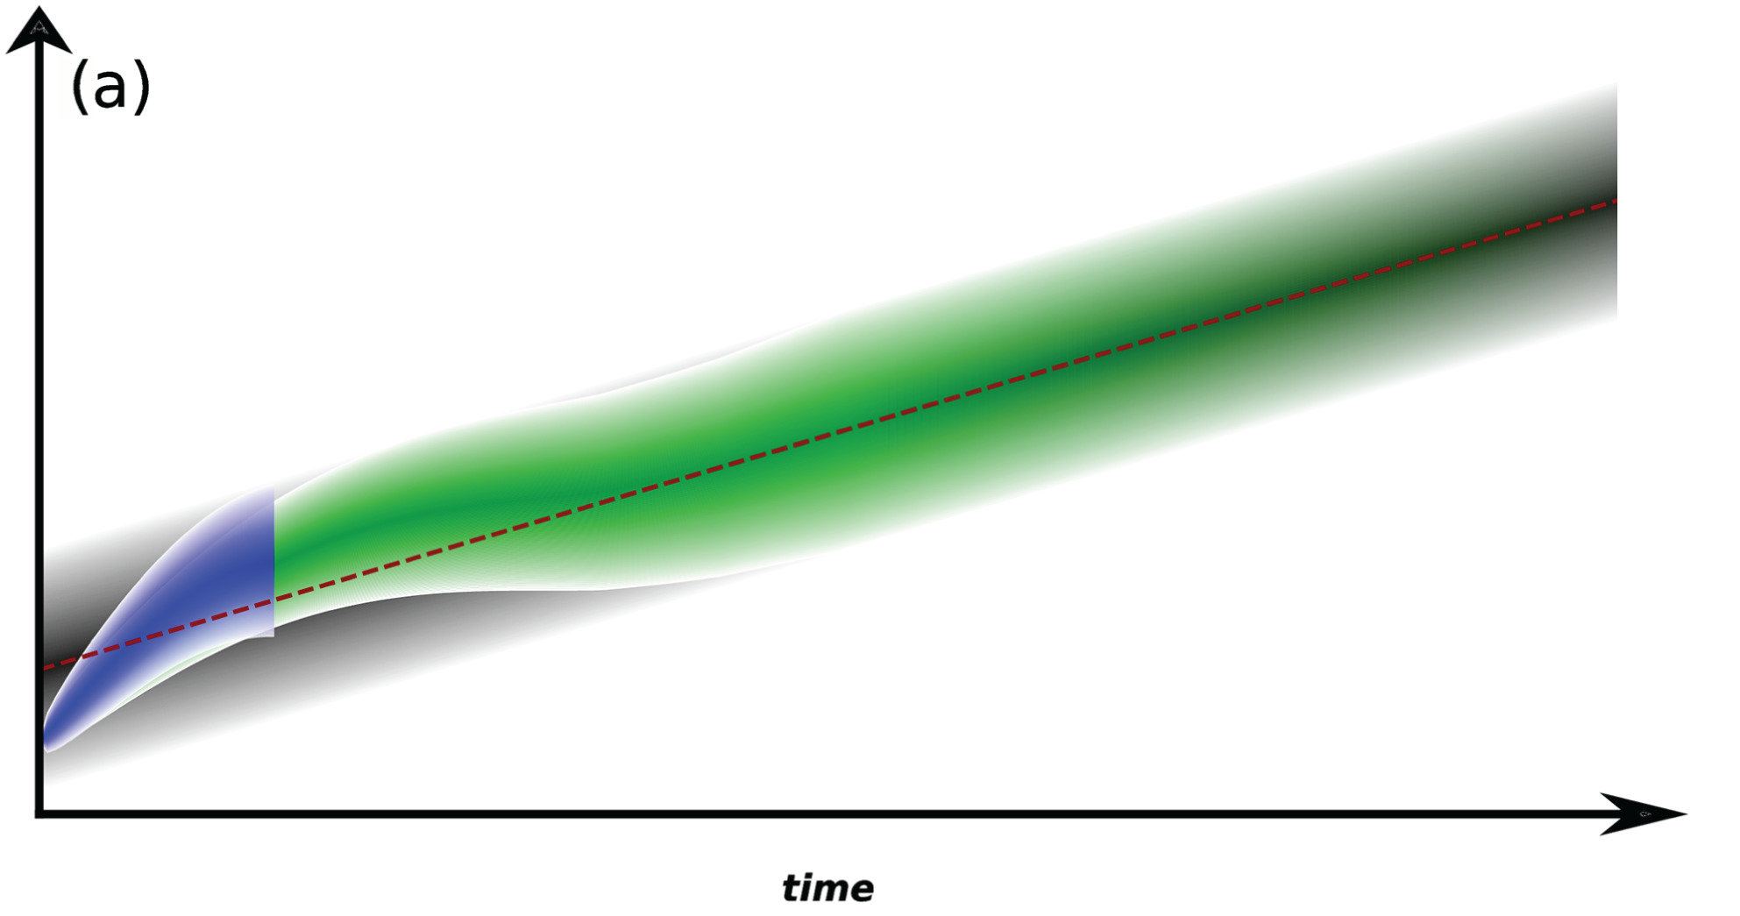
REVEALING INCONSISTENCIES
Drift Illustration
Courtesy of R. Bilbao
PREDICTIONS (decadal) | PROJECTIONS
Initialized from observed state | Based on uninitialized ensembles
Subject to important model drifts | Model is already in its preferred state
Ensemble mean captures internal+forced predictability | Ensemble mean only captures forced predictability
Ensemble spread constrained by the initial state | Ensemble spread seeks to include all internal variability phases
Retrospective predictions required with very high computational costs | Continuous simulations (only a few members needed)
Two temporal dimensions (forecast time and initialization time) | Only one temporal dimension (simulated year)
Only about a dozen modelling centers worldwide produce them | All major modelling centers (>40) worldwide produce them
Global surface temperature
Ensemble Comparison
Befort et al.(2020)

Slide 9
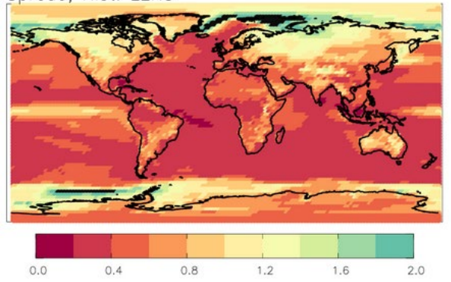
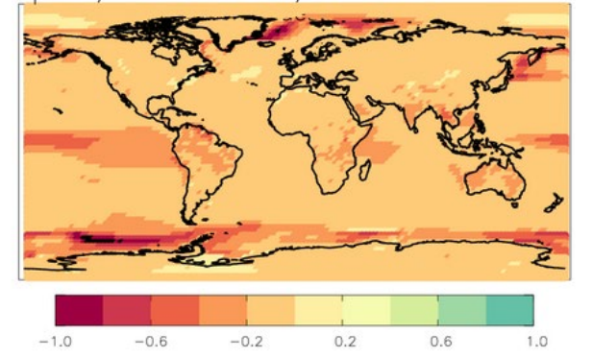
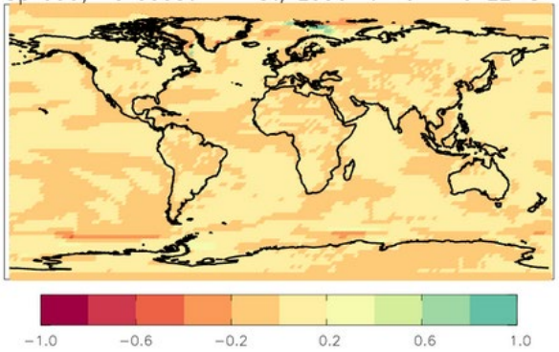
REVEALING INCONSISTENCIES: Ensemble Spread
Mean inter-model ensemble spread of surface air temperature
Historical
Prediction (FY1) - Historical
Prediction (FY10) - Historical
NCAR Large Ensembles
DMI: Christensen et al (2023)

Slide 10
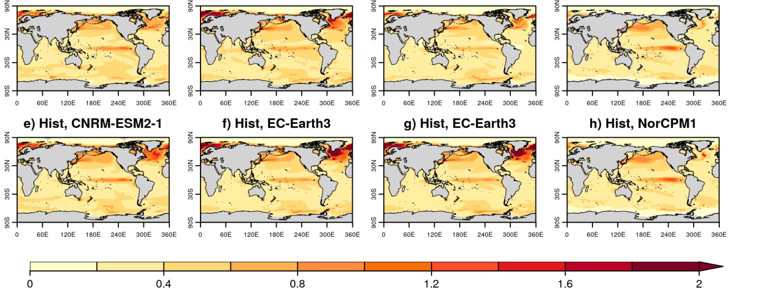
REVEALING INCONSISTENCIES: Ensemble Spread
Mean inter-model ensemble spread of sea surface temperature
CNRM-ESM2-1
EC-Earth3-i2
EC-Earth3-i4
NorCMP1
Predictions (FY10)
Historical
BSC: R. Bilbao and co-authors

Slide 11
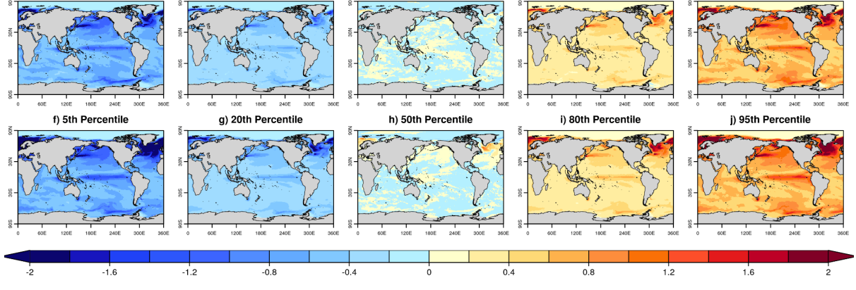
REVEALING INCONSISTENCIES: Ensemble Spread
Selected percentiles in the inter-model ensemble of sea surface temperature
5th percentile
20th percentile
50th percentile
80th percentile
95th percentile
Predictions (FY10)
Historical
For EC-Earth3 (i2)
BSC: R. Bilbao and co-authors

Slide 12
REVEALING INCONSISTENCIES: Long-term trends
Ensemble mean regional surface temperature trends
West Central Europe
Northern Europe
Mediterranean
CNRS-CERFACS: R. Bonnet and co-authors

Slide 13
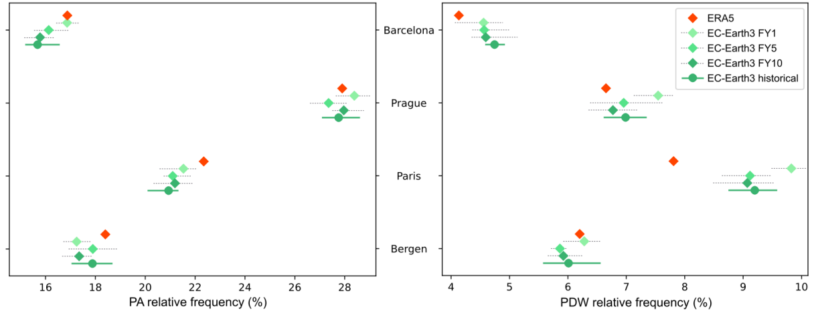
REVEALING INCONSISTENCIES: Dynamical drivers
Mean relative frequency of main weather types in the four I4C demonstrator cities
Pure Anticyclonic WT
Pure Directional Westerly WT
CSIC: S. Brands and co-authors

Slide 14
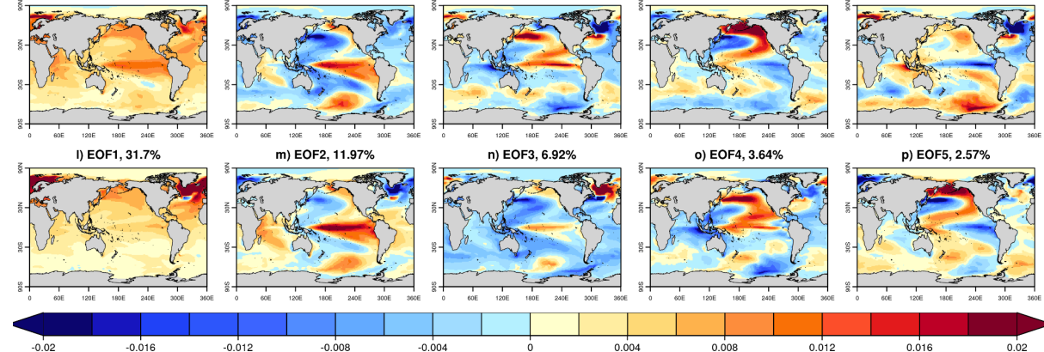
REVEALING INCONSISTENCIES: Large-scale drivers
Leading EOFs of the SST anomaly fields (in the member dimension)
EOF1
EOF2
EOF3
EOF4
EOF5
Predictions
19.7%
12.2%
4.7%
4.0%
3.6%
Historical
31.7%
12.0%
6.9%
3.6%
2.6%
For EC-Earth3 (i2)
BSC: R. Bilbao and co-authors

Slide 15
EXAMPLES OF BLENDING METHODS
Stitching methods
Constraining methods
Befort et al (2020)
Befort et al (2022)
Advantages
Advantages
Exploit full ensemble information
Bias and variance correction largely improve reliability
Can boost predictive skill in the projections
Constraints based on 1 variable but affect all system
Limitations
Limitations
Do not address physical consistency
Cannot be applied uniformly across variables
Variance inflation not usable in non-gaussian variables
Currently work only with ensemble prediction means
Probabilistic consistency is currently neglected

Slide 16
I4C NEW BLENDING APPROACHES (Spatial analogs)
Based on a methodology developed to constrain future projections with decadal predictions
Constrained predictions show added predictive skill for 20-year forecast horizons
start date 1
start date 2
start date 3
start date N
Ensemble mean
Decadal
Predictions
1st
analog
Ensemble of Projections
2nd
analog
This methodology will be
adapted to do a seamless blending of both datasets that ensures both physical and probabilistic consistency
...
...
...
...
Mahmood et al. (2021, 2022)

Slide 17
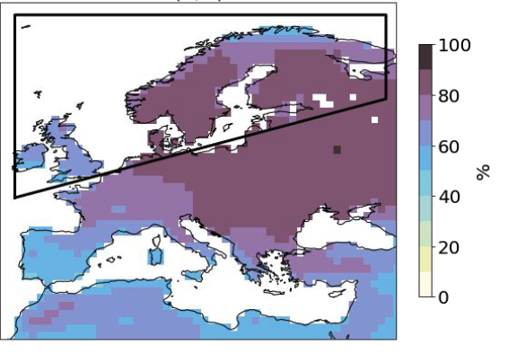
I4C NEW BLENDING APPROACHES (Storylines)
Storylines: self-consistent and plausible physical trajectories of the climate system,
according to the future state of key selected drivers of the regional variability
Example study: Role of internal variability in near-term projections of northern Europe (NEU) wintertime with large ensemble CMIP6 simulations
Internal variability explains 81% of total uncertainty in winter temperature projections (2020-2039)
AMV-, NAO+
AMV+, NAO+
NEU
4 storylines for 2020-2039
AMV-, NAO-
AMV+, NAO-
AMV & NAO are the main drivers (Cusinato et al. 2021)
Liné et al. (In prep)

Slide 18
TAKE HOME MESSAGES
Blending approaches seek to produce seamless climate information from daily to multi-decadal scales through the merging of different products.
This implies addressing important inconsistencies across those products that affect both their probabilistic properties, long-term trends and the internal state of the main large-scale drivers of regional variability
I4C is developing new blending methods to solve such inconsistencies, focusing on the merging of decadal predictions & climate projections.
Stay tuned to WP5 for future updates on these methodologies

Slide 21
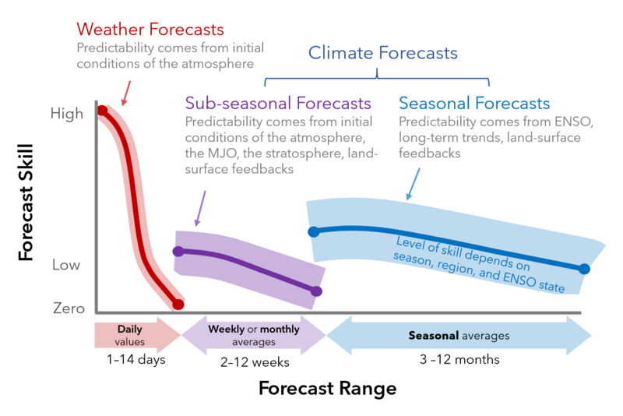
Notes:
Source: https://coloradoriverscience.org/Weather_and_climate_forecasts

