Slide 1
INTAROS – Integrated Arctic Observation System
A project funded by EC - H2020-BG-09-2016
Coordinator: Stein Sandven
Nansen Environmental and Remote Sensing Center, Norway
Total budget: 15.5 mEuro - 49 partners from 20 countries
Start date: 01 December 2016 - Duration: 5 years

Slide 2
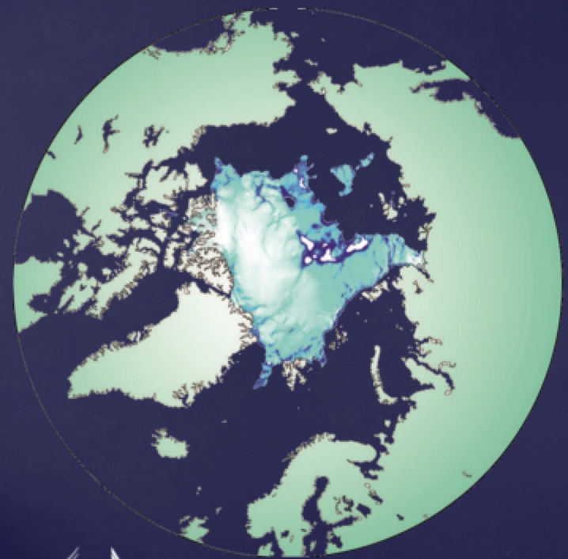
INTAROS overall objective
to develop an efficient integrated Arctic Observation System by
extending,
improving and
unifying
existing and evolving systems in the different regions of the Arctic

Slide 3
INTAROS objectives
Establish a Pan-Arctic forum for collaboration across EU and non-EU countries and transnational organisations (WP1)
Develop a Roadmap for building a sustainable Arctic observing system (WP1)
Exploit existing observing systems and databases (WP2)
Fill gaps of the present in situ observing systems (WP3)
Enhance community-based observing programmes (WP4)
Develop and implement the iAOS platform for integration of multidisciplinary data from distributed repositories (WP5)
Demonstrate assimilation into climate models (collaboration with BLUE ACTION)
Conduct case studies using iAOS to selected stakeholders

Slide 4
An integrated Arctic Observing System needs to cover
Atmosphere
Ocean
Terrestrial themes
at appropriate temporal and spatial scales and resolution.
The largest gaps are in the in-situ observation network, which should provide
data not obtained from remote sensing and numerical models
data needed for validation of remote sensing and numerical models

Slide 5
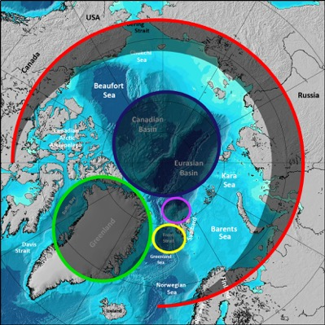
In situ observing system deployments
Coastal Greenland
North of Svalbard towards the deep Nansen Basin
Fram Strait - Kongsfjorden
Central Arctic Ocean
Selected sites across Arctic
land areas

Slide 6
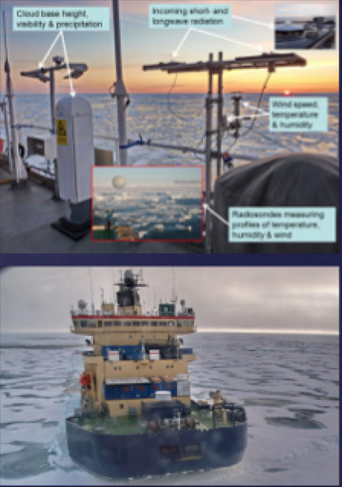
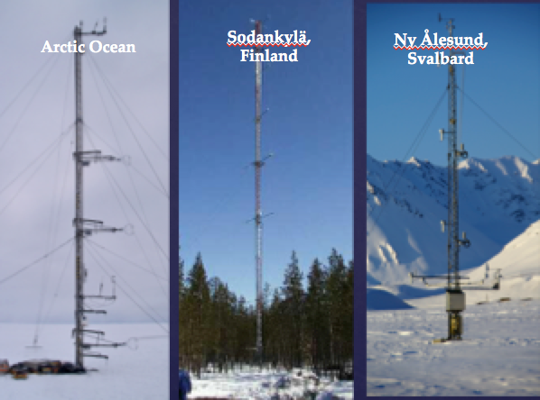
Observing system using in-situ observations from supersites, field campaigns, buoys, research vessels, aircraft and satellites
Atmosphere
Arctic Ocean
Sodankylä, Finland
Ny Ålesund, Svalbard

Slide 7
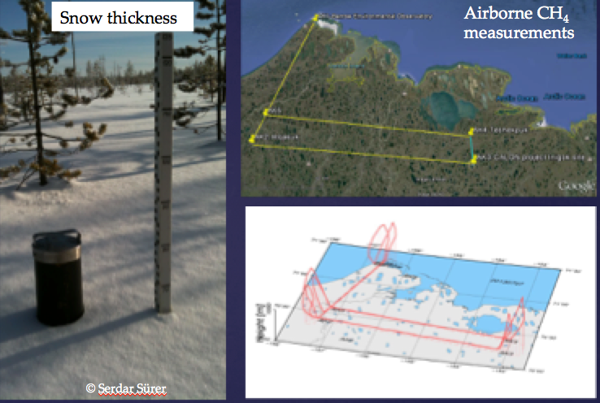
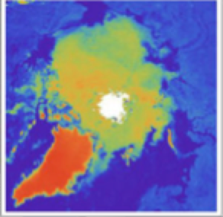
Cryosphere and land
In-situ cryospheric and land observations from past and new campaigns and research stations
Use of satellite snow, hydrological, and ice mass change products

Slide 8
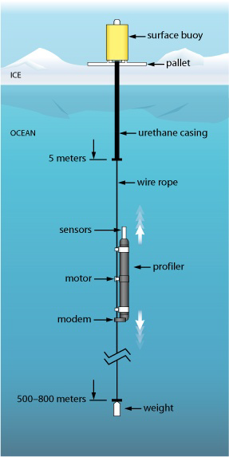
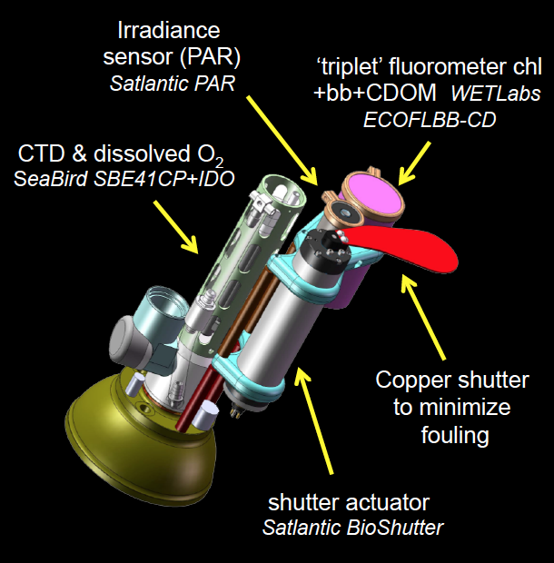
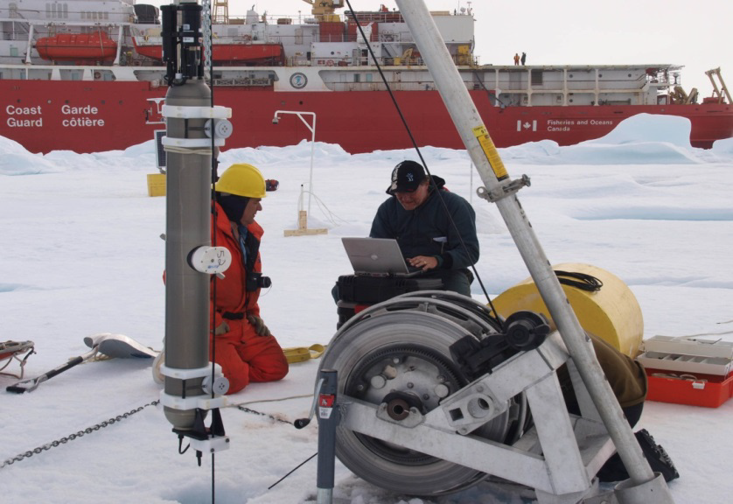
Central Arctic Ocean
ice-tethered platforms (WHOI) for measurements of ocean physical variables combined with biogeochemical sensors
Laney et al., 2014, 2015
Proposed sensors:
Customized ‘triplet’ fluorometer to measure chlorophyll fluorescence, dissolved organic matter fluorescence, and optical scatter
Radiometer (light levels)
Copper shutter: for biofouling
Toole et al., 2011

Slide 9
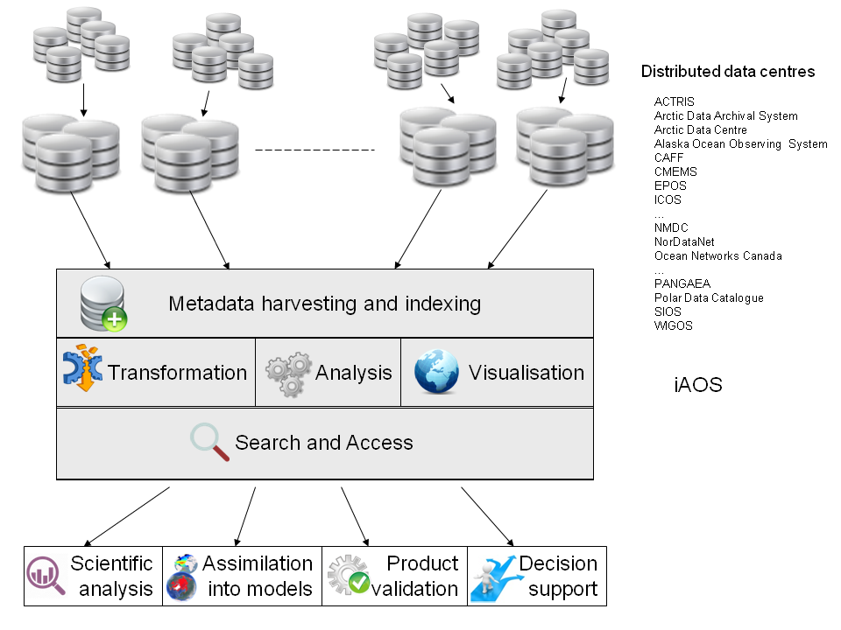
Integrated Arctic Observing system: conceptual architecture

