Slide 1
S2S4E: Development of user-oriented services in the energy sector
Julia Cannata, Isadora Christel, Albert Soret, Ilaria Vigo, Marta Terrado, Andrea Manrique, Fernando Cucchietti, Lluis Palma, Luz Calvo, Dragana Bojovic, Llorenç Lledó
Notes:
“Sub-seasonal to Seasonal Climate Predictions for Energy”
Discuss the development of this user-oriented service for the energy sector

Slide 2
Project background

Slide 3
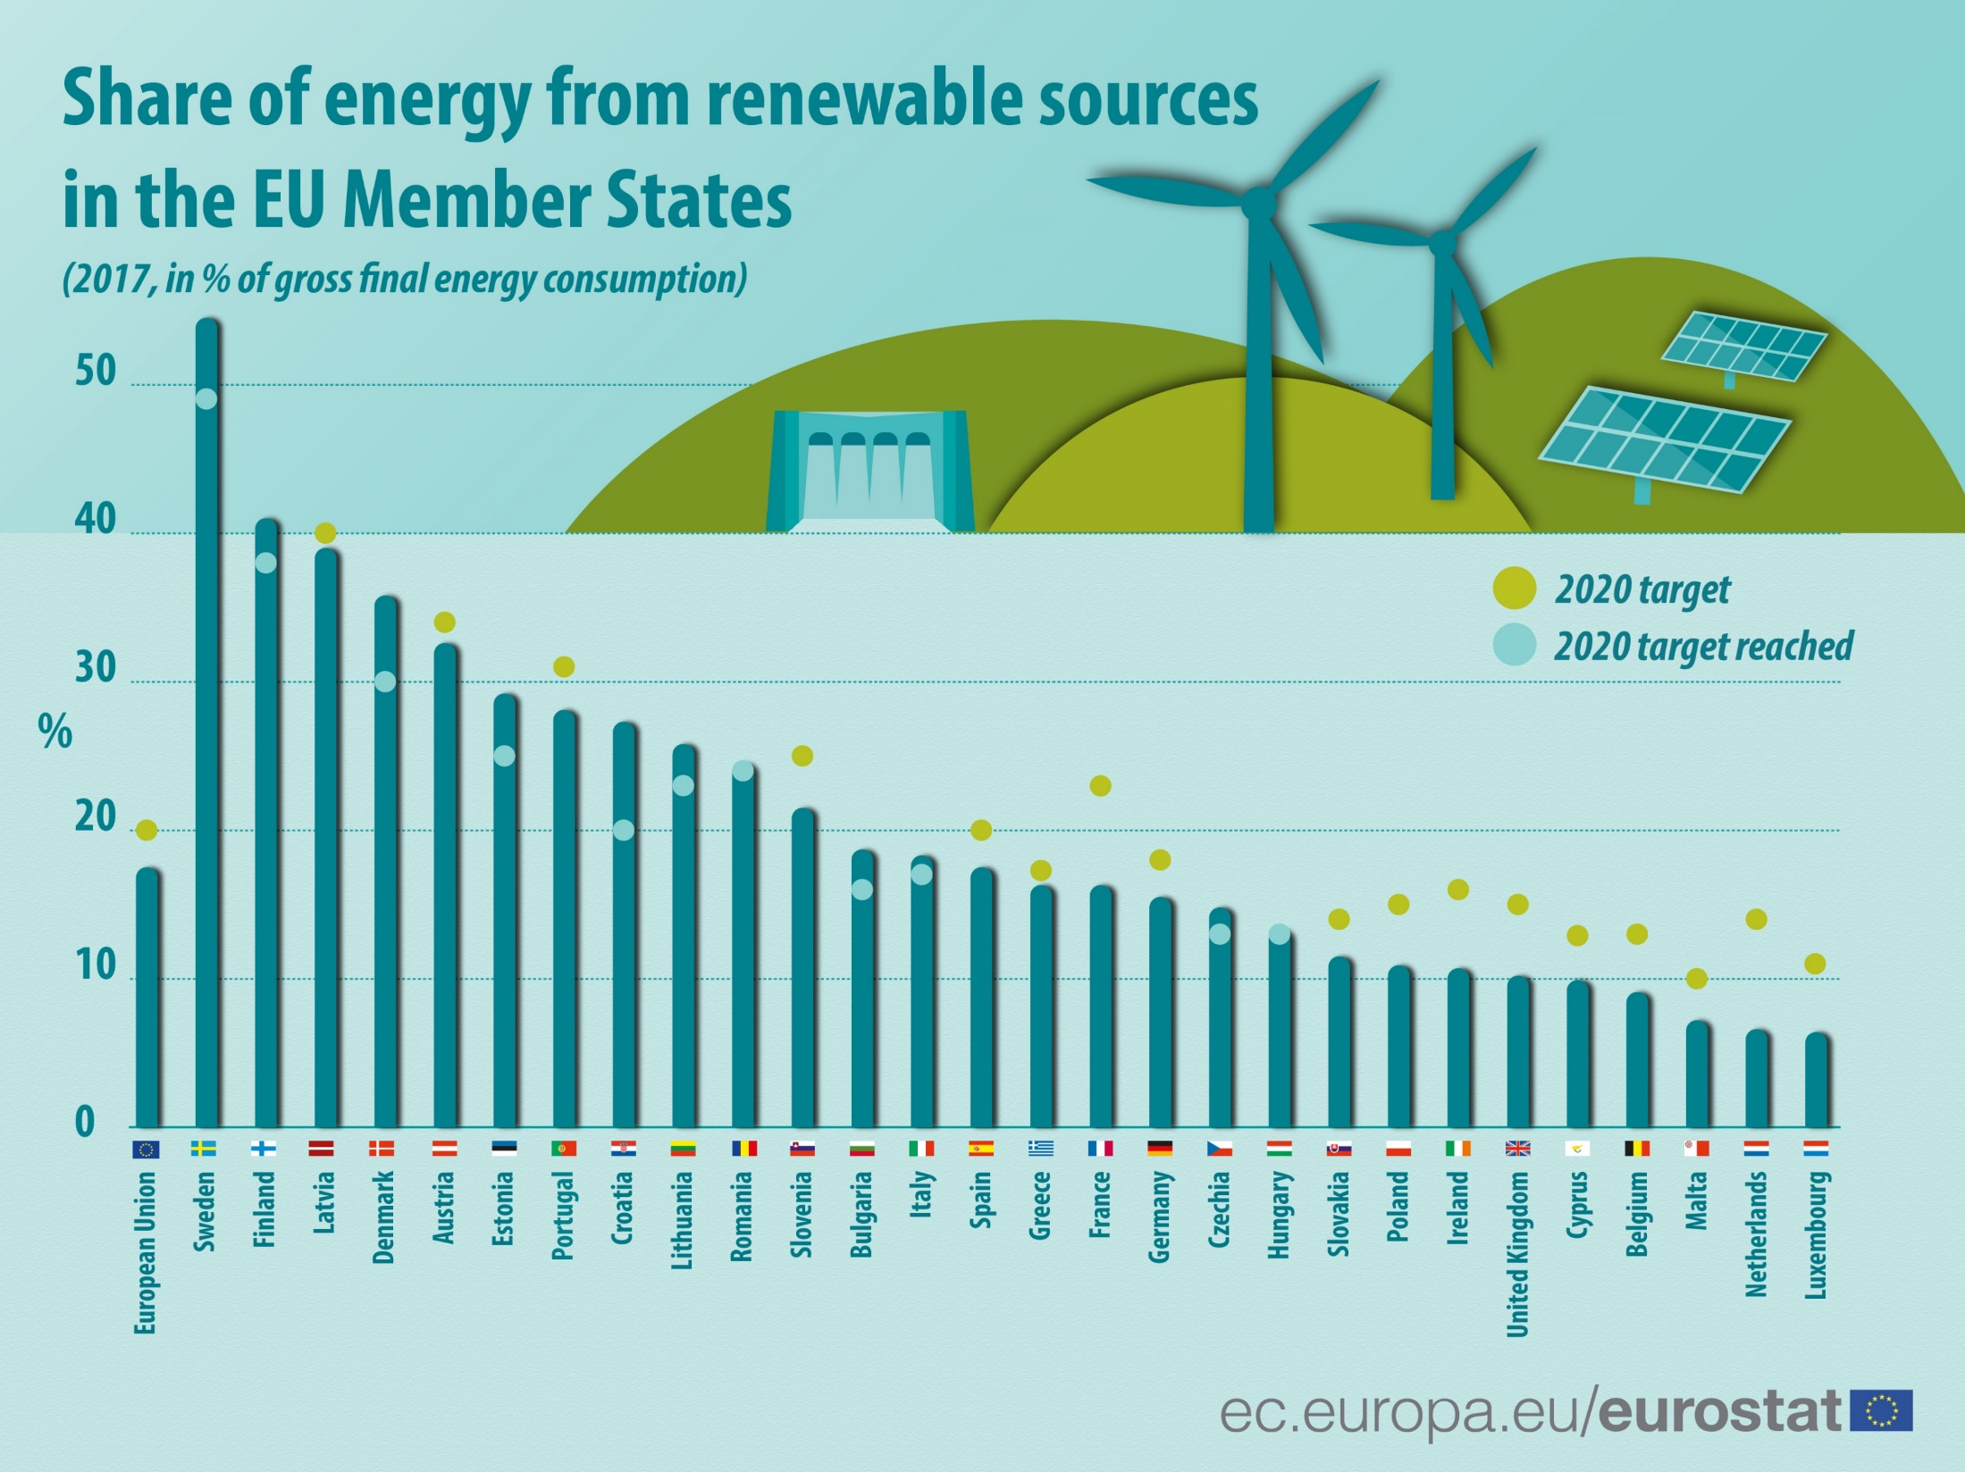
Increasing renewable energy use
Notes:
As most of us know, the EU is attempting to increase its share of renewable energy in the energy mix, so that we can reduce greenhouse gas emissions and minimize minimize the consequences of a warming planet.

Slide 4
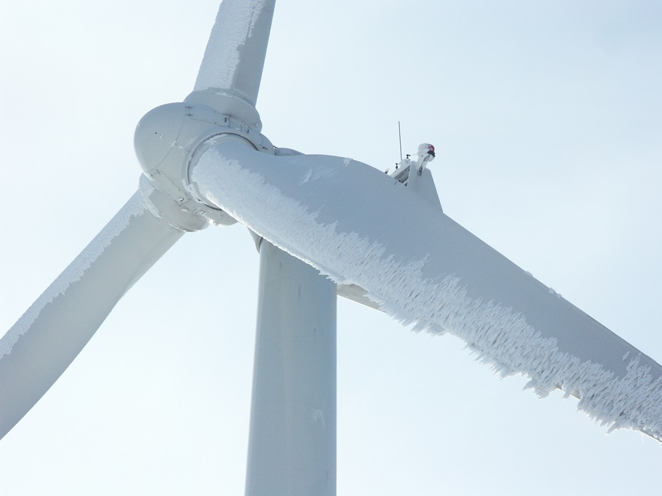
Challenges of integrating renewable energy
Source: IceWind
Source: The National
Notes:
However, increasing our share of renewable energy faces two major challenges: 1. renewable energy is dependent on an increasingly variable climate that makes it difficult to manage supply and demand. 2. Current energy systems are not fully prepared for this variability, bringing some mistrust to the renewable energies as a power source.

Slide 5
Project purpose

Slide 6
CLIMATE SERVICES
Notes:
So S2S4E is attempting to fill this gap by developing a tool specifically designed for the energy sector, by tailoring climate science to a meaningful service that helps helps RE stakeholders better prepare and plan for climate variability.

Slide 7
Co-produced with users themselves
S2S4E
Industrial Partners
...and external stakeholders
Notes:
So, what better way to create a usable tool for RE users, than develop the tool with RE users themselves? And that’s what we have been doing throughout the process of S2S4E. The main users we have been working with is EDPR, EDF, and ENBW, who are directly part of the S2S4E consortium.

Slide 8
Developing the climate service

Slide 9
From climate science to climate service
Weather Forecast
Climate Predictions
Multidecadal and Projections
Present-15d
10 d-1 month
1 month–7 month
2-30 years
20-100 years
●
●
●
●
●
The S2S4E Project
Next 4 weeks and 3 months
Notes:
With the insight and co-development with these users, we have defined:
Climate predictions are most useful for the upcoming 4 weeks and 3 months, part of the “sub-seasonal” and “seasonal” timescale.
That the climate variables studied would be oriented towards wind power, solar power, hydropower, and energy demand.
Altogether, this makes S2S4E ultimately an innovative projects as it integrates for the for the first time sub-seasonal to seasonal (S2S) climate predictions with RE production and electricity demand.

Slide 10
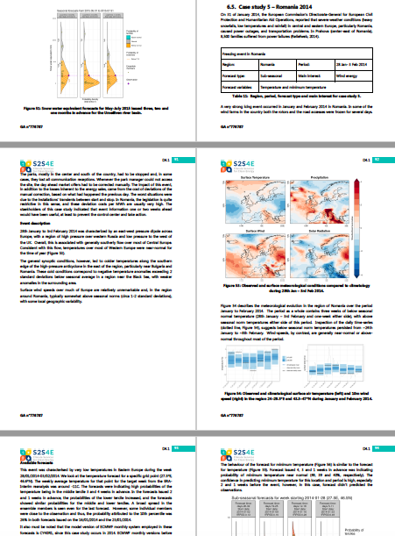
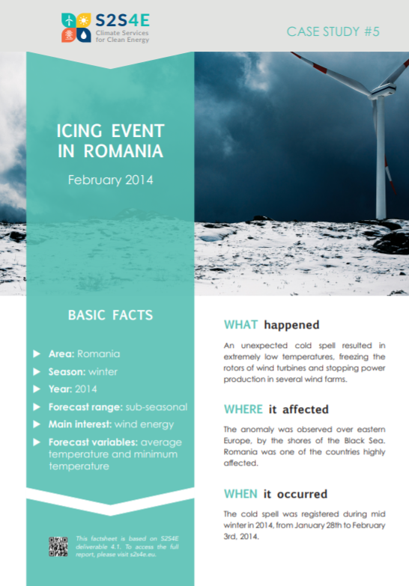
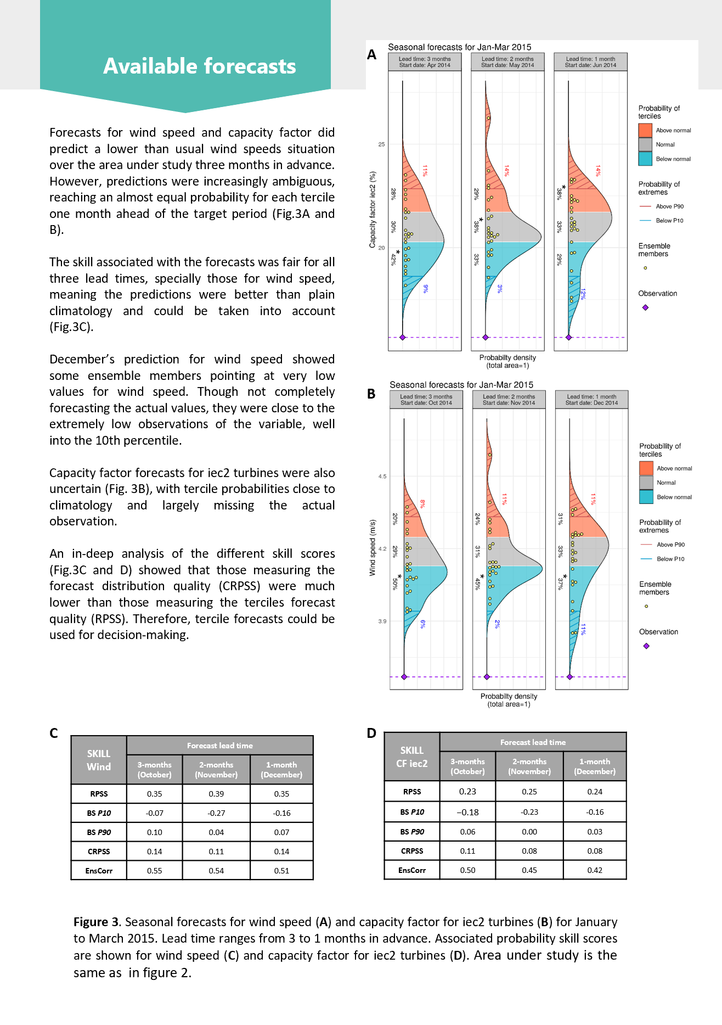
Case studies & factsheets
Notes:
8 case studies prepared demonstrate the potential of the forecasts used in real cases in the past, that energy users noted as events that could have used extra help with decision making

Slide 11
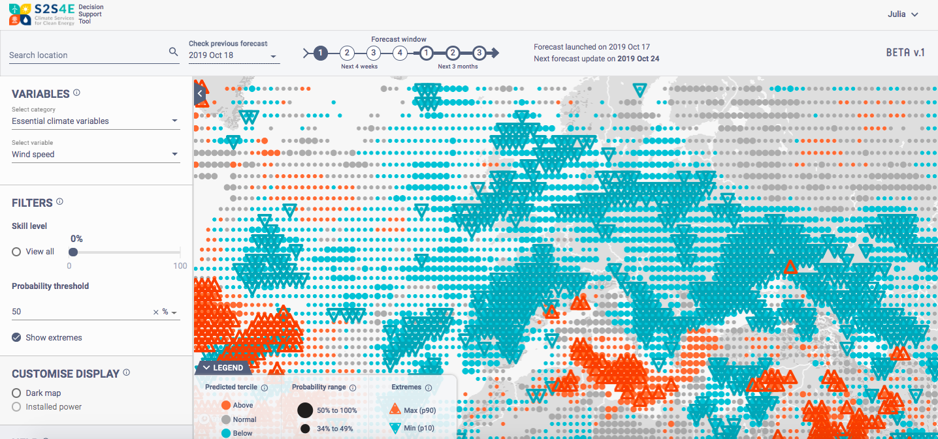
The S2S4E Decision Support Tool (DST)
Categories
Essential Climate
Wind Energy
Solar Energy
Hydro Energy
Energy Balance
Variables
Climate variables (temp, wind speed, precip, solar radiation.)
Energy indicators (capacity factor, demand,etc.)
www.s2s4e.eu/dst
Notes:
Probailistic forecasts demonstrating the probability of forecasts of different climate conditions for the next 4 weeks and 3 months will be above, below, and at normal conditions compared to climatology.
Essential climate variables:
(per grid point / country aggregated):
Wind speed
Temperature (Tmean/Tmax/Tmin)
Solar radiation
Precipitation
Mean sea level pressure
Energy Indicators (coming soon):
Wind capacity factor
Solar capacity factor
Electricity demand at country level
Hydro power (inflow/ annual snow max anomaly)
and they have been highly involved in the creation of the tool and in finding the best ways of presenting the information. Additional stakeholder, including REE, also contributed in this process
The DST is co-developed together with industrial partners and other stakeholders. EDPR, EDF and EnBW are energy companies that take part in the project as partners and they have been highly involved in the creation of the tool and in finding the best way to visualise the information. Additional stakeholders external to the project have also contributed in this process

Slide 12
Forecast Outlooks
Notes:
Forecast outlooks providing an overview 1-4 weeks and next 3 month selecting specific patterns that are relevant to energy users.

Slide 13
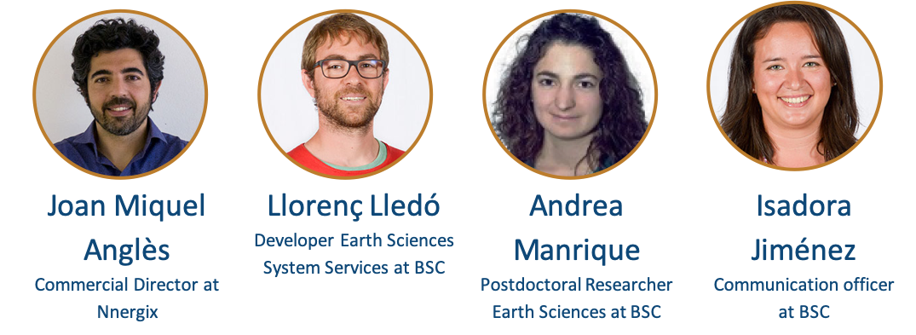
Webinars
Technical and Hands-On Introduction:
S2S4E Decision Support Tool (DST)
First webinar
Climate Prediction Researcher at BSC
Commercial Director at Nnergix
Climate Prediction Researcher at BSC
Communication Specialist at BSC
Notes:
Another climate service we are providing is webinars, to connect with users better explain the science behind the DST to and maximize the the tool
In our last webinar we maxed out registration with 100 registered participants and more than 50 attended.

Slide 14
Done?
Source: Medium

Slide 15
Not yet…

Slide 16
Changes to the DST
www.s2s4e.eu/dst
Categories
Essential Climate
Wind Energy
Solar Energy
Hydro Energy
Energy Balance
Variables
Climate variables (T, wind, precipitation, etc.)
Energy indicators (capacity factor, demand,etc.)
Notes:
Essential climate variables:
(per grid point / country aggregated):
Wind speed
Temperature (Tmean/Tmax/Tmin)
Solar radiation
Precipitation
Mean sea level pressure
Energy Indicators (coming soon):
Wind capacity factor
Solar capacity factor
Electricity demand at country level
Hydro power (inflow/ annual snow max anomaly)
and they have been highly involved in the creation of the tool and in finding the best ways of presenting the information. Additional stakeholder, including REE, also contributed in this process
The DST is co-developed together with industrial partners and other stakeholders. EDPR, EDF and EnBW are energy companies that take part in the project as partners and they have been highly involved in the creation of the tool and in finding the best way to visualise the information. Additional stakeholders external to the project have also contributed in this process

Slide 17
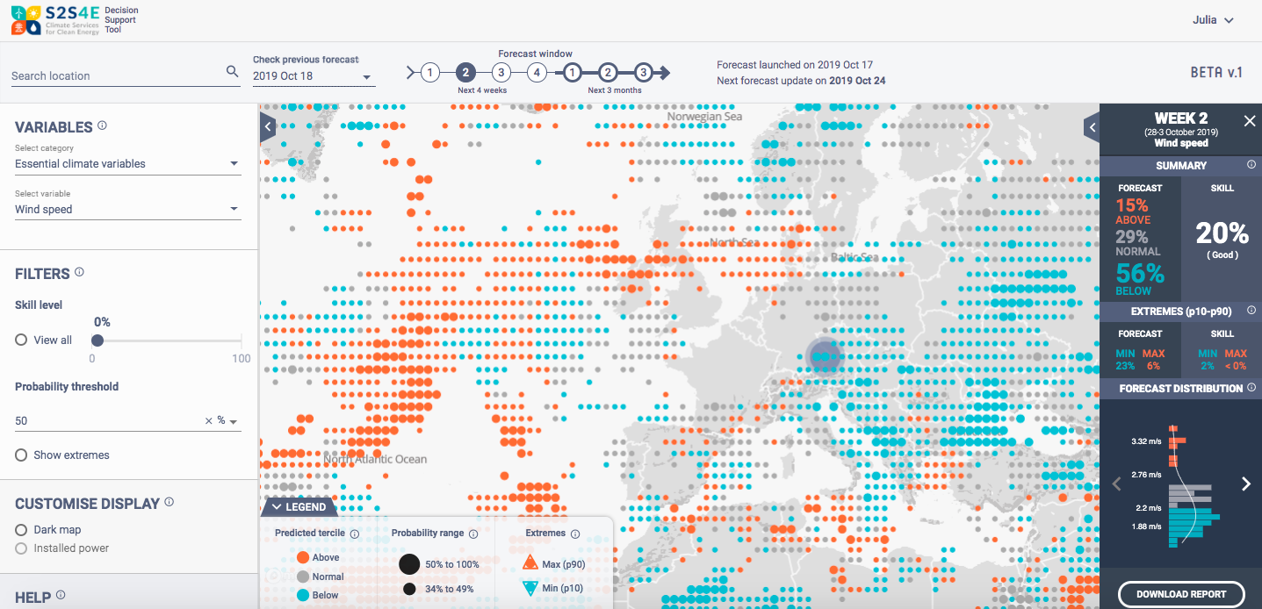
Changes behind the scenes

Slide 18
Old Forecast Outlooks

Slide 19
New Forecast Outlooks

Slide 20
New Forecast Outlooks

Slide 21
New Forecast Outlooks

Slide 22
New Forecast Outlooks

Slide 23
New Forecast Outlooks

Slide 24
Next steps...
More improvements to the DST
https://s2s4e.eu/dst
At least 5 more webinars, next planned for end of November:
https://s2s4e.eu/climate-services/webinar-series
Monthly subseasonal to seasonal outlooks, published mid-month:
https://s2s4e.eu/climate-services/outlooks
More factsheets demonstrating the potential of the forecasts in the DST
https://s2s4e.eu/climate-services/case-studies

Slide 25
Thank you
Public reports of the project are available for download on the S2S4E website: www.s2s4e.eu
Project coordinator: Albert Soret, Barcelona Supercomputing Center Project contact email: s2s4e@bsc.es
Stay connected by following us on LinkedIn, Twitter, and Facebook.
My email: jcannata@bsc.es

