Slide 1
An anatomy of the forecast errors in the seasonal prediction system with EC-Earth
R. Cruz-García, P. Ortega, J.C. Acosta-Navarro, F. Massonnet, F.J. Doblas-Reyes
29th/April/2019
ELIC Seminars-UCLouvain. Louvain-la-Neuve.

Slide 2
1. Experimental setup
7-months seasonal predictions starting in May and November. 10 members. Period 1993-2008. EC-Earth3.2
Initial conditions:
Atmosphere
ERA-Interim
Sea Ice
NEMO-LIM Standalone Reconstruction with assimilation of Sea Ice Concentration from ESA
Ocean
ORAS4
1/16
Notes:
Our analysis focus on a set of 10 members-seasonal predictions of 7 months-long, with start dates in May and November and covering the period 1993-2008, run of course with EC-Earth.
Since I consider this is a key point of the study, I would like to explain briefly the initial conditions of each model component.
Atmosphere was initialized from ERA-Interim.
For the ocean, we used ORAS4 as initial conditions. And finally, for the sea ice we used a NEMO-LIM standalone reconstruction that assimilates SIC from ESA the last day of every month via ensemble Kalman Filter. Why is this a key question? I will explain in a while…

Slide 3
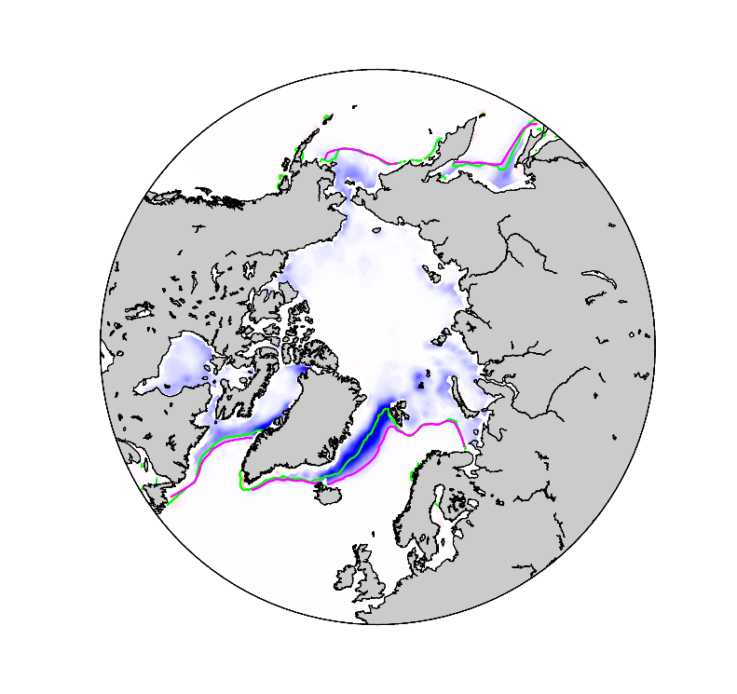
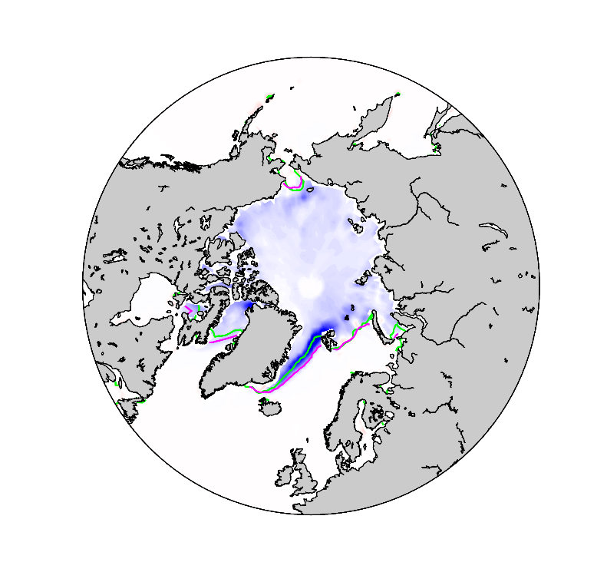
2. Motivation
Large SIC bias from the first prediction day (vs NSIDC):
May 1st
Nov 1st
15% SIC
Prediction
NSIDC
Prediction - NSIDC
1993-2008
2/16
Notes:
The main motivation was the large SIC bias that we found during the first forecast day. This is the SIC bias in comparison with NSIDC data for the period 1993 to 2008. As you can see, the largest positive bias is along the Greenland Sea, although also across the interior Arctic ocean.

Slide 4
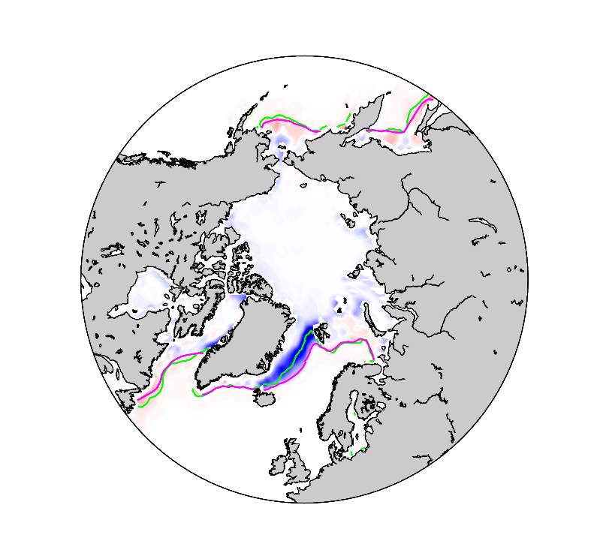
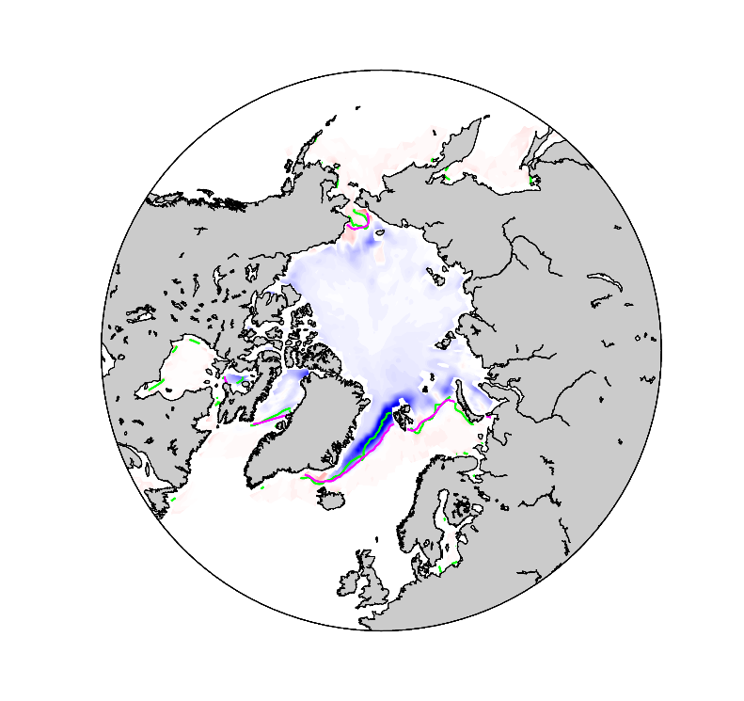
3.1 Particularities in the assimilation procedure
The sea ice initial conditions (EnKF reconstruction) do not assimilate the target observations (ESA) adequately in some regions:
May 1st
Nov 1st
15% SIC
Assim. Run
ESA
Assimilation run – ESA
3/16
Notes:
We tried to disentangle some of the sources of error in the predictions and we came out with 3 main contributions:
The first one is the limitation when assimilating observational data.
These figures illustrate the discontinuous assimilation of ESA from the EnKF reconstruction that was used as the sea ice initial conditions. As you can see the large differences become apparent in the same regions where the initial errors that I have shown in the previous figure emerge. This means that ESA SIC has been weakly assimilated by the EnFK over those áreas.

Slide 5
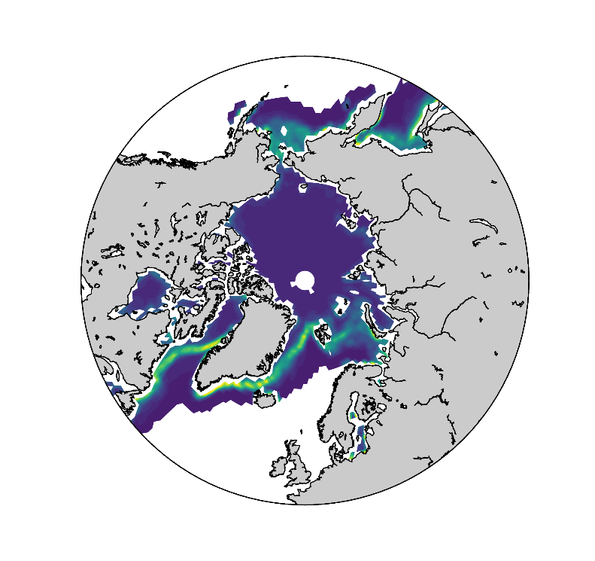
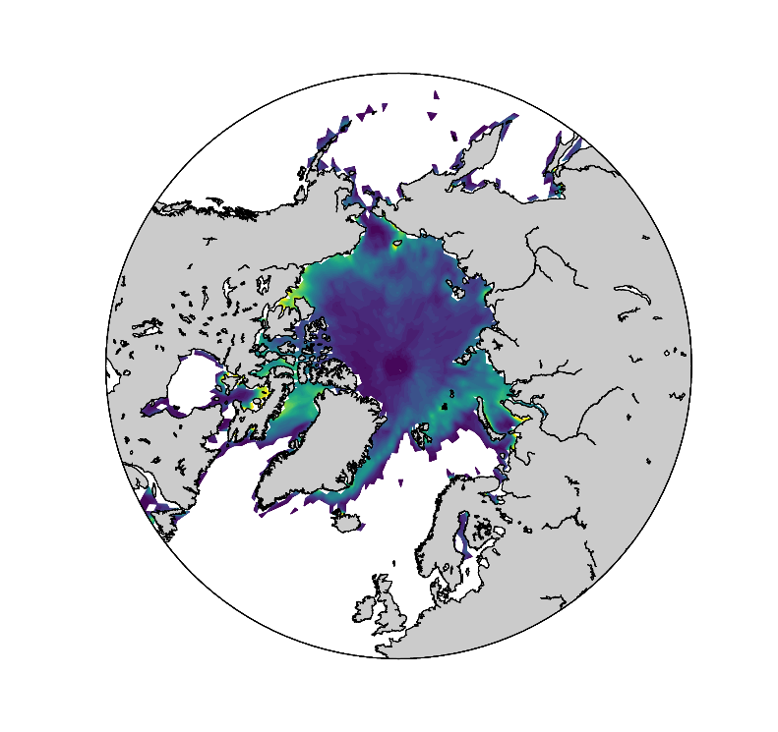
3.1 Particularities in the assimilation procedure
The locations with a weak assimilation agree with the places with a larger observational uncertainty.
May 1st
Nov 1st
ESA uncertainty
4/16
Notes:
To understand this differences it’s important to understand how the EnKF works. The assimilation will depend on the observational uncertainty and the simulated ensemble spread. Regions with high observational uncertainty will remain close to the model state. This happens for example in the Greenland Sea.
By contrast, large model spread with well
constrained observations lead to large EnKF increments and therefore closer values
to the assimilated data, like in November for the Kara Sea.
In regions exhibiting both important
observational uncertainties and large EnKF spread the strength of the assimilation
will depend on the weights the EnKF associates to each of them.
All this suggests that in the assessment of forecast errors it is important to take into account observational uncertainty not to overemphasize errors.

Slide 6
3.1 Particularities in the assimilation procedure
The locations where assimilation does not work properly match the places with large observational uncertainty.
Given the large magnitude of this error, the rest of the errors will be quantified relative to the assimilation run (initial conditions).
May 1st
Nov 1st
ESA uncertainty
4/16
Notes:
For this reason and given the large magnitude of the initial forecast biases, the rest of errors will be quantified relative to the EnKF reconstruction (sea ice ICs), and not to observational data. Since the reconstruction assimilates satellite data the last day of each month which disrupts the evolution of the EnKF simulation in free-running mode, we will just focus on the ﬁrst 31 forecast days, i.e. May and November.

Slide 7
3.2 Model drift
The analysis of historical (and therefore uninitialized) simulations allows us to determine the systematic model bias.
Nature climate
Initialized forecast
Model climate
5/16
Notes:
The second source of errors is the model drift. The model adjusts towards its own (and biased) climatological state. The analysis of a historical experiment allows us to determine the systematic model bias.

Slide 8
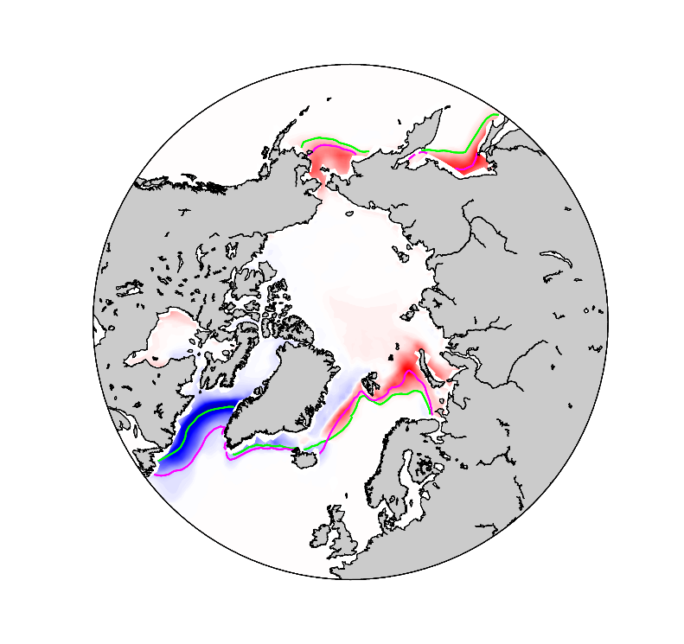
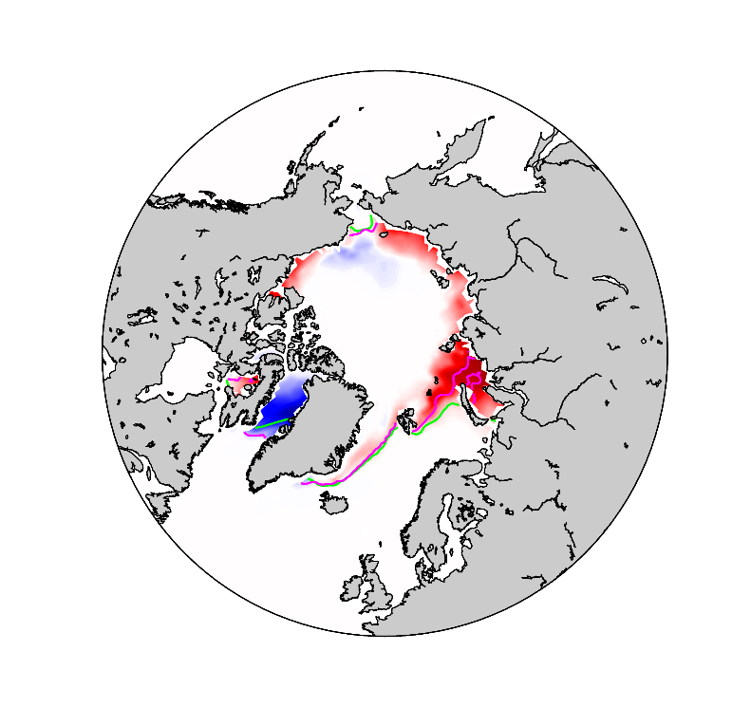
3.2 Model drift
The analysis of historical (and therefore uninitialized) simulations allows us to determine the systematic model bias.
May 1st
Nov 1st
15% SIC
Historical
Assim. Run
Historical – Assimilation run
6/16
Notes:
The second source of errors is the model drift. The model adjusts towards its own (and biased) climatological state. The analysis of a historical experiment allows us to determine the systematic model bias.

Slide 9
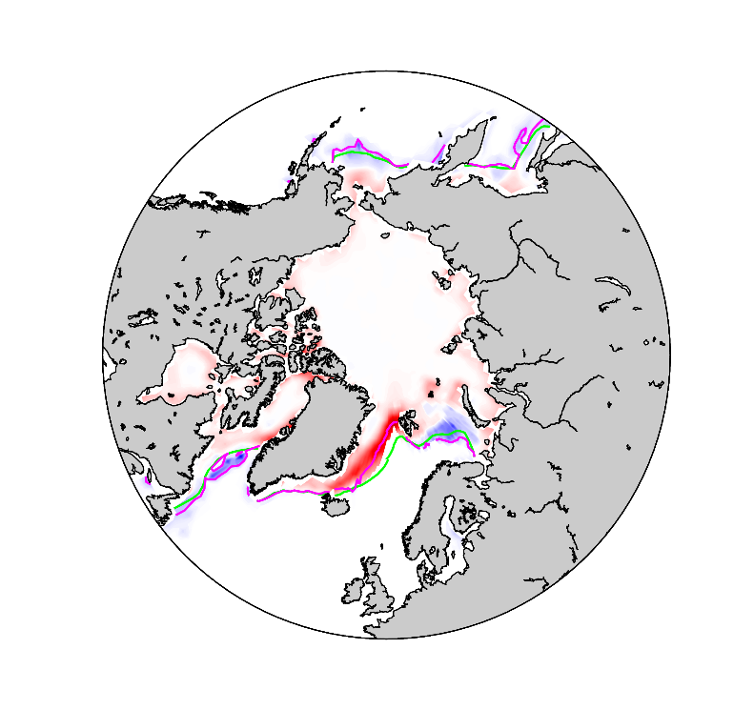
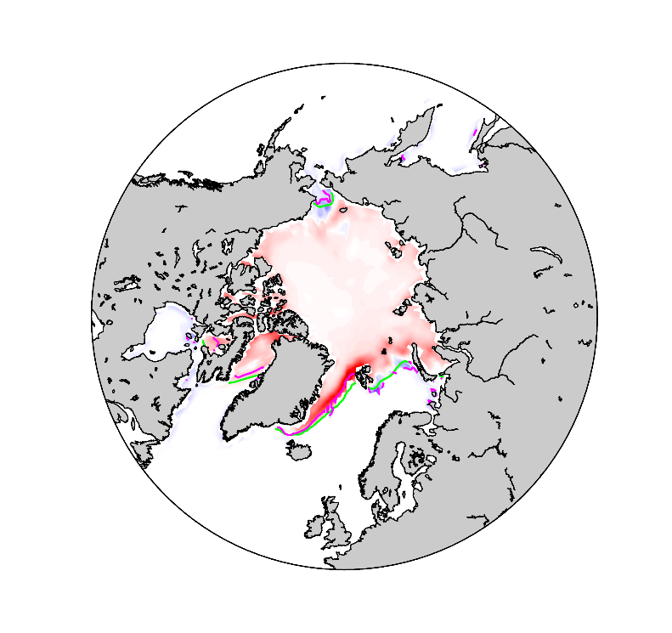
3.3 Inconsistency between the initialization products
Incompatibility between the sea ice of ORAS4 (ocean ICs) and the sea ice in the assimilation run (sea ice ICs).
May 1st
Nov 1st
15% SIC
ORAS4
Assim. Run
Thanks to
M. Balmaseda for the ORAS4 sea ice data
ORAS4 - Assimilation run
7/16
Notes:
The third source of error is the incompatibility between the initial conditions of the ocean and the sea ice, so between ORAS4 and the assimilation run. In order to compare them (since we are trying to assess the sea ice), we used the correspondent sea ice concentration used by ORAS4.
The assimilation run simulates sea ice along the Greendland Sea, where ORAS4 does not. This seems directly related to the bad ESA assimilation by the EnKF. If the sea ice in the assimilation run was closer to the observations of ESA, the differences wouldn’t be so high. This has been checked with the SST (monthly outputs and restarts used for the initialization).

Slide 10
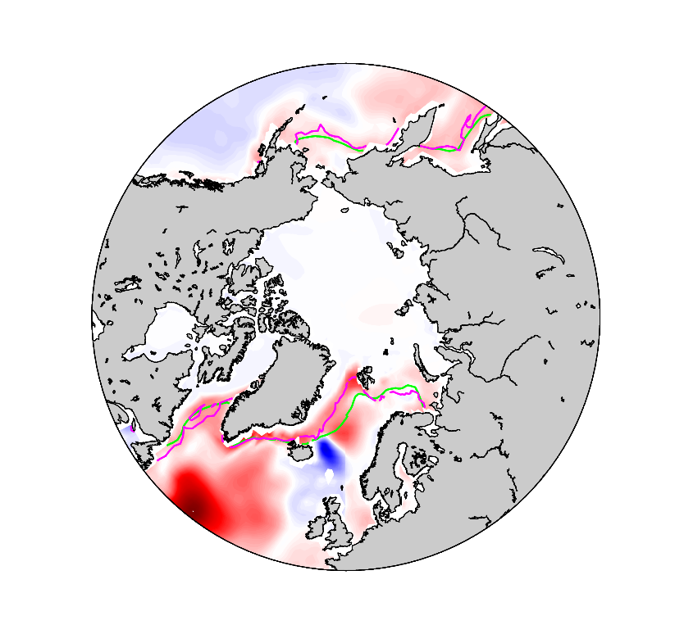
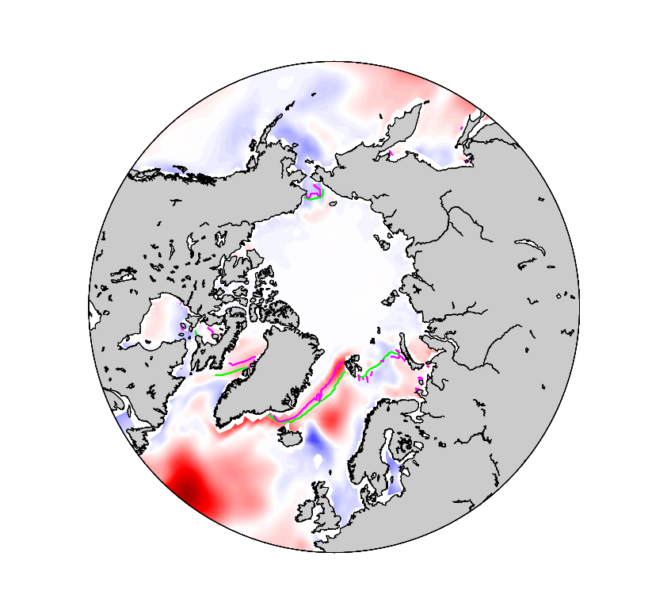
3.3 Inconsistency between the initialization products
This incompatibility agrees with the SST difference for the restarts on April 30 and October 31.
April 30th
Oct 31st
15% SIC
ORAS4
Assim. Run
ORAS4 - Assimilation run
8/16
Notes:
The third source of error is the incompatibility between the initial conditions of the ocean and the sea ice, so between ORAS4 and the assimilation run. In order to compare them (since we are trying to assess the sea ice), we used the correspondent sea ice concentration used by ORAS4.
The assimilation run simulates sea ice along the Greendland Sea, where ORAS4 does not. This seems directly related to the bad ESA assimilation by the EnKF. If the sea ice in the assimilation run was closer to the observations of ESA, the differences wouldn’t be so high. This has been checked with the SST (monthly outputs and restarts used for the initialization).

Slide 11
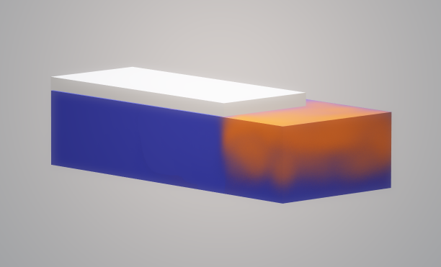
3.3 Inconsistency between the initialization products
Consistent ocean-sea ice initial conditions.
9/16
Notes:
The third source of error is the incompatibility between the initial conditions of the ocean and the sea ice, so between ORAS4 and the assimilation run. In order to compare them (since we are trying to assess the sea ice), we used the correspondent sea ice concentration used by ORAS4.
The assimilation run simulates sea ice along the Greendland Sea, where ORAS4 does not. This seems directly related to the bad ESA assimilation by the EnKF. If the sea ice in the assimilation run was closer to the observations of ESA, the differences wouldn’t be so high. This has been checked with the SST (monthly outputs and restarts used for the initialization).

Slide 12
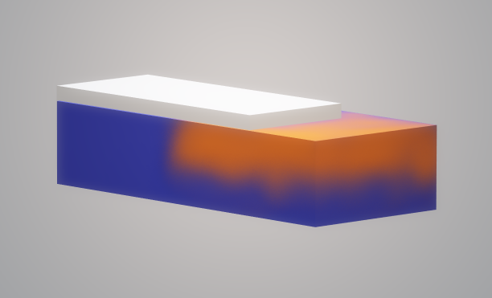
3.3 Inconsistency between the initialization products
Inconsistent ocean-sea ice initial conditions.
10/16
Notes:
The third source of error is the incompatibility between the initial conditions of the ocean and the sea ice, so between ORAS4 and the assimilation run. In order to compare them (since we are trying to assess the sea ice), we used the correspondent sea ice concentration used by ORAS4.
The assimilation run simulates sea ice along the Greendland Sea, where ORAS4 does not. This seems directly related to the bad ESA assimilation by the EnKF. If the sea ice in the assimilation run was closer to the observations of ESA, the differences wouldn’t be so high. This has been checked with the SST (monthly outputs and restarts used for the initialization).

Slide 13
3.3 Inconsistency between the initialization products
Inconsistent ocean-sea ice initial conditions.
Nov 1st Sea Ice Concentration Differences
10/16
Notes:
The third source of error is the incompatibility between the initial conditions of the ocean and the sea ice, so between ORAS4 and the assimilation run. In order to compare them (since we are trying to assess the sea ice), we used the correspondent sea ice concentration used by ORAS4.
The assimilation run simulates sea ice along the Greendland Sea, where ORAS4 does not. This seems directly related to the bad ESA assimilation by the EnKF. If the sea ice in the assimilation run was closer to the observations of ESA, the differences wouldn’t be so high. This has been checked with the SST (monthly outputs and restarts used for the initialization).

Slide 14
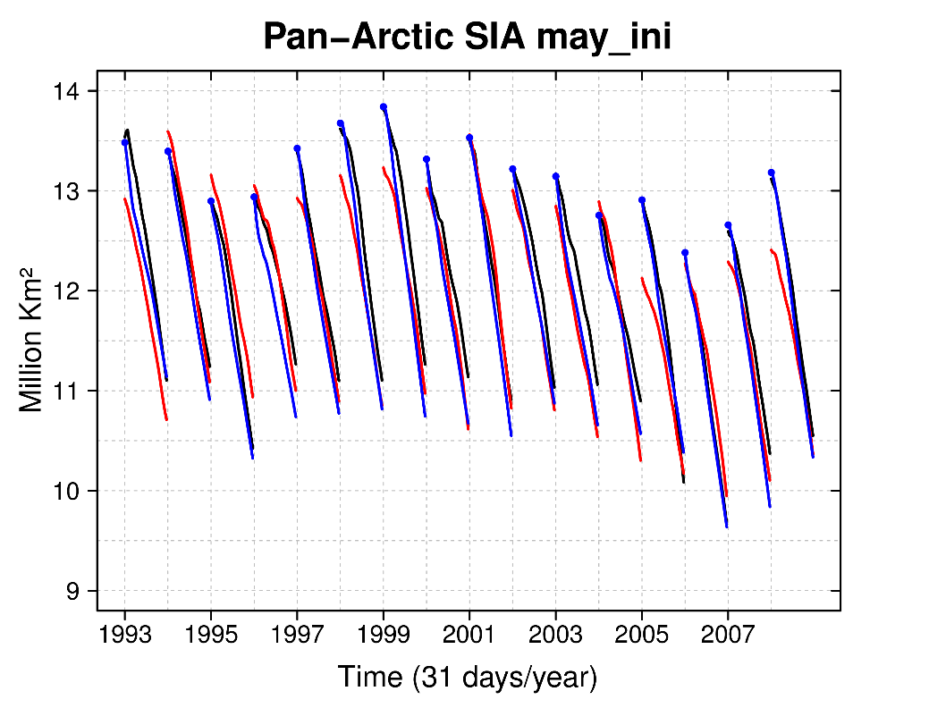
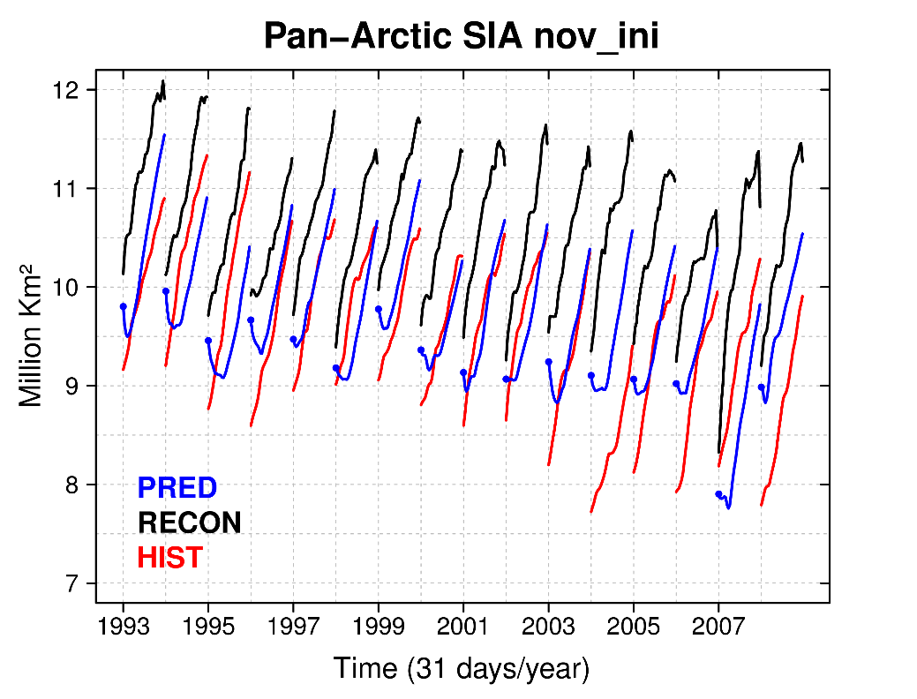
4.1 Error evolution in the Sea Ice Area
The forecasts drift towards their model attractor in ~1 week.
The shrinking (growing) trend in May (November) favours (hampers) the absorption of the initialization shock.
11/16
Notes:
For understanding how the errors develop we have plotted the sea ice area during the first month for all start dates for the predictions, the assimilation run and the historical simulation.
We can see how the prediction drifts towards its own attractor really fast (about 1 week).
An important difference between May and November forecasts concerns the growing/shrinking trend due to the seasonal cycle. In May, the ICs incompatibility and the drift go in the same direction as the seasonal trend (to melt), so the impact of both sources of error is small.
However, in November, the effect of the incompatibility of ICs hampers the seasonal trend, but pushes the forecast towards its climatology faster, being negatively biased the rest of the prediction (7 months).

Slide 15
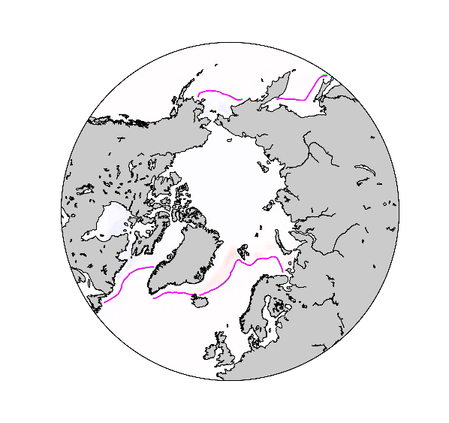
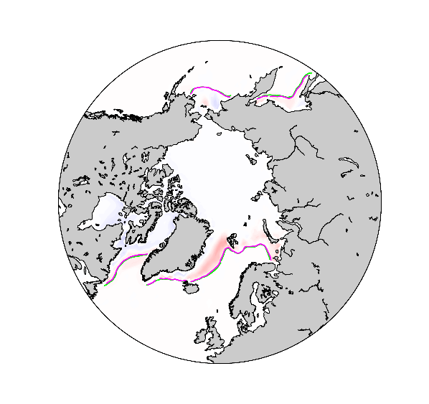
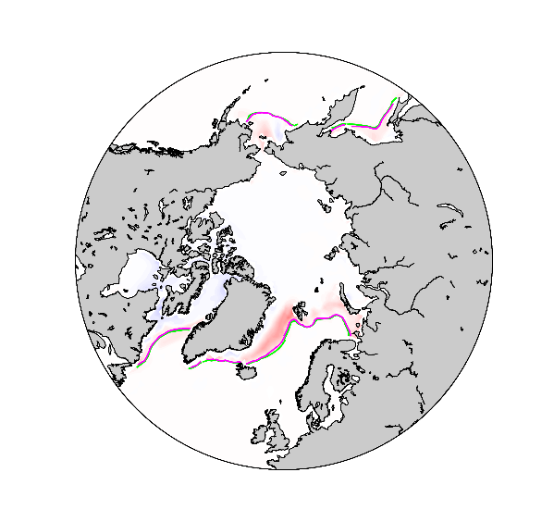
4.2 Spatial evolution of the forecast errors
We expect a fast response in the forecasts in which the warmer ocean below degrades the overly extensive sea ice conditions from the assimilation.
May 1st
May 3rd
May 5th
Prediction – Assimilation run
12/16
Notes:
Because of these two last reasons (the initial conditions incompatibility and the drift), we see a fast response in which the warmer ocean of ORAS4 melts the sea ice that is over it, as you can see when we compare the forecasts with its sea ice initial conditions in May.

Slide 16
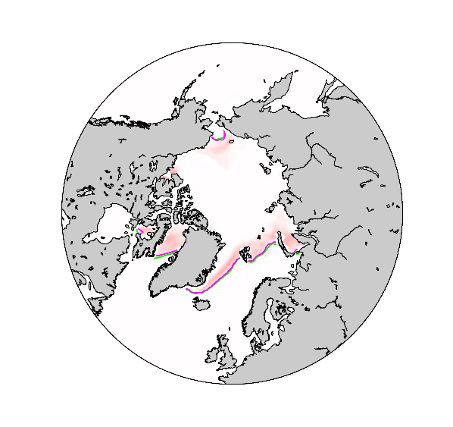
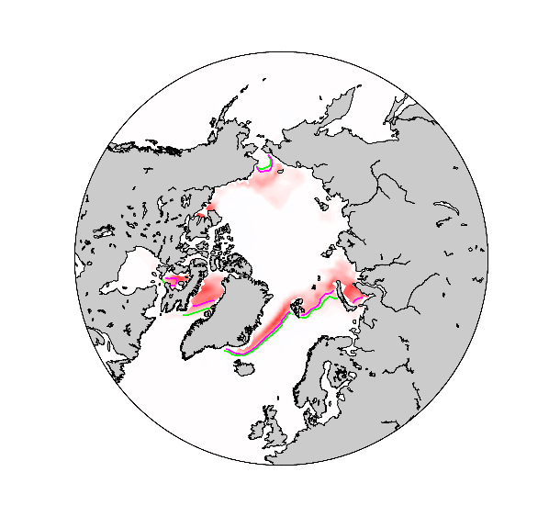
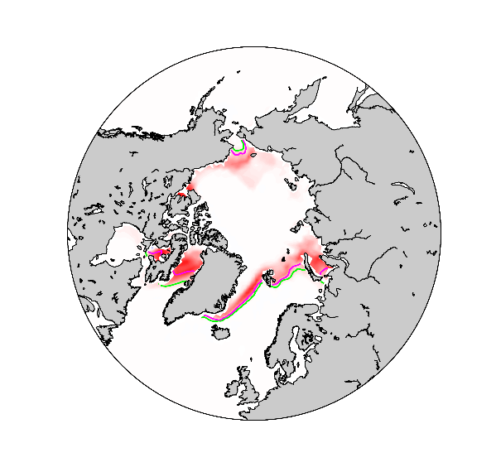
4.2 Spatial evolution of the forecast errors
We expect a fast response in the forecasts in which the warmer ocean below degrades the overly extensive sea ice conditions from the assimilation.
Nov 1st
Nov 3rd
Nov 5th
Prediction – Assimilation run
13/16
Notes:
And more significant in November.
%%% But, is this response originated just because of the initial incompatibility between ocean and sea ice?

Slide 17
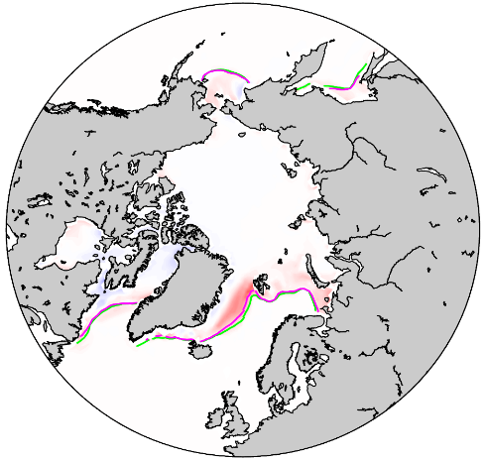
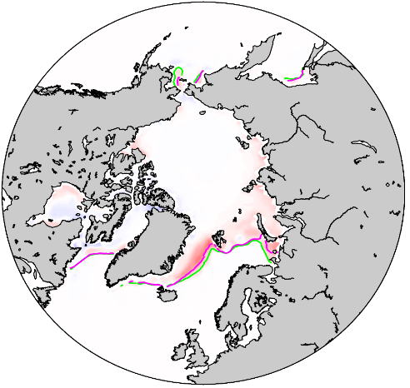
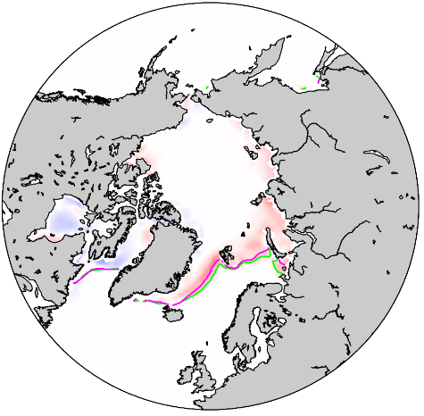
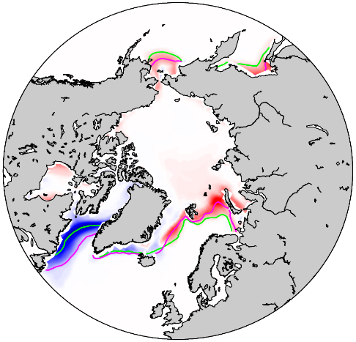
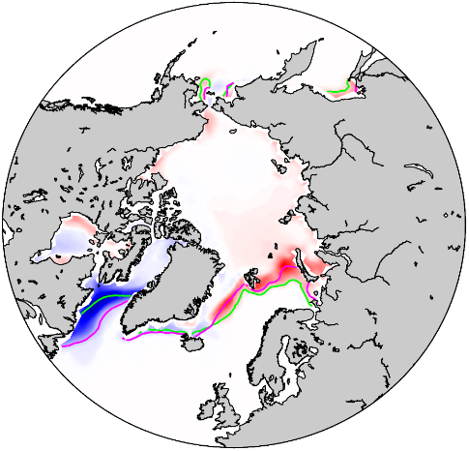
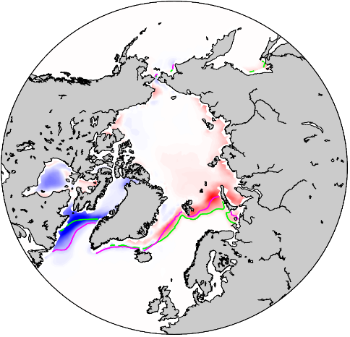
4.2 Spatial evolution of the forecast errors: May
While the initialization shock in Greenland Sea decreases, the systematic error in Hudson Bay arises.
Initial Inconsistency
Forecast Error
Systematic Error
14/16
May 10th
May 20th
May 30th
Notes:
And more significant in November.
%%% But, is this response originated just because of the initial incompatibility between ocean and sea ice?

Slide 18
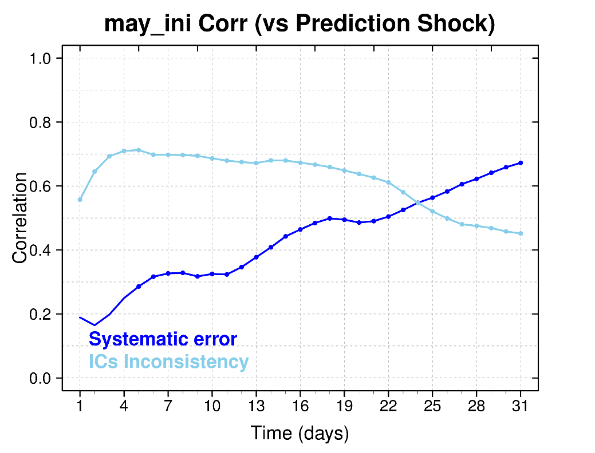
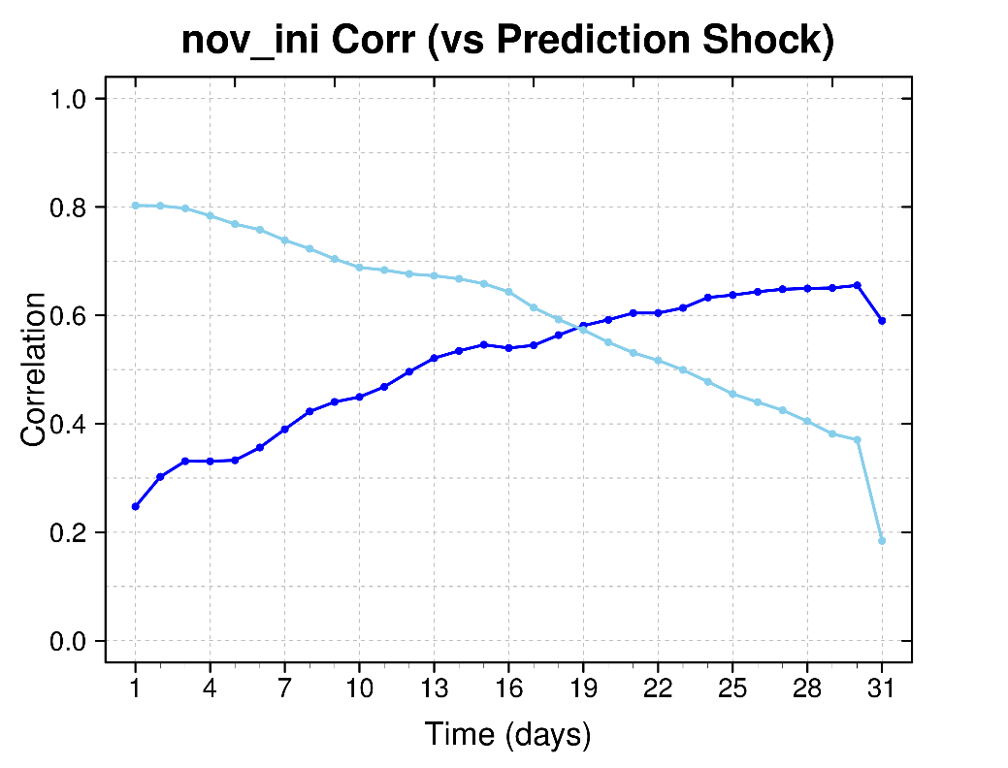
4.2 Spatial evolution of the forecast errors
After 25 (19) days the systematic model error becomes the largest contributor to the forecast error in May (November).
15/16
Notes:
In order to characterize the timescale for which the initial conditions incompatibility has an effect on the forecast error, we correlated the incompatibility of SIC the day 0 and the shock bias the following 31 days. We also calculated the synchronous correlation between the systematic bias and the shock bias during the first month.
After 26(21 days) the systematic error becomes the largest contributor to the forecast error in May (Nov)

Slide 19
Conclusions
Inconsistent initialization products (generally a too warm ocean) impact the predictions (leading to an extensive sea ice melting the first days).
The impact of initialization incompatibilities depends on the initialization date and the seasonality of the systematic error.
Forecast errors do not reach the systematic bias by the end of the month. Model drift takes more than one month to settle.
The initialization shock dominates the forecast error the first 25 (19) days in May (Nov.). After that, it is the systematic error the major contributor to the total forecast error.
16/16

Slide 20
Conclusions
Inconsistent initialization products (generally a too warm ocean) impact the predictions (leading to an extensive sea ice melting the first days).
The impact of initialization incompatibilities depends on the initialization date and the seasonality of the systematic error.
Forecast errors do not reach the systematic bias by the end of the month. Model drift takes more than one month to settle.
The initialization shock dominates the forecast error the first 25 (19) days in May (Nov.). After that, it is the systematic error the major contributor to the total forecast error.
16/16

Slide 21
Conclusions
Inconsistent initialization products (generally a too warm ocean) impact the predictions (leading to an extensive sea ice melting the first days).
The impact of initialization incompatibilities depends on the initialization date and the seasonality of the systematic error.
Forecast errors do not reach the systematic bias by the end of the month. Model drift takes more than one month to settle.
The initialization shock dominates the forecast error the first 25 (19) days in May (Nov.). After that, it is the systematic error the major contributor to the total forecast error.
16/16

Slide 22
Conclusions
Inconsistent initialization products (generally a too warm ocean) impact the predictions (leading to an extensive sea ice melting the first days).
The impact of initialization incompatibilities depends on the initialization date and the seasonality of the systematic error.
Forecast errors do not reach the systematic bias by the end of the month. Model drift takes more than one month to settle.
The initialization shock dominates the forecast error the first 25 (19) days in May (Nov.). After that, it is the systematic error the major contributor to the total forecast error.
16/16

Slide 23
Thank you
ruben.cruzgarcia@bsc.es

