Slide 1
DECM project meeting, Oslo, 12/10/2017
Observational interaction between QA4Seas and other C3S lots
Pierre-Antoine Bretonnière, BSC

Slide 2
Outline
Introduction
The observational datasets in QA4Seas
Datasets requirements
Data availability
Format
QA4Seas requirements on coordination with other lots (M2.3)
Coordination with other lots
Importance of observational uncertainty
Discussion

Slide 3
Introduction
Observations are used in QA4Seas to verify the forecasts of models provided in the Climate Data Store (CDS)
WP2 (“CDS inventory”) has to make recommendations on variables, datasets, formats, both from model outputs and observations that should be included in the CDS, focusing on seasonal datasets
3 milestones and 1 deliverable have specific focus on observations

Slide 4
The observational datasets in QA4Seas
M2.1: User-oriented table of available ECVs relevant to seasonal forecast evaluation (M1)
D2.1: User-oriented inventory of ECVs (M9)
Based on user recommendations, a list of datasets (both from models, reconstructions and observations) “required” or frequently used for seasonal verification was provided, with a detailed list of resolution, format, time coverage,...

Slide 5
The observational datasets in QA4Seas
Gridded observational and satellite product datasets |  | Reanalyses
EOBS | CRU | ERA-INTERIM
HADISST | CRUTEM4 | MERRA
HADSLP | GPCP | JRA55
ISCCP | ERSST | ORAS4
NSIDC_daac | GHCN | GLORYS
Quikscat | HADCRUT4 | NCEP/NCAR
WFDEI EOBS | ... | ...

Slide 6
Data update
One criteria in the choice of the datasets is their availability/time coverage
A list of use cases for verification has been defined in WP4 containing more or less recent “real” events
=> need to distinguish/rank datasets according to their update pace:
Operational (reanalysis: erainterim, era5,...)
“Closed” (1979-2016)
Updated “from time to time” (for example: GPCC -> 2017/07 )

Slide 7
Format requirements
For the model data providers of the CDS, a “File Structure for C3S netCDF Files” has been created
It contains a list of metadata, variable names, dimensions as well as a file and directory structure and file format (NetCDF4 compressed) that the providers of (model) data to the CDS must comply
This document and requirements are done, a priori, for model outputs, what about observations? Need for standardization at least of format

Slide 8
QA4Seas requirements on coordination with other lots (M2.3)
Task 2.3: “The contractor will participate in the workshops organised by the contributors to the different C3S 51 lots to identify redundancies in the requirements for observational ECVs (including those from reanalyses and observations) and to identify synergies between the datasets used for seasonal prediction and climate projection, allowing for a coordinated response to the user needs.”
QA4Seas
Common
requirements on observations
EQCO
DECM

Slide 9
QA4Seas requirements on coordination with other lots (M2.3)
Milestone 2.3, submitted at M12, after Barcelona’s workshop on EQC in June, lists the different needs, requirements and usages of observations in the 3 C3S 51 lots:
EQCO
QA4Seas
DECM

Slide 10
QA4Seas requirements on coordination with other lots (M2.3)
Points mentioned during the EQC workshop:
Results of surveys led by the different lots mention the importance of observations => how can we give a synchronized answer to the users
Discussion on definitions for data quality for observations took place with several issues involving several C3S51 lots. The importance of quality flags for the metadata of observations
Validation is confronted with quality of the validation sources (sampling issues, particularly in old observations), coverage of ECV parameter space (does it cover all possible prior states and ECV values) and whether the correct statistics have been calculated (especially in instruments for which not all the relevant information exists)

Slide 11
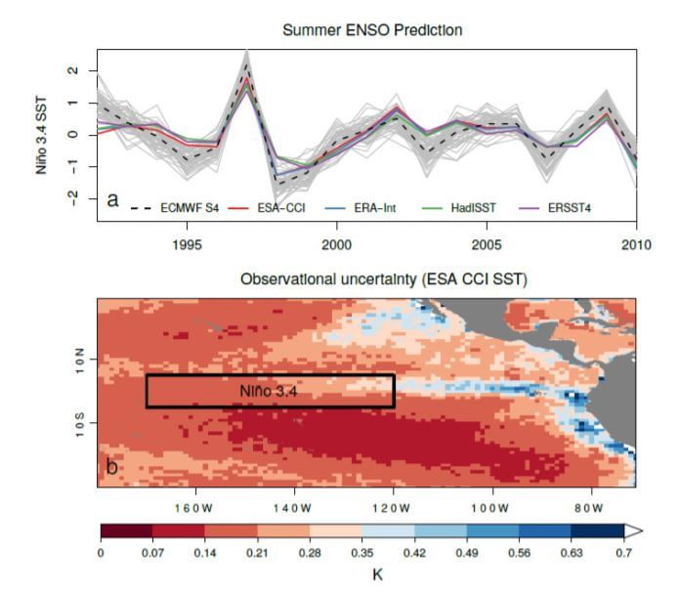
How to deal with observational uncertainties
Choice of observational dataset and accounting for observational uncertainty can have a huge impact on the prediction and the verification

Slide 12
Format requirements: how to unify the needs?
If QA4Seas pushes for a “standardization” of observational datasets in the CDS, we need an agreement from the other lots, depending on which datasets, data organization they use
Who is using which observational datasets and what are the needs in terms of temporal coverage/availability
Do other contracts have format requirements, even it is “just for models”?

Slide 13
Other conclusions from M2.3
Need to coordinate with other projects related with observations to understand users’ needs:
MAGIC
FIDUCEO
MAGIC
Fidelity and uncertainty in climate data records from Earth Observations

Slide 14
Discussion
What are the common points and differences between DECM and QA4Seas in terms of observations?
And with other lots?

Slide 15
Discussion
Do we need the same datasets/variables?
Observations needed by Q4Seas
Observations needed by DECM
Observations needed by ...

Slide 16
Discussion
Could we/do we need to agree on a common metadata scheme?

Slide 17
Discussion
How do we go further than a milestone or a workshop? Interlots working group?

Slide 18
DECM project meeting, Oslo, 12/10/2017
Thank you!
For any further question:
pierre-antoine.bretonniere@bsc.es

