Slide 1
2nd ACTRIS-2 General Meeting, ESRIN, Frascati, March 1 2016
Mineral dust modelling and ensemble-based data assimilation at the Barcelona Supercomputing Center
Enza Di Tomaso
with inputs from the rest of the BSC Team

Slide 2
BSC Tasks in WP13
- To establish a delayed and NRT model monitoring/evaluation system using ACTRIS-2 data for the WMO Sand and Dust Storm-Warning and Assessment System (SDS-WAS) models.
Multi-Model Activities
- To investigate the value of assimilating ACTRIS-2 data in a dust prediction system (NMMB/BSC-CTM) for selected case studies in a regional domain.
BSC Dust Model

Slide 3
BSC Tasks in WP13
- To establish a delayed and NRT model monitoring/evaluation system using ACTRIS-2 data for the WMO Sand and Dust Storm-Warning and Assessment System (SDS-WAS) models.
Multi-Model Activities
- To investigate the value of assimilating ACTRIS-2 data in a dust prediction system (NMMB/BSC-CTM) for selected case studies in a regional domain.
BSC Dust Model

Slide 4
BSC Tasks in WP13
- To establish a delayed and NRT model monitoring/evaluation system using ACTRIS-2 data for the WMO Sand and Dust Storm-Warning and Assessment System (SDS-WAS) models.
Multi-Model Activities
- To investigate the value of assimilating ACTRIS-2 data in a dust prediction system (NMMB/BSC-CTM) for selected case studies in a regional domain.
BSC Dust Model
We will build on our current capabilities that have been developed so far mainly for column-integrated products

Slide 5
WMO Dust Centres
BSC evaluation activities are carried out under two WMO initiativies
in collaboration with
Slide courtesy of Sara Basart

Slide 6
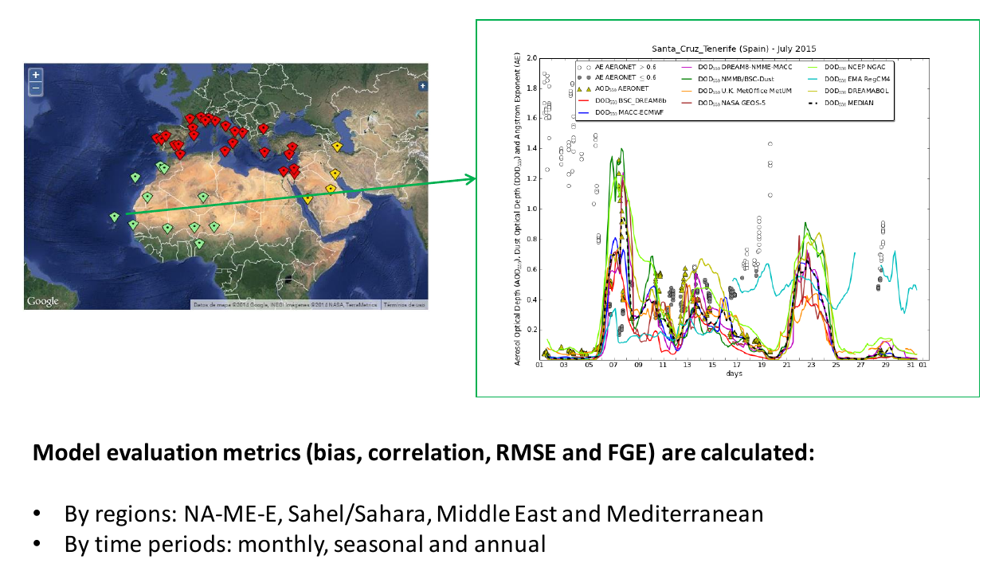
SDS-WAS: NRT Evaluation using AERONET
NRL evaluation is performed also using not assimilated satellite observations
Slide courtesy of Sara Basart

Slide 7
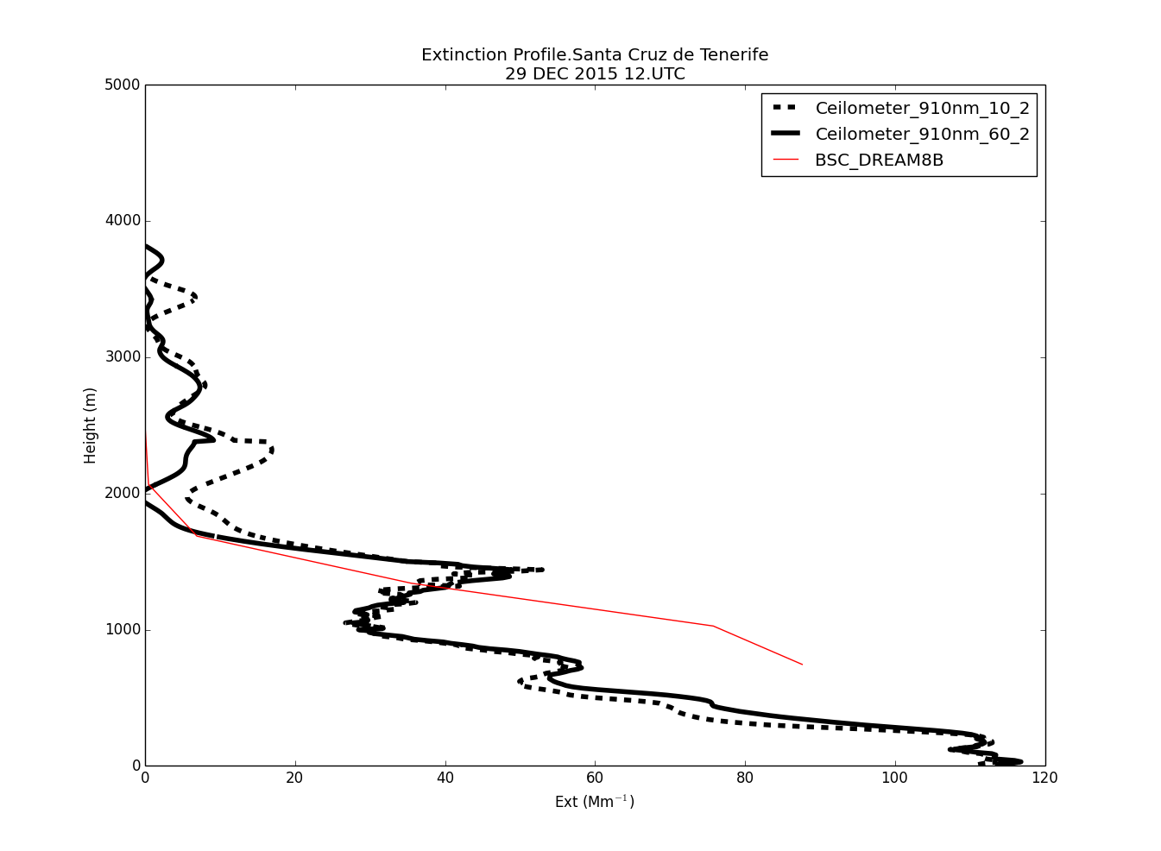
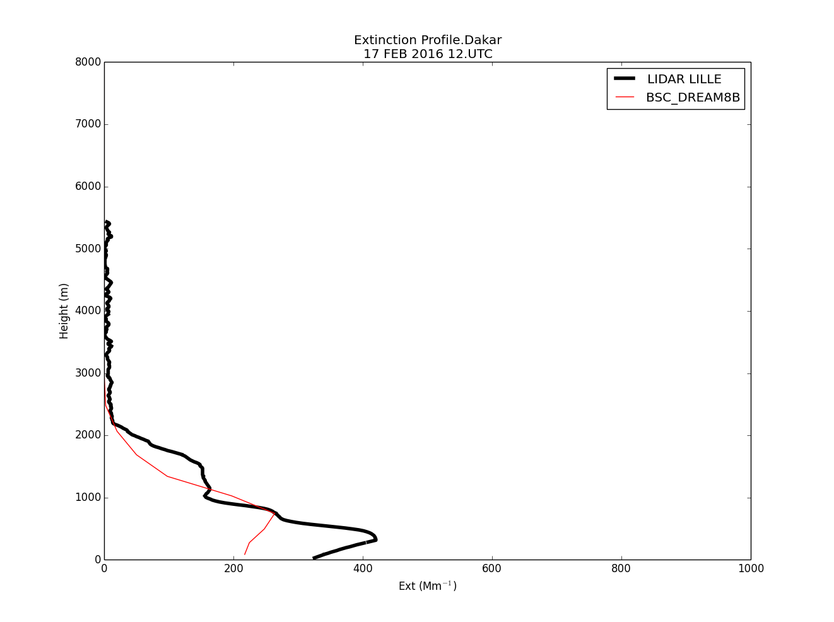
SDS-WAS: Comparison of Vertical Profiles
- Daily comparison of extinction vertical profiles involving the BSC-DREAM8b model and the profilers of Santa Cruz de Tenerife (AEMET) and Dakar (Univ. Lille)
- The plan is to extend it to other models and profilers
Slide courtesy of Enric Terradellas

Slide 8
SDS-WAS: Comparison of Vertical Profiles
Points that need attention for WP13:
- time sampling
- assumptions on the optical properties
- interpolation to a reference standard profile
- Daily comparison of extinction vertical profiles involving the BSC-DREAM8b model and the profilers of Santa Cruz de Tenerife (AEMET) and Dakar (Univ. Lille)
- The plan is to extend it to other models and profilers
Slide courtesy of Enric Terradellas

Slide 9
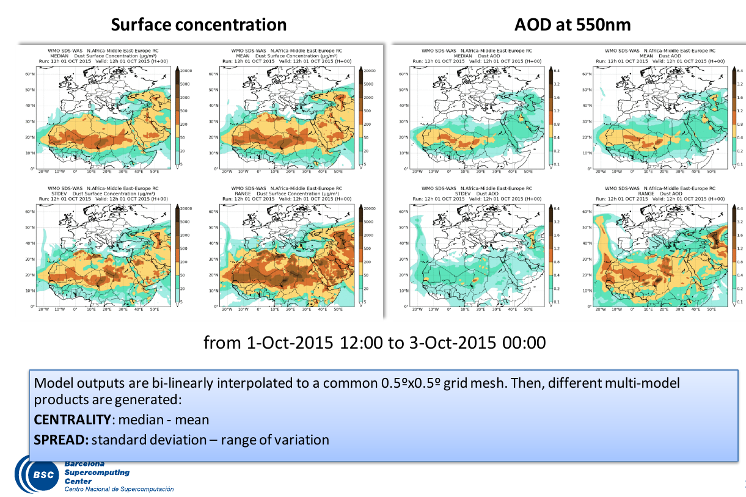
SDS-WAS: Multi-Model Products
Slide courtesy of Sara Basart

Slide 10
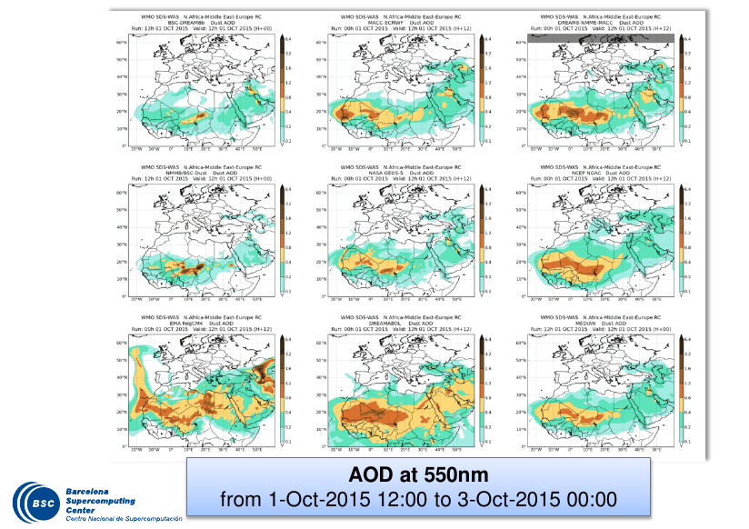
SDS-WAS: Joint Visualisation
Slide courtesy of Sara Basart

Slide 11
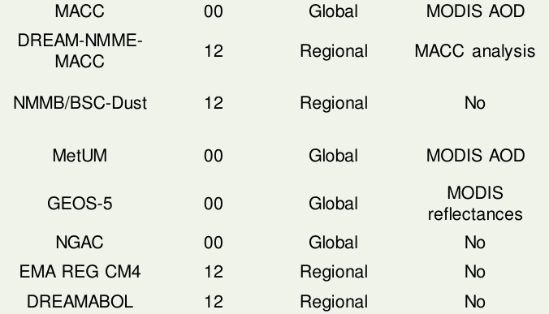
SDS-WAS: Joint Visualisation
Slide courtesy of Sara Basart

Slide 12
SDS-WAS: Joint Visualisation
Slide courtesy of Sara Basart

Slide 13
Operation Forecast Flow at BSC
time
day 1 day 2 …
model
forecast

Slide 14
Operation Forecast Flow at BSC
time
day 1 day 2 …
model
forecast
short-term forecast
model
forecast

Slide 15
Data Assimilation Flow
time
day 1 day 2 …
observations
model
DA

Slide 16
Data Assimilation Flow
time
day 1 day 2 …
observations
model
DA
analysis
model
analysis-initialised forecast

Slide 17
Data Assimilation Flow
time
day 1 day 2 …
observations
model
DA
- Proven successful for AOD
- Challenging to extend to satellite vertical profiles
- Positive impact of lidar signals in case studies (eg. Wang et al. 2014)
analysis
model
analysis-initialised forecast

Slide 18
Ensemble-Based Approach
time
day 1 day 2 …
observations
member 1
DA
member 2
ensemble forecast
…
member n
ensemble analysis
model
analysis-initialised forecast

Slide 19
Ensemble-Based Approach
time
day 1 day 2 …
observations
member 1
DA
member 2
ensemble forecast
…
member n
ensemble analysis
LETKF
- usage of a flow-dependent background error covariance
- performing the analysis locally
model
analysis-initialised forecast

Slide 20
Ensemble-Based Approach
time
day 1 day 2 …
observations
Role of the B matrix
- spatial spreading of information from observations
- statistically consistent increments between neighbouring grid points
- multivariate analysis
member 1
DA
member 2
ensemble forecast
…
member n
ensemble analysis
LETKF
- usage of a flow-dependent background error covariance
- performing the analysis locally
model
analysis-initialised forecast

Slide 21
Ensemble-Based Approach
time
day 1 day 2 …
observations
member 1
DA
member 2
ensemble forecast
…
member n
ensemble analysis
model
analysis-initialised forecast

Slide 22
Ensemble-Based Approach
time
day 1 day 2 …
observations
observation operator
member 1
DA
member 2
ensemble forecast
…
member n
ensemble analysis
model
analysis-initialised forecast

Slide 23
Ensemble-Based Approach
time
day 1 day 2 …
observations
observation operator
member 1
DA
member 2
Points that need attention for WP13:
-interpolation and model vertical resolution
-assumption on the optical properties
ensemble forecast
…
member n
ensemble analysis
model
analysis-initialised forecast

Slide 24
Ensemble-Based Approach
time
day 1 day 2 …
observations
observation operator
member 1
DA
member 2
Points that need attention for WP13:
-interpolation and model vertical resolution
-assumption on the optical properties
ensemble forecast
…
member n
ensemble analysis
Observation operator for AOD
${AOD}_{λ}=$ $\sum_{z}{\sum_{i}{C_{ext,i}(}λ})c_{z,i} ∆z$
$c_{z,i}$ ensemble member mass concentrations for bin i [kg/m^3]
$C_{ext,i}\left(λ\right)$ mass extinction coefficients [m^2/kg]
$Δz$ layer thickness [m]
model
analysis-initialised forecast

Slide 25
Ensemble-Based Approach
time
observations handling
day 1 day 2 …
observations
member 1
DA
member 2
ensemble forecast
…
member n
ensemble analysis
model
analysis-initialised forecast

Slide 26
Ensemble-Based Approach
time
observations handling
day 1 day 2 …
observations
member 1
DA
Points that need attention for WP13:
- temporal sampling
- dust-dominated conditions
- localisation
member 2
ensemble forecast
…
member n
ensemble analysis
model
analysis-initialised forecast

Slide 27
Ensemble-Based Approach
time
observations handling
day 1 day 2 …
observations
member 1
DA
Points that need attention for WP13:
- temporal sampling
- dust-dominated conditions
- localisation
member 2
ensemble forecast
…
member n
ensemble analysis
Observation-space localisation for AOD
- observation error is divided by a distance-dependent function that decays to zero with increasing distance (horizontal localisation)
- observation error is divided by the square of the model AOD normalised sensitivity function (vertical localisation)
model
analysis-initialised forecast

Slide 28
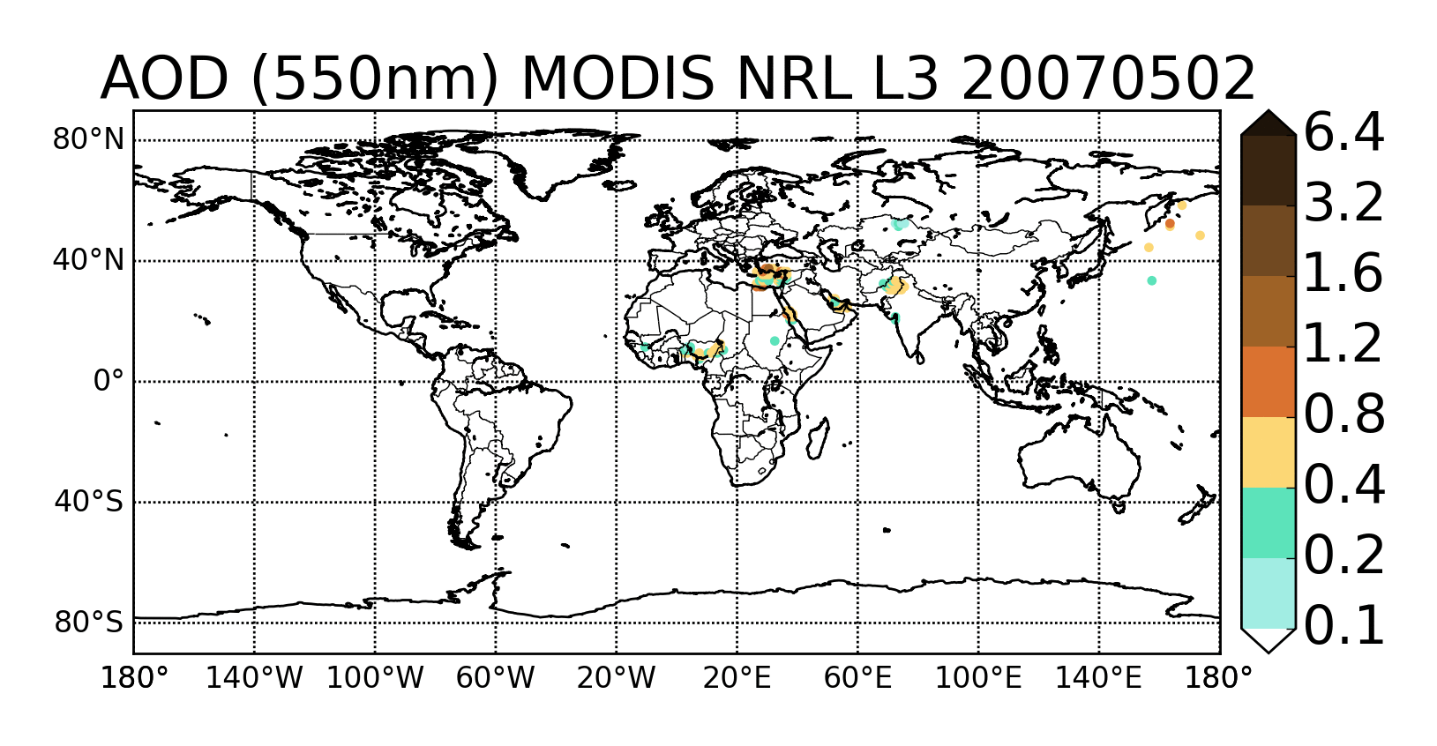
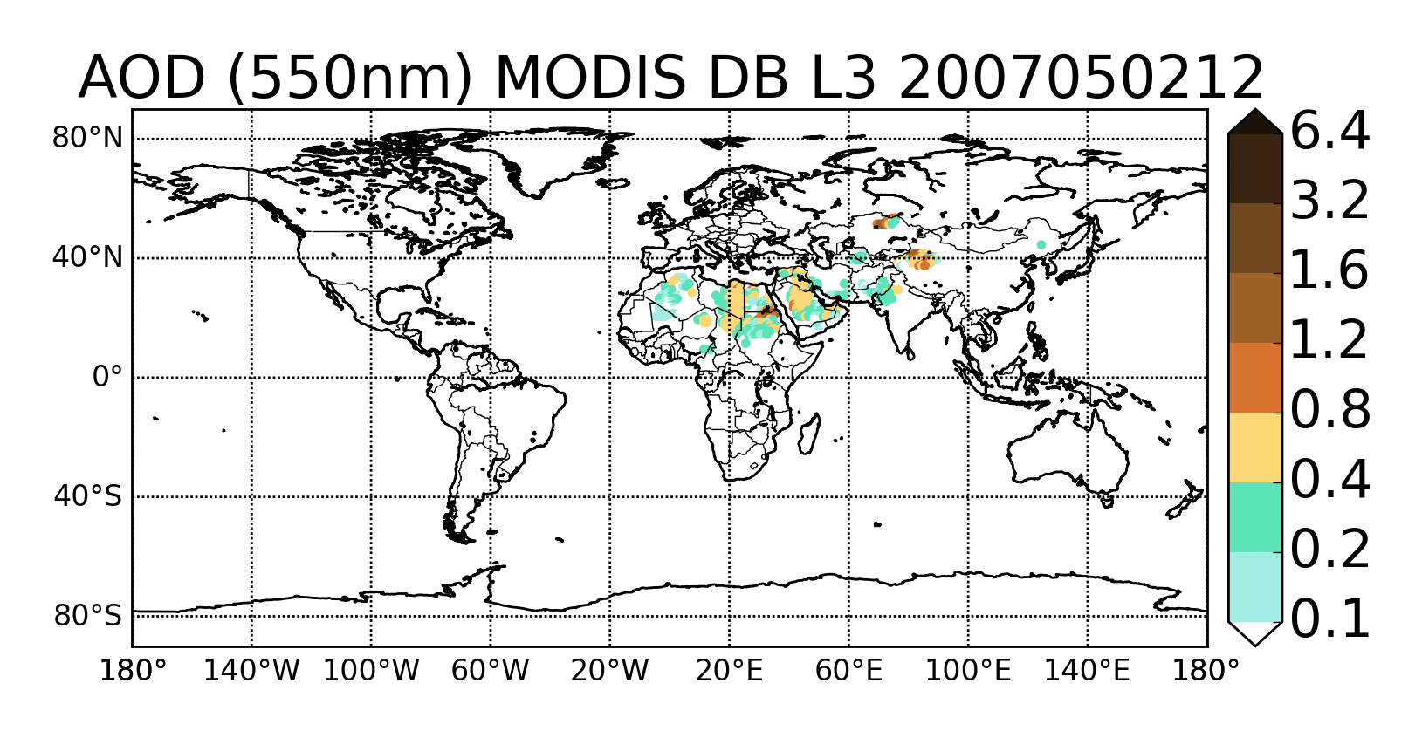
Satellite AOD Example
Selected
NRL MODIS
observations
Selected
MODIS DB
observations

Slide 29
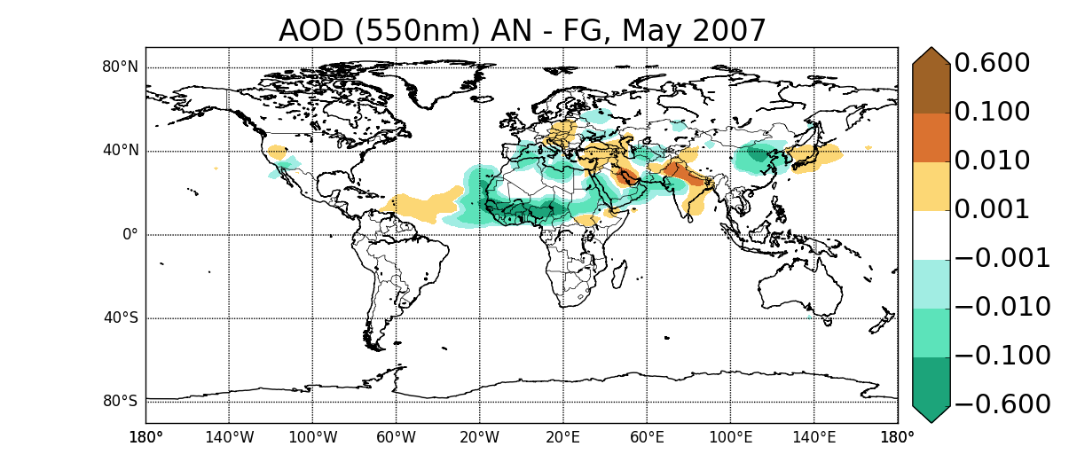
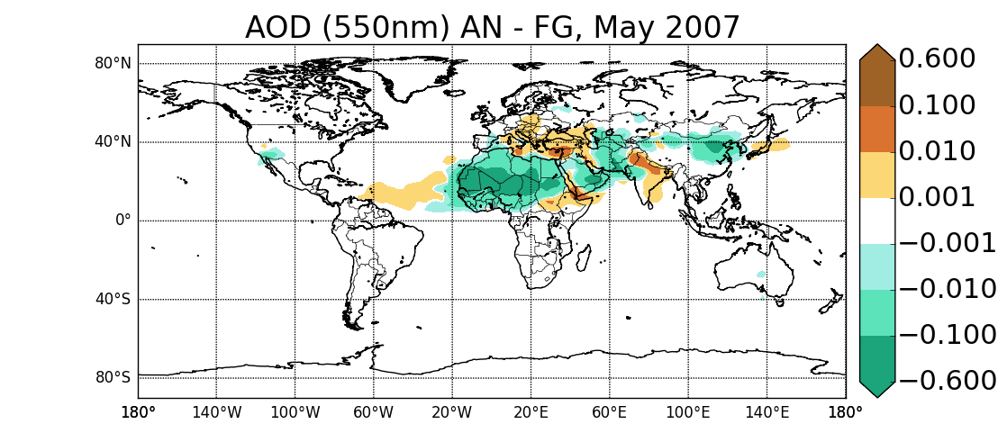
Satellite AOD Example
Mean increments
MODIS NRL
MODIS NRL +DB

Slide 30
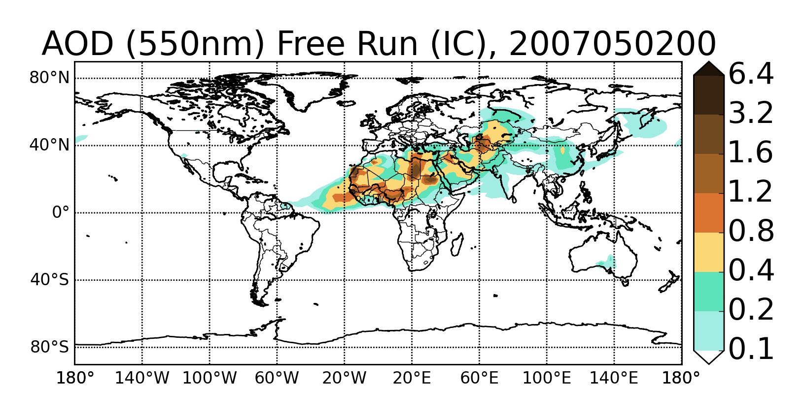
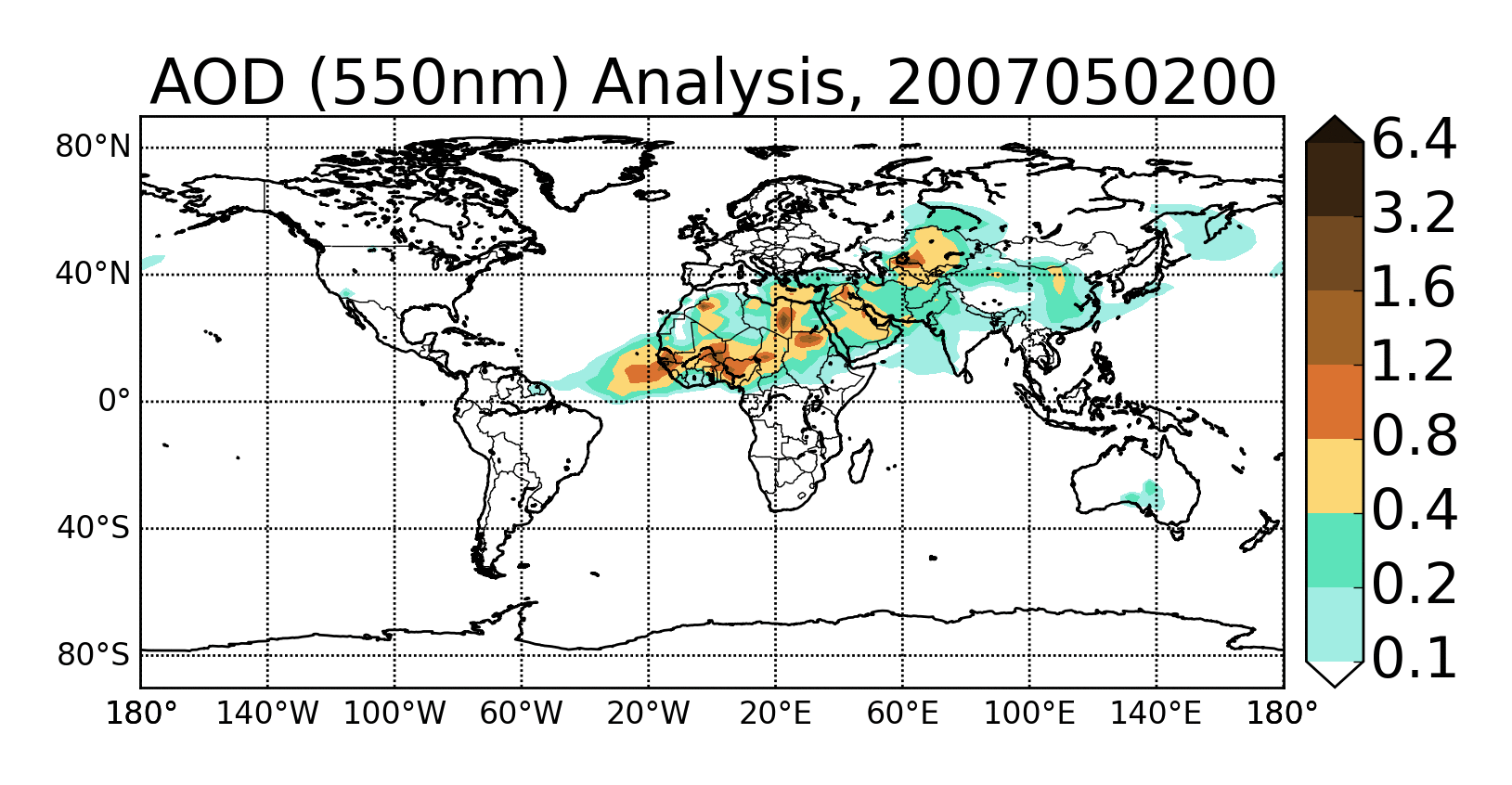
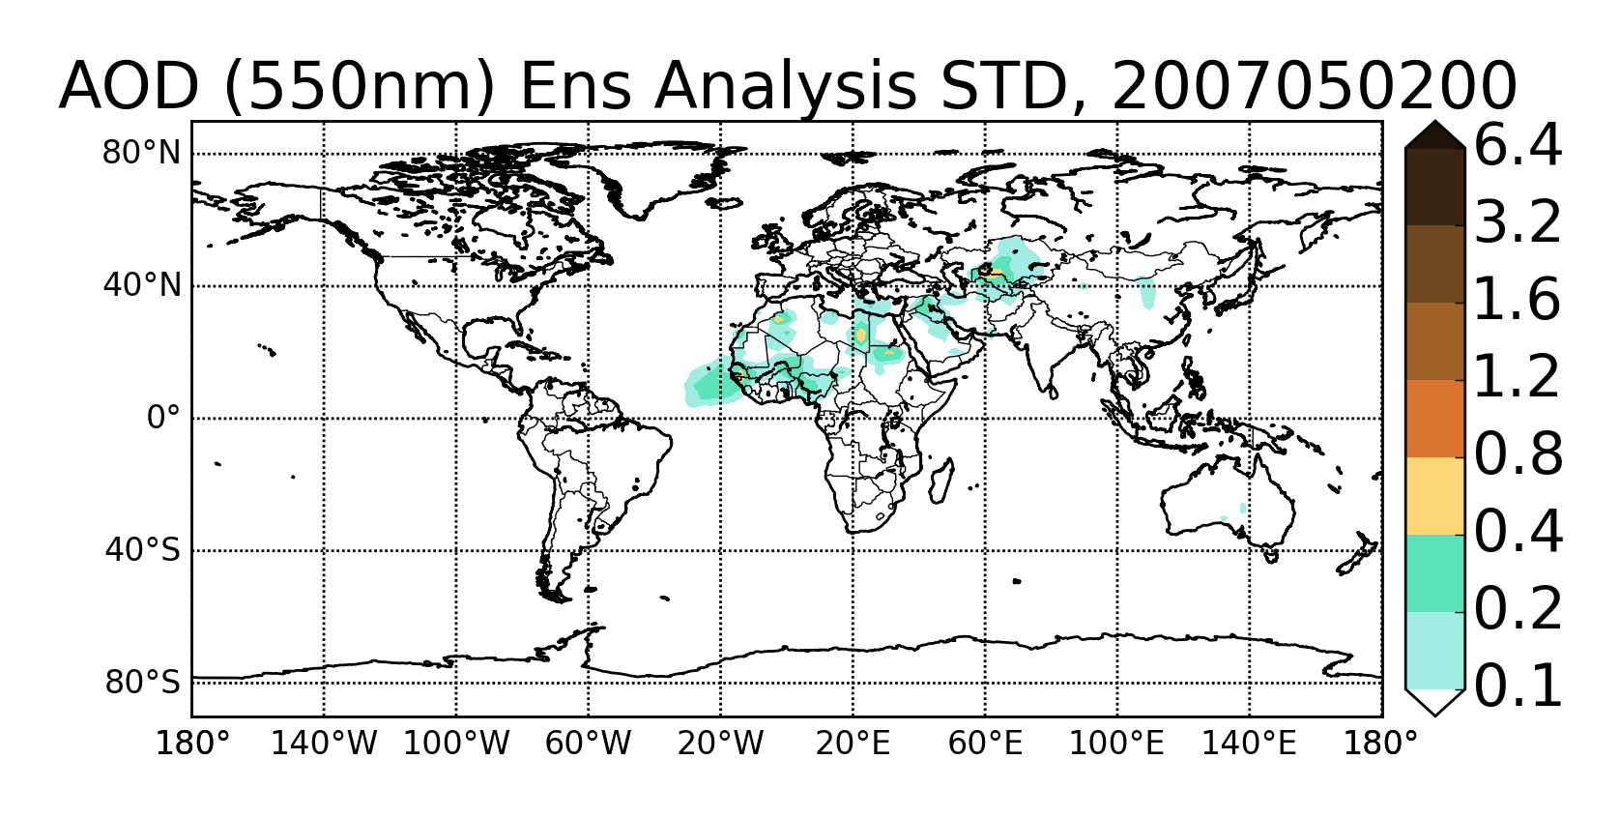
Satellite AOD Example
Control Simulation (No Assimilation)
Analysis
Analysis Spread

Slide 31
Thank you!
For further information please contact
enza.ditomaso@bsc.es

Slide 32
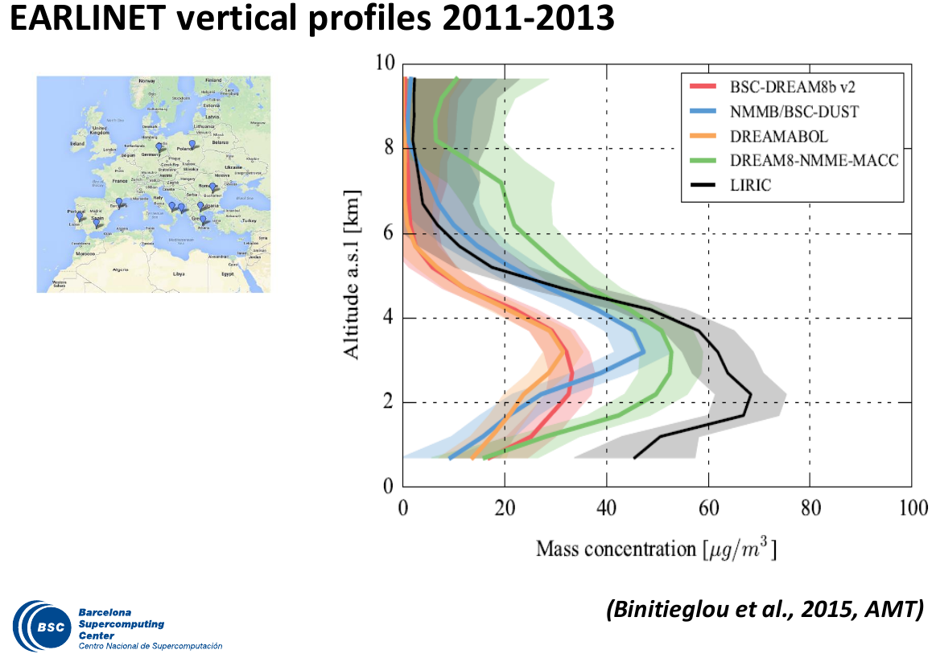
SDS-WAS: Model Intercomparison
Slide courtesy of Sara Basart

