Slide 1
ES-PMO Earth Science Project Management Office Brief description
BSC

Slide 2
INDEX
PMO: chart, interactions, duties and figures
PMO: wiki and contacts
Proposals preparation process

Slide 3
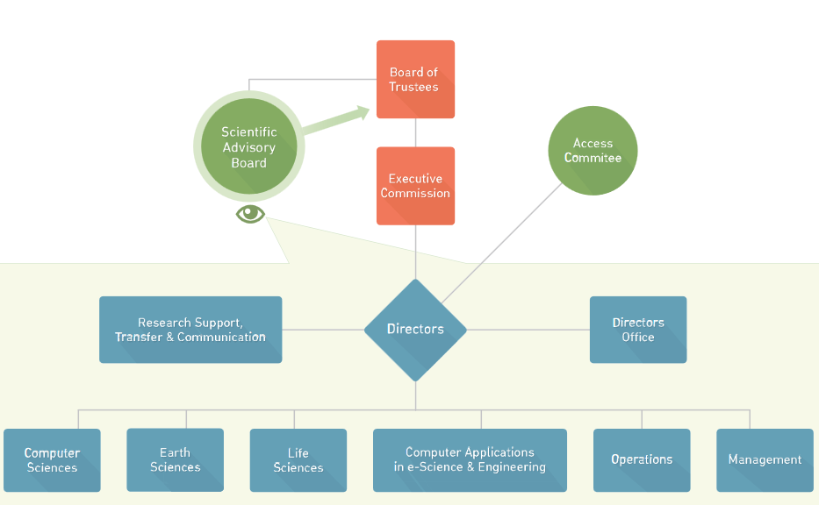
PMO in BSC Organisation Chart
PMID: Project Management, Innovation and Dissemination Area
Directors’ Office
Project Management, Innovation and Dissemination Area

Slide 4
PMID staff
Head of Area
Eugene
Project Dissemination
Renata (7)
Project Management
Office
Marta (28)
Project
Innovation
Vanessa I (3)
Earth Science
SPM: Mar (5)
Computer Science & Operations
SPM: Vanessa F (9)
Institutional
SPM: Marta (4)
CASE
SPM: David (5)
Life Science
SPM: Raquel (5)
SPM: Senior Project Manager
PM: Project Manager
Jolita
Federico
Arianna
New member

Slide 5
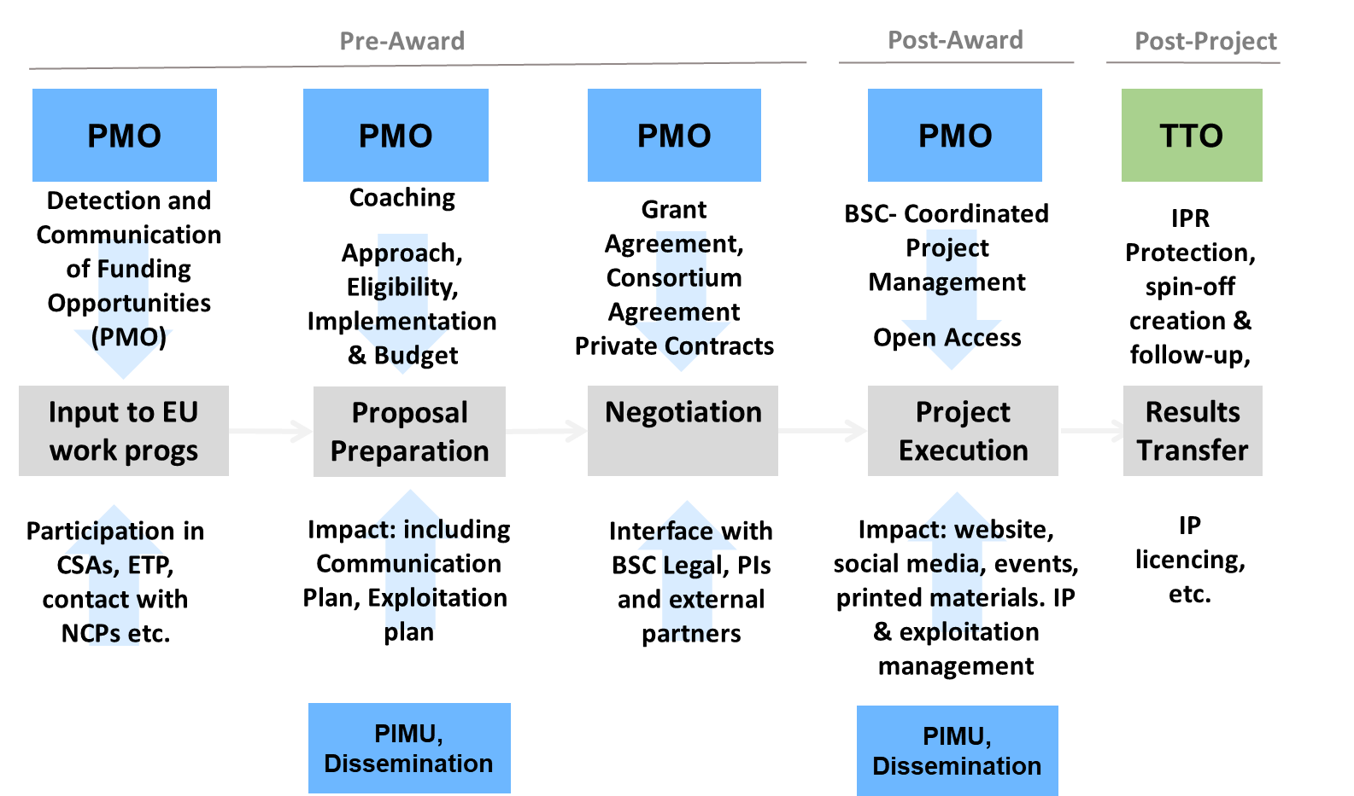
PMO duties
Main Responsibilities in Project Lifecycle
PMO: Project Management Office
TTO: Technology Transfer Office
PIMU: Project Innovation Management Unit

Slide 6
PMO interactions within BSC
In pre-award and post-award phases
PMO
Administration
Legal and exploitation
Human Resources
Research
Legal team
Finance Projects
ES Research
Groups
Directors
TTO
Finance
PIMU
TTO: Technology Transfer Office
PIMU: Project Innovation Management Unit

Slide 7
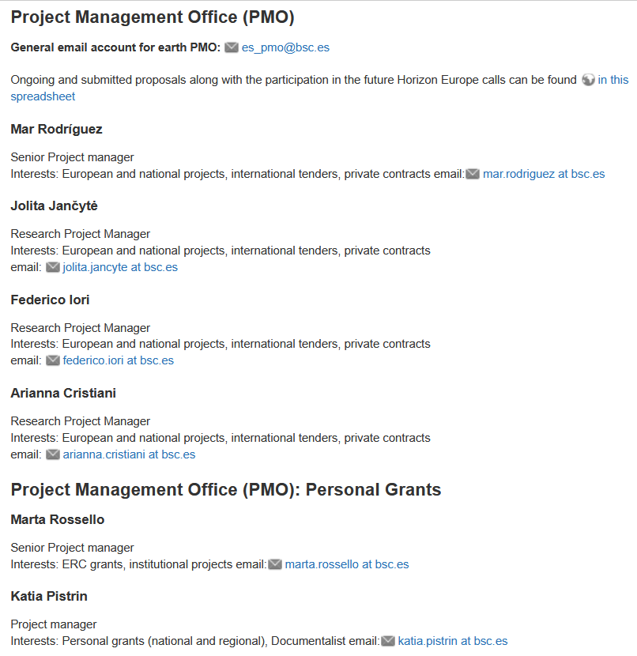
Wiki and contacts
ES- PMO main contacts in the ES wiki:
Section Research groups and staff: link

Slide 8
Wiki and contacts
ES- PMO main contacts classified per type of call:
Section Open and future calls calendar: link

Slide 9
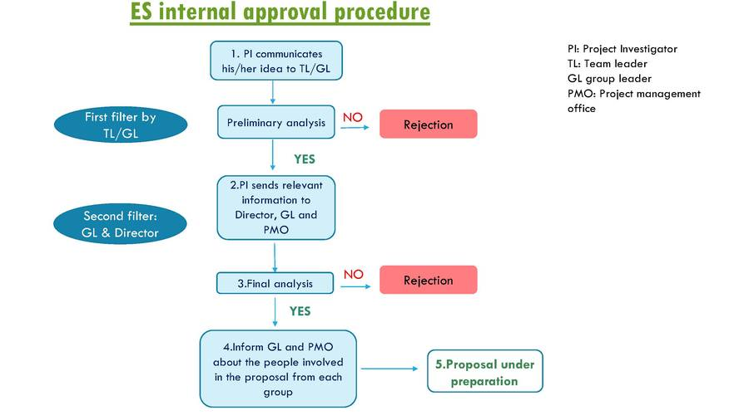
Proposals preparation process
Approval process in the ES wiki.
New step added: Researchers involved approved by GL

Slide 10
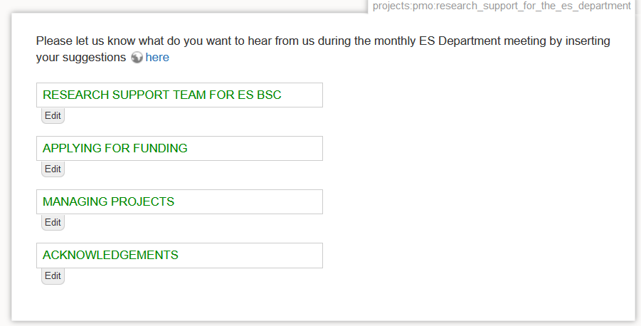
ES-PMO support
Specific section in the section Projects and proposals => ES PMO Support

Slide 11
Thanks
ES-PMO

