Slide 1
EC-Earth, a coupled Climate Model for extreme Event Prediction
Kim Serradell, Mario C. Acosta, Miguel Castrillo, Oriol Tintó, Xavier Yepes
Computational Earth Sciences
26/06/2018
Tornados, Disaster
& Early Warning ISC 2018

Slide 2
Outline
Introduction
Hurricanes at ISC
EC-Earth model
Performance analysis to increase resolution
Using Machine Learning for hurricanes

Slide 3
Barcelona Supercomputing Center Centro Nacional de Supercomputación
BSC-CNS objectives
Supercomputing services
to Spanish and
EU researchers
R&D in Computer,
Life, Earth and
Engineering Sciences
PhD programme,
technology transfer,
public engagement
Spanish Government 60%
Catalonian Government 30%
Univ. Politècnica de Catalunya (UPC) 10%
BSC-CNS is
a consortium
that includes

Slide 4
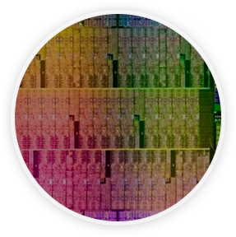
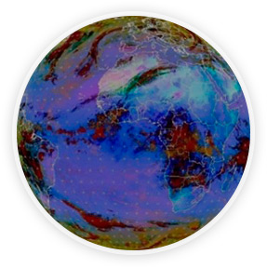
Mission of BSC Scientific Departments
Computer
Sciences
Earth Sciences
To influence the way machines are built, programmed and used: programming models, performance tools, Big Data, computer architecture, energy efficiency
To develop and implement global and regional state-of-the-art models for short-term air quality forecast and long-term climate applications
Life
Sciences
CASE
To understand living organisms by means of theoretical and computational methods (molecular modeling, genomics, proteomics)
To develop scientific and engineering software to efficiently exploit super-computing capabilities (biomedical, geophysics, atmospheric, energy, social and economic simulations)

Slide 5
Interdisciplinary work
Weather and Climate Science
Computational Earth Sciences
Computer Science
Knowledge about the mathematical and computational side of Earth System Applications
Knowledge about the specific needs in HPC of the Earth System Applications
Researching about HPC methods specifically used for Earth System Applications

Slide 6
Why hurricanes in ISC?

Slide 7
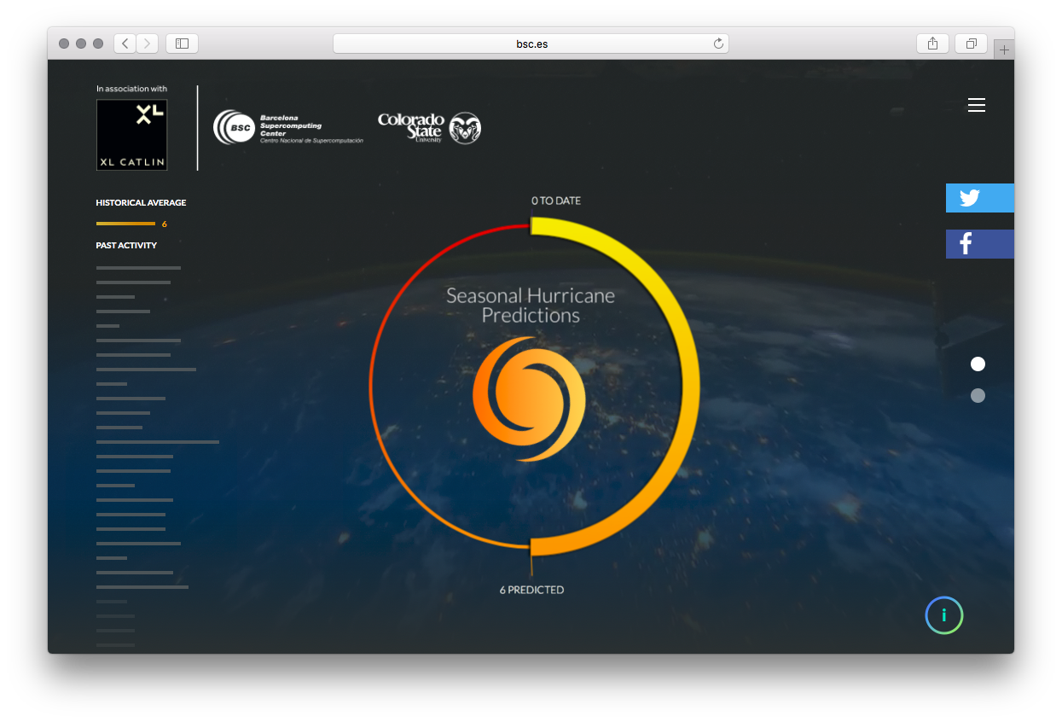
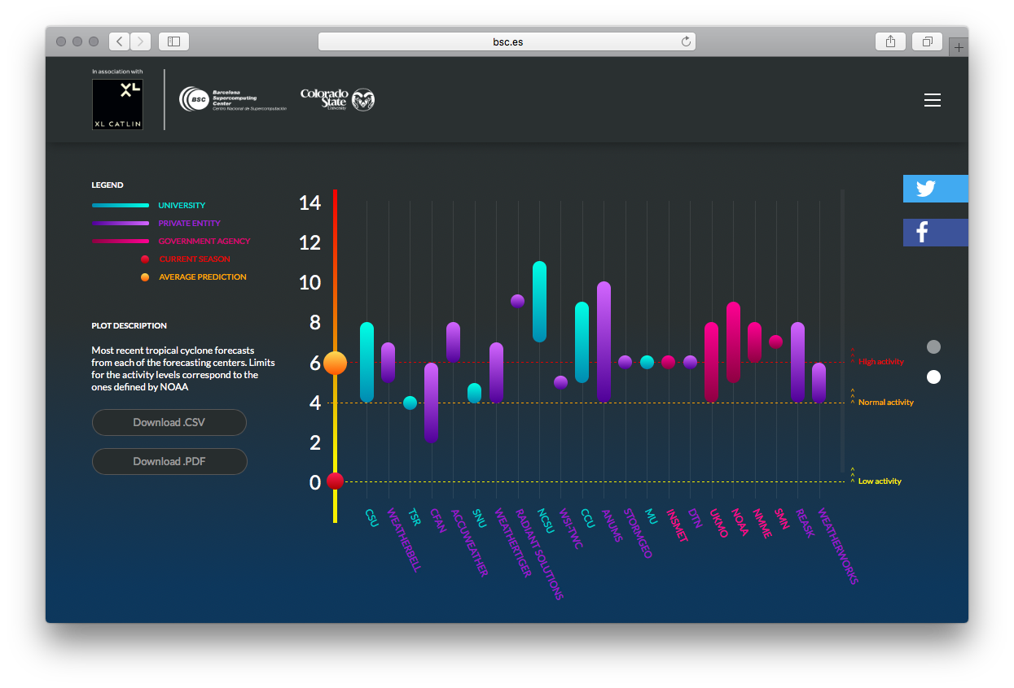
www.bsc.es/seasonalhurricanepredictions
Notes:
All this forecast are based on earth system models running in HPC.

Slide 8
EC-Earth

Slide 9
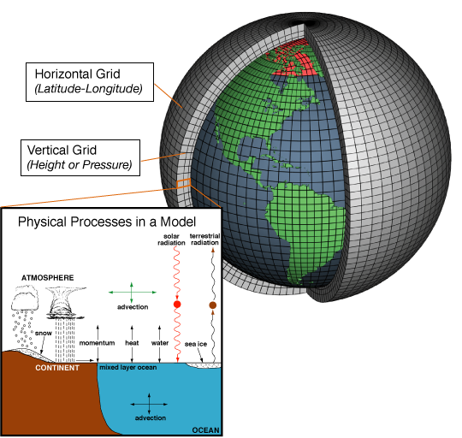
EC-Earth Model
EC-EARTH coupled model
The Integrated Forecasting System (IFS) as atmosphere model
The Nucleus for European Modelling of the Ocean (NEMO) as ocean model
The OASIS3-MCT coupler
The Louvain-la-Neuve sea-Ice Model 3 (LIM3) as sea ice model

Slide 10
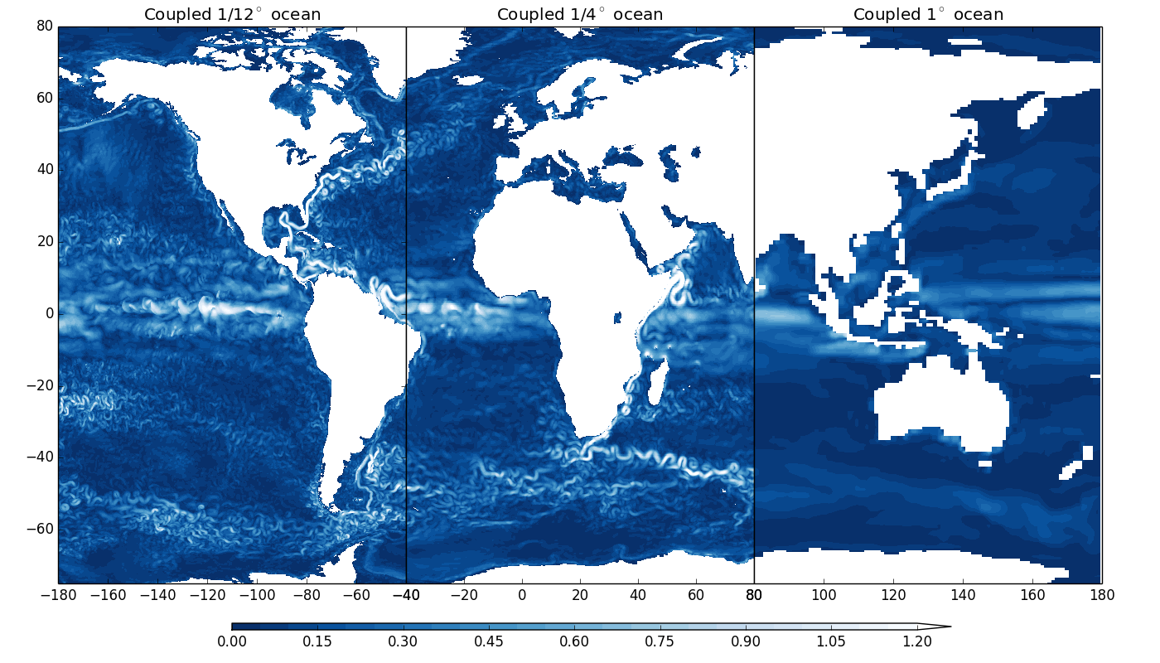
PRIMAVERA Project
Ocean surface currents from HadGEM3-based global coupled (atmosphere-ocean/sea-ice) models at three different resolutions - (left) 25km-1/12 degree, (middle) 60km-1/4 degree, (right) 130km-1 degree (courtesy of Malcolm Roberts)

Slide 11
Ultra-high configuration
In ESiWACE, BSC is developing an ultra-high configuration (T1279-ORCA12).
Configuration T1279 - ORCA12 deployed in MareNostrum 4
Technical issues with OPA network and large number of cores
Run with real production output (3,5 Tb per year)
Notes:
0.6 SYPD → 100 years of simulation → 166 days → more than four months.

Slide 12
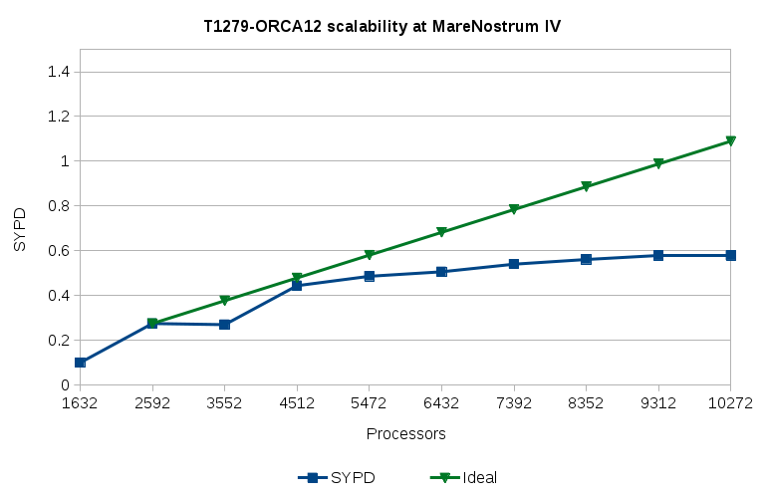
Ultra-high configuration
Low amount of SYPD (360s timestep):
In IFS, I/O is done by a single process
IFS-36r4 is an old release (Nov. 2010)

Slide 13
Performance analysis
We need to understand where are the bottlenecks
Not trivial in a coupled simulation of 10.000 cores
Application
Trace files
DIMEMAS simulator
Simulated trace files
EXTRAE library
Paraver
Paraver
Trace visualization
DIMEMAS generated trace. Target = ideal machine

Slide 14
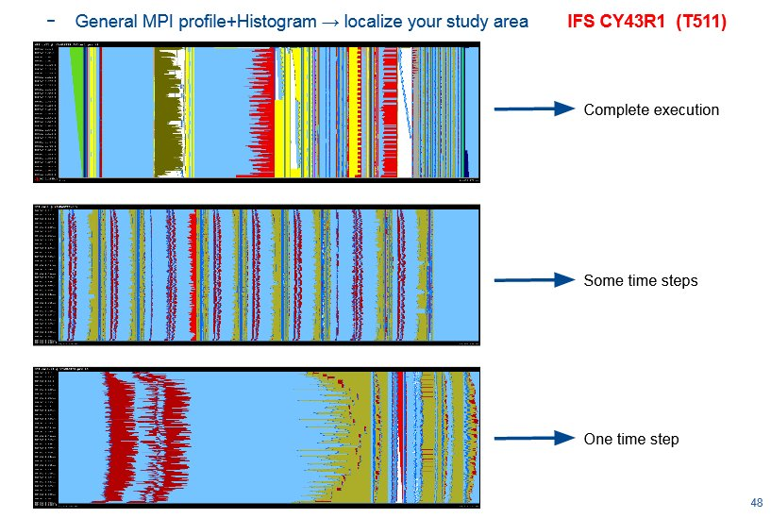
Performance analysis

Slide 15
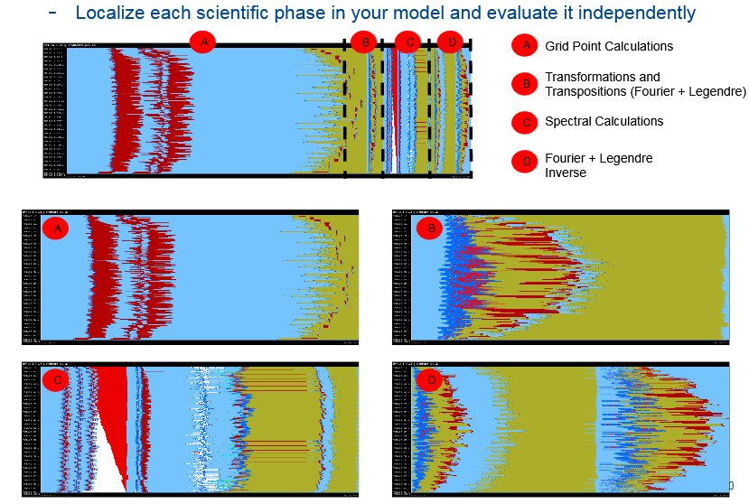
Performance analysis

Slide 16
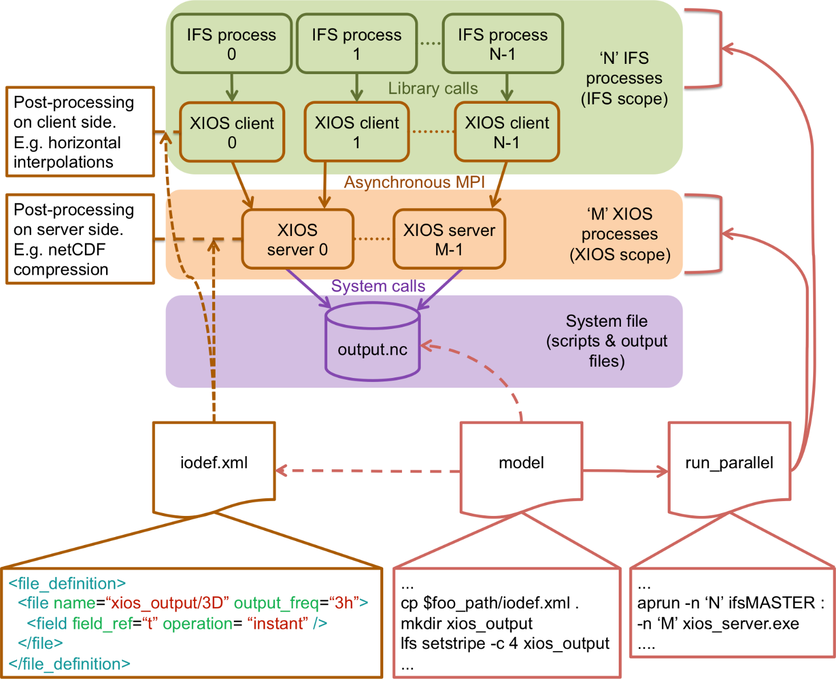
Asynchronous I/O
After identifying the I/O bottleneck, we developed a solution
Port XIOS I/O server to IFS

Slide 17
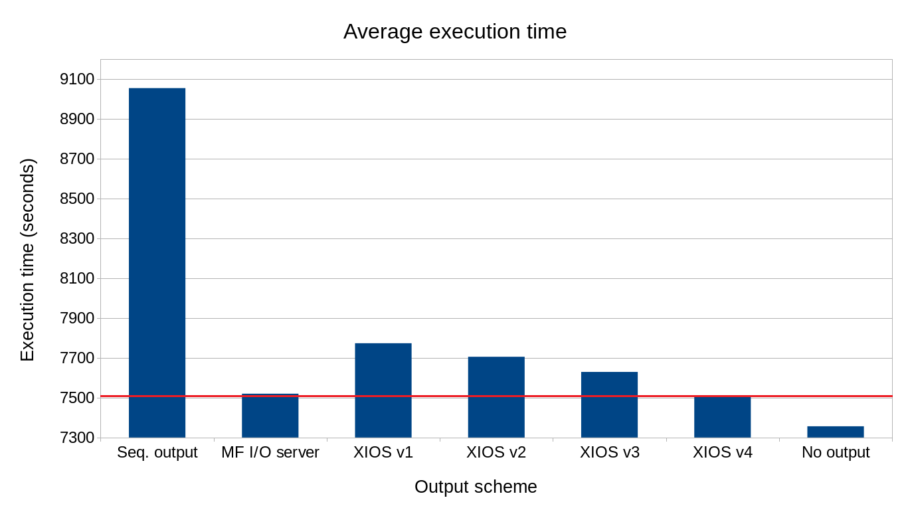
Asynchronous I/O

Slide 18
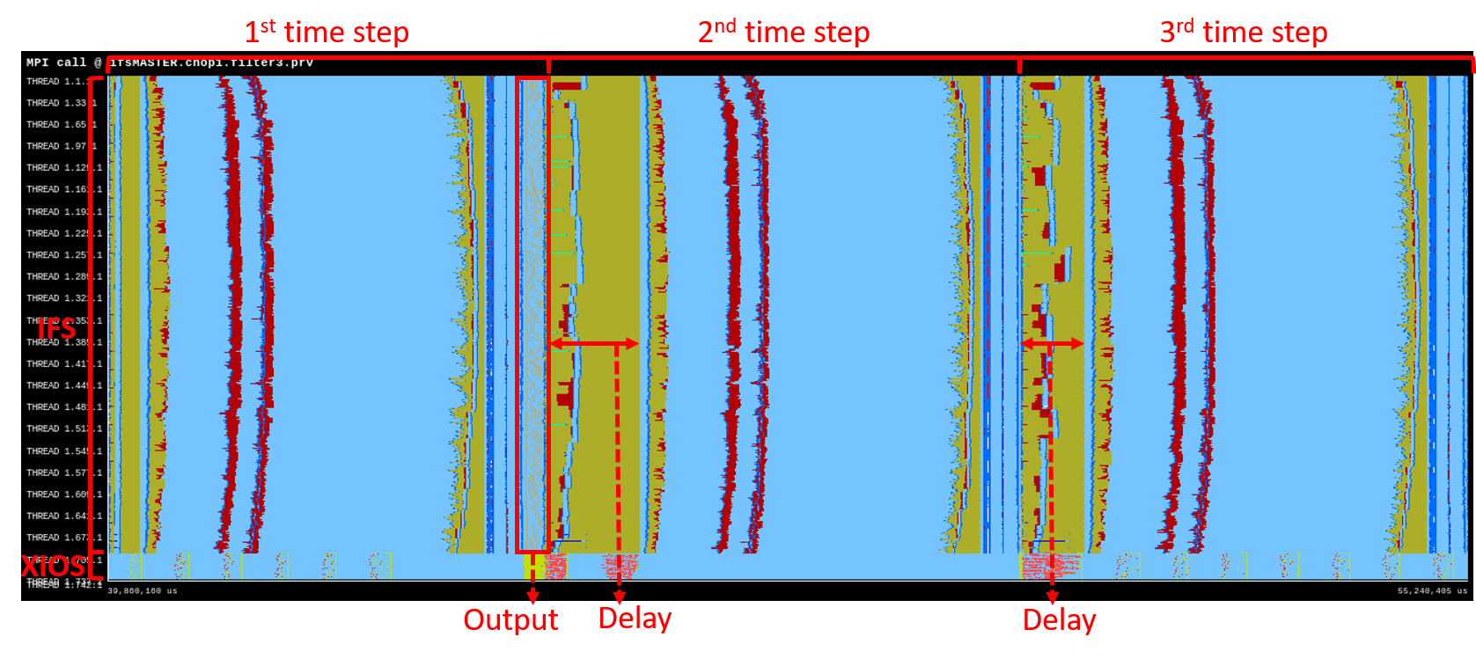
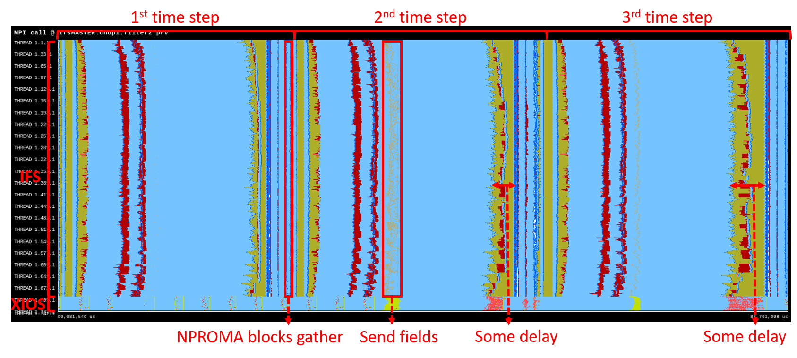
More performance analysis

Slide 19
Why not using ML for hurricane prediction?

Slide 20
Machine Learning
In collaboration with Computer Sciences department at BSC to:
Use Machine Learning(ML) to predict the nature and number of named storms in a hurricane season
Build and end to end Workflow
Using EC-Earth CMIP5 data
Developments in Minotauro HPC – GPUs (K80) with Keras and Tensor Flow
Thanks to Albert Kahira (in the room):
Poster at PhD Forum (Monday, June 25th 1pm - 3pm)
Workshop (Thursday, June 28th 12.00 -12.30 )

Slide 21
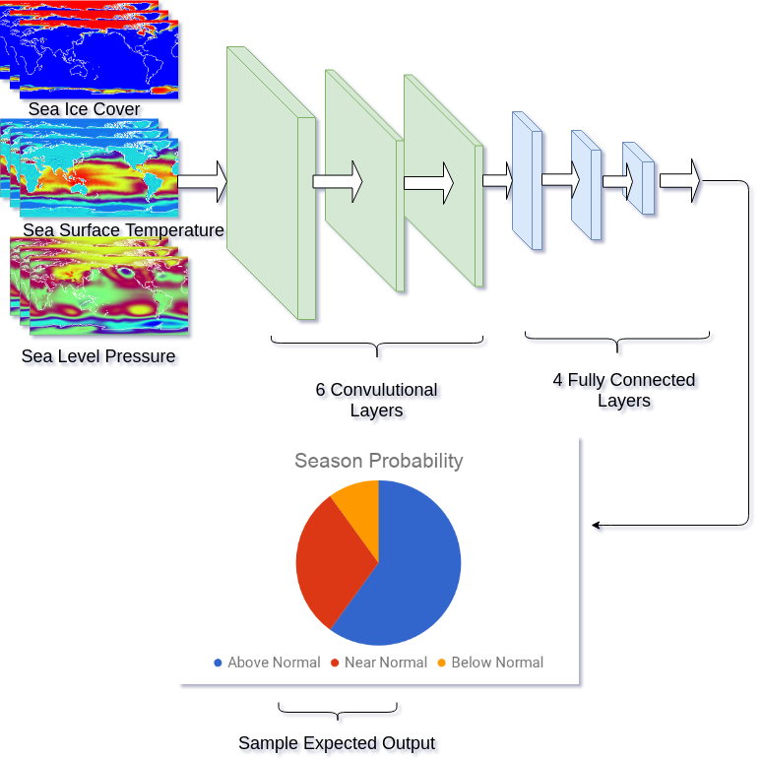
Methodology

Slide 22
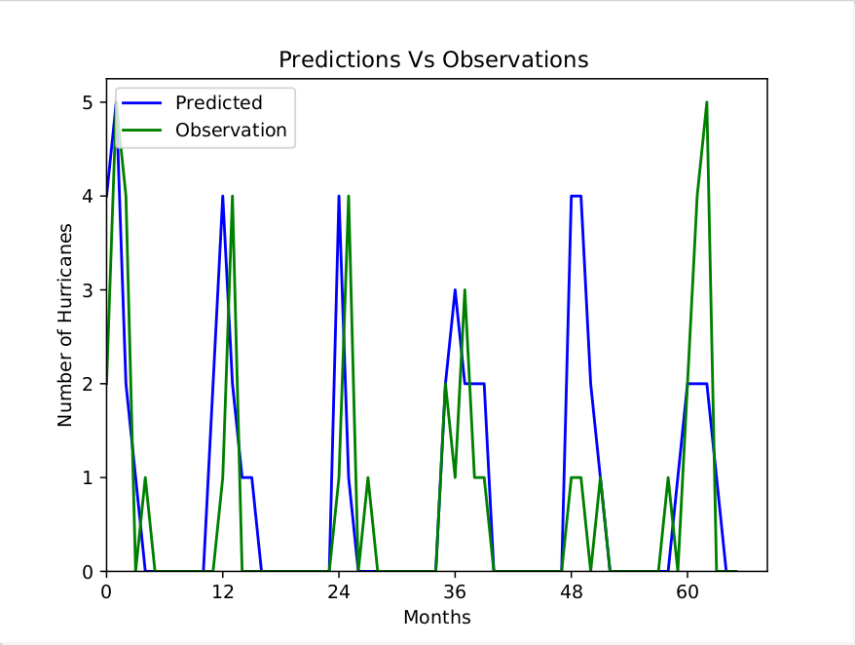
Early Results
72% Accuracy
Season Pattern is clear
Sea Surface Temperature as main determinant

Slide 23
Thank you
kim.serradell@bsc.es

